Slide 1
NPOWER JUNIOR DATA ANALYST PROGRAM
IBM Employee Attrition
— Exploratory Data Analysis
Understanding the Factors Associated with Employee Attrition
NPower JDA Cohort 2026 · 8-person team project
github.com/NPower-JDA-Cohort-2026/ibm-analytics-attrition-eda
September 2026
Notes:
Open: this is a diagnostic exploratory analysis of IBM's HR Analytics dataset — 1,470 employee records, 35 attributes, 16.1% overall attrition. Eleven notebooks, eight contributors, run in numeric order. Say up front: the dataset is fictional — IBM authored it as a teaching set, so every finding is a statement about this data and about our method, not an HR benchmark. Hand off to the introduction.

Slide 2
PROJECT INTRODUCTION
Why attrition analysis
What attrition means
Attrition is the loss of employees from an organisation — in this dataset, one column with two values: whether an employee has left (Yes) or is still employed (No).
Why it matters
Replacing a mid-level employee costs a meaningful multiple of their salary once recruiting, onboarding, lost productivity and institutional knowledge are counted. The signals that precede a resignation usually already sit in HR data that nobody has cross-tabulated.
The five question groups the project set out to answer
• Concentration Which roles, departments and levels exceed the baseline — and by enough to matter given headcount?
• Timing Is attrition an early-tenure phenomenon, a mid-career one, or both?
• Conditions Does overtime, travel, commute or promotion stagnation move the rate?
• Compensation Do leavers earn less than stayers? Do stock options behave like a lever?
• Sentiment Which satisfaction dimension separates leavers from stayers most cleanly?
OUR GOAL
FRAMING
Not “can we guess who quits” but “which conditions are over-represented among leavers, by how much, and is the gap large enough to act on.”
Diagnostic, not predictive. With one cross-sectional snapshot and no experiment, the honest ceiling is “this condition is over-represented among leavers by n percentage points.”
README.md · Overview and Analysis Questions
2
Notes:
Frame the business problem before any numbers. The key sentence is the goal box: we are measuring over-representation, not causation. That constraint is a property of the data — one snapshot, no event timestamps, no control group — not modesty. The five question groups on the right are the README's own structure and they map onto the notebook sequence you are about to see. Note for honesty: the notebooks fully answer groups 1 and 2 and partially answer 3–5; we will say so again at the end.

Slide 3
DATASET OVERVIEW
IBM HR Analytics Employee Attrition dataset
1,470
35
16.1%
0
Employee records
Columns
Overall attrition
Missing values
One row per employee
26 numeric · 9 text
237 left · 1,233 stayed
0 duplicate rows
Variable groups
Source and data quality
• Target Attrition (Yes / No)
• Demographics Age, Gender, MaritalStatus, Education, EducationField, DistanceFromHome
• Role & org Department, JobRole, JobLevel, BusinessTravel, OverTime
• Compensation MonthlyIncome, HourlyRate, DailyRate, MonthlyRate, PercentSalaryHike, StockOptionLevel
• Tenure & history YearsAtCompany, TotalWorkingYears, YearsInCurrentRole, YearsSinceLastPromotion, YearsWithCurrManager, NumCompaniesWorked, TrainingTimesLastYear
• Survey / ordinal JobSatisfaction, EnvironmentSatisfaction, RelationshipSatisfaction, JobInvolvement, WorkLifeBalance, PerformanceRating
• Source Kaggle — IBM HR Analytics Employee Attrition & Performance, published by pavansubhasht, authored by IBM
• File WA_Fn-UseC_-HR-Employee-Attrition.csv, a single flat table
• Grain Cross-sectional snapshot — no date or event-timestamp column
• Quality No missing values, no duplicate rows, all 1,470 EmployeeNumbers unique
• Dropped Three constant columns carry no information: EmployeeCount = 1, StandardHours = 80, Over18 = Y
• Imbalance Leavers are 16.1% of records — every segment rate is reported with its headcount
IMPORTANT
The dataset is fictional — created by IBM data scientists to demonstrate HR analytics. No rate in it is an industry benchmark. Findings demonstrate method.
notebooks/00, 01, 02 · README.md
3
Notes:
Hit the four cards and move on: 1,470 records, 35 columns, 16.1% baseline, zero missing values. The 16.1% is 237 of 1,470 — that number becomes the reference line on nearly every chart from here on. Two things worth pausing on: the grain is a single snapshot with no dates, which is why we can never speak about sequence or cause; and the class imbalance, 237 versus 1,233, which is why we always print the segment headcount next to the rate — a 40% rate on 83 people is a different claim than a 40% rate on 800. Transition: here is the order we worked in.

Slide 4
METHODOLOGY
Eleven notebooks, run in numeric order
Each notebook reads data/raw and is reproducible on its own; every derived table regenerates by running them in sequence.
00–02
03–04
05
06–07
08
09
10
Profile & validate
Prepare
Attrition analysis
Distribution & outliers
Correlation
Visualise
Model
›
›
›
›
›
›
Shape, dtypes, duplicates, missing values
Encoding, scaling, feature groups, wrangled extract
Segment rates vs the 16.1% baseline
Shape of every numeric feature, IQR review
Group gaps and Pearson screening
Age, income, tenure, experience distributions
Logistic regression as a closing check
How every segment rate is read
WHY EXCESS ATTRITION MATTERS
• Rate Leavers ÷ headcount within the segment
• Gap Segment rate minus the 16.1% company baseline, in percentage points
• Relative Segment rate ÷ baseline — how many times the company rate
• Excess Actual leavers minus headcount × 16.1% — separates a high rate from a large number of extra departures
A 23.1% rate in Human Resources (52 people) and a 23.9% rate among Laboratory Technicians (259 people) look alike as percentages. In excess departures they are +4 and +20. Rate says where the problem is sharpest; excess says where it is biggest.
notebooks/00–10 · README.md Roadmap
4
Notes:
This is the actual notebook sequence, not an idealised pipeline. Two points to make. First, every notebook re-reads data/raw rather than chaining off the previous one — that keeps each step independently reproducible, at the cost of re-deriving the same bins in a few places. Second, the four measures at the bottom are the vocabulary for the rest of the deck. Spend your time on excess attrition: it is the one that stops a 23% rate on 52 people from being mistaken for the company's biggest retention problem. Notebook 10 is greyed because it is a predictive check, deliberately outside the diagnostic frame.

Slide 5
EDA STEP 00–02
Steps 00–02 · Profiling, duplicates and missing values
Objective: establish that the data is complete, unique and structurally sound before any analysis depends on it.
00 · Exploring the dataset
01 · Handling duplicates
02 · Handling missing values
ANALYSIS PERFORMED
ANALYSIS PERFORMED
ANALYSIS PERFORMED
Loaded the CSV, checked shape, catalogued every column's data type and unique-value count, and read the summary statistics for all numeric fields.
Checked for fully duplicated rows and for repeated values in EmployeeNumber, the dataset's unique identifier.
Counted nulls and the null percentage for each of the 35 columns.
FINDING
FINDING
FINDING
1,470 rows × 35 columns, with 26 numeric and 9 text columns. Three columns hold a single value throughout — EmployeeCount, StandardHours and Over18 — and carry no analytical value.
Zero completely duplicated rows and 1,470 unique EmployeeNumbers, so every record represents a distinct employee. No de-duplication was required.
Zero missing values in every column — 0.0% throughout. No imputation and no record deletion was needed.
CONCLUSION
The dataset needed no cleaning in the usual sense — it arrives complete, unique and consistently typed. The real preparation work is therefore interpretive: decoding unlabelled 1–4 survey scales and dropping the three constant columns, which is what steps 03 and 04 take on.
notebooks/00-exploring-the-dataset · 01-handling-duplicates · 02-handling-missing-values
5
Notes:
Move fast here — the headline is that there is nothing to fix. Zero duplicates, zero missing values, 1,470 unique employee numbers. Worth saying explicitly that this is a property of a curated teaching dataset and is not what a real HR extract looks like; the value of running these checks is that we now know the later segment denominators are trustworthy. The one substantive finding is the three constant columns, which get dropped downstream. Transition: with nothing to clean, preparation becomes about making the data legible.

Slide 6
EDA STEP 03
Step 03 · Normalizing data
Objective: turn a mixed table of text, binary and ordinal columns into a purely numeric matrix that a model can read.
Analysis performed
Result
• Binary mapping Attrition and OverTime recoded from Yes/No to 1/0 so they can be averaged and correlated directly.
• One-hot encoding Six categorical columns: BusinessTravel, Department, EducationField, Gender, JobRole and MaritalStatus are expanded into indicator columns, one per category.
• Rating collapse PerformanceRating holds only two values in this data (3 and 4), so it was recoded to 0/1.
• Scaling Fourteen continuous columns standardised, so a monthly income in the thousands does not outweigh a tenure in single years.
• Column drop EmployeeNumber (an identifier) plus the three constant columns removed, no predictive variability.
50
1,470
Model features
Rows retained
from 35 source columns
nothing dropped
Written to data/processed/Employee-Attrition_Regression_Ready.csv, leaving the raw file untouched so the descriptive notebooks keep their readable labels.
FINDING
Encoding is a reversible presentation choice, not an analytical result — but it is what makes step 10 possible at all.
INTERPRETATION
Decoding matters beyond modelling: the survey fields arrive as bare integers 1–4 with no labels attached. An axis reading “1, 2, 3, 4” is unreadable to an HR audience, so the codebook in the README (1 Low → 4 Very High, 1 Bad → 4 Best) is a required step rather than a nicety.
notebooks/03-normalizing-data.ipynb
6
Notes:
Translate, do not read the code. The point of this notebook is that it produces a second, model-ready copy of the data rather than overwriting the original — so the descriptive notebooks keep human-readable labels like 'Sales Executive' while the model gets a 50-column numeric matrix. Two judgement calls worth mentioning if asked: PerformanceRating was collapsed to 0/1 because only ratings 3 and 4 actually occur in the data, and scaling was applied to the 14 continuous columns only — which is why the coefficient magnitudes in step 10 are not strictly comparable across feature types.

Slide 7
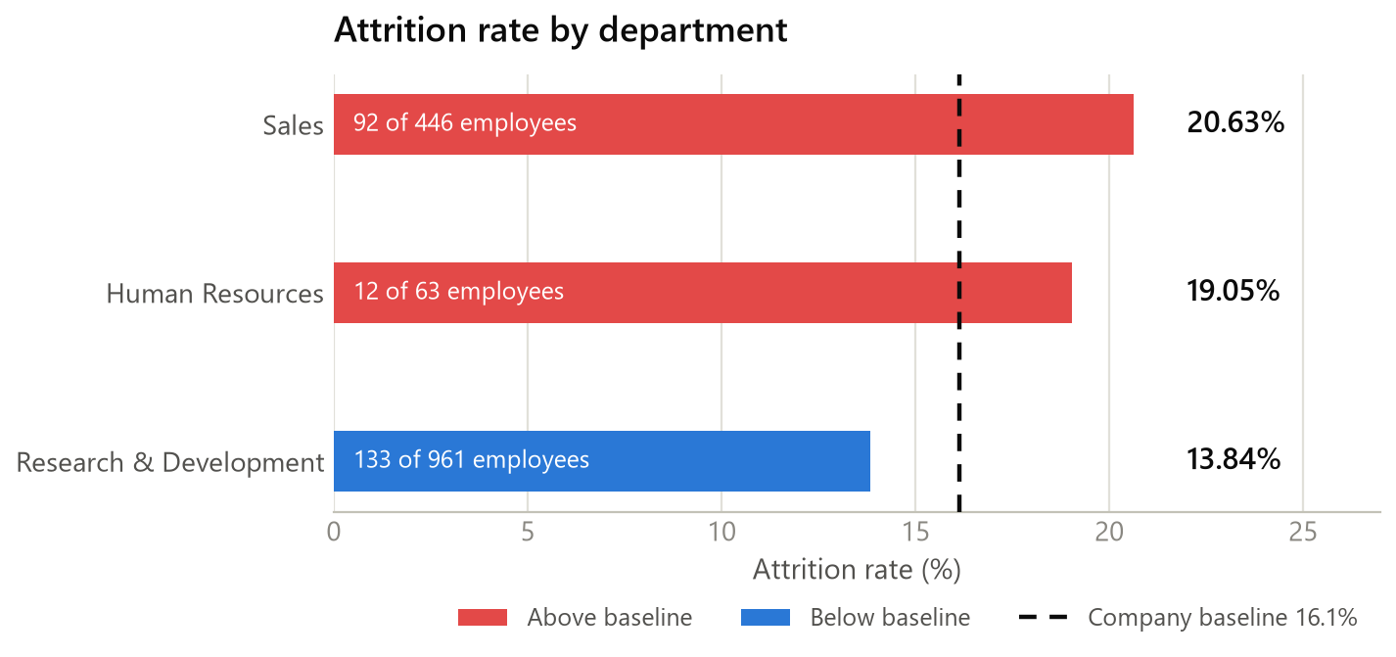
EDA STEP 04
Step 04 · Data wrangling
Objective: build a compact, analysis-ready extract with comparable employee groups instead of raw continuous columns.
Analysis performed
• Selection Fourteen variables most relevant to attrition kept from the 35, covering demographics, role, pay, sentiment and tenure.
• Binary mapping Attrition and OverTime recoded to 1/0 so group means read directly as attrition rates.
• Age groups Under 30 · 30–39 · 40–49 · 50+
• Tenure groups 0–2 · 3–5 · 6–10 · 10+ years
• Validation Result is 1,470 rows × 16 columns with zero nulls, saved as HR_Employee_Attrition_Wrangled.csv.
FINDING
INTERPRETATION
The first departmental cut already separates the business: Sales leaves at 20.63% (92 of 446) and Human Resources at 19.05% (12 of 63), both above the 16.1% company rate, while Research & Development sits below it at 13.84% (133 of 961).
Grouping is what makes comparison possible — a 0–2 year band can be set beside an 11+ year band, which 37 distinct tenure values cannot. R&D also holds the largest share of headcount, so its below-average rate still accounts for the largest absolute number of leavers.
notebooks/04-data-wrangling.ipynb
7
Notes:
The deliverable here is the grouped extract, and the chart is the first real result in the project. Numbers: Sales 20.63%, HR 19.05%, R&D 13.84%, against a 16.1% baseline. Make the interpretation point carefully — R&D is below baseline on rate but contributes 133 of the 237 total leavers because it holds 961 of 1,470 employees. Rate and volume answer different questions, which is exactly why notebook 05 adds excess attrition. Also flag the labelling caveat: the bins used here are re-derived in later notebooks with slightly different labels (10+ versus 11+ years) although the edges are identical.

Slide 8
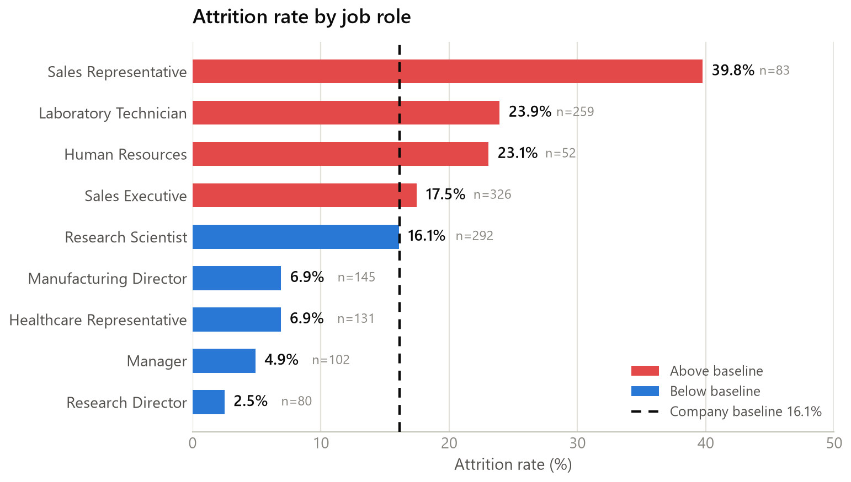
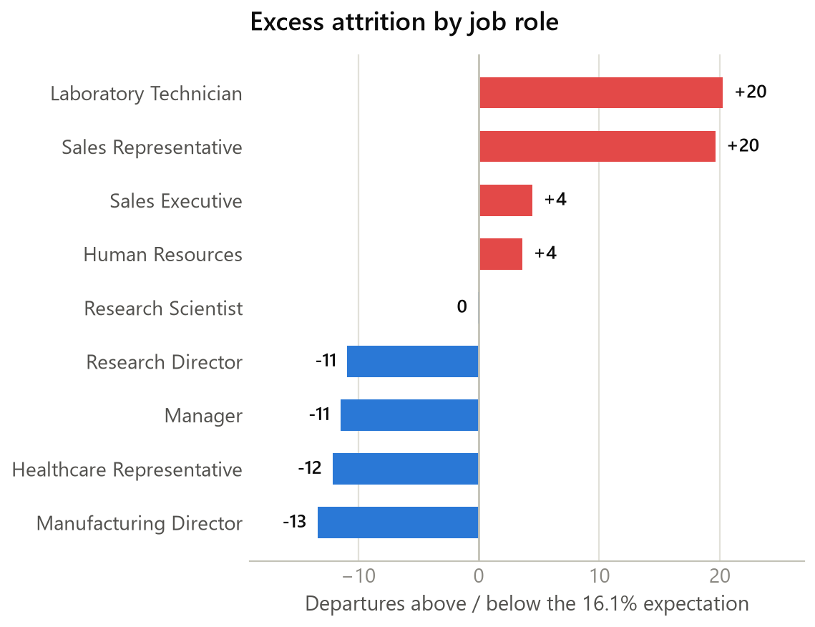
EDA STEP 05 · 1 OF 3
Step 05 · Where is attrition concentrated?
Objective: find which job roles exceed the 16.1% baseline — and which of them matter once headcount is taken into account.
FINDING
INTERPRETATION
Four of nine roles sit above the baseline. Sales Representatives leave at 39.76% — 2.47× the company rate, +23.6 pp — followed by Laboratory Technicians at 23.94% and Human Resources at 23.08%. Both Sales Representatives and Laboratory Technicians account for roughly 20 excess departures each.
Rate and volume point to different roles. Sales Representatives have the sharpest rate on only 83 people; Laboratory Technicians reach the same excess on 259. Research Directors sit at the opposite end — 2.50%, 0.16× baseline — so attrition is associated with specific operational roles rather than spread evenly.
notebooks/05-exploratory-data-analysis.ipynb
8
Notes:
Lead with the single most quotable number in the project: Sales Representatives at 39.76%, nearly two and a half times the company rate. Then immediately temper it — that is 33 people out of 83, so the confidence interval is wide. The right-hand chart is the corrective: on excess departures, Laboratory Technicians tie Sales Representatives at about +20, and they are a 259-person group. If you only had budget for one intervention, excess is the chart that tells you where to spend it. Note the wording: over-represented, associated with — we have no evidence that the role causes the leaving. Transition: same question, by department and level.

Slide 9
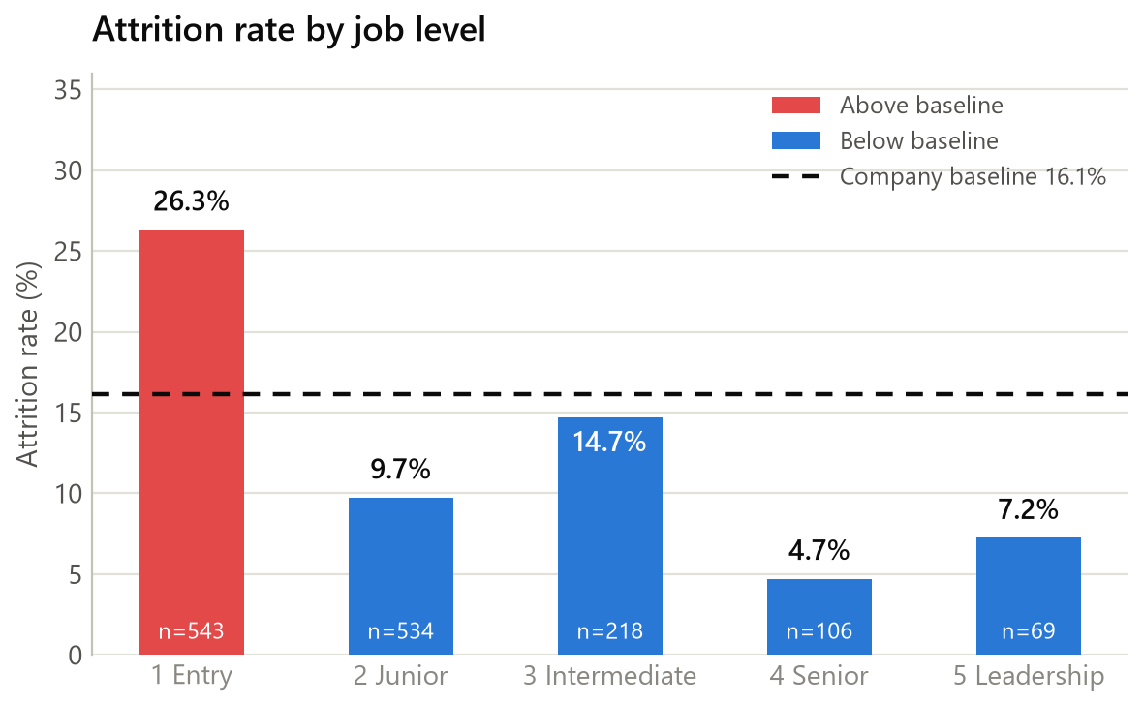
EDA STEP 05 · 2 OF 3
Step 05 · Department and job level
Objective: test whether the concentration is organisational (which department) or hierarchical (which level).
What the two cuts show
• Job level 1 26.34% on 543 employees — 1.63× baseline, +10.2 pp, and +55 excess departures, the largest excess of any segment in the project.
• Levels 2–5 All below baseline: 9.74%, 14.68%, 4.72% and 7.25% respectively.
• Departments Sales 20.63% (+20 excess) and Human Resources 19.05% (+2 excess) sit above baseline; R&D 13.84% sits 22 departures below its expectation.
• Headcount check Level 1 and level 2 together hold 1,077 of 1,470 employees, so the level-1 result is not a small-sample artefact.
FINDING
INTERPRETATION
Level is the stronger of the two cuts. Entry-level attrition of 26.34% produces 55 more departures than the baseline would predict — more than the Sales and Human Resources departments' excess combined.
Seniority is associated with staying, and the relationship is close to monotonic above level 1. The high-attrition roles identified on the previous slide are also predominantly entry-level roles, so department, role and level are not independent signals — they overlap on the same population.
notebooks/05-exploratory-data-analysis.ipynb
9
Notes:
The takeaway is that level beats department as an explanation. Entry level: 26.3% on 543 people, +55 excess departures — the single largest excess figure anywhere in the analysis. Compare that with Sales at +20 and HR at +2. Then make the confounding point, because someone will ask: Sales Representatives and Laboratory Technicians are largely level-1 roles, so we are looking at overlapping views of one group, not three independent risk factors. Disentangling them would need stratified rates, which this analysis does not do — that is an honest limitation, and it is on the What We Learned slide. Transition: so is this about being new?

Slide 10
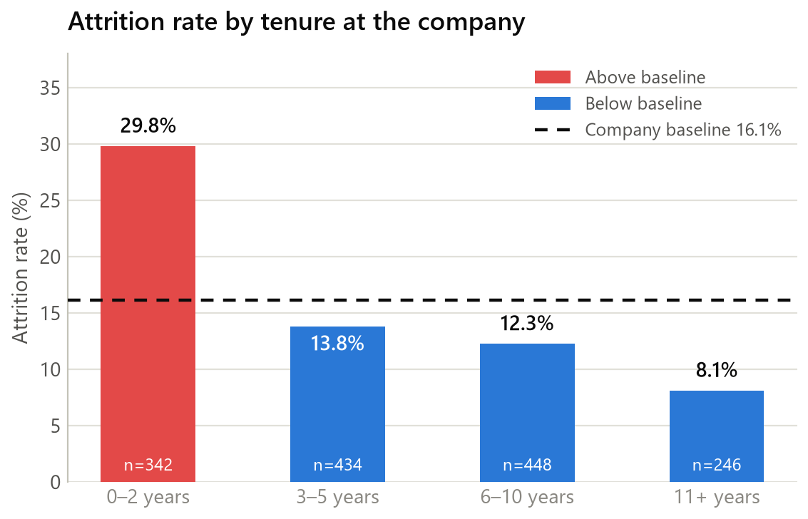
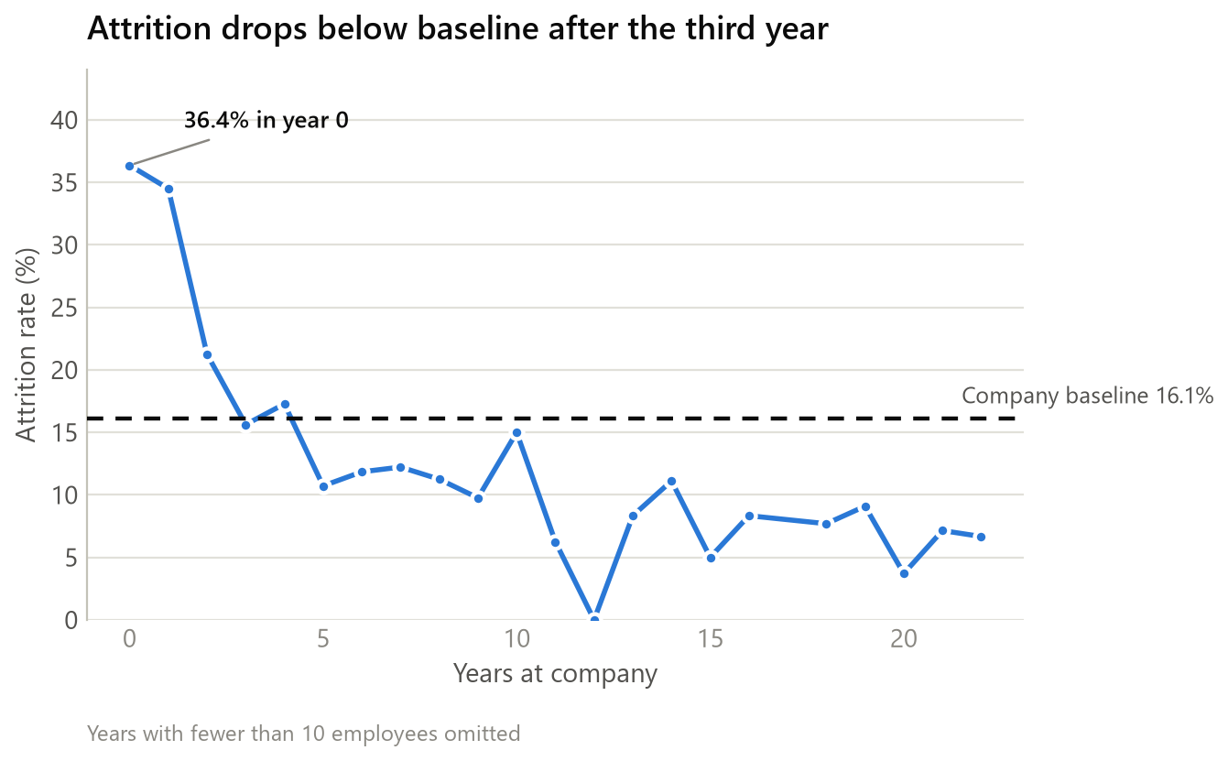
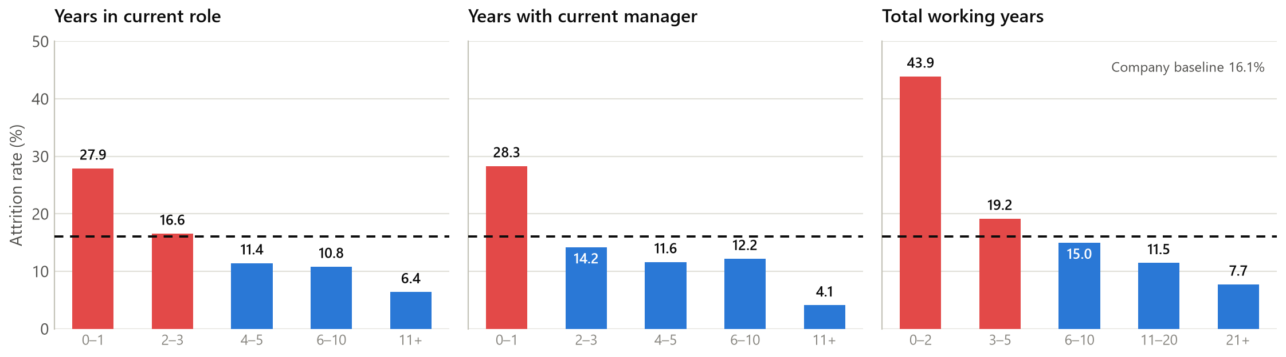
EDA STEP 05 · 3 OF 3
Step 05 · Is attrition an early-tenure phenomenon?
Objective: separate “new to the company” from “early in a career” and find when the risk period ends.
FINDING
INTERPRETATION
Attrition is an early-tenure phenomenon. It runs at 29.82% in the first two years (342 employees, 1.85× baseline, +47 excess), then falls to 13.82%, 12.28% and 8.13% across the later bands.
Three independent clocks agree: first year in role 27.91%, first year with a manager 28.32%, first two years of a whole career 43.90%. Risk is concentrated in the first two years, with no second mid-career peak.
notebooks/05-exploratory-data-analysis.ipynb
10
Notes:
This is the most robust finding in the deck because four separate measures agree. Company tenure 0–2 years: 29.8%. Years in current role 0–1: 27.9%. Years with current manager 0–1: 28.3%. Total career experience 0–2 years: 43.9%, which is 2.7 times baseline. The year-by-year line is worth pointing at: 36.4% in year zero, 34.5% in year one, then it crosses below the baseline by year three and stays there. The bumps at years 4 and 10 are small-sample noise, which is why we suppressed years with fewer than ten employees. What we cannot say: whether people leave because they are new, or whether the roles that hire heavily are also the roles people leave. Answering the question the README asked — early-tenure or mid-career — the evidence points clearly at early-tenure.

Slide 11
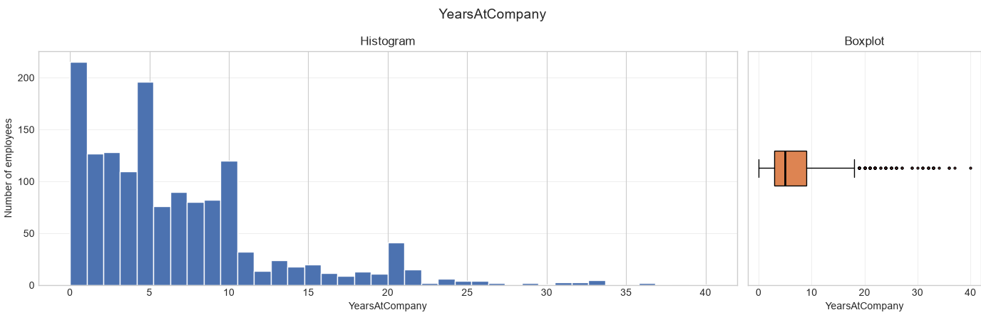
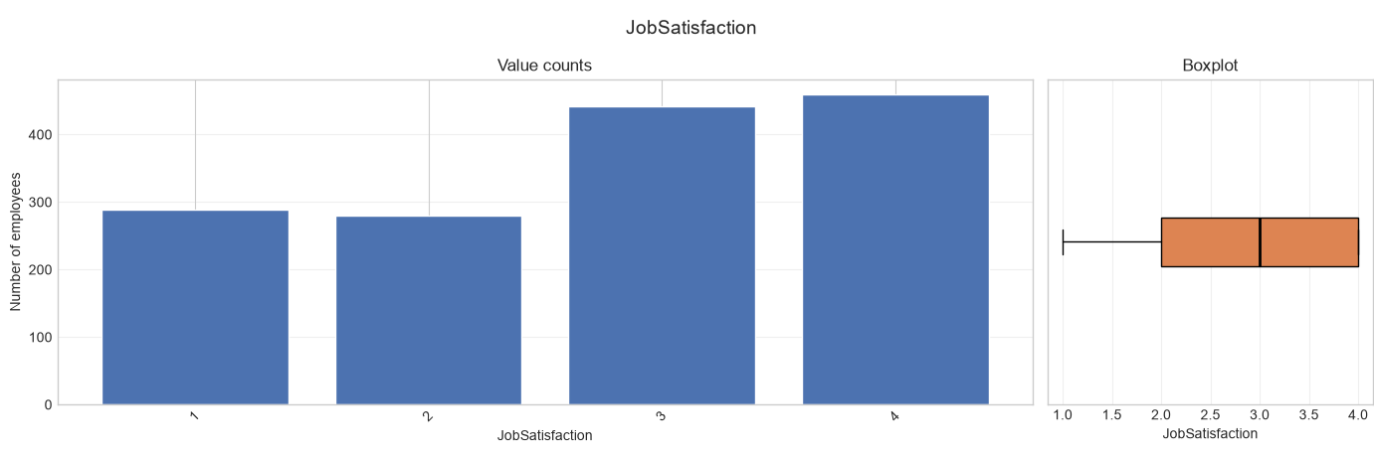
EDA STEP 06
Step 06 · Finding how the data is distributed
Objective: profile the shape of every numeric feature before trusting any mean, correlation or bin edge drawn from it.
FINDING
Numeric features showed two distinct patterns:
  Continuous variables (MonthlyIncome, TotalWorkingYears, YearsAtCompany) displayed strong left-skewed distributions with long lower tails.
  Ordinal survey variables (JobSatisfaction, EnvironmentSatisfaction, WorkLifeBalance) clustered around mid-higher values.
Median values are more representative than means for compensation and tenure variables because a relatively small group of highly paid, highly experienced employees pulls averages upward.
No unusual distributional patterns suggested data-quality issues; observed extreme values aligned with realistic senior employee profiles.
INTERPRETATION
The employee population is not evenly distributed. Most employees are concentrated in lower-tenure, lower-income, and lower-experience ranges, while a relatively small group occupies the high-income and long-tenure tail. This matters because later attrition analysis shows the highest attrition rates occur within these larger early-career groups. The distribution therefore suggests that attrition risk is concentrated where most employees are already located, amplifying its business impact.
notebooks/06-finding-how-data-distributed.ipynb
11
Notes:
Twenty-three individual distribution figures in the notebook — we are showing the method, not all of them. The design decision worth calling out is the split treatment: continuous columns get a histogram, columns with ten or fewer distinct values get value-count bars. That matters because a KDE over a 1–4 satisfaction scale invents a shape that is not in the data. The substantive finding is the right skew in income, tenure and experience, and it drives three later decisions: median over mean, the volume of IQR flags in step 07, and banded rather than mean-based comparisons throughout. Transition: so what did the IQR rule flag?

Slide 12
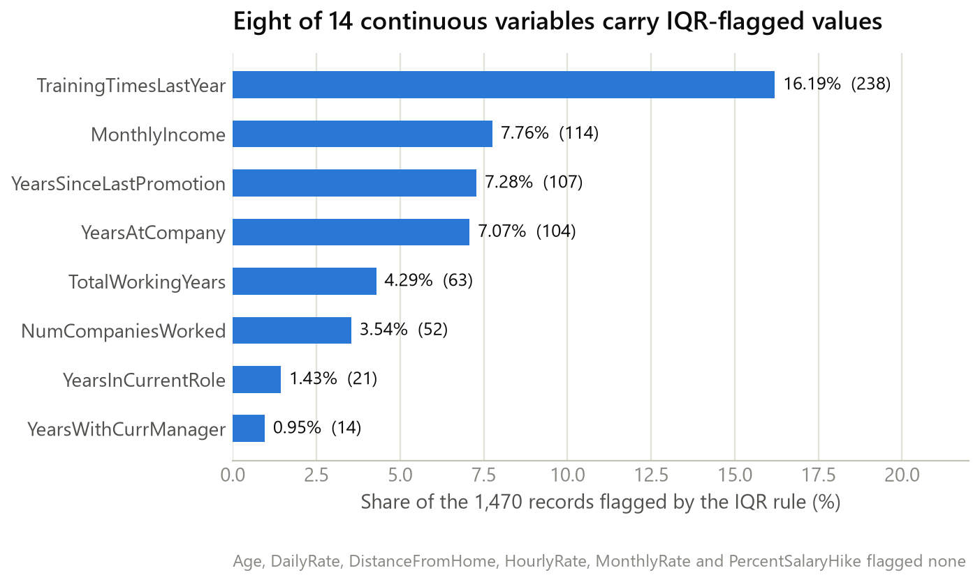
EDA STEP 07
Step 07 · Finding outliers
Objective: identify unusually high or low values with the IQR rule, then decide whether each is a data error or a real employee.
Analysis performed
• Scope Fourteen genuinely continuous columns. Identifiers, constant columns and rating scales such as JobLevel and JobSatisfaction were excluded — a category code has no meaningful upper fence.
• Rule Values below Q1 − 1.5×IQR or above Q3 + 1.5×IQR were flagged.
• Review The 114 MonthlyIncome flags were inspected individually against job level, role and total experience.
FINDING
Eight of the 14 columns carry flagged values. All 114 MonthlyIncome flags exceed the $16,581 upper fence — every one is a level 4 or 5 Manager or Research Director with 21 to 35 years of experience.
INTERPRETATION
CONCLUSION
These are not errors, they are the senior tail of a right-skewed pay distribution. TrainingTimesLastYear is flagged at 16.19% for a different reason: it takes only seven values with a one-unit IQR, so the fence sits at 4.5 and any employee with five or six sessions falls outside it.
All flagged values were retained. Removing them would delete exactly the senior, long-tenured, well-paid employees whose low attrition rates are central to the analysis — and would bias the results rather than clean them.
notebooks/07-finding-outliers.ipynb
12
Notes:
The interesting result here is a decision, not a number. The IQR rule flagged 238 TrainingTimesLastYear values (16.19%) and 114 MonthlyIncome values (7.76%), but inspection showed both are artefacts of the rule rather than problems in the data. For income, every single one of the 114 is above the fence and every one is a senior manager or research director with two to three decades of experience — real people, not typos. For training, the variable has a one-unit interquartile range, so the fence lands at 4.5 and anyone attending five sessions is an 'outlier'. That is the rule misfiring on a discrete variable. So everything was retained. If asked why that is the right call: those senior employees have the lowest attrition rates in the dataset — deleting them would remove the contrast the whole analysis rests on.

Slide 13
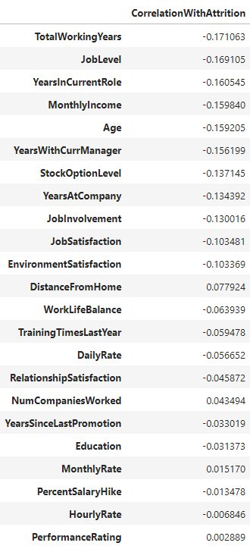
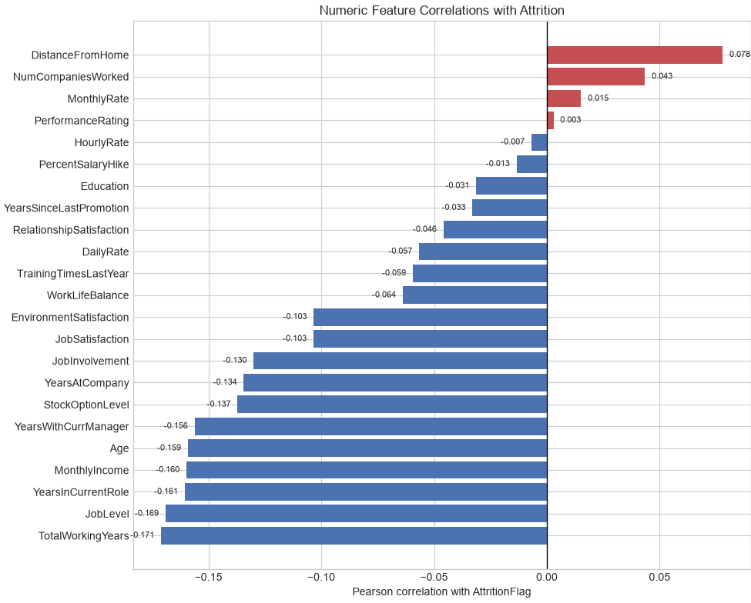
EDA STEP 08
Step 08 · Finding correlation
Objective: screen every variable at once — both as grouped attrition rates and as a direct correlation with leaving.
FINDING
All correlations are relatively weak (|r| < 0.20), indicating that no single numeric variable strongly explains employee attrition.
Employees with less total work experience, lower job levels, lower income, and shorter tenure with managers were more likely to leave.
The only notable positive relationship was DistanceFromHome (+0.078), suggesting attrition tends to increase as commute distance grows.
Correlations should be viewed as screening indicators, not evidence of causation.
INTERPRETATION
Employees with ≤ 6 total working years had a 25.6% attrition rate, compared with 8.7% for employees with more than 15 years of experience.
Employees in the lowest income quartile experienced 29.3% attrition, nearly three times the rate of the highest income quartile (~10%).
notebooks/08-finding-correlation.ipynb
13
Notes:
Two charts, one lesson. On the left, the twelve biggest group gaps among segments of at least fifty people — and overtime is the standout because it is both a large gap and a large group: 416 employees, 30.5% versus 10.4%. On the right, every numeric correlation with leaving, and the strongest is total working years at minus 0.171. That is a weak correlation by any standard. Make the methodological point clearly, because it is the most sophisticated thing in the deck: a Pearson coefficient against a 0/1 outcome is answering a different and less useful question than 'what share of this group left'. The notebook's own comment says to treat these as screening signals, not causal explanations, and we agree. Also note the direction: almost every correlation is negative — more of anything (tenure, level, income, age, satisfaction) travels with staying. Distance from home at plus 0.078 is the only meaningful positive.

Slide 14
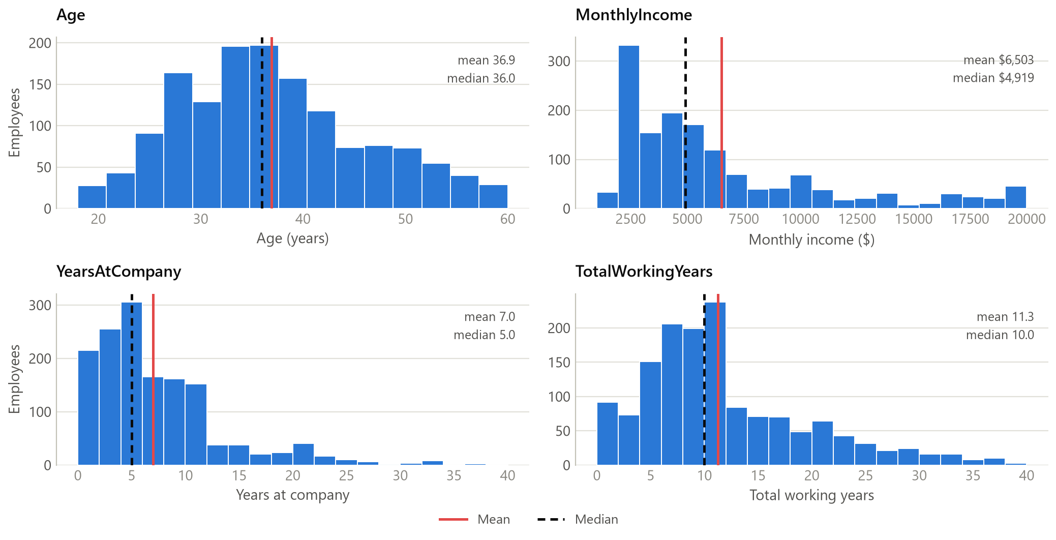
EDA STEP 09
Step 09 · Visualizing distribution
Objective: describe the workforce itself — age, pay, tenure and experience — so the segment rates have a population to sit in.
Finding
• Age 18 to 60, mean 36.9, median 36.0 — close to symmetric with a mild right skew.
• Monthly income Mean $6,503 against a median of $4,919 — strongly right-skewed.
• Years at company Mean 7.0 against a median of 5.0; most employees sit between 2 and 10 years.
• Total working years Mean 11.3 against a median of 10.0, concentrated between 5 and 12 years.
INTERPRETATION
Where mean and median diverge, the median is the honest description of a typical employee — a small group of senior, high-earning, long-tenured people pulls every average upward.
CONCLUSION
These charts describe the population, not the leaving. They matter to the argument in one specific way: the workforce is concentrated in exactly the early-tenure, lower-income, entry-level bands that the attrition analysis identified as highest-risk — which is why those segments carry large headcounts as well as high rates. The notebook states plainly that distributions alone establish nothing about what causes attrition.
notebooks/09-visualizing-distribution.ipynb · contributor: Asif Hassan
14
Notes:
Short slide — it is context, not a finding about attrition, and the notebook says so itself in its closing line. Numbers to have ready: income mean $6,503 versus median $4,919; tenure mean 7 versus median 5; experience mean 11.3 versus median 10. In all three the mean sits above the median, which is the signature of a right skew. The one bridge back to the main story is in the conclusion box: the bulk of the workforce lives in the same low-tenure, lower-paid, entry-level region we flagged as high risk, so those segments are big as well as risky. That is the reason the excess-attrition numbers were as large as they were.

Slide 15
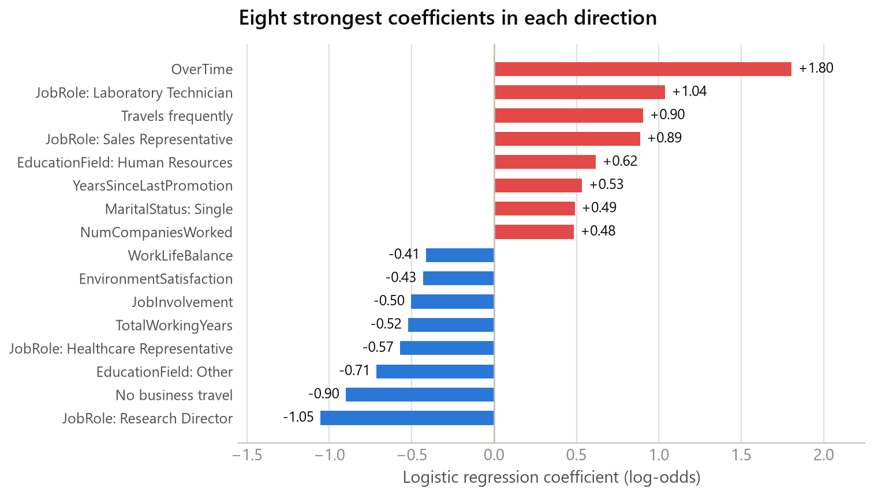
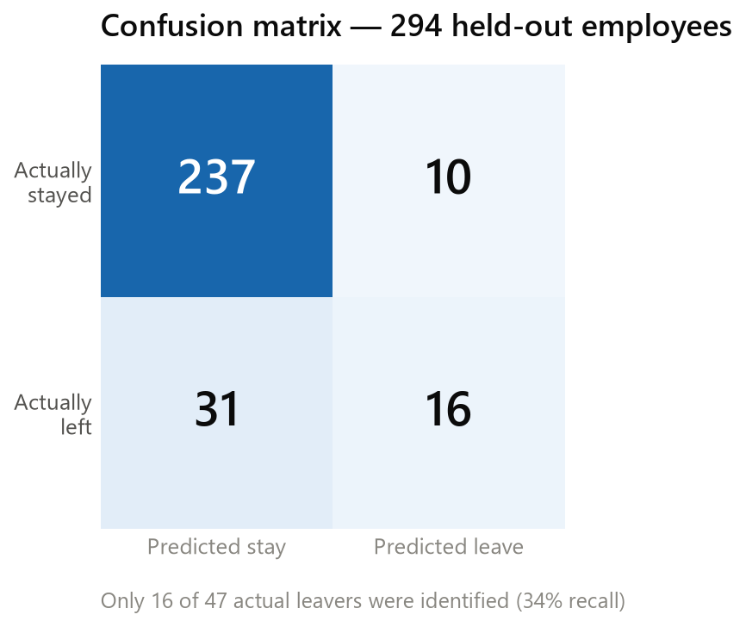
EDA STEP 10
Step 10 · Regression model
Objective: check whether the patterns found descriptively also separate leavers from stayers when fitted together.
86.0%
0.811
FINDING
INTERPRETATION
Accuracy
ROC-AUC
86.0% accuracy is misleading: the model recalls only 34% of actual leavers (16 of 47) at 62% precision, while recalling 96% of stayers. ROC-AUC of 0.811 says it ranks risk reasonably even though its yes/no calls on leavers are poor.
The coefficients agree with the descriptive work, overtime is the largest positive weight at +1.80, and Research Director the largest negative at −1.05. A coefficient is still an association inside this model, not a cause, and magnitudes are not directly comparable because only the continuous features were scaled.
294 held-out rows
ranking quality
notebooks/10-regression-model.ipynb
15
Notes:
Handle this slide carefully, because the accuracy number invites the wrong conclusion. 86% accuracy sounds strong until you notice that predicting 'nobody leaves' would score 84% on a dataset that is 16% leavers. The honest read is in the confusion matrix: of 47 people who actually left, the model found 16 and missed 31. Recall of 34%. So as a screening tool it is weak. What it does do well is rank — ROC-AUC 0.811 means it usually puts a leaver above a stayer, and the notebook's probability output is more useful than its yes/no call. The coefficients are the real payoff: overtime plus 1.80 is the single largest weight, which independently corroborates the step 08 finding. Two caveats to volunteer: coefficient magnitudes are not comparable across feature types because only the 14 continuous columns were standardised; and this model is a check on the descriptive work, not a deployable risk score.

Slide 16
KEY FINDINGS
What the analysis established
Ranked by strength of evidence — gap size, segment headcount and how many independent measures agree.
FINDING
EVIDENCE
INTERPRETATION
1
Attrition is an early-tenure phenomenon
29.82% in the first two years vs 8.13% after eleven; 27.91% in a first year in role; 28.32% in a first year with a manager; 43.90% in a first two years of career
The strongest result in the project — four independent tenure clocks agree, on large segments. Retention effort has a clear window.
2
Seniority travels with staying
Job level 1: 26.34% on 543 employees, +55 excess departures. Levels 2–5 all below baseline, down to 4.72%
The largest excess of any single segment. Entry level is where the volume of preventable loss sits.
3
Overtime carries the largest single-condition gap
30.53% of 416 employees working overtime left, vs 10.44% of 1,054 who did not — +14.4 pp; largest positive model coefficient at +1.80
Both the descriptive rates and the fitted model agree, on a large group. The most actionable-looking association in the data.
4
Attrition concentrates in specific operational roles
Sales Representative 39.76% (2.47× baseline); Laboratory Technician 23.94%; both ~+20 excess departures
Rate and volume point to different roles, so targeting needs both views. These are also largely entry-level roles.
5
Lower pay is associated with leaving
Lowest income quartile (≤$2,911): 29.27% vs 10.34% in the top quartile; correlation −0.160
Real as a gap, but heavily confounded with level and tenure — the analysis did not control for them.
6
Low satisfaction shifts the rate, but modestly
Job involvement low 21.6% vs high 9.0%; environment satisfaction 20.1% vs 13.5%; job satisfaction 19.7% vs 11.3%
Directionally consistent across all four survey scales, but every correlation is under 0.13 — weaker than tenure or overtime.
notebooks/05, 08, 10
16
Notes:
This is the slide to slow down on. The ranking is by strength of evidence, not by size of the headline number — which is why Sales Representatives at 39.8% sit at number four rather than number one. Findings one to four are the ones we would defend; five and six are real but confounded or weak, and they are marked differently for that reason. If you take one thing away: early tenure, entry level and overtime, all on large segments, all corroborated by more than one method. Every statement here is 'associated with' — we have one snapshot of one fictional company and no experiment, so nothing here establishes cause.

Slide 17
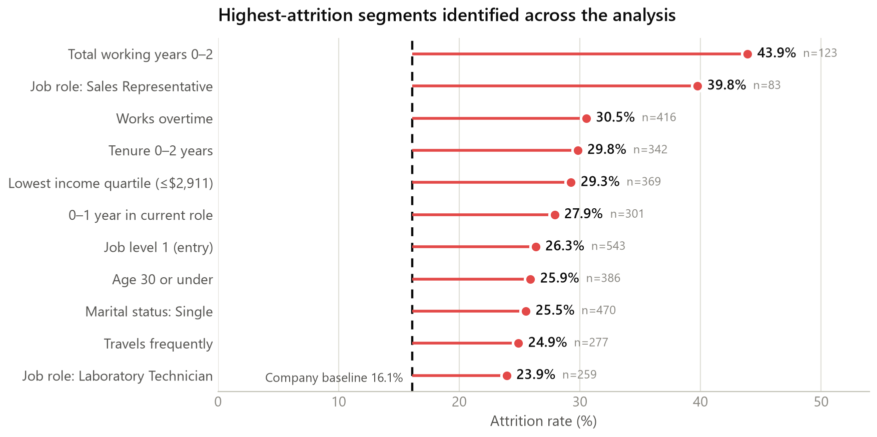
SYNTHESIS
Attrition risk patterns
Every segment shown was measured in notebook 05 or 08; headcount is printed beside each rate because a rate on 83 people is a weaker claim than the same rate on 543.
Associated with staying
Research Director — 2.50%
Job level 4 — 4.72%
Manager — 4.90%
Healthcare Rep — 6.87%
Manufacturing Dir — 6.90%
11+ years tenure — 8.13%
8+ years with manager — 4.11%
No business travel — 8.00%
No overtime — 10.44%
READ WITH CARE
These segments overlap heavily. An entry-level Sales Representative in their first year is one person counted in four rows.
INTERPRETATION
The high-attrition profile is consistent across every cut: early in tenure, early in career, low in the hierarchy, lower-paid, and working overtime. Nothing here identifies an individual as a flight risk.
notebooks/05, 08
17
Notes:
Use this as the picture the audience takes home. The left panel is every above-baseline segment we measured, sorted by rate, with headcount attached. The right column is the mirror image — the profile associated with staying. The single most important caveat is the overlap box: these eleven rows are not eleven independent risk factors. A 26-year-old entry-level Sales Representative in their first year on the lowest pay quartile appears in five of them. Building a risk score by adding these up would double-count badly. Also repeat the ethics point: this is a segment-level description. The README is explicit that gender, age and marital status stay out of anything that scores an individual, and we will come back to that on the next slide.

Slide 18
REFLECTION
What we learned
Separating what the data told us from what the process taught us.
Findings about the data
Lessons about the analysis
• Strong relationships Tenure, job level and overtime produce the widest, most consistent gaps — all on segments of 300 or more.
• Weak relationships Hourly rate, monthly rate, percent salary hike and performance rating are effectively flat; performance rating correlates +0.003 with leaving.
• The surprise Attrition is not monotonic in seniority. Level 3 (14.68%) leaves more than level 2 (9.74%), and level 5 (7.25%) more than level 4 (4.72%).
• Second surprise Promotion stagnation barely registers descriptively (−0.033 correlation) yet is the sixth-largest positive coefficient in the model — a signal only visible alongside other variables.
• Commute Distance from home is the only clearly positive numeric correlation (+0.078): 20.6% in the furthest quartile vs 12.9% in the nearest.
• Rate is not volume Excess attrition changed our conclusions: Human Resources at 23.08% is +4 departures, Laboratory Technicians at 23.94% are +20.
• Correlation is a screen No numeric correlation exceeds 0.171. Grouped rates carried every interpretable finding; Pearson on a binary target understates real gaps.
• Confounding is unresolved Role, level, tenure and pay overlap on the same employees. We report each separately and did not stratify — so no gap here is an independent effect.
• Imbalance breaks accuracy At 16.1% positives, a model predicting “nobody leaves” scores 84%. Ours scored 86% while finding 34% of leavers.
• Limitations One fictional snapshot, no dates, no costs, no exit reasons. Small segments (Human Resources role, n=52) stay wide. And the README's own ethics rule — keep gender, age and marital status out of individual scoring — is not honoured by the notebook 10 model, which includes all three.
notebooks/05–10 · README.md Caveats and Ethics
18
Notes:
Left column is about the company, right column is about us. Two genuine surprises worth narrating. First, attrition is not a clean staircase down the hierarchy — level 3 leaves more than level 2, and level 5 more than level 4. With 218 and 69 people in those bands, some of that is noise, but it undercuts any simple 'seniority protects you' story. Second, years since last promotion looks like nothing on its own, a correlation of minus 0.033, yet it is a strong positive weight in the model — a reminder that a variable can be invisible alone and informative in combination. On the right, the most important admission is confounding: we never stratified, so we genuinely cannot say whether overtime matters independently of job level. And be upfront about the last one — our own README says protected attributes stay out of individual scoring, and the notebook 10 model includes age, gender and marital status. That is an inconsistency we should fix, not defend.

Slide 19
HOW THE WORK WAS ORGANISED
Repository and team
A public GitHub repository with numerically-prefixed notebooks meant to be run in order, committed with their outputs so they read on GitHub.
Repository structure
Team · NPower JDA Cohort 2026
ibm-analytics-attrition-eda/
├─ data/
│ ├─ raw/ WA_Fn-UseC_-HR-Employee-Attrition.csv
│ ├─ processed/ Employee-Attrition_Regression_Ready.csv
│ └─ HR_Employee_Attrition_Wrangled.csv
├─ notebooks/ 00 … 10 (11 notebooks, run in order)
├─ dashboards/
│ └─ app/ Dash app — layout, callbacks, figures, theme
├─ requirements.txt
└─ README.md
Pablo Fiterman
Asif Hassan
Attrition analysis (05), dashboard, README, repo structure
Distribution visualisation (09)
Dhanan Thannoo
Amruta Atul
Normalizing data (03), regression model (10)
Listed contributor
Tanvi Varshney
Moustafa Ismail
Data wrangling (04), outlier detection (07)
Listed contributor
Yunseo Jang
Stephanie Jivoderova
Distribution profiling (06), correlation (08)
Listed contributor
Beyond the notebooks. The repository also ships an interactive Dash application over the same raw extract — filter the workforce by ten attributes and every statistic and chart re-reads the slice. It shares the exact bin edges from notebook 04, so a number in the app matches a number in the analysis.
Collaborative team project. Analysis, documentation, visualization and review completed through GitHub — feature branches, pull requests and Conventional Commits. Notebook ownership above reflects the commit history; the four contributors without a notebook line are credited in the README without notebook-level commits under those names.
README.md · git history
19
Notes:
Keep this brief and let the tree do the work. Three things to say. One: the notebooks are numerically prefixed and committed with their outputs, so a reviewer can read the whole analysis on GitHub without running anything. Two: the team used actual branch-and-pull-request workflow with Conventional Commits, which is why we can attribute notebooks to people from the history rather than from memory. Three: the repository goes beyond notebooks — there is a Dash application over the same raw file that shares notebook 04's bin edges, so the app and the analysis cannot drift apart. If asked about the four contributors listed without a notebook: they are credited in the README author table, but the git history does not record notebook-level commits under those names, and we would rather say that than invent responsibilities.

Slide 20
TECHNICAL SKILLS
Tools and techniques applied
Only what the repository actually contains — every item below appears in a notebook, the dashboard, or requirements.txt.
Language & environment
Data manipulation
Visualization
Analysis & modelling
Collaboration
Python 3
pandas
Matplotlib
Descriptive statistics
Git & GitHub
Analysis language throughout
Loading, grouping, cross-tabulation, qcut/cut banding, Styler formatting
Bar, line, box and histogram composition
Segment rates, baseline gaps, excess attrition
Feature branches, pull requests, merge conflict resolution
Jupyter
11 notebooks, committed with outputs
seaborn
IQR outlier detection
Conventional Commits
NumPy
Statistical plots and distribution comparison
Fences, review and a documented retention decision
Typed, scoped commit messages as a readable changelog
Numeric operations and bin arithmetic
venv + requirements.txt
Pinned, reproducible environment
Plotly + Dash
Pearson correlation
Interactive attrition explorer dashboard
Numeric screening against the target
scikit-learn
StandardScaler, stratified split, logistic regression, classification report, ROC-AUC
NOT USED, DESPITE THE README
The README's technology table also lists Microsoft Excel and Streamlit. Neither appears anywhere in the repository — the dashboard is built with Dash and Plotly.
notebooks/ · dashboards/app/ · requirements.txt
20
Notes:
Do not read the grid aloud — point at the columns. The framing that matters: everything on this slide is evidenced in the repository, which is why Excel and Streamlit are called out at the bottom as listed in the README but absent from the code. If someone asks what the most transferable skill was, the honest answer is not a library — it is the excess-attrition calculation and knowing to print a headcount next to every rate. Two small things worth knowing: pandas Styler is how the notebooks format their summary tables for readability, and scikit-learn appears in two places, scaling in notebook 03 and the model in notebook 10.

Slide 21
WHERE THIS LEAVES US
Conclusion
What the exploratory analysis proved, what it means, and what would have to happen next — kept clearly apart.
What we discovered
Why it matters
Next steps — not findings
• Attrition runs at 16.1% overall — 237 of 1,470 employees.
• It is concentrated in the first two years: 29.82% vs 8.13% after eleven, with four independent tenure measures agreeing.
• Entry level carries the largest preventable volume: 26.34% on 543 employees, +55 excess departures.
• Overtime is the widest single-condition gap: 30.53% vs 10.44%, and the largest coefficient in the fitted model.
• Specific operational roles stand out — Sales Representative 39.76%, Laboratory Technician 23.94%.
• The risk window is narrow and identifiable, so retention effort has somewhere specific to go — onboarding, the first role, the first manager.
• Rate alone would have sent effort to the wrong places; excess attrition changes the priority order.
• Weak correlations across 23 numeric features mean no single lever explains attrition — it is a combination of conditions.
• Reporting headcount with every rate is what keeps a finding on 52 people from reading like a finding on 543.
• Stratify the big gaps: does overtime still shift the rate within one job level and tenure band?
• Answer the two README questions the notebooks left open — pay within role and level, and what share of leavers are senior high performers.
• Strengthen the model as a ranking tool: class weighting, threshold tuning and cross-validation, judged on recall rather than accuracy.
• Bring the notebook 10 feature set in line with the project's own ethics rule by removing gender, age and marital status from individual scoring.
• Attach cost-per-departure so excess attrition converts into a budget case.
THE LINE WE DO NOT CROSS
Every statement above is an association measured in one cross-sectional snapshot of a fictional dataset. Predictive modelling is a next step, not a finding — and nothing here establishes a cause.
notebooks/05–10 · README.md
21
Notes:
Three columns, three different kinds of claim, and the distinction is the point. Left: what we measured. Middle: what a reader should do with it. Right: what we have not done — and predictive modelling belongs there, not in the findings, even though notebook 10 exists. If you have time for one next step, argue for stratification: until we know whether overtime still moves the rate inside a single level and tenure band, we cannot tell an HR team which lever to pull. Close on the red box: one snapshot, fictional data, associations only.

Slide 22
Thank you
Questions welcome
NPower JDA Cohort 2026
Amruta Atul · Asif Hassan · Dhanan Thannoo · Moustafa Ismail · Pablo Fiterman · Stephanie Jivoderova · Tanvi Varshney · Yunseo Jang
github.com/NPower-JDA-Cohort-2026/ibm-analytics-attrition-eda
Notes:
Anticipated questions and the short answers. Why is accuracy 86% but the model weak? Because 84% comes free from predicting nobody leaves — look at recall, 34%. Why not just use the correlations? Because the strongest is minus 0.171; grouped rates are the interpretable view. Is Sales Representative really the worst role? Highest rate, yes, on 83 people — Laboratory Technicians tie it on excess departures with 259 people, and that is the more actionable number. Does overtime cause attrition? Unknown and unknowable from this data: one snapshot, no experiment, and we never controlled for job level. Can we predict who will leave? Not responsibly from this work — and the project's own ethics rules keep protected attributes out of individual scoring, which the current model does not yet respect.

