Slide 1
Computer Abstractions and Technology

Slide 2
Outline
Preliminary
Introduction
Eight Great Ideas in Computer Architecture
Below Your Program
Under the Covers
Technologies for Building Processors and Memory
Performance
The Power Wall
The Sea Change: The Switch from Uniprocessors to Multiprocessors
Real Stuff: Benchmarking the Intel Core i7
Fallacies and Pitfalls

Slide 3
Preliminary
Computer architecture deals with the functional behavior of a computer systems viewed by a programmer
The sizes of data types
The types of operations that are supported
Computer organization deals with structural relationships that may not be visible to the programmer
Interfaces to peripheral devices
Clock frequency
The technology used for the memory

Slide 4
Introduction
Computer revolution makes novel applications feasible
Computers in automobiles, cell phones, human genome project, World Wide Web (WWW), search engine
Classes of computing applications and their characteristics
Personal computers (PCs)
To emphasize delivery of good performance to single users at low cost
Usually execute third-party software
Servers
Much larger computers usually are accessed only via a network
To carry large workloads
Single complex applications: usually a scientific or engineering application
Many small jobs: a large web server
Usually based on software from another source
Database or simulation system
Often modified or customized for a particular function

Slide 5
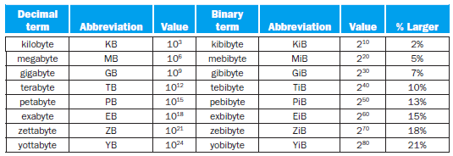
Classes of computing applications and their characteristics (Cont.)
Servers (Cont.)
Much larger computers usually are accessed only via a network (Cont.)
Built from the same basic technology as PCs
To provide greater computing, storage, and I/O capacity
To place a greater emphasis on dependability
The widest range in cost and capability
Low-end server
Used for file storage, small business application, or simple web serving
Supercomputers (the peak of computing capability)
To consist of tens of thousands of processors and many terabytes of memory
To cost tens to hundreds of millions of dollars
Used for high-end scientific and engineering calculations
A relatively small fraction of the servers and the overall computer market
Fig. 1.1 The 2^{X} vs. 10^{Y} bytes ambiguity was resolved by adding a binary notation for all the common size terms.

Slide 6
Classes of computing applications and their characteristics (Cont.)
Embedded computers
The largest class of computers
The widest range of application and performance
Designed to run one application or one set of related applications
Normally integrated with the hardware and delivered as a single system
Embedded applications
Often have unique application requirements that combine a minimum performance with stringent limitations on cost or power
Often have lower tolerance for failure
In consumer-oriented applications, dependability is achieved through simplicity
Redundancy are often employed in large embedded systems
Welcome to the PostPC era
PC → personal mobile device (PMD)
A smart phone or a tablet computer
Battery operated with wireless connectivity to the Internet
Like PCs: users can download software (apps) to run on them
Unlike PCs: keyboard and mouse → touch-sensitive screen or speech input

Slide 7
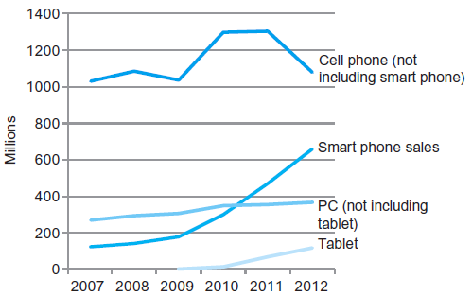
Welcome to the PostPC era (Cont.)
Server → cloud computing
Warehouse scale computers (WSC)
To rely upon giant datacenters
Companies like Amazon and Google build these WSCs containing 100,000 servers and let companies rent portions of them
Software as a Service (SaaS)
To deliver software and data as a service over the Internet (cloud)
Only a thin program such as a browser runs on local client devices
Examples: web search, social networking
Fig. 1.2 The number manufactured per year of tablets and smart phones, which reflect the PostPC era, versus personal computers and traditional cell phones.

Slide 8
Eight Great Ideas in Computer Architecture
Design for Moore’s law
Moore’s law
Integrated circuit resources double every 18~24 months
Gordon Moore, 1965
Designing for rapid change
Computer architects must anticipate where the technology will be when the design finishes rather than design for where it starts
Use abstraction to simplify design
Use abstractions to represent the design at different levels of representation
Lower-level details are hidden to offer a simpler model at higher levels
Make the common case fast
Making the common case fast will tend to enhance performance better than optimizing the rare case
The common case is often simpler and easier to enhance than rare case

Slide 9
Performance via parallelism
To perform operations in parallel to get more performance
Performance via pipelining
An implementation technique in which multiple instructions are overlapped in execution
Performance via prediction
To guess and start working rather than wait until you know for sure
Assumptions
The recovery from a misprediction is not too expensive
The prediction is relatively accurate
Hierarchy of memories
Programmers want memory to be fast, large, and cheap
Hierarchy of memories
The fastest, smallest, and most expensive memory per bit at the top
The slowest, largest, and cheapest per bit at the bottom
Cache ↔ main memory ↔ disk

Slide 10
Dependability via redundancy
Computers need to be fast and dependable
Since any physical device can fail, we make systems dependable by including redundant components
To take over when a failure occurs
To help detect failures

Slide 11
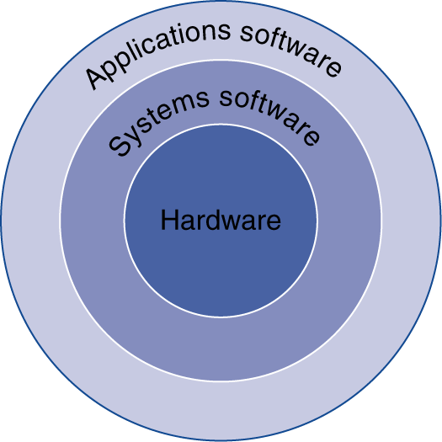
Below Your Program
A simple view of hardware and software
Application software
To consists of millions of lines of code
To rely on sophisticated software libraries that implement complex functions
Systems software
Operating system
Handling basic input and output operations
Allocating storage and memory
Providing for protected sharing of the computer among multiple applications using it simultaneously
Compiler
To translate a program written in a high-level languages into instructions that the hardware can execute
Hardware
Can only execute extremely simple low-level instructions
Fig. 1.3 A simplified view of hardware and software as hierarchical layers, shown as concentric circles with hardware in the center and applications software outermost.

Slide 12
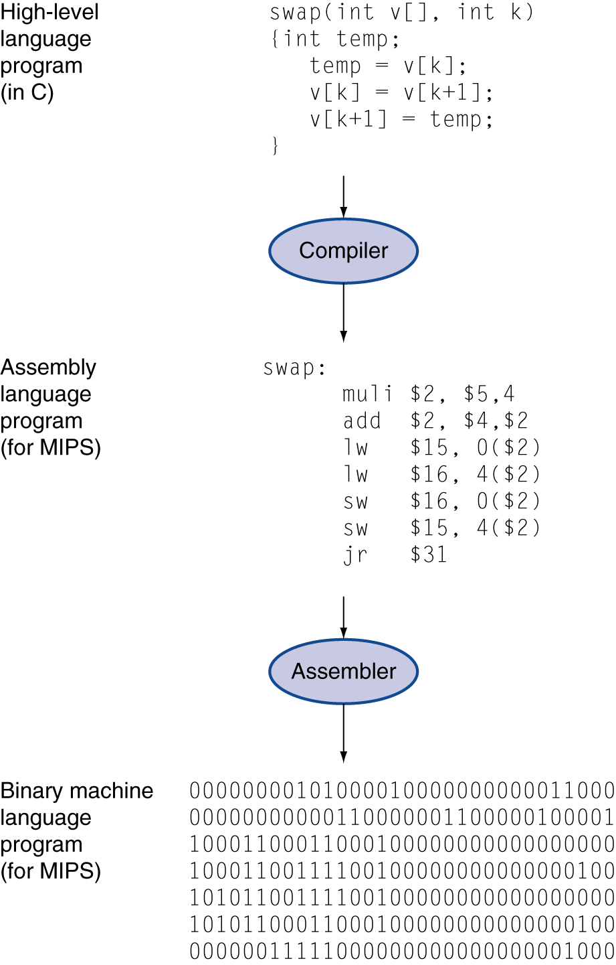
From a high-level language to the language of hardware
High-level programming language
Composed of words and algebraic notation
To provide for productivity and portability
Can be translated by a compiler into assembly language
Assembly language
A symbolic representation of machine instructions
Can be translated by an assembler into the binary version
Machine language
A binary representation of machine instruction
Binary digit (bit)
Fig. 1.4 C program compiled into assembly language and then assembled into binary machine language.

Slide 13
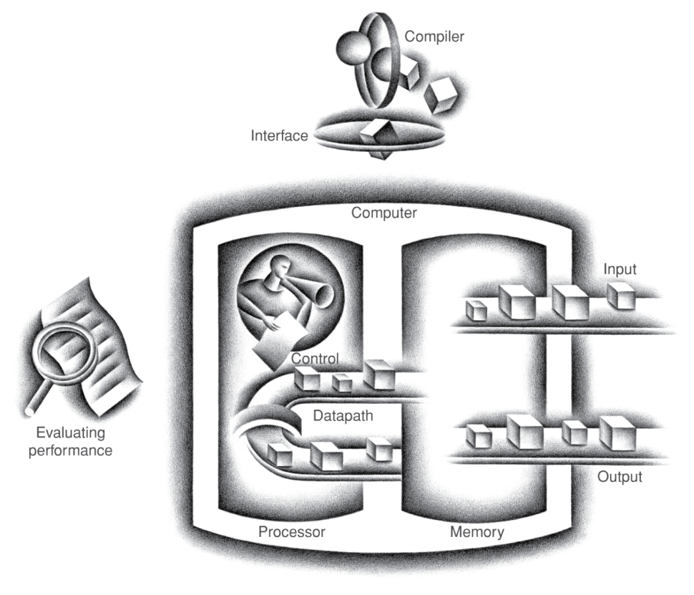
Under the Covers
Five classic components of a computer
Input device, output device, memory, datapath, control
Datapath and control are sometimes combined and called the processor
This organization is independent of hardware technology
Fig. 1.5 The organization of a computer, showing the five classic components.

Slide 14
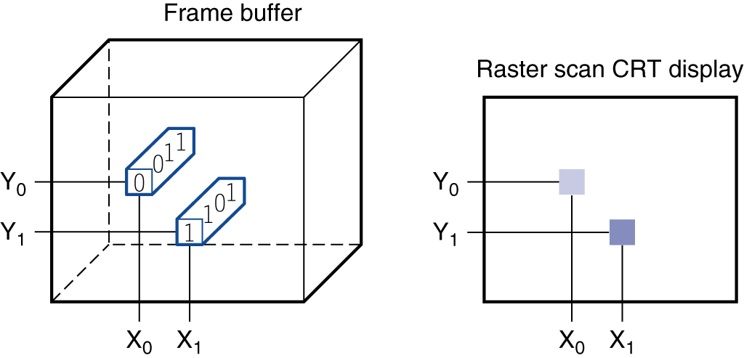
Through the looking glass
Liquid crystal displays (LCDs)
A display technology using a thin layer of liquid ploymers that can be used to transmit or block light according to whether a charge is applied
Active matrix display
Using a transistor to control the transmission of light at each individual pixel
Pixel
The smallest individual picture element
Can be represented as a matrix of bits (bit map)
Depending on the size of the screen and the resolution
To faithfully represent what is on the screen
A color display might use 8 bits for each of he three colors (red, blue, and green)
Raster refresh buffer (frame buffer): to store the bit map
Fig. 1.6 Each coordinate in the frame buffer on the left determines the shade of the corresponding coordinate for the raster scan CRT display on the right.

Slide 15
Touchscreen
Touch sensitive displays
Capacitive sensing
Can allow multiple touches simultaneously
Opening the box
Integrated circuit (chip)
A device combining dozens to millions of transistors
Central processor unit (CPU): also called processor
The active part of the computer which contains the datapath and control
To add numbers, test numbers, signal I/O devices to active, and so on
Dynamic random access memory (DRAM)
Memory build as an integrated circuit
To provide random access to any location
Cache memory
A small, fast memory that acts as a buffer for a slower, larger memory
Static random access memory (SRAM)
A faster and less dense memory than DRAM

Slide 16
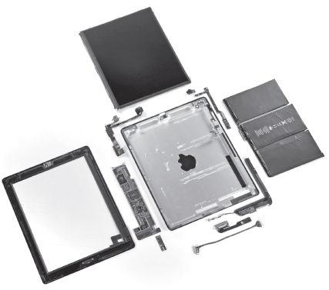
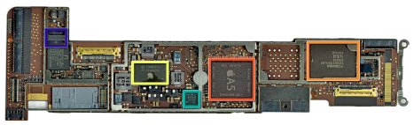
Opening the box (Cont.)
Instruction set architecture (ISA): also called architecture
An abstract interface between the hardware and the lowest-level software
To encompass all the information necessary to write a machine language program that will run correctly
Including instructions, registers, memory accesses, I/O, and so on
Application binary interface (ABI)
The user portion of the instruction set plus the operating system interfaces used by application programmers
It define a standard for binary portability across computers
Implementation
Hardware that obeys the architecture abstraction
Fig. 1.7 Components of the Apple iPad 2 A1395.
Fig. 1.8 The logic board of Apple iPad 2 in Fig. 1.7.

Slide 17
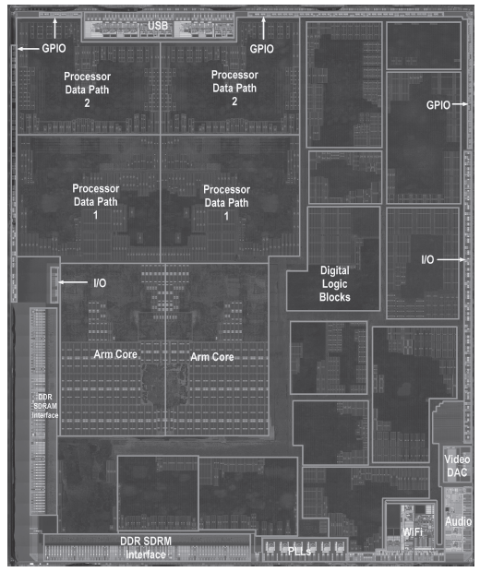
Fig. 1.9 The processor integrated circuit inside the A5 package.

Slide 18
A safe place for data
Volatile memory vs. nonvolatile memory
Volatile memory
To retain data only if it is receiving power
Ex: SRAM, DRAM
Nonvolatile memory
To retain data even in the absence of a power source
Ex: magnetic disk (hard disk), flash memory, DVD disk
Primary memory vs. secondary memory
Primary memory (main memory)
Memory used to hold programs while they are running
DRAMs have dominated main memory since 1975
More expensive, smaller (size and capacity), more rugged, more power efficient
Secondary memory
Nonvolatile memory used to store programs and data between runs
Magnetic disks dominated secondary memory before 1975
Flash memory is the standard secondary memory for PMDs

Slide 19
Communicating with other computers
Networked computers have several advantages
Communication, resource sharing, non-local access
Local area network (LAN)
Designed to carry data within a geographically confined area
Typically within a single building
Wide area network (WAN)
A network extended over hundreds of kilometers that can span a continent
Wireless network
WiFi, Bluetooth…

Slide 20
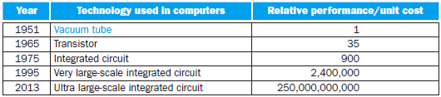
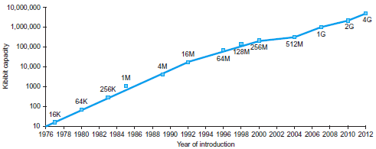
Technologies for Building Processors and Memory
The technologies that have been used over time
Vacuum tube → transistor → integrated circuit (IC) → very large-scale integrated circuit (VLSI) → ultra large-scale integrated circuit (ULSI)
Fig. 1.10 Relative performance per unit cost of technologies used in computers over time.
Fig. 1.11 Growth of capacity per DRAM chip over time.

Slide 21
The manufacture of a chip
Terminologies
Silicon
A natural element that is a semiconductor
Semiconductor
A substance that does not conduct electricity well
Silicon crystal ingot
A rod composed of a silicon crystal
8~12 inches in diameter, 12~24 inches long
Wafer
A slice from a silicon ingot no more than 0.1 inch thick
Used to create chips
Die (chip)
The individual rectangular sections that are cut from a wafer
Defect
A microscopic flaw in a wafer or in patterning steps
Can result in the failure of the die containing that defect
Yield
The percentage of good dies from the total number of dies on the wafer

Slide 22
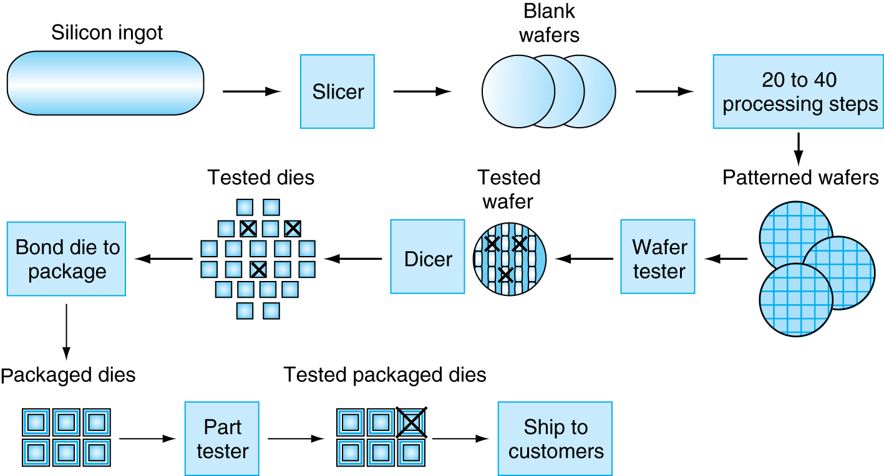
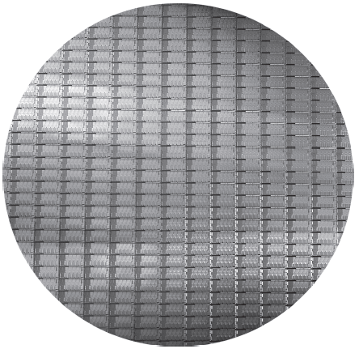
Fig. 1.12 The chip manufacturing process.
Fig. 1.13 A 12-inch (300 mm) wafer of Intel Core i7 (Courtesy Intel).

Slide 23
The manufacture of a chip (Cont.)
The cost of an integrated circuit
Cost per die = Cost per wafer / (Dies per wafer × Yield)
Dies per wafer ≈ Wafer area / Die area

Slide 24
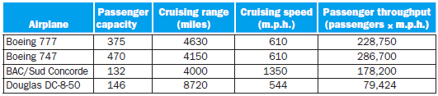
Performance
Defining performance
What is “one computer has better performance than another”?
Example 1
Highest cruising speed: BAC/Sud Concorde
Longest cruising range: Douglas DC-8
Largest capacity: Boeing 747
To transport 450 passengers: Boeing 747, not BAC/Sud Concorde
Example 2
Running a program on two different computers
The faster computer is the one that gets the job done first
Running jobs on several servers submitted by many users
The faster computer is the one that completes the most jobs

Slide 25
Defining performance (Cont.)
Response time vs. throughput
Response time (execution time)
The time between the start and completion of a task
Including disk access, memory access, I/O activities, operating system overhead, CPU execution time, and so on
An individual computer user is interested in reducing response time
Throughput (bandwidth)
The total amount of work done in a given time
Datacenter managers are often interested in increasing throughput
Example: throughput and response time
Replacing the processor in a computer with a faster version
Both response time and throughput are improved
Adding additional processors to a system for parallel processing
Throughput is increased
If the demand for processing is almost as large as the throughput, the response time also can be improved

Slide 26
Defining performance (Cont.)
We are primarily concerned with response time
To relate the performance of two different computers quantitatively
X is n times faster than Y, X is n times as fast as Y
Example: relative performance
Problem
Computer A runs a program in 10 sec, computer B runs the same program in 15 sec
How much faster is A than B?
Solution
A is 1.5 times faster than B, or B is 1.5 times slower than A

Slide 27
Defining performance (Cont.)
Terminology
Normally use the terminology faster than
Improved performance → increased performance
Improved execution time → decreased execution time
Measuring performance
Time is the measure of computer performance
Wall-clock time (response time, elapsed time)
The total time to complete a task
Including disk accesses, memory accesses, I/O activities, OS overhead…
A processor may work on several programs simultaneously
The system may try to optimize throughput rather than attempt to minimize the elapsed time for one program
CPU execution time (CPU time)
The time the CPU spends computing for a task
Not include time spent waiting for I/O or running other programs
User CPU time: the CPU time spent in a program itself
System CPU time: the CPU time spent in the operating system performing tasks on behalf of the program

Slide 28
Measuring performance (Cont.)
Time is the measure of computer performance (Cont.)
System performance: the elapsed time on an unloaded system
CPU performance: user CPU time
Other metrics
Clock cycle (tick, clock tick, clock period, clock, cycle)
The time for one clock period (ps)
Clock rate
The inverse of the clock period (Hz)
CPU performance and its factors
To relate different performance metrics
CPU execution time for a program equals to
CPU clock cycles for a program × Clock cycle time
CPU clock cycles for a program / Clock rate
The hardware designer can improve performance by
Reducing the length of the clock cycle
Reducing the number of clock cycles required for a program
Trade-off between above two factors

Slide 29
CPU performance and its factors (Cont.)
Example: improving performance
Problem
A program runs in 10 seconds on computer A, which has a 2 GHz clock
We want to build a computer B that will run this program in 6 seconds
To increase the clock rate is possible, but will require 1.2 times as many clock cycles as computer A
What clock rate should computer B have?
Solution
CPU time_{A} = CPU clock cycles_{A} / Clock rate_{A}
10 = CPU clock cycles_{A} / 2 × 10⁹ ⇒ CPU clock cycles_{A} = 20 × 10⁹ cycles
CPU time_{B} = 1.2 × CPU clock cycles_{A} / Clock rate_{B}
6 = 1.2 × 20 × 10⁹ / Clock rate_{B} ⇒ Clock rate_{B} = 4 GHz
Instruction performance
The execution time must depend on the number of instructions in a program
CPU clock cycles required for a program
Instructions for a program × Average clock cycles per instruction
Clock cycles per instruction (CPI)
The average number of clock cycles each instruction takes to execute
One way to compare different implementations of the same ISA

Slide 30
Instruction performance (Cont.)
Example: using the performance equation
Problem
Computer A and B have the same ISA
Computer A: clock cycle time 250 ps, CPI 2.0 for some program
Computer B: clock cycle time 500 ps, CPI 1.2 for the same program
Which computer is faster for this program and by how much?
Solution
Assume the program has I instruction
CPU clock cycles_{A} = I × 2.0 CPU clock cycles_{B} = I × 1.2
CPU time_{A} = I × 2.0 × 250 = 500 × I ps faster !
CPU time_{B} = I × 1.2 × 500 = 600 × I ps
Computer A is 1.2 times as fast as computer B for this program
The classic CPU performance equation
Instruction count
The number of instructions executed by the program
CPU time
Instruction count × CPI × Clock cycle time
Instruction count × CPI / Clock rate

Slide 31
The classic CPU performance equation (Cont.)
Example: comparing code segments
Problem
Which code sequence executes the most instructions? Which will be faster? What is the CPI for each sequence?
Solution
The number of executed instructions
Sequence 1: 2 + 1 + 2 = 5
Sequence 2: 4 + 1 + 1 = 6 more !
Execution time
CPU clock cycles₁ = (2 × 1) + (1 × 2) + (2 × 3) = 10 cycles
CPU clock cycles₂ = (4 × 1) + (1 × 2) + (1 × 3) = 9 cycles faster !
CPI
CPI₁ = CPU clock cycles₁ / Instruction count₁ = 10/5 = 2
CPI₂ = CPU clock cycles₂ / Instruction count₂ = 9/6 = 1.5
 | CPI for each instruction class
 | A | B | C
CPI | 1 | 2 | 3
Code sequence | Instruction counts for each instruction class
 | A | B | C
1 | 2 | 1 | 2
2 | 4 | 1 | 1

Slide 32
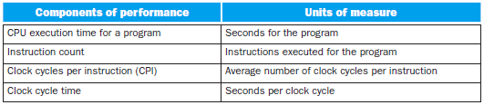
The classic CPU performance equation (Cont.)
To combine all factors
The only complete and reliable measure of performance is time
Changing the instruction set to lower instruction count
⇒ An organization with a slower clock cycle time or higher CPI
CPI depends on type of instructions executed
⇒ The fewest number of instructions may not be the fastest
Fig. 1.15 The basic components of performance and how each is measured.

Slide 33
The classic CPU performance equation (Cont.)
How to determine the value of factors
CPU execution time
Running the program
Clock cycle time
Usually be published for a computer
Instruction count
Depend on the architecture but not on the exact implementation
Using software tools to profile the execution
Simulator of the architecture
Hardware counter
CPI
Depend on a wide variety of design details in the computer
Detailed simulation of an implementation
Hardware counter
To look at the different types of instructions and using their individual clock cycle counts
The danger of using only one factor to access performance
All three components must be considered

Slide 34
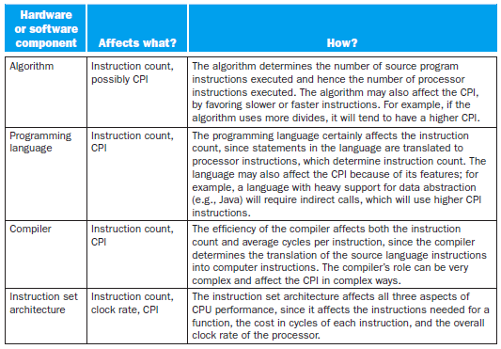
The classic CPU performance equation (Cont.)
Major factors to affect CPI
The performance of the pipeline
The performance of the memory system

Slide 35
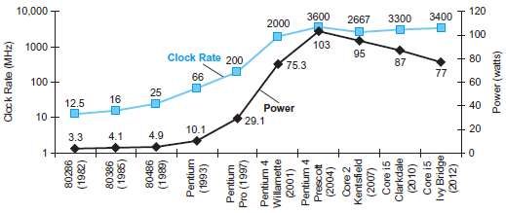
The Power Wall
Clock rate vs. power
Both increased rapidly for decades and then flattened off recently
The reason they grew together
Clock rate and power are correlated
The reason for their recent slowing
We have to run into the practical power limit for cooling commodity microprocessors
Fig. 1.16 Clock rate and power for Intel x86 microprocessors over eight generations and 25 years.

Slide 36
The really critical resource is energy in the PostPC era
Battery life can trump performance in the PMD
Architects of WSCs try to reduce the costs of powering and cooling servers
The energy metric joules is a better measure than a power rate like watts
In CMOS technology
The primary source of energy consumption is dynamic energy, which is consumed when transistors switch states from 0 to 1 and vice versa
Energy ∝ Capacitive load × Voltage²
The energy of a pulse during the logic transition of 0 → 1 → 0 or 1 → 0 → 1
Energy ∝ ½ × Capacitive load × Voltage²
The energy of a single transition
The power required per transistor
Energy ∝ Capacitive load × Voltage² × Frequency switched
Frequency switched is a function of the clock rate
Capacitive load per transistor is a function of fanout and the technology
Energy and thus power can be reduced by lowering the voltage
The voltage was reduced about 15% per generation
Voltages have gone from 5V to 1V in 20 years

Slide 37
Example: relative power
Problem
A new processor with 85% capacitive load, voltage is reduced by 15%, and 15% shrink in frequency
What is the impact on dynamic power?
Solution
Problem today
Further lower the voltage will make the transistors too leaky
40% of the power consumption in server chips is due to leakage
If transistors started leaking more, the whole process could become unwieldy
Power reducing methods
To attach large devices to increase cooling
Too expensive for PCs and even servers, not to mention PMDs
To turn off parts of the chip that are not used in a given clock cycle
Computer designers slammed into a power wall
A different path to design newer microprocessors

Slide 38
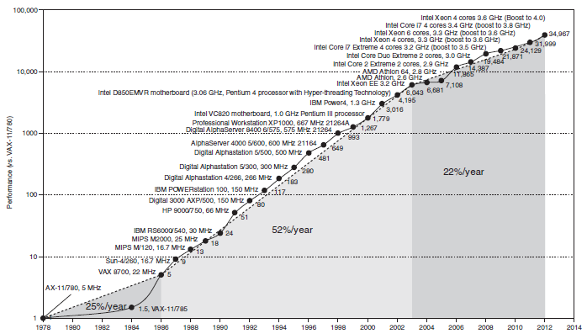
The Sea Change: The Switch from Uniprocessors to Multiprocessors
Fig. 1.17 Growth in processor performance since the mid-1980s.

Slide 39
Multicore microprocessor
The improving rate in response time of programs has slowed down
1.5 → 1.2 per year since 2002 for desktop microprocessor
Since 2006, microprocessors → multiple processor per chip
The benefit is often more on throughput than on response time
Both desktop microprocessor and server
For programmers to get significant improvement in response time
In the past
To rely on innovations in hardware, architecture, and compilers to double performance every 18 months
Without having to change a line of code
Today
To rewrite programs to take advantage of multiple processors
To continue to improve performance of their code as the number of cores increases
It is hard to write explicitly parallel programs
Programming for performance
The program need to be not only correct but also fast

Slide 40
It is hard to write explicitly parallel programs (Cont.)
Load balancing
To divide an application so that each processor has roughly the same amount to do at the same time
The overhead of scheduling and coordination
Communication and synchronization overhead

Slide 41
Real Stuff: Benchmarking the Intel Core i7
SPEC CPU benchmark
Workload
A set of programs run on a computer
Either the actual collection of applications run by a user or constructed from real programs to approximate such a mix
Typically specify both the programs and the relative frequencies
Benchmark
Programs specifically chosen to measure performance
To predict the performance of the actual workload
To know accurately “which case is common”
SPEC (system performance evaluation corporation) benchmark
Standard sets of benchmarks for modern computer systems
Funded and supported by a number of computer vendors
SPEC CPU2006 (CINT2006 + CFP2006)
The latest benchmark set focusing on processor performance

Slide 42
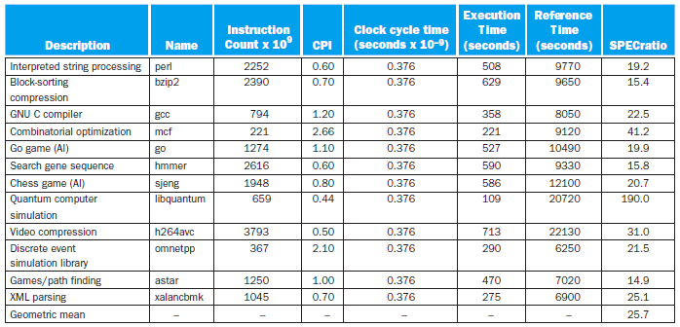
SPEC CPU benchmark (Cont.)
SPEC (system performance evaluation corporation) benchmark (Cont.)
Reported measurement
SPEC ratio: normalized execution time
To divide the execution time of a reference processor by the execution time of the measured computer
The inverse of execution time
Summary measurement
Geometric mean of the SPEC ratios to all benchmarks
Fig. 1.18 SPECINT2006 benchmarks running on a 2.66 GHz Intel Core i7 920.

Slide 43
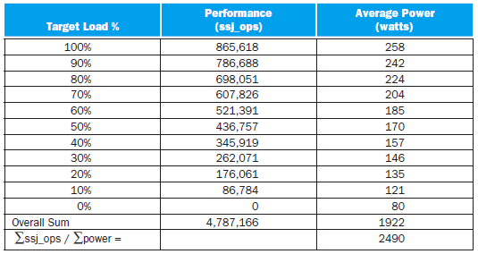
SPEC power benchmark
To report power consumption of servers at different workload levels over a period time
Divided into 10% increments
Performance is measured in throughput
Unit: business operations per second (ssj_ops)
Summary measurement
Fig. 1.19 SPECpower_ssj2008 running on a dual socket 2.66 GHz Intel Xeon X5650 with 16 GB of DRAM and one 100 GB SSD disk.

Slide 44
Fallacies and Pitfalls
Pitfalls
Expecting the improvement of one aspect of a computer to increase performance by an amount proportional to the size of the improvement
Example
Problem
A program runs in 100 seconds, with multiplication responsible for 80 seconds
If we want the program to run five times faster, how much do we have to improve the speed of multiplication?
Solution
Execution time after improvement =
Execution time after improvement = 80 sec / n + (100 – 80 sec)
⇒ 20 sec = 80 sec / n + 20 sec ⇒ 0 = 80 sec / n !!
Amdahl’s law
A rule stating that the performance enhancement possible with a given improvements is limited by the amount that the improved feature is used

Slide 45
Pitfalls (Cont.)
Using a subset of the performance equation as a performance metric
Nearly all alternatives to the use of time as the performance metric have led to misleading claims, distorted results, or incorrect interpretations
MIPS (million instructions per second)
Instruction execution rate
To specify performance inversely to execution time
Problems with using MIPS as a measure
Cannot compare computers with different instruction sets
MIPS does not take into account the capabilities of the instructions
A computer cannot have a single MIPS rating
MIPS varies between programs on the same computer
MIPS can vary inversely with performance
Example
Problem
Computers clock rate: 4 GHz
Which code sequence will execute faster according to MIPS? According to execution time?

Slide 46
Pitfalls (Cont.)
Using a subset of the performance equation as a performance metric (Cont.)
Example (Cont.)
Solution
CPU clock cycles₁ = (5 × 1 + 1 × 2 + 1 × 3) × 10⁹ = 10 × 10⁹
CPU clock cycles₂ = (10 × 1 + 1 × 2 + 1 × 3) × 10⁹ = 15 × 10⁹
faster !
faster !
 | CPI for each instruction class
 | A | B | C
CPI | 1 | 2 | 3
 | Instruction counts (in billions) for each instruction class
 | A | B | C
Compiler 1 | 5 | 1 | 1
Compiler 2 | 10 | 1 | 1

Slide 47
Fallacies
Computers at low utilization use little power
Utilization of servers in Google’s WSC
Mostly operates at 10%~50% of the load
At 100% of the load less than 1% of the time
The specially configured computer in 2012 still uses 33% of the peak power at 10% of the load
To redesign hardware to achieve energy-proportional computing
Designing for performance and designing for energy efficiency are unrelated goals
Energy = power × time
Hardware or software optimizations that take less time save energy overall even if the optimization takes a bit more energy when it is used
Server Manufacturer | Micro-processor | Total Cores/ Sockets | Clock Rate | Peak Performance (ssj_ops) | 100% Load Power | 50% Load Power | 50% Load/ 100% Power | 10% Load Power | 10% Load/ 100% Power | Active Idle Power | Active Idle/ 100% Power
HP | Xeon E5440 | 8/2 | 3.0 GHz | 308,022 | 269 W | 227 W | 84% | 174 W | 65% | 160 W | 59%
Dell | Xeon E5440 | 8/2 | 2.8 GHz | 305,413 | 276 W | 230 W | 83% | 173 W | 63% | 157 W | 57%
Fujitsu Seimens | Xeon X3220 | 4/1 | 2.4 GHz | 143,742 | 132 W | 110 W | 83% | 85 W | 65% | 80 W | 60%
Fig. Extra SPECPower results for three servers with the best overall ssj_ops per watt in the fourth quarter of 2007.

