Slide 1
Arithmetic for Computers

Slide 2
Outline
Fixed-Point Numbers
Addition and Subtraction
Multiplication
Division
Floating Point
Fallacies and Pitfalls

Slide 3
Fixed-Point Numbers
Preliminary
In a fixed-point number system, each number has exactly the same number of digits, and the point is always in the same place
0.23, 5.12, 9.11
Ordinary integers: 2, 53, 120
(11.10)₂, (01.10)₂, (00.11)₂
In the computer the binary point is not stored anywhere
Range and precision in fixed-point numbers
A fixed-point representation can be characterized by
Range of expressible numbers
The distance between the largest and smallest numbers
Precision
The distance between two adjacent numbers on a number line
Error
½ of the difference between two adjoining numbers

Slide 4
Range and precision in fixed-point numbers (Cont.)
Example
Three digits, the decimal point is placed two digits from the right
Range: [0.00, 9.99] Precision: 0.01 Error: 0.005
There is a trade-off between range and precision if the total number of digits is limited
There is no reason why the range must begin with 0
The associative law of algebra does not always hold in computers
Associative law of algebra: a + (b + c) = (a + b) + c
Example
Range: [-9, 9] (a, b, c) = (7, 4, -3)
a + (b + c) = 7 + (4 + -3) = 8
(a + b) + c = (7 + 4) + -3 = 11 + -3 11 is outside the range
To detect overflow wherever it occurs

Slide 5
Radix number systems
The base or radix of a number system defines the range of possible values that a digit may have
Binary (base 2)
Octal (base 8): one octal digit is represented by 3 binary bits
Hexadecimal (base 16): one hexadecimal digit is represented by 4 binary bits
The general form for determining the decimal value of a number in a radix k fixed-point number system
Weighted position code
Ex: (541.25)₁₀ = 5 × 10² + 4 × 10¹ + 1 × 10⁰ + 2 × 10⁻¹ + 5 × 10⁻²
= (500)₁₀ + (40)₁₀ + (1)₁₀ + (2/10)₁₀ + (5/100)₁₀
Ex: (1010.01)₂ = 1 × 2³ + 0 × 2² + 1 × 2¹ + 0 × 2⁰ + 0 × 2⁻¹ + 1 × 2⁻²
= (8)₁₀ + (0)₁₀ + (2)₁₀ + (0)₁₀ + (0/2)₁₀ + (1/4)₁₀
Most Significant Bit (MSB) vs. Least Significant Bit (LSB)
MSB: the leftmost bit
LSB: the rightmost bit

Slide 6
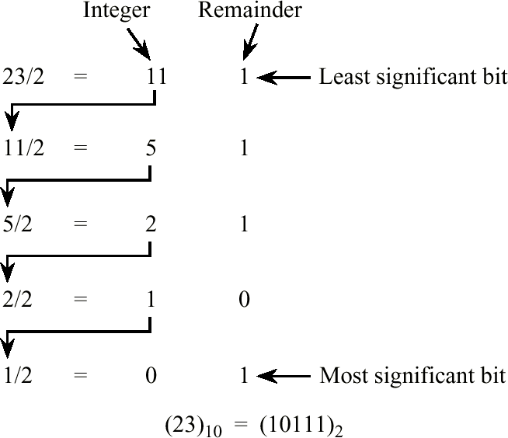
Conversions among radices
Converting the integer part of a fixed-point number: the remainder method
Description
General polynomial form for representing a binary integer:
b_{i} × 2^{i} + b_{i-1} × 2^{i-1} + ... + b₁ × 2¹ + b₀ × 2⁰
To divide the integer by 2:
b_{i} × 2^{i-1} + b_{i-1} × 2^{i-2} + ... + b₁ × 2⁰ remainder: b₀
All b_{i} can be obtained by iterating the process on the remaining polynomial
Example
Fig. Extra.1 A conversion from a base 10 integer to a base 2 integer using the remainder method.

Slide 7
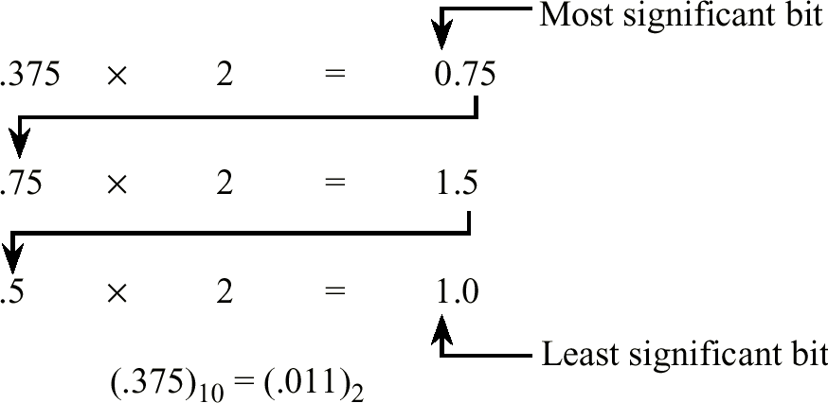
Conversions among radices (Cont.)
Converting the fractional part of a fixed-point number: the multiplication method
Description
General polynomial form for representing a binary fraction:
b₋₁ × 2⁻¹ + b₋₂ × 2⁻² + b₋₃ × 2⁻³ + …
To multiply the integer by 2:
b₋₁ + b₋₂ × 2⁻¹ + b₋₃ × 2⁻² + …
All b_{i} can be obtained by iterating the process on the remaining fraction
Example
Fig. Extra.2 A conversion from a base 10 fraction to a base 2 fraction using the multiplication method.

Slide 8
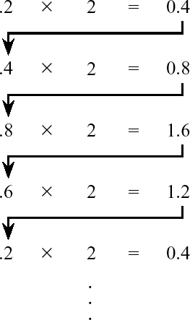
Conversions among radices (Cont.)
Non-terminating fractions
Not all terminating base 10 fractions have a terminating base 2 form
Description
A non-repeating fraction in base b can be represented as i / b^{k} for some integers i and k
A non-repeating base 10 fraction:
i/10^{k} = i/(5^{k} × 2^{k}) = j/2^{k} where j = i/5^{k}
Hence, if a non-repeating base 10 fraction has a non-repeating base 2 form, 5^{k} must be a factor of i
Fig. Extra.3 A terminating base 10 fraction that does not have a terminating base 2 form.

Slide 9
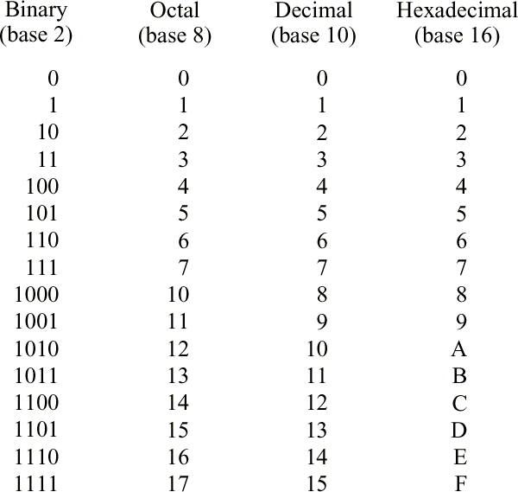
Conversions among radices (Cont.)
Binary, octal, and hexadecimal radix representations
k bits are needed to represent each digit in base 2^{k}
Base 10 form can be used as an intermediate step when we perform an unnatural conversion
Fig. Extra.4 Values for digits in the binary, octal, decimal, and hexadecimal number systems.

Slide 10
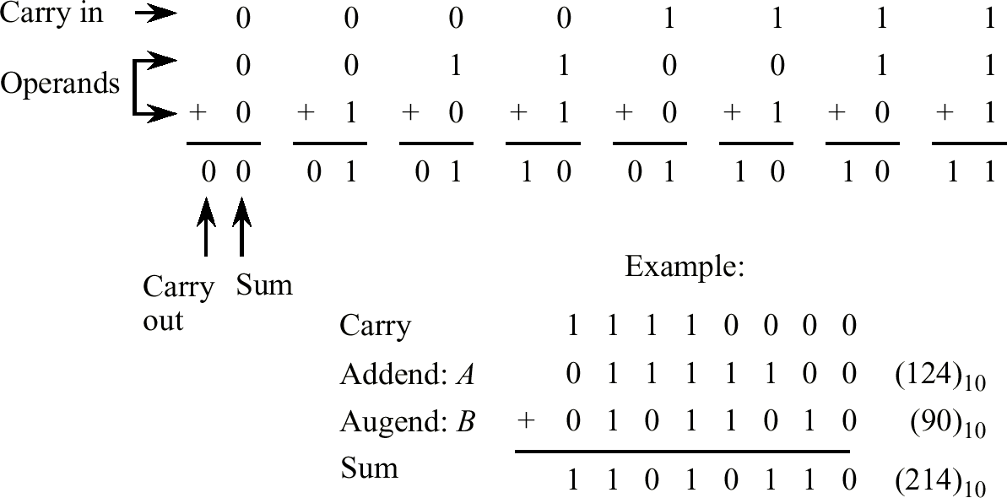
An early look at computer arithmetic
Fig. Extra.5 Example of binary addition.

Slide 11
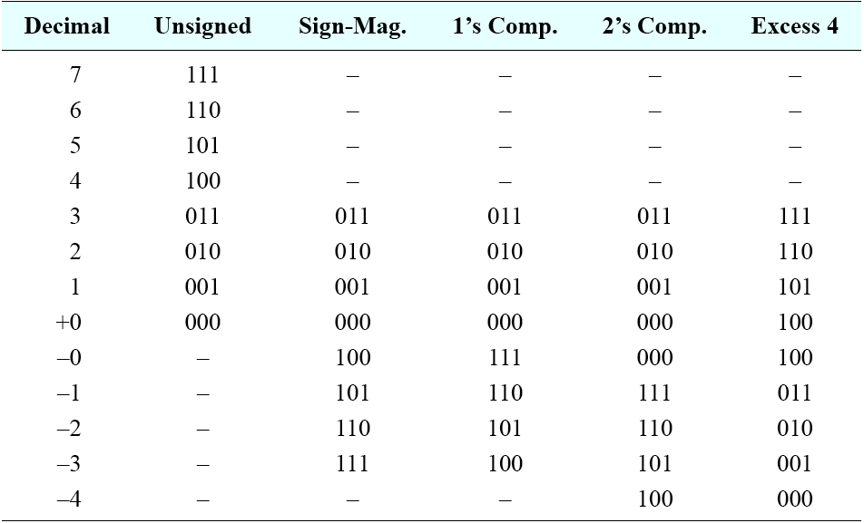
Signed fixed-point numbers
For a k-bit number, there are 2^{k} possible bit patterns
One half of the bit patterns to positive numbers and the other half to negative numbers
Four commonly used signed representations
Table Extra.1 3-bit integer representations.

Slide 12
Signed fixed-point numbers (Cont.)
Signed magnitude (sign and magnitude)
The leftmost bit is used for the sign (0 for positive, 1 for negative)
(+12)₁₀ = (00001100)₂ (-12)₁₀ = (10001100)₂
+0 = (00000000)₂ -0 = (10000000)₂
For a k-bit number
Range: [-(2^{k-1} – 1), 2^{k-1} – 1]
2^{k} – 1 different numbers can be represented
One’s complement
0 ↔ 1 (complementing)
(+12)₁₀ = (00001100)₂ (-12)₁₀ = (11110011)₂
+0 = (00000000)₂ -0 = (11111111)₂
The leftmost bit is the sign bit (0 for positive, 1 for negative)
For a k-bit number
Range: [-(2^{k-1} – 1), 2^{k-1} – 1]
2^{k} – 1 different numbers can be represented
Not commonly used in arithmetic calculations
Practical application
Checksums in the headers of network packets

Slide 13
Signed fixed-point numbers (Cont.)
Two’s complement
0 ↔ 1 then add 1, discard the carry-out from the MSB
(+12)₁₀ = (00001100)₂ (-12)₁₀ = (11110100)₂
+0 = (00000000)₂ -0 = (00000000)₂
The leftmost bit is the sign bit (0 for positive, 1 for negative)
For a k-bit number
Range: [-2^{k-1}, 2^{k-1} – 1]
2^{k} different numbers can be represented
The most commonly used representation in conventional computers
Excess (biased) representation
Two’s complement form plus a bias (Ex: excess 128)
(+12)₁₀ = (10001100)₂ (-12)₁₀ = (01110100)₂
(-128)₁₀ = (00000000)₂ (+127)₁₀ = (11111111)₂
+0 = (10000000)₂ -0 = (10000000)₂
The leftmost bit is the sign bit (1 for positive, 0 for negative)
Numerically smaller numbers have smaller bit patterns
For a k-bit number
Range: [-2^{k-1}, 2^{k-1} – 1]
2^{k} different numbers can be represented

Slide 14
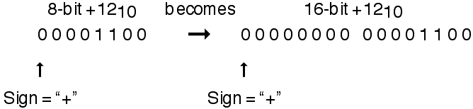
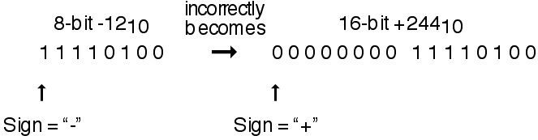
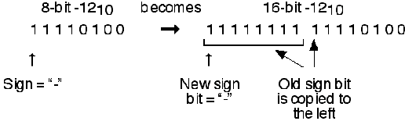
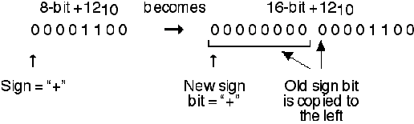
Sign extension
A number is placed into a larger container
To pad the left side with 0s
Positive number: correct
Negative number: incorrect
To copy the sign bit to the left side: sign extension

Slide 15
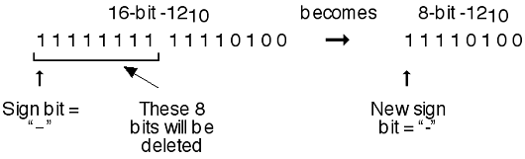
Sign extension (Cont.)
A number is placed into a smaller container
To remove bits on the left side

Slide 16




Addition and Subtraction
Binary addition and subtraction
Digits are added bit by bit from right to left, with carries passed to the next digit to the left
Subtraction uses addition, but the appropriate operand is negated before being added
Example: adding and then subtracting 6_{ten} to 7_{ten} in binary
Addition
Subtraction

Slide 17
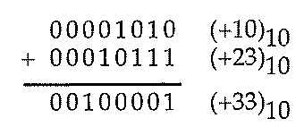
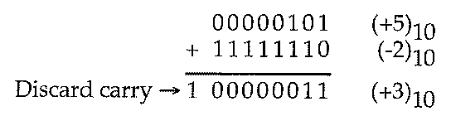
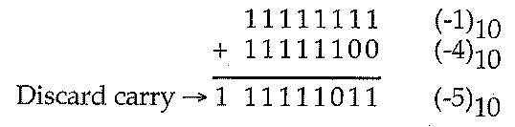
Overflow
To occur when the result from an operation cannot be represented with the available hardware
Examples
The carry-out of the leftmost bit is discarded because the number system is modular
Examples without overflow
Example with overflow
01010000 (+80)₁₀
+ 00110010 (+50)₁₀
--------------------------------
10000010 (-126)₁₀

Slide 18
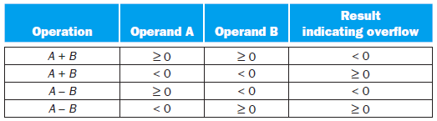
Overflow (Cont.)
When overflow cannot occur
No overflow can occur when adding positive and negative operands
The sum must be no larger than one of the operands
No overflow can occur when subtracting two operands of the same sign
Can be ended up by adding operands of different signs
How to detect overflow for two’s complement numbers in a computer
If the numbers being added are of the same sign and the result is of the opposite sign, then an overflow occurs
If the numbers being added are of opposite signs, then an overflow will never occur
If a positive (negative) number is subtracted from a negative (positive) number and the result is positive (negative), then an overflow occurs
If the numbers being subtracted are of the same sign, then an overflow will never occur
Fig. 3.2 Overflow conditions for addition and subtraction.

Slide 19
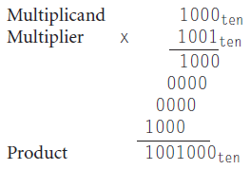
Multiplication
Unsigned multiplication
Review the multiplication of decimal numbers in longhand
Multiplicand × Multiplier = Product
Example: 1000₁₀ × 1001₁₀ (using only digits 0 and 1)
Steps
To take the digits of the multiplier one at a time from right to left
To multiply the multiplicand by the single digit of the multiplier
Just place a copy of the multiplicand in the proper place if the multiplier digit is a 1
Place 0 in the proper place if the digit is 0
To shift the intermediate product one digit to the left of the earlier intermediate products
The number of digits in the product
n-bit multiplicand × m-bit multiplier = (n+m)-bit product
(ignoring the sign bits)
We frequently want a 32-bit product as the result of
multiplying two 32-bit numbers
⇒ Must copy with overflow

Slide 20
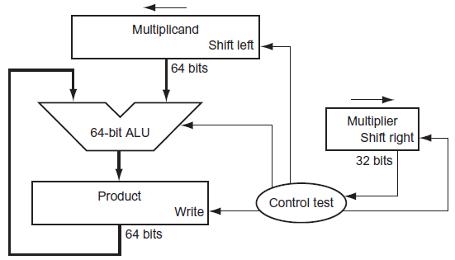
Unsigned multiplication (Cont.)
Sequential version of the multiplication algorithm and hardware
First version of the multiplication hardware
Multiplier is in the 32-bit Multiplier register
The 64-bit Product register is initialized to 0
A 64-bit Multiplicand register is initialized with the 32-bit multiplicand in the right half and zero in the left half
The Multiplier register is shifted right 1 bit each step
The Multiplicand register is shifted left 1 bit each step to align the multiplicand with the sum being accumulated in the 64-bit Product register
Fig. 3.3 First version of the multiplication hardware.

Slide 21
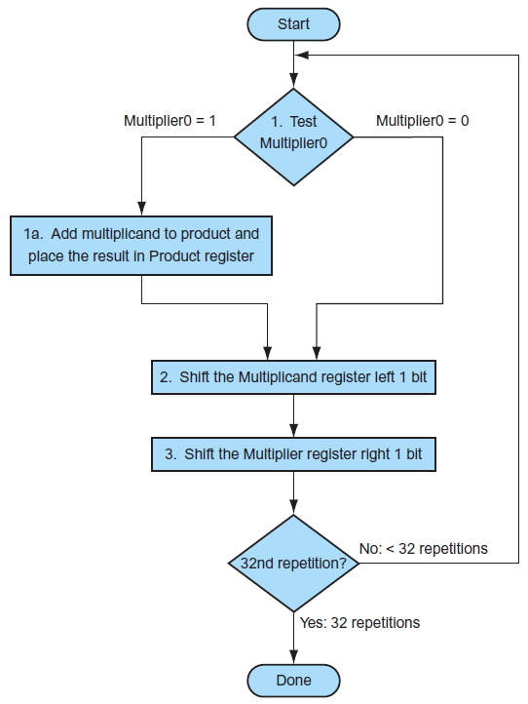
Unsigned multiplication (Cont.)
Sequential version of the multiplication algorithm and hardware (Cont.)
Three basic steps needed for each bit
Step 1: the LSB of the multiplier determines whether the multiplicand is added to the Product register
Step 2: the left shift of the Multiplicand register has the effect of moving the intermediate operands to the left
Step 3: the shift right of the Multiplier register gives the next bit of the multiplier to examine in the following iteration
Above steps are repeated 32 times
Fig. 3.4 The first multiplication algorithm, using the hardware shown in Fig. 3.3.

Slide 22
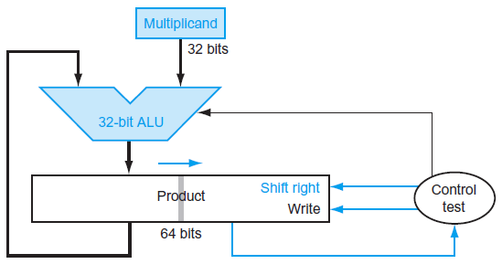
Unsigned multiplication (Cont.)
Sequential version of the multiplication algorithm and hardware (Cont.)
Above three steps are repeated 32 times to obtain the product
If each step took a clock cycle, this algorithm requires almost 100 clock cycles to multiply two 32-bit numbers
Refined version of the multiplication hardware
To perform operations in parallel: 1 clock cycle per step
The multiplier and multiplicand are shifted while the multiplicand is added to the product if the multiplier bit is a 1
The hardware has to ensure that it tests the LSB of the multiplier and gets the pre-shifted version of the multiplicand
To halve the width of the adder and registers
The multiplier is placed in the right half of the Product register
The Product is shifted right
Fig. 3.5 Refined version of the multiplication hardware.

Slide 23
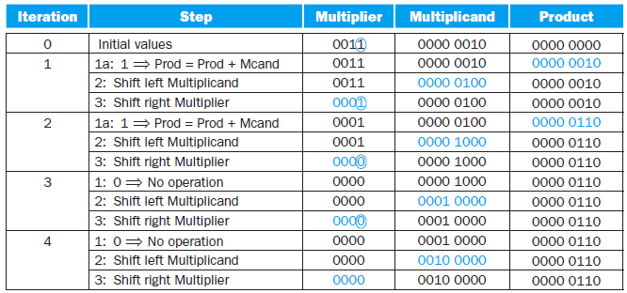
Unsigned multiplication (Cont.)
Sequential version of the multiplication algorithm and hardware (Cont.)
Example: a multiply algorithm
Using 4-bit numbers to save space, multiply 2₁₀ × 3₁₀, or 0010₂ × 0011₂
Using the hardware in Fig. 3.3 and algorithm in Fig. 3.4
Fig. 3.6 Multiply example using algorithm in Fig. 3.4.

Slide 24
Signed multiplication
Leaving the signs out of the calculation
To convert the multiplier and multiplicand to positive numbers and then remember the original signs
The algorithms should be run for 31 iterations
The algorithm in Fig. 3.4 will work for signed numbers
The shifting steps would need to extend the sign of the product
When the algorithm completes, the lower word would have the 32-bit product
Iteration | Step | Multiplier | Multiplicand | Product
0 | Initial values | 1101 | 0000 0010 | 0000 0000
1 | 1a: 1 ⇒ Prod = Prod + Mcand | 1101 | 0000 0010 | 0000 0010
 | 2: Shift left Multiplicand | 1101 | 0000 0100 | 0000 0010
 | 3: Shift right Multiplier | 1110 | 0000 0100 | 0000 0010
2 | 1: 0 ⇒ No operation | 1110 | 0000 0100 | 0000 0010
 | 2: Shift left Multiplicand | 1110 | 0000 1000 | 0000 0010
 | 3: Shift right Multiplier | 1111 | 0000 1000 | 0000 0010
3 | 1a: 1 ⇒ Prod = Prod + Mcand | 1111 | 0000 1000 | 0000 1010
 | 2: Shift left Multiplicand | 1111 | 0001 0000 | 0000 1010
 | 3: Shift right Multiplier | 1111 | 0001 0000 | 0000 1010
4 | 1a: 1 ⇒ Prod = Prod + Mcand | 1111 | 0001 0000 | 0001 1010
 | 2: Shift left Multiplicand | 1111 | 0010 0000 | 0001 1010
 | 3: Shift right Multiplier | 1111 | 0010 0000 | 0001 1010
2₁₀ × (-3)₁₀ = -6₁₀
0010₂ × 1101₂ = 1010₂

Slide 25
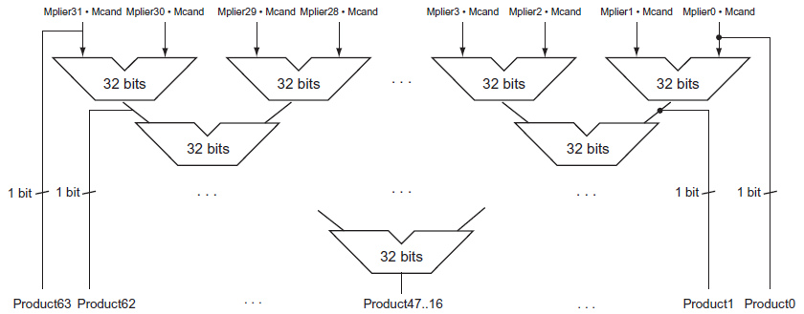
Faster multiplication
Whether the multiplicand is to be added or not is known at the beginning of the multiplication by looking at each of the 32 multiplier bits
To provide one 32-bit adder for each bit of the multiplier
Two input bits
One input is the multiplicand ANDed with a multiplier bit
One input is the output of a prior adder
To organize these 32 additions
To connect the outputs of adders on the right to the inputs of adders on the left
Parallel tree
Fig. 3.7 Fast multiplication hardware.

Slide 26
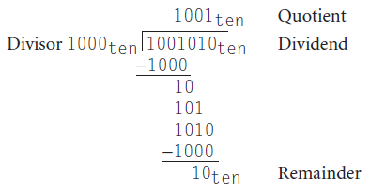
Division
Unsigned division
Review the division of decimal numbers in longhand
Dividend / Divisor = Quotient + Remainder
Dividend = Quotient × Divisor + Remainder
Example: 1001010₁₀ / 1000₁₀ (using only digits 0 and 1)
Steps
To see how big a number can be subtracted
To create a digit of the quotient on each attempt

Slide 27
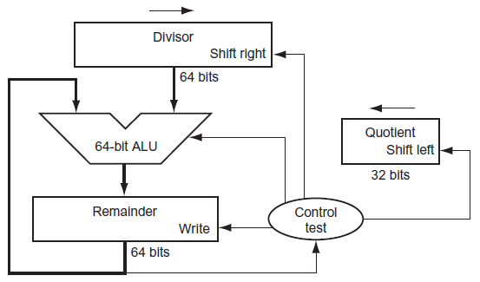
Unsigned division (Cont.)
A division algorithm and hardware
First version of the division hardware
The 32-bit Quotient register is initialized to 0
The divisor is placed in the left half of the 64-bit Divisor register
The Remainder register is initialized with the dividend (sign extension)
The Divisor register is shifted right 1 bit each step to align with the dividend
The Quotient register is shifted left 1 bit each step
Fig. 3.8 First version of the division hardware.

Slide 28
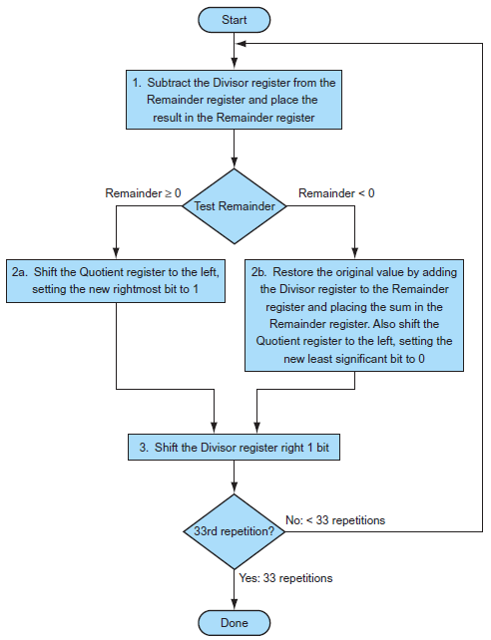
Unsigned division (Cont.)
A division algorithm and hardware (Cont.)
Three steps of the first division algorithm
Step 1: subtract the Divisor register from the Remainder register
Step 2a: if the result is positive, we generate a 1 in the quotient
Step 2b: if the result is negative, we restore the original value to the remainder and generate a 0 in the quotient
Step 3: the Divisor register is shifted right 1 bit
Above steps are repeated 33 times
Fig. 3.9 A division algorithm, using the hardware in Fig. 3.8.

Slide 29
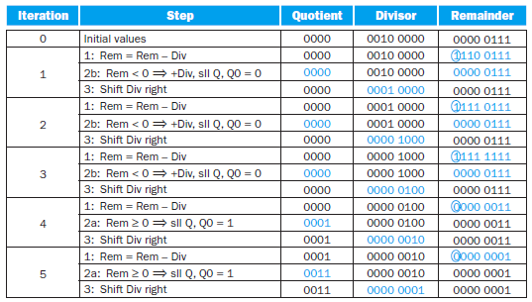
Unsigned division (Cont.)
A division algorithm and hardware (Cont.)
Example: a divide algorithm
Using 4-bit numbers to save space, divide 7₁₀ / 2₁₀, or 0000 0111₂ / 0010₂
Using the hardware in Fig. 3.8 and algorithm in Fig. 3.9
Fig. 3.10 Division example using the algorithm in Fig. 3.9.

Slide 30
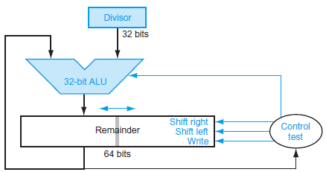
Unsigned division (Cont.)
A division algorithm and hardware (Cont.)
An improved version of the division hardware
To shift the operands and the quotient simultaneously with the subtraction
To halve the width of the adder and registers
The Remainder register is shifted left
To combine the Quotient register with the right half of the Remainder register
Fig. 3.11 An improved version of the division hardware.

Slide 31
Signed division
To remember the signs of the divisor and dividend and then negate the quotient if the signs disagree
Dividend = Quotient × Divisor + Remainder
The dividend and remainder must have the same signs
+7 ÷ -2: Quotient = -3, Remainder = +1
-7 ÷ -2: Quotient = +3, Remainder = -1
Faster division: SRT division
Try to predict several quotient bits per step
Using a table lookup based on the upper bits of the dividend and remainder
6 bits from the remainder and 4 bits from the divisor to index a table
Subsequent steps to correct wrong predictions
A typical value today is 4 bits
The accuracy depends on having proper values in the lookup table

Slide 32
Floating Point
Preliminary
Programming languages support numbers with fractions
Floating point
Computer arithmetic that represent numbers in which the decimal point (or binary point) is not fixed
Scientific notation
Numbers with a single digit to the left of the decimal point
Example
1.0₁₀ × 10⁻⁹, 3.155710 × 10⁹
1.0₂ × 2⁻¹
Normalized
A number in floating-point notation that has no leading 0s
Example
1.0₁₀ × 10⁻⁹ = 0.1₁₀ × 10⁻⁸ = 10.0₁₀ × 10⁻¹⁰ 1.0₁₀ × 10⁻⁹ is in normalized form
1.xxxxxxxxx₂ × 2^{yyyy}

Slide 33

Floating-point representation
General form of a floating-number: (-1)^{s} × F × 2E
s is the sign of the floating-point number
F: fraction (mantissa)
A value generally between 0 and 1 to determine the precision
Larger F enhances the precision of the fraction
E: exponent
A signed integer to determine the range
Larger E increases the range of numbers that can be represented
A tradeoff is between precision and range
Floating-point representation in MIPS
Format (single precision)
A floating-point value represented in a single 32-bit word
A separate sign bit: 0 or positive, 1 for negative
8-bit exponent field (including the sign of the exponent)
23-bit fraction field
Range: 2.0₁₀ × 10⁻³⁸ ~ 2.0₁₀ × 10³⁸

Slide 34
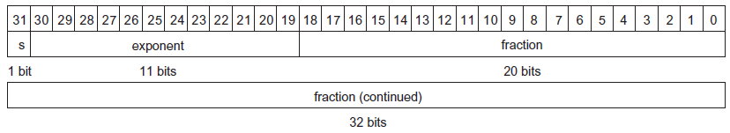
Floating-point representation (Cont.)
Floating-point representation in MIPS (Cont.)
Overflow
A positive exponent is too large to be represented in the exponent field
Underflow
A negative exponent is too large to fit in the exponent field
Format (double precision)
A floating-point value represented in two 32-bit words
Sign bit, 11-bit exponent field, 52-bit fraction field
Range: 2.0₁₀ × 10⁻³⁰⁸ ~ 2.0₁₀ × 10³⁰⁸
Greater precision due to the much larger fraction

Slide 35
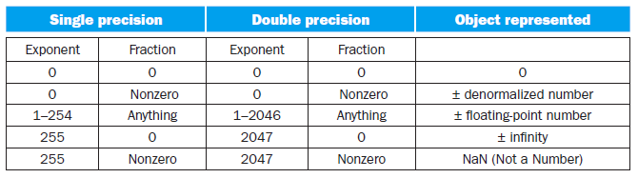
Floating-point representation (Cont.)
IEEE 754 floating-point standard
Making the leading 1-bit of normalized binary numbers implicit
The significand is actually 24-bit long in single precision and 53-bit long in double precision
Since 0 has no leading 1, it needs a special format to represent
Format
00…00₂ represent 0
The representation of ±floating-point number
(-1)^{s} × (1 + Fraction) × 2^{(Exponent – Bias)}
Using a bias of 127 for single precision and 1023 for double precision
Range of single precision number
±1.00000000000000000000000 × 2⁻¹²⁶ ~ ±1.11111111111111111111111 × 2⁺¹²⁷
The largest exponent is reserved for ±infinity and NaN (not a number)
±infinity (+∞ and -∞) can represent the result of a divide by 0
NaN can represent invalid operations, such as 0/0 or subtracting infinity from infinity

Slide 36

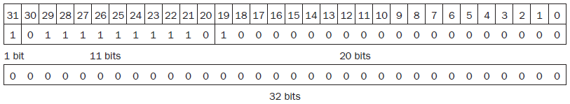
Floating-point representation (Cont.)
IEEE 754 floating-point standard (Cont.)
Format (Cont.)
The representation of ±denormalized number
Without the leading 1-bit
(-1)^{s} × Fraction × 2⁻¹²⁶ in single precision and (-1)^{s} × Fraction × 2⁻¹⁰²² in double precision
To represent numbers between 0 and the smallest (or largest) positive (or negative) number in the ±floating-point number type
Example: show the IEEE 754 binary representation of the number -0.75₁₀
-0.75₁₀ = (-3/4)₁₀ = (-3/2²)₁₀ = -0.11₂
Scientific notation: -0.11₂ × 2⁰ Normalized form: -1.1₂ × 2⁻¹
The general form of single precision: (-1)^{s} × (1 + Fraction) × 2^{(Exponent – 127)}
⇒ -1.1₂ × 2⁻¹ = (-1)¹ × (1 + .1000 0000 0000 0000 0000 000₂) × 2^{(126 – 127)}

Slide 37
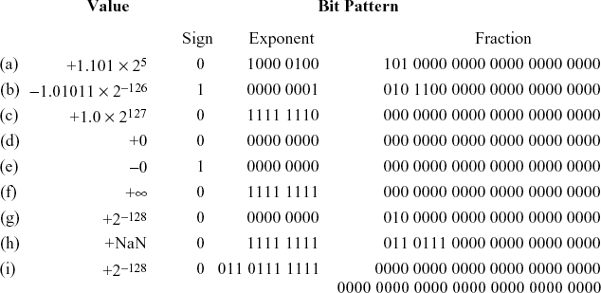
Floating-point representation (Cont.)
IEEE 754 floating-point standard (Cont.)
Example: converting binary to decimal floating point
Sign bit: 1 Exponent field: 129 Fraction field: 1 × 2⁻² = 1/4 = 0.25
(-1)^{s} × (1 + Fraction) × 2^{(Exponent – Bias)} = (-1)¹ × (1 + 0.25) × 2^{(129 – 127)}
= -1 × 1.25 × 2² = -1.25 × 4 = -5.0

Slide 38
IEEE 754 floating-point standard
分 5 種 types, exponent 若為全 0 或全 1 代表特殊 type
Exponent 全 0 或全 1 不代表真正的 exponent 值
為何需要 denormalized number
IEEE 754 有使用 hidden bit, 因此能表示的最小 positive floating-point number 為
0 0000 0001 0000 0000 0000 0000 0000 000
+ -126 1.00…0 ⇒ 2⁰ × 2⁻¹²⁶ = 2⁻¹²⁶
若將所有能表示的 floating-point number 畫在數線上, 會發現 [0, 2⁻¹²⁶] 之間的距離相對很大, 中間的數字都無法表示, 因此設計 denormalized number 希望能表示此區間數字
如何表示 [0, 2⁻¹²⁶] 之間數字
這些數字可表示為 a × 2⁻¹²⁶, a < 1
配合 IEEE 754 standard 原本的格式可以下列方式表示
Exponent 固定為 -126
Mantissa 不使用 hidden bit, 意即 mantissa 表示的數字小於 1

Slide 39
Floating-point addition
Example: 9.999₁₀ × 10¹ + 1.610₁₀ × 10⁻¹
Assume we can store 4 decimal digits of the significand and 2 decimal digits of the exponent
Step 1: align the decimal point of the number that has the smaller exponent
1.610₁₀ × 10⁻¹ = 0.1610₁₀ × 10⁰ = 0.01610₁₀ × 10¹
We can represent only 4 decimal digits ⇒ 0.016₁₀ × 10¹
The number will be truncated directly
Step 2: add the significands
9.999₁₀ + 0.016₁₀ = 10.015₁₀
The sum is 10.015₁₀ × 10¹
Step 3: adjust the sum to normalized form
10.015₁₀ × 10¹ = 1.0015₁₀ × 10²
Check for overflow or underflow to make sure the exponent still fits in its field
Step 4: round the number
Truncate the number: if the digit to the right of the desired point is between 0 and 4
Add 1 to the digit: if the number to the right is between 5 and 9
1.0015₁₀ × 10² ⇒ 1.002₁₀ × 10²
If the sum is no longer normalized ⇒ perform step 3 again

Slide 40
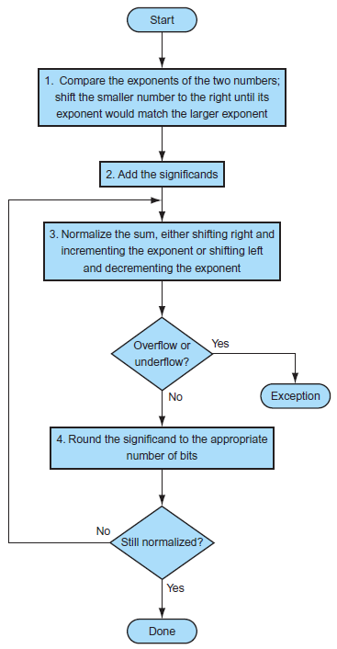
Floating-point addition (Cont.)
The algorithm for binary floating-point addition
Step 1: adjust the significand of the number with the smaller exponent
Shift the smaller number to the right until its exponent would match the larger exponent
Step 2: add the two significands
Step 3: normalize the results and check for overflow or underflow
Depend on the precision of the operands
The patterns of all 0 and all 1 bits in the exponent are reserved
For single precision, the exponent is between -126 and 127
Step 4: round the significand to the appropriate number of bits
Perform step 3 again if necessary
Fig. 3.14 Floating-point addition.

Slide 41
Floating-point addition (Cont.)
Example: try to add 0.5₁₀ and -0.4375₁₀ in binary
Assume that we keep 4 bits of precision
The binary version of the two numbers in normalized form
0.5₁₀ = (1/2)₁₀ = (1/2¹)₁₀ = 0.1₂ = 0.1₂ × 2⁰ = 1.000₂ × 2⁻¹
-0.4375₁₀ = (-7/16)₁₀ = (-7/2⁴)₁₀ = -0.0111₂ = -0.0111₂ × 2⁰ = -1.110₂ × 2⁻²
Step 1: shift the significand of the number with the smaller exponent
-1.110₂ × 2⁻² = -0.111₂ × 2⁻¹
Step 2: add the significands
1.000₂ × 2⁻¹ + (-0.111₂ × 2⁻¹) = 0.001₂ × 2⁻¹
Step 3: normalized the sum and check for overflow or underflow
0.001₂ × 2⁻¹ = 0.010₂ × 2⁻² = 0.100₂ × 2⁻³ = 1.000₂ × 2⁻⁴
Since -126 ≤ -4 ≤ 127, there is no overflow or underflow
The biased exponent: -4 + 127 = 123, which is between 1 and 254
Step 4: round the sum
The sum 1.000₂ × 2⁻⁴ already fits exactly in 4 bits, so there is no change to the bits du to rounding
1.000₂ × 2⁻⁴ = 0.0001000₂ = 0.0001₂ = (1/2⁴)₁₀ = (1/16)₁₀ = 0.0625₁₀

Slide 42
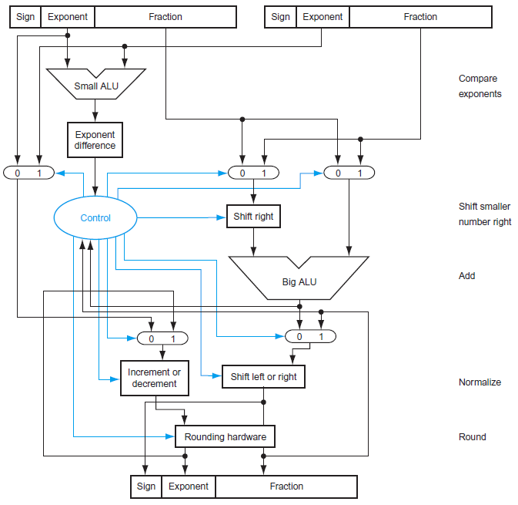
Fig. 3.15 Block diagram of an arithmetic unit dedicated to floating-point addition.

Slide 43

Floating-point multiplication
Example: 1.110₁₀ × 10¹⁰ × 9.200₁₀ × 10⁻⁵
Assume we can store 4 decimal digits of the significand and 2 decimal digits of the exponent
Step 1: calculate the exponent of the product by simply adding the exponents of the operands together
New exponent = 10 + (-5) = 5
The biased exponents: (10 + 127) + (-5 + 127) – 127 = 132 = 5 + 127
Step 2: multiply the significands
There should be 6 digits from the right in the product significand
We can keep only 3 digits to the right of the decimal point
10.212000₁₀ = 10.212₁₀ × 10⁵
Step 3: normalize the product and check for overflow and underflow
10.212₁₀ × 10⁵ = 1.0212₁₀ × 10⁶
Step 4: round the number
1.0212₁₀ × 10⁶ = 1.021₁₀ × 10⁶
Step 5: determine the sign of the product
Depend on the signs of the original operands
+1.021₁₀ × 10⁶

Slide 44
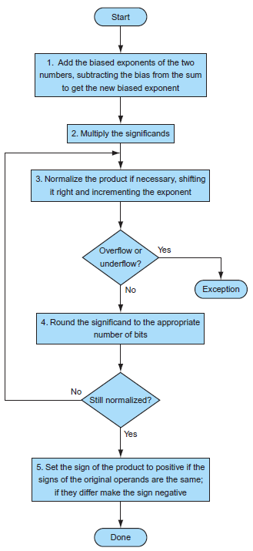
Floating-point multiplication (Cont.)
The algorithm for binary floating-point multiplication
Step 1: calculate the new exponent of the product
Add the biased exponents and subtract one bias
Step 2: multiply the significands
Step 3: normalize the product and check for overflow or underflow
Optional
The size of the exponent is checked for overflow or underflow
Step 4: round the product
If rounding leads to further normalized, we once again check for exponent size
Step 5: determine the sign bit
Fig. 3.16 Floating-point multiplication.

Slide 45
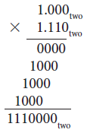
Floating-point multiplication (Cont.)
Example: try to multiply 0.5₁₀ and -0.4375₁₀ in binary
Assume that we keep 4 bits of precision
The binary version of the two numbers in normalized form
0.5₁₀ = 1.000₂ × 2⁻¹ -0.437510 = -1.110₂ × 2⁻²
Step 1: calculate the new exponent of the product
(-1 + 127) + (-2 + 127) – 127 = 124 = -3 + 127 or (-1) + (-2) = -3
Step 2: multiply the significands
We need to keep it to 4 bits
1110000₂ = 1.110000₂ × 2⁻³ = 1.110₂ × 2⁻³
Step 3: normalize the product and check for overflow or underflow
Since -126 ≤ -3 ≤ 127, there is no overflow or underflow
The biased exponent: -3 + 127 = 124, which is between 1 and 254
Step 4: round the product
The sum 1.110₂ × 2⁻³ already fits exactly in 4 bits, so there is no change to the bits du to rounding
Step 5: determine the sign bit
Since the signs of the original operands differ ⇒ -1.110₂ × 2⁻³
-1.110₂ × 2⁻³ = -0.001110₂ = -0.00111₂ = -(7/2⁵)₁₀ = -(7/32)₁₀ = -0.21875₁₀

Slide 46
Accurate arithmetic
Floating-point numbers are normally approximations for a number they can’t really represent
The computer numbers have limited size and hence limited precision
Getting the floating-point representation close to the actual number
It requires extra bits in the calculation to round accurately
If every intermediate result had to be truncated to the exact number of digits, there would be no opportunity to round
IEEE 754 always keeps two extra bits on the right during intermediate additions
Guard bit and round bit
Example: 2.56₁₀ × 10⁰ + 2.34₁₀ × 10²
Round to the nearest decimal number with 3 significant decimal digits
With guard and round digits
2.56₁₀ × 10⁰ + 2.34₁₀ × 10² = (0.0256₁₀ + 2.3400₁₀) × 10² = 2.3656₁₀ × 10²
We have two digits to round ⇒ 2.37₁₀ × 10²
0 ~ 49 to round down, 51~99 to round up, 50 is the tiebreaker
Without guard and round digits
To drop two digits from the calculation
2.56₁₀ × 10⁰ + 2.34₁₀ × 10² = (0.02₁₀ + 2.34₁₀) × 10² = 2.36₁₀ × 10²

Slide 47
Accurate arithmetic (Cont.)
IEEE 754 has four rounding modes
Always round up (toward +∞), always round down (toward -∞), truncate
Round to nearest even: the most commonly used
To determine what to do if the number is exactly halfway in between
If the LSB retained in a halfway case is odd ⇒ add 1
If the LSB retained in a halfway case is even ⇒ truncate
Always creates a 0 in the LSB in the tie-breaking case
Ex: 1.011010₂ → 1.0110₂ (truncate) 1.011110₂ → 1.1000₂ (add 1)
Sticky bit
A bit used in rounding in addition to grand and round bits
Sticky bit is set whenever there are nonzero bits to the right of the round bit
Example: 5.01₁₀ × 10⁻¹ + 2.34₁₀ × 10²
Round to the nearest decimal number with 3 significant decimal digits
5.01₁₀ × 10⁻¹ + 2.34₁₀ × 10² = (0.0050₁₀ + 2.3400₁₀) × 10² = 2.3450₁₀ × 10²
The sticky bit is set since there are nonzero bits to the right
With the sticky bit to remember that the number is actually larger than 2.3450₁₀
⇒ Round to 2.35₁₀ × 10²
Without the sticky bit ⇒ Round to 2.34₁₀ × 10²

Slide 48
Fallacies and Pitfalls
Fallacies
Just as a left shift instruction can replace an integer multiply by a power of 2, a right shift is the same as an integer division by a power of 2
Above statement is only true for unsigned integers
The problem for signed integer
To divide -5₁₀ by 4₁₀ ⇒ the quotient should be -1₁₀
-5₁₀ = 1111 1111 1111 1111 1111 1111 1111 1011₂
Shifting right by two: 0011 1111 1111 1111 1111 1111 1111 1110₂ ≠ -1₁₀
Solution: to have an arithmetic right shift that extends the sign bit instead of shifting in 0s
-5₁₀ = 1111 1111 1111 1111 1111 1111 1111 1011₂
2-bit arithmetic right: 1111 1111 1111 1111 1111 1111 1111 1110₂ = -2₁₀ ≠ -1₁₀
Parallel execution strategies that work for integer data types also work for floating-point data types
Read it yourself

Slide 49

Fallacies (Cont.)
Only theoretical mathematicians care about floating-point accuracy
Fig. 3.25 A sampling of newspaper and magazine articles from November 1994, including the New York Times, San Jose Mercury News, San Francisco Chronicle, and Infoworld.

Slide 50
Pitfalls
Floating-point addition is not associative
Associativity holds for a sequence of 2’s complement integer additions, even if the computation overflows
Associativity does not hold for floating-point numbers because
Floating-point numbers are approximations of real numbers
Computer arithmetic has limited precision
Problems occur when adding two large numbers of opposite signs plus a small number
Example
a = 1.5₁₀ × 10³⁸ b = 1.0₁₀ c = -1.5₁₀ × 10³⁸
c + (a + b) = -1.5₁₀ × 10³⁸ + (1.5₁₀ × 10³⁸ + 1.0₁₀)
= -1.5₁₀ × 10³⁸ + (1.5₁₀ × 10³⁸) = 0.0₁₀
(c + a) + b = (-1.5₁₀ × 10³⁸ + 1.5₁₀ × 10³⁸) + 1.0₁₀
= 0.0₁₀ + 1.0₁₀ = 1.0₁₀
c + (a + b) ≠ (c + a) + b
The MIPS instruction add immediate unsigned (addiu) sign-extends its 16-bit immediate field
Read it yourself

