Slide 1
Instructions: Language of the Computer

Slide 2
Outline
Introduction
Operations of the Computer Hardware
Operands of the Computer Hardware
Representing Instructions in the Computer
Logical Operations
Instructions for Making Decisions
Supporting Procedures in Computer Hardware
Communicating with People
MIPS Addressing for 32-Bit Immediates and Addresses
Fallacies and Pitfalls

Slide 3
Introduction
To command a computer’s hardware
Instructions: the words of a computer’s language
Instruction set: vocabulary of a computer’s language
Computer languages are quite similar
All computers are constructed from hardware technologies based on similar underlying principles
There are a few basic operations that all computers must provide
A common goal for computer designers
To find a language that makes it easy to build the hardware and the compiler
To maximize performance and minimize cost and energy
MIPS instruction set
Stored-program concept
Instructions and data of many types can be stored in memory as numbers

Slide 4
Operations of the Computer Hardware
MIPS arithmetic instruction
add/sub a, b, c
To add/subtract variables b and c and to put their sum/difference in a
Example: a = b + c + d + e
add a, b, c
add a, a, d
add a, a, e
Design principle 1: simplicity favors regularity
Requiring every MIPS arithmetic instruction to have exactly three operands to keep the hardware simple
Hardware for a variable number of operands is more complicated
Notes for MIPS language
Each line can contain at most one instruction
Sharp symbol (#) is used for comments
Comments always terminate at the end of a line

Slide 5
Examples: compiling C assignments into MIPS
a = b + c; d = a – e;
add a, b, c
sub d, a, e
f = (g + h) – (i + j);
add t0, g, h
add t1, i, j
sub f, t0, t1
Compiler creates temporary variable t0 and t1 to store immediate results

Slide 6
Operands of the Computer Hardware
Variables vs. operands
Unlike programs in high-level languages, the operands of arithmetic instructions are restricted
Operands must be from a limited number of special locations called registers
MIPS has 32 32-bit registers (1 word = 32 bits)
Typically 32 registers on current computers
Design principle 2: smaller is faster
Larger number of registers may increase the clock cycle time and the number of bits required in the instruction format
To balance between the designer’s desire and the limitation of hardware
Example: f = (g + h) – (i + j);
(f, g, h, i, j) are in ($s0, $s1, $s2, $s3, $s4)
add $t0, $s1, $s2
add $t1, $s3, $s4
sub $s0, $t0, $t1

Slide 7
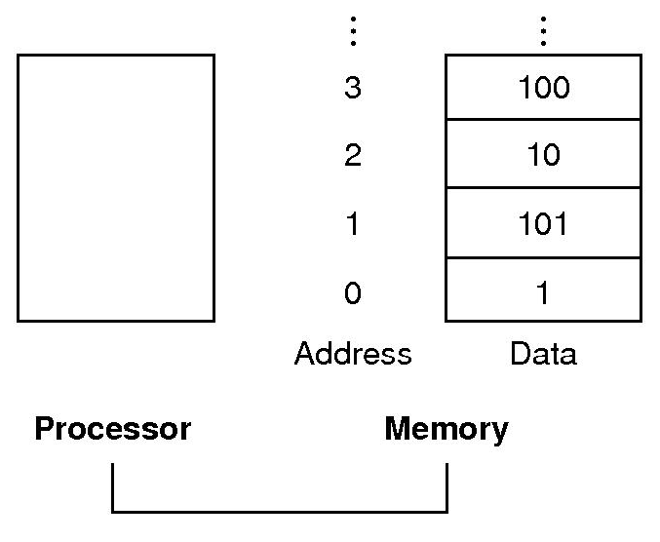
Memory operands
Registers only keep small amount of data, but memory contains millions of data elements
Memory is a large single-dimensional array
Address acts as the index to the memory, starting at 0
Data transfer instructions
A command that moves data between memory and registers
lw $destination, offset($base)
Load word, memory → register
sw $source, offset($base)
Store word, register → memory
Memory address = contents of the base register + offset
Base register: the second register of the instruction
The compiler can place the proper starting address into the data transfer instructions
Offset: the constant portion of the instruction
Example: g = h + A[8];
(g, h) are in ($s1, $s2), base address of A is in $s3
lw $t0, 8($s3)
add $s1, $s2, $t0
byte addressing

Slide 8
(F)₁₆ | = | (1111)₂ |  | 00010011
(E)₁₆ | = | (1110)₂ |  | 01001100
(D)₁₆ | = | (1101)₂ |  | 11100000
(C)₁₆ | = | (1100)₂ |  | 00001111
(B)₁₆ | = | (1011)₂ |  | 10101100
(A)₁₆ | = | (1010)₂ |  | 10010000
(9)₁₆ | = | (1001)₂ |  | 00000011
(8)₁₆ | = | (1000)₂ |  | 11100111
(7)₁₆ | = | (0111)₂ |  | 11110110
(6)₁₆ | = | (0110)₂ |  | 01001100
(5)₁₆ | = | (0101)₂ |  | 10011010
(4)₁₆ | = | (0100)₂ |  | 11001001
(3)₁₆ | = | (0011)₂ |  | 01011011
(2)₁₆ | = | (0010)₂ |  | 00111101
(1)₁₆ | = | (0001)₂ |  | 10110000
(0)₁₆ | = | (0000)₂ |  | 01101101
address |  |  |  | memory
A[9]
A[8]
A[7]
A[6]
A[5]
A[4]
A[3]
A[2]
A[1]
A[0]
base address of A ⇒ address of A[0]
若 base address of A 存在 $s3
⇒ 要存取 A[8], 位址為 8($s3)

Slide 9
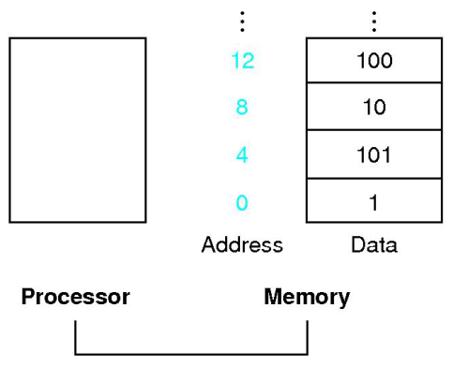
Memory operands (Cont.)
Most data items use words not bytes
1 word = 4 bytes = 32 bits
The address of a word matches the address of one of the 4 bytes within the word
Addresses of sequential words differ by 4
Alignment restriction
Words must start at address that are multiples of 4
Many architectures, including MIPS, have to satisfied the alignment restriction
Big endian vs. Little endian
Example: A[12] = h + A[8];
h is in $s2, base address of A is in $s3
lw $t0, 32($s3)
add $t0, $s2, $t0
sw $t0, 48($s3)
Spilling
To put less commonly used variables into memory
To keep the most frequently used variables in registers
An ISA must have a sufficient number of registers and compilers must use registers efficiently
Fig. 2.3 Actual MIPS memory addresses and contents of memory for those words.

Slide 10
(17)₁₆ | = | (10111)₂ |  | 10000010
(16)₁₆ | = | (10110)₂ |  | 00011001
(15)₁₆ | = | (10101)₂ |  | 00001110
(14)₁₆ | = | (10100)₂ |  | 10001110
(13)₁₆ | = | (10011)₂ |  | 11110001
(12)₁₆ | = | (10010)₂ |  | 11111111
(11)₁₆ | = | (10001)₂ |  | 01110000
(10)₁₆ | = | (10000)₂ |  | 00110011
(0F)₁₆ | = | (01111)₂ |  | 00010011
(0E)₁₆ | = | (01110)₂ |  | 01001100
(0D)₁₆ | = | (01101)₂ |  | 11100000
(0C)₁₆ | = | (01100)₂ |  | 00001111
(0B)₁₆ | = | (01011)₂ |  | 10101100
(0A)₁₆ | = | (01010)₂ |  | 10010000
(09)₁₆ | = | (01001)₂ |  | 00000011
(08)₁₆ | = | (01000)₂ |  | 11100111
(07)₁₆ | = | (00111)₂ |  | 11110110
(06)₁₆ | = | (00110)₂ |  | 01001100
(05)₁₆ | = | (00101)₂ |  | 10011010
(04)₁₆ | = | (00100)₂ |  | 11001001
(03)₁₆ | = | (00011)₂ |  | 01011011
(02)₁₆ | = | (00010)₂ |  | 00111101
(01)₁₆ | = | (00001)₂ |  | 10110000
(00)₁₆ | = | (00000)₂ |  | 01101101
byte address |  |  |  | memory
(10100)₂ = (14)₁₆
(10000)₂ = (10)₁₆
(01100)₂ = (0C)₁₆
(01000)₂ = (08)₁₆
(00100)₂ = (04)₁₆
(00000)₂ = (00)₁₆
word address

Slide 11
Constant or immediate operands
Constant operand occurs frequently
Using only lw and arithmetic instructions
Constants are placed in memory and loaded by program when necessary
Assume that $s1 + AddrConstant4 is the memory address of the constant 4
lw $t0, AddrConstant4($s1) #$t0 = constant 4
add $s3, $s3, $t0 #$s3 = $s3 + $t0 ($t0 == 4)
Including constants inside arithmetic instructions
Add immediate instruction addi
The second operand of addi must be a constant
addi $s3, $s3, 4 #$s3 = $s3 + 4
Design principle 3: make the common case fast

Slide 12
Representing Instructions in the Computer
Instruction format
The layout of the instruction
A form of representation of an instruction composed of fields of binary numbers
MIPS instruction takes exactly 32 bits
The same size as a data word
To keep with design principle 1: simplicity favors regularity
Machine language
The numeric version of instructions
Binary representation used for communication within a computer system
Machine code: a sequence of machine instructions
Register names → numbers
$t0~$t7 → 8~15
$s0~$s7 → 16~23

Slide 13
MIPS fields
R-type (R-format) (for register)
op (opcode): basic operation of the instruction
rs (rt): the first (second) register source operand
rd: the register destination operand, to get the results of the operation
shamt (shift amount)
funct (function code): to select the specific variant of the operation in the op field
op and funct fields in combination determines a specific instruction
Example: add $t0, $s1, $s2
If an instruction needs longer fields?
The 5-bit field is too small to specify a constant (2⁵ = 32)
Design principle 4: Good design demands good compromises
To keep all instructions the same length, thereby requiring more than one instruction formats
op | rs | rt | rd | shamt | funct
6 bits | 5 bits | 5 bits | 5 bits | 5 bits | 6 bits
0 | 17 | 18 | 8 | 0 | 32
000000 | 10001 | 10010 | 01000 | 00000 | 100000

Slide 14
MIPS fields (Cont.)
I-type (I-format) (for immediate)
op (opcode): basic operation of the instruction
rs: the base register for lw/sw, the first register operand for addi
rt: the destination register for lw/addi, the source register for sw
constant or address: constant for addi, address for lw/sw
Region of lw instruction: rs ± 2¹⁵ or 32768 bytes (2¹³ or 8192 words)
Constant for addi instruction: ± 2¹⁵ or 32768
Example: lw $t0, 32($s3)
Keeping the formats similar
Formats are distinguished by the values in the opcode
The first three fields of the R-type and I-type have the same sizes and names
The length of the 4th field in I-type is equal to the sum of the lengths of the last three fields of R-type
op | rs | rt | constant or address
6 bits | 5 bits | 5 bits | 16 bits
35 | 19 | 8 | 32
100011 | 10011 | 01000 | 0000 0000 0010 0000

Slide 15
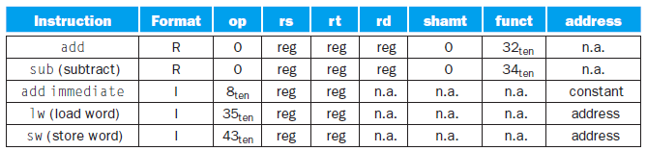
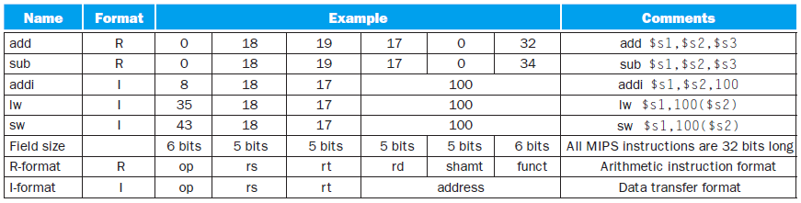
MIPS fields (Cont.)
Example: A[300] = h + A[300]
h is in $s2, base address of A is in $t1
lw $t0, 1200($t1)
add $t0, $s2, $t0
sw $t0, 1200($t1)
35 | 9 | 8 | 1200
0 | 18 | 8 | 8 | 0 | 32
43 | 9 | 8 | 1200
100011 | 01001 | 01000 | 0000 0100 1011 0000
000000 | 10010 | 01000 | 01000 | 00000 | 100000
101011 | 01001 | 01000 | 0000 0100 1011 0000
Fig. 2.5 MIPS instruction encoding.

Slide 16
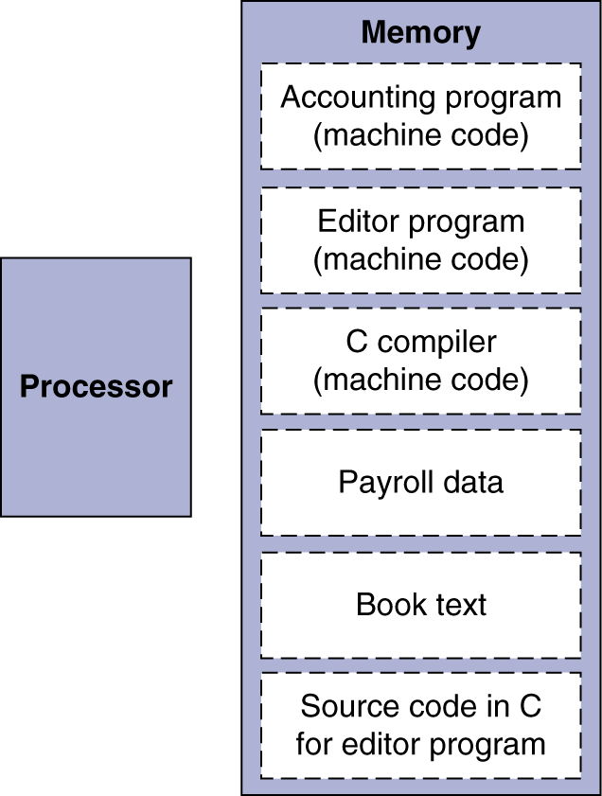
Store-program concept
Key principles
Instructions are represented as numbers
Programs are stored in memory to be read or written, just like data
Fetch and execute cycle
Instructions are fetched and put into a special register
Bits in the register control the subsequent actions
Fetch the next instruction and continue
Fig. 2.7 The stored-program concept.

Slide 17
Logical Operations
Shifts
Shift left logical (sll), shift right logical (srl)
To move all the bits in a word to the left or right
To fill the emptied bits with 0s
Example
Register $s0 contains 0000 0000 0000 0000 0000 0000 0000 1001₂ = 9₁₀
⇒ To shift left by 4: 0000 0000 0000 0000 0000 0000 1001 0000₂ = 144₁₀
R-format instructions
Using the shamt field to specify the number of bits been shifted
The rs field is unused and thus is set to 0
Example: sll $t2, $s0, 4 # reg $t2 = reg $s0 << 4 bits
Shifting left by i bits gives the same result as multiplying by 2^{i}
Above shift left by 4 example: 144 = 9 × 16 = 9 × 2⁴
0 | 0 | 16 | 10 | 4 | 0

Slide 18
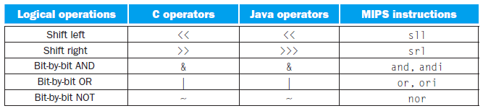
Bit-by-bit operations
AND (and), AND immediate (andi)
Mask instruction
and $t0, $t1, $t2 # reg $t0 = reg $t1 & reg $t2
andi $t0, $t1, 100 # reg $t0 = reg $t1 & constant 100
OR (or), OR immediate (ori)
or $t0, $t1, $t2 # reg $t0 = reg $t1 | reg $t2
ori $t0, $t1, 100 # reg $t0 = reg $t1 | constant 100
NOT OR (nor), NOT OR immediate (nori)
To keep with the three-operand format
If one operand is zero, then it is equivalent to NOT
nor $t0, $t1, $t2 # reg $t0 = ~(reg $t1 | reg $t2)
nori $t0, $t1, 100 # reg $t0 = ~(reg $t1 | constant 100)
Fig. 2.8 C and Java logical operators and their corresponding MIPS instructions.

Slide 19
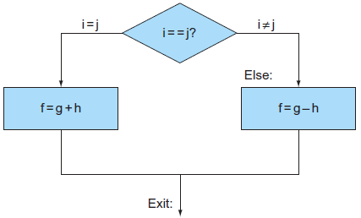
Instructions for Making Decisions
if-else
Decision-making instructions
Based on the input data and the values created during computation
Conditional branches
Branch if equal: beq register1, register2, L1
Branch if not equal: bne register1, register2, L1
Unconditional branches
Jump: j L1
Example: if (i = = j) f = g + h; else f = g – h;
(f, g, h, i, j) are in ($s0, $s1, $s2, $s3, $s4)
bne $s3, $s4, Else # go to Else if i ≠ j
add $s0, $s1, $s2 # f = g + h (skipped if i ≠ j)
j Exit
Else: sub $s0, $s1, $s2 # f = g – h (skipped if i = = j)
Exit:

Slide 20
Loops
Decisions are important both for
Choosing between alternatives (if-else statements, case/switch statements)
Iterating a computation (loops)
Example: while (save[i] = = k) i += 1;
(i, k) are in ($s3, $s5), base address of save is in $s6
Loop: sll $t1, $s3, 2 # $t1 = i × 4
add $t1, $t1, $s6 # $t1 = address of save[i]
lw $t0, 0($t1) # $t0 = save[i]
bne $t0, $s5, Exit # go to Exit if save[i] ≠ k
addi $s3, $s3, 1
j Loop
Exit:
Basic block
A sequence of instructions without branches (except possibly at the end) and without branch targets or branch labels (except possibly at the beginning)
One of the first early phase of compilation is breaking the program into basic blocks

Slide 21
Register comparison
Set on less than instruction (for signed integers)
To compare two registers and set a third register to 1 if the first is less than the second; otherwise, it is set to 0
slt $t0, $s3, $s4 # $t0 = 1 if $s3 < $s4
slti $t0, $s2, 10 # $t0 = 1 if $s2 < 10
MIPS compilers use the slt, slti, beq, bne, and the fixed value 0 to create all relative conditions
Register $zero always contains the fixed value 0
For unsigned integers
Set on less than unsigned (sltu)
Set on less than immediate unsigned (sltiu)
Example: signed vs. unsigned comparison
$s0: 1111 1111 1111 1111 1111 1111 1111 1111₂
$s1: 0000 0000 0000 0000 0000 0000 0000 0001₂
slt $t0, $s0, $s1 ⇒ (-1)₁₀ < 1₁₀ ⇒ $t0 = 1
sltu $t0, $s0, $s1 ⇒ 4,294,967,295₁₀ > 1₁₀ ⇒ $t0 = 0

Slide 22
Case/switch statement
To select one of many alternatives depending on a single value
Jump address table (jump table)
A table of address of alternative instruction sequences
To index into the table and then jump to the appropriate sequence
Jump register (jr)
Unconditional jump to the address specified in a register
jr $s0

Slide 23
Supporting Procedures in Computer Hardware
Procedure
A stored subroutine that performs a specific task based on the parameters with which it is provided
Caller: the calling program Callee: the procedure itself
Execution of a procedure
Put parameters in a place where the callee can access them
Transfer control to the callee
Acquire the storage resources needed for the callee
Perform the desired task
Put the result value in a place where the caller can access it
Return control to the caller
Registers for procedure calling
$a0 ~ $a3: four argument registers in which to pass parameters
$v0 ~ $v1: two value registers in which to return value
$ra: one return address register to return to the point of origin

Slide 24
Procedure (Cont.)
Jump-and-link instruction jal
jal ProcedureAddress
To jump to an address and simultaneously save the return address (PC + 4) in register $ra
Program counter (PC)
Execution steps
The caller puts parameter values in $a0 ~ $a3
jal X
The callee performs the calculations and places results in $v0 ~ $v1
jr $ra
Using more registers
A compiler may needs more registers for a procedure
Stack
A data structure for spilling registers organized as a last-in-first-out queue
Stack pointer ($sp)
A value denoting the most recently allocated address in a stack
Push: $sp is decreased Pop: $sp is increased

Slide 25
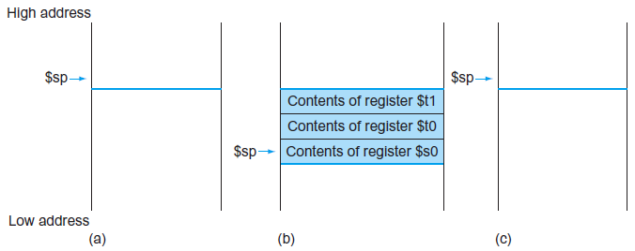
Using more registers (Cont.)
Example: compiling a C procedure that doesn’t call another procedures
(f, g, h, i, j) are in ($s0, $a0, $a1, $a2, $a3)
To avoid saving and restoring a register whose value is never use
$t0 ~ $t9: temporary registers, not preserved by the callee on a procedure call
$s0 ~$s7: saved registers, preserved on a procedure call
leaf_example: addi $sp, $sp, -12 # adjust stack to make room for 3 items
sw $t1, 8($sp) # save $t1 for use afterwards
sw $t0, 4($sp) # save $t0 for use afterwards
sw $s0, 0($sp) # save $s0 for use afterwards
add $t0, $a0, $a1 # $t0 contains g + h
add $t1, $a2, $a3 # $t1 contains i + j
sub $s0, $t0, $t1 # f = $t0 - $t1, which is (g + h) – (i + j)
add $v0, $s0, $zero # returns f ($v0 = $s0 + 0)
lw $s0, 0($sp) # restore $s0 for caller
lw $t0, 4($sp) # restore $t0 for caller
lw $t1, 8($sp) # restore $t1 for caller
addi $sp, $sp, 12 # adjust stack to delete 3 items
jr $ra # jump back to calling routine
int leaf_example (int g, int h, int i, int j)
{
int f;
f = (g + h) – (i + j);
return f;
}

Slide 26
Nested procedures
Leaf procedure: a procedure do not call other
Recursive procedure call
Conflict over $a0 ~ $a3 and $ra
Solution: to push all the other registers that must be preserved onto the stack
Example: compiling a recursive C procedure, showing nested procedure linking
n is in $a0
fact: addi $sp, $sp, -8 # adjust stack for 2 items
sw $ra, 4($sp) # save the return address
sw $a0, 0($sp) # save the argument n
slti $t0, $a0, 1 # test for n < 1
beq $t0, $zero, L1 # if n ≥ 1, go to L1
addi $v0, $zero, 1 # return 1
addi $sp, $sp, 8 # pop 2 items off stack
jr $ra # return to caller
L1: addi $a0, $a0, -1 # n ≥ 1: argument gets (n – 1)
jal fact # call fact with (n – 1)
lw $a0, 0($sp) # return from jal: restore argument n
lw $ra, 4($sp) # restore the return address
addi $sp, $sp, 8 # adjust stack pointer to pop 2 items
mul $v0, $a0, $v0 # return n × fact (n – 1)
jr $ra # return to the caller
int fact (int n)
{
if (n < 1) return (1);
else return (n × fact (n – 1));
}
return (1)
call n×fact(n-1)
return n×fact(n-1)

Slide 27
High address
$sp
Low address
int fact (int n)
{
if (n < 1) return (1);
else return (n × fact (n – 1));
}
1 2 3 4 5 9 10 1 2 3 4 5 9 10 1 2 3 4 5 9 10 1 2 3 4 5
$ra = ?
$a0 = 3
$v0 = 0
$ra = 58
$a0 = 2
$v0 = 0
$ra = 58
$a0 = 1
$v0 = 0
$ra = 58
$a0 = 0
$v0 = 0
? ($ra)
3 ($a0)
? ($ra)
3 ($a0)
58 ($ra)
2 ($a0)
? ($ra)
3 ($a0)
58 ($ra)
2 ($a0)
58 ($ra)
1 ($a0)
? ($ra)
3 ($a0)
58 ($ra)
2 ($a0)
58 ($ra)
1 ($a0)
58 ($ra)
0 ($a0)
$sp
No.
(Addr.)₁₆
$sp
1 30 fact: addi $sp, $sp, -8
2 34 sw $ra, 4($sp)
3 38 sw $a0, 0($sp)
4 3C slti $t0, $a0, 1
5 40 beq $t0, $zero, L1
6 44 addi $v0, $zero, 1
7 48 addi $sp, $sp, 8
8 4C jr $ra
9 50 L1: addi $a0, $a0, -1
10 54 jal fact
11 58 lw $a0, 0($sp)
12 5C lw $ra, 4($sp)
13 60 addi $sp, $sp, 8
14 64 mul $v0, $a0, $v0
15 68 jr $ra
$sp
$sp
6 7 8 11 12 13 14 15 11 12 13 14 15 11 12 13 14 15
$ra = 58
$a0 = 0
$v0 = 1
$ra = 58
$a0 = 1
$v0 = 1×1 = 1
$ra = 58
$a0 = 2
$v0 = 2×1 = 2
$ra = ?
$a0 = 3
$v0 = 3×2 = 6
? ($ra)
3 ($a0)
58 ($ra)
2 ($a0)
58 ($ra)
1 ($a0)
? ($ra)
3 ($a0)
58 ($ra)
2 ($a0)
? ($ra)
3 ($a0)
$sp
$sp
$sp
$sp

Slide 28
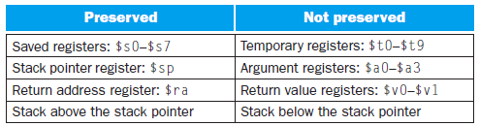
Nested procedures (Cont.)
A C variable is generally a location in storage
Type: integers, characters, …
Storage classes
Automatic
Local to a procedure and be discarded when the procedure exits
Static
Will exist across exits from and entries to procedures
To be declared outside all procedures
To be declared using the keyword static
Global pointer ($gp)
The register reserved to point to static data
Fig. 2.11 What is and what is not preserved across a procedure call.

Slide 29
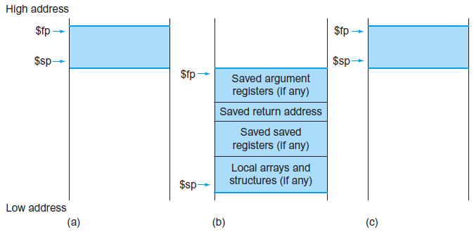
Allocating space for new data on the stack
Procedure frame (activation record)
The segment of the stack containing a procedure’s saved registers and local variables
Frame pointer ($fp)
To point to the first word of the frame of a procedure
To offer a stable base register within a procedure for local memory references
$sp might change during the procedure
Using $sp to reference to a local variable in memory might have different offsets depending on where they are in the procedure
Fig. 2.12 Illustration of the stack allocation (a) before, (b) during, and (c) after the procedure call.

Slide 30
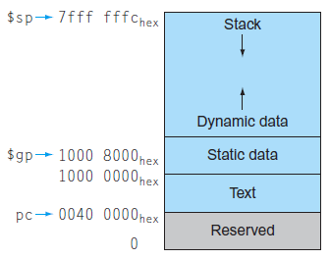
Allocating space for new data on the heap
The MIPS memory allocation
Reserved (0 ~ 003FFFFF_{hex})
Text segment (00400000_{hex} ~ 0FFFFFFF_{hex})
MIPS machine code
Static data segment (10000000_{hex} ~ 1000FFFF_{hex})
Constants and static variables
$gp: initialized to 10008000_{hex}
Stack and dynamic data (10010000_{hex} ~7FFFFFFC_{hex})
Stack: $sp is initialized to 7FFFFFFC_{hex} and grows down
Dynamic data structure (heap)
To start at 10010000_{hex} and grow up
Malloc (), free ()
To allow the stack and heap to grow toward each other
Memory allocation is controlled by programs in C
Memory leak, dangling pointers
Java uses automatic memory allocation and garbage collection
Fig. 2.13 The MIPS memory allocation for program and data.

Slide 31
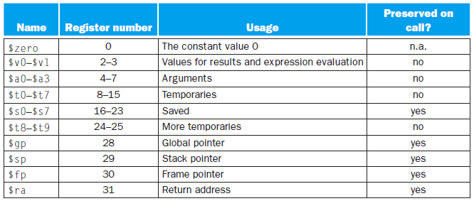
Elaboration
If there are more than four parameters, these extra parameters are placed on the stack just above the frame pointer in MIPS
Frame pointer $fp is not necessary
jal will save the address of the instruction that follow jal into register $ra
Fig. 2.14 MIPS register conventions.

Slide 32
Communicating with People
Instructions to move bytes and halfword
lb/sb $t0, 0($sp)
Memory ↔ the rightmost 8-bits of a register
lh/sh $t0, 0($sp)
Memory ↔ the rightmost 16-bits of a register
Characters (ASCII code) → strings
Three choices for representing a string
The first position of the string is reserved to give the length of a string
An accompanying variable has the length of the string
Java includes a word that gives the length of the string
The last position of a string is indicated by a character used to mark the end of a string
In C, a string is terminated with a byte whose value is 0

Slide 33
Example: compiling a string copy procedure, showing how to use C strings
i is in $s0, base address of (x, y) is in ($a0, $a1)
strcpy is a leaf procedure, i can be allocated to a temporary register instead of $s0
strcpy: addi $sp, $sp, -4 # adjust stack for 3 more items
sw $s0, 0($sp) # save $s0
add $s0, $zero, $zero # i = 0 + 0
L1: add $t1, $s0, $a1 # address of y[i] in $t1
lbu $t2, 0($t1) # $t2 = y[i]
add $t3, $s0, $a0 # address of x[i] in $t3
sb $t2, 0($t3) # x[i] = y[i]
beq $t2, $zero, L2 # if y[i] = = 0, go to L2
addi $s0, $s0, 1 # i = i + 1
j L1 # go to L1
L2: lw $s0, 0($sp) # y[i] = = 0: end of string. Restore old $s0
addi $sp, $sp, 4 # pop 1 word off stack
jr $ra # return
void strcpy (char x[], char y[])
{
int i;
i = 0;
while ((x[i] = y[i]) != ‘\0’)
i += 1;
}

Slide 34
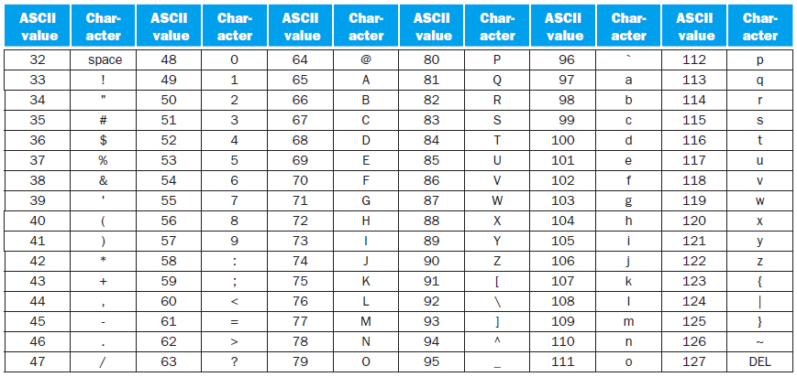
Fig. extra ASCII representation of characters.

Slide 35
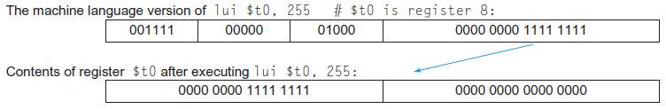
MIPS Addressing for 32-bit Immediates and Addresses
32-bit immediate operands
Load upper immediate instruction lui
To set the upper 16 bits of a constant in a register
lui $t0, 255
Two immediate instructions are used to specify a 32-bit constant
Example: load 0000 0000 0011 1101 0000 1001 0000 0000₂ to $s0
lui $s0, 61 # 61₁₀ = 0000 0000 0011 1101₂
ori $s0, $s0, 2304 # 2304₁₀ = 0000 1001 0000 0000₂
Fig. 2.15 The effect of the lui instruction.

Slide 36
Addressing in branches and jumps
J-type format (J-format)
op (opcode): basic operation of the instruction
Target address: 2²⁶ words
For jump (j) and jump-and-link (jal) instructions
Example: j 10000 # go to location 10000
Conditional branch
I-type instruction
Example: bne $s0, $s1, Exit # go to Exit if $s0 ≠ $s1
Program counter = register + branch address
Branch range: ±2¹⁵ words
The program to be as large as 2³² words
op | target address
6 bits | 26 bits
2 | 10000
5 | 16 | 17 | Exit
6 bits | 5 bits | 5 bits | 16 bits

Slide 37
Addressing in branches and jumps (Cont.)
PC-relative addressing
The address is the sum of the program counter (PC) and a constant in the instruction
Conditional branch instructions can branch within ±2¹⁵ words of the current instruction
Almost all loops and if statements are much smaller than 2¹⁶ words
The 26-bit field in jump instructions is also a word address
Example: showing branch offset in machine language
Loop starting at location 80000 in memory
Loop: sll $t1, $s3, 2
add $t1, $t1, $s6
lw $t0, 0($t1)
bne $t0, $s5, Exit
addi $s3, $s3, 1
j Loop
Exit:
80000 | 0 | 0 | 19 | 9 | 2 | 0
80004 | 0 | 9 | 22 | 9 | 0 | 32
80008 | 35 | 9 | 8 | 0
80012 | 5 | 8 | 21 | 2
80016 | 8 | 19 | 19 | 1
80020 | 2 | 20000
80024 | …
20000 × 4 = 80000
80016 + 2 × 4 = 80024

Slide 38
Addressing in branches and jumps (Cont.)
Branching far away
The target address of a conditional branch instruction exceeds 2¹⁶ words
To insert an unconditional jump to the branch target and invert the condition
beq $s0, $s1, L1
⇒ bne $s0, $s1, L2
j L1
L2:
MIPS addressing mode summary
Immediate addressing
The operand is a constant within the instruction itself
Register addressing
The operand is a register
Base or displacement addressing
The operand is at the memory location
Address = base register + constant (in the instruction)
PC-relative addressing
Branch address = PC + constant (in the instruction)

Slide 39
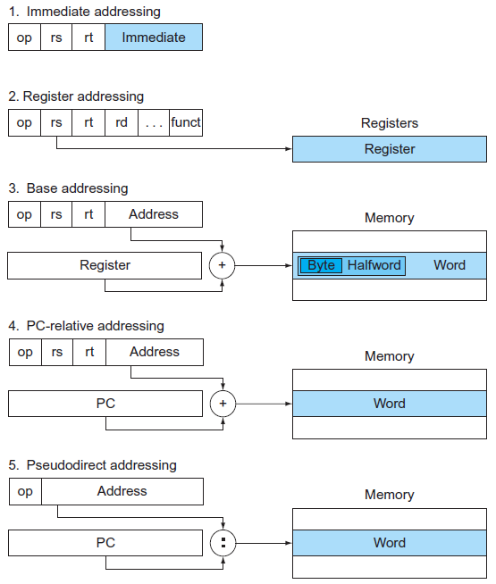
MIPS addressing mode summary (Cont.)
Pseudodirect addressing
Jump address is the 26 bits of the instruction concatenated with the upper bits of the PC
Fig. 2.16 Illustration of the five MIPS addressing modes.

Slide 40
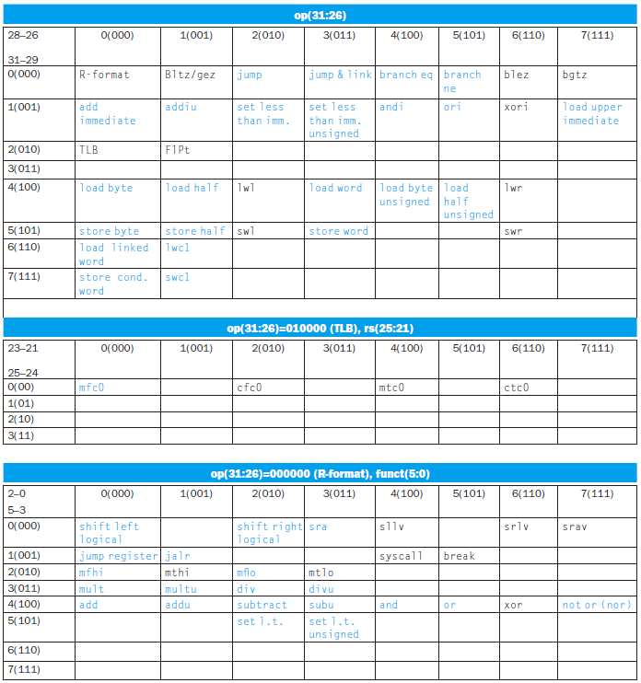
Fig. 2.17 MIPS instruction encoding.

Slide 41
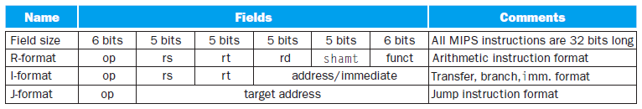
Fig. 2.18 MIPS instruction formats.

Slide 42
Fallacies and Pitfalls
Fallacies
More powerful instructions mean higher performance
Example: to move data in memory (Intel x86)
Solution 1: using a move instruction with the repeat prefix
Solution 2: using standard load and store instructions
Solution 3: using the larger floating-point registers instead of the integer registers
⇒ Speed: solution 1 : solution 2 : solution 3 = 1 : 1.5 : 2
Write in assembly language to obtain the highest performance
The increasing sophistication of compilers means the gap between compiled code and code produced by hand is closing fast
The dangers of writing in assembly language
The longer time spent coding and debugging
The loss in portability
The difficulty of maintaining such code
When a program becomes popular, someone has to update the code and make it work with new releases of operating systems and new models of machines

Slide 43
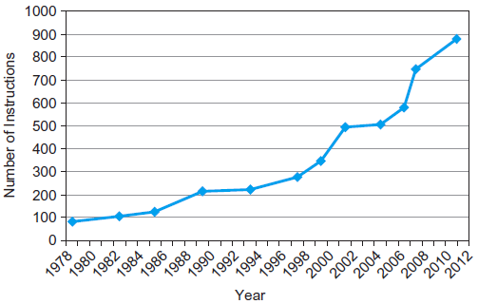
Fallacies (Cont.)
Write in assembly language to obtain the highest performance (Cont.)
Writing in higher-level language
To allow future compilers to tailor the code to future machines
To make the software easier to maintain
To allow the program to run on more brands of computers
The importance of commercial binary compatibility means successful instruction sets don’t change
Fig. 2.39 Growth of x86 instruction set over time.

Slide 44
Pitfalls
Forgetting that sequential word addresses in machines with byte addressing do not differ by one
1 word = 4 bytes = 32 bits
Addresses of sequential words differ by 4
Using a pointer to an automatic variable outside its defining procedure
A common mistake: to pass a result from a procedure that includes a pointer to a local array
The memory that contains the local array will be reused as soon as the procedure returns

