Slide 1
Large and Fast: Exploiting Memory Hierarchy

Slide 2
Outline
Introduction
Memory Technologies
The Basics of Caches
Measuring and Improving Cache Performance
Dependable Memory Hierarchy
Virtual Memory
A Common Framework for Memory Hierarchies
Using a Finite-State Machine to Control a Simple Cache
Real Stuff: The ARM Cortex-A8 and Intel Core i7 Memory Hierarchies
Fallacies and Pitfalls

Slide 3
Introduction
A library example
Principle of locality
Programs access a relatively small portion of their address space at any instant of time
It is impossible to make most memory accesses fast and still have large memory in computers
Temporal locality (locality in time)
If an item is referenced, it will tend to be reference again soon
Ex: loops
Spatial locality (locality in space)
If an item is reference, items whose addresses are close by will tend to be referenced soon
Ex: program (instructions) and array data are normally sequentially accessed

Slide 4
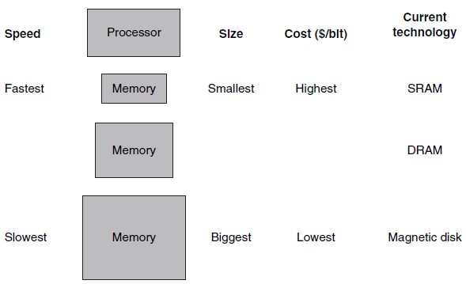
Memory hierarchy
The basic structure
Multiple levels of memory with different speeds and sizes
The faster memories are more expensive per bit than the slower memories and thus are smaller
The faster memory is close to the processor and the slower, less expensive memory is below it
To present the user with as much memory as is available in the cheapest technology
To provide access at the speed offered by the fastest memory
The data is similarly hierarchical
All the data is stored at the lowest level
Inclusion property
A level closer to the processor is
generally a subset of any level
further away
Fig. 5.1 The basic structure of a memory hierarchy.

Slide 5
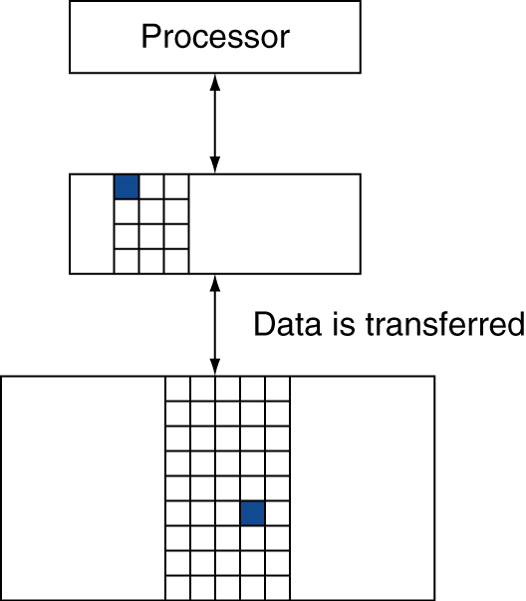
Memory hierarchy (Cont.)
Data is copied between only two adjacent levels at a time
The upper level is smaller, faster, and expensive
Block (line)
The minimum unit of information that can be either present or not present in a cache
Hit vs. Miss
Hit: the data requested by the processor appears in some block in the upper level
Miss: the requested data is not found in the upper level
Hit rate (hit ratio) vs. Miss rate
The fraction of memory accesses found (or not found) in the upper level
Hit rate + Miss rate = 1
Hit time
The time to access the upper level of the memory hierarchy
Including the time needed to determine whether the access
is a hit or a miss
Miss penalty
The time to replace a block in the upper level
Including the time to deliver this block to the processor
Hit time will be much smaller than the time to access the
next level in the hierarchy

Slide 6
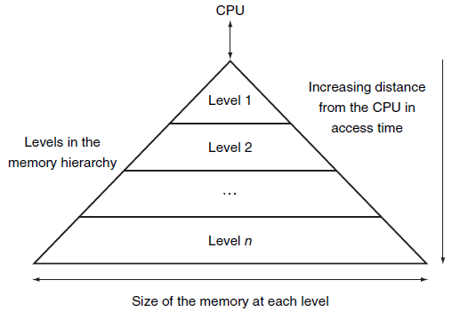
Memory systems are critical to performance
All programs spend much of their time accessing memory
The memory system is necessarily a major factor in determining performance
Memory hierarchy vs. locality
Programs exhibit both temporal locality and spatial locality
Temporal locality
To keep more recently accessed data items closer to the processor
Accesses that hit in the highest level of the hierarchy can be processed quickly
Spatial locality
To move blocks consisting of multiple contiguous words in memory to upper levels of the hierarchy
In most system, data cannot be present in
level i unless it is also present in level i + 1
Fig. 5.3 This diagram shows the structure of a memory hierarchy: as the distance from the processor increases, so does the size.

Slide 7
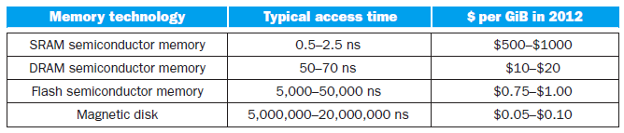
Memory Technologies
Preliminary
Four primary technologies used today in memory hierarchies
DRAM (dynamic random access memory)
Used to implement the main memory
Slower and less costly per bit than SRAM
DRAM uses significantly less area per bit of memory
SRAM (static random access memory)
Used to implement the cache
Flash memory
Nonvolatile memory, the secondary memory in PMD (personal mobile devices)
Magnetic disk
Used to implement the largest and slowest level in the hierarchy in servers
The access time and price per bit vary widely among these technologies

Slide 8
SRAM technology
Memory arrays with (usually) a single access port that can provide either a read or a write
A fixed access time to any datum
The read and write access times may differ
SRAMs don’t need to refresh
The access time is very close to the cycle time
Access time: the time between a read is requested and the desired word arrive
Cycle time: the minimum time between requests to memory
Cycle time is greater than access time
Typically uses 6~8 transistors per bit to prevent the information from being disturbed when read
SRAM needs only minimal power to retain the charge in standby mode
Today all levels of caches are integrated onto the processor chip
DRAM technology
In a DRAM, the value kept in a cell is stored as a charge in a capacitor
A single transistor is used to access the stored charge
DRAM is much denser and cheaper per bit than SRAM

Slide 9
DRAM technology (Cont.)
DRAM cells must be periodically refreshed
To read contents for a cell and write it back
The charge can be kept for several milliseconds
The difference between the access time and the cycle time as well as the need to refresh
Designers try to keep time spent refreshing to less than 5% of the total time
All bits in a row can be refreshed simultaneously
The internal organization of a DRAM
The memory is organized as a rectangular matrix addressed by rows and columns
To multiplex the address lines
Row address vs. Column address
Row access strobe (RAS) vs. Column access strobe (CAS)
DRAMs buffer rows for repeated access
Random bits can be accessed in the row buffer until the next row access
The access time to bits in the row is much lower
Within the buffer, bits can be transferred by successive addresses or by specifying a block transfer and the starting address
Making the chip wider also improves the memory bandwidth of the chip

Slide 10
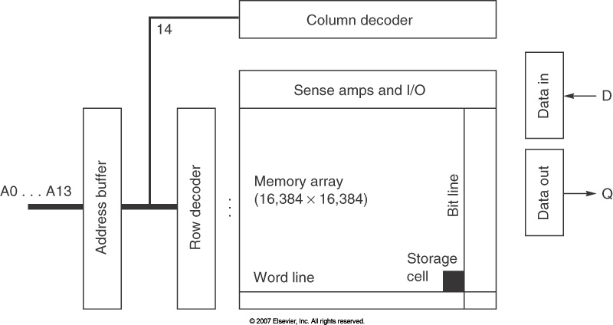
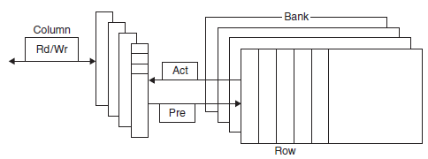
Fig. extra Internal organization of a 256 Mbit DRAM.
Instead of one 16384×16384 memory, a DRAM might use 256 1024×1024 arrays or 64 2048×2048 arrays.
Fig. 5.4 Internal organization of a DRAM.

Slide 11
DRAM technology (Cont.)
Synchronous DRAM (SDRAM)
The use of a clock eliminates the time for the memory and processor to synchronize
Burst mode
The clock transfers the successive bits in a burst without having to specify additional address bits
Double data rate (DDR) SDRAM
Data transfers on both the rising and falling edge of the clock
Getting twice as much bandwidth
Multiple banks inside a DRAM
Each memory bank has its own row buffer
Address interleaving
Sending an address to several banks permits them to read or write simultaneously
Address: bank number, row address, column address
Dual inline memory modules (DIMMs)
A DIMM typically contains 4~16 DRAM chips
DRAM chips are normally organized to be 8 bytes wide for server systems

Slide 12
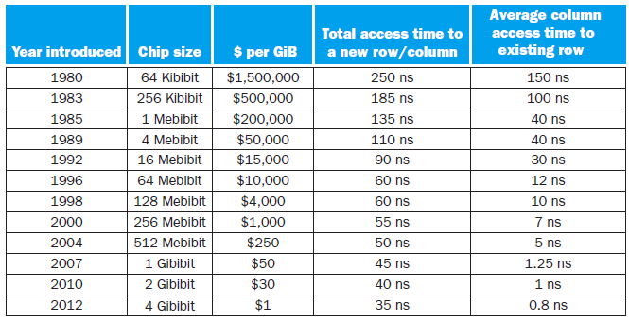
Fig. 5.5 DRAM size increased by multiples of four approximately once every three years until 1996, and thereafter considerably slower.

Slide 13
Flash memory
A type of electrically erasable programmable read-only memory (EEPROM)
Nonvolatile memory, more power efficient and shock resistant
Read time is much shorter than write time
Wear leveling technique
Writes can wear out flash memory bits
To include a controller to remap blocks
Uniformly distributing written blocks to maximize the lifetime
PMDs are very unlikely to exceed the write limits in the flash
To improve yield by mapping out memory cells that were manufactured incorrectly
To lower the potential performance of flash
Disk memory
Structure
A collection of platters
Covered with magnetic recording material on both sides
Typically only one or two platters per drive today
Rotation rate: 5400~15000 RPM Diameter: 2.5 or 3.5 inches
A movable arm containing a read-write head is located just above each surface

Slide 14
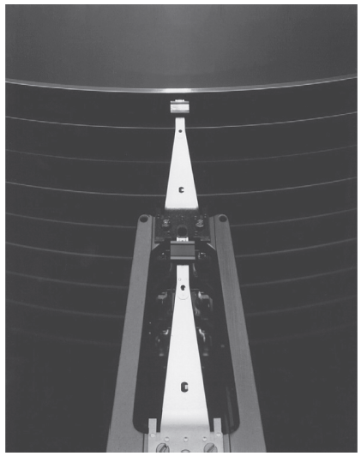
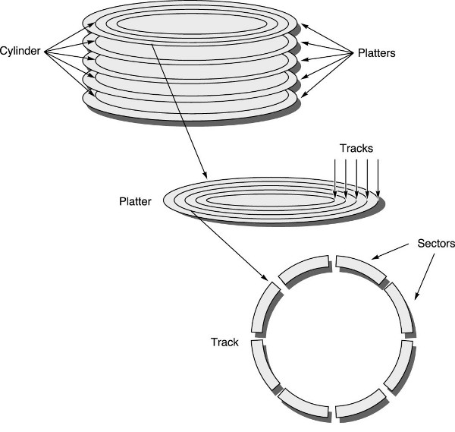
Disk memory (Cont.)
Structure (Cont.)
Each disk surface is divided into concentric circles (tracks)
Typically tens of thousands of tracks per surface
Each track is divided into sectors
Each track may have thousands of sectors
Sectors are typically 512~4096 bytes in size
The sequence recorded on the magnetic media
A sector number, a gap, the information including ECC, a gap, sector number…
The disk heads for each surface are connected together and move in conjunction
Every head is over the same track of every surface
Cylinder: all the tracks under the heads at a given point on all surfaces
Fig. 5.6 A disk showing 10 disk platters and the read-write heads.

Slide 15
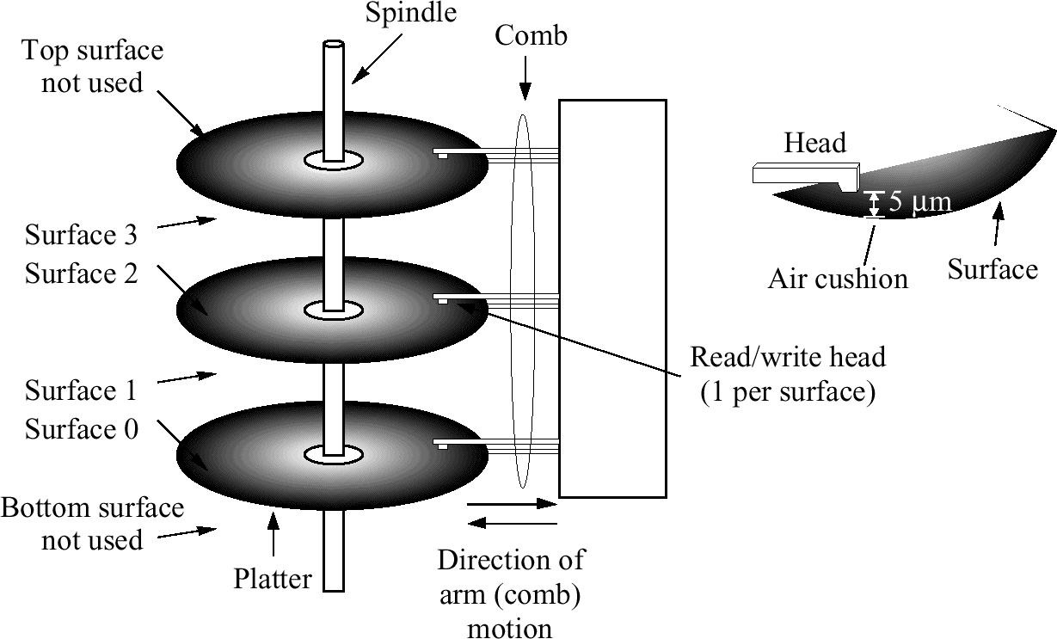

Slide 16
Disk memory (Cont.)
Three-stage process of the operating system to access data
Seek time
Seek: to position the read-write head over the proper track
Minimum/maximum/average seek time is reported in manuals
Average seek time depends on the seek distance
Usually advertised as 3~13 ms
The actual time may be only 25% ~ 33% of the advertised number
Rotational latency (rotational delay)
To wait for the desired sector to rotate under the read-write head
The average latency is halfway around the disk
5400~15000 RPM ⇒ 2.0~5.6 ms
Transfer time
To transfer a block of bits
A function of the sector size, the rotation speed, and the recording density of a track
Transfer rate is 100~250 MB/sec in 2012
With a built-in cache: transfer rate is up to 750 MB/sec in 2012

Slide 17
Disk memory (Cont.)
The new disk model
Conventional: sector-track-cylinder model
Nearby blocks are on the same track
Blocks in the same cylinder take less time to access (no seek time)
To offer higher-level intelligent interfaces
To include a microprocessor inside a disk
Logical blocks are ordered in serpentine fashion across a single surface
To capture all the sectors that are recorded at the same bit density
Sequential blocks may be on different tracks
Primary differences between magnetic disks and semiconductor memory technologies
Disks have a slower access time because they are mechanical devices
Flash is 1000 times as fast, DRAM is 100000 times as fast
Disks are cheaper per bit
Very high storage capacity at a modest cost
Disk is 10~100 time cheaper
Magnetic disks are nonvolatile like flash but no write wear-out problem

Slide 18
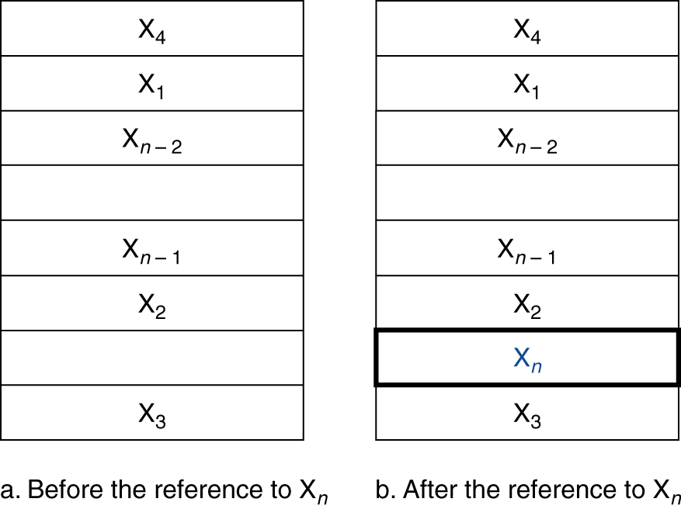
The Basics of Caches
A simple cache
A safe place to store things that we needed to examine
The name to represent the level of the memory hierarchy between the processor and main memory
Two questions to answer
How do we know if a data item is in the cache?
If it is, how do we find it?
Assumption:
The processor requests are each one word and the blocks also consist of a single word
Fig. 5.7 The cache just before and just after a reference to a word X_{n} that is not initially in the cache.

Slide 19
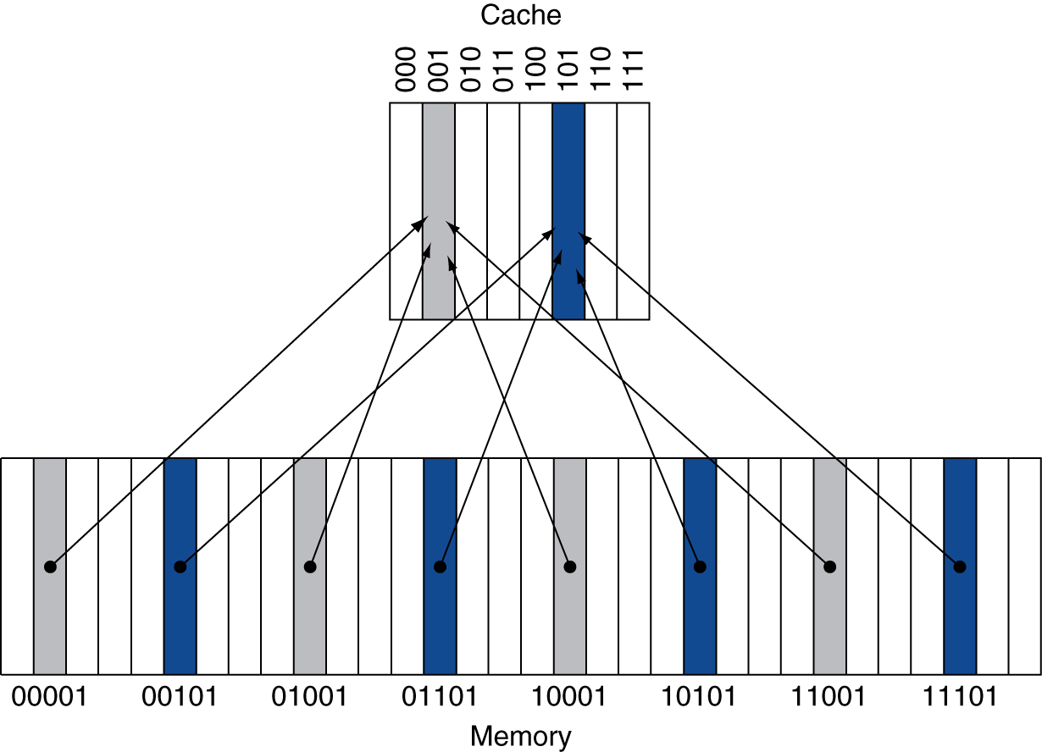
A simple cache (Cont.)
Direct-mapped cache
Each memory location is mapped to exactly one location in the cache
To assign the cache location based on the memory address of the word
(block address) modulo (number of cache blocks in the cache)
It is better to have the number of entries in the cache is a power of 2
Different memory locations will be mapped to the same cache location
Tags
To identify whether a word in the cache corresponds to the requested word
Only contains the upper portion of the address, which is not used as an index into the cache
Valid bit
To indicate whether an entry contains
a valid address
Fig. 5.8 A direct-mapped cache with eight entries showing the addresses of memory words between 0 and 31 that map to the same cache locations.

Slide 20
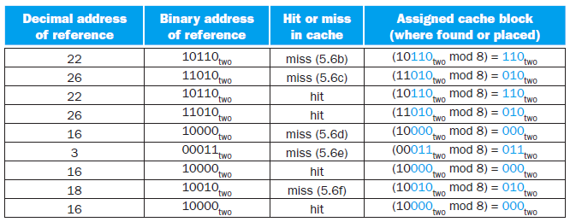
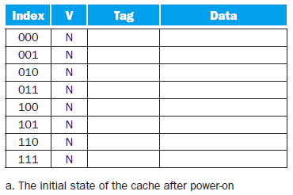
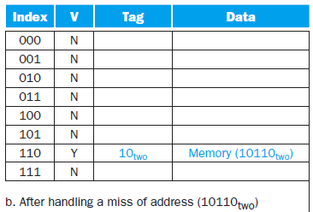
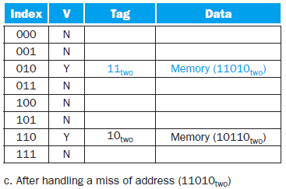
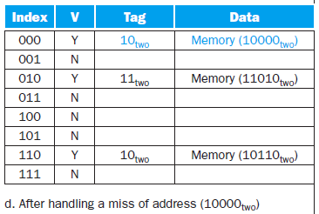
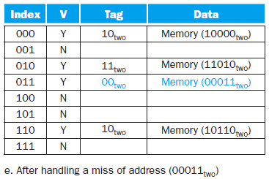
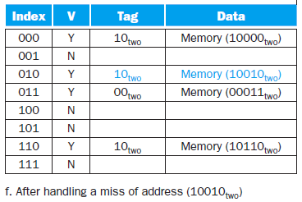
Accessing a cache
An example: 8-block direct-mapped cache
Each block contains one word
The low-order 3 bits of an address give the block number

Slide 21
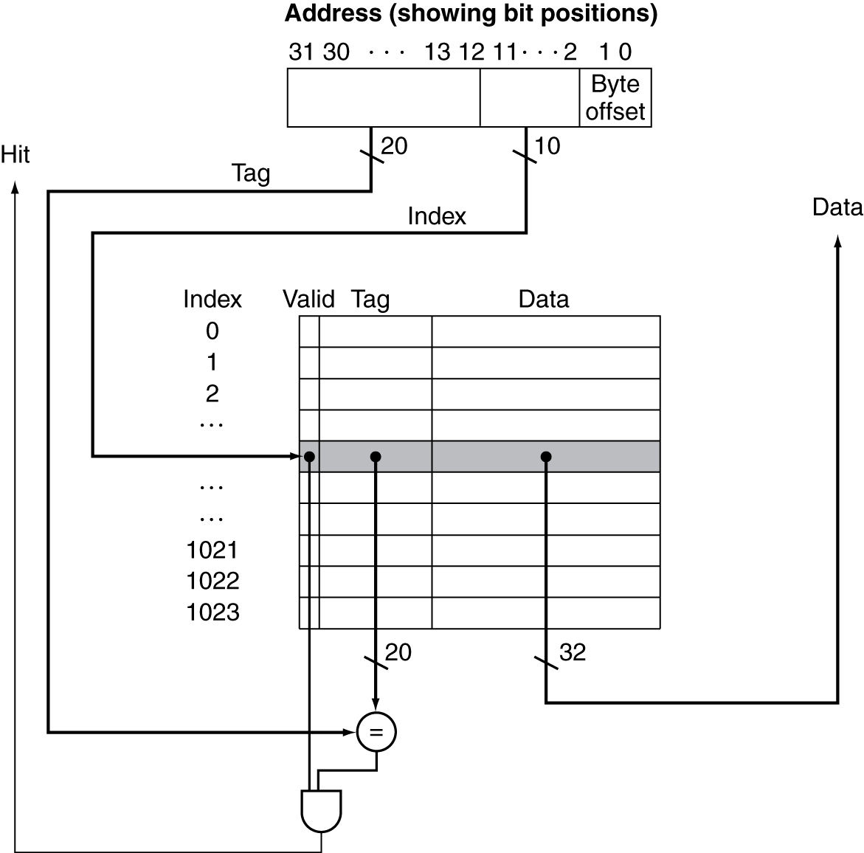
Accessing a cache (Cont.)
A referenced address is divided into
A cache index
Used to select the cache block
The total number of entries in a direct-mapped cache must be a power of 2
A tag field
Used to compare with the value of the tag field of the cache
The least significant 2 bits are ignored when selecting a word in the block
Words are aligned to multiples of 4 bytes in the MIPS architecture
Fig. 5.7 For this cache, the lower portion of the address is used to select a cache entry consisting of a data word and a tag.

Slide 22
Accessing a cache (Cont.)
An example cache: the Intrinsity FastMATH processor
A embedded microprocessor that uses the MIPS architecture and a simple cache implementation
Processor
12-stage pipeline
When operating at peak speed, both an instruction word and a data word can be request on every clock
Separate instruction and data caches
Each is 16 KB (4 K words) with 16-word blocks
Separate control signals to read and write each cache
A block index field is used to select the requested word from the 16 words in the indexed block
To offer both write-through and write-back strategies
One-entry write buffer
Fig. 5.13 Approximate instruction and data miss rates for the Intrinsity FastMATH processor for SPEC CPU2000 benchmarks.

Slide 23
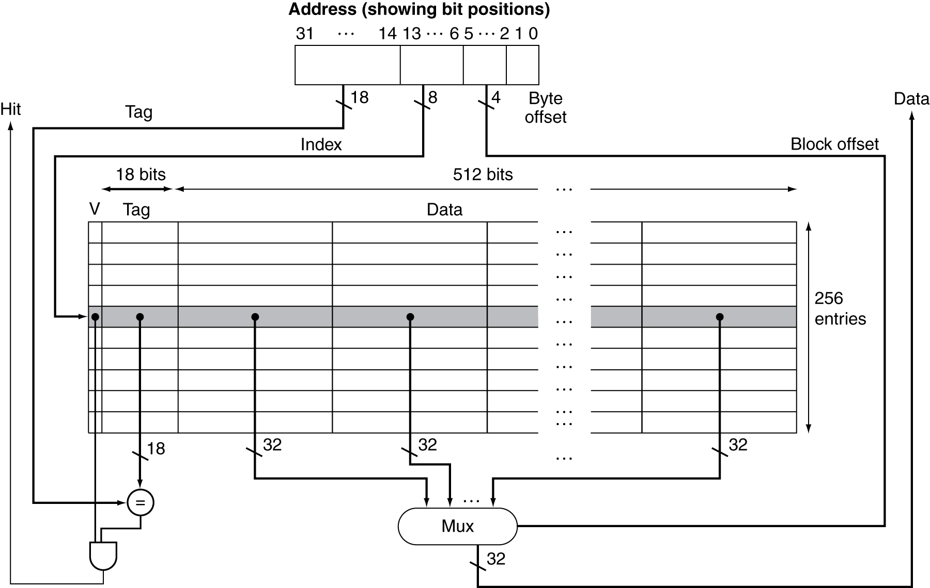
Fig. 5.12 The 16 KB caches in the Intrinsity FastMATH each contain 256 blocks with 16 words per block.

Slide 24
Accessing a cache (Cont.)
The total number of bits needed for a cache
Example
A direct-map cache
32-bit byte address, 2^{n} blocks with 2^{m}-word block
⇒ Tag size: 32 – (n + m + 2) bits
Total number of bits: 2^{n} × (block size + tag size + valid field size)
= 2^{n} × (2^{m} × 32 + (32 – n – m – 2) + 1) = 2^{n} × (2^{m} × 32 + 31 – n – m)
Usually to count only the size of the data
Example: bits in a cache
Problem
How many total bits are required for a direct-mapped cache with 16 KB of data and 4-word blocks, assuming a 32-bit address?
Solution
16 KB data, 4-word block ⇒ 2¹⁰ blocks
Tag size: 32 – 10 – 2 – 2 = 18 bits
Each block has 4 × 32 = 128 bits
Total cache size = 2¹⁰ × (128 + 18 + 1) = 2¹⁰ × 147 = 147 Kbits (or 18.4 KB)
Total size: 18.4 KB Data size: 16 KB ⇒ 1.15 times

Slide 25
Accessing a cache (Cont.)
Example: mapping an address to a multiword cache block
Problem
Consider a cache with 64 blocks and a block size of 16 bytes
What block number does byte address 1200 map to?
Solution
The block is given by: (Block address) modulo (Number of cache blocks)
The address of the block:
Block contains all addresses between
and
Byte address 1200 is block address
which maps to cache block number (75 modulo 64) = 11
Block 11 maps all address between 1200 and 1215

Slide 26
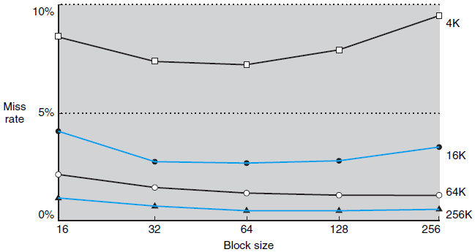
Accessing a cache (Cont.)
When the cache block size becomes larger
Larger blocks exploit spatial locality to lower miss rates
The miss rate may go up if the block size becomes too large, because the number of blocks that can be held in the cache will become small
To increase the block size will increase the miss penalty
Miss penalty: the latency to the first word + the transfer time for the rest of the block
The transfer time will increase as the block size grows
⇒ To increase the block size and obtain good performance
To design the memory to transfer larger block more efficiently
Fig. 5.11 Miss rate versus block size.

Slide 27
Handling cache misses
When a cache miss occurs
Done with the processor control unit and a separate controller
To stall the processor and wait for memory
To freeze the contents of the temporary and programmer-visible registers
More sophisticated out-of-order processors can allow execution of instructions while waiting for a cache miss
To initiate the memory access and refill the cache
How instruction misses are handled for pipelined datapath
Send the original PC (current PC – 4) to the memory
Instruct memory to perform a read and wait for the memory to complete its access
Write the cache entry
Putting the data in the data portion of the entry
Writing the upper bits of the address into the tag field
Turning the valid bit on
Restart the instruction execution at the first step (instruction refetch)
The control of the cache on a data access is essentially identical

Slide 28
Handling writes
The cache and memory may be inconsistent
Data is written into only the data cache without changing memory
Write-through
Always write the data into both the memory and the cache
Simple but not efficient
Write buffer
To store the data while it is waiting to be written to memory
The processor can continue execution after writing the data into the cache and into the write buffer
A write buffer entry is freed when a write to main memory completes
If the write buffer is full when the processor reaches a write
The processor must stall until there is an empty position in the write buffer
Using deeper write buffer to reduce the occurrence of such stalls
Write-back
Data is written only to the block in the cache
The modified block is written to the memory when it is replaced
Complex but efficient

Slide 29
Elaboration
Write allocate cache vs. No write allocate cache
For write-through cache
Write allocate cache
The missed block is fetched from memory and then allocate a block in the cache
The appropriate portion of the block in the cache is overwritten
No write allocate cache
To update the portion of the block in memory but not put it in the cache
Combined cache vs. Split cache
Combined cache
A single cache stored both instructions and data
Better hit rate
Split cache
Two independent caches that operate in parallel with one handling instructions and one handling data
Slightly increased miss rate
Doubling the cache bandwidth
Almost all processors today use split cache to match what modern pipelines expect

Slide 30
Measuring and Improving Cache Performance
To measure and analyze cache performance
To compute the CPU time
CPU time = (CPU execution clock cycles + Memory-stall clock cycles)
× Clock cycle time
The costs of cache hits are part of the normal CPU execution cycles
Memory-stall clock cycles = Read-stall cycles + Write-stall cycles
(write-through)
Write-through: with a reasonable write buffer depth, write buffer stall will be small and can be safely ignored
Write-back: additional stalls arising from the need to write a cache block back to memory when the block is replace

Slide 31
To measure and analyze cache performance (Cont.)
To compute the CPU time (Cont.)
(write-through)
The read and write miss penalties are the same in most write-through cache organization
The write buffer stalls are negligible
Example: calculating cache performance
Problem
Instruction cache miss rate: 2%
Data cache miss rate: 4%
A processor has a CPI of 2 without any memory stalls
Miss penalty: 100 cycles for all misses
Assume the frequency of all loads and stores is 36%
How much faster a processor would run with a perfect cache that never missed?

Slide 32
To measure and analyze cache performance (Cont.)
Example: calculating cache performance (Cont.)
Solution
Assume there are total I instructions
Instruction miss cycles = I × 2% × 100 = 2 × I
Data miss cycles = I × 36% × 4% × 100 = 1.44 × I
Total number of memory-stall cycles: (2 + 1.44) × I = 3.44 × I
CPI with memory stalls: 2 + 3.44 = 5.44
The ratio of the CPU execution times is:
If the processor is made faster but the memory system is not
The amount of time spent on memory stalls will take up an increasing fraction of the execution time
In previous example, suppose the CPI is reduced from 2 to 1
CPI of the system with cache miss: 1 + 3.44 = 4.44
The system with the perfect cache will be 4.44 (4.44/1) times faster
Execution time spent on memory stalls: 63% (CPI = 2) vs. 77% (CPI = 1)
Increasing the clock rate without changing the memory system also increases the performance lost due to cache misses

Slide 33
To measure and analyze cache performance (Cont.)
A larger cache could have a longer access time (the increase in hit time)
An increase in accessing a word from the memory system
An increase in the processor cycle time
Likely adds another stage to the pipeline
It may take multiple cycles for a cache hit
The increase in hit time for a larger cache could dominate the improvement in hit rate, leading to a decrease in processor performance
Average memory access time (AMAT)
AMAT = Time for a hit + Miss rate × Miss penalty
The average time to access memory considering both hits and misses and the frequency of different accesses
Example:
Problem
A processor with a 1 ns clock cycle time
Miss penalty: 20 clock cycles Miss rate: 0.05 misses per instruction
A cache access time (including hit detection): 1 clock cycle
Find the AMAT for this processor
Solution
AMAT = Time for a hit + Miss rate × Miss penalty = 1 + 0.05 × 20 = 2 clock cycles = 2 ns

Slide 34
Reducing cache misses by more flexible placement of blocks
Different placement schemes
Direct mapped
A block can go in exactly one place in the cache
Position: (Block number) modulo (Number of cache blocks)
Fully associative
A block can be placed in any location in the cache
All tags of all the blocks in the cache must be searched (in parallel)
Comparators significantly increase the hardware cost
Only practical for caches with small numbers of blocks
Set associative
Each block can be placed in a fixed number of locations
n-way set-associative cache
A cache with n locations for a block
A cache consists of a number of sets, each of which consists of n blocks
Each block in the memory maps to a unique set in the cache given by the index field, and a block can be placed in any element of that set
All tags of all the elements of the set must be searched
Position: (Block number) modulo (Number of sets in the cache)

Slide 35
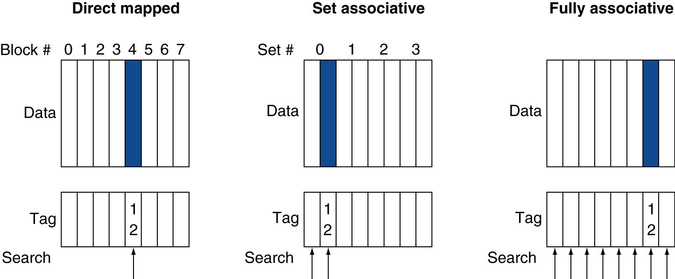
Fig. 5.14 The location of a memory block whose address is 12 in a cache with 8 blocks varies for direct-mapped, set-associative, and fully associative placement.

Slide 36
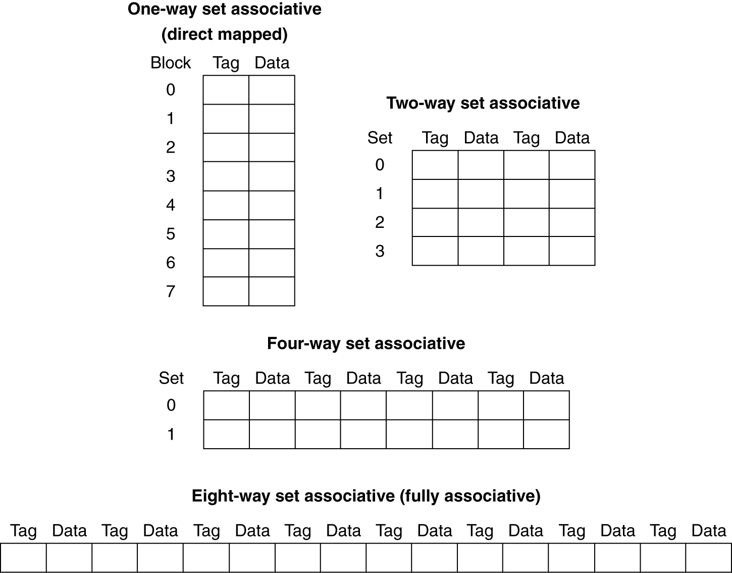
Reducing cache misses by more flexible placement of blocks (Cont.)
To increase the degree of associativity
A direct-mapped cache is simply a one-way set-associative cache
A fully associative cache with m entries
An m-way set-associative cache, only one set with m blocks
Advantage: decreases the miss rate
Disadvantage: increases in the hit time
Fig. 5.15 An eight-block cache configured as direct mapped, two-way set associative, four-way set associative, and fully associative.

Slide 37
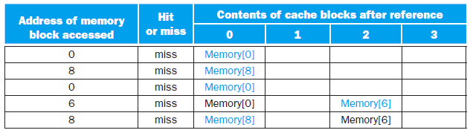
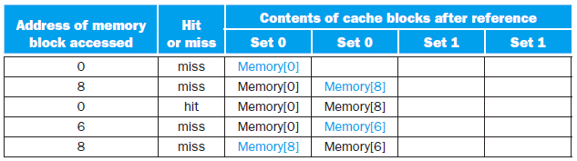
Reducing cache misses by more flexible placement of blocks (Cont.)
Example: misses and associativity in caches
Problem
Three small cache, each consists of four one-word blocks
Direct mapped, two-way set associative, fully associative
Given a sequence of block addresses: 0, 8, 0, 6, 8
Find the number of misses for each cache organization
Solution
Direct-mapped: 5 misses
Two-way set associative: 4 misses
Using the least recently used (LRU) replacement rule

Slide 38
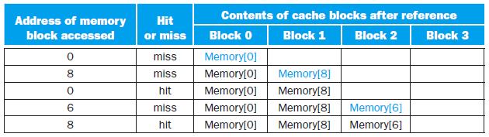
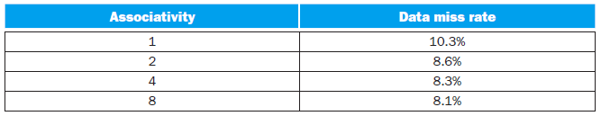
Reducing cache misses by more flexible placement of blocks (Cont.)
Example: misses and associativity in caches (Cont.)
Solution (Cont.)
Fully-associative: 3 misses
The best we can do
Reduction in the miss rate vs. associativity
64 KB data cache, 16-word block
One-way to two-way associativity: 15% decreasing
Little further improvement in going to higher associativity
Fig. 5.16 The data cache miss rates for an organization like the Intrinsity FastMATH processor for SPEC2000 benchmarks with associativity varying from one-way to eight-way.

Slide 39
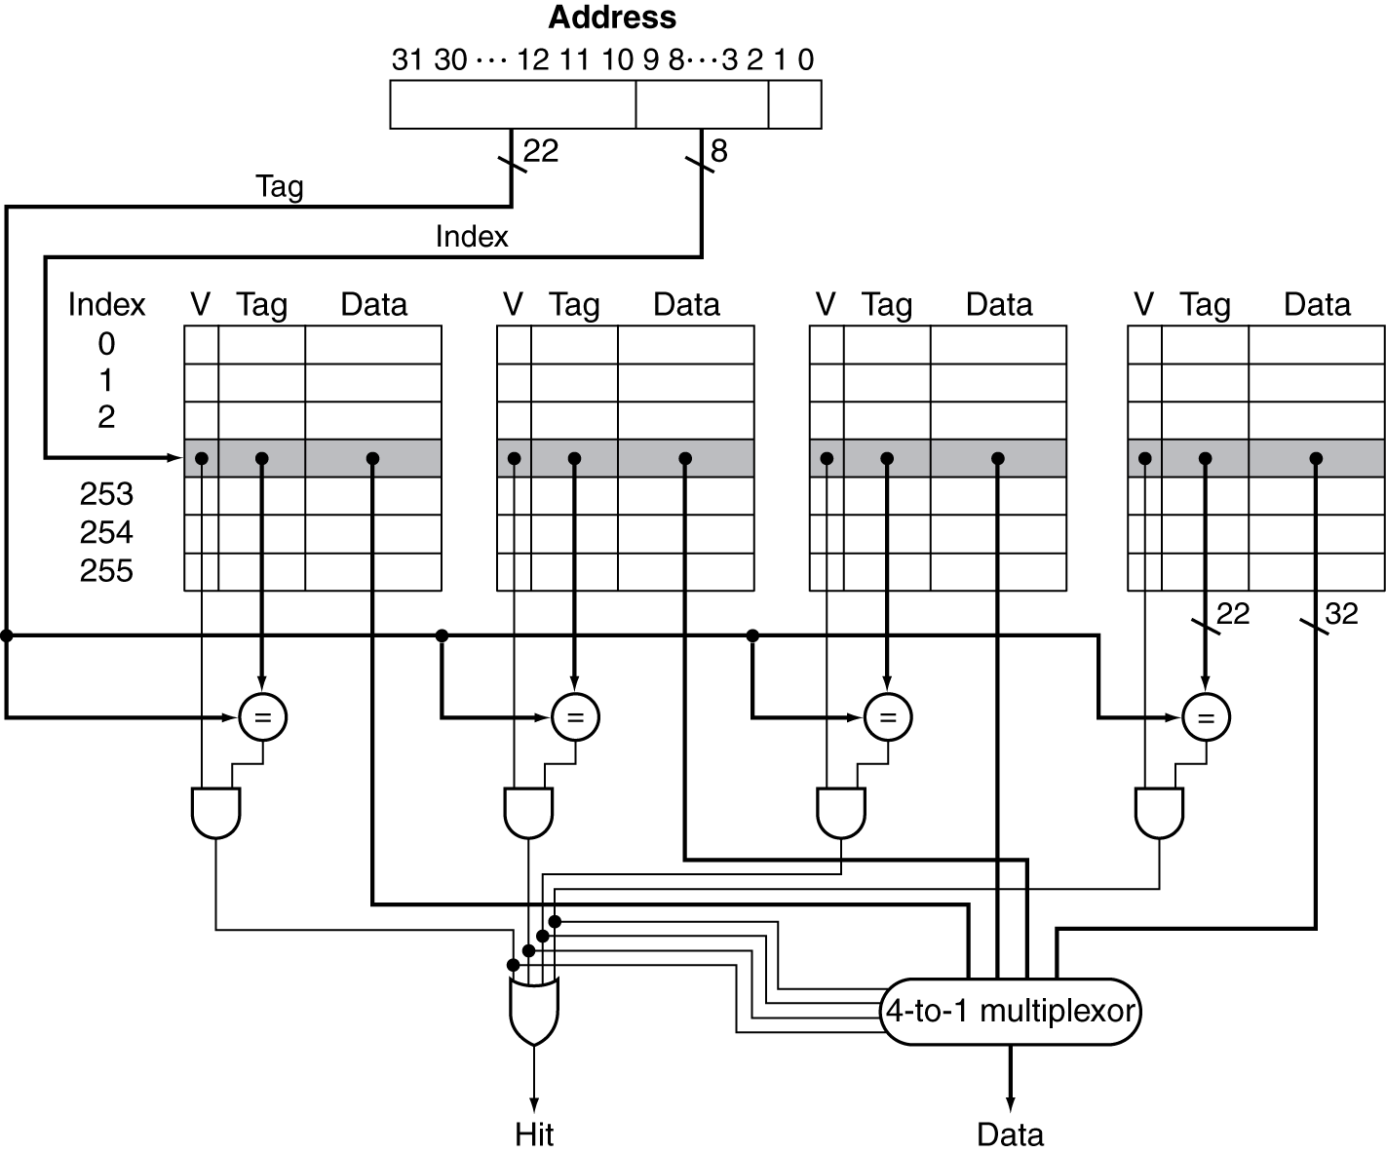
Locating a block in the cache
Address decomposition
Index: used to select the set containing the address of interest (n bits)
Tag: all the tags in the selected set are searched in parallel
Block offset: block offset (m bit) + byte offset (2 bits)
Costs of an associative cache
Extra comparators and n-to-1 multiplier
Any delay imposed by having to do the compare and select from among the elements of the set
Fig. 5.17 The three portions of an address in a set-associative or direct-mapped cache.
Fig. 5.18 The implementation of a four-way set-associative cache requires four comparators and a 4-to-1 multiplexor.

Slide 40
Locating a block in the cache (Cont.)
The choice among three placement schemes
Depending on the cost of a miss versus the cost of implementing associativity
Both in time and in extra hardware
Example: size of tags versus set associativity
Problem
A cache of 4096 blocks, 4-word block size, 32-bit address
Find the total number of sets and the total number of tag bits for caches that are direct mapped, two-way set associative, four-way set associative, and full associative
Solutions
32-bit address: 4 bits for block offset, 28 bits for index and tag
Direct mapped
4096 sets Index: log₂(4096) = 12 bits Tag: (28 – 12) × 4096 ≈ 66 K bits
Two-way set associative
2048 sets Index: log₂(2048) = 11 bits Tag: (28 – 11) × 2 × 2048 ≈ 70 K bits
Four-way set associative
1024 sets Index: log₂(1024) = 10 bits Tag: (28 – 10) × 4 × 1024 ≈ 74 K bits
Fully associative
1 sets Index: log₂(1) = 0 bits Tag: (28 – 0) × 4096 × 1 ≈ 115 K bits

Slide 41
Choosing which block to replace
To choose a block among the blocks in the selected set to replace
Least recently used (LRU)
The block replaced is the one that has been unused for the longest time
Implemented by keeping track of when each element in a set was used relative to the other elements in the set
As associativity increases, implementing LRU gets harder
Reducing the miss penalty using multilevel caches
Multilevel cache
A memory hierarchy with multiple levels of caches
To close the gap further between the fast clock rates of modern processors and the increasingly long time required to access DRAMs
Using a second-level cache
Normally on the same chip as the processor and primary cache
To be accessed when a miss occurs in the primary cache
The access time is much less than the access time of main memory
If neither the primary nor secondary cache contains the data, a main memory access is required and incurred a larger miss penalty

Slide 42
Reducing the miss penalty using multilevel caches (Cont.)
Example: performance of multilevel caches
Problem
A processor with a base CPI of 1.0 and a clock rate of 4 GHz
Main memory access time: 100 ns Secondary cache access time: 5 ns
Miss rate per instruction at the primary cache: 2%
After adding a secondary cache, the miss rate to main memory is 0.5%
How much faster will the processor with and without a secondary cache?
Solution 1
Miss penalty to main memory: 100 ns ⇒ 400 clock cycles
Miss penalty to secondary cache: 5 ns ⇒ 20 clock cycles
For the processor with one level of caching
Total CPI = Base CPI + Memory-stall cycles per instruction
Total CPI = 1.0 + 2% × 400 = 9
For the processor with two level of caching
Total CPI = Base CPI + Primary stalls per instruction + Secondary stalls per instruction
Total CPI = 1 + 2% × 20 + 0.5% × 400 = 3.4
Relative performance: 9/3.4 = 2.6
Solution 2
For the processor with two level of caching
Total CPI = 1 + (2% – 0.5%) × 20 + 0.5% × (20 + 400) = 3.4

Slide 43
Reducing the miss penalty using multilevel caches (Cont.)
Design considerations for a primary and secondary cache
Primary cache
To focus on minimizing hit time to yield a shorter clock cycle or fewer pipeline stages
Smaller cache size, higher miss rate
Smaller block size to reduce the miss penalty
Secondary cache
To focus on miss rate to reduce the penalty of long memory access times
Larger cache size, the access time is less critical
Larger block size
Higher associativity to reduce miss rates
Elaboration
Global miss rate
The fraction of references that miss in all levels of a multilevel cache
Local miss rate
The fraction of references to one level of a cache that miss; used in multilevel hierarchies

Slide 44
Dependable Memory Hierarchy
Defining failure
Dependability
A system alternating between two states
Service accomplishment, where the service is delivered as specified
Service interruption, where the delivered service is different from the specified service
Failure: service accomplishment → service interruption
Restoration: service interruption → service accomplishment
Failures can be permanent or intermittent
Intermittent failures are harder to diagnose the problem when a system oscillates between above two states
Permanent failures are far easier to diagnose
Reliability
Mean time to failure (MTTF)
A measure of the continuous service accomplishment from a reference point
When MTTF gets large it can be misleading

Slide 45
Defining failure (Cont.)
Reliability (Cont.)
Annual failure rate (AFR)
The percentage of devices that would be expected to fail in a year for a given MTTF
AFR leads to better intuition
Example: MTTF vs. AFR
Problem
Disks are quoted to have a 1,000,000-hour MTTF (≈ 114 years)
50,000 servers, each server has 2 disks
Use AFR to calculate how many disks we would expect to fail per year
Solution
One year is 365 × 24 = 8760 hours
1,000,000-hour MTTF ⇒ AFR = 8760/1,000,000 = 0.876%
With 100,000 disks, we expect 876 disks to fail per year (2 disk failures per day)
Mean time to repair (MTTR): the time of service interruption
Mean time between failures (MTBF): MTBF = MTTF + MTTR
Availability
A measure of service accomplishment with respect to the alternation between the two states of accomplishment and interruption
Availability = MTTF / (MTTF + MTTR)

Slide 46
Defining failure (Cont.)
Dependability vs. Reliability vs. Availability
Dependability is just synonyms
Reliability and availability are actually quantifiable measures
Shrinking MTTR can help availability as much as increasing MTTF
Tools for fault detection, diagnosis, and repair help reduce the time to repair faults
The number of nines of availability per year
Definition
One nine: 90% ⇒ 36.5 days of repair/year
Two nines: 99% ⇒ 3.65 days of repair/year
Three nines: 99.9% ⇒ 526 minutes of repair/year
Four nines: 99.99% ⇒ 52.6 minutes of repair/year
Five nines: 99.999% ⇒ 5.26 minutes of repair/year
Example:
A very good Internet service today offers 4 or 5 nines of availability
Failure vs. Fault
Failure needs to be defined with respect to a context
Failure of a component may not lead to a failure of the system
Fault: failure of a component

Slide 47
Defining failure (Cont.)
Three ways to improve MTTF
Fault avoidance
Preventing fault occurrence by construction
Fault tolerance
Using redundancy to allow the service to comply with the service specification despite faults occurring
Fault forecasting
Predicting the presence and creation of faults, allowing the component to be replaced before it fails
The Hamming Single Error Correcting, Double Error Detecting Code (SEC/DED)
Self-study

Slide 48
Virtual Memory
Preliminary
Virtual memory
A technique that uses main memory as a cache for secondary storage
Two major motivations for virtual memory
To allow efficient and safe sharing of memory among multiple programs
Such as for the memory needed by multiple virtual machines for cloud computing
To remove the programming burdens of a small, limited amount of main memory
The first motivation
Consider multiple virtual machines running at once on a computer
The total required memory size may be much larger than the available size
Main memory need contain only the active portions of the many virtual machines
Only a fraction of total required memory is actively being used at any point in time
Must be able to protect the virtual machines from each other
To ensure that a program can only access the portions of main memory that have been assigned to it

Slide 49
Preliminary (Cont.)
The first motivation (Cont.)
The virtual machines sharing the memory change dynamically while the virtual machines are running
To compile each program into its own address space
Virtual memory implements the translation of a program’s address space to physical addresses
The translation process enforces protection of a program’s address space from other virtual machine
The second motivation
If a program became too large for memory, it was up to the programmer to make it fit
Programmers divided programs into mutually exclusive pieces
Overlays were loaded or unloaded under user program control during execution
The program never tried to access an unloaded overlay
The overlays loaded never exceeded the total size of the memory
Overlays were traditionally organized as modules, each containing both code and data
Virtual memory automatically manages the main memory (physical memory) and secondary storage

Slide 50
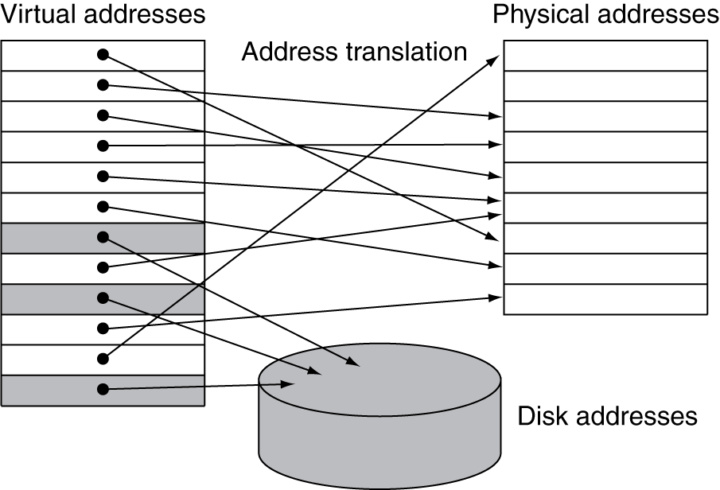
The structure of virtual memory
Terminologies in virtual memory system
Page: a virtual memory block
Page fault: a virtual memory miss
Virtual address
An address that corresponds to a location in virtual space
To be translated by address mapping to a physical address when memory is accessed
Address translation (address mapping)
The process by which a virtual address is mapped to an address used to access memory
Fig. 5.25 In virtual memory, blocks of memory are mapped from one set of addresses to another set.

Slide 51
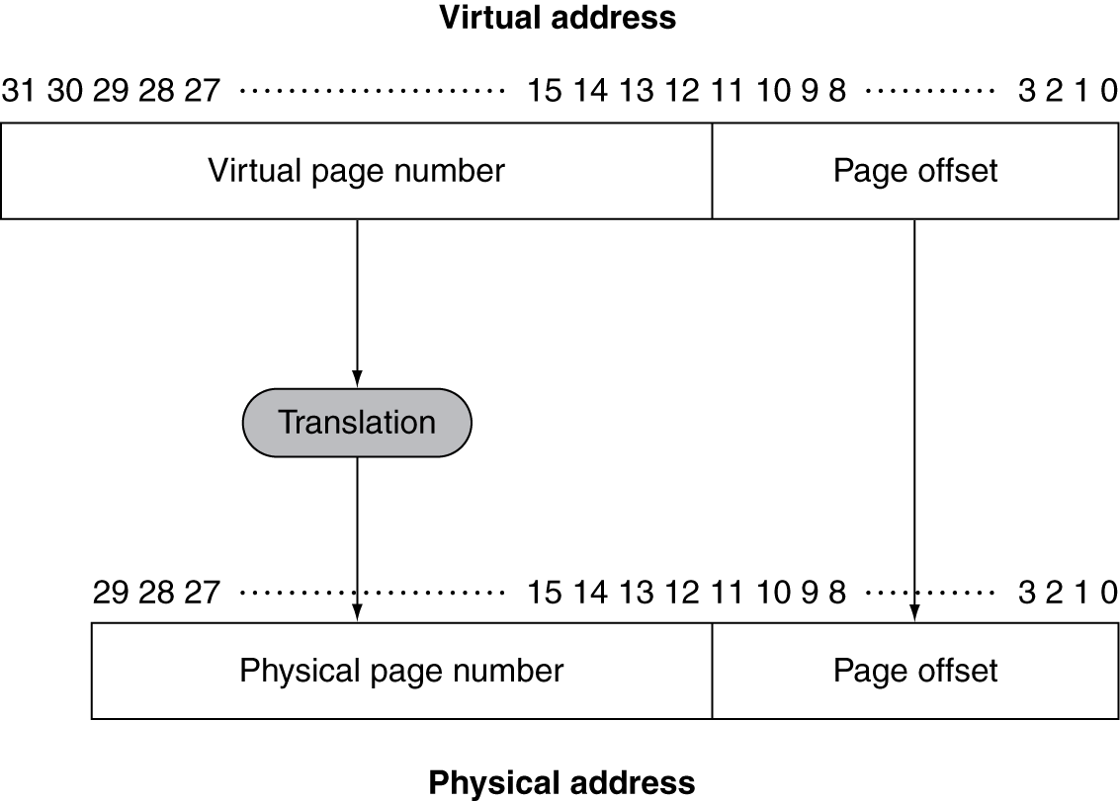
The structure of virtual memory (Cont.)
Relocation
To map the virtual addresses to different physical addresses before the addresses are used to access memory
Program can be loaded to anywhere in main memory
All virtual memory systems relocate the program as a set of pages
To eliminate the need to find a contiguous block of memory to allocate a program
The operating system only need to find a sufficient number of pages in main memory
Virtual address format
Page offset
Not changed during address translation
To determine the page size
Virtual page number
To be translate to physical page number during
address translation
The number of pages addressable with the virtual
addresses need not match those of addressable
with the physical addresses
The number of virtual pages is larger
Fig. 5.26 Mapping from a virtual to a physical address.

Slide 52
The structure of virtual memory (Cont.)
A page fault will take millions of clock cycles to process
Dominated by the time to get the first word for typical page sizes
Key decisions in designing virtual memory systems
Pages should be large enough to amortize the high access time
Typical size: 4 KB ~ 16 KB
New desktop and server system: to support 32 KB and 64 KB
New embedded system: 1 KB
Organizations that reduce the page fault rate are attractive
To allow fully associative placement
Page faults can be handled in software
The overhead will be small compared to the disk access time
To use clever algorithms for choosing how to place pages
Write-through will not work for virtual memory
Writes take too long
Virtual memory system uses write-back

Slide 53
Placing a page and finding it again
Using fully associative placement of pages
To reduce page fault frequency
To use a clever and flexible replacement scheme
To use a sophisticated algorithm and complex data structure to track page usage
To try to choose a page that will not be needed for a long time
Page table
The table containing the virtual to physical address translations
Resided in memory, to avoid a full search of memory
Indexed with the page number from the virtual address to discover the corresponding physical page number
Each program has its own page table
Different programs use the same virtual addresses
The page table may contain entries for pages not present in memory
A valid bit is used in each page table entry
No tags are required
The page table contains a mapping for every possible virtual page
Page table register
A register that points to the start of the page table

Slide 54
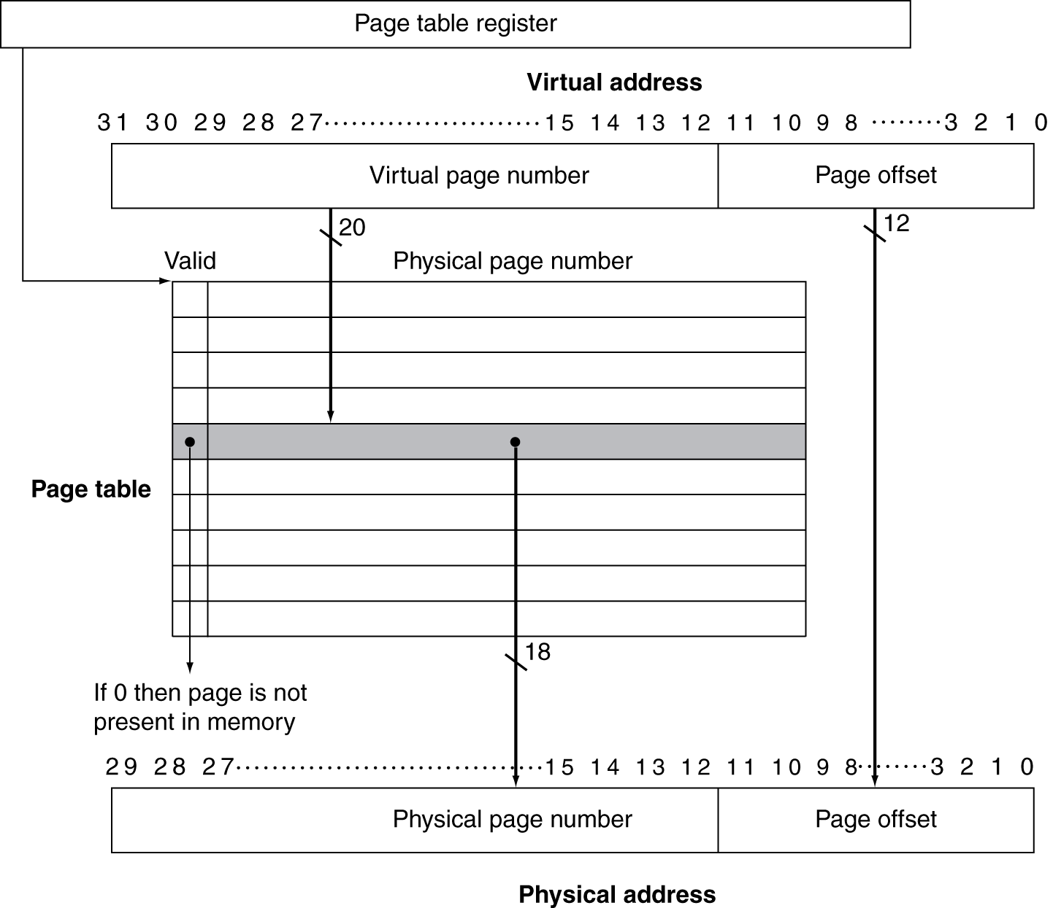
Fig. 5.27 The page table is indexed with the virtual page number to obtain the corresponding portion of the physical address.

Slide 55
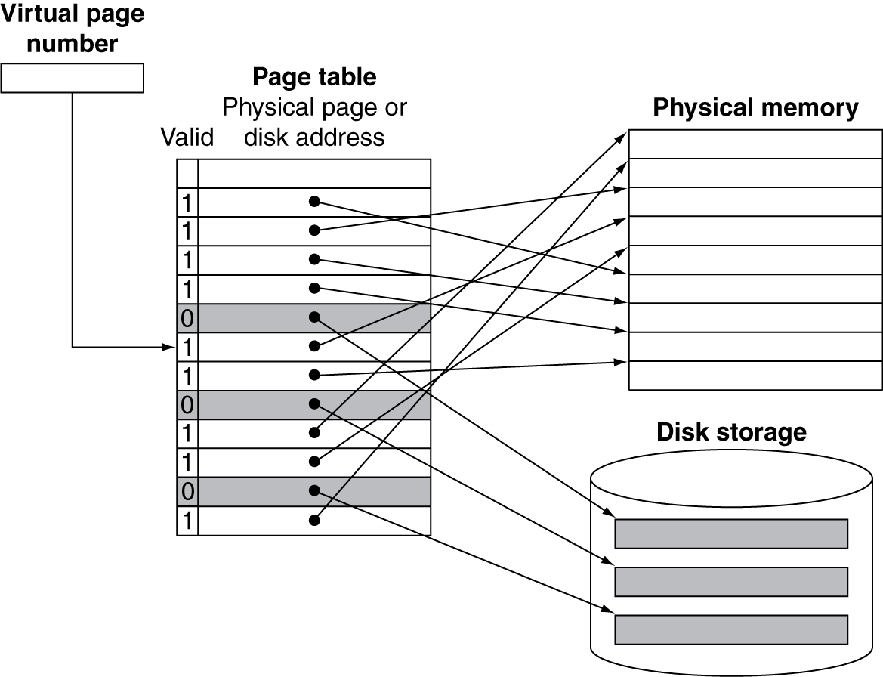
Page faults
A page fault occurs if the valid bit for a virtual page is off
The operating system gets control, done with the exception mechanism
To find the page in the next level of the hierarchy and decide where to place the requested page
When a process is created, the operating system creates
A swap space on flash memory or disk
The space reserved for the full virtual memory space of a process
A data structure to record where each virtual page is stored on disk
Part of the page table
An auxiliary data structure indexed in the same way as the page table
Fig. 5.28 The page table maps each page in virtual memory to either a page in main memory or a page stored on disk, which is the next level in the hierarchy.

Slide 56
Page faults (Cont.)
The operating system tracks which processes and which virtual addresses use each physical page
When a page fault occurs and all pages in memory are in use
Usually follow the least recently used (LRU) replacement scheme
The replaced pages are written to swap space on the disk
Approximate LRU replacement scheme
To keep track which pages have and which pages have not been recently used
Use bit (reference bit)
To be set whenever a page is accessed
The operating system periodically clears the reference bits
To determine which pages were touched during a particular time period
The operating system will replace a page which reference bit is off
What about writes?
Virtual memory must use write-back scheme
Dirty bit
A dirty bit is associated with each page in the page table
To be set if any word in a page is written
To indicate whether the page needs to be written out when it is replaced

Slide 57
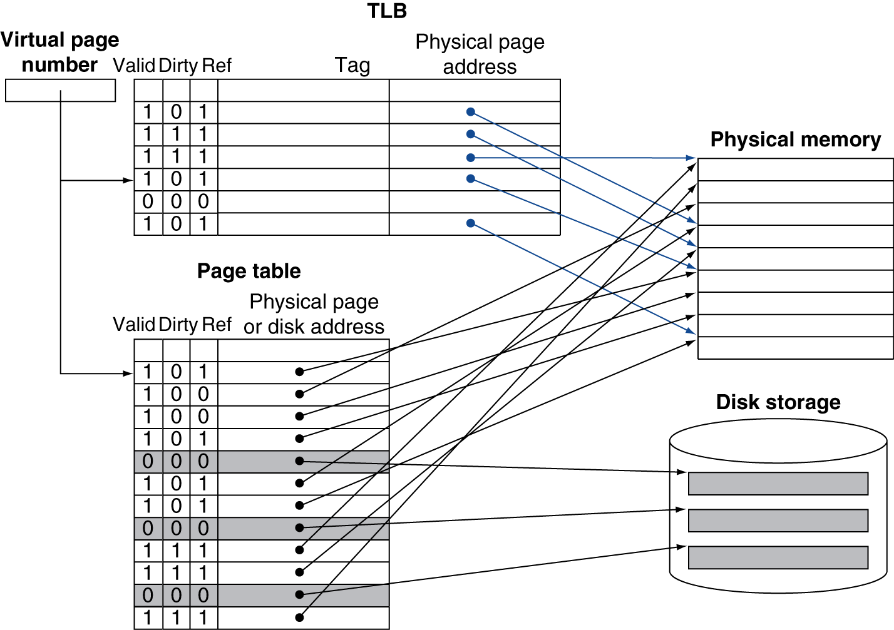
Making address translation fast: the TLB
Every memory access by a program can take at least twice as long
One memory access to the page table to obtain the physical address
A second access to get the data
Translation lookaside buffer (TLB)
A special cache that keeps track of recently used translations
Tag entry: virtual page number Data entry: physical page number
Valid bit, dirty bit, reference bit
Fig. 5.29 The TLB acts as a cache on the page table for the entries that map to physical pages only.

Slide 58
Making address translation fast: the TLB (Cont.)
On every reference, we access the TLB instead of the page table
To look up the virtual page number in the TLB
TLB hit
The physical page number is used to form the address
The corresponding reference bit is turned on
The dirty bit is turned on if the processor is performing a write
TLB miss
Merely TLB miss
The page exists in memory, only the translation is missing in the TLB
To load the translation from the page table and replace an TLB entry
To copy the reference and dirty bits back to the page table entry when a TLB entry is replaced (write-back scheme)
True page fault
The page is not present in memory
To invoke the operating system using an exception
Merely TLB miss will be much more frequent than true page faults
The TLB miss rate is expected to very small
TLB misses can be handled either in hardware or in software
With care there can be little performance between the two approaches

Slide 59
Making address translation fast: the TLB (Cont.)
Typical values for a TLB
TLB size: 16 ~ 512 entries
Block size: 1 ~ 2 page table entries (typically 4~8 bytes each)
Hit time: 0.5 ~ 1 clock cycle
Miss penalty: 10 ~ 100 clock cycles Miss rate: 0.01% ~ 1%
Associativities in TLBs
Small and fully associative TLBs
Lower miss rate
Since the TLB is small, the cost of a fully associativity mapping is not too high
Choosing the entry to replaced becomes tricky since implementing a hardware LRU scheme is too expensive
Randomly choosing an entry to replace
Larger TLBs with small associativity
Example: the Intrinsity FastMATH TLB
4 KB pages, 32-bit address space ⇒ The virtual page number is 20 bits long
The physical address is the same size as the virtual address
The TLB contains 16 entries, fully associative
Each TLB entry is 64 bits wide (bookkeeping bits)

Slide 60
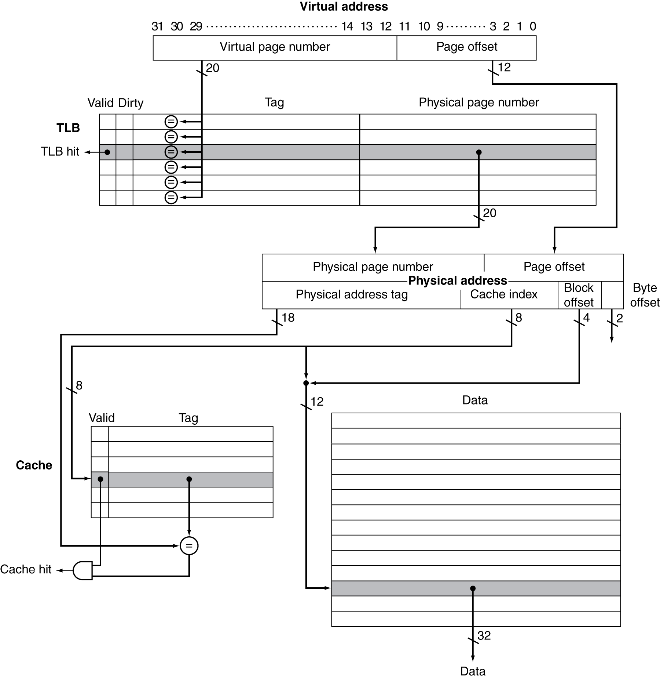
Fig. 5.30 The TLB and cache implement the process of going from a virtual address to a data item in the Intrinsity FastMATH.

Slide 61
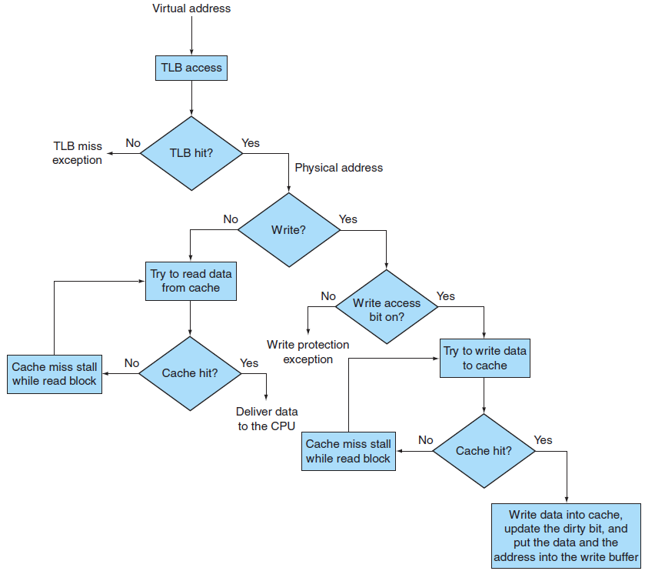
Fig. 5.31 Processing a read or a write through in the Intrinsity FastMATH TLB and cache.

Slide 62
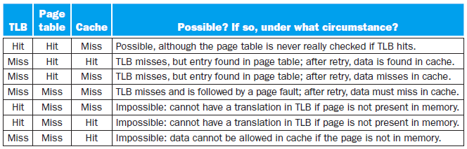
Integrating virtual memory, TLBs, and caches
Data cannot be in the cache unless it is present in main memory
The operating system helps maintain the memory hierarchy
To flush the contents of any page from the cache when it decides to migrate that page to disk
To modify the page tables and TLB
To generate a page fault when the processor tries to access any data on the migrated page
Example: overall operation of a memory hierarchy
In a memory hierarchy includes a TLB and a cache
Three different types of misses: TLB miss, page fault, cache miss
Consider all the combinations of these three events with one or more occurring
State whether this event can actually occur and under what circumstances
Fig. 5.32 The possible combinations of events in the TLB, virtual memory system, and cache.

Slide 63
Implementing protection with virtual memory
To allow sharing of a single main memory by multiple processes and provide memory protection among these processes and the operating system
To ensure one renegade process cannot write into the address space of another user process or into the operating system
The write access bit in the TLB can protect a page from being write
Basic capabilities must be provided by the operating system
At least two modes
User mode: the running process is a user process
Kernel (supervisor) mode: the running process is an operating system process
A portion of the processor state that a user process can read but not write
Including the user/supervisor mode bit, the page table pointer, and the TLB
The operating system uses special instructions that are only available in supervisor mode to write these element
Alternating between user and supervisor modes
User mode → supervisor mode
Using a special system call instruction
The PC from the point of the system call is saved in the EPC
Supervisor mode → user mode
Using the return from exception (ERET) instruction

Slide 64
Implementing protection with virtual memory (Cont.)
To prevent a process from reading the data of another process
Each process has it own virtual address space
The operating system keeps the page tables organized and let the independent virtual pages map to disjoint physical pages
One process will not be able to access another’s data
To place the page tables in the protected address space
The operating system can assure safety if it prevents the user process from modifying its own page table
The operating system must be able to modify the page tables
When processes want to share information in a limited way
The operating system must assist them
It requires changing the page table
The write access bit can be used to restrict the sharing to just read sharing
To allow process P1 to read a page owned by process P2
P2 would ask the operating system to let a virtual page in P1’s address space point to the same physical page that P2 wants to share
The write protection bit can be used to prevent P1 from writing the data
Any bits that determine the access rights must be included in both the page table and the TLB

Slide 65
Handling TLB misses and page faults
Two possibilities of TLB miss
Merely TLB miss
The page is present in memory
Only need to create the missing TLB entry
Page fault
The page is not present in memory
Need to transfer control to the operating system
MIPS traditionally handles a TLB miss in software
To bring in the page table entry from memory and re-execute the instruction
To generate a page fault exception if necessary
Using the exception mechanism to handle a TLB miss
To interrupt the active process → to transfer control to the OS → to resume execution of the interrupted process
PC of the instruction caused the TLB miss must be saved in the EPC
The exception must be asserted by the end of the same clock cycle that the memory access occurs
A page fault will be recognized during the clock cycle used to access memory
The next clock cycle will begin exception processing

Slide 66
Handling TLB misses and page faults (Cont.)
Once the operating system knows the virtual address that caused the page fault (for instruction access)
Find the location of the referenced page on disk
Using the virtual address to look up the page table entry
Choose a physical page to replace
If the chosen page is dirty, it must be written out to disk
Start a read to bring the referenced page from disk into the chosen physical page
It may take millions of processor clock cycle
The operating system will usually select another process to execute until the disk access completes
Re-execute the instruction that faulted
Restore the PC and state of the process that caused the page fault
Reset the processor from kernel to user mode
Access the requested page successfully and continue execution
Page fault exceptions for data accesses are difficult to implement
They occur in the middle of instructions
The instruction cannot be completed before handling the exception
The instruction must be restarted after handling the exception

Slide 67
Handling TLB misses and page faults (Cont.)
Making instructions restartable
The exception can be handled and the instruction later continued
For an architecture like the MIPS: easy
Each instruction writes only one data item and this write occurs at the end of the instruction cycle
Simply prevents the instruction from completing and restarts the instruction at the beginning
For processors with complex instructions: hard
Each instruction my touch many memory locations and write many data items
⇒ To generate a number of page faults
Instruction often cannot be restarted from the beginning
⇒ To interrupt and later continue midstream in its execution
To resume an instruction in the middle of its execution, it requires saving some special state during the execution
Careful and detailed coordination between the exception-handling code in the operating system and the hardware
Example: how MIPS architecture works when a TLB miss occurs

Slide 68
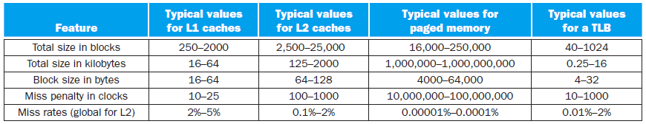
Handling TLB misses and page faults (Cont.)
If page faults occur too frequently
A program routinely accesses more virtual memory than it has physical memory
Thrashing
A program continuously swaps pages between memory and disk
The program will run very slowly
Solutions
Using a computer with more memory
To reexamine the algorithm and data structure to change the locality
Fig. 5.35 The key quantitative design parameters that characterize the major elements of memory hierarchy in a computer.

Slide 69
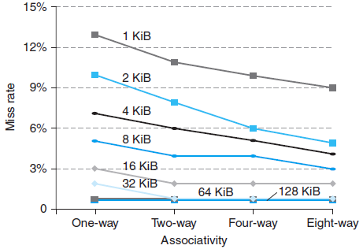
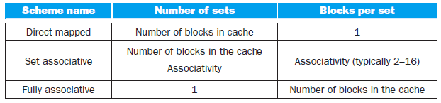
A Common Framework for Memory Hierarchies
Question 1: Where can a block be placed?
Direct mapped, set associative, fully associative
The advantage of higher degree of associativity: the lower miss rate
Reducing misses that compete for the same location
The largest gains are obtained in going from one-way to two-way associative
As cache sizes grow, the relative improvement increases only slightly
The potential disadvantages of associativity
Increased cost, slower access time
Fig. 5.30 The data cache miss rates for each of eight cache sizes improve as the associativity increases.

Slide 70
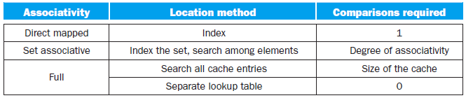
Question 2: How is a block found?
The choice among three block placement schemes
Depending on the cost of a miss versus the cost of implementing associativity
Both in time and in extra hardware
Including the L2 cache on the chip enables much higher associativity
The hit times are not as critical
Fully associative caches are prohibitive except for small sizes
The cost of the comparators is not overwhelming
The absolute miss rate improvements are greatest
Four location methods
Indexing: used in direct-mapped cache
A few systems have used it because of their advantages in access time and simplicity
Finding the requested block does not depend on a comparison
Fully search: used in fully-associative cache

Slide 71
Question 2: How is a block found? (Cont.)
Four location methods (Cont.)
Limited search: used in set-associative cache
Often used for caches and TLB
The access combines indexing and the search of a small set
A separate lookup table
Example: page table for the virtual memory system
Extra storage and extra memory access is required
The motivation for choosing fully-associative placement and the extra table
Fully associativity is beneficial since misses are very expensive
Fully associativity allows the software to use sophisticated replacement schemes that are designed to reduce the miss rate
The full map can be easily indexed with no extra hardware and no searching required
The large page size means the page table size is relatively small
Question 3: Which block should be replaced on a cache miss?
Number of candidates
In a fully associativity cache, all blocks are candidates for replacement
In a set-associative cache, candidates are chosen among the blocks in the set
In a direct-mapped cache, there is only one candidate

Slide 72
Question 3: Which block should be replaced on a cache miss? (Cont.)
Primary replacement strategies in set-associative or fully associative caches
Random
Candidate blocks are randomly selected
Simple to build in hardware
Least recently used (LRU)
To replace the block that has been unused for the longest time
Too costly to implement for caches with more than a small degree of associativity
Approximated LRU
Used for four-way or larger set-associativity cache
Tracking which set is LRU, and which block in each set is LRU
Random replacement can sometimes be better than the simple LRU approximations
For larger associativity, either approximated LRU or random replacement can be used
As the cache become larger
The miss rate for both replacement strategies falls
The absolute difference becomes small

Slide 73
Question 3: Which block should be replaced on a cache miss? (Cont.)
In virtual memory
A tiny reduction in the miss rate can be important
Approximated LRU implemented in software is acceptable
Misses are so expensive and relatively infrequent
Question 4: What happens on a write?
Write-through vs. Write-back
Only write-back policy is practical in virtual memory systems
Today lowest-level caches typically use write-back
Advantages of both policies
Write-through
Misses are simpler and cheaper
Easier to implement although a write buffer is required
Write-back
Individual words can be written at the rate that the cache can accept them
Multiple writes within a block require only one write to the lower level in the hierarchy
To make effective use of a high-bandwidth transfer since the entire block is written

Slide 74
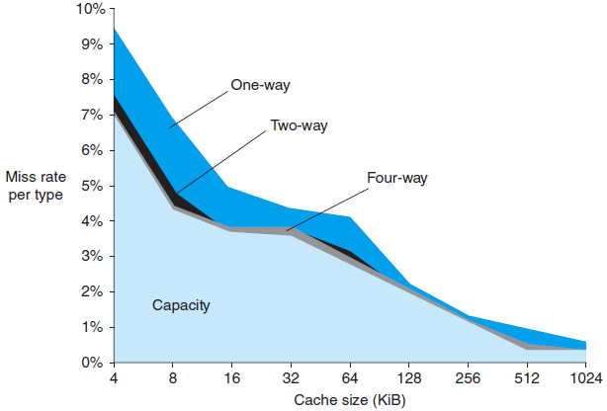
The three Cs: An intuitive model for understanding the behavior of memory hierarchies
Three Cs model
A qualitative cache model in which all cache misses are classified into one of three categories
Compulsory misses (cold-start misses)
Caused by the first access to a block that has never been in the cache
Capacity misses
Caused when the cache cannot contain all the blocks needed during execution
To occur when blocks are replaced and then later retrieved
Conflict misses (collision misses)
Occur in set-associative or direct-mapped caches when multiple blocks compete for the same set
Can be eliminated in a fully associative
cache of the same size
Fig. 5.37 The miss rate can be broken into three sources of misses.

Slide 75
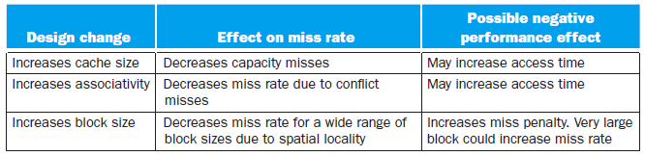
The three Cs: An intuitive model for understanding the behavior of memory hierarchies (Cont.)
Methods to attack three categories of misses
Conflict misses
To increase associativity
May slow access time to lower overall performance
Capacity misses
To enlarge the cache
The increased access time could lead to lower overall performance
Second-level caches have been growing steadily larger for many years
First-level caches have been growing slowly, if at al
Compulsory misses
To increase the block size
Too large block will lead too high miss penalty
Fig. 5.32 Memory hierarchy design challenges.

Slide 76
Using a Finite-State Machine to Control a Simple Cache
A simple cache
Key characteristics of the cache
Direct-mapped
Write-back using write allocate
Block size: 4 words (16 bytes, 128 bits) Cache size: 16 KB (1024 blocks)
The cache includes a valid bit and dirty bit per block
Cache address
32-bit byte address
Signals between the processor, cache, and memory
Tag | Cache index | Block offset
18 bits | 10 bits | 4 bits
Read/Write
Read/Write
Valid
Valid
Address
32
Address
32
CPU
Data
32
Cache
Data
128
Memory
Data
32
Data
128
Ready
Ready

Slide 77
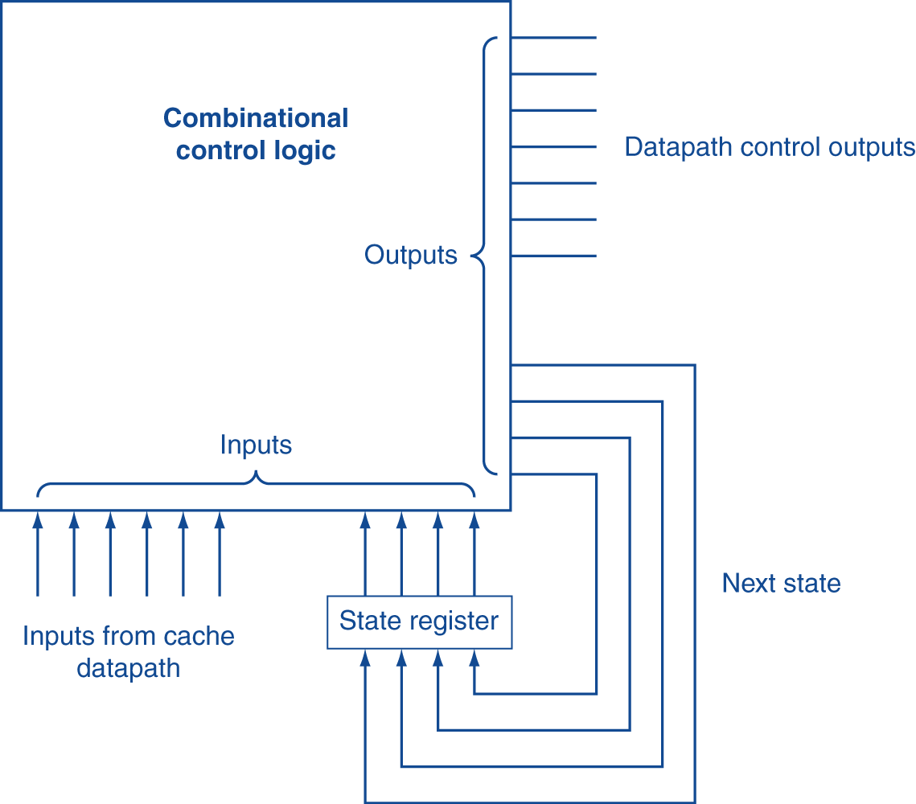
Finite-state machines
A sequential logic consists of
A set of states, inputs, and outputs
Next-state function
To map the current state and the inputs to a new state
Output function
To map the current state and possibly the inputs to a set of asserted outputs
The implementation
A temporary register holds the current state
A block of combinational logic determines both the datapath signals to be asserted and the next state
Fig. 5.39 Finite-state machine controllers are typically implemented using a block of combinational logic and a register to hold the current state.

Slide 78
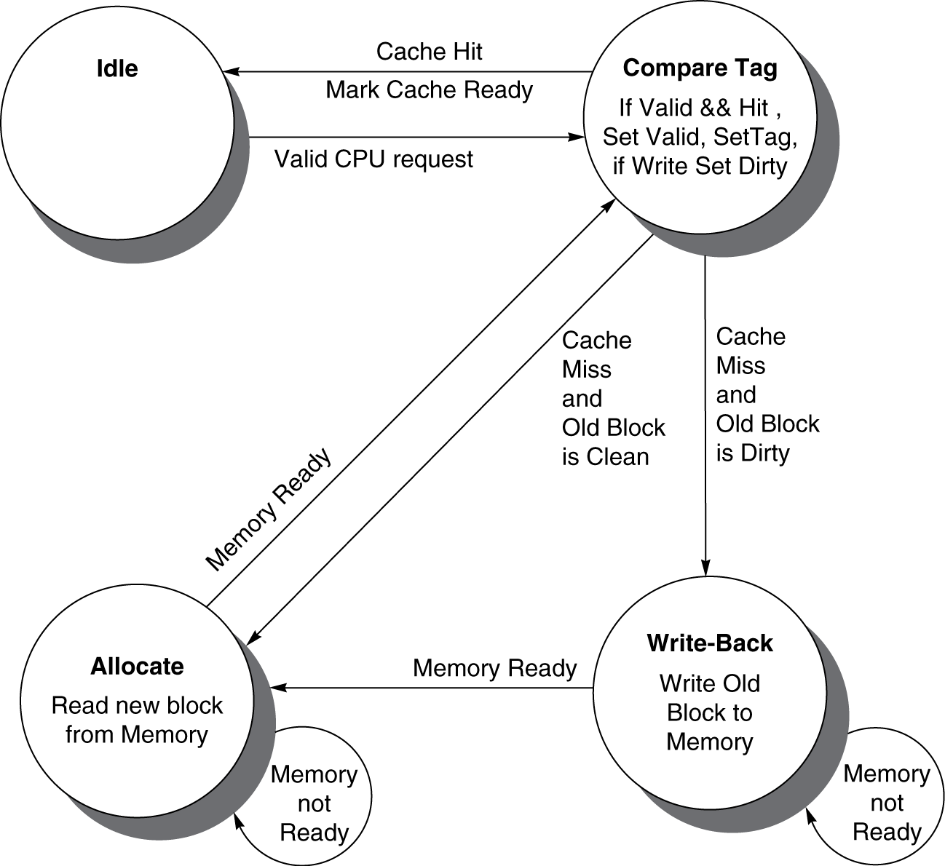
FSM for a simple cache controller
Fig. 5.40 Four states of the simple controller.

Slide 79
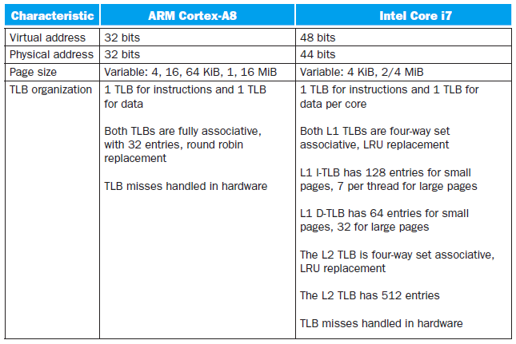
Real Stuff: The ARM Cortex-A8 and Intel Core i7 Memory Hierarchies
Fig. 5.43 Address translation and TLB hardware for the ARM Cortex-A8 and Intel Core i7 920.

Slide 80
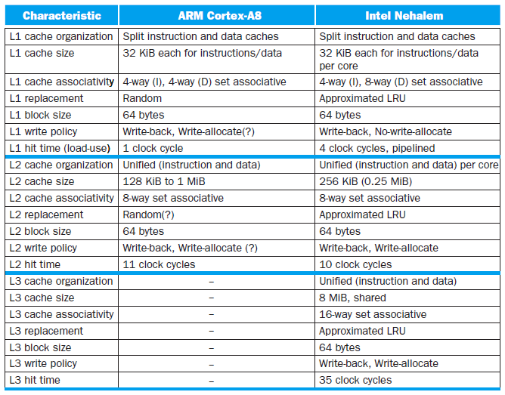
Fig. 5.44 Caches in the ARM Cortex-A8 and Intel Core i7 920.

Slide 81
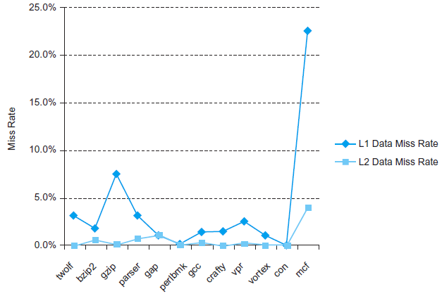
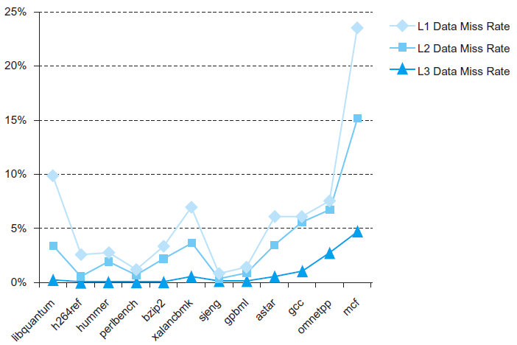
Fig. 5.45 Data cache miss rates for ARM Cortex-A8 when running Minnespec, a small version of SPEC2000.
Fig. 5.47 The L1, L2, and L3 data cache miss rates for the Intel Core i7 920 running the full integer SPECCPU2006 benchmarks.

Slide 82
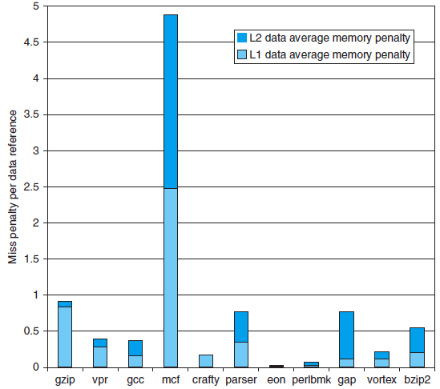
Fig. 5.46 The average memory access penalty in clock cycles per data memory reference coming from L1 and L2 is shown for the ARM processor when running Minnespec.

Slide 83

Fallacies and Pitfalls
Pitfalls
Forgetting to account for byte addressing or the cache block size in simulating a cache
To make sure to account for the effect of byte addressing and multiword blocks
Example: 32-byte direct-mapped cache, block size is 4 bytes
The byte address 36 maps into block 1
Byte address 36 is block address 9 and (9 mod 8) = 1
The word address 36 maps into block 4
(36 mod 8) = 4
Example: 256-byte direct-mapped cache, block size is 32 bytes
The byte address 300 maps into block 1
The number of blocks in the cache is (256/32) = 8
Byte address 300 is block address 9 and (9 mod 8) = 1

Slide 84
Pitfalls (Cont.)
Ignoring memory system behavior when writing programs or when generating code in a compiler
Equivalent fallacy
Programmers can ignore memory hierarchies in writing code
Example: matrix multiply, 500 × 500 double precision matrices
for (i = 0; i != 500; i = i + 1)
for (j = 0; j != 500; j = j + 1)
for (k = 0; k != 500; k = k + 1)
x [i][j] = x [i][j] + y [i][k] × z [k][j]
Using a MIPS CPU with a 1 MB 2nd cache, loop order k → j → i costs about half the execution time
Having less set associativity for a shared cache than the number of cores or threads sharing that cache
A parallel program running on 2^{n} processors or threads can easily allocate data structures to addresses that would map to the same set of a shared L2 cache
If the L2 cache is less than 2^{n}-way associative, it will occur performance bugs due to conflict misses in L2 cache

Slide 85
Pitfalls (Cont.)
Using average memory access time to evaluate the memory hierarchy of an out-of-order processor
When a processor stalls during a cache miss
Separately calculate the memory-stall time and the processor execution time
To evaluate the memory hierarchy independently using average memory access time
For an out-of-order processor
The processor continues to execute instructions and may even sustain more cache misses during a cache miss
The out-of-order processor must be simulated along with the memory hierarchy
Fallacies
Disk failure rates in the field match their specifications
Study 1
Almost 100,000 disks
Quoted MTTF 1,000,000 ~ 1,500,000 AFR 0.6% ~ 0.8%
In the field: 2% ~ 4%
Study 2
100,000 disks at Google with quoted AFR 1.5%
In the field: 1.7% in the 1st year, 8.6% in the 3rd year

Slide 86



Fallacies (Cont.)
Operating systems are the best place to schedule disk accesses
Higher-level disk interfaces offer logical block addresses to the hose operating system
An operating system can try to sort the logical block addresses into increasing order to help performance
The disk can reduce the rotational and seed latencies by rescheduling the logical block addresses
Only the disk knows the actual mapping of the logical addresses onto the physical geometry of sectors, tracks, and surfaces
Example
The original read sequence
The sequence after reordering by OS
Fig. 5.50 Example showing OS vs. disk schedule accesses, labeled host-ordered vs. drive-ordered.

