Slide 1


Week 1A: Course Information
CSIE 2136 Algorithm Design and Analysis, Fall 2015
http://www.csie.ntu.edu.tw/~ada/
Hsu-Chun Hsiao

Slide 2
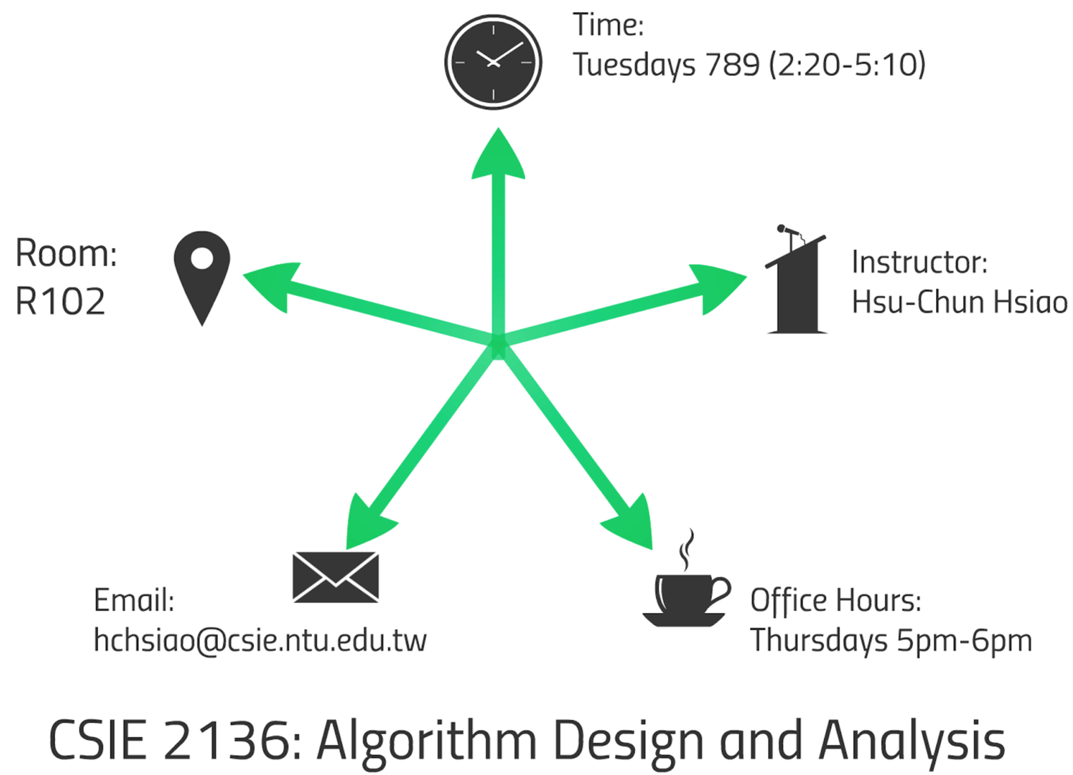
演算法設計與分析 (Algorithm Design and Analysis)

Slide 3
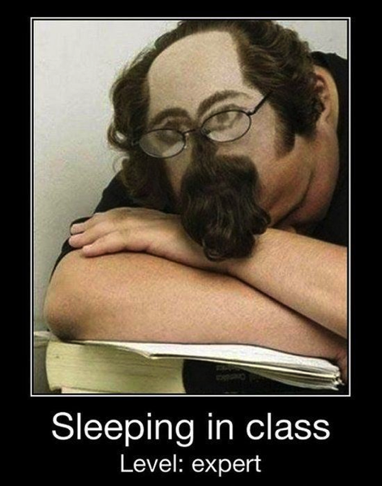
演算法設計與分析 (Algorithm Design and Analysis)
中文授課
投影片 English 為主，mix 中文 prevent 同學 from 睡著
大原則：不要打擾別人或影響老師上課

Slide 4
單班雙班有什麼不同？
相同點
助教
作業
大致相同
上課進度
課程網站
不同點
上課時間
原始成績計算方式
期中期末考試題目
蔡欣穆老師班會多學到軟體工程相關的課程
轉班、加簽OK

Slide 5

加簽原則
建議先修過資料結構和程式設計等課程
加簽順位
本系學生優先
大二 > 研究所應修 > 大四 > 大三 > 大一
電機資訊學院
其他外系同學
上限＝教室容量
今天先登記（姓名, 系級, 學號及E-mail）
名單確定後助教會寄送授權碼

Slide 6

課程網站
http://www.csie.ntu.edu.tw/~ada
課程大綱 (投影片裡有、網站上也會有）

Slide 7
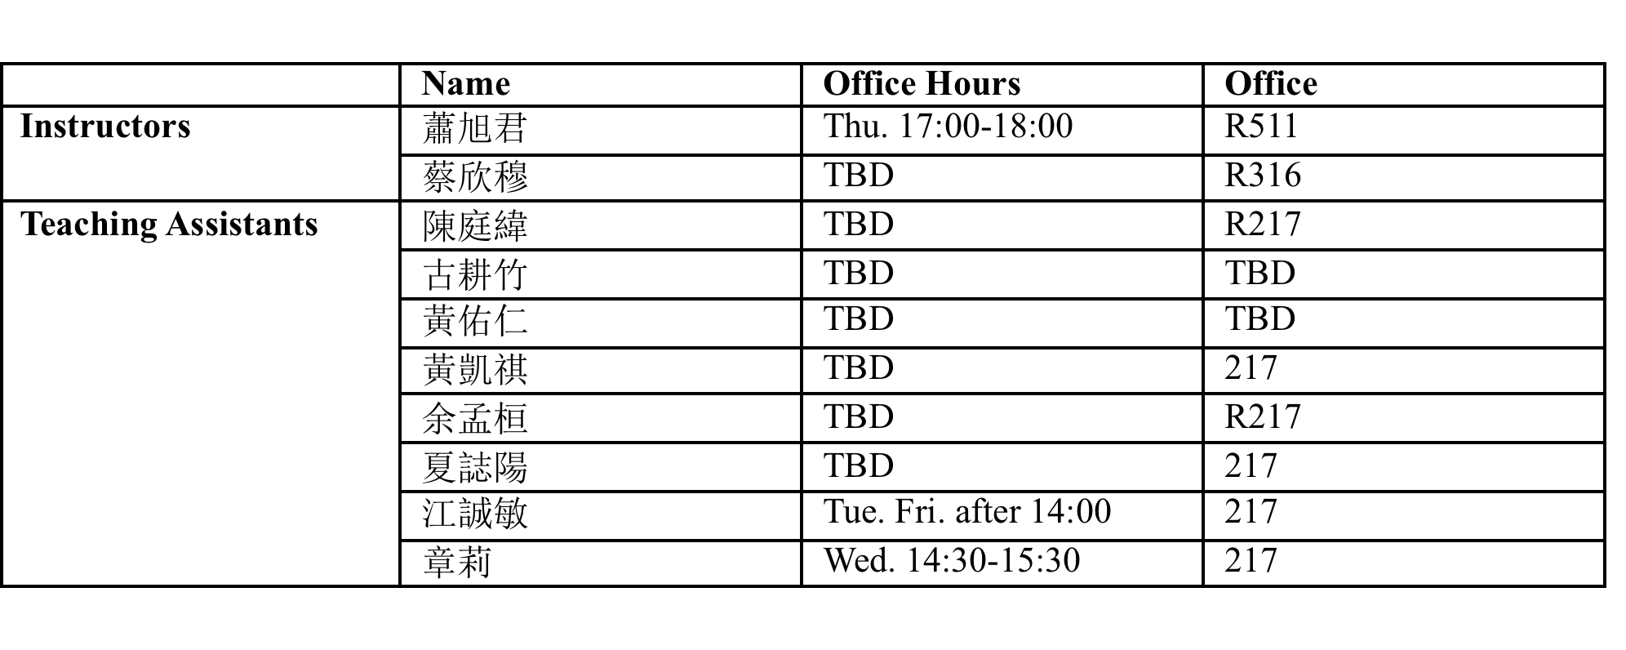
TAs and office hours
ada@csie.ntu.edu.tw
To ensure timely response, email title should contain “[ADA2015]”
Please don’t send to our personal emails
https://www.facebook.com/groups/tsai.dsa.ada/

Slide 8
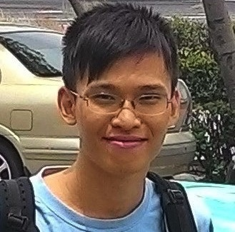
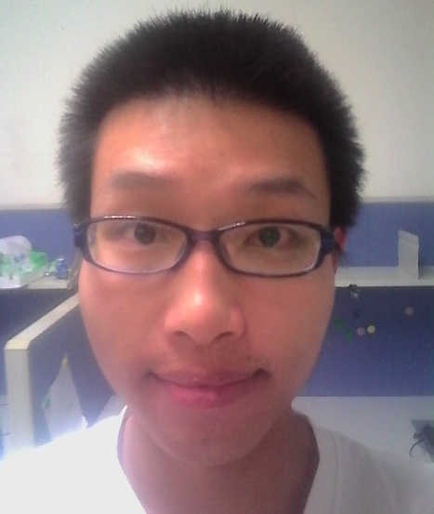
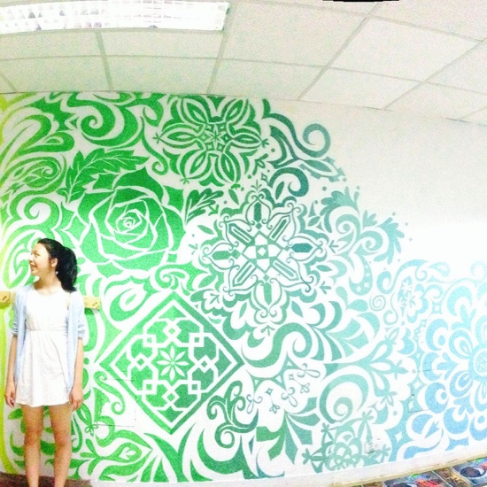

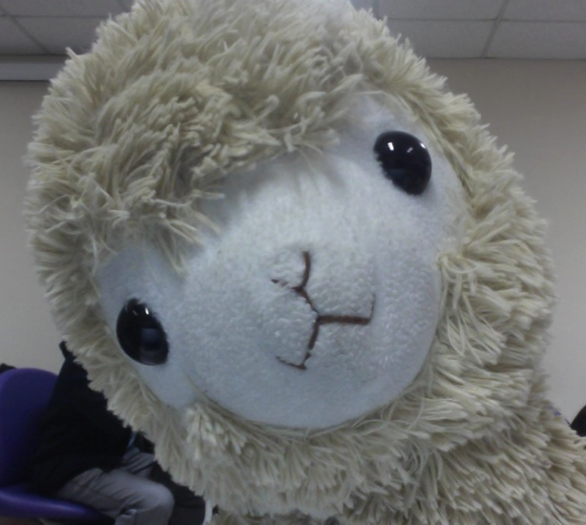

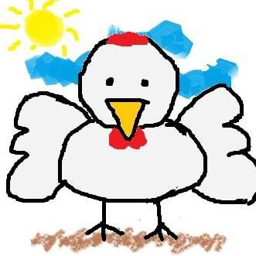
黃佑仁
古耕竹
章莉
夏誌陽
余孟桓
陳庭緯
江誠敏
黃凱祺
Notes:
我們非常強大的助教團

Slide 9
TAs and office hours
Want to ask questions outside office hours?
Preferred: Ask questions via emails or on Facebook
Send a meeting request to TAs
TAs are nice and helpful, but please kindly ask for TAs’ availability before visiting them outside office hours!
NEW: TA sessions coming soon

Slide 10
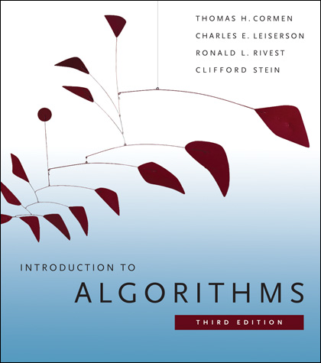
Textbook
Thomas H. Cormen, Charles E. Leiserson, Ronald L. Rivest and Clifford Stein. Introduction to Algorithms. 3rd edition, MIT Press, 2009

Slide 11
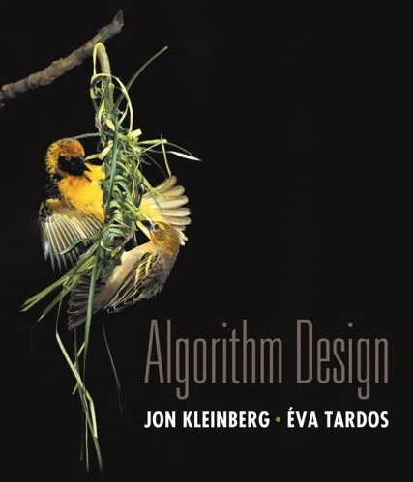
Optional readings
Jon Kleinberg and Éva Tardos. Algorithm Design. Addison Wesley, 2005.

Slide 12

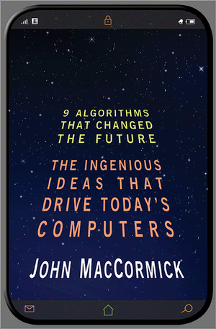
Bedtime readings
John MacCormick. Nine Algorithms That Changed the Future: The Ingenious Ideas That Drive Today's Computers. Princeton University Press, 2013.

Slide 13
改變世界的九大演算法 by John MacCormick
搜尋引擎的索引 Search Engine Indexing: Finding Needles in the World’s Biggest Haystack
網頁排序 PageRank: The Technology That Launched Google
公開金鑰加密 Public Key Cryptography: Sending Secrets on a Postcard
錯誤更正碼 Error-Correcting Codes: Mistakes That Fix Themselves
模式辨識 Pattern Recognition: Learning from Experience
資料壓縮 Data Compression: Something for Nothing
資料庫 Databases: The Quest for Consistency
數位簽章 Digital Signatures: Who Really Wrote This Software?
什麼是可計算的？ What Is Computable?

Slide 14

Course objectives
這門課不會學到上一頁那些fancy的演算法 (╯-_-)╯ ~╩╩
但是！這門課會透過經典的演算法問題，介紹設計與分析演算法的技術
如何設計正確、有效率的演算法
如何分析演算法的複雜度
如何證明演算法的正確性
解決問題的能力GET!

Slide 15
Schedule: overview
1) Algorithmic Fundamentals
Introduction to algorithms
Asymptotic Analysis
2) Design Techniques
Divide and Conquer
3) Graph and Advanced Analysis Techniques
Graph Algorithms
4) Selected Topics
NP completeness
Approximation algorithms
Dynamic Programing
Greedy Algorithms
Randomized Algorithms
Amortized Analysis
Probabilistic Analysis
Cryptography
Recurrences
Mid-term exam (11/10/2015)
Final exam (1/12/2016)

Slide 16
Tentative class schedule
Wk. | Date | Topic
1 | Sep 15 | Course Overview
2 | Sep 22 | Divide-and-Conquer
3 | Sep 29 | Divide-and-Conquer / Dynamic Programming
4 | Oct 6 | Dynamic Programming
5 | Oct 13 | Dynamic Programming
6 | Oct 20 | Greedy Algorithms
7 | Oct 27 | Greedy Algorithms / Graph Algorithms
8 | Nov 3 | Review
9 | Nov 10 | Mid-term Exam

Slide 17
Tentative class schedule
Wk. | Date | Topic
10 | Nov 17 | Graph Algorithms
11 | Nov 24 | Graph Algorithms
12 | Dec 1 | Amortized Analysis
13 | Dec 8 | NP Completeness
14 | Dec 15 | NP Completeness
15 | Dec 22 | Approximation Algorithms
16 | Dec 29 | Cryptography or other topics
17 | Jan 5 | Review
18 | Jan 12 | Final exam

Slide 18
Grading components
單雙班相同
Homework Assignments (30%)
NEW: Same-day Exercise and/or Pop Quiz (10%)
Mid-term Exam (25%)
Final Exam (30%)
Class Participation (5%)
Note: Make sure you go to the right class, do the right assignments, and take the right exams!
單雙班可能不同

Slide 19
Final grade: criteria
A+： All goals achieved beyond expectation
A： All goals achieved
A-： All goals achieved but need some polishing
B+： Some goals well achieved
B： Some goals adequately achieved
B-： Some goals achieved with minor flaws
C+：Minimum goals achieved
C： Minimum goals achieved with minor flaws
C-：Minimum goals achieved with major flaws
F： Minimum goals not achieved
Failing grade for grad students
Failing grade for undergrads
Warning: final grade is non-negotiable
http://www.oia.ntu.edu.tw/upload/files/20150616223619.pdf

Slide 20

Grading component 1: Homework assignments
Six homework assignments
About once every two weeks
Problem types
非程式題 約3-4題
程式題 約1-2題

Slide 21
Grading component 1: Homework assignments
Submission policy
NEW: Electronic copies only
A good time to start using LaTeX or other typesetting tools
For scanned docs, make sure they are clear and readable
Late penalty: decreases linearly, goes to 0 after one day
Detailed submission instructions will be available at the beginning of each homework hangout
Read them carefully! you don’t want to miss hints, rules, deadlines

Slide 22
Grading component 1: Homework assignments
可和別人討論或查詢參考資料 但要明確地註明來源 並獨立完成作業
例1: 本題參考wikipedia的xxx網頁(附上網址)
例2: 本題跟蕭旭君還有蔡欣穆討論過
例3: 本題參考課本第xxx頁
必要時TAs和老師會請同學當面解釋作業
Do not write answers that you can’t explain!
抄襲行為: zero tolerance
作業抄襲(就算只有一次)：學期成績為F
考試作弊：學期成績為F

Slide 23

Grading component 2: Same-day Exercise and/or Pop Quiz
目的：及時檢驗是否理解課程內容
Same-day exercise
簡單的小作業 (20-30 mins)
課程當天繳交
Pop quiz
小考當天第一節課公佈 第二節考試
Notes:
新的嘗試

Slide 24
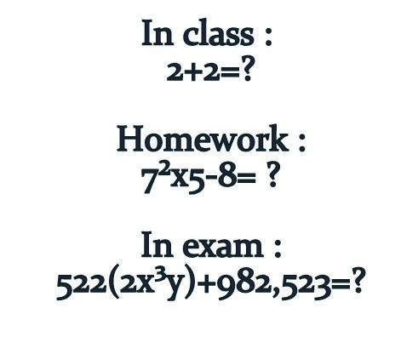
Grading component 3 & 4: Exams
Mid-term Exam (25%) 涵蓋期中考前課程內容
Final Exam (30%) 涵蓋全課程內容
Exam
Homework

Slide 25

Grading component 5: Class participation
Asking questions during or after the class
Listening when your peers ask questions
Giving opinion during class discussion
Going to the TAs/professor’s office hours
Helping your peers
分數 = F(老師的印象分, TAs的印象分, 同學的印象分)
NEW: 期末調查most helpful peers

Slide 26
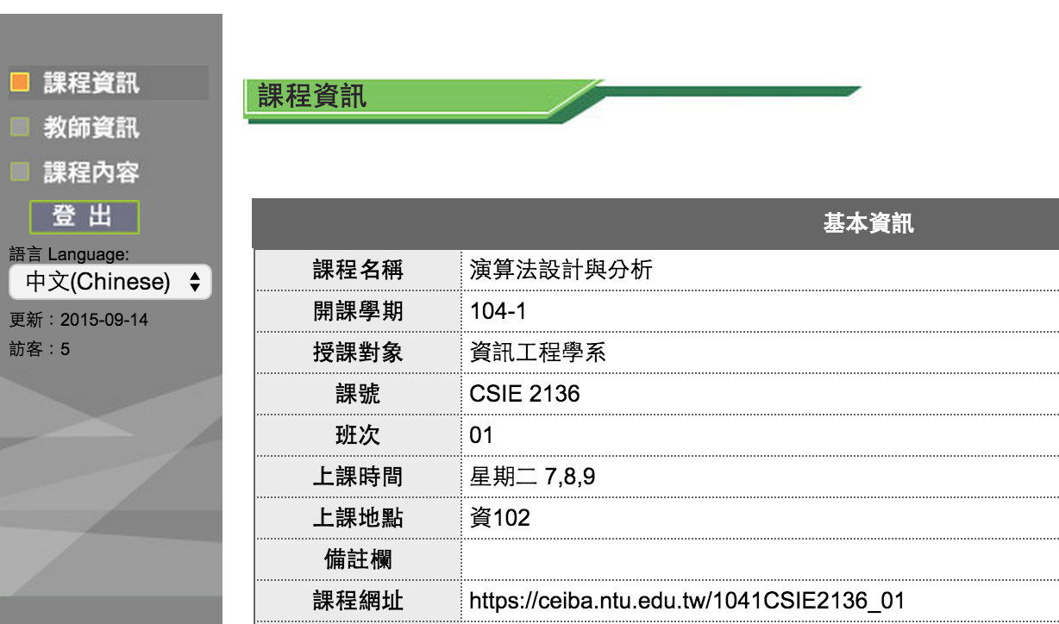
Grade will be available on CEIBA
https://ceiba.ntu.edu.tw/1041CSIE2136_01
單純公佈成績用

Slide 27

Questions?
Course website: http://www.csie.ntu.edu.tw/~ada/
Email: ada@csie.ntu.edu.tw
Facebook: https://www.facebook.com/groups/tsai.dsa.ada/
Make sure to check your NTU mailbox regularly

Slide 28
要加簽的同學請先到前方登記你的姓名、系級、學號及E-mail，名單確定後助教會寄送授權碼

