Slide 1

Week 1B: Introduction to Algorithms
CSIE 2136 Algorithm Design and Analysis, Fall 2015
http://www.csie.ntu.edu.tw/~ada/
Hsu-Chun Hsiao

Slide 2
Agenda
What is an algorithm?
The processes of design and analysis
Review of asymptotic analysis
Our very first example: the stable matching problem

Slide 3
What is an algorithm?

Slide 4

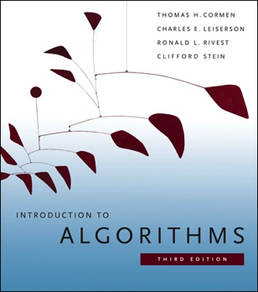
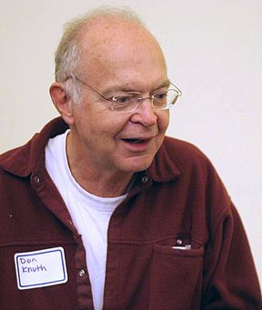
What is an algorithm?
A process or set of rules to be followed in calculations or other problem-solving operations, especially by a computer
A well-defined computational procedure that transforms some input to some output
An algorithm is a finite, definite, effective procedure, with some input and some output
Donald Knuth

Slide 5

The design step
Computational Problem
E.g.排序(sorting)問題：要怎麼把n個數字由小排到大？
Input: an unsorted array (E.g. 8, 5, 7, 2, 3, 9)
Output: a sorted array (E.g. 2, 3, 5, 7, 8, 9)
Algorithm Design
Algorithm
E.g. 插入排序法
(Insertion Sort)

Slide 6
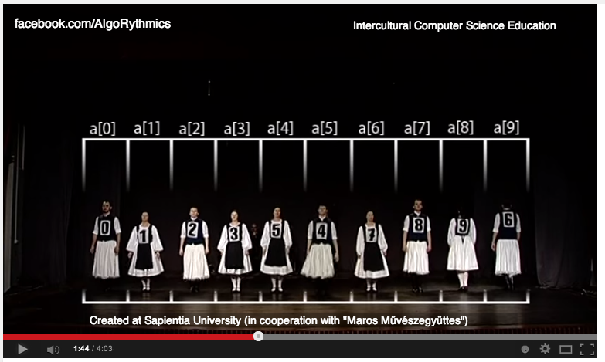
Recap: Insertion Sort
http://en.wikipedia.org/wiki/Insertion_sort
Insert-sort with Romanian folk dance
https://www.youtube.com/watch?v=ROalU379l3U

Slide 7
The analysis step
Computational Problem
E.g.排序(sorting)問題：要怎麼把n個數字由小排到大？
Input: an unsorted array (E.g. 8, 5, 7, 2, 3, 9)
Output: a sorted array (E.g. 2, 3, 5, 7, 8, 9)
Algorithm Design
Algorithm
E.g. 插入排序法
(Insertion Sort)
Algorithm Analysis
Correctness 對每個input都能找出正確的結果嗎？程序會停止嗎？
Efficiency 執行時間是多久？要使用多少儲存空間？

Slide 8
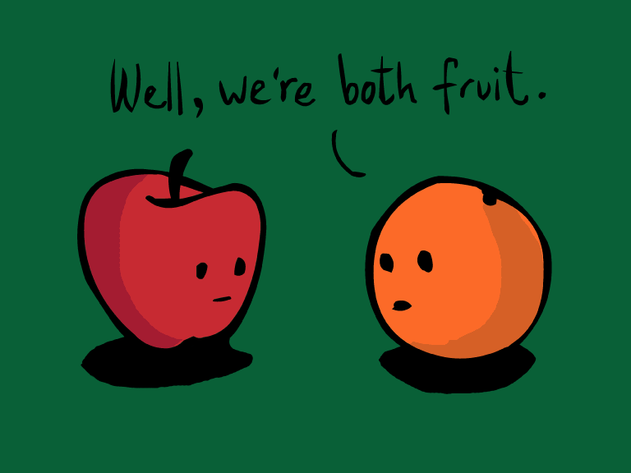
How “efficient” is efficient?
給定數列[8, 5, 7, 2, 3, 9]，Algorithm A 花10秒排序，Algorithm B花20秒
Is Algorithm A efficient?
Is Algorithm A more efficient than B?
Both questions are inconclusive. Why?

Slide 9
asymptotic analysis (漸進分析)

Slide 10

Review of asymptotic notation (Textbook Ch. 3.1)
f(n) = time or space of an algorithm for an input of size n
Asymptotic analysis: focus on the growth of f(n) as

Slide 11
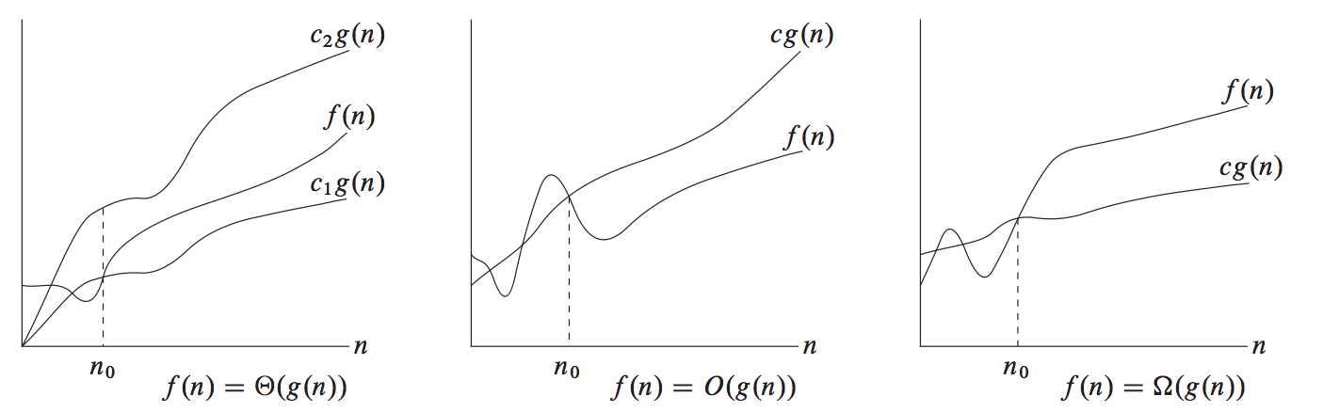
Review of asymptotic notation (Textbook Ch. 3.1)
f(n) = time or space of an algorithm for an input of size n
Asymptotic analysis: focus on the growth of f(n) as
Ο, or Big-O: upper bounding function

Slide 12
Review of asymptotic notation (Textbook Ch. 3.1)
f(n) = time or space of an algorithm for an input of size n
Asymptotic analysis: focus on the growth of f(n) as
Ο, or Big-O: upper bounding function
Ω, or Big-Omega: lower bounding function

Slide 13
Review of asymptotic notation (Textbook Ch. 3.1)
f(n) = time or space of an algorithm for an input of size n
Asymptotic analysis: focus on the growth of f(n) as
Ο, or Big-O: upper bounding function
Ω, or Big-Omega: lower bounding function
Θ, or Big-Theta: tightly bounding function

Slide 14
Review of asymptotic notation (Textbook Ch. 3.1)
Asymptotic notions的優點：可以把low-order terms和系數捨去，大幅簡化演算法的複雜度分析
E.g., f(n) = 5n³ + 7n² – 8
Upper bound: f(n) = O(n³), f(n) = O(n⁴), f(n) = O(n³log₂n)
Lower bound: f(n) = Ω(n³), f(n) = Ω(n²), f(n) = Ω(nlog₂n)
Tight bound: f(n) = Θ(n³)

Slide 15
Review of asymptotic notation (Textbook Ch. 3.1)
Asymptotic notions的優點：可以把low-order terms和系數捨去，大幅簡化演算法的複雜度分析
f(n) = O(n³) and f(n) = O(n⁴), so O(n³) = O(n⁴)…?
不要被這裡的等號迷惑！
O(n²) represents a set of functions that are upper bounded by cn² for some constant c when n is large enough
In asymptotic analysis, “=” means “the function belongs to this set”

Slide 16
How “efficient” is efficient?
給定長度為n的數列，Algorithm A 花 Θ(n logn) 時間排序，Algorithm B花 Θ(n²) 時間
Is Algorithm A efficient?
Is Algorithm A more efficient than B?
A rule of thumb: efficient = polynomial running time

Slide 17
Importance of asymptotic analysis
Easier to compare two algorithms that solve the same problem
Find room for improvement when the lower bound is known
E.g. Comparison-based sorting’s lower bound: Ω(n log n) comparison operations; Insertion sort is not optimal.
See the growing trend and scalability with the size of the problem instance
…

Slide 18
Type of running-time analyses
Worst case | Maximum running time for any input of size n
Average case | Expected running time for a random input of size n
Probabilistic | Expected running time of a randomized algorithm
Amortized | Worst-case running time for a series of operations

Slide 19
Running time of insertion sort in asymptotic notion?
Worst-case running time? Average-case running time?
Θ(n)
Θ(n log n)
Θ(n²)
Θ(n³)

Slide 20
example: Stable Matching

Slide 21
演算法設計與分析的流程
Formulate problem
Develop algorithm
Prove correctness
Analyze running time

Slide 22






問題：T大A系跟B系要一起辦迎新宿營，兩系各出n個同學當小隊輔，每隊的小隊輔需由兩個不同系的大二同學擔任。然而每個同學都有自己的偏好…
>
>
A系
>
>
B系

Slide 23




總召隨便分組？
>
>
配對黑箱！ 維尼 & 阿布 會想拋棄原本的夥伴
>
>
甲系
乙系

Slide 24
Preference lists
維尼 and 阿布 are unstable since they are better off if they pair with each other
 | 1st | 2nd | 3rd
維尼 | 阿布 | 大眼仔 | 毛怪
跳跳虎 | 大眼仔 | 毛怪 | 阿布
小豬 | 阿布 | 大眼仔 | 毛怪
 | 1st | 2nd | 3rd
毛怪 | 維尼 | 跳跳虎 | 小豬
大眼仔 | 維尼 | 跳跳虎 | 小豬
阿布 | 跳跳虎 | 維尼 | 小豬
Definition
x of the first set and y of the second set are unstable if
x prefers y to his/her assigned partner, y’
y prefers x to his/her assigned partner, x’
Both entities in a unstable pair can improve their outcomes if they ditch their own partners and form a new pair together

Slide 25
Preference lists
Q: Can you identify another unstable pair?
 | 1st | 2nd | 3rd
維尼 | 阿布 | 大眼仔 | 毛怪
跳跳虎 | 大眼仔 | 毛怪 | 阿布
小豬 | 阿布 | 大眼仔 | 毛怪
 | 1st | 2nd | 3rd
毛怪 | 維尼 | 跳跳虎 | 小豬
大眼仔 | 維尼 | 跳跳虎 | 小豬
阿布 | 跳跳虎 | 維尼 | 小豬

Slide 26
Stable matching
A stable matching means:
兩組人 兩兩配對 沒有人落單
No unstable pairs
Can you find a stable matching?
 | 1st | 2nd | 3rd
維尼 | 阿布 | 大眼仔 | 毛怪
跳跳虎 | 大眼仔 | 毛怪 | 阿布
小豬 | 阿布 | 大眼仔 | 毛怪
 | 1st | 2nd | 3rd
毛怪 | 維尼 | 跳跳虎 | 小豬
大眼仔 | 維尼 | 跳跳虎 | 小豬
阿布 | 跳跳虎 | 維尼 | 小豬

Slide 27
Stable matching
A stable matching means:
兩組人 兩兩配對 沒有人落單
No unstable pairs
Can you find a stable matching?
 | 1st | 2nd | 3rd
維尼 | 阿布 | 大眼仔 | 毛怪
跳跳虎 | 大眼仔 | 毛怪 | 阿布
小豬 | 阿布 | 大眼仔 | 毛怪
 | 1st | 2nd | 3rd
毛怪 | 維尼 | 跳跳虎 | 小豬
大眼仔 | 維尼 | 跳跳虎 | 小豬
阿布 | 跳跳虎 | 維尼 | 小豬

Slide 28

Stable matching problem 穩定配對問題
Given the preference lists of n people of the first set and n people in the second set, find a stable matching if it exists
Many real-world applications: matching applicants with schools, donors with patients, doctors with hospitals, etc.

Slide 29

Stable matching problem 穩定配對問題
Given the preference lists of n people of the first set and n people in the second set, find a stable matching if it exists
Does a stable matching always exist?
How can we find one stable matching?

Slide 30
How can we find one stable matching?
Attempt 1: 暴力法 (brute force)
Checking all possible perfect matchings to find out if there exist a stable one
Q: How many perfect matchings are there between two sets of n?
A: n*(n-1)*(n-2)…* 1 = n! possible combinations

Slide 31
How can we find one stable matching?
Attempt 2: 就讓大家自由交換 換到不想換為止
This process may not terminate!
Can you prove that this approach is incorrect by showing a counterexample, i.e., finding a set of preference lists and an exchange sequence such that the exchange process will go on forever?

Slide 32
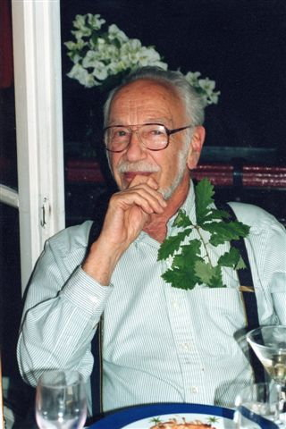
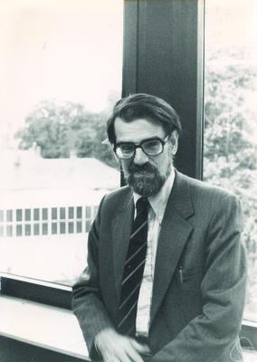
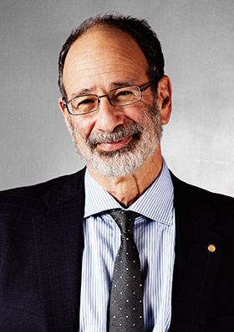
The Gale-Shapley (G-S) algorithm
Solve the stable matching problem and proved that stable matching always exists
Shapley and Roth were awarded the Nobel Prize in Economics in 2012 “for the theory of stable allocations and the practice of market design.”
David Gale
Lloyd Shapley
Alvin Roth

Slide 33

The G-S algorithm
A.k.a. the proposal algorithm 求婚演算法
They considered how to match n men with n women
Similarly, each person ranked the opposite sex unambiguously, and the goal is to put everyone in a stable marriage

Slide 34
The G-S algorithm
How does it work?
Let’s call one set “Proposers” and the other set “Responders”
活會階段：Everyone is free (unmarried) initially
訂婚階段（死會還可以活標）：In each step, a free proposer p proposes to a highest-ranked responder r to whom the proposer has not yet proposed. If r is free, then they get engaged. If r is engaged to p’, r chooses to engage with the preferred one, and the other becomes free.
穩定婚姻：Eventually, this algorithm terminates (i.e. everyone is engaged), and they can happily get married

Slide 35
//1. 活會階段
Initially all p in Proposers and all r in Responders are free
//2. 訂婚階段
While there a proposer p who is free and hasn’t proposed to every responder
____Let r be the highest-ranked responder (for p) to whom p has not yet proposed
____If r is free then
________(p, r) become engaged
____Else //r is currently engaged to p’
________If r prefers p’ to p then
____________p remains free
________Else //r prefers p to p’ then
____________(p, r) become engaged
____________p’ becomes free
________Endif
____Endif
Endwhile
//3. 找到穩定配對
Return the set of engaged pairs

Slide 36
The G-S algorithm: Try it!
Proposers
Responders
 | 1st | 2nd | 3rd
維尼 | 阿布 | 大眼仔 | 毛怪
跳跳虎 | 大眼仔 | 毛怪 | 阿布
小豬 | 阿布 | 大眼仔 | 毛怪
 | 1st | 2nd | 3rd
毛怪 | 維尼 | 跳跳虎 | 小豬
大眼仔 | 維尼 | 跳跳虎 | 小豬
阿布 | 跳跳虎 | 維尼 | 小豬
維尼 proposes to 阿布: (維尼, 阿布)
跳跳虎 proposes to 大眼仔: (維尼, 阿布), (跳跳虎, 大眼仔)
小豬 proposes to 阿布: (維尼, 阿布), (跳跳虎, 大眼仔)
小豬 proposes to 大眼仔: (維尼, 阿布), (跳跳虎, 大眼仔)
小豬 proposes to 毛怪: (維尼, 阿布), (跳跳虎, 大眼仔), (小豬, 毛怪)
Q: What would happen if the role of proposers and responders are switched?

Slide 37
The G-S algorithm: Try it!
Q: What would happen if the role of proposers and responders are switched?
A: It may produce a different stable matching.
In essence, proposers have an advantage over responders, as the proposers get their best possible matches while the responders get the worst possible one.

Slide 38
Running time of the G-S algorithm
O(n)
O(n log n)
O(n²)

Slide 39
Running time of the G-S algorithm
Ans: O(n²)
Observation 1: Initially the number of proposed pairs is 0
Observation 2: In each step, a man proposes to a woman to whom the man has never proposed before => the number of proposed pairs strictly increases by 1 for each iteration
Observation 3: There are in total n² pairs => the number of proposed pairs is at most n²
Hence, the G-S algorithm terminates after at most n² iterations; O(n²) worst-case running time.

Slide 40
Correctness: Does this algorithm produce a perfect matching?
Perfect matching = 沒有人落單
Prove by contradiction (反證法) is a powerful tool to validate a proposition
先假設命題不成立，然後推理出矛盾的結果，因此得證原命題為真。

Slide 41
Correctness: Does this algorithm produce a perfect matching?
Perfect matching = 沒有人落單
Prove by contradiction (反證法) is a powerful tool to validate a proposition
先假設命題不成立，然後推理出矛盾的結果，因此得證原命題為真。
Proof: Suppose there is a single man in the end
=> This man had proposed to every woman
=> This man was rejected by every woman
=> Every woman is married because a woman only rejected a man when there was a better choice
=> However, since #of free men = #of free women, there cannot be a free man while every woman is married. This is a contradiction. 

Slide 42
Correctness: Does this algorithm produce a stable matching?
Stable matching = 不會發生外遇
Let’s prove by contradiction again

Slide 43
Correctness: Does this algorithm produce a stable matching?
Stable matching = 不會發生外遇
Let’s prove by contradiction again
Proof:
Suppose the algorithm outputs a perfect matching that contains two pairs (A男,A女) and (B男, B女) such that
A男 prefers B女 to A女
B女 prefers A男 to B男
=> If A男 prefers B女 to A女, then A男 must have proposed to B女 before
=> But B女 is married to B男, so B女 prefers B男 to A男. This contradicts our assumption. 

Slide 44
Generalized stable matching problem
多元價值觀
不分男女兩兩配對
三人以上的問題
要怎麼model三人的配對？
Stable Roommates Problem
不一定有穩定解
若穩定解存在，有演算法能在O(n²)時間找到解
Three-Dimensional Stable Matching Problem
NP-complete（不知道是否存在快速解）

Slide 45
What did you learned so far?
演算法設計與分析的流程
Formulate problem
Develop algorithm
Prove correctness
Analyze running time
暴力法 (brute force) 很慢，通常不是最有效率的方法
一些分析或證明的小技巧
證明一個命題是對的：反證法 (prove by contradiction)
證明演算法會停止、分析執行時間的上限：progress measure
看起來差不多的問題 解法和難度也可能會差很多

Slide 46

Questions?

