Slide 1

Week 2: Divide and Conquer
CSIE 2136 Algorithm Design and Analysis, Fall 2015
http://www.csie.ntu.edu.tw/~ada/
Hsu-Chun Hsiao

Slide 2

Housekeeping
課程網站上線 https://www.csie.ntu.edu.tw/~ada
Email請記得註明班級、學號、姓名
加簽授權碼已寄出
JudgeGirl帳號已寄出
若需要創帳號，請寄信給ada@csie
Same-day Exercise Mini-HW1 out
Due on 9/24 (Thu.) 23:59
練習如何上傳作業
作業上傳教學
Git, bitbucket, JudgeGirl

Slide 3
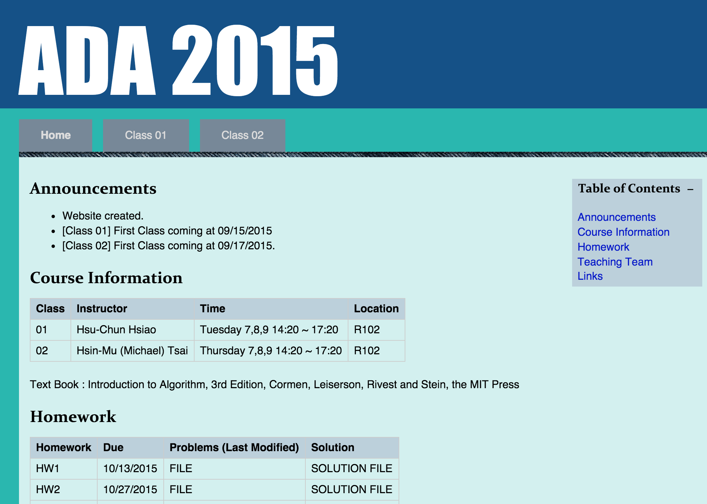

Slide 4
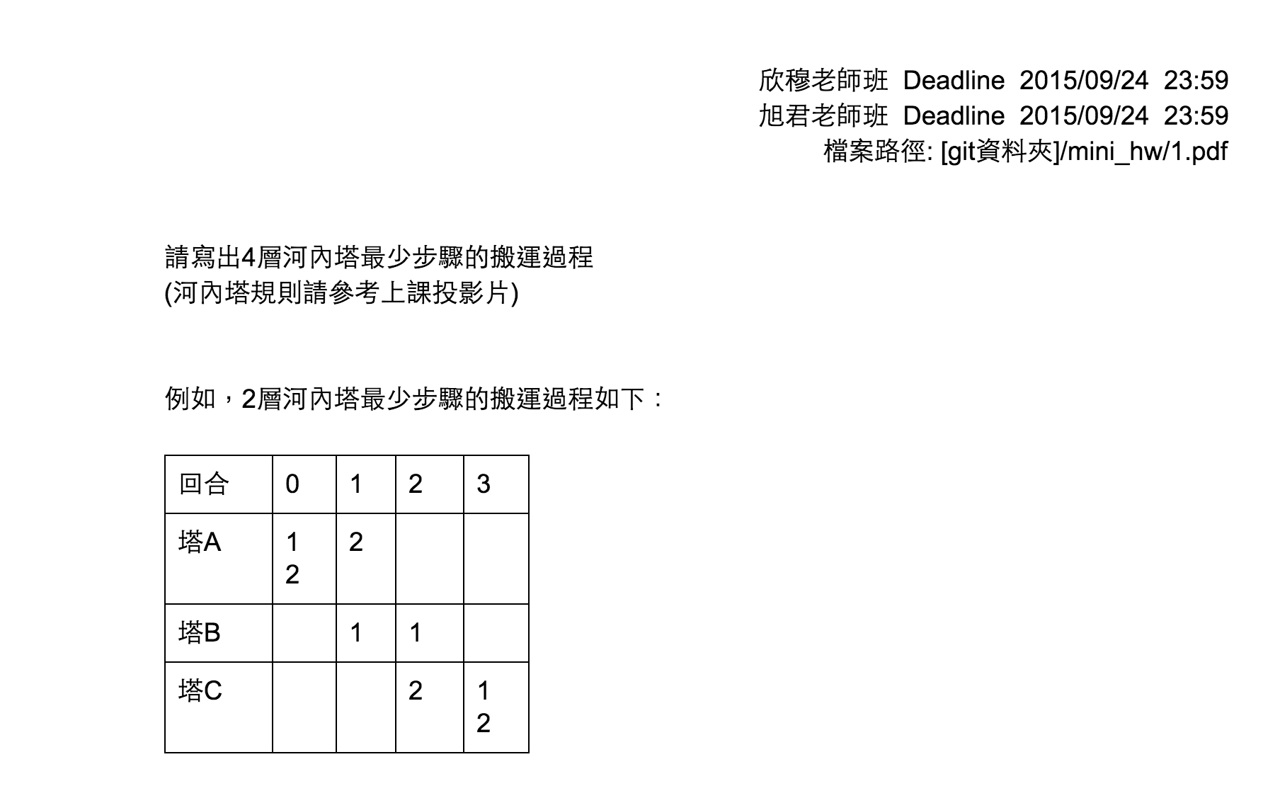
Mini-homework 1

Slide 5

作業上傳教學
Git
bitbucket
JudgeGirl

Slide 6
Agenda for two weeks
Recurrence (遞迴)
Divide and Conquer (分治法)
Example #1: Tower of Hanoi (河內塔)
Example #2: Merge sort (合併排序法)
Example #3: Maximum subarray (最大子序列)
How to solve recurrences
Example #4: Find the closest pair of points (最近點對問題)
Example #5: Matrix multiplication (矩陣相乘)

Slide 7
Recurrence (遞迴)

Slide 8
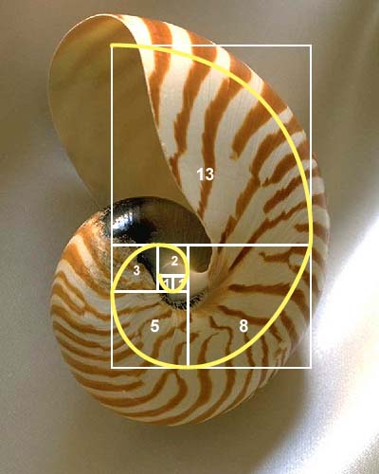
Recurrence relation (遞迴關係式)
“equation that recursively defines a sequence, once one or more initial terms are given: each further term of the sequence is defined as a function of the preceding terms” -- Wikipedia
Ex: Fibonacci sequence (費波那契數列)
Base case: F(0) = F(1) = 1
Recursive case: F(n) = F(n-1) + F(n-2)
n | 0 | 1 | 2 | 3 | 4 | 5 | 6 | 7 | 8 | …
F(n) | 1 | 1 | 2 | 3 | 5 | 8 | 13 | 21 | 34 | …
http://mathforum.org/mathimages/imgUpload/NAUTILUS.jpg

Slide 9
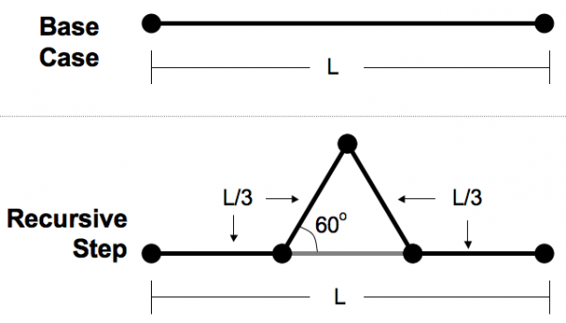
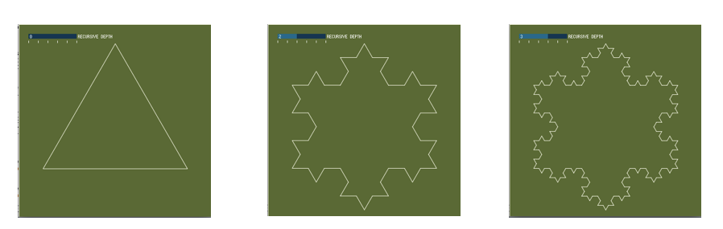
Recurrence relation (遞迴關係式)
Ex: 雪花生成的過程
n=0
n=1
n=2
http://makezine.com/2011/05/11/codebox-explore-recursion-with-processing/

Slide 10
遞迴的優點
簡潔明瞭：只要定義base case和recursive case，就間接定義了一個無限長的序列
Base case
Recursive case
F(0), F(1), F(2)……………
無限長的序列

Slide 11
遞迴的優點
簡潔明瞭：只要定義base case和recursive case，就間接定義了一個無限長的序列
Base case
Recursive case
F(0), F(1), F(2)……………
無限長的序列
寫一隻程式解F(n)
Fibonacci(n) //遞迴函數 = 程式中會呼叫自己的函數
if n < 2 //base case: 遞迴的終止條件，很重要否則程式無法停止
____return 1
//recursive case: 呼叫自己來解決小問題
return Fibonacci(n-1) + Fibonacci(n-2)

Slide 12
用遞迴?還是不用遞迴?
Fibonacci(n)
if n < 2 //base case
____return 1
//recursive case
return Fibonacci(n-1) + Fibonacci(n-2)
用遞迴函數的寫法
結構簡單清楚
但效率可能比較差
Fibonacci(n)
if n < 2
____return 1
a[0] <- 1
a[1] <- 1
for i = 2 … n
____a[i] <- a[i-1] + a[i-2]
return a[n]
不是用遞迴函數的寫法
效率較好
但結構較不清楚

Slide 13
遞迴的優點
簡潔明瞭：只要定義base case和recursive case，就間接定義了一個無限長的序列
反過來說，如果一個複雜的問題可以被化約成base case和recursive case，我們就找到了一個解決它的演算法！
Base case
Recursive case
F(0), F(1), F(2)……………
無限長的序列
寫一隻程式解F(n)
Hanoi(n)? 不知道怎麼解
但是當n很小時，可以直接解
也找到了Hanoi(n)跟Hanoi(n-1)之間的關聯
Base case
Recursive case
寫一隻程式解Hanoi(n)

Slide 14
Divide and Conquer (分治法)
Chapter 4

Slide 15
Divide and Conquer (分治法)
A powerful tool to design an algorithm
基本精神：找到base case和recursive case =>切割複雜的問題，用base case和recursive case 描述解決此問題的演算法
Hanoi(n)? 不知道怎麼解
但是當n很小時，可以直接解
也找到了Hanoi(n)跟Hanoi(n-1)之間的關聯
Base case
Recursive case
寫一隻程式解Hanoi(n)

Slide 16
Algorithm design view
Q: 如果切割成較小的不同的問題呢？
A: 無法精簡地用遞迴函數表示演算法
1. Divide
2. Conquer
3. Combine
把大問題切割成較小的同樣問題
分割
Recursive case: 遞迴呼叫自己解決小問題
Base case: 當問題足夠“小”時 直接解決
各個擊破
有時候需整合小問題的答案
以重建大問題的答案
合擊

Slide 17
Algorithm design view
Q: 切法只有一種嗎？
A: 可能有許多種，但切法必須確保之後能定義recursive case，且能combine答案
1. Divide
2. Conquer
3. Combine
把大問題切割成較小的同樣問題
分割
Recursive case: 遞迴呼叫自己解決小問題
Base case: 當問題足夠“小”時 直接解決
各個擊破
有時候需整合小問題的答案
以重建大問題的答案
合擊

Slide 18
Call tree view
Divide recursively until getting “directly solvable subproblem”, or base case
problem
subproblem
subproblem
subproblem
subproblem
subproblem
subproblem
subsolution
subsolution
solution

Slide 19
Example #1: Tower of Hanoi (河內塔)

Slide 20
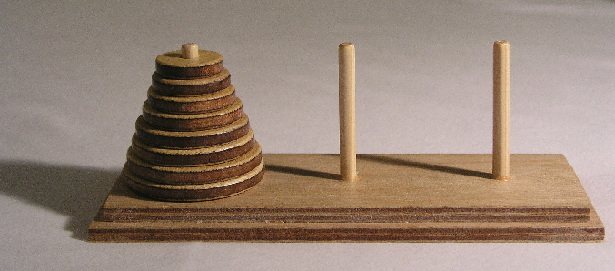
河內塔 (Tower of Hanoi)
A
B
C
Move n disks from A to C
Move one disk at a time
Cannot place a larger disk onto a smaller disk
Play online: https://www.mathsisfun.com/games/towerofhanoi.html

Slide 21
When n = 1
Move 1 from A to C
=> 1 move in total
Disk 1
A
B
C

Slide 22
When n = 2
Move 1 from A to B
Move 2 from A to C
Move 1 from B to C
=> 3 moves in total
Disk 1
Disk 2
A
B
C

Slide 23
When n = 3
How to move 3 disks?
How many moves in total?
Disk 1
Disk 2
Disk 3
A
B
C

Slide 24
How to move n disks?
How to move n disks?
How many moves in total?
Disk 1
…
Disk n-2
Disk n-1
Disk n
A
B
C

Slide 25
For n > 1
To move n disks from A to C (for n > 1):
Move Disk 1~n-1 from A to B
Move Disk n from A to C
Move Disk 1~n-1 from B to C
Disk 1
…
Disk n-2
Disk n-1
Disk n
A
B
C

Slide 26
For n > 1
To move n disks from A to C (for n > 1):
Move Disk 1~n-1 from A to B
Move Disk n from A to C
Move Disk 1~n-1 from B to C
Disk 1
…
Disk n-2
Disk n
Disk n-1
A
B
C

Slide 27
For n > 1
To move n disks from A to C (for n > 1):
Move Disk 1~n-1 from A to B
Move Disk n from A to C
Move Disk 1~n-1 from B to C
Disk 1
…
Disk n-2
Disk n-1
Disk n
A
B
C

Slide 28
For n > 1
To move n disks from A to C (for n > 1):
Move Disk 1~n-1 from A to B
Move Disk n from A to C
Move Disk 1~n-1 from B to C
Disk 1
…
Disk n-2
Disk n-1
Disk n
A
B
C

Slide 29
Pseudocode
Hanoi(n, src, dest, spare)
if n==1 // base case
Move disk from src to dest
else // recursive case
Hanoi(n-1, src, spare, dest)
Move disk from src to dest
Hanoi(n-1, spare, dest, src)
No need to combine the results in this case.

Slide 30
Call tree
Hanoi(n, src, dest, spare)
if n==1 // base case
Move disk from src to dest
else // recursive case
Hanoi(n-1, src, spare, dest)
Move disk from src to dest
Hanoi(n-1, spare, dest, src)
Hanoi(3, A, C, B)
Hanoi(2, A, B, C)
Hanoi(2, B, C, A)
Hanoi(1,A,C,B)
Hanoi(1,C,B,A)
Hanoi(1,B,A,C)
Hanoi(1,A,C,B)

Slide 31
# of moves?
Hanoi(n, src, dest, spare)
if n==1 // base case
Move disk from src to dest
else // recursive case
Hanoi(n-1, src, spare, dest)
Move disk from src to dest
Hanoi(n-1, spare, dest, src)
Let T(n) be the number of moves with n disks
T(1) = 1
For n >1, T(n) = 2T(n-1) + 1
=> T(n) = ?
We will learn how to derive T(n) later
T(n) = 2^{n} - 1

Slide 32
Further questions
Is this an optimal strategy? Can T(n) < 2^{n} -1?
What happen when there are more than 3 pegs?

Slide 33
Example #2: Merge Sort (合併排序法)
Textbook Chapter 2.3.1

Slide 34
Sorting by Divide-and-Conquer
problem
Unsorted list of size n
6
3
5
1
8
7
2
4
???
What are the base case and recursive case?
solution
Sorted list of size n
1
2
3
4
5
6
7
8

Slide 35
Base case and recursive case
Base case (n = 1)
Nothing to be done, the list is sorted already
Recursive case (n > 1)
Divide the list into two sub-lists
Sort each sub-list recursively
Merge the two sorted lists

Slide 36
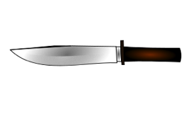
Call tree view
One unsorted list of size 8
6
3
5
1
8
7
2
4
Two unsorted lists of size 4
6
3
5
1
8
7
2
4
Four unsorted lists of size 2
6
3
5
1
8
7
2
4
Eight sorted lists of size 1
6
3
5
1
8
7
2
4
Four sorted lists of size 2
3
6
1
5
7
8
2
4
Two sorted lists of size 4
1
3
5
6
2
4
7
8
One sorted list of size 8
1
2
3
4
5
6
7
8

Slide 37
Combine 2 sorted lists into one
1
3
5
6
2
4
7
8
2 sublists of size n/2
# of comparisons = Θ(n)

Slide 38
Pseudocode
MergeSort(A, p, r)
//base case
if p = r
___return
//recursive case
//divide
q <- [(p+r-1)/2]
//conquer
MergeSort(A, p, q)
MergeSort(A, q+1, r)
//combine
Merge(A, p, q, r)

Slide 39

精簡優雅的Merge Sort遞迴函數
實際上 程式在背後鴨子划水
MergeSort(A, p, r)
//base case
if p = r
___return
//recursive case
//divide
q <- [(p+r-1)/2]
//conquer
MergeSort(A, p, q)
MergeSort(A, q+1, r)
//combine
Merge(A, p, q, r)
6
3
5
1
8
7
2
4
6
3
5
1
8
7
2
4
6
3
5
1
8
7
2
4
6
3
5
1
8
7
2
4
3
6
1
5
7
8
2
4
1
3
5
6
2
4
7
8
1
2
3
4
5
6
7
8

Slide 40
Time complexity of Merge Sort
T(n) = running time for input size n
1. Divide
2. Conquer
3. Combine
Divide a list of size n into 2 sublists of size n/2 in constant time
Θ(1)
Recursive case:
Sort 2 sublists recursively using merge sort
Base case (n=1):
Return itself in constant time
2T(n/2)
Θ(1)
Merge 2 sorted sublists into one sorted list in linear time
Θ(n)

Slide 41
Time complexity
用遞迴關係式表示時間複雜度
Merge Sort的時間複雜度
(以遞迴關係式表示, n=r-p+1）
Merge Sort的遞迴函數
MergeSort(A, p, r)
//base case
if p = r //Θ(1)
___return
//recursive case
q <- [(p+r-1)/2] //Θ(1)
MergeSort(A, p, q) //T(n/2)
MergeSort(A, q+1, r) //T(n/2)
Merge(A, p, q, r) //Θ(n)
Useful tricks to simplify recurrences
Ignore floors and ceilings (boundary conditions)
Assume base cases are constant (for small n)

Slide 42
Expand the recurrence
1st expansion
2nd expansion
k = number of expansions
The expansion stops when 2^{k} = n
Replace k with log₂n, we get

Slide 43
How to solve recurrence relations?
Substitution method (取代法)
Make a guess and then prove by induction
Recursion-tree method (遞迴樹法)
Expand the recurrence into a tree and sum up the cost
Master method (套公式大法)
Apply Master Theorem to a specific form of recurrences
Let’s see more examples first and come back to this later

Slide 44
Example #3: Maximum Subarray Problem (最大子序列問題)
Textbook Chapter 4.1

Slide 45
最賺錢的營業時段？
兄弟草雞排的每小時的淨營收如下：
千元
4
3pm-10:59pm
總淨營收= 8k
1pm | 2pm | 3pm | 4pm | 5pm | 6pm | 7pm | 8pm | 9pm | 10pm | 11pm
3
2
1
0
-1
-2
-3
-4
假設每小時的淨營收不受日期影響。在每天只開店關店一次的前提之下，雞排老闆要怎麼找出最賺錢的營業時段？

Slide 46
Maximum subarray problem
Given an array of positive and negative integers, find a subarray whose elements have the largest sum
Input: an array of n integers
Output: a subarray with the largest sum
Input =
-3 | 1 | -2 | 6 | -2 | 3 | 2 | -5 | 4
Output =
6 | -2 | 3 | 2
Sum = 9
How do you write a computer program to do this task?
Brute force: enumerate every possible subarray & calculate its sum? Ω(n²)

Slide 47
Base case and recursive case
Base case (n = 1)
Nothing to be done, the array itself is the maximum subarray
Recursive case (n > 1)
Divide the array into two sub-arrays
Find the maximum sub-array recursively?
Merge the results?
Is this sufficient?
How?

Slide 48
Blind attempt
MaxSub(A, low, high) is a function that returns the maximum subarray between A[low…high]
Let’s define MaxSub in a recursive form
1. Divide
2. Conquer
3. Combine
MaxSub(A, low, high)
-3 | 1 | -2 | 6 | -2 | 3 | 2 | -5 | 4
low
high
MaxSub(A, low, mid)
MaxSub(A, mid, high)
-3 | 1 | -2 | 6
-2 | 3 | 2 | -5 | 4
low
mid
mid+1
high
Solved by recurrence magic
MaxSub(A, low, mid)’s return value
MaxSub(A, mid+1, high)’s return value
-3 | 1 | -2 | 6
-2 | 3 | 2 | -5 | 4
How do we combine these two subsolutions?

Slide 49
A closer look at Combine
MaxSub(A, low, mid)’s return value
MaxSub(A, mid+1, high)’s return value
-3 | 1 | -2 | 6
-2 | 3 | 2 | -5 | 4
How do we combine?
Attempt: Pick the one with a large sum?
-3 | 1 | -2 | 6 | -2 | 3 | 2 | -5 | 4
The maximum should be [6, -2, 3, 2] ☹
What went wrong here?

Slide 50
Let’s step back to Divide
For any input, the maximum subarray must be in one of the following places:
Case 1: left
low
mid
mid+1
high
Case 2: right
Case 3: cross the middle
Case 1: MaxSub(A, low, high) = MaxSub(A, low, mid)
Case 2: MaxSub(A, low, high) = MaxSub(A, mid+1, high)
Case 3: MaxSub(A, low, high) cannot be expressed using MaxSub!

Slide 51
Handle Case 3 separately
所有橫跨左右兩邊的subarray當中，哪一個的總值最大？
Observation
假設 A[x…y]的和是跨越中點的subarray中最大的
=> A[x…mid]的和一定是所有A[i…mid]中最大的 (i≤mid)
=> A[mid+1…y]的和一定是所有A[mid+1…j]中最大的 (j>mid)
=> Solvable in linear time
x
y
low
mid
high

Slide 52
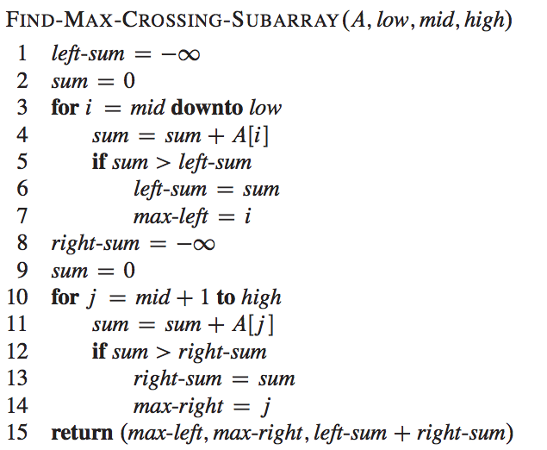
MaxCrossSub(A, low, mid, high)
low
mid
mid+1
high
Line 1-7
Line 8-14
Time complexity = ?
Θ(n) loop iterations

Slide 53
1. Divide
2. Conquer
3. Combine
MaxSub(A, low, high)
-3 | 1 | -2 | 6 | -2 | 3 | 2 | -5 | 4
MaxSub(low, mid)
MaxSub(mid, high)
MaxCrossSub(A, low, mid, high)
-3 | 1 | -2 | 6
-2 | 3 | 2 | -5 | 4
-3 | 1 | -2 | 6 | -2 | 3 | 2 | -5 | 4
……
Recursive case: call MaxSub
Base case (n=1): return itself
……
MaxSub(A, low, mid)
MaxSub(A, mid+1, high)
MaxCrossSub(A, low, mid, high)
-3 | 1 | -2 | 6
-2 | 3 | 2 | -5 | 4
-3 | 1 | -2 | 6 | -2 | 3 | 2 | -5 | 4
Pick the max out of these three
-3 | 1 | -2 | 6 | -2 | 3 | 2 | -5 | 4
Correct answer ☺

Slide 54
MaxSub’s time complexity
T(n) = running time of MaxSub on a subarray of size n
1. Divide
2. Conquer
3. Combine
Divide a list of size n into 2 subarrays of size n/2: Θ(1)
Recursive case: find MaxSub for each subarrays 2T(n/2)
Base case (n=1): return itself Θ(1)
Find MaxCrossSub for the original list: Θ(n)
Pick the subarray with the maximum sum among 3 subarrays: Θ(1)

Slide 55
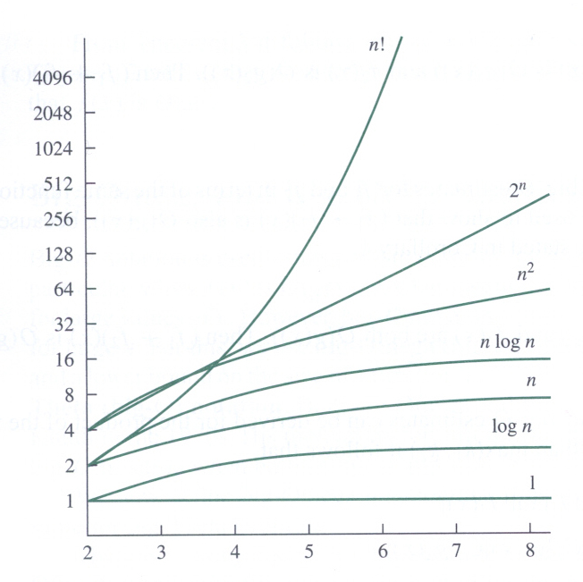
Not everyone was satisfied with Θ(nlogn)
Brute force: Θ(n²)
Divide and conquer: Θ(nlogn)
Can we do better, like in linear time?
Kadane's algorithm by Jay Kadane
A dynamic programming approach
Our next topic
Log scale
http://www2.lv.psu.edu/ojj/courses/discrete-math/topics/images/growth-fn.jpg

Slide 56
How to Solve Recurrence
Textbook Chapter 4.3-4.5

Slide 57
How to solve recurrence relations?
Substitution method (取代法)
Make a guess and then prove by mathematical induction
Recursion-tree method (遞迴樹法)
Expand the recurrence into a tree and sum up the cost
Master method (套公式大法 or 大師法)
Apply master theorem to a specific form of recurrences
Useful simplification tricks
Ignore floors and ceilings
Assume base cases are constant (for small n)

Slide 58

Substitution method (取代法)
Guess the form of the solution
Verify by mathematical induction (數學歸納法)
Solve for constants
If the guess is proven wrong, go back to Step 1
Prove O and Ω separately
數學歸納法的常見形式
證明此命題對 n = 1 成立
證明若此命題對 n = m 成立，則它在 n = m + 1 時也成立
=>此命題對所有正整數n都成立

Slide 59
Example of substitution method
Our guess
⬄ Exists positive constants n₀ and c, s.t. for all n > n₀,
也就是我們要找出一組c和n₀的解

Slide 60
Example of substitution method
Claim:
Exists positive constants n₀ and c, s.t. for all n ≥ n₀,
Proof: 使用歸納法證明並找出一組c和n₀
To satisfy initial condition when n = 1,
=> T(n) = 1 ≤ cn³
=> c ≥ 1

Slide 61
Example of substitution method
Claim:
Exists positive constants n₀ and c, s.t. for all n ≥ n₀,
Proof: 使用歸納法證明並找出一組c和n₀
Suppose T(n) ≤ cn³ for n = m-1, m-2, …
When n = m,
T(n) = 4T(n/2) + n
≤ 4c(n/2)³ + n
= cn³/2 + n
= cn³ - (cn³/2 - n)
≤ cn³
(cn³/2 – n) ≥ 0
E.g., c ≥ 2, n ≥ 1
Hence, we can set c = 2, n₀ = 1

Slide 62
Can we get a tighter upper bound?
Our guess
⬄ Exists positive constants n₀ and c, s.t. for all n > n₀,
也就是我們要找出一組c和n₀的解

Slide 63
A tighter bound
Our guess:
Claim:
Exists positive constants n₀ and c, s.t. for all n ≥ n₀,
Proof: 使用歸納法證明並找出一組c和n₀
Suppose T(n) ≤ cn² for n = m-1, m-2, …
When n = m,
T(n) = 4T(n/2) + n
≤ 4c(n/2)² + n
= cn² + n
証不出來…Orz 猜錯了？還是推導錯了？
沒猜錯 推導也沒錯
這是取代法的小盲點

Slide 64
Fixing wrong substitution
Our guess:
Strengthen the inductive hypothesis by subtracting a low-order term
Proof: 使用歸納法證明並找出一組c₁, c₂和n₀
Suppose T(n) ≤ c₁n² - c₂n for n = m-1, m-2, …
When n = m,
T(n) = 4T(n/2) + n
≤ 4(c₁(n/2)² - c₂n/2) + n
= c₁n² - c₂n - (c₂ -1)n
≤ c₁n² - c₂n
(c₂ -1)n ≥ 0
E.g., c₂ ≥ 1, n ≥ 0

Slide 65
Initial conditions
歸納法成立的另一要素：初始條件需成立
When n = 1 and c₂ ≥ 1, pick a big enough c₁
s.t. T(n) = 1 ≤ c₁n² - c₂n
E.g., c₁ ≥ 1 + c₂
Hence, we can set c₁ = 2, c₂ = 1, n₀ = 1

Slide 66
Useful tricks
Strengthen the inductive hypothesis by subtracting a low-order term
Change variables
E.g.,
Change variable: let k = logn, n=2^{k}
Change variable again: let S(k) = T(2^{k})
Solve recurrence
➔
➔

Slide 67


