Slide 1
Divide and Conquer II
Michael Tsai
2013/09/12

Slide 2

矩陣相乘
問題:
Input: A, B 都是 n x n 的Square Matrix
Output: C, n x n 的square matrix, $C=A∙B$

Slide 3
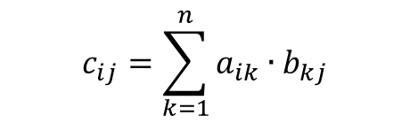
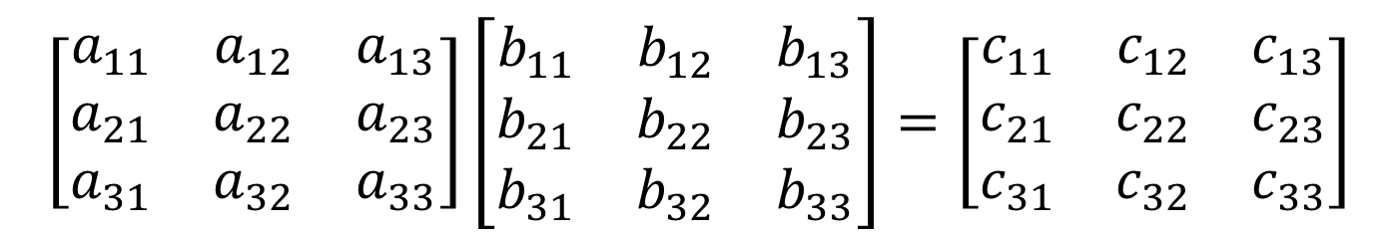

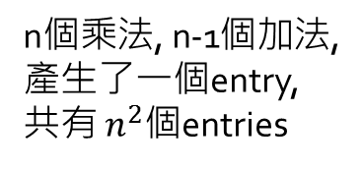
矩陣相乘 – 基本法
n個乘法, n-1個加法,
產生了一個entry,共有 $n^{2}$個entries
n個
n個
$$\left[\begin{matrix}a_{11} & a_{12} & a_{13} \\ a_{21} & a_{22} & a_{23} \\ a_{31} & a_{32} & a_{33}\end{matrix}\right]\left[\begin{matrix}b_{11} & b_{12} & b_{13} \\ b_{21} & b_{22} & b_{23} \\ b_{31} & b_{32} & b_{33}\end{matrix}\right]=\left[\begin{matrix}c_{11} & c_{12} & c_{13} \\ c_{21} & c_{22} & c_{23} \\ c_{31} & c_{32} & c_{33}\end{matrix}\right]$$
$$c_{ij}=\sum_{k=1}^{n}{a_{ik}∙b_{kj}}$$
Running time = ?
$$Θ(n^{3})$$

Slide 4
















矩陣相乘 – D&C嘗試一
Recursive case:
從$A_{11}B_{11}$可得
$$A_{11}$$
$$A_{12}$$
$$B_{11}$$
$$B_{12}$$
$$A_{21}$$
$$A_{22}$$
$$B_{21}$$
$$B_{22}$$
從$A_{12}B_{21}$可得
$$C_{11}$$
$$C_{12}$$
$$C_{11}=A_{11}B_{11}+A_{12}B_{21}$$
$$C_{21}$$
$$C_{22}$$

Slide 5

矩陣相乘 – D&C嘗試一
Base case:
n=1
則$C=A∙B$直接算 (A,B,C各自為一個數)

Slide 6
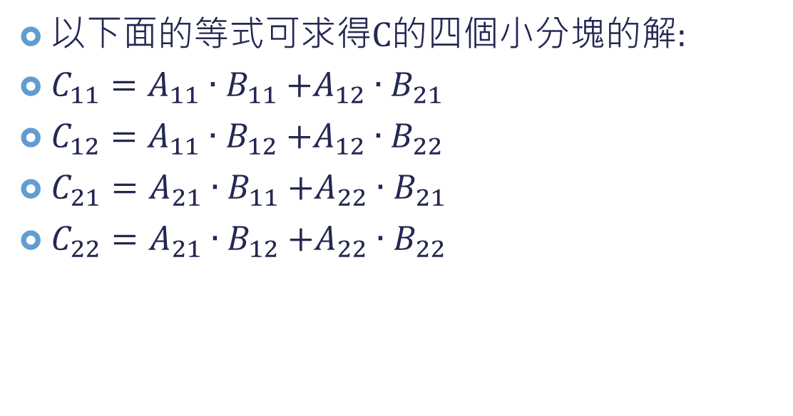
矩陣相乘 – D&C嘗試一
以下面的等式可求得C的四個小分塊的解:
$C_{11}=A_{11}{∙B}_{11}+A_{12}∙B_{21}$
$C_{12}=A_{11}{∙B}_{12}+A_{12}∙B_{22}$
$C_{21}=A_{21}{∙B}_{11}+A_{22}∙B_{21}$
$C_{22}=A_{21}{∙B}_{12}+A_{22}∙B_{22}$

Slide 7

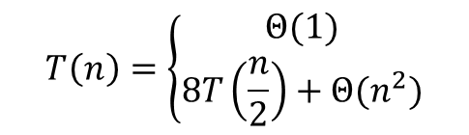


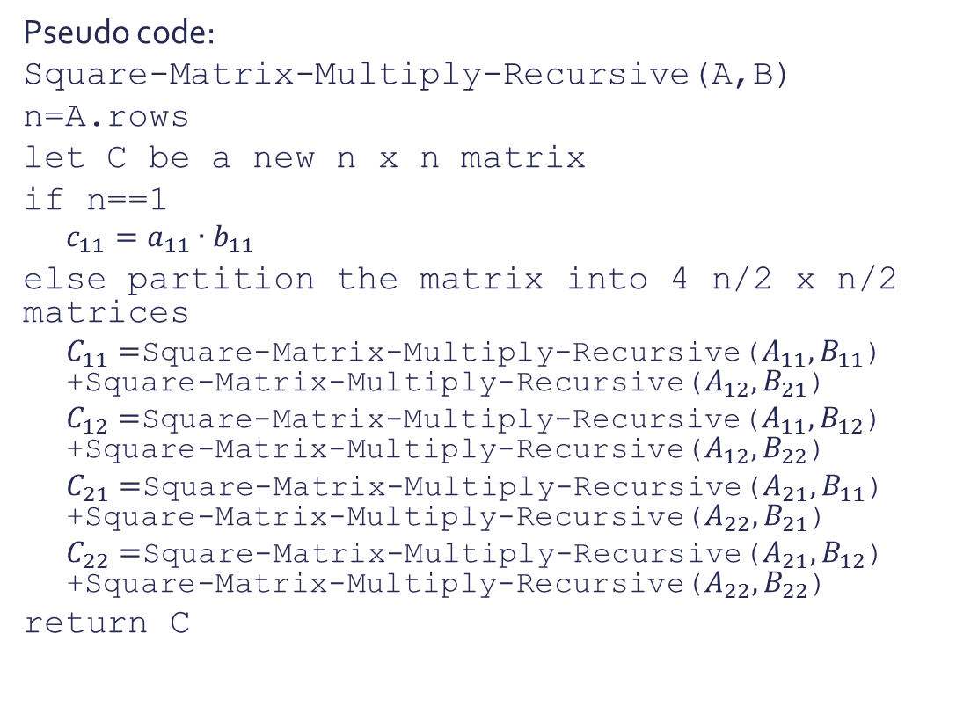






矩陣相乘 – D&C嘗試一
Pseudo code:
Square-Matrix-Multiply-Recursive(A,B)
n=A.rows
let C be a new n x n matrix
if n==1
$$c_{11}=a_{11}{∙b}_{11}$$
else partition the matrix into 4 n/2 x n/2 matrices
$C_{11}=$Square-Matrix-Multiply-Recursive($A_{11},B_{11}$) +Square-Matrix-Multiply-Recursive($A_{12},B_{21}$)
$C_{12}=$Square-Matrix-Multiply-Recursive($A_{11},B_{12}$) +Square-Matrix-Multiply-Recursive($A_{12},B_{22}$)
$C_{21}=$Square-Matrix-Multiply-Recursive($A_{21},B_{11}$) +Square-Matrix-Multiply-Recursive($A_{22},B_{21}$)
$C_{22}=$Square-Matrix-Multiply-Recursive($A_{21},B_{12}$) +Square-Matrix-Multiply-Recursive($A_{22},B_{22}$)
return C
Base case
$$T\left(1\right)=Θ(1)$$
Recursive case
$$Θ(1)$$
Combine
$$8T(\frac{n}{2})$$
$$Θ(n^{2})$$
$$T\left(n\right)=Θ\left(1\right)+8T\left(\frac{n}{2}\right)+Θ\left(n^{2}\right)=8T\left(\frac{n}{2}\right)+Θ\left(n^{2}\right)$$
$$T\left(n\right)=\left\{\begin{matrix}Θ(1) \\ 8T\left(\frac{n}{2}\right)+Θ(n^{2})\end{matrix}\right.$$
,if $n=1$
,if $n>1$
$$T\left(n\right)=Θ\left(n^{3}\right)$$

Slide 8
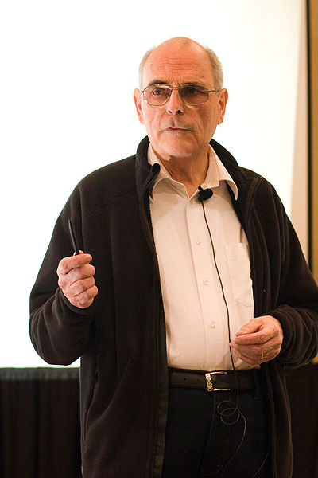
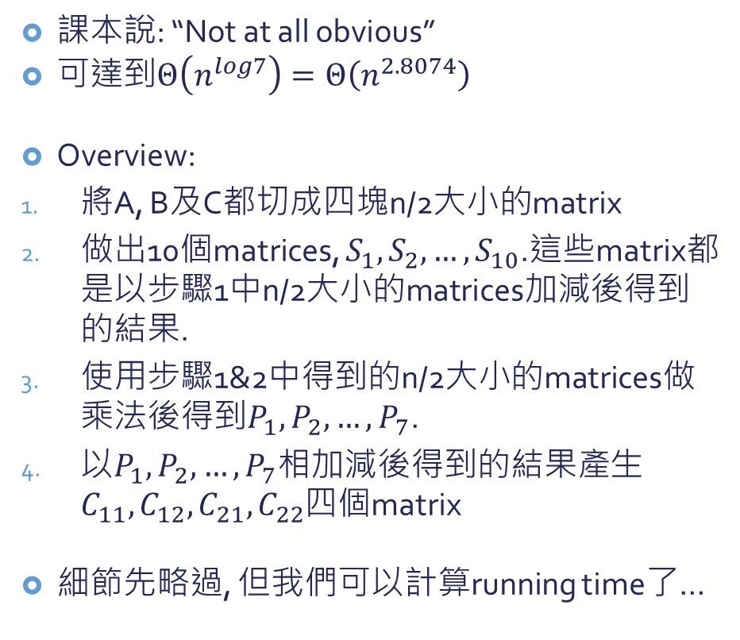
矩陣相乘 – Strassen’s method
課本說: “Not at all obvious”
可達到$Θ\left(n^{log7}\right)=Θ\left(n^{2.8074}\right)$
Overview:
將A, B及C都切成四塊n/2大小的matrix
做出10個matrices, $S_{1},S_{2},…,S_{10}$.這些matrix都是以步驟1中n/2大小的matrices加減後得到的結果.
使用步驟1&2中得到的n/2大小的matrices做乘法後得到$P_{1},P_{2},…,P_{7}$.
以$P_{1},P_{2},…,P_{7}$相加減後得到的結果產生$C_{11},C_{12},C_{21},C_{22}$四個matrix
細節先略過, 但我們可以計算running time了…
德國數學家 Volker Strassen 攝於2009年

Slide 9


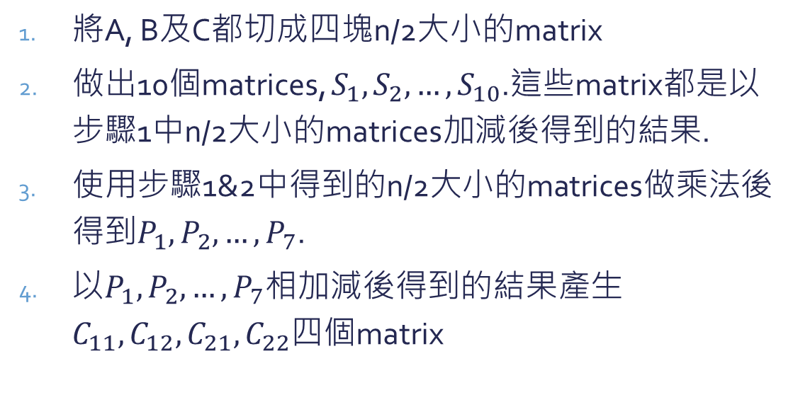



矩陣相乘 – Strassen’s method
$$Θ(1)$$
將A, B及C都切成四塊n/2大小的matrix
做出10個matrices, $S_{1},S_{2},…,S_{10}$.這些matrix都是以步驟1中n/2大小的matrices加減後得到的結果.
使用步驟1&2中得到的n/2大小的matrices做乘法後得到$P_{1},P_{2},…,P_{7}$.
以$P_{1},P_{2},…,P_{7}$相加減後得到的結果產生$C_{11},C_{12},C_{21},C_{22}$四個matrix
$$Θ(n^{2})$$
$$7T(\frac{n}{2})$$
$$Θ(n^{2})$$
$$T\left(n\right)=Θ\left(1\right)+Θ\left(n^{2}\right)+7T\left(\frac{n}{2}\right)+Θ\left(n^{2}\right)=7T\left(\frac{n}{2}\right)+Θ\left(n^{2}\right)$$
$$T\left(n\right)=Θ\left(n^{\log{7}}\right)$$

Slide 10
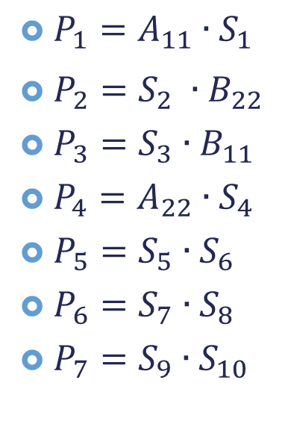
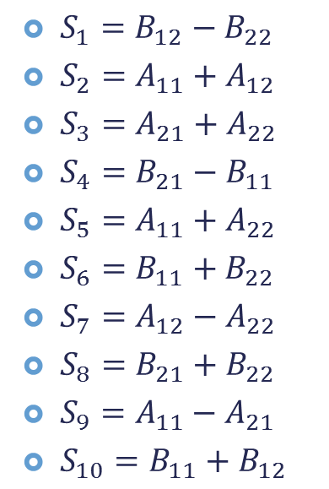
矩陣相乘 – Strassen’s method
$S_{1}=B_{12}−B_{22}$
$S_{2}=A_{11}+A_{12}$
$S_{3}=A_{21}+A_{22}$
$S_{4}=B_{21}−B_{11}$
$S_{5}=A_{11}+A_{22}$
$S_{6}=B_{11}+B_{22}$
$S_{7}=A_{12}−A_{22}$
$S_{8}=B_{21}+B_{22}$
$S_{9}=A_{11}−A_{21}$
$S_{10}=B_{11}+B_{12}$
$P_{1}=A_{11}∙S_{1}$
$P_{2}=S_{2} ∙B_{22}$
$P_{3}=S_{3}∙B_{11}$
$P_{4}=A_{22}∙S_{4}$
$P_{5}=S_{5}∙S_{6}$
$P_{6}=S_{7}∙S_{8}$
$P_{7}=S_{9}∙S_{10}$
Not at all obvious

Slide 11
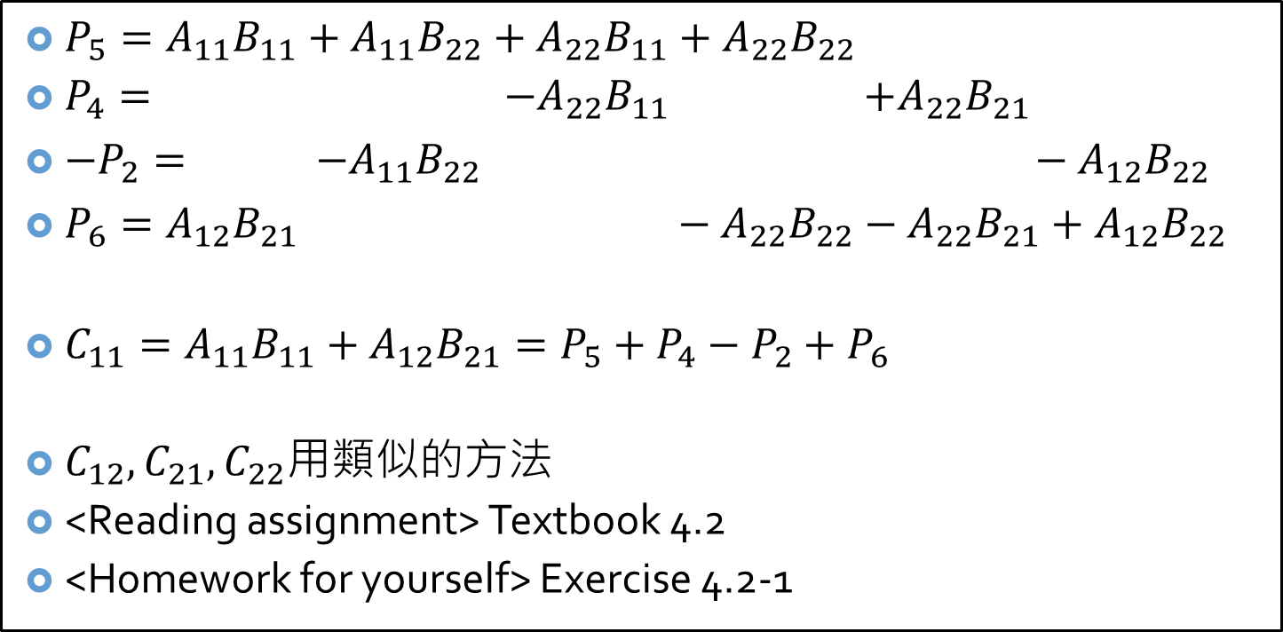
矩陣相乘 – Strassen’s method
$P_{5}=A_{11}B_{11}+A_{11}B_{22}+A_{22}B_{11}+A_{22}B_{22}$
$P_{4}= −A_{22}B_{11}$ $+A_{22}B_{21}$
$−P_{2}= −A_{11}B_{22} −A_{12}B_{22}$
$P_{6}=A_{12}B_{21} −A_{22}B_{22}−A_{22}B_{21}+A_{12}B_{22}$
$C_{11}=A_{11}B_{11}+A_{12}B_{21}=P_{5}+P_{4}−P_{2}+P_{6}$
$C_{12},C_{21},C_{22}$用類似的方法
<Reading assignment> Textbook 4.2
<Homework for yourself> Exercise 4.2-1
Not at all obvious

Slide 12
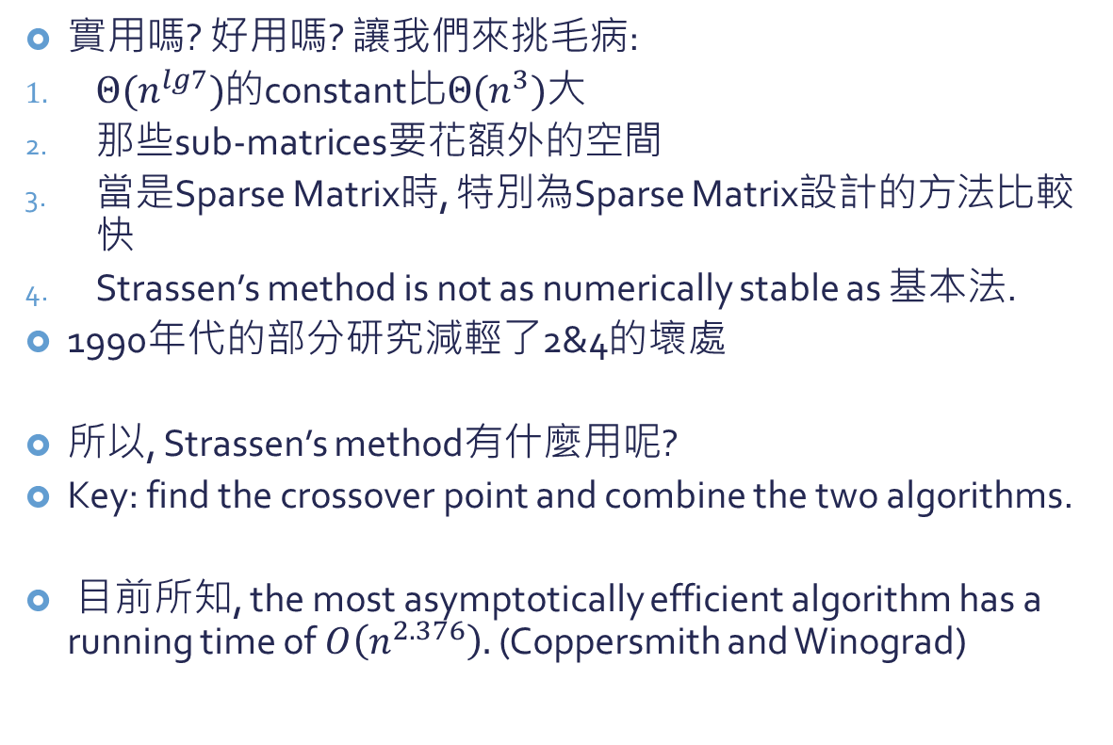
矩陣相乘 – Strassen’s method
實用嗎? 好用嗎? 讓我們來挑毛病:
$Θ(n^{lg7})$的constant比$Θ(n^{3})$大
那些sub-matrices要花額外的空間
當是Sparse Matrix時, 特別為Sparse Matrix設計的方法比較快
Strassen’s method is not as numerically stable as 基本法.
1990年代的部分研究減輕了2&4的壞處
所以, Strassen’s method有什麼用呢?
Key: find the crossover point and combine the two algorithms.
目前所知, the most asymptotically efficient algorithm has a running time of $O\left(n^{2.376}\right).$ (Coppersmith and Winograd)

Slide 13

接下來…
問題: 我們要怎麼解遞迴式?
取代法
遞迴樹法
大師定理法
http://www.origin-zero.com/senzi/JOKE1.jpg

Slide 14
取代法
成功
猜答案的形式
用數學歸納法證明此形式成立
得到遞迴式的解
失敗

Slide 15
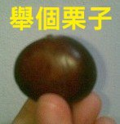
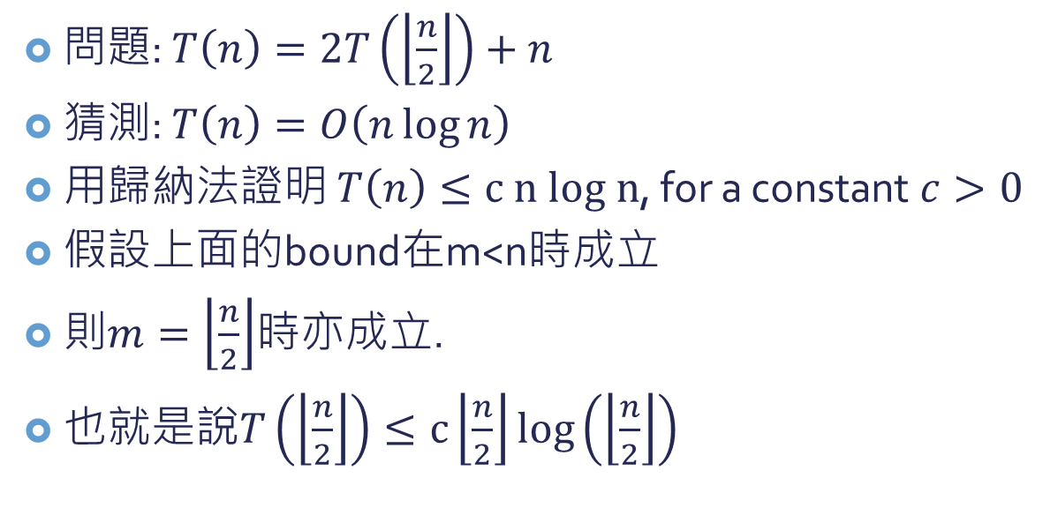
取代法-例子
問題: $T\left(n\right)=2T\left(\left\lfloor \frac{n}{2}\right\rfloor \right)+n$
猜測: $T\left(n\right)=O\left(n\log{n}\right)$
用歸納法證明 $T\left(n\right)≤c n log n$, for a constant $c>0$
假設上面的bound在m<n時成立
則$m=\left\lfloor \frac{n}{2}\right\rfloor$時亦成立.
也就是說$T\left(\left\lfloor \frac{n}{2}\right\rfloor \right)≤c\left\lfloor \frac{n}{2}\right\rfloor \log\left(\left\lfloor \frac{n}{2}\right\rfloor \right)$

Slide 16

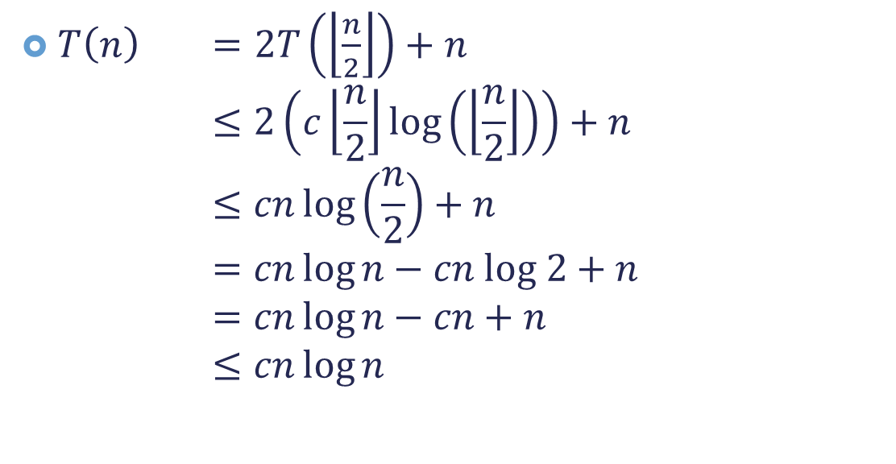
取代法-例子
$T\left(n\right) =2T\left(\left\lfloor \frac{n}{2}\right\rfloor \right)+n$ $≤2\left(c\left\lfloor \frac{n}{2}\right\rfloor \log\left(\left\lfloor \frac{n}{2}\right\rfloor \right)\right)+n$ $≤cn\log\left(\frac{n}{2}\right)+n$ $=cn\log{n}−cn log 2+n$ $=cn\log{n}−cn+n$ $≤cn\log{n}$
as long as $c≥1$

Slide 17
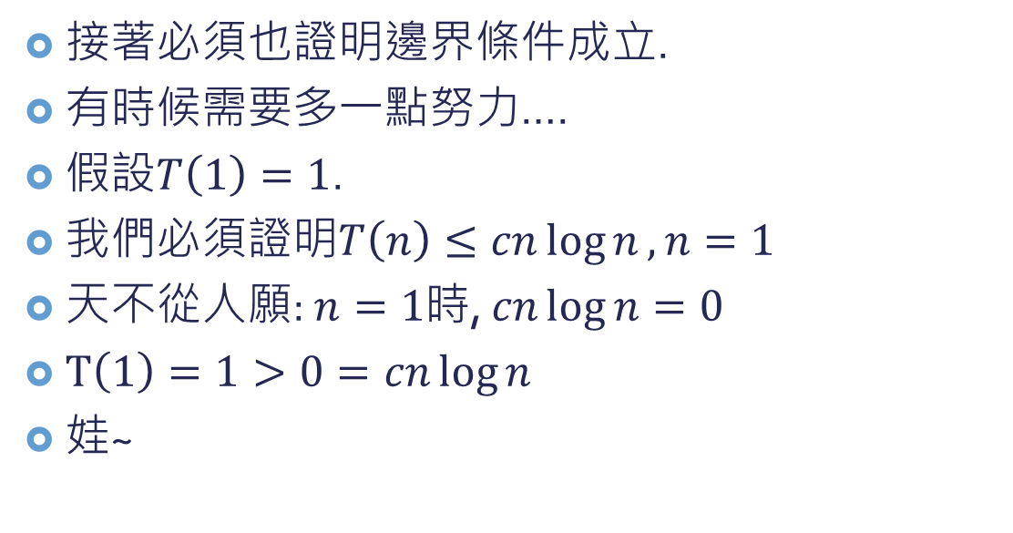
取代法-例子
接著必須也證明邊界條件成立.
有時候需要多一點努力….
假設$T\left(1\right)=1$.
我們必須證明$T\left(n\right)≤cn\log{n}, n=1$
天不從人願: $n=1$時, $cn\log{n}=0$
$T\left(1\right)=1>0=cn\log{n}$
娃~

Slide 18
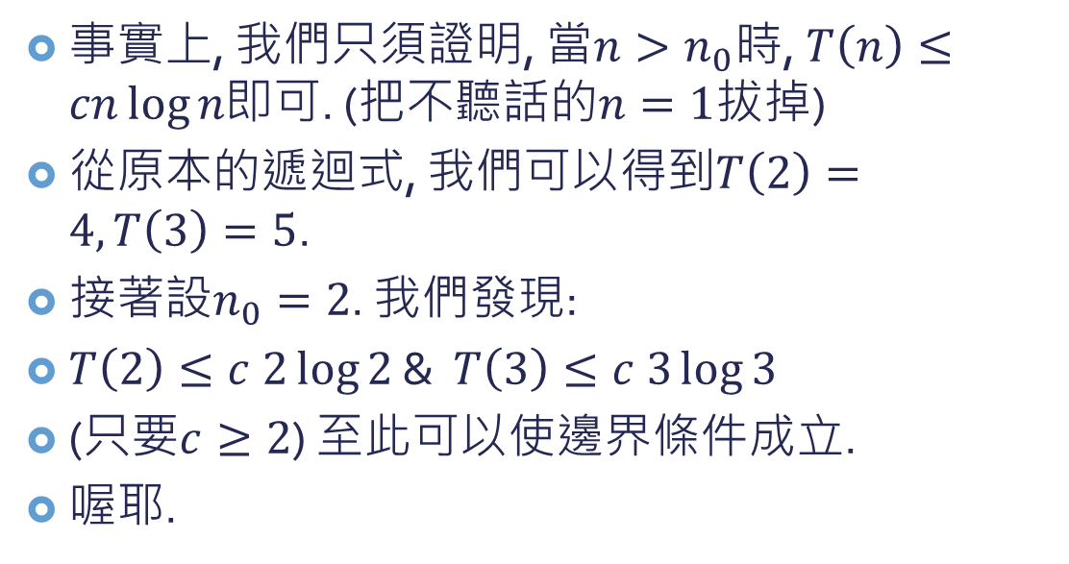
取代法-例子
事實上, 我們只須證明, 當$n>n_{0}$時, $T\left(n\right)≤cn\log{n}$即可. (把不聽話的$n=1$拔掉)
從原本的遞迴式, 我們可以得到$T\left(2\right)=4, T\left(3\right)=5$.
接著設$n_{0}=2$. 我們發現:
$T\left(2\right)≤c 2\log{2}$ & $T\left(3\right)≤c 3\log{3}$
(只要$c≥2$) 至此可以使邊界條件成立.
喔耶.

Slide 19
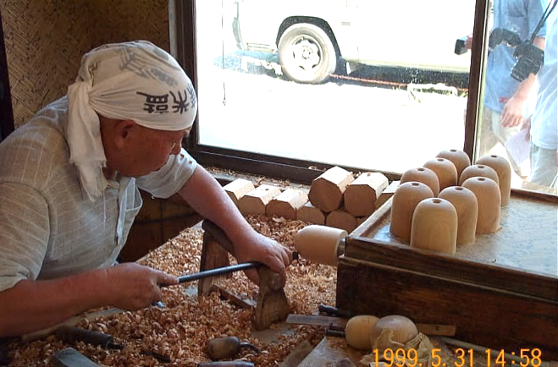

取代法-怎麼猜?
老工匠
靠經驗.
跟沒講一樣.
一些小方法:
根據以前看過類似的遞迴式來猜測
使用等一下要介紹的遞迴樹
證明比較鬆的upper bound或lower bound來慢慢接近tight bound
$$T\left(n\right)=2T\left(\left\lfloor \frac{n}{2}\right\rfloor +17\right)+n$$

Slide 20
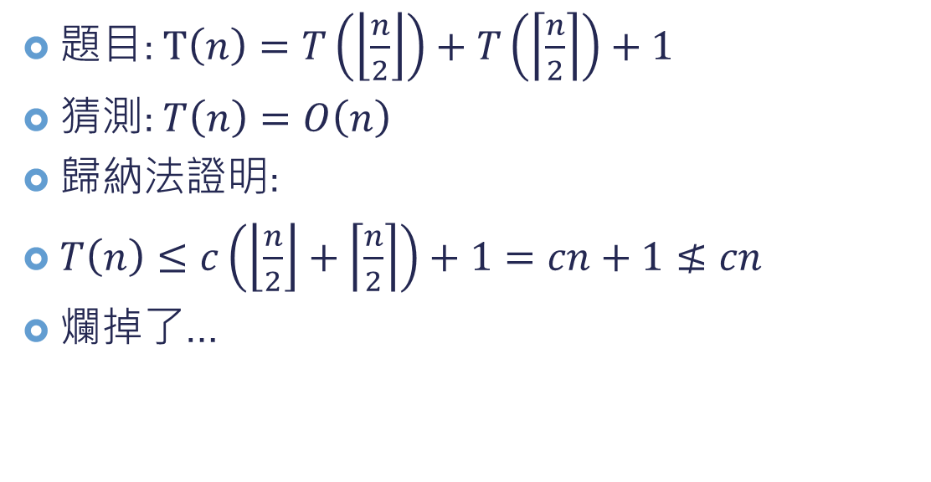
取代法-小技巧1
題目: $T\left(n\right)=T\left(\left\lfloor \frac{n}{2}\right\rfloor \right)+T\left(\left\lceil \frac{n}{2}\right\rceil \right)+1$
猜測: $T\left(n\right)=O\left(n\right)$
歸納法證明:
$T\left(n\right)≤c\left(\left\lfloor \frac{n}{2}\right\rfloor +\left\lceil \frac{n}{2}\right\rceil \right)+1=cn+1≰cn$
爛掉了…

Slide 21
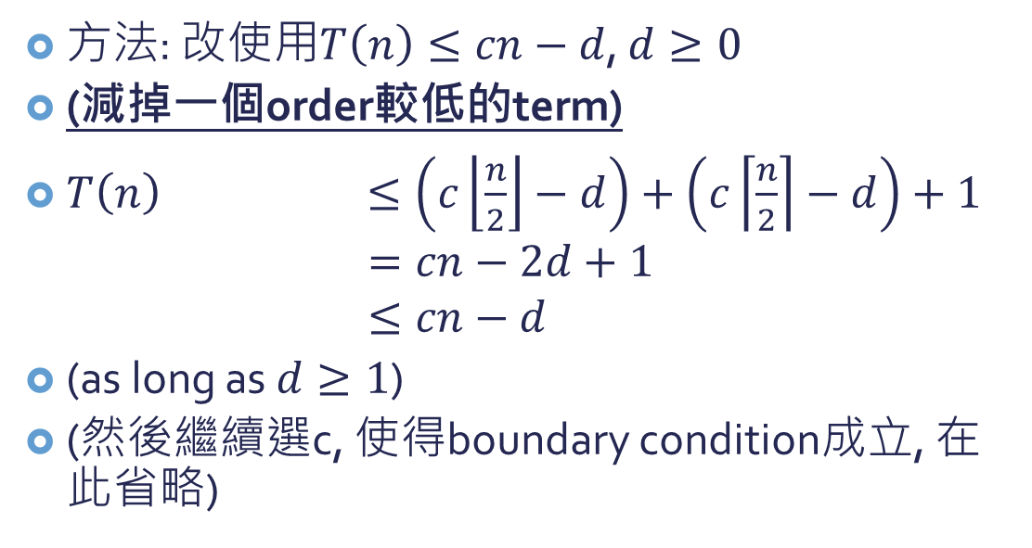
取代法-小技巧1
方法: 改使用$T\left(n\right)≤cn−d$, $d≥0$
(減掉一個order較低的term)
$T\left(n\right) ≤\left(c\left\lfloor \frac{n}{2}\right\rfloor −d\right)+\left(c\left\lceil \frac{n}{2}\right\rceil −d\right)+1$ $=cn−2d+1$ $≤cn−d$
(as long as $d≥1$)
(然後繼續選c, 使得boundary condition成立, 在此省略)

Slide 22
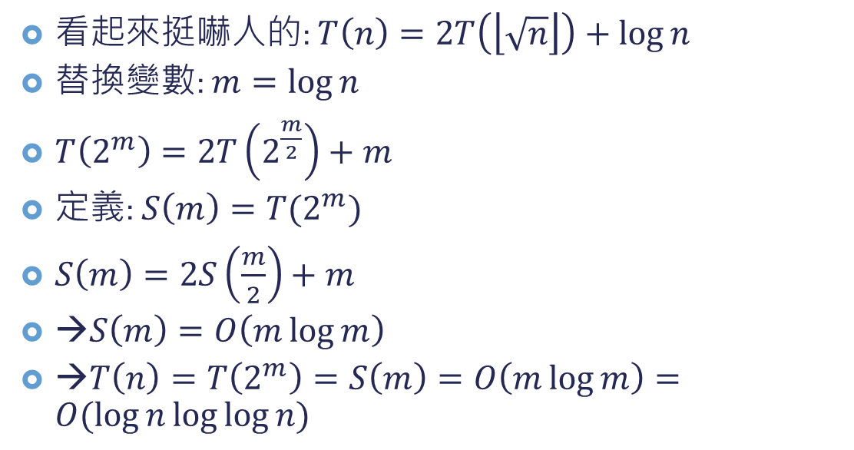
取代法–小技巧2
看起來挺嚇人的: $T\left(n\right)=2T\left(\left\lfloor \sqrt{n}\right\rfloor \right)+\log{n}$
替換變數: $m=\log{n}$
$T\left(2^{m}\right)=2T\left(2^{\frac{m}{2}}\right)+m$
定義: $S\left(m\right)=T(2^{m})$
$S\left(m\right)=2S\left(\frac{m}{2}\right)+m$
→$S\left(m\right)=O\left(m\log{m}\right)$
→$T\left(n\right)=T\left(2^{m}\right)=S\left(m\right)=O\left(m\log{m}\right)=O(\log{n}\log{\log{n}})$
暫時不管flooring

Slide 23
遞迴樹法
畫出遞迴樹
用比較不嚴謹的方法加總得到解
用數學歸納法證明此解成立

Slide 24


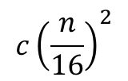

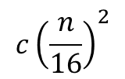




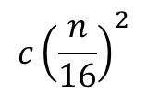
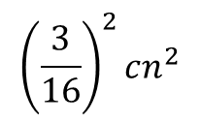



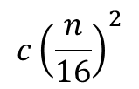



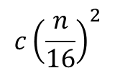
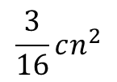



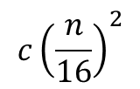
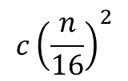







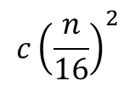
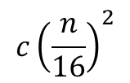




遞迴樹法–例子1
例子: $T\left(n\right)=3T\left(\left\lfloor \frac{n}{4}\right\rfloor \right)+Θ\left(n^{2}\right)$
level $0$
$$T(n)$$
$$cn^{2}$$
$$cn^{2}$$
level $1$
$$c{\left(\frac{n}{4}\right)}^{2}$$
$$c{\left(\frac{n}{4}\right)}^{2}$$
$$T(\frac{n}{4})$$
$$T(\frac{n}{4})$$
$$c{\left(\frac{n}{4}\right)}^{2}$$
$$\frac{3}{16}cn^{2}$$
$$T(\frac{n}{4})$$
$$T(\frac{n}{16})$$
$$T(\frac{n}{16})$$
$$T(\frac{n}{16})$$
$$T(\frac{n}{16})$$
$$T(\frac{n}{16})$$
$$T(\frac{n}{16})$$
$$T(\frac{n}{16})$$
$$T(\frac{n}{16})$$
$$T(\frac{n}{16})$$
$${\left(\frac{3}{16}\right)}^{2}cn^{2}$$
level $2$
$$c{\left(\frac{n}{16}\right)}^{2}$$
$$c{\left(\frac{n}{16}\right)}^{2}$$
$$c{\left(\frac{n}{16}\right)}^{2}$$
$$c{\left(\frac{n}{16}\right)}^{2}$$
$$c{\left(\frac{n}{16}\right)}^{2}$$
$$c{\left(\frac{n}{16}\right)}^{2}$$
$$c{\left(\frac{n}{16}\right)}^{2}$$
$$c{\left(\frac{n}{16}\right)}^{2}$$
$$c{\left(\frac{n}{16}\right)}^{2}$$
$$T(1)$$
…………………………………………………………
$$T(1)$$
$$Θ\left(n^{\log_{4}{3}}\right)$$
level $\log_{4}{n}$
$3^{\log_{4}{n}}=n^{\log_{4}{3}}$個node

Slide 25
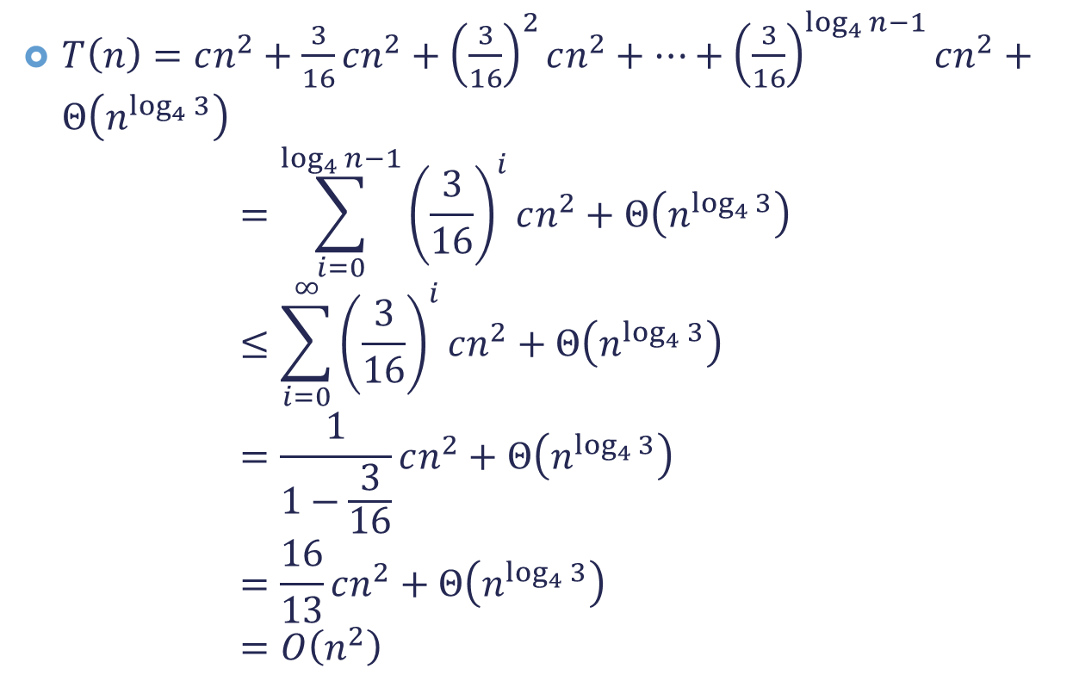
遞迴樹法–例子1
$T\left(n\right)=cn^{2}+\frac{3}{16}cn^{2}+{\left(\frac{3}{16}\right)}^{2}cn^{2}+…+{\left(\frac{3}{16}\right)}^{\log_{4}{n}−1}cn^{2}+Θ\left(n^{\log_{4}{3}}\right)$ $=\sum_{i=0}^{\log_{4}{n}−1}{{\left(\frac{3}{16}\right)}^{i}cn^{2}+Θ\left(n^{\log_{4}{3}}\right)}$ $≤\sum_{i=0}^{∞}{{\left(\frac{3}{16}\right)}^{i}cn^{2}+Θ\left(n^{\log_{4}{3}}\right)}$ $=\frac{1}{1−\frac{3}{16}}cn^{2}+Θ\left(n^{\log_{4}{3}}\right)$ $=\frac{16}{13}cn^{2}+Θ\left(n^{\log_{4}{3}}\right)$ $=O\left(n^{2}\right)$

Slide 26

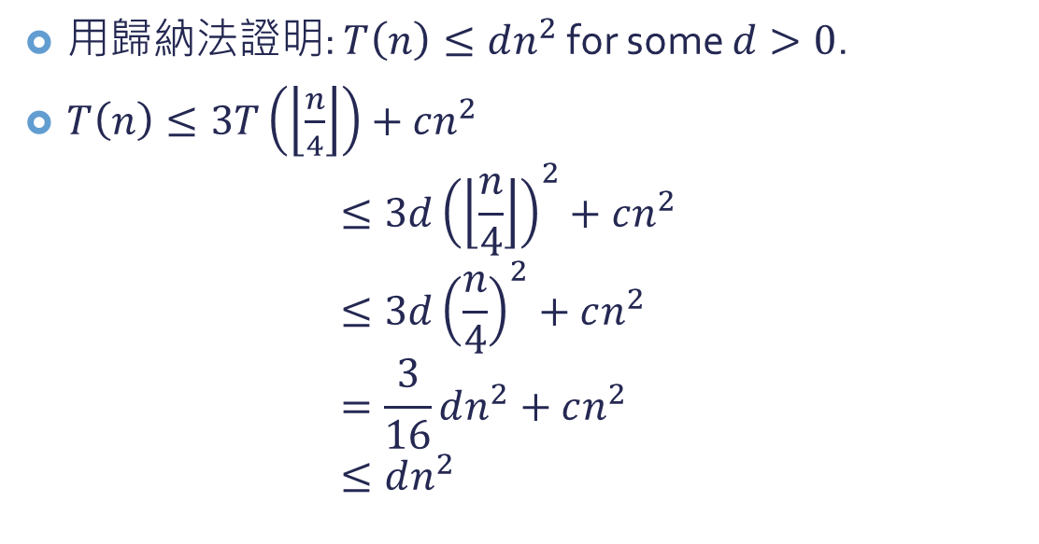
遞迴樹法–例子1
用歸納法證明: $T\left(n\right)≤dn^{2}$ for some $d>0$.
$T\left(n\right)≤3T\left(\left\lfloor \frac{n}{4}\right\rfloor \right)+cn^{2}$ $≤3d{\left(\left\lfloor \frac{n}{4}\right\rfloor \right)}^{2}+cn^{2}$ $≤3d{\left(\frac{n}{4}\right)}^{2}+cn^{2}$ $=\frac{3}{16}dn^{2}+cn^{2}$ $≤dn^{2}$
as long as $d≥\left(\frac{16}{13}\right)c$

Slide 27

遞迴樹法–例子2
例子: $T\left(n\right)=T\left(\frac{n}{3}\right)+T\left(\frac{2n}{3}\right)+O\left(n\right)$
請一位同學上來畫遞迴樹 (有點跛腳的遞迴樹)

Slide 28

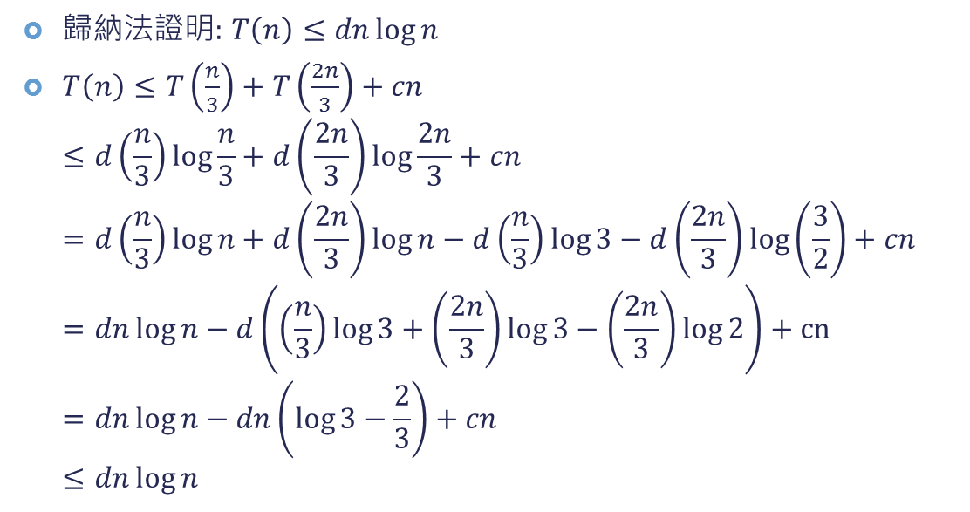
遞迴樹法–例子2
歸納法證明: $T\left(n\right)≤dn\log{n}$
$T\left(n\right)≤T\left(\frac{n}{3}\right)+T\left(\frac{2n}{3}\right)+cn$ $≤d\left(\frac{n}{3}\right)\log{\frac{n}{3}}+d\left(\frac{2n}{3}\right)\log{\frac{2n}{3}}+cn$ $=d\left(\frac{n}{3}\right)\log{n}+d\left(\frac{2n}{3}\right)\log{n}−d\left(\frac{n}{3}\right)\log{3}−d\left(\frac{2n}{3}\right)\log\left(\frac{3}{2}\right)+cn$ $=dn\log{n}−d\left(\left(\frac{n}{3}\right)\log{3}+\left(\frac{2n}{3}\right)\log{3}−\left(\frac{2n}{3}\right)\log{2}\right)+cn$ $=dn\log{n}−dn\left(\log{3}−\frac{2}{3}\right)+cn$ $≤dn\log{n}$
as long as $d≥\frac{c}{\log{3}−\frac{2}{3}}$

Slide 29

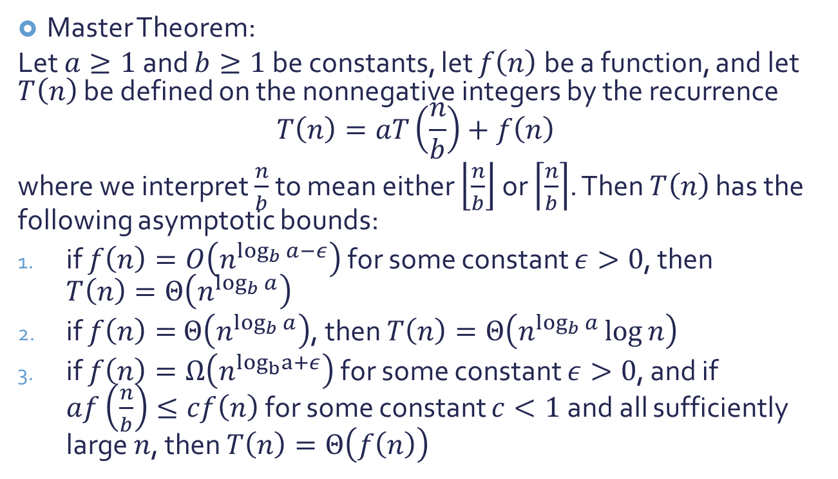
大師定理
Master Theorem:
Let $a≥1$and $b≥1$be constants, let $f\left(n\right)$ be a function, and let $T\left(n\right)$ be defined on the nonnegative integers by the recurrence $$T\left(n\right)=aT\left(\frac{n}{b}\right)+f\left(n\right)$$
where we interpret $\frac{n}{b}$ to mean either $\left\lfloor \frac{n}{b}\right\rfloor$ or $\left\lceil \frac{n}{b}\right\rceil$. Then $T\left(n\right)$ has the following asymptotic bounds:
if $f\left(n\right)=O\left(n^{\log_{b}{a−ε}}\right)$ for some constant $ε>0$, then $T\left(n\right)=Θ\left(n^{\log_{b}{a}}\right)$
if $f\left(n\right)=$ $Θ\left(n^{\log_{b}{a}}\right)$, then $T\left(n\right)=Θ\left(n^{\log_{b}{a}}\log{n}\right)$
if $f\left(n\right)=Ω\left(n^{\log_{b}a+ε}\right)$ for some constant $ε>0$, and if $af\left(\frac{n}{b}\right)≤cf\left(n\right)$ for some constant $c<1$and all sufficiently large $n$, then $T\left(n\right)=Θ\left(f\left(n\right)\right)$

Slide 30

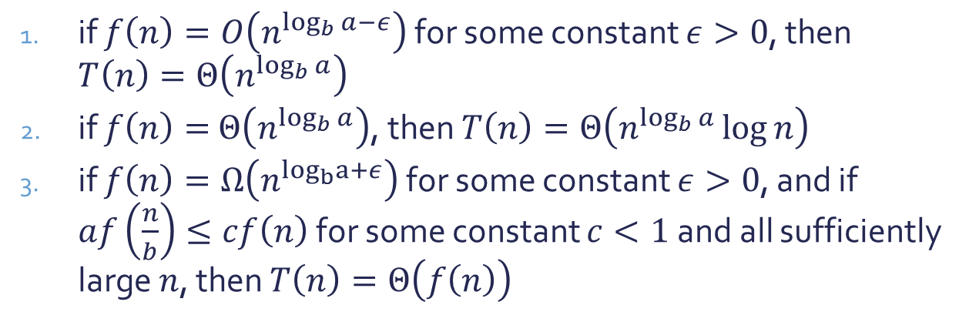


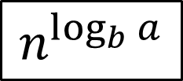
大師定理
$n^{\log_{b}{a}}$is larger
if $f\left(n\right)=O\left(n^{\log_{b}{a−ε}}\right)$ for some constant $ε>0$, then $T\left(n\right)=Θ\left(n^{\log_{b}{a}}\right)$
if $f\left(n\right)=$ $Θ\left(n^{\log_{b}{a}}\right)$, then $T\left(n\right)=Θ\left(n^{\log_{b}{a}}\log{n}\right)$
if $f\left(n\right)=Ω\left(n^{\log_{b}a+ε}\right)$ for some constant $ε>0$, and if $af\left(\frac{n}{b}\right)≤cf\left(n\right)$ for some constant $c<1$and all sufficiently large $n$, then $T\left(n\right)=Θ\left(f\left(n\right)\right)$
The same order
$f(n)$is larger
Which one is polynomially larger/smaller?
$$f(n)$$
$$n^{\log_{b}{a}}$$
Note: not all possibilities for $f\left(n\right)$ can be covered by these 3 cases!

Slide 31


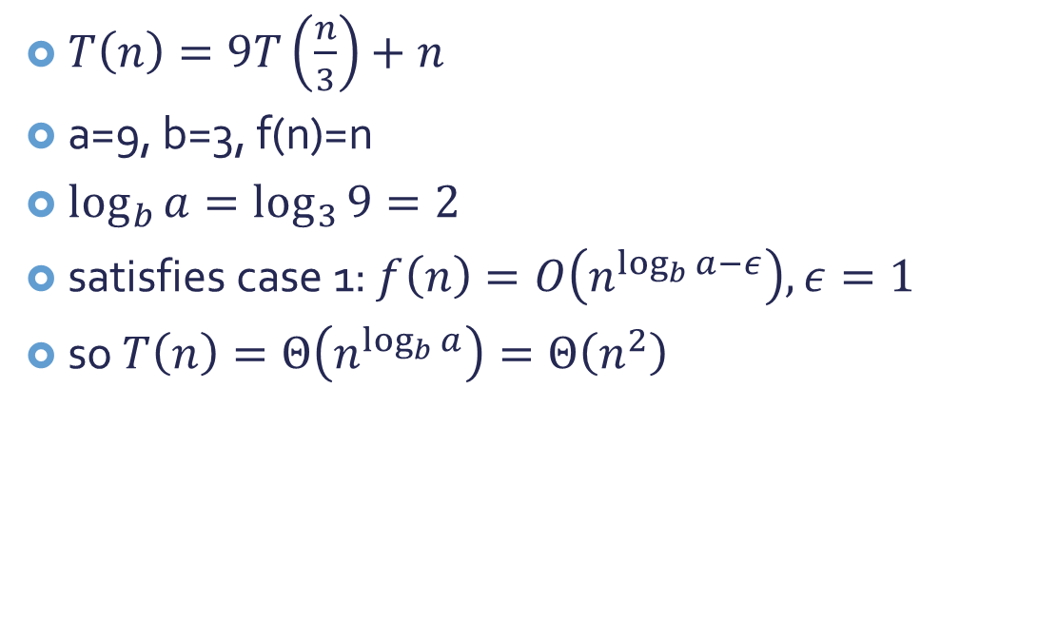

大師定理-例子1
$T\left(n\right)=9T\left(\frac{n}{3}\right)+n$
a=9, b=3, f(n)=n
$\log_{b}{a}=\log_{3}{9}=2$
satisfies case 1: $f\left(n\right)=O\left(n^{\log_{b}{a−ε}}\right), ε=1$
so $T\left(n\right)=Θ\left(n^{\log_{b}{a}}\right)=Θ\left(n^{2}\right)$
For your reference: $T\left(n\right)=aT\left(\frac{n}{b}\right)+f\left(n\right)$
$$f(n)$$
$$n^{\log_{b}{a}}$$

Slide 32
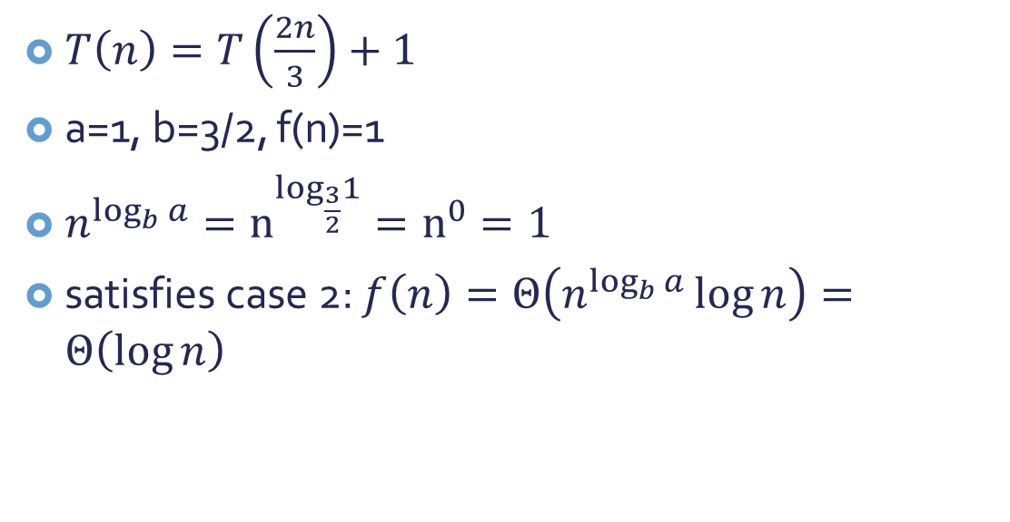
大師定理-例子2
$T\left(n\right)=T\left(\frac{2n}{3}\right)+1$
a=1, b=3/2, f(n)=1
$n^{\log_{b}{a}}=n^{\log_{\frac{3}{2}}1}=n^{0}=1$
satisfies case 2: $f\left(n\right)=Θ\left(n^{\log_{b}{a}}\log{n}\right)=Θ\left(\log{n}\right)$
For your reference: $T\left(n\right)=aT\left(\frac{n}{b}\right)+f\left(n\right)$
$$f(n)$$
$$n^{\log_{b}{a}}$$

Slide 33
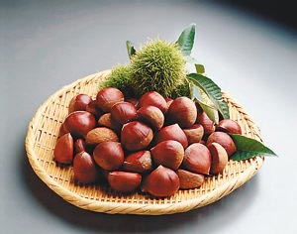
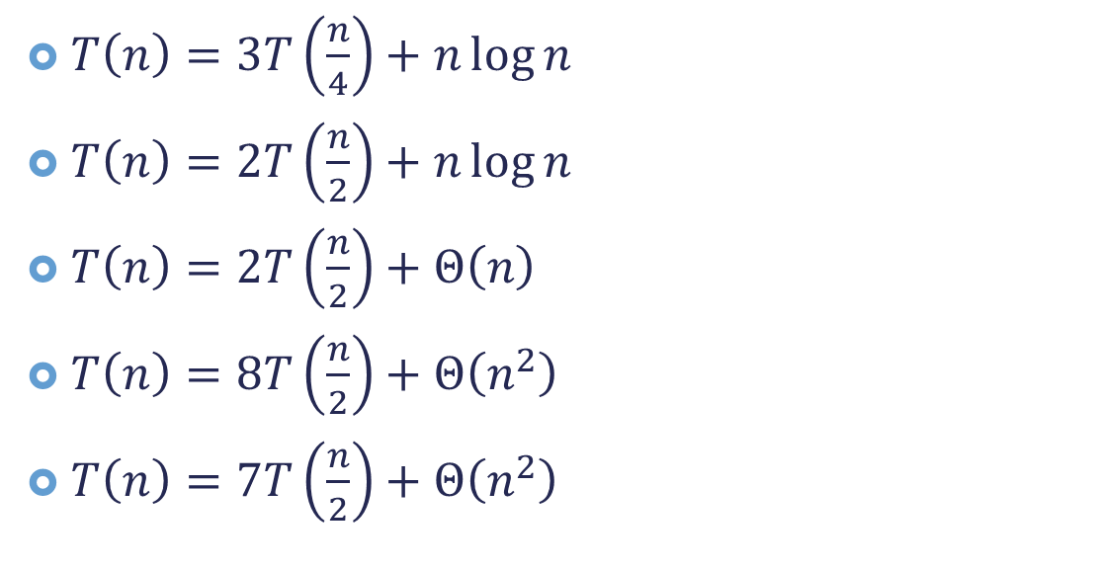
大師定理-更多例子
上台解題時間…
$T\left(n\right)=3T\left(\frac{n}{4}\right)+n\log{n}$
$T\left(n\right)=2T\left(\frac{n}{2}\right)+n\log{n}$
$T\left(n\right)=2T\left(\frac{n}{2}\right)+Θ\left(n\right)$
$T\left(n\right)=8T\left(\frac{n}{2}\right)+Θ\left(n^{2}\right)$
$T\left(n\right)=7T\left(\frac{n}{2}\right)+Θ\left(n^{2}\right)$

Slide 34
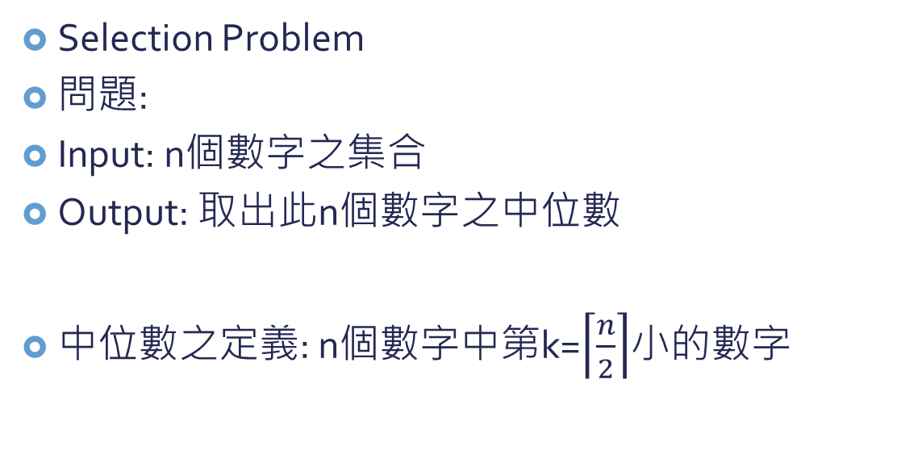
取數問題
Selection Problem
問題:
Input: n個數字之集合
Output: 取出此n個數字之中位數
中位數之定義: n個數字中第k=$\left\lceil \frac{n}{2}\right\rceil$小的數字

Slide 35


取數問題
菜瓜布解法:
先把n個數sort好
從最小的數過去算到第$k$小的數字即為答案
running time=?
$Ω(n\log{n})$
Can we do a better job?

Slide 36




取數問題
n個數
某數a (pivot)
$$L_{2}$$
$$L_{1}$$
小於等於a的
大於a的
if $k>\left|L_{2}\right|,$ 找$L_{1}$中第$k−\left|L_{2}\right|$小的
if $k≤\left|L_{2}\right|,$ 找$L_{2}$中第$k$小的

Slide 37

取數問題
下一個問題: 怎麼選a?
選不好的話…$L_{1}=n, L_{2}=0$
最好是可以平均分成兩分.
那就是選中位數.
咦, 我們不是就要找中位數嗎?
能不能花少一點時間, 找個”差不多”的中位數

Slide 38
取數問題
差不多的中位數:
把n個數分成很多大小為5個的sub list (大約共有n/5個sub list
這些sub list中各自找中位數
找出n/5個中位數中的中位數
→此為差不多的中位數

Slide 39




取數問題
$$\frac{3n}{5}$$
$$\frac{3n}{10}$$
有多差不多呢?
比”差不多中位數”小的至少有$\frac{3n}{10}$
$\left|L_{2}\right|≥\frac{3n}{10}$
$\left|L_{1}\right|≤\frac{7n}{10}$
$n/5$個中位數
中位數的中位數

Slide 40









取數問題
Algorithm:
if $n≤5$ then 直接找出其中位數
else
把數列拆成$\frac{n}{5}$個大小為5的小數列
每個小數列找出其中位數
找出$\frac{n}{5}$個中位數的中位數m
用此中位數把原本的數列拆成兩部分: 比m大($L_{1}$)及不比m大的($L_{2}$)
if $k>\left|L_{2}\right|,$ 找$L_{1}$中第$k−\left|L_{2}\right|$小的
if $k≤\left|L_{2}\right|,$ 找$L_{2}$中第$k$小的
$$Θ(1)$$
$$Θ(n)$$
$$Θ(n)$$
$$T(\frac{n}{5})$$
$$Θ(n)$$
Max: $T(\frac{7n}{10})$
$$T\left(n\right)=Θ\left(n\right)+Θ\left(n\right)+T\left(\frac{n}{5}\right)+Θ\left(n\right)+T\left(\frac{7n}{10}\right) \\ =T\left(\frac{n}{5}\right)+T\left(\frac{7n}{10}\right)+Θ(n)$$
$$T\left(n\right)=Θ\left(n\right)$$

Slide 41
Today’s Reading Assignment
Cormen ch 4.2 – 4.5

