Slide 1
Advanced Graph
Homer Lee
2013/10/31

Slide 2
Reference
Slides from Prof. Ya-Yunn Su’s and Prof. Hsueh-I Lu’s course

Slide 3
Today’s goal
Flow networks
Ford-Fulkerson (and Edmonds-Karp)
Bipartite matching

Slide 4
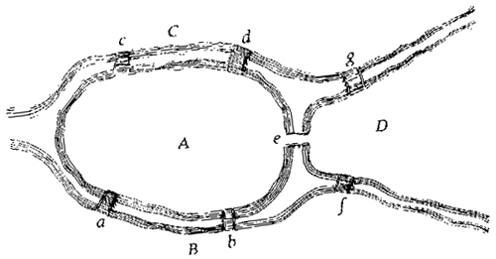
Flow networks

Slide 5
Network
1
4
2
*
s
2
t
3
3
1
A directed graph G, each of whose edges has a capacity
Two nodes s and t of G
Denoted as (G,s,t)

Slide 6
Flow
1
1
4
1
2
2
1
s
2
t
3
2
1
3
A flow of network (G,s,t) is (weighted) subgraph of G satisfying the capacity constraint and the conservation law

Slide 7
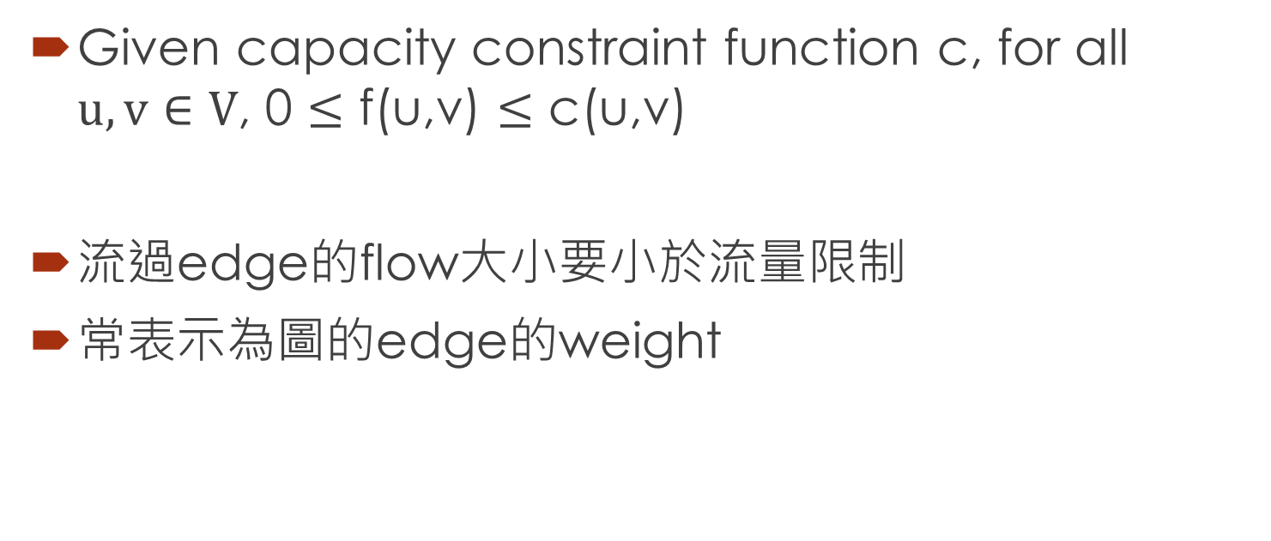
Capacity constraint
1
1
4
2
2
1
1
s
2
3
2
1
3
Given capacity constraint function c, for all $u,v∈V$, 0 $≤$ f(u,v) $≤$ c(u,v)
流過edge的flow大小要小於流量限制
常表示為圖的edge的weight

Slide 8
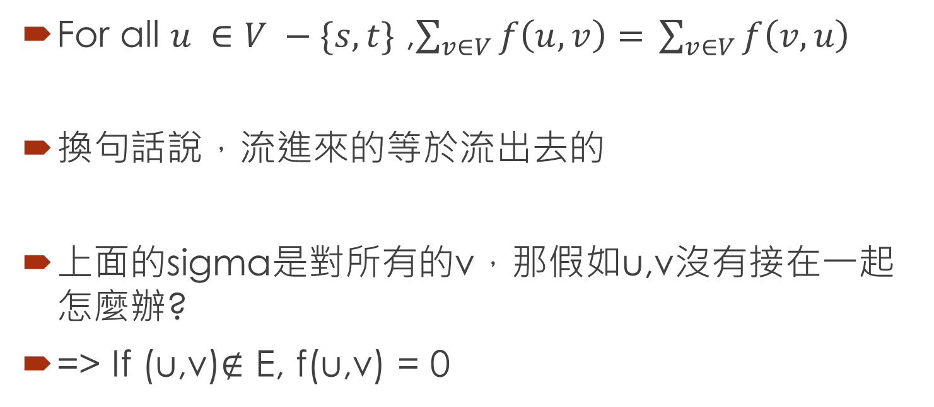
Conservation Law
1
1
4
2
2
1
1
s
2
3
2
1
3
For all $u ∈V −\{s,t\}$ ,$\sum_{v∈V}{f\left(u,v\right)= }\sum_{v∈V}{f\left(v,u\right) }$
換句話說，流進來的等於流出去的
上面的sigma是對所有的v，那假如u,v沒有接在一起怎麼辦?
=> If (u,v)∉ E, f(u,v) = 0

Slide 9
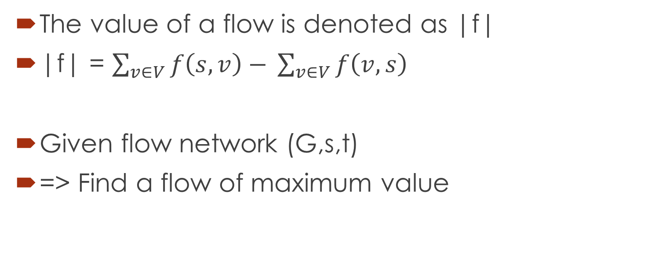
What’s maximum flow problem?
The value of a flow is denoted as |f|
|f| = $\sum_{v∈V}{f\left(s,v\right)− }\sum_{v∈V}{f\left(v,s\right) }$
Given flow network (G,s,t)
=> Find a flow of maximum value

Slide 10
A famous theorem
Maximum flow ←→ Minimum cut

Slide 11
How to solve the problem?
1
2
1
s
2
t
2
1
1

Slide 12
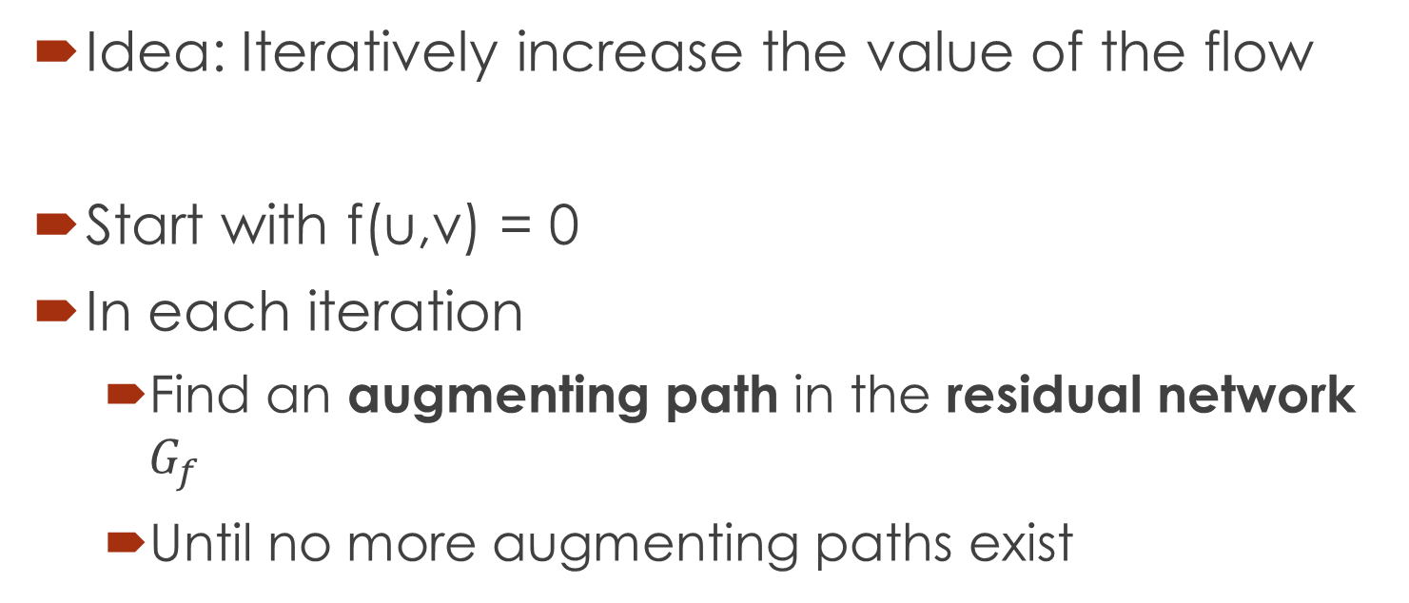
Ford-Fulkerson
Idea: Iteratively increase the value of the flow
Start with f(u,v) = 0
In each iteration
Find an augmenting path in the residual network $G_{f}$
Until no more augmenting paths exist

Slide 13
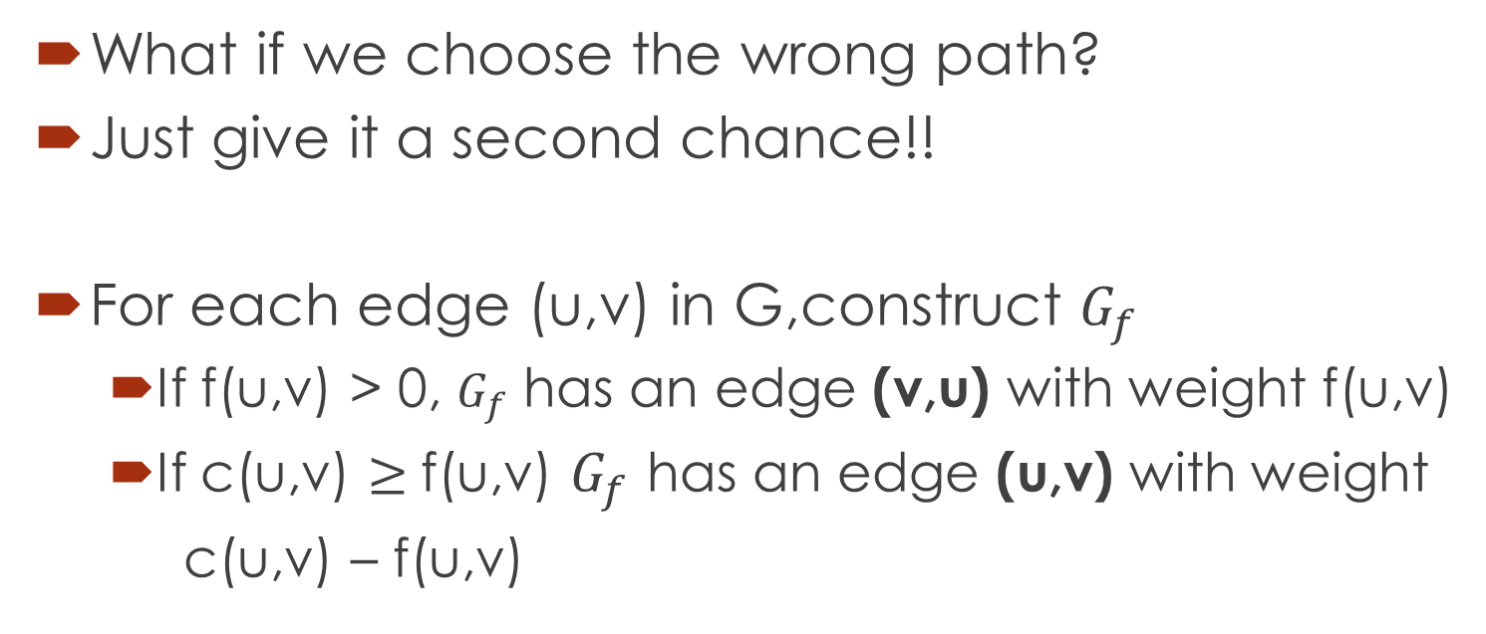
Residual Network
What if we choose the wrong path?
Just give it a second chance!!
For each edge (u,v) in G,construct $G_{f}$
If f(u,v) > 0, $G_{f}$ has an edge (v,u) with weight f(u,v)
If c(u,v) $≥$f(u,v) $G_{f}$ has an edge (u,v) with weight
c(u,v) – f(u,v)

Slide 14
illustration
1
1
4
2
2
1
1
s
2
t
3
2
1
1
3
1
2
1
1
1
2
s
1
t
2
1
2
1
1

Slide 15
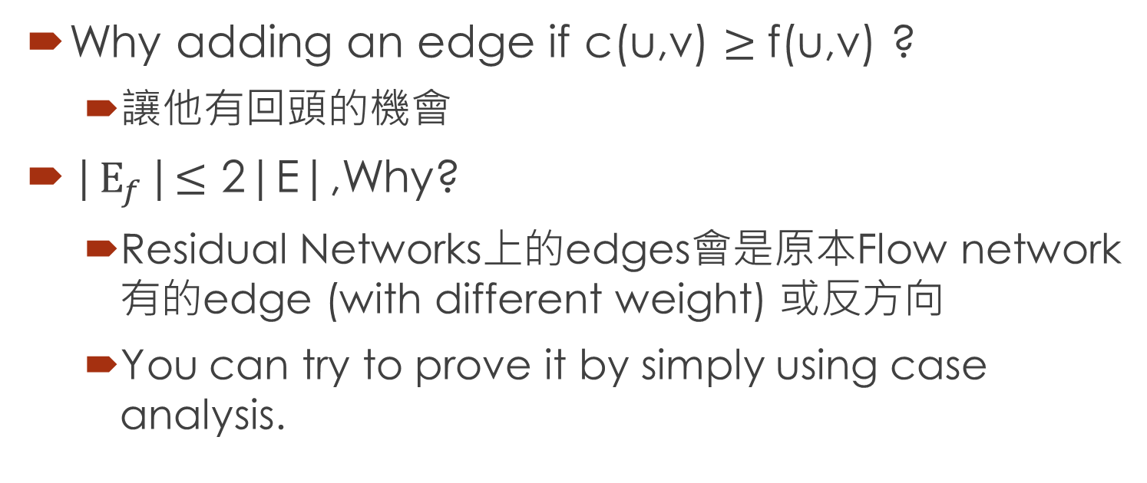
Some notes
Why adding an edge if c(u,v) $≥$f(u,v) ?
讓他有回頭的機會
|$E_{f}$|$≤$ 2|E|,Why?
Residual Networks上的edges會是原本Flow network有的edge (with different weight) 或反方向
You can try to prove it by simply using case analysis.

Slide 16
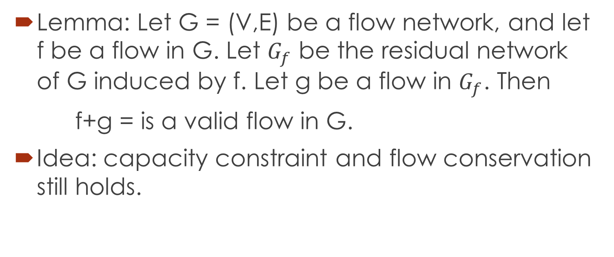
How can residual network help us?
Lemma: Let G = (V,E) be a flow network, and let f be a flow in G. Let $G_{f}$ be the residual network of G induced by f. Let g be a flow in $G_{f}$. Then
f+g = is a valid flow in G.
Idea: capacity constraint and flow conservation still holds.

Slide 17
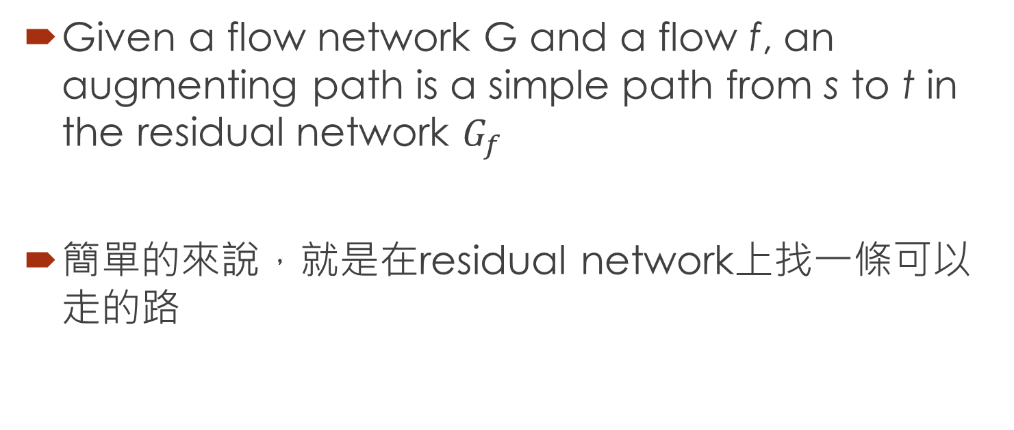
Augmenting paths
Given a flow network G and a flow f, an augmenting path is a simple path from s to t in the residual network $G_{f}$
簡單的來說，就是在residual network上找一條可以走的路

Slide 18
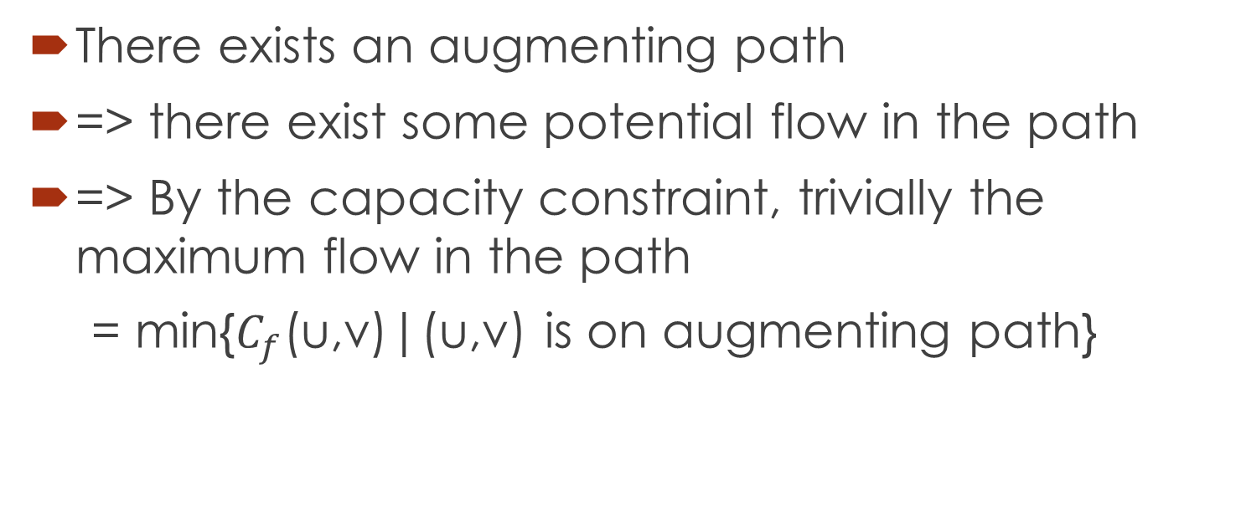
How can Augmenting paths help us?
There exists an augmenting path
=> there exist some potential flow in the path
=> By the capacity constraint, trivially the maximum flow in the path
= min{$C_{f}$(u,v)|(u,v) is on augmenting path}

Slide 19
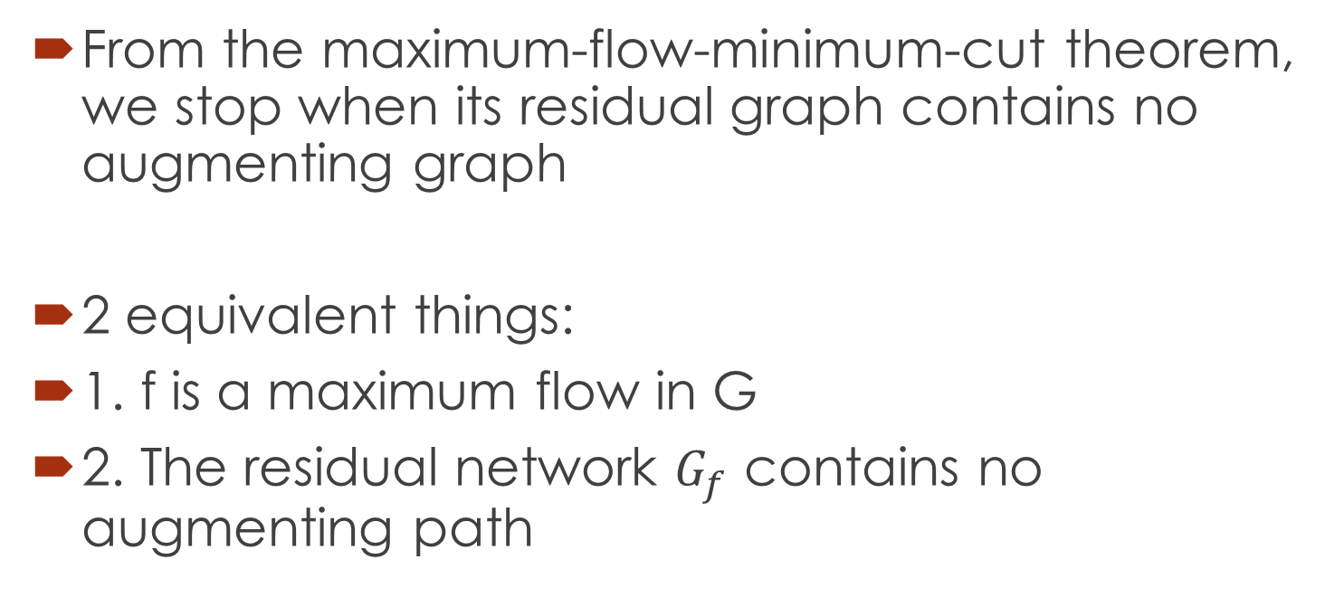
How do we know when we have found maximum flow?
From the maximum-flow-minimum-cut theorem, we stop when its residual graph contains no augmenting graph
2 equivalent things:
1. f is a maximum flow in G
2. The residual network $G_{f}$ contains no augmenting path

Slide 20
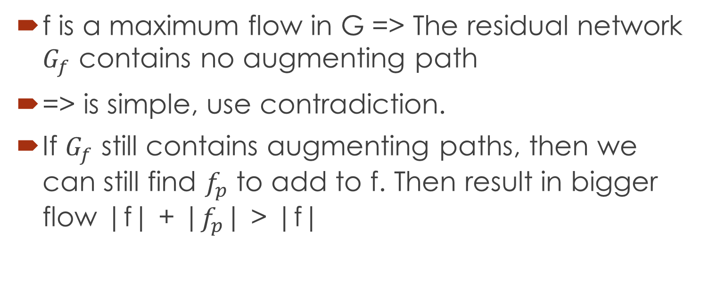
Let’s prove it!
f is a maximum flow in G => The residual network $G_{f}$ contains no augmenting path
=> is simple, use contradiction.
If $G_{f}$ still contains augmenting paths, then we can still find $f_{p}$ to add to f. Then result in bigger flow |f| + |$f_{p}$| > |f|

Slide 21
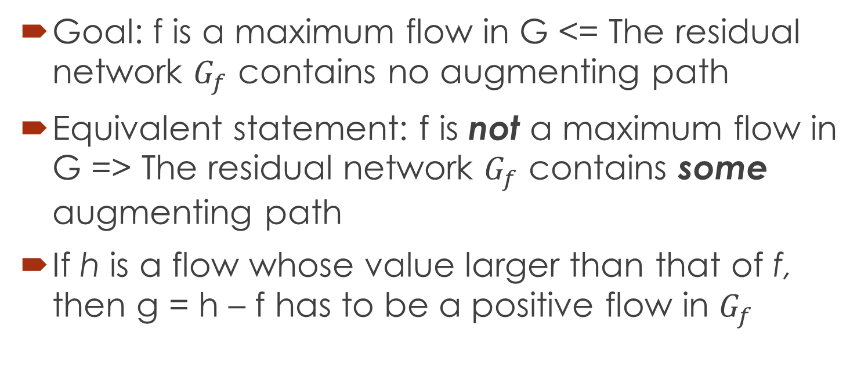
Let’s prove it!!
Goal: f is a maximum flow in G <= The residual network $G_{f}$ contains no augmenting path
Equivalent statement: f is not a maximum flow in G => The residual network $G_{f}$ contains some augmenting path
If h is a flow whose value larger than that of f, then g = h – f has to be a positive flow in $G_{f}$

Slide 22
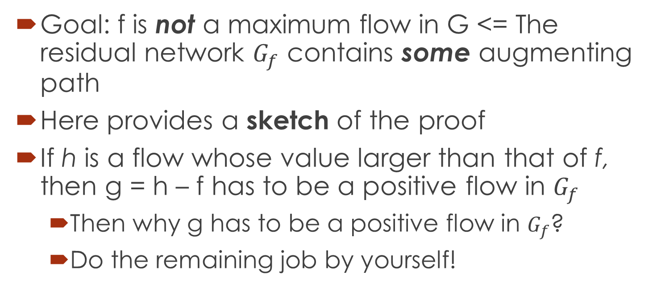
Let’s prove it!!!
Goal: f is not a maximum flow in G <= The residual network $G_{f}$ contains some augmenting path
Here provides a sketch of the proof
If h is a flow whose value larger than that of f, then g = h – f has to be a positive flow in $G_{f}$
Then why g has to be a positive flow in $G_{f}$?
Do the remaining job by yourself!

Slide 23
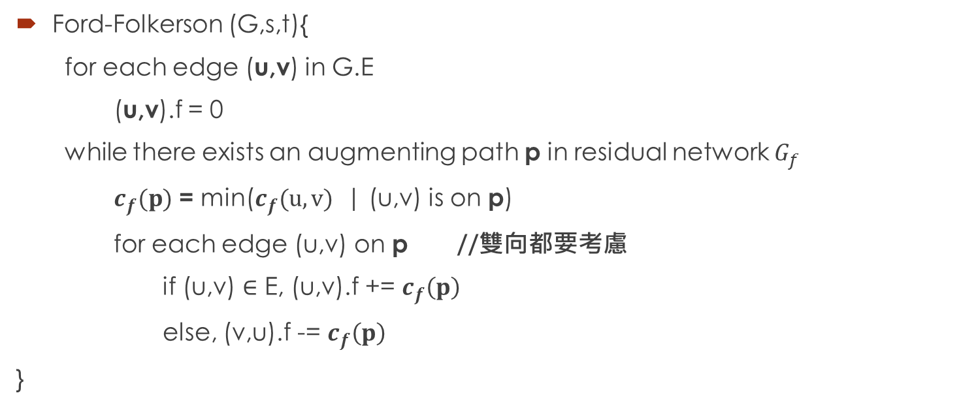
Pseudo code
Ford-Folkerson (G,s,t){
for each edge (u,v) in G.E
(u,v).f = 0
while there exists an augmenting path p in residual network $G_{f}$
$c_{f}(p)$ = min($c_{f}(u,v)$ | (u,v) is on p)
for each edge (u,v) on p //雙向都要考慮
if (u,v) $∈$ E, (u,v).f += $c_{f}\left(p\right)$
else, (v,u).f -= $c_{f}\left(p\right)$
}

Slide 24
Example:
1
4
2
s
2
t
3
3
1

Slide 25
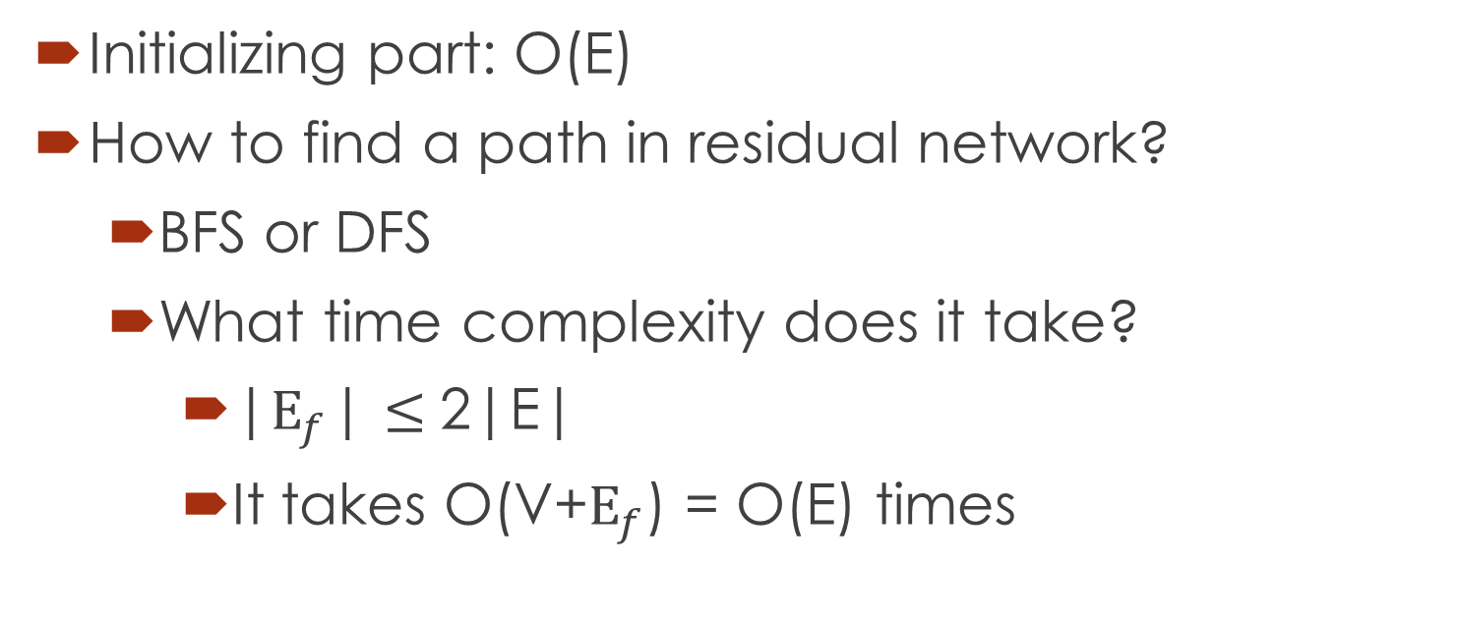
Running time analysis
Initializing part: O(E)
How to find a path in residual network?
BFS or DFS
What time complexity does it take?
|$E_{f}$| $≤$2|E|
It takes O(V+$E_{f}$) = O(E) times

Slide 26
Running time analysis
If the edge capacity are integer, and f be the maximum flow of the network
The for-loop may be executed at most f times(increment by 1 unit at a time)
Each time takes O(E) times
Totally O(E)+O(E)*O(f) = O(Ef)
=> This depends on f, not a good idea

Slide 27
Issues
What is C is not an integer?(each time the amount that the augmenting path adding has no lower-bound)
How can we improve this bound?
(Edmonds-Karp)

Slide 28
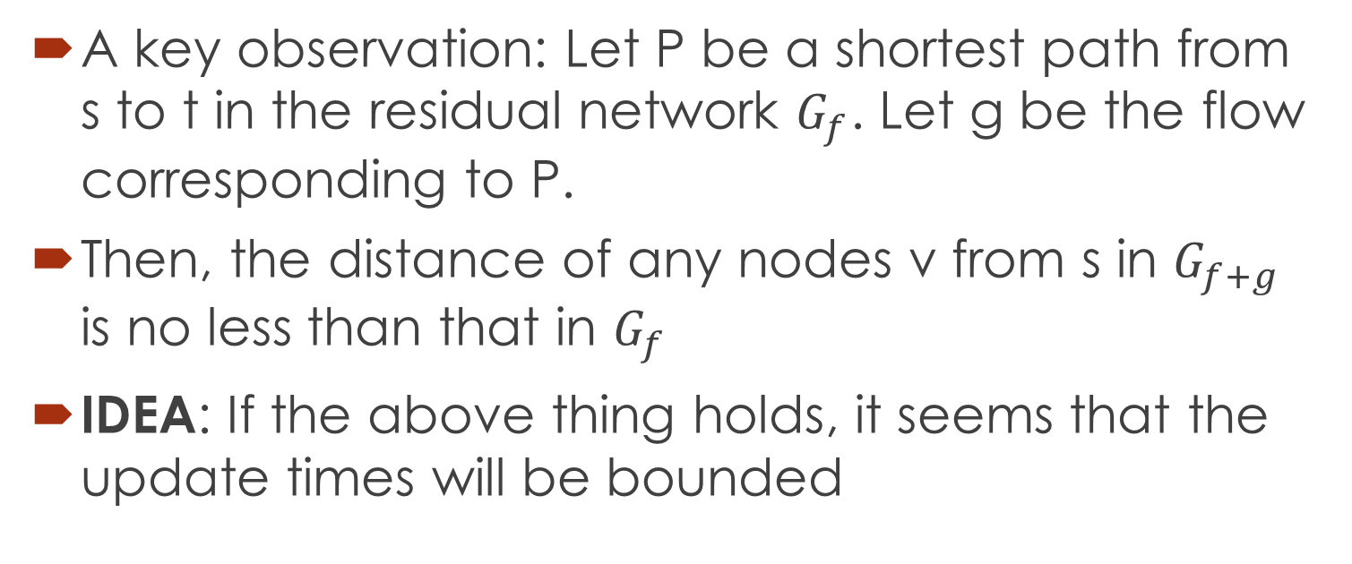
To improve the time complexity
A key observation: Let P be a shortest path from s to t in the residual network $G_{f}$. Let g be the flow corresponding to P.
Then, the distance of any nodes v from s in $G_{f+g}$ is no less than that in $G_{f}$
IDEA: If the above thing holds, it seems that the update times will be bounded

Slide 29
2
1
3
2
2
1
1
s
2
t
3
2
1
1
3
1
1
2
2
2
1
1
1
1
0
1
1
3
2
2
1
1
1
2
1

Slide 30
2
1
3
3
2
1
2
s
2
t
3
3
1
1
3
1
1
2
3
2
1
1
1
0
2
5
3
2
1
3
4
1
1

Slide 31
2
2
3
3
2
2
1
s
2
t
3
3
2
2
3
2
∞
∞
3
2
2
1
0
1
∞
3
1
∞
∞
2

Slide 32
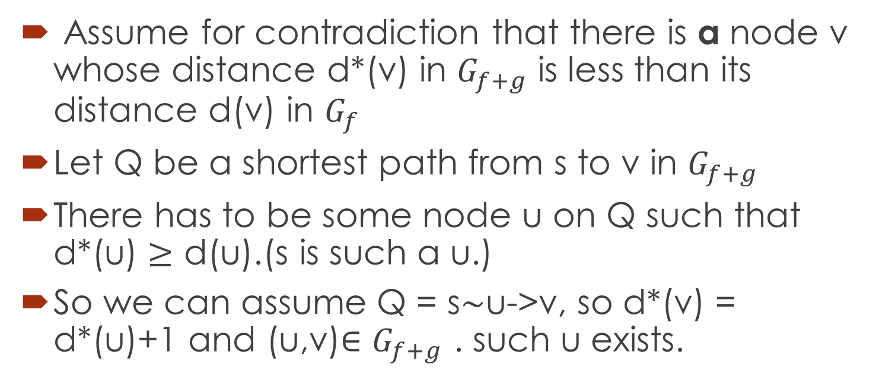
Proof of the monotonically increased distance
Assume for contradiction that there is a node v whose distance d*(v) in $G_{f+g}$ is less than its distance d(v) in $G_{f}$
Let Q be a shortest path from s to v in $G_{f+g}$
There has to be some node u on Q such that d*(u) $≥$ d(u).(s is such a u.)
So we can assume Q = s$\sim$u->v, so d*(v) = d*(u)+1 and (u,v)$∈G_{f+g}$ . such u exists.
s
v
u

Slide 33

That’s what we said last page Note: d*(u) $≤$ d(u)
s
v
s
v
u

Slide 34
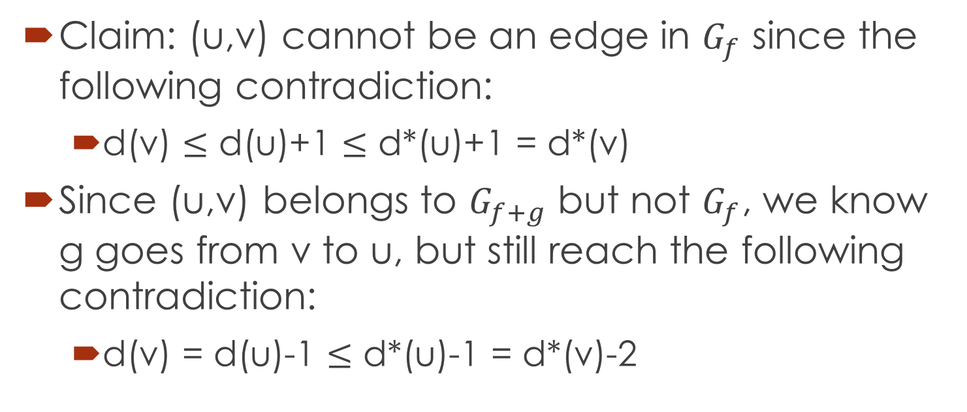
Proof-contd.
Claim: (u,v) cannot be an edge in $G_{f}$ since the following contradiction:
d(v) $≤$ d(u)+1 $≤$ d*(u)+1 = d*(v)
Since (u,v) belongs to $G_{f+g}$ but not $G_{f}$, we know g goes from v to u, but still reach the following contradiction:
d(v) = d(u)-1 $≤$ d*(u)-1 = d*(v)-2

