Slide 1
Multi-threaded Algorithm 2
Michael Tsai
2014/1/2

Slide 2
Scheduling
Scheduler的工作:把strand指定給processor執行.
On-line: scheduler事先並不知道什麼時候strand會spawn, 或者spawn出來的什麼時候會完成.
Centralized scheduler: 單一的scheduler知道整體狀況並作scheduling (比較容易分析)
Distributed scheduler: 每個thread互相溝通合作, 找出最好的scheduling方法

Slide 3
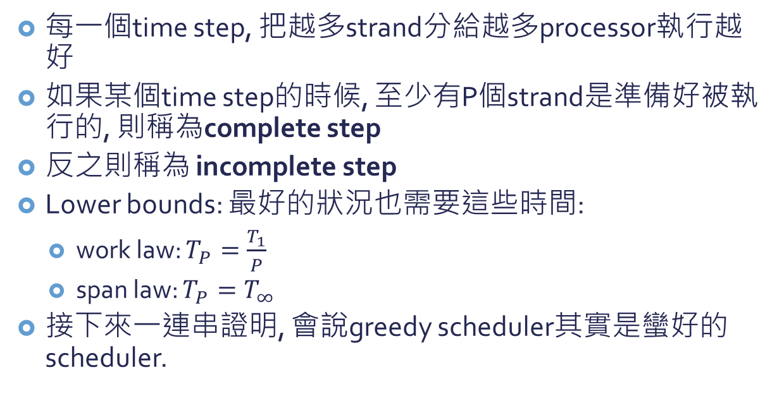
Greedy scheduler
每一個time step, 把越多strand分給越多processor執行越好
如果某個time step的時候, 至少有P個strand是準備好被執行的, 則稱為complete step
反之則稱為 incomplete step
Lower bounds: 最好的狀況也需要這些時間:
work law: $T_{P}=\frac{T_{1}}{P}$
span law: $T_{P}=T_{∞}$
接下來一連串證明, 會說greedy scheduler其實是蠻好的scheduler.

Slide 4



Theorem: On an ideal parallel computer with P processors, a greedy scheduler executes a multithreaded computation with work $T_{1}$ and span $T_{∞}$ in time $T_{P}≤\frac{T_{1}}{P}+T_{∞}$.
Proof:
我們想證明complete steps最多為$\left\lfloor \frac{T_{1}}{P}\right\rfloor$個.
用反證法: 假設complete steps超過$\left\lfloor \frac{T_{1}}{P}\right\rfloor$個.
則所有complete steps所完成的工作有:
$P∙\left(\left\lfloor \frac{T_{1}}{P}\right\rfloor +1\right)=P\left\lfloor \frac{T_{1}}{P}\right\rfloor +P$ $=T_{1}−\left(T_{1} mod P\right)+P$ $>T_{1}$
矛盾, 因為全部的工作也才$需花T_{1}$.
因此complete steps最多為$\left\lfloor \frac{T_{1}}{P}\right\rfloor$個.

Slide 5

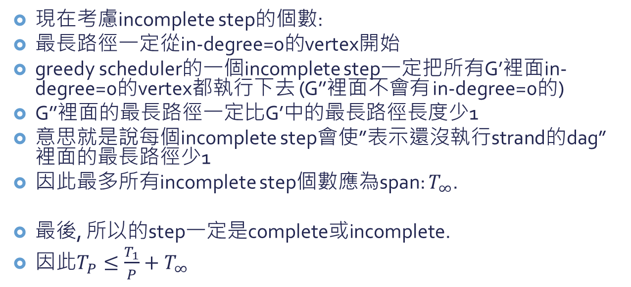


Incomplete step
$$G$$
$$G^{′}$$
$$G^{′′}$$
…
…
…
現在考慮incomplete step的個數:
最長路徑一定從in-degree=0的vertex開始
greedy scheduler的一個incomplete step一定把所有G’裡面in-degree=0的vertex都執行下去 (G’’裡面不會有 in-degree=0的)
G’’裡面的最長路徑一定比G’中的最長路徑長度少1
意思就是說每個incomplete step會使”表示還沒執行strand的dag”裡面的最長路徑少1
因此最多所有incomplete step個數應為span: $T_{∞}$.
最後, 所以的step一定是complete或incomplete.
因此$T_{P}≤\frac{T_{1}}{P}+T_{∞}$

Slide 6
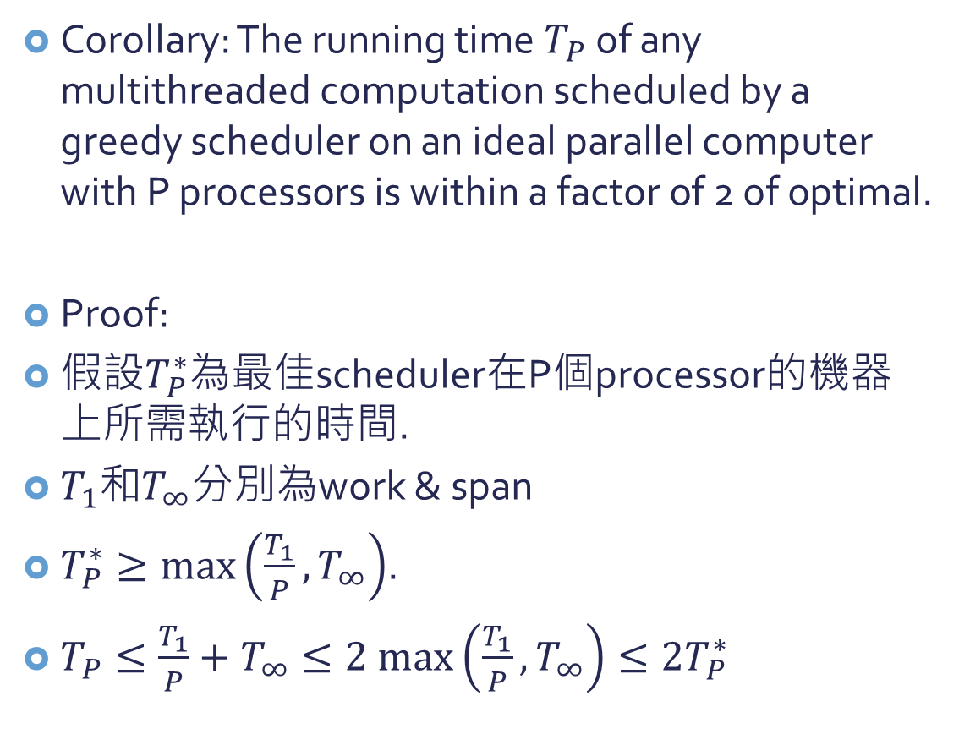
Corollary: The running time $T_{P}$ of any multithreaded computation scheduled by a greedy scheduler on an ideal parallel computer with P processors is within a factor of 2 of optimal.
Proof:
假設$T_{P}^{∗}$為最佳scheduler在P個processor的機器上所需執行的時間.
$T_{1}$和$T_{∞}$分別為work & span
$T_{P}^{∗}≥\max\left(\frac{T_{1}}{P},T_{∞}\right)$.
$T_{P}≤\frac{T_{1}}{P}+T_{∞}≤2 max\left(\frac{T_{1}}{P},T_{∞}\right)≤{2T}_{P}^{∗}$

Slide 7


Corollary: Let $T_{P}$ be the running time of a multithreaded computation produced by a greedy scheduler on an ideal parallel computer with P processors, and let $T_{1}$ and $T_{∞}$ be the work and span of the computation, respectively. Then, if $P≪\frac{T_{1}}{T_{∞}}$, we have $T_{P}≈T_{1}/P$, or equivalently, a speedup of approximately P.
Proof:
If $P≪T_{1}/T_{∞}$, then $T_{∞}≪\frac{T_{1}}{P}$.
So $T_{P}≤\frac{T_{1}}{P}+T_{∞}≈\frac{T_{1}}{P}$.
(Work law: $T_{P}≥\frac{T_{1}}{P}$)
Or, the speedup is $\frac{T_{1}}{T_{P}}≈P$.
When is << ?
When the slackness ($\frac{T_{1}}{T_{∞}}/P)≥10$.

Slide 8
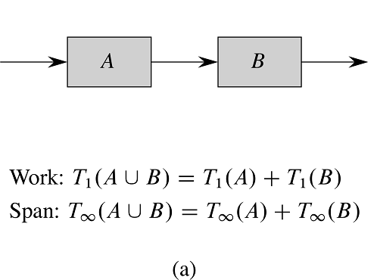

Slide 9
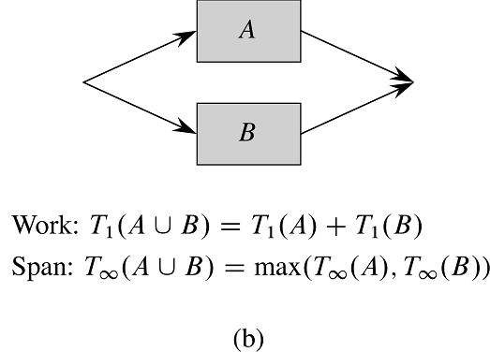

Slide 10

Back to P-FIB
$T_{1}\left(n\right)=T\left(n\right)=Θ\left(φ^{n}\right)$
$T_{∞}\left(n\right)=\max\left(T_{∞}\left(n−1\right),T_{∞}\left(n−2\right)\right)+Θ\left(1\right)$ $=T_{∞}\left(n−1\right)+Θ\left(1 \right)$
$T_{∞}\left(n\right)=Θ\left(n\right)$
Parallelism: $\frac{T_{1}\left(n\right)}{T_{∞}\left(n\right)}=Θ\left(\frac{φ^{n}}{n}\right)$
P-FIB(n)
if n<=1
return n
else
x=spawn P-FIB(n-1)
y=P-FIB(n-2)
sync
return x+y
即使對大平行電腦, 一個普通的n都可以使我們的程式達到near perfect linear speedup. (Parallelism比P大很多→slackness很大)

Slide 11
Parallel Loops
Parallel loops: 把loop的iterations平行地執行.
在for關鍵字前面加上 “parallel”.
也可以用spawn和sync, 不過這樣的語法比較方便.

Slide 12

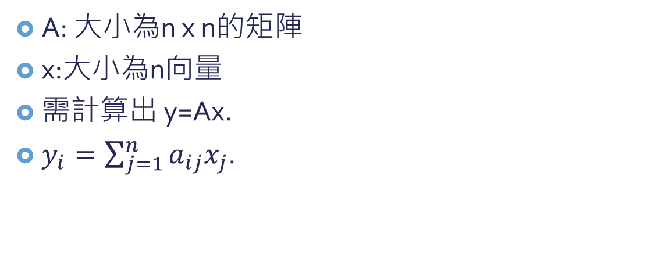
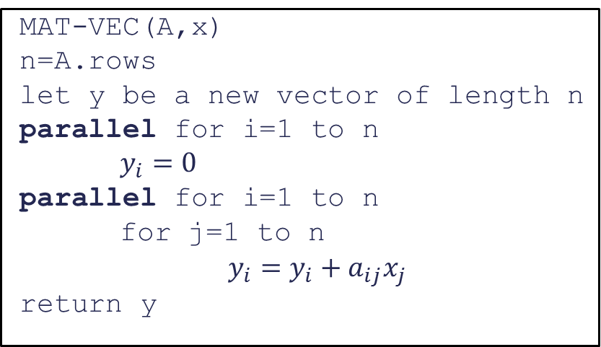
矩陣與向量相乘
y
A
x
A: 大小為n x n的矩陣
x:大小為n向量
需計算出 y=Ax.
$y_{i}=\sum_{j=1}^{n}{a_{ij}x_{j}}$.
$$y_{i}$$
=
i
MAT-VEC(A,x)
n=A.rows
let y be a new vector of length n
parallel for i=1 to n
$y_{i}=0$
parallel for i=1 to n
for j=1 to n
$y_{i}=y_{i}+a_{ij}x_{j}$
return y
j

Slide 13
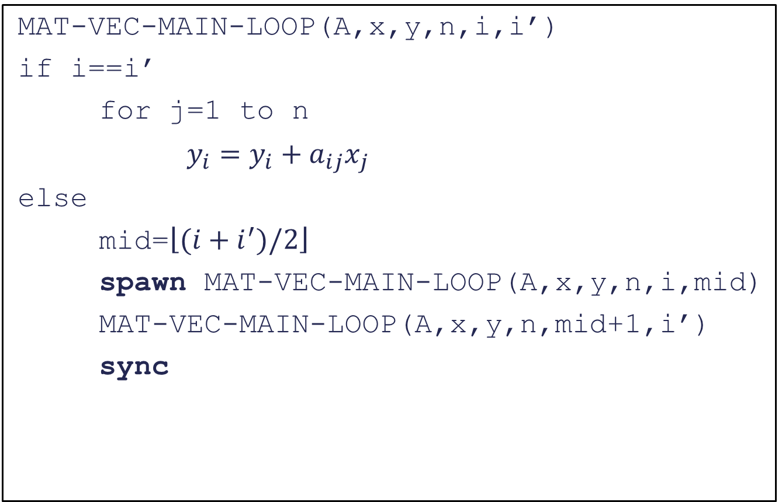
MAT-VEC-MAIN-LOOP(A,x,y,n,i,i’)
if i==i’
for j=1 to n
$y_{i}=y_{i}+a_{ij}x_{j}$
else
mid=$\left\lfloor (i+i^{′})/2\right\rfloor$
spawn MAT-VEC-MAIN-LOOP(A,x,y,n,i,mid)
MAT-VEC-MAIN-LOOP(A,x,y,n,mid+1,i’)
sync
n: A和x的大小
i: 從第幾個row開始算
i’: 算到第幾個row

Slide 14
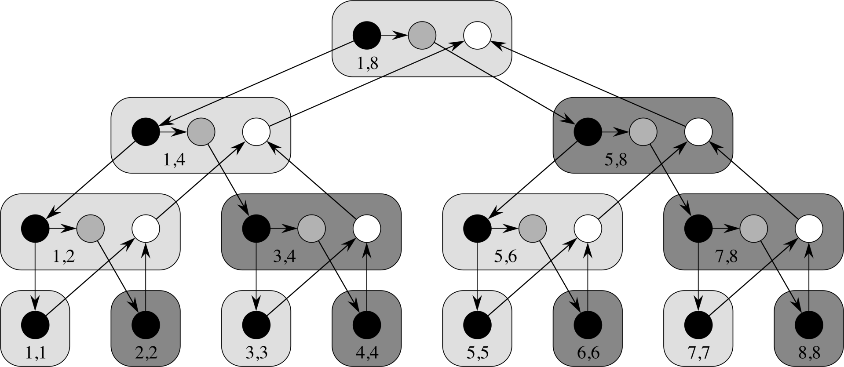

y
A
x
1,4
$$y_{i}$$
=
i
5,8
j

Slide 15

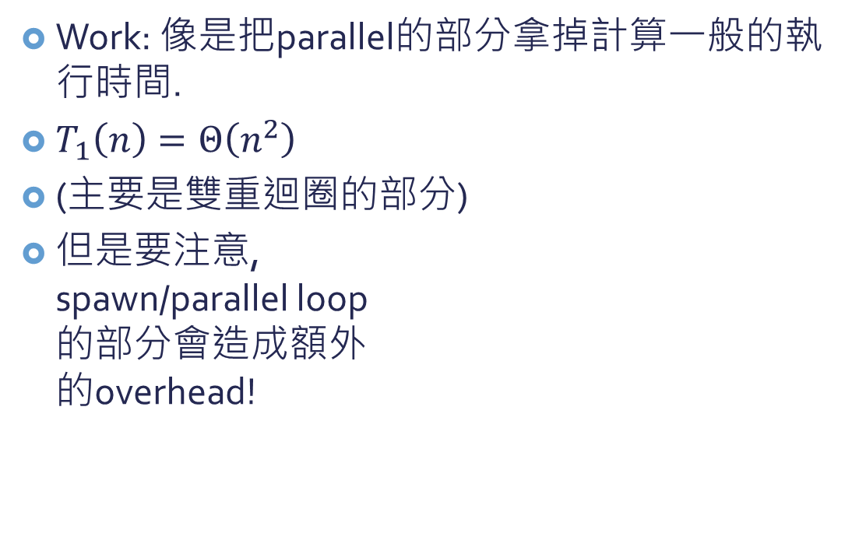
Analyze MAT-VEC
Work: 像是把parallel的部分拿掉計算一般的執行時間.
$T_{1}\left(n\right)=Θ\left(n^{2}\right)$
(主要是雙重迴圈的部分)
但是要注意, spawn/parallel loop 的部分會造成額外 的overhead!
MAT-VEC(A,x)
n=A.rows
let y be a new vector of length n
parallel for i=1 to n
$y_{i}=0$
parallel for i=1 to n
for j=1 to n
$y_{i}=y_{i}+a_{ij}x_{j}$
return y

Slide 16
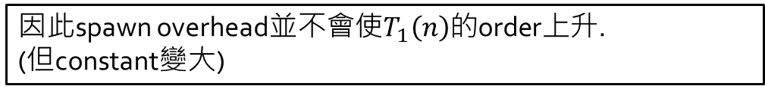
n-1個internal nodes
每個internal node都會spawn一次. (spawn overhead為constant)
n個leaves
leave比internal node多, 因此spawn的cost可以平均分攤給leave
因此spawn overhead並不會使$T_{1}\left(n\right)$的order上升. (但constant變大)

Slide 17

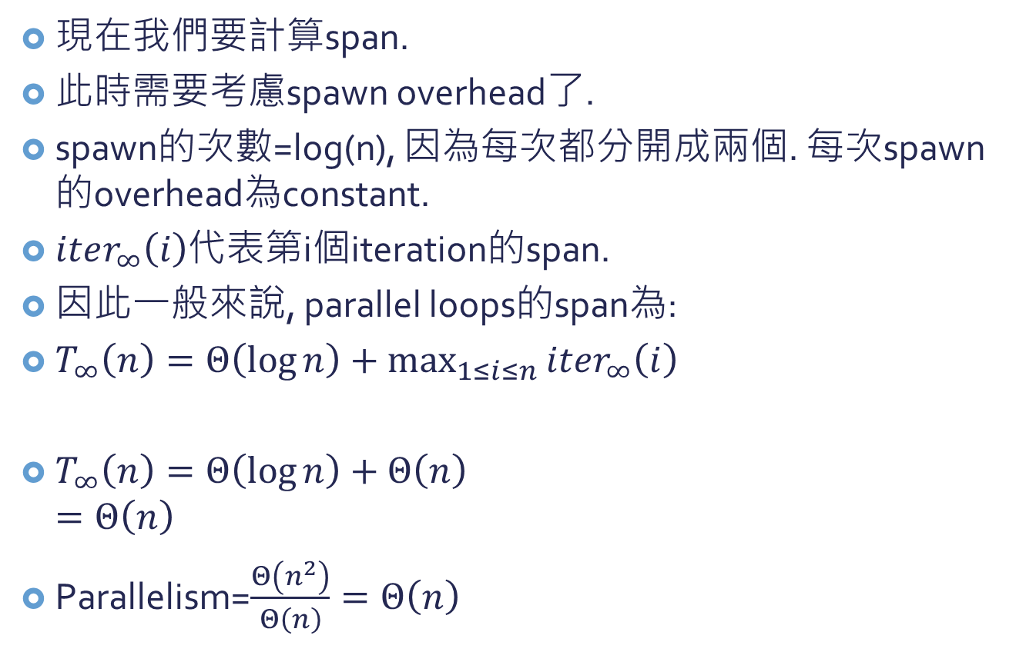
Analyze MAT-VEC
現在我們要計算span.
此時需要考慮spawn overhead了.
spawn的次數=log(n), 因為每次都分開成兩個. 每次spawn的overhead為constant.
$iter_{∞}\left(i\right)$代表第i個iteration的span.
因此一般來說, parallel loops的span為:
$T_{∞}\left(n\right)=Θ\left(\log{n}\right)+\max_{1≤i≤n}{iter_{∞}\left(i\right)}$
$T_{∞}\left(n\right)=Θ\left(\log{n}\right)+Θ\left(n\right)$ $=Θ\left(n\right)$
Parallelism=$\frac{Θ\left(n^{2}\right)}{Θ\left(n\right)}=Θ\left(n\right)$
MAT-VEC(A,x)
n=A.rows
let y be a new vector of length n
parallel for i=1 to n
$y_{i}=0$
parallel for i=1 to n
for j=1 to n
$y_{i}=y_{i}+a_{ij}x_{j}$
return y

Slide 18
Race Conditions
一個multithreaded algorithm應該要是deterministic的→每次執行的結果都一樣
不管怎麼去把程式的不同部分排程給不同的processor/core去執行
通常”失敗”的時候, 都是因為有”determinacy race”.
Determinacy Race: 當有兩個邏輯上平行的指令存取相同的記憶體位置而且至少有一個指令是寫入.

Slide 19
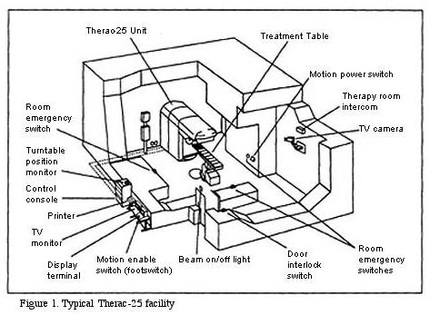
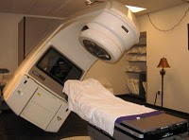
Determinacy Race Examples
Therac-25: 放射線治療機組. 1985-1987年間造成至少6個病人受到原本設定劑量100倍的輻射, 造成死亡或嚴重輻射灼傷.
延伸閱讀: 殺人的軟體. http://hiraman-sharma.blogspot.com/2010/07/killer-softwares.html

Slide 20
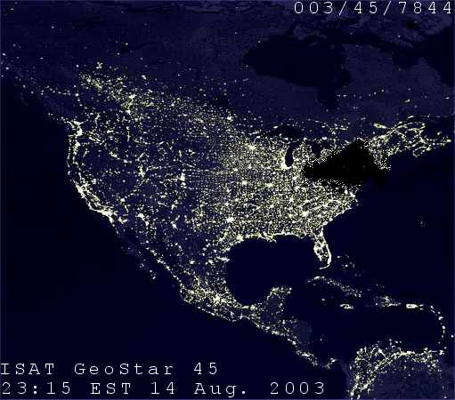
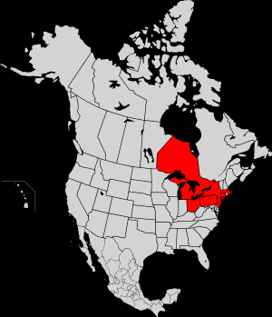
Determinacy Race Examples
2003 Northeast Blackout: Affected 10M people in Ontario & 45M people in 8 U.S. states. Cause: A software bug known existed in General Electric Energy's Unix-based XA/21 energy management system

Slide 21
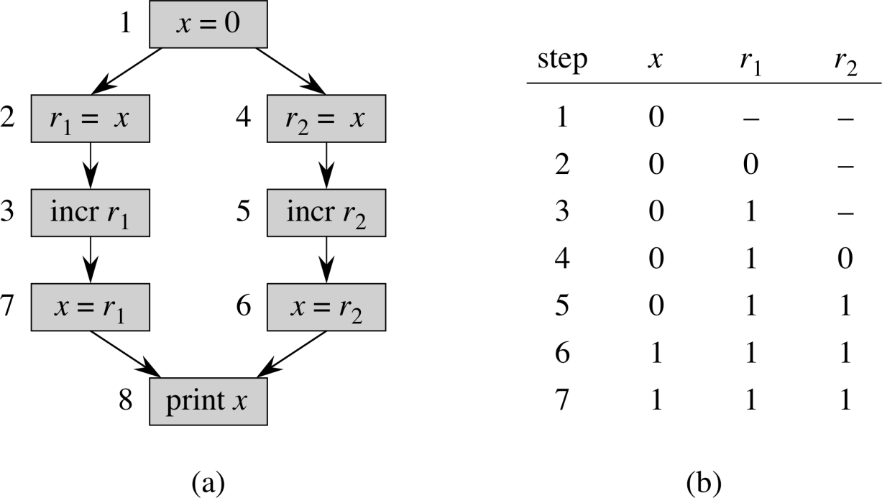
Race-Example
注意: 大部分的執行順序都會得到正確的結果, 只有少部分的順序才會造成錯誤!
→要找出這些錯誤非常困難!
RACE-EXAMPLE()
x=0
parallel for i=1 to 2
x=x+1
print x

Slide 22
如何避免race condition?
有很多方法(Mutex等, OS裡面會教)
簡單的方法: 只將平行運算運用在獨立的運算上, 也就是說互相之間沒有關聯性.
spawn出來的child跟parent, 還有其他spawn出來的child都互相之間沒有關係.

Slide 23
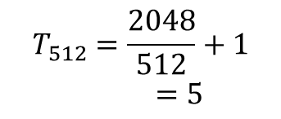
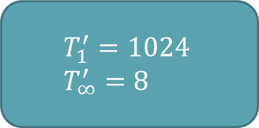

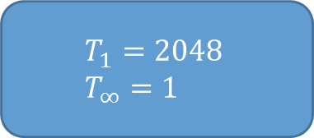
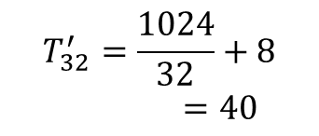
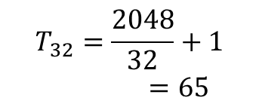

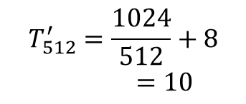
Socrates chess-playing program
Original version
“Optimized version”
$$T_{1}=2048 \\ T_{∞}=1$$
$$T_{1}^{′}=1024 \\ T_{∞}^{′}=8$$
$$T_{32}=\frac{2048}{32}+1=65$$
$$T_{32}^{′}=\frac{1024}{32}+8=40$$
$$P=32$$
$$T_{512}=\frac{2048}{512}+1=5$$
$$T_{512}^{′}=\frac{1024}{512}+8=10$$
$$P=512$$

Slide 24

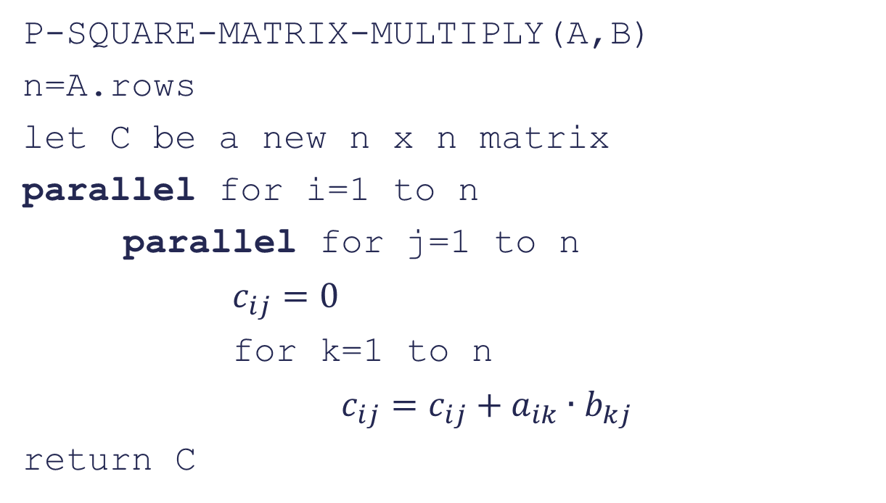
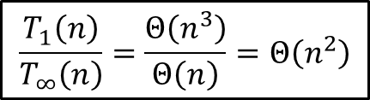
Multithreaded matrix multiplication
P-SQUARE-MATRIX-MULTIPLY(A,B)
n=A.rows
let C be a new n x n matrix
parallel for i=1 to n
parallel for j=1 to n
$c_{ij}=0$
for k=1 to n
$c_{ij}=c_{ij}+a_{ik}∙b_{kj}$
return C
$$T_{1}(n)=Θ\left(n^{3}\right)$$
$$T_{∞}\left(n\right)=Θ\left(log n\right)+Θ\left(\log{n}\right)+Θ\left(n\right)=Θ(n)$$
$$\frac{T_{1}\left(n\right)}{T_{∞}\left(n\right)}=\frac{Θ\left(n^{3}\right)}{Θ\left(n\right)}=Θ\left(n^{2}\right)$$

Slide 25
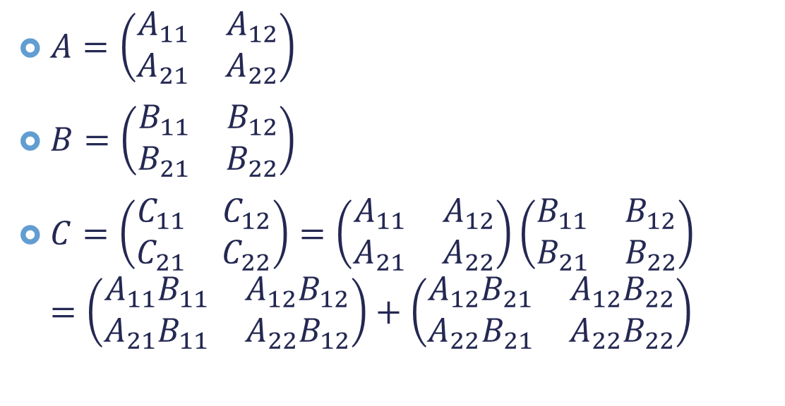
Divide-and-conquer Multithreaded Algorithm for Matrix Multiplication (勒勒長)
$A=\left(\begin{matrix}A_{11} & A_{12} \\ A_{21} & A_{22}\end{matrix}\right)$
$B=\left(\begin{matrix}B_{11} & B_{12} \\ B_{21} & B_{22}\end{matrix}\right)$
$C=\left(\begin{matrix}C_{11} & C_{12} \\ C_{21} & C_{22}\end{matrix}\right)=\left(\begin{matrix}A_{11} & A_{12} \\ A_{21} & A_{22}\end{matrix}\right)\left(\begin{matrix}B_{11} & B_{12} \\ B_{21} & B_{22}\end{matrix}\right)$ $=\left(\begin{matrix}A_{11}B_{11} & A_{12}B_{12} \\ A_{21}B_{11} & A_{22}B_{12}\end{matrix}\right)+\left(\begin{matrix}{A_{12}B}_{21} & {A_{12}B}_{22} \\ A_{22}B_{21} & {A_{22}B}_{22}\end{matrix}\right)$
C
T

Slide 26

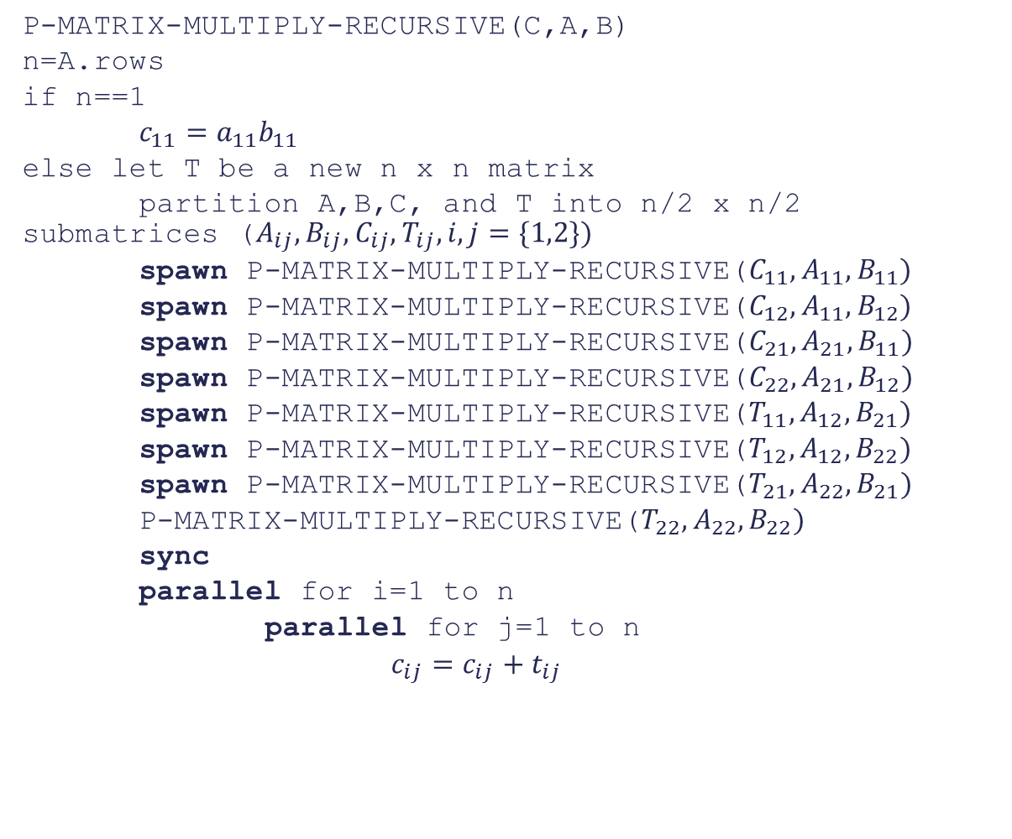
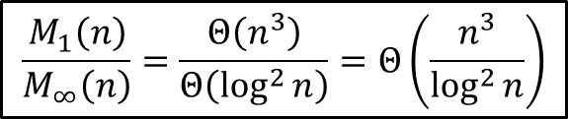

P-MATRIX-MULTIPLY-RECURSIVE(C,A,B)
n=A.rows
if n==1
$c_{11}=a_{11}b_{11}$
else let T be a new n x n matrix
partition A,B,C, and T into n/2 x n/2 submatrices ($A_{ij},B_{ij},C_{ij},T_{ij}, i,j=\{1,2\})$
spawn P-MATRIX-MULTIPLY-RECURSIVE($C_{11},A_{11},B_{11})$
spawn P-MATRIX-MULTIPLY-RECURSIVE($C_{12},A_{11},B_{12})$
spawn P-MATRIX-MULTIPLY-RECURSIVE($C_{21},A_{21},B_{11})$
spawn P-MATRIX-MULTIPLY-RECURSIVE($C_{22},A_{21},B_{12})$
spawn P-MATRIX-MULTIPLY-RECURSIVE($T_{11},A_{12},B_{21})$
spawn P-MATRIX-MULTIPLY-RECURSIVE($T_{12},A_{12},B_{22})$
spawn P-MATRIX-MULTIPLY-RECURSIVE($T_{21},A_{22},B_{21})$
P-MATRIX-MULTIPLY-RECURSIVE($T_{22},A_{22},B_{22})$
sync
parallel for i=1 to n
parallel for j=1 to n
$c_{ij}=c_{ij}+t_{ij}$
$$M_{1}\left(n\right)=8M_{1}\left(\frac{n}{2}\right)+Θ\left(n^{2}\right)=Θ\left(n^{3}\right)$$
$$\frac{M_{1}\left(n\right)}{M_{∞}\left(n\right)}=\frac{Θ\left(n^{3}\right)}{Θ\left(\log^{2}{n}\right)}=Θ\left(\frac{n^{3}}{\log^{2}{n}}\right)$$
$$M_{∞}\left(n\right)=M_{∞}\left(\frac{n}{2}\right)+Θ\left(\log{n}\right)+Θ\left(\log{n}\right)=Θ\left(\log^{2}{n}\right)$$

Slide 27
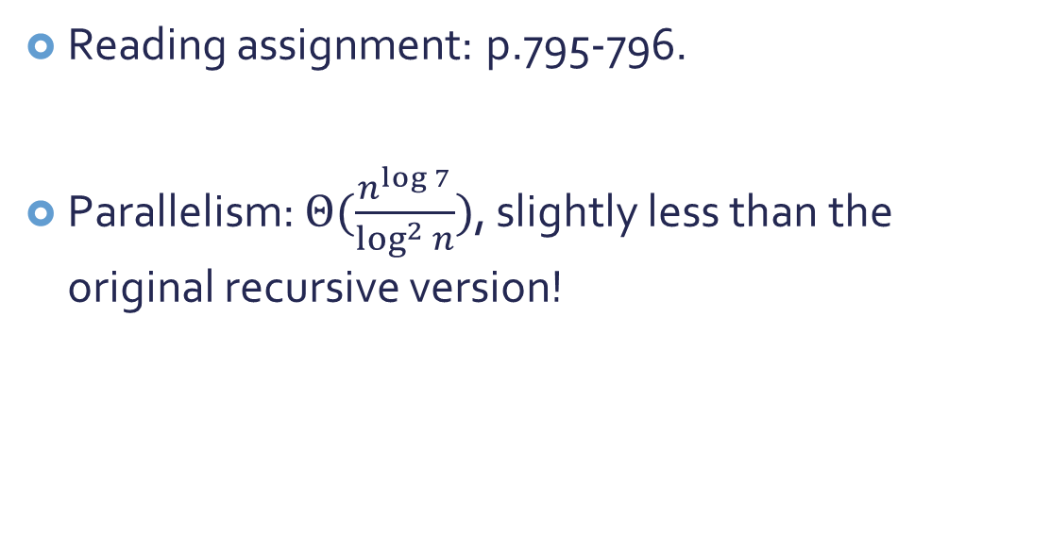
How about Strassen’s method?
Reading assignment: p.795-796.
Parallelism: $Θ(\frac{n^{\log{7}}}{\log^{2}{n}})$, slightly less than the original recursive version!

