Slide 1
Multi-threaded Algorithm 3
Michael Tsai
2014/1/2

Slide 2

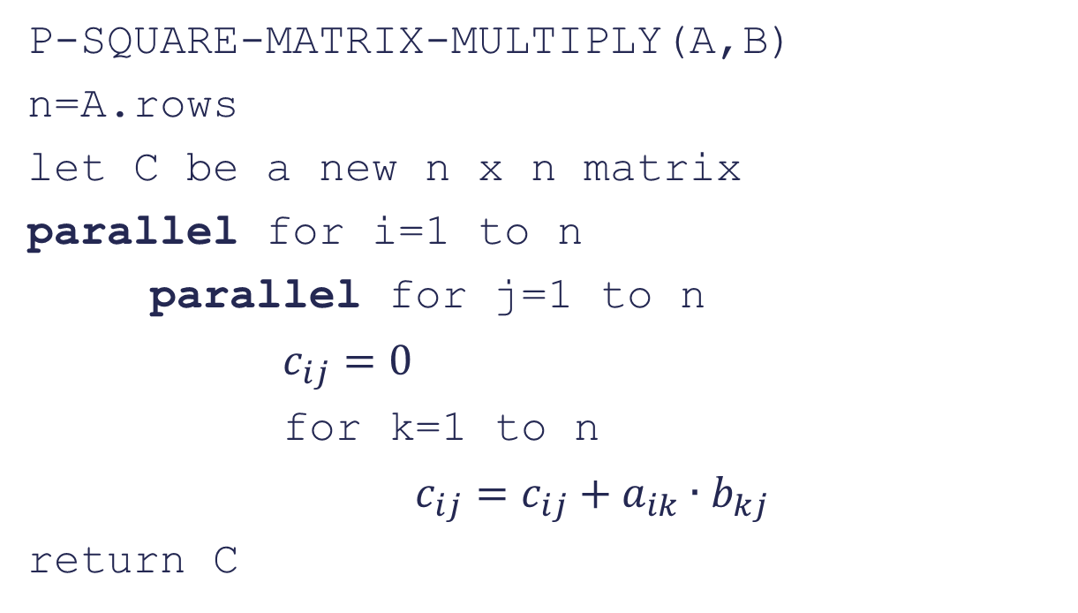
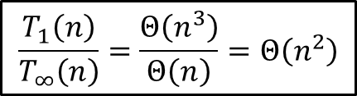
Multithreaded matrix multiplication
P-SQUARE-MATRIX-MULTIPLY(A,B)
n=A.rows
let C be a new n x n matrix
parallel for i=1 to n
parallel for j=1 to n
$c_{ij}=0$
for k=1 to n
$c_{ij}=c_{ij}+a_{ik}∙b_{kj}$
return C
$$T_{1}(n)=Θ\left(n^{3}\right)$$
$$T_{∞}\left(n\right)=Θ\left(log n\right)+Θ\left(\log{n}\right)+Θ\left(n\right)=Θ(n)$$
$$\frac{T_{1}\left(n\right)}{T_{∞}\left(n\right)}=\frac{Θ\left(n^{3}\right)}{Θ\left(n\right)}=Θ\left(n^{2}\right)$$

Slide 3
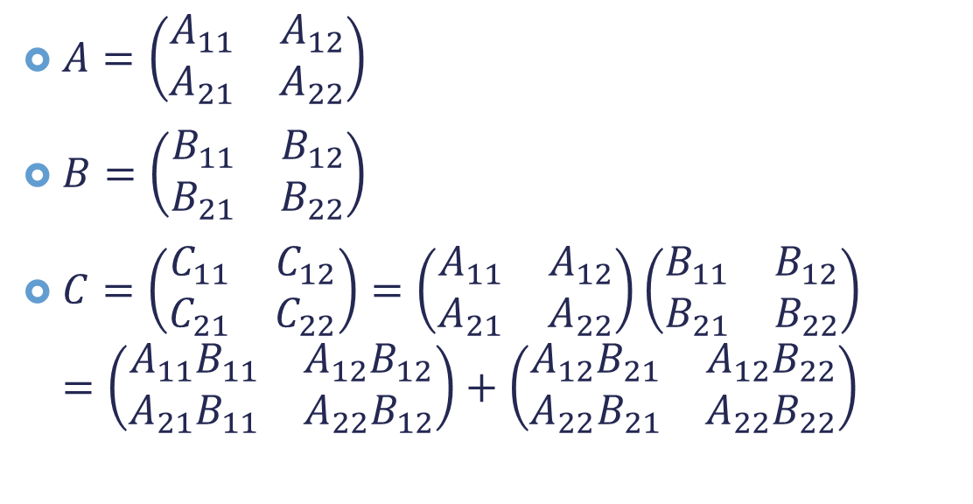
Divide-and-conquer Multithreaded Algorithm for Matrix Multiplication (勒勒長)
$A=\left(\begin{matrix}A_{11} & A_{12} \\ A_{21} & A_{22}\end{matrix}\right)$
$B=\left(\begin{matrix}B_{11} & B_{12} \\ B_{21} & B_{22}\end{matrix}\right)$
$C=\left(\begin{matrix}C_{11} & C_{12} \\ C_{21} & C_{22}\end{matrix}\right)=\left(\begin{matrix}A_{11} & A_{12} \\ A_{21} & A_{22}\end{matrix}\right)\left(\begin{matrix}B_{11} & B_{12} \\ B_{21} & B_{22}\end{matrix}\right)$ $=\left(\begin{matrix}A_{11}B_{11} & A_{12}B_{12} \\ A_{21}B_{11} & A_{22}B_{12}\end{matrix}\right)+\left(\begin{matrix}{A_{12}B}_{21} & {A_{12}B}_{22} \\ A_{22}B_{21} & {A_{22}B}_{22}\end{matrix}\right)$
C
T

Slide 4

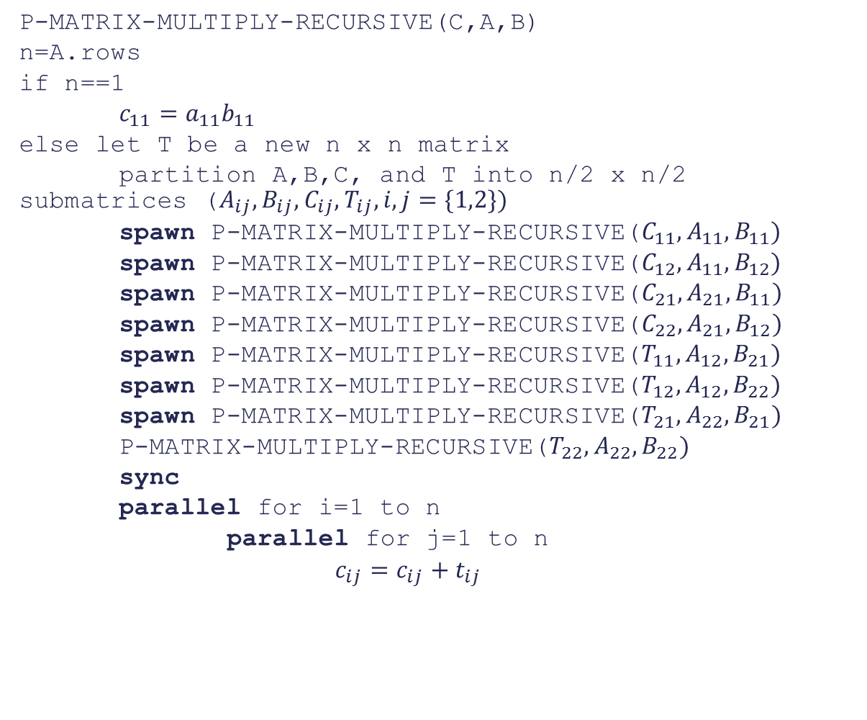
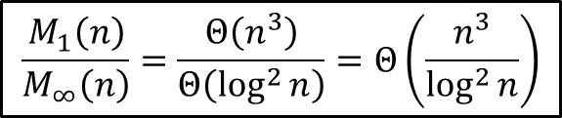

P-MATRIX-MULTIPLY-RECURSIVE(C,A,B)
n=A.rows
if n==1
$c_{11}=a_{11}b_{11}$
else let T be a new n x n matrix
partition A,B,C, and T into n/2 x n/2 submatrices ($A_{ij},B_{ij},C_{ij},T_{ij}, i,j=\{1,2\})$
spawn P-MATRIX-MULTIPLY-RECURSIVE($C_{11},A_{11},B_{11})$
spawn P-MATRIX-MULTIPLY-RECURSIVE($C_{12},A_{11},B_{12})$
spawn P-MATRIX-MULTIPLY-RECURSIVE($C_{21},A_{21},B_{11})$
spawn P-MATRIX-MULTIPLY-RECURSIVE($C_{22},A_{21},B_{12})$
spawn P-MATRIX-MULTIPLY-RECURSIVE($T_{11},A_{12},B_{21})$
spawn P-MATRIX-MULTIPLY-RECURSIVE($T_{12},A_{12},B_{22})$
spawn P-MATRIX-MULTIPLY-RECURSIVE($T_{21},A_{22},B_{21})$
P-MATRIX-MULTIPLY-RECURSIVE($T_{22},A_{22},B_{22})$
sync
parallel for i=1 to n
parallel for j=1 to n
$c_{ij}=c_{ij}+t_{ij}$
$$M_{1}\left(n\right)=8M_{1}\left(\frac{n}{2}\right)+Θ\left(n^{2}\right)=Θ\left(n^{3}\right)$$
$$\frac{M_{1}\left(n\right)}{M_{∞}\left(n\right)}=\frac{Θ\left(n^{3}\right)}{Θ\left(\log^{2}{n}\right)}=Θ\left(\frac{n^{3}}{\log^{2}{n}}\right)$$
$$M_{∞}\left(n\right)=M_{∞}\left(\frac{n}{2}\right)+Θ\left(\log{n}\right)+Θ\left(\log{n}\right)=Θ\left(\log^{2}{n}\right)$$

Slide 5
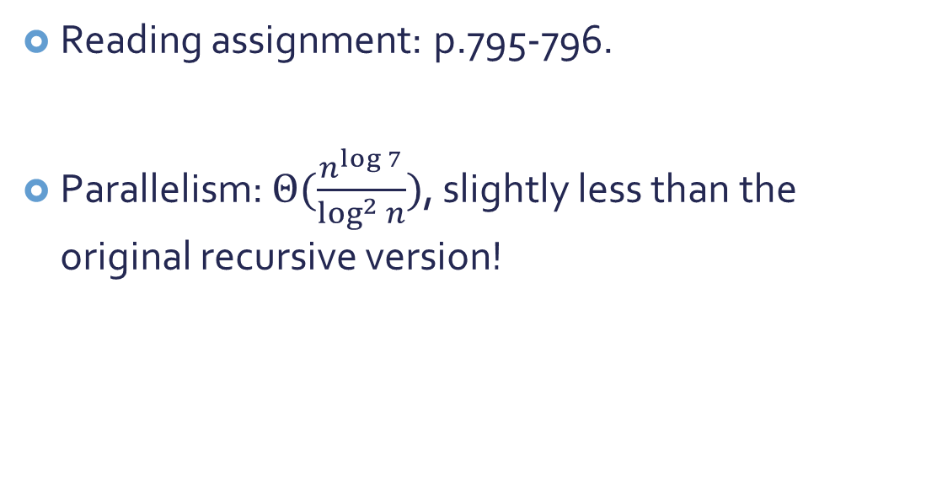
How about Strassen’s method?
Reading assignment: p.795-796.
Parallelism: $Θ(\frac{n^{\log{7}}}{\log^{2}{n}})$, slightly less than the original recursive version!

Slide 6


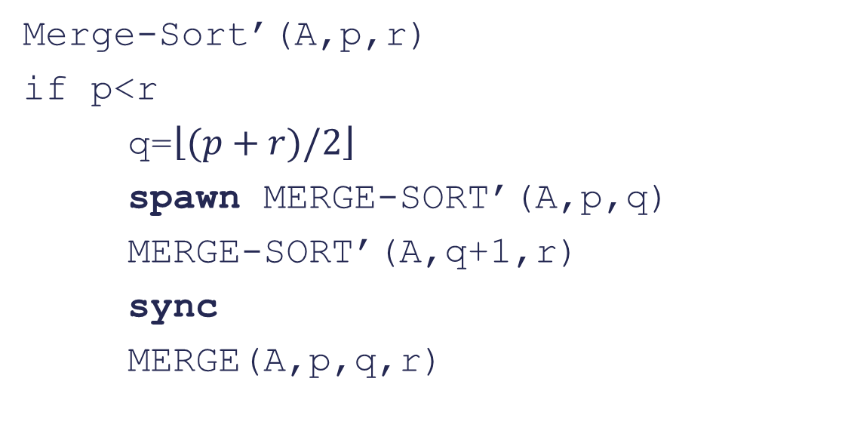



Multithreaded Merge Sort
A: Array to be sorted
p and r: Start and end index of the range to be sorted
Merge-Sort’(A,p,r)
if p<r
q=$\left\lfloor (p+r)/2\right\rfloor$
spawn MERGE-SORT’(A,p,q)
MERGE-SORT’(A,q+1,r)
sync
MERGE(A,p,q,r)
Merge() is the bottleneck!
$$Θ(n)$$
$$MS_{1}^{′}\left(n\right)=2MS_{1}^{′}\left(\frac{n}{2}\right)+Θ\left(n\right)=Θ\left(n\log{n}\right)$$
Parallelism= $Θ(\log{n})$
$$MS_{∞}^{′}\left(n\right)=MS_{∞}^{′}\left(\frac{n}{2}\right)+Θ\left(n\right)=Θ\left(n\right)$$

Slide 7
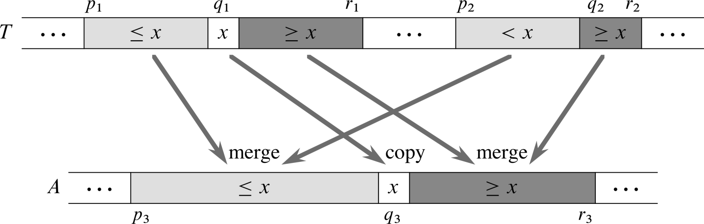

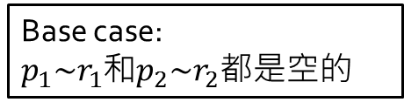
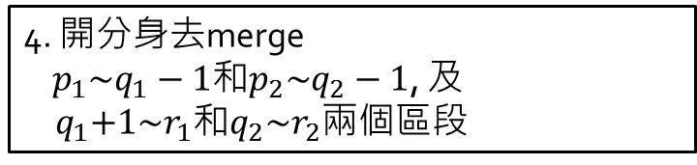

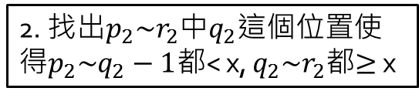
把Merge也用Divide & Conquer來解!
(方便交給不同的thread去做)
2. 找出$p_{2}\sim r_{2}$中$q_{2}$這個位置使得$p_{2}\sim q_{2}−1$都< x, $q_{2}\sim r_{2}$都$≥$x
1. 挑出$p_{1}\sim r_{1}$的中位數x
3. Copy x 到新地方(根據x和$q_{2}的位置)$
Base case:
$p_{1}\sim r_{1}$和$p_{2}\sim r_{2}$都是空的
4. 開分身去merge
$p_{1}\sim q_{1}−1$和$p_{2}\sim q_{2}−1$, 及
${ q}_{1}+1\sim r_{1}$和$q_{2}\sim r_{2}$兩個區段

Slide 8

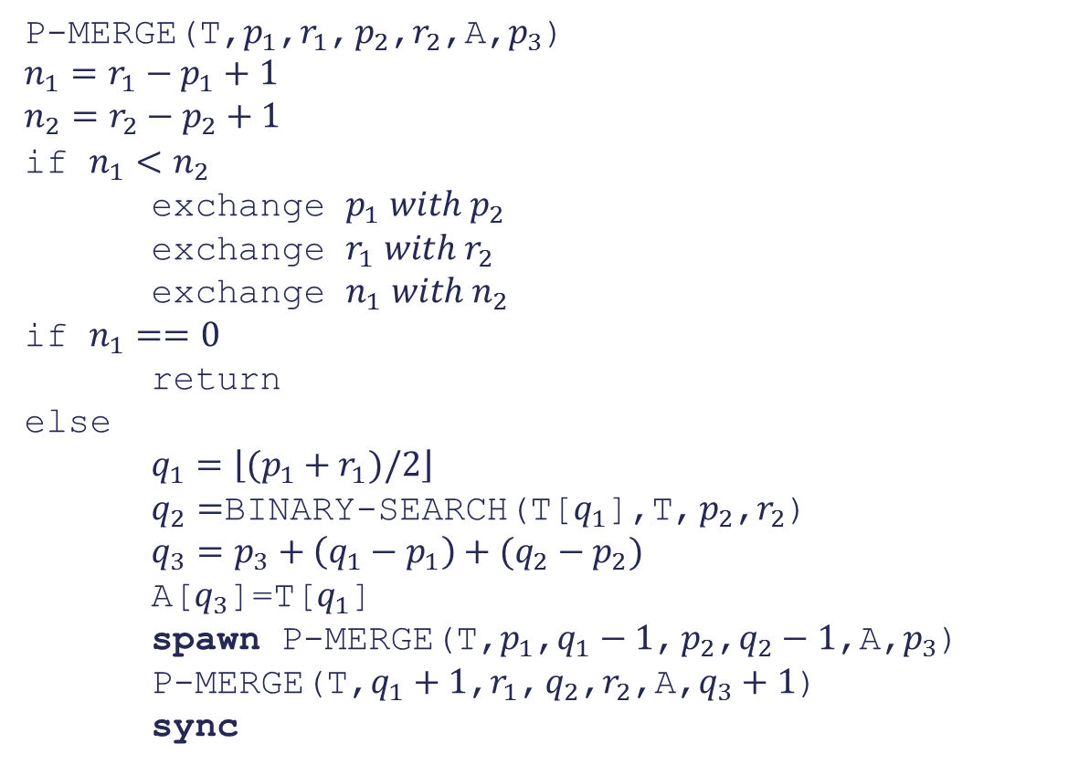
Multithreaded Merge
P-MERGE(T,$p_{1}$,$r_{1}$, $p_{2}$,$r_{2}$,A,$p_{3}$)
$$n_{1}=r_{1}−p_{1}+1$$
$$n_{2}=r_{2}−p_{2}+1$$
if $n_{1}<n_{2}$
exchange $p_{1} with p_{2}$
exchange $r_{1} with r_{2}$
exchange $n_{1} with n_{2}$
if $n_{1}==0$
return
else
$q_{1}=\left\lfloor (p_{1}+r_{1})/2\right\rfloor$
$q_{2}=$BINARY-SEARCH(T[$q_{1}$],T, $p_{2}$,$r_{2}$)
$q_{3}=p_{3}+\left(q_{1}−p_{1}\right)+(q_{2}−p_{2})$
A[$q_{3}$]=T[$q_{1}$]
spawn P-MERGE(T,$p_{1}$,$q_{1}−1$, $p_{2}$,$q_{2}−1$,A,$p_{3}$)
P-MERGE(T,$q_{1}+1$,$r_{1}$, $q_{2}$,$r_{2}$,A,$q_{3}+1$)
sync
T: Array to be merged
A: Array to save the merged result
$p_{1}$,$r_{1}$, $p_{2}$,$r_{2}$: Start and end index of the range to be merged
$p_{3}$: The index of the median in A

Slide 9
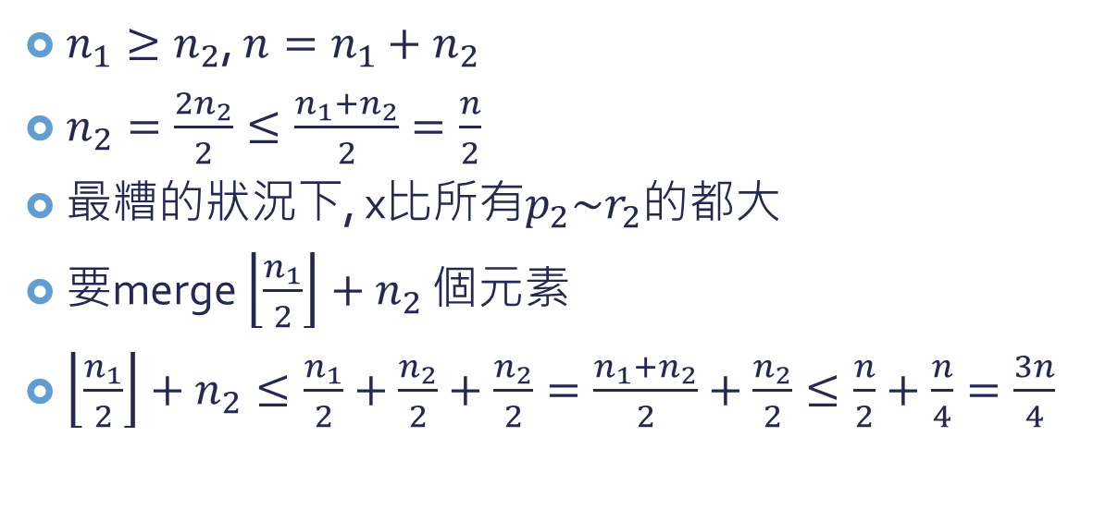
$n_{1}≥n_{2}$, $n=n_{1}+n_{2}$
$n_{2}=\frac{2n_{2}}{2}≤\frac{n_{1}+n_{2}}{2}=\frac{n}{2}$
最糟的狀況下, x比所有$p_{2}\sim r_{2}$的都大
要merge $\left\lfloor \frac{n_{1}}{2}\right\rfloor +n_{2}$ 個元素
$\left\lfloor \frac{n_{1}}{2}\right\rfloor +n_{2}≤\frac{n_{1}}{2}+\frac{n_{2}}{2}+\frac{n_{2}}{2}=\frac{n_{1}+n_{2}}{2}+\frac{n_{2}}{2}≤\frac{n}{2}+\frac{n}{4}=\frac{3n}{4}$

Slide 10




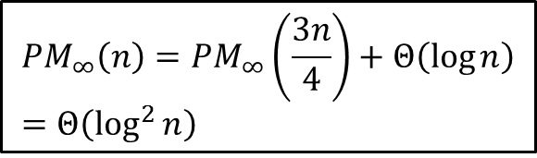
Multithreaded Merge
P-MERGE(T,$p_{1}$,$r_{1}$, $p_{2}$,$r_{2}$,A,$p_{3}$)
$$n_{1}=r_{1}−p_{1}+1$$
$$n_{2}=r_{2}−p_{2}+1$$
if $n_{1}<n_{2}$
exchange $p_{1} with p_{2}$
exchange $r_{1} with r_{2}$
exchange $n_{1} with n_{2}$
if $n_{1}==0$
return
else
$q_{1}=\left\lfloor (p_{1}+r_{1})/2\right\rfloor$
$q_{2}=$BINARY-SEARCH(T[$q_{1}$],T, $p_{2}$,$r_{2}$)
$q_{3}=p_{3}+\left(q_{1}−p_{1}\right)+(q_{2}−p_{2})$
A[$q_{3}$]=T[$q_{1}$]
spawn P-MERGE(T,$p_{1}$,$q_{1}−1$, $p_{2}$,$q_{2}−1$,A,$p_{3}$)
P-MERGE(T,$q_{1}+1$,$r_{1}$, $q_{2}$,$r_{2}$,A,$q_{3}+1$)
sync
$$PM_{∞}\left(n\right)=PM_{∞}\left(\frac{3n}{4}\right)+Θ\left(\log{n}\right) \\ =Θ\left(\log^{2}{n}\right)$$
$PM_{1}\left(n\right)=Ω\left(n\right)$, 因為至少要copy n elements
$PM_{1}\left(n\right)=O\left(n\right)$, 見課本p.802
$$⇒PM_{1}\left(n\right)=Θ\left(n\right)$$
$$Θ\left(\log{n}\right)$$

Slide 11
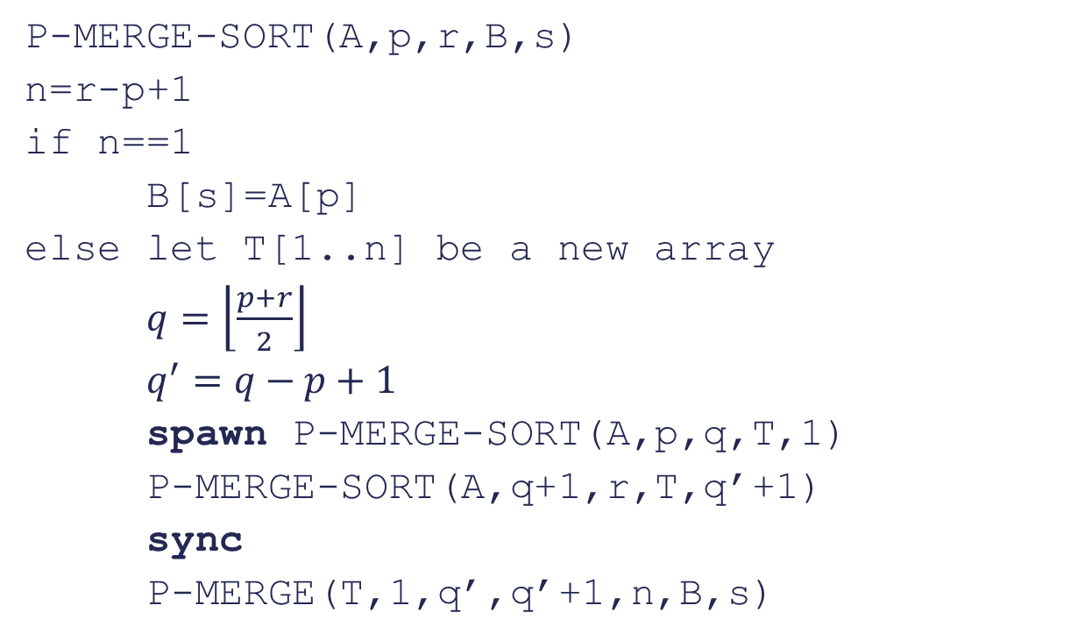

P-MERGE-SORT(A,p,r,B,s)
n=r-p+1
if n==1
B[s]=A[p]
else let T[1..n] be a new array
$q=\left\lfloor \frac{p+r}{2}\right\rfloor$
$q^{′}=q−p+1$
spawn P-MERGE-SORT(A,p,q,T,1)
P-MERGE-SORT(A,q+1,r,T,q’+1)
sync
P-MERGE(T,1,q’,q’+1,n,B,s)
A: Array to be merged
p,r: Index of the range to be sorted
B: Array to save the result
$$PMS_{1}\left(n\right)=2PMS_{1}\left(\frac{n}{2}\right)+PM_{1}\left(n\right)=2PMS_{1}\left(\frac{n}{2}\right)+Θ\left(n\right)=Θ\left(n\log{n}\right)$$
$$PMS_{∞}\left(n\right)=PMS_{∞}\left(\frac{n}{2}\right)+PM_{∞}\left(n\right)=PMS_{∞}\left(\frac{n}{2}\right)+Θ\left(\log^{2}{n}\right)=Θ\left(\log^{3}{n}\right)$$
Parallelism = $Θ\left(\frac{n\log{n}}{\log^{3}{n}}\right)=Θ\left(\frac{n}{\log^{2}{n}}\right)$
Much better now!

Slide 12
怎麼自己學演算法
非常重要
這堂課沒辦法把所有”重要”的演算法都教完
但是希望過程中你已經建立了自己學習演算法的能力
準備研究所考試的時候可能會需要

Slide 13
我的經驗
我也跟著大家一起學習 資料結構 與 演算法
一些好方法(自以為)跟大家分享:
畫圖, 用簡單的例子圖解步驟
先了解概念(大方向), 不急著看複雜的數學 (我常說: 如果什麼都沒弄懂, 先弄懂這個)
一次了解一小部分就好 (模組化學習), 不急著弄懂所有的部分
相信自己一定可以弄懂 (非常重要)
不知道自己到底懂了沒? 用一些古怪的例子來試試 (boundary case)
練習自己看課本 (非常重要)

Slide 14
期末考內容&型式
Closed book, 2 x A4 cheat sheets (double-sided)
佔學期成績26%
包含整學期上課內容, 但以期中考過後的內容為主
180 minutes
題型與期中考類似 (是非+選擇+解釋)
Extra office hour ??

