Slide 1
NP-Completeness
Michael Tsai
2013/11/21

Slide 2

1. 這些問題目前尚未找到可以在polynomial time內解決的algorithm.
NP-Complete
2. 這些問題目前尚未被證明無法在polynomial time內解決.
$$O\left(n^{k}\right), for some k$$

Slide 3
NP
這些問題可以在polynomial time內解決
P
這些問題可以在polynomial time內被verify
P=NP???
2011/05/04 為P v.s. NP提出之四十周年紀念!!
Ref: http://blog.computationalcomplexity.org/2011/05/forty-years-of-p-v-np.html

Slide 4
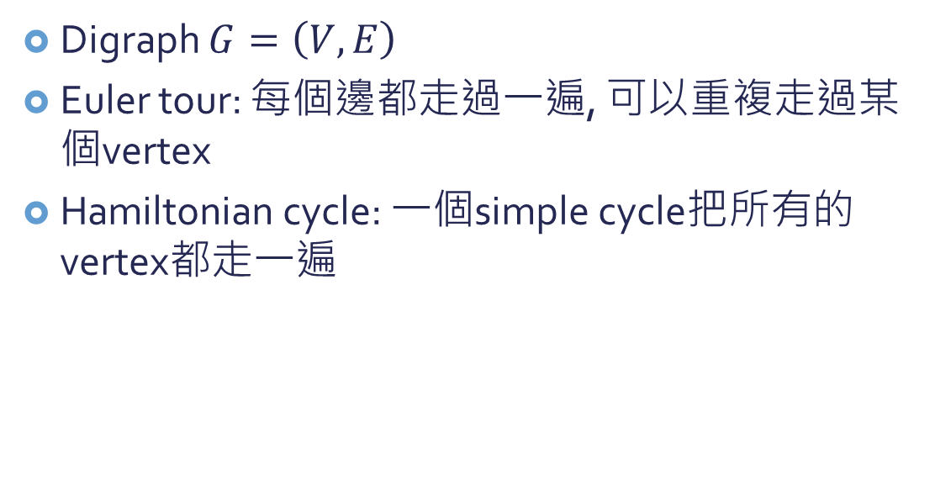
Euler tour versus hamiltonian cycle
Digraph $G=\left(V,E\right)$
Euler tour: 每個邊都走過一遍, 可以重複走過某個vertex
Hamiltonian cycle: 一個simple cycle把所有的vertex都走一遍

Slide 5
一些NP-complete的問題
Solvable in polynomial time
NP-Complete
Shortest simple path
Longest simple path
2-CNF satisfiability
3-CNF satisfiability
Euler Tour
Hamiltonian Cycle
CNF: conjunctive normal form
2-CNF example: $\left(x_{1}∨¬x_{2}\right)∧\left(¬x_{1}∨x_{3}\right)∧\left(¬x_{2}∨¬x_{3}\right)$

Slide 6
NP-Complete
一個問題是NP, 而且跟NP裡面的其他問題至少”一樣難”
(一樣難: 所有NP裡面的問題可以在polynomial time裡面轉換成NP-complete的問題)
因為以上, 所以”一解則全解”
學這個有什麼用?
雖然還沒有人證明出NP-complete problems無法在polynomial time裡面解出來
但是經過了40年了, 沒有任何NP-complete problem被解出來(polynomial time), 因此證明某問題為NP-complete某種程度上也證明了它非常難解(或甚至無法解)

Slide 7
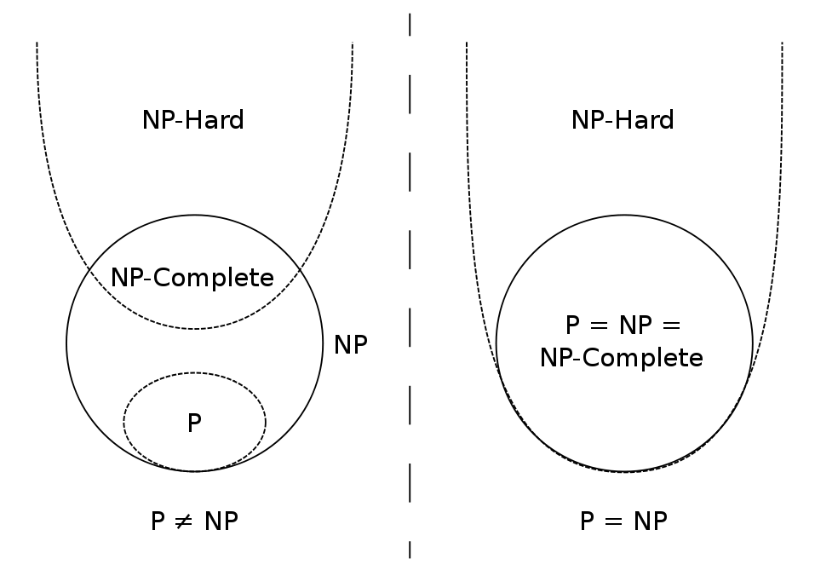

Slide 8
Decision problem v.s. optimization problem
Decision problem: 輸出是yes/no (1/0) (可不可以找到答案)
Optimization problem: 輸出是最好的解 (可以的答案中找出最好的那個)
例子: Shortest path v.s. Path
NP-Complete只適用於decision problems

Slide 9
Decision problem v.s. optimization problem
怎麼將optimization problem轉換成decision problem呢?
對要optimize的值設定一個bound
將Shortest path轉換成decision problem:
給定graph G, vertices u & v, integer k, 有沒有從u到v的路徑使用少於k個edge?

Slide 10
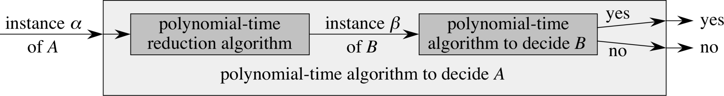

Reduction

Slide 11
用Reduction證明”一樣難”
假設以下兩樣存在
則B也沒有polynomial-time algorithm可以解
使用反證法,假設有
Polynomial-time reduction algorithm:
instances of A → instances of B
A: no polynomial-time algorithm exist
Polynomial-time reduction algorithm:
instances of A → instances of B
B: polynomial-time algorithm
A: polynomial-time algorithm
矛盾. 所以B也沒有.

Slide 12
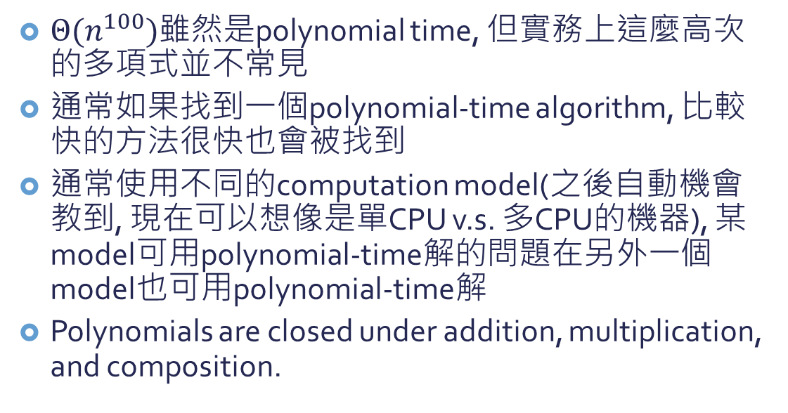
為什麼Polynomial time就是”容易解”?
$Θ(n^{100})$雖然是polynomial time, 但實務上這麼高次的多項式並不常見
通常如果找到一個polynomial-time algorithm, 比較快的方法很快也會被找到
通常使用不同的computation model(之後自動機會教到, 現在可以想像是單CPU v.s. 多CPU的機器), 某model可用polynomial-time解的問題在另外一個model也可用polynomial-time解
Polynomials are closed under addition, multiplication, and composition.

Slide 13
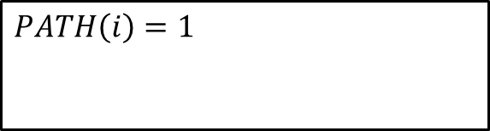


Abstract problem
I: instances of problem
S: solutions
Q: Abstract problem (binary relation)
Decision problem:
S={0,1}
Example: PATH
$$PATH\left(i\right)=1$$
if a shortest path from u to v has at most k edges
$$i=\left\langle G,u,v,k\right\rangle$$
$$PATH\left(i\right)=0$$
otherwise

Slide 14
Encoding
A set S of abstract objects
The set of binary strings
encoding: mapping
Polygons, numbers, graphs, functions, ordered pairs, programs, …

Slide 15
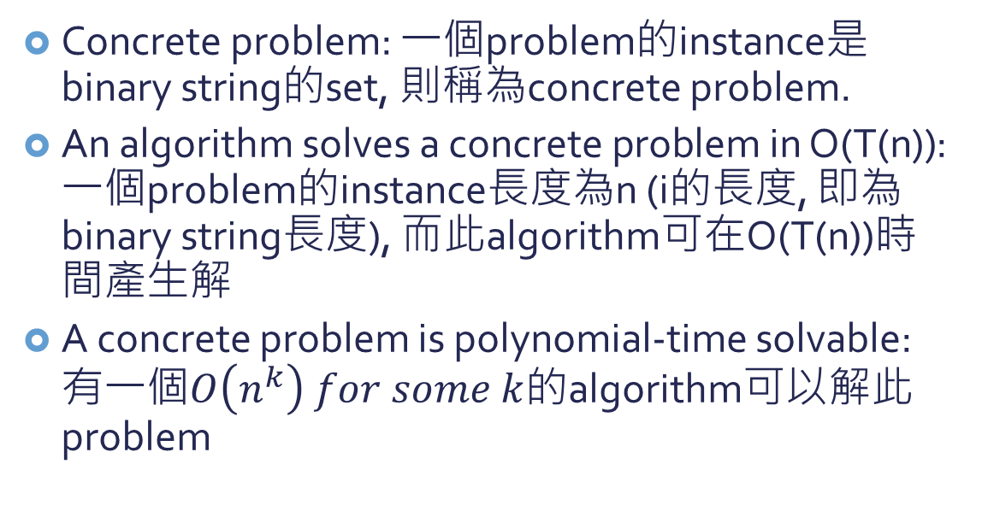
Some more definitions
Concrete problem: 一個problem的instance是binary string的set, 則稱為concrete problem.
An algorithm solves a concrete problem in O(T(n)): 一個problem的instance長度為n (i的長度, 即為binary string長度), 而此algorithm可在O(T(n))時間產生解
A concrete problem is polynomial-time solvable: 有一個$O\left(n^{k}\right) for some k$的algorithm可以解此problem

Slide 16
P的正式定義
The complexity class P: The set of concrete decision problems that are polynomial-time solvable

Slide 17

Abstract problem轉換成concrete problem
I: instances of problem
S: solutions
Q: Abstract problem (binary relation)
Decision problem:
S={0,1}
$$e:I→{\left\{0,1\right\}}^{∗}$$
e(I): {0,1}*
e(Q): Concrete problem

Slide 18
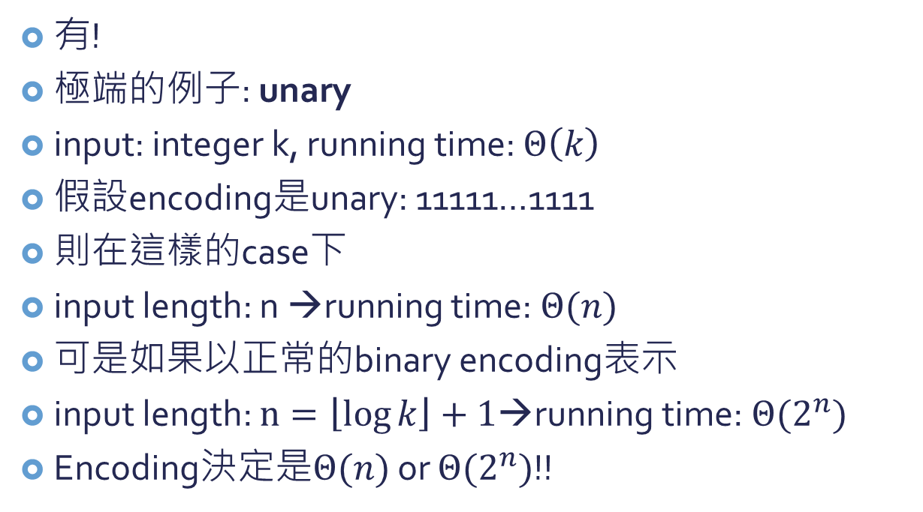
Encoding和花的時間有關嗎?
有!
極端的例子: unary
input: integer k, running time: $Θ\left(k\right)$
假設encoding是unary: 11111…1111
則在這樣的case下
input length: n →running time: $Θ(n)$
可是如果以正常的binary encoding表示
input length: $n=\left\lfloor \log{k}\right\rfloor +1$→running time: $Θ(2^{n})$
Encoding決定是$Θ(n)$ or $Θ(2^{n})$!!
k個

Slide 19
Encoding和花的時間有關嗎?
然而如果我們不考慮這麼極端的例子(unary), 大部分的encoding都不會影響到一個問題是否可以在polynomial time解決.
例: 使用三進位數和二進位數是沒有差別的, 因為我們可以在polynomial time裡面將三進位數轉換成二進位數.
input
f: {0,1}*→{0,1}*
output
如果f花polynomial time可以把任何input轉成output, 則稱為polynomial-time computable

Slide 20
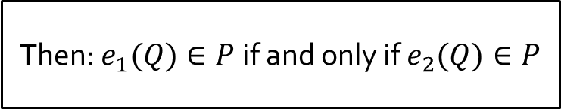


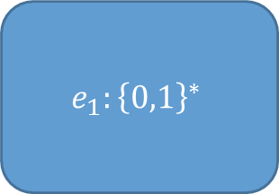

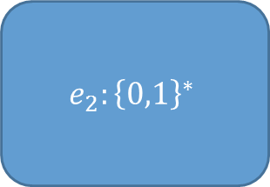

Lemma:
$$e_{2}:{\left\{0,1\right\}}^{∗}$$
$e_{2}(Q)$: Concrete problem
$$e_{2}:I→{\left\{0,1\right\}}^{∗}$$
if:
I: instances of problem
S: solutions
polynomially related
Q: Abstract problem (binary relation)
Decision problem:
S={0,1}
$$e_{1}:I→{\left\{0,1\right\}}^{∗}$$
$$e_{1}:{\left\{0,1\right\}}^{∗}$$
$e_{1}(Q)$: Concrete problem
Then: $e_{1}(Q)∈P$ if and only if $e_{2}(Q)∈P$

Slide 21
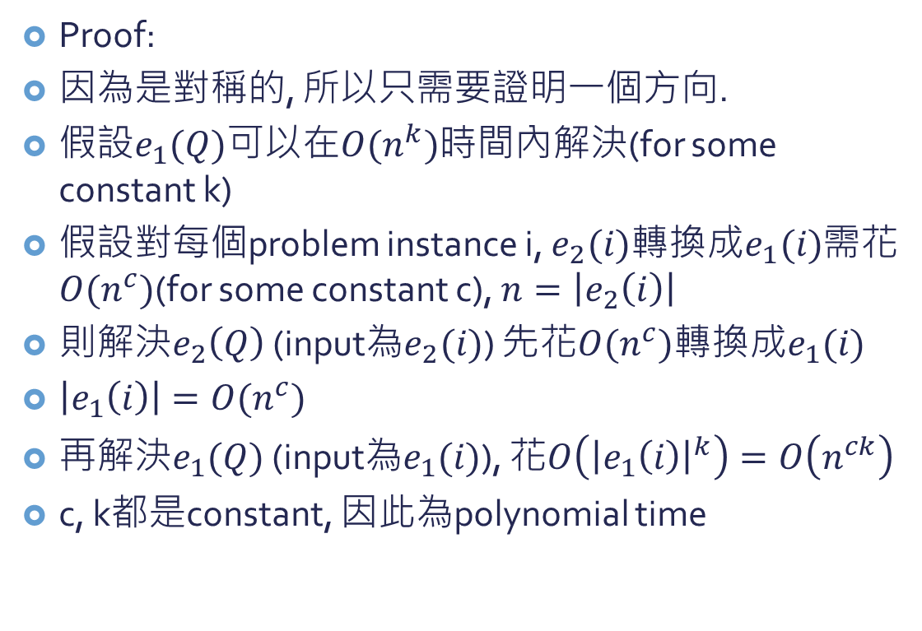
Proof:
因為是對稱的, 所以只需要證明一個方向.
假設$e_{1}(Q)$可以在$O(n^{k})$時間內解決(for some constant k)
假設對每個problem instance i, $e_{2}(i)$轉換成$e_{1}(i)$需花$O(n^{c})$(for some constant c), $n=\left|e_{2}\left(i\right)\right|$
則解決$e_{2}\left(Q\right)$ (input為$e_{2}(i)$) 先花$O(n^{c})$轉換成$e_{1}(i)$
$\left|e_{1}\left(i\right)\right|=O(n^{c})$
再解決$e_{1}(Q)$ (input為$e_{1}(i)$), 花$O\left({\left|e_{1}\left(i\right)\right|}^{k}\right)=O\left(n^{ck}\right)$
c, k都是constant, 因此為polynomial time
只要encoding都是”合理的” (“簡要的”)表示方式, 一個問題的複雜度(能否在polynomial time裡面解掉)不會被encoding影響.

Slide 22
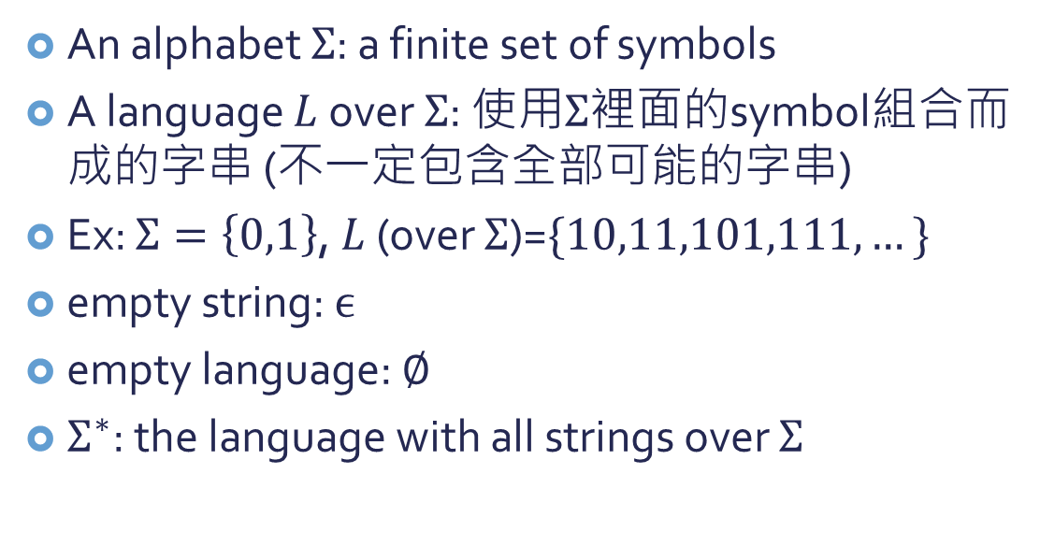
A Formal-language Framework
An alphabet $Σ$: a finite set of symbols
A language $L$ over $Σ$: 使用$Σ$裡面的symbol組合而成的字串 (不一定包含全部可能的字串)
Ex: $Σ=\left\{0,1\right\}$, $L$ (over $Σ$)=$\{10,11,101,111,…\}$
empty string: $ϵ$
empty language: $∅$
$Σ^{∗}$: the language with all strings over $Σ$

Slide 23
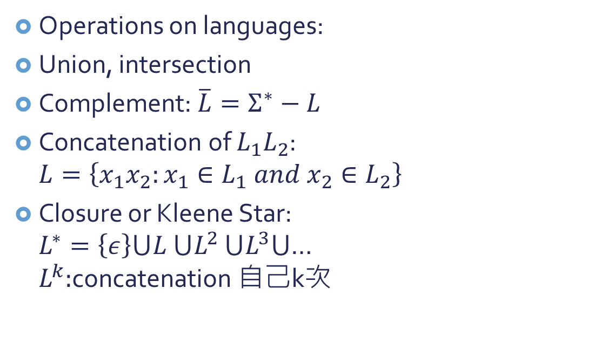
A Formal-language Framework
Operations on languages:
Union, intersection
Complement: $\overline{L}=Σ^{∗}−L$
Concatenation of $L_{1}L_{2}$: $L=\left\{x_{1}x_{2}:x_{1}∈L_{1} and x_{2}∈L_{2}\right\}$
Closure or Kleene Star: $L^{∗}=\left\{ε\right\}⋃L$ $⋃L^{2}$ $⋃L^{3}⋃$… $L^{k}:$concatenation 自己k次

Slide 24
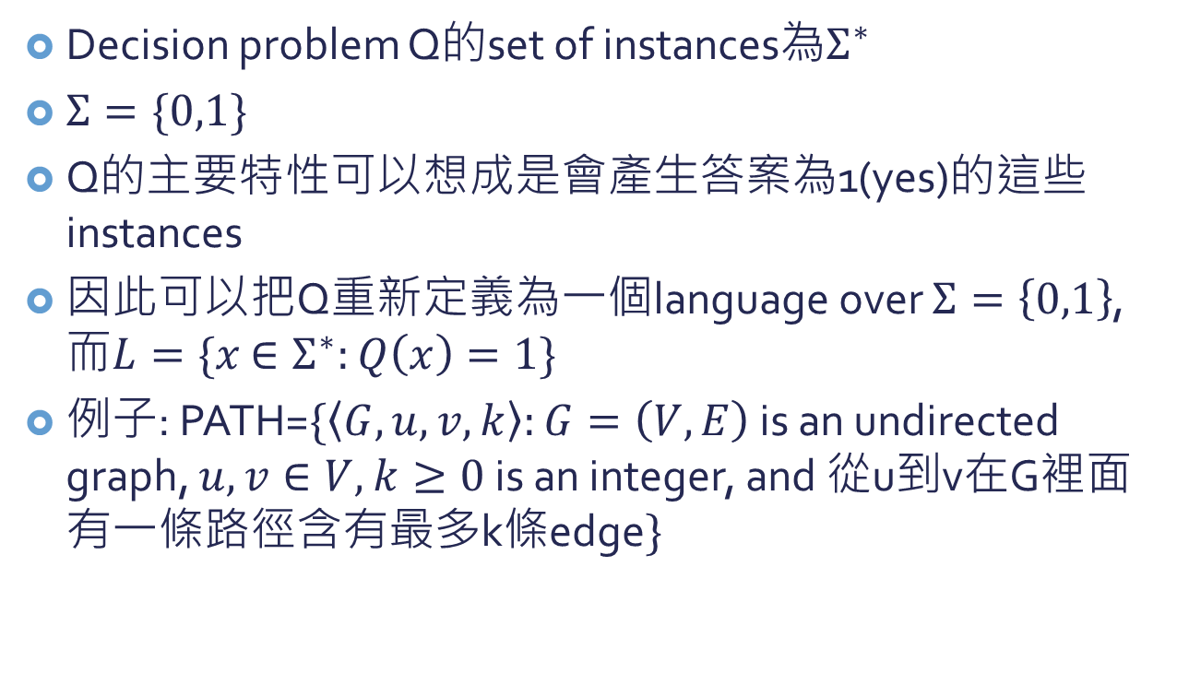
應用formal language framework…
Decision problem Q的set of instances為$Σ^{∗}$
$Σ=\{0,1\}$
Q的主要特性可以想成是會產生答案為1(yes)的這些instances
因此可以把Q重新定義為一個language over $Σ=\left\{0,1\right\}$, 而$L=\{x$ $∈Σ^{∗}:Q\left(x\right)=1\}$
例子: PATH=$\{\left\langle G,u,v,k\right\rangle :G=\left(V,E\right)$ is an undirected graph, $u,v∈V,$ $k≥0$ is an integer, and 從u到v在G裡面有一條路徑含有最多k條edge$\}$

Slide 25
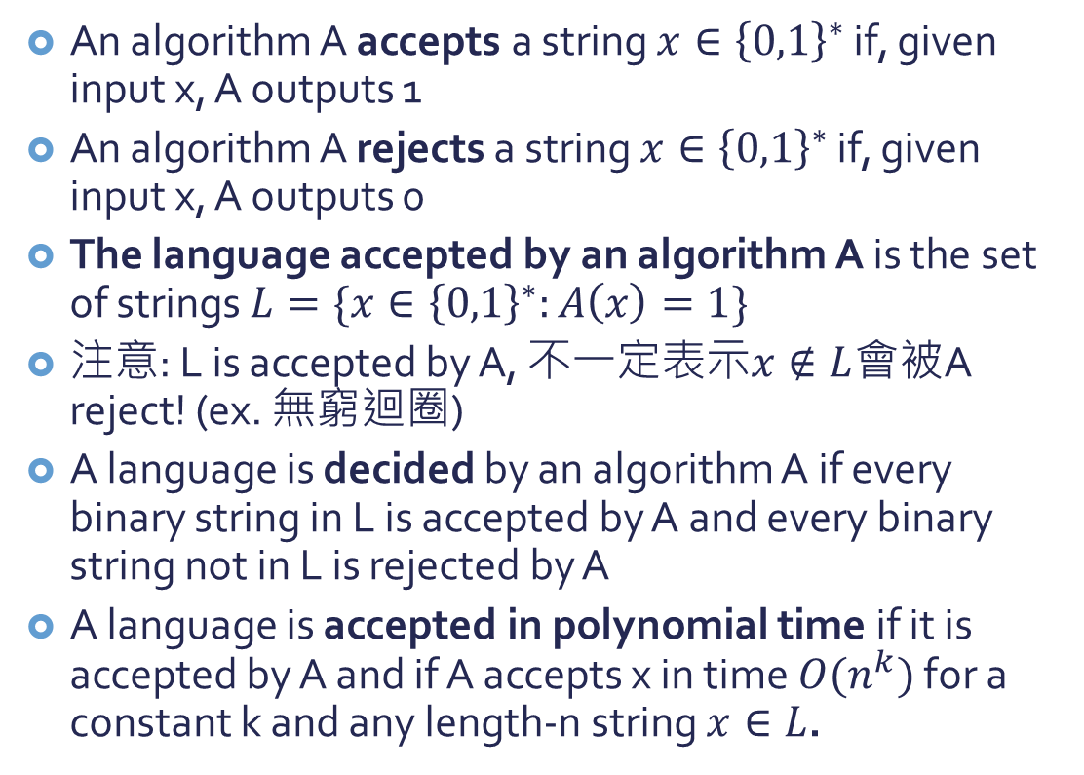
Accepts and Rejects
An algorithm A accepts a string $x∈{\left\{0,1\right\}}^{∗}$ if, given input x, A outputs 1
An algorithm A rejects a string $x∈{\left\{0,1\right\}}^{∗}$ if, given input x, A outputs 0
The language accepted by an algorithm A is the set of strings $L=\{x∈{\left\{0,1\right\}}^{∗}:A\left(x\right)=1\}$
注意: L is accepted by A, 不一定表示$x∉L$會被A reject! (ex. 無窮迴圈)
A language is decided by an algorithm A if every binary string in L is accepted by A and every binary string not in L is rejected by A
A language is accepted in polynomial time if it is accepted by A and if A accepts x in time $O(n^{k})$ for a constant k and any length-n string $x∈L$.

Slide 26
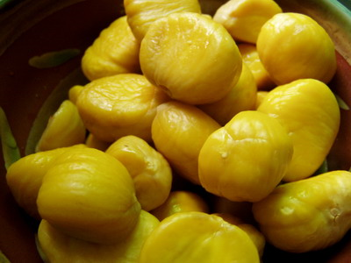
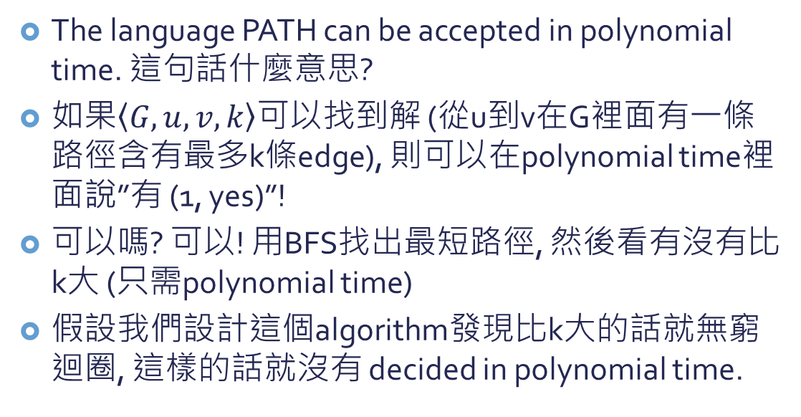
: PATH
The language PATH can be accepted in polynomial time. 這句話什麼意思?
如果$\left\langle G,u,v,k\right\rangle$可以找到解 (從u到v在G裡面有一條路徑含有最多k條edge), 則可以在polynomial time裡面說”有 (1, yes)”!
可以嗎? 可以! 用BFS找出最短路徑, 然後看有沒有比k大 (只需polynomial time)
假設我們設計這個algorithm發現比k大的話就無窮迴圈, 這樣的話就沒有 decided in polynomial time.

Slide 27
使用formal-language framework定義complexity class P
Complexity class: a set of languages, 是不是在其中由algorithm的complexity measure決定(ex. running time), 而此algorithm是決定一個string x是否屬於L.
使用這個方式, 我們可以重新定義P這個complexity class:
$$P=\{L⊆{\left\{0,1\right\}}^{∗}: \\ there exists an algorithm A that decides L in polynomial time\}$$

Slide 28
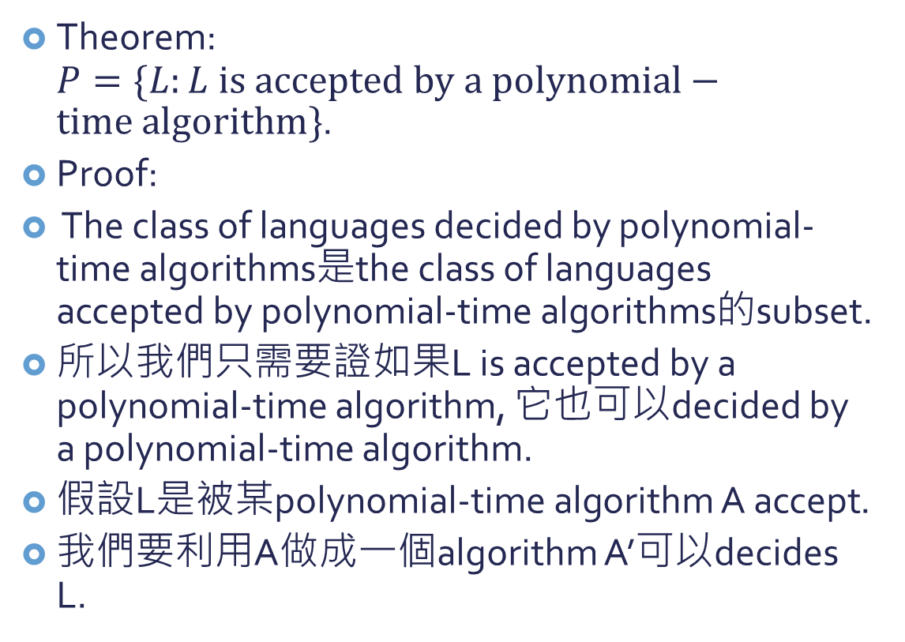
Theorem: $P=\{L:L is accepted by a polynomial−time algorithm\}$.
Proof:
The class of languages decided by polynomial-time algorithms是the class of languages accepted by polynomial-time algorithms的subset.
所以我們只需要證如果L is accepted by a polynomial-time algorithm, 它也可以decided by a polynomial-time algorithm.
假設L是被某polynomial-time algorithm A accept.
我們要利用A做成一個algorithm A’可以decides L.

Slide 29
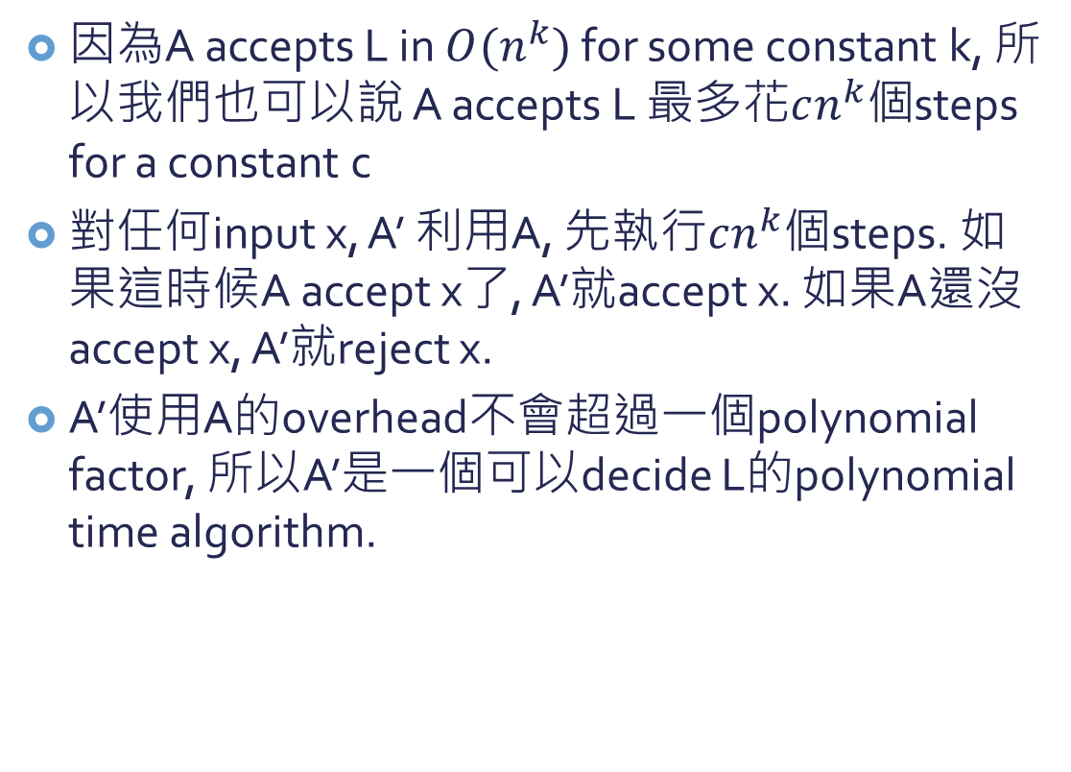
因為A accepts L in $O(n^{k})$ for some constant k, 所以我們也可以說 A accepts L 最多花$cn^{k}個$steps for a constant c
對任何input x, A’ 利用A, 先執行$cn^{k}個$steps. 如果這時候A accept x了, A’就accept x. 如果A還沒accept x, A’就reject x.
A’使用A的overhead不會超過一個polynomial factor, 所以A’是一個可以decide L的polynomial time algorithm.

Slide 30

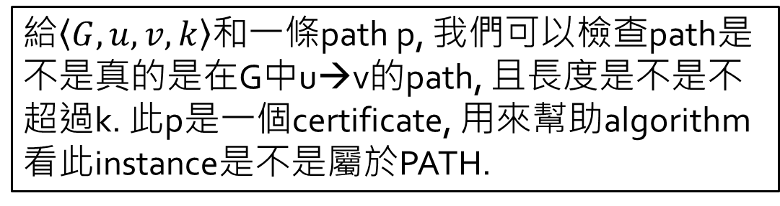
Algorithms that accepts/rejects/decides L
告訴你某個instance是不是有解(在L裡面)
Algorithms that verify L with a certificate
給你一個certificate (可能是答案), 可以讓你檢查某個instance是不是有解(在L裡面)
給$\left\langle G,u,v,k\right\rangle$和一條path p, 我們可以檢查path是不是真的是在G中u→v的path, 且長度是不是不超過k. 此p是一個certificate, 用來幫助algorithm看此instance是不是屬於PATH.
對PATH來說其實沒有太大差別, 因為本來就可以在polynomial time decide PATH. 但是對於其他問題可能有差別!

Slide 31
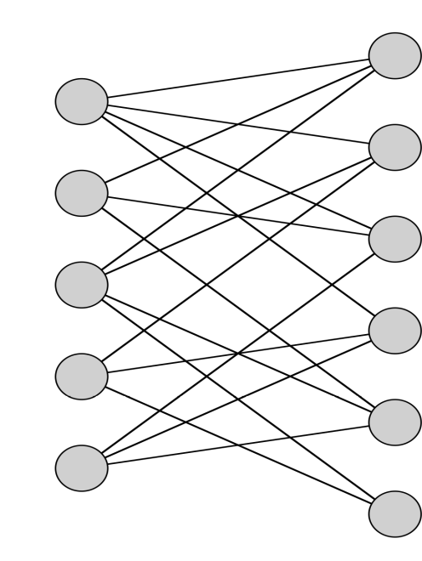
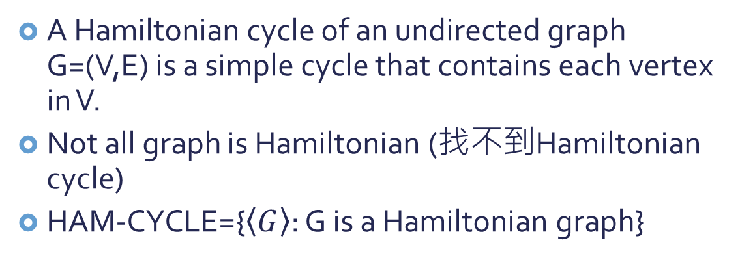
Hamiltonian cycles
A Hamiltonian cycle of an undirected graph G=(V,E) is a simple cycle that contains each vertex in V.
Not all graph is Hamiltonian (找不到Hamiltonian cycle)
HAM-CYCLE={$\left\langle G\right\rangle$: G is a Hamiltonian graph}

Slide 32
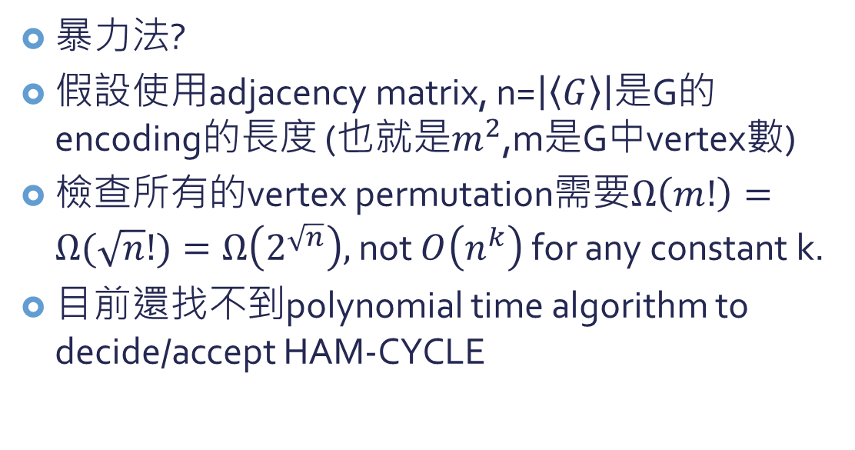
Hamiltonian cycles
暴力法?
假設使用adjacency matrix, n=$\left|\left\langle G\right\rangle \right|$是G的encoding的長度 (也就是$m^{2}$,m是G中vertex數)
檢查所有的vertex permutation需要$Ω\left(m!\right)=Ω(\sqrt{n}!)=Ω\left(2^{\sqrt{n}}\right),$not $O\left(n^{k}\right)$ for any constant k.
目前還找不到polynomial time algorithm to decide/accept HAM-CYCLE

Slide 33
Verify會簡單一點嗎?
會!
假設告訴你某一個graph G是Hamiltonian, 然後告訴你一個vertex的序列(certificate)可以組成Hamiltonian cycle.
則我們可以在polynomial time裡面檢查:
這個vertex序列是不是真的是G裡面的vertex的permutation
vertex序列的相鄰vertices之間是不是在G中有那個edge

Slide 34
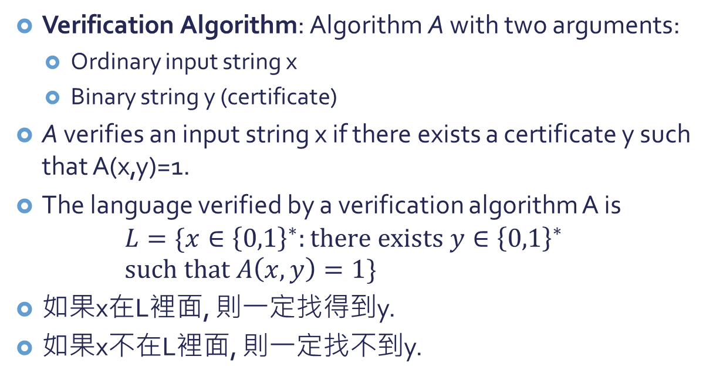
Verification Algorithm
Verification Algorithm: Algorithm A with two arguments:
Ordinary input string x
Binary string y (certificate)
A verifies an input string x if there exists a certificate y such that A(x,y)=1.
The language verified by a verification algorithm A is $L=\{x∈{\left\{0,1\right\}}^{∗}:there exists y∈{\left\{0,1\right\}}^{∗}$ $such that A\left(x,y\right)=1\}$
如果x在L裡面, 則一定找得到y.
如果x不在L裡面, 則一定找不到y.

Slide 35
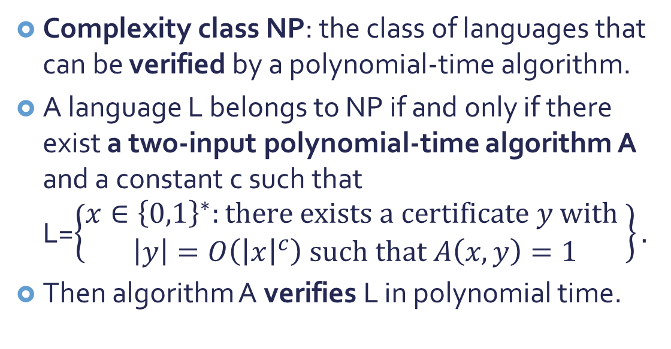
The complexity class NP
Complexity class NP: the class of languages that can be verified by a polynomial-time algorithm.
A language L belongs to NP if and only if there exist a two-input polynomial-time algorithm A and a constant c such that L=$\left\{\begin{aligned}x∈{\left\{0,1\right\}}^{∗}:there exists a certificate y with \\ \left|y\right|=O\left({\left|x\right|}^{c}\right) such that A\left(x,y\right)=1\end{aligned}\right\}.$
Then algorithm A verifies L in polynomial time.

Slide 36
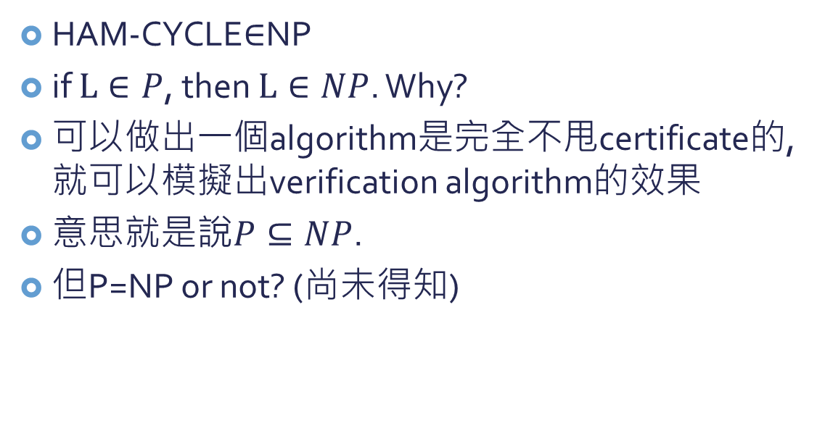
What is in NP?
HAM-CYCLE$∈$NP
if $L∈P$, then $L∈NP$. Why?
可以做出一個algorithm是完全不甩certificate的, 就可以模擬出verification algorithm的效果
意思就是說$P⊆NP$.
但P=NP or not? (尚未得知)

Slide 37
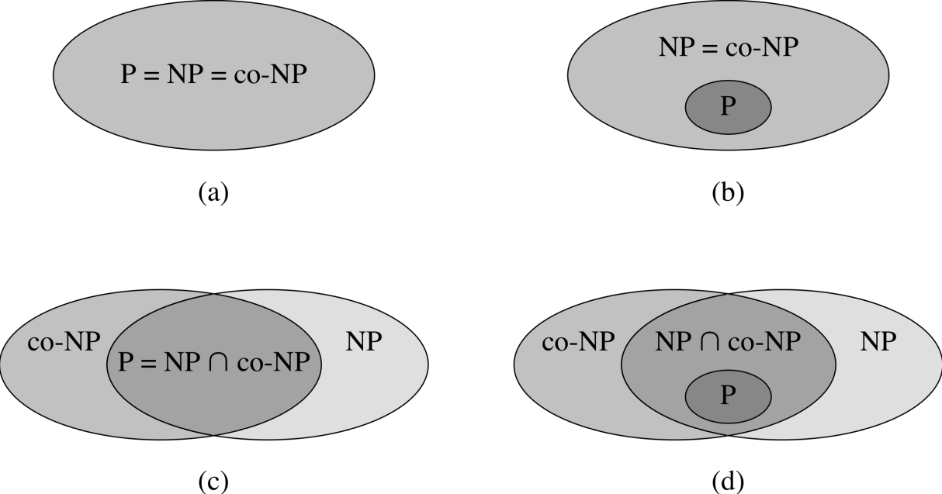

Complexity class co-NP
class NP is closed under complement? (尚未得知)
意思就是說$L∈NP$的話, $\overline{L}$ $∈NP$否?
co-NP: all languages that satisfies $\overline{L}$ $∈NP$

Slide 38
NP-Complete languages
“The hardest languages in NP”
If NP-P is nonempty, then these in NP-Complete are in NP-P (such as HAM-CYCLE)
Reducibility → 解一個破全部, 一箭千雕

Slide 39
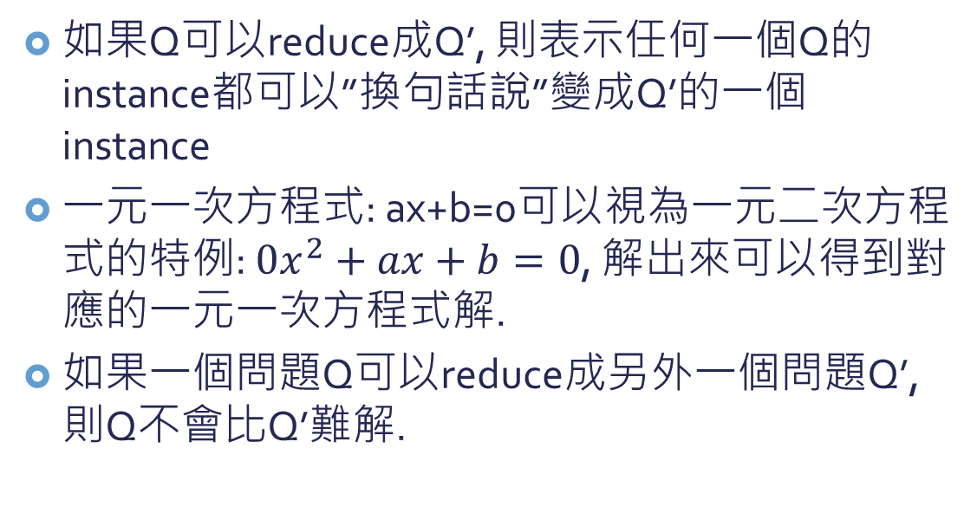
Reducibility
如果Q可以reduce成Q’, 則表示任何一個Q的instance都可以”換句話說”變成Q’的一個instance
一元一次方程式: ax+b=0可以視為一元二次方程式的特例: $0x^{2}+ax+b=0$, 解出來可以得到對應的一元一次方程式解.
如果一個問題Q可以reduce成另外一個問題Q’, 則Q不會比Q’難解.

Slide 40
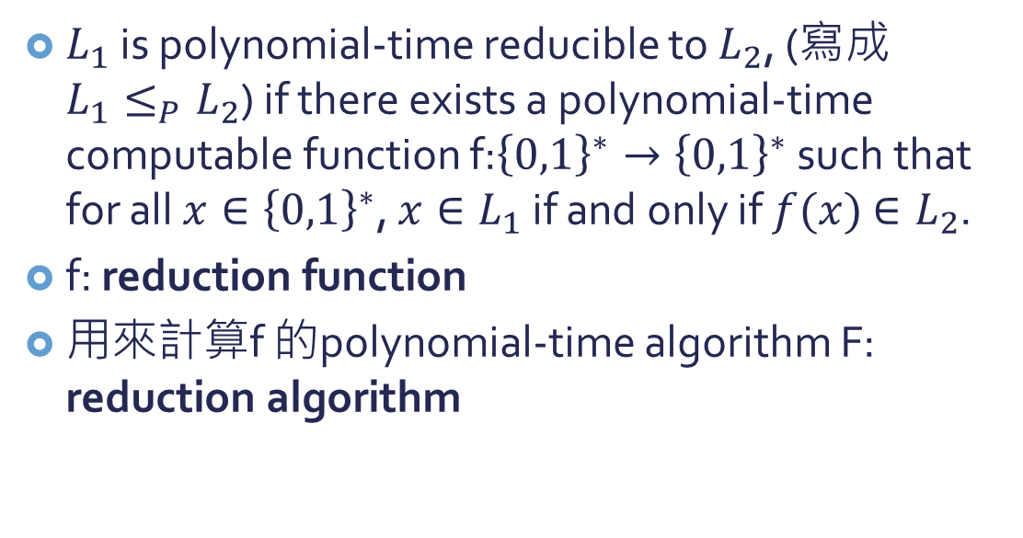
Reduction
$L_{1}$ is polynomial-time reducible to $L_{2}$, (寫成$L_{1}≤_{P}L_{2}$) if there exists a polynomial-time computable function f:${\left\{0,1\right\}}^{∗}→{\left\{0,1\right\}}^{∗}$ such that for all $x∈{\left\{0,1\right\}}^{∗}$, $x∈L_{1}$ if and only if $f(x)$ $∈L_{2}$.
f: reduction function
用來計算f 的polynomial-time algorithm F: reduction algorithm

Slide 41
