Slide 1
NP-Completeness
Jennya
2013/10/31

Slide 2
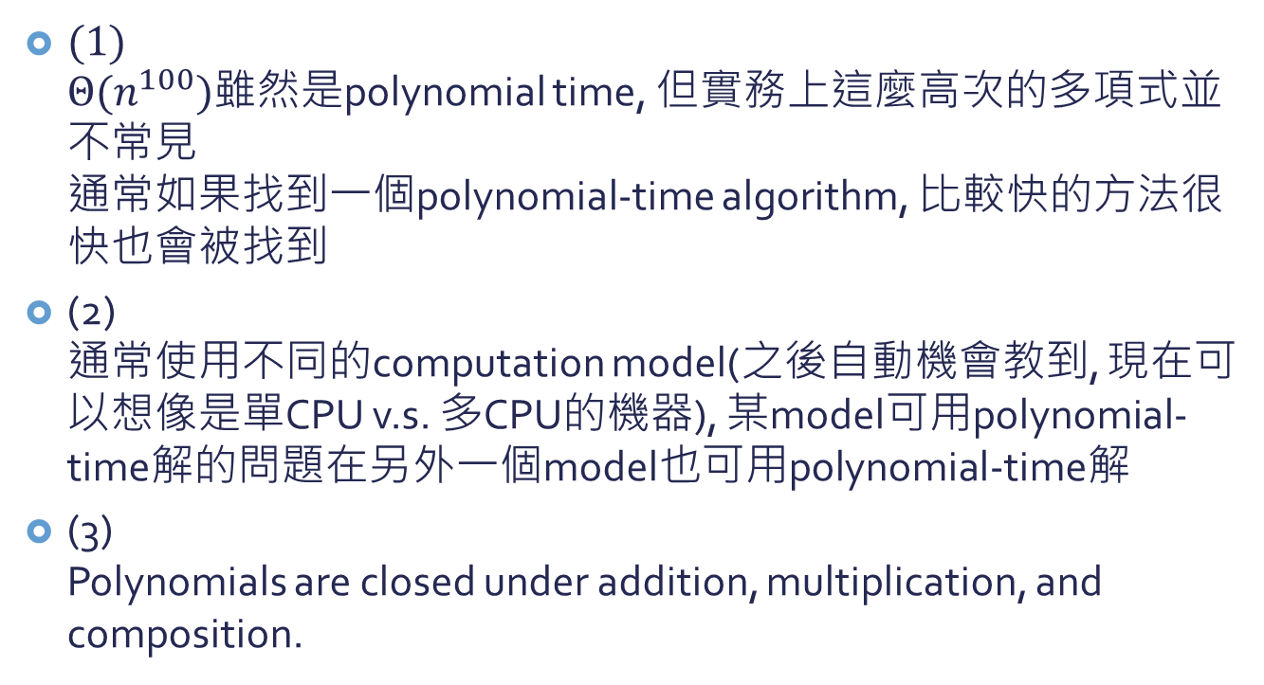
為什麼Polynomial time就是 ”容易解”, ”可解的”?
(1) $Θ(n^{100})$雖然是polynomial time, 但實務上這麼高次的多項式並不常見 通常如果找到一個polynomial-time algorithm, 比較快的方法很快也會被找到
(2) 通常使用不同的computation model(之後自動機會教到, 現在可以想像是單CPU v.s. 多CPU的機器), 某model可用polynomial-time解的問題在另外一個model也可用polynomial-time解
(3) Polynomials are closed under addition, multiplication, and composition.

Slide 3
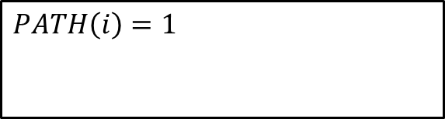


Abstract problem
I problem instances
S
problem solutions
Q: Abstract problem (binary relation)
Example: PATH
$$PATH\left(i\right)=1$$
if a shortest path from u to v has at most k edges
$$i=\left\langle G,u,v,k\right\rangle$$
$$PATH\left(i\right)=0$$
otherwise
Decision problem:
S={0,1}

Slide 4
Encoding
A set S of abstract objects
The set of binary strings
encoding: mapping
Polygons, numbers, graphs, functions, ordered pairs, programs, …

Slide 5

Abstract problem轉換成concrete problem We can use encodings to map abstract problems to concrete problems
Abstract Decision Problem Q
Instance set I
solution set S
{0,1}
Q
Abstract problem
$$e: I→{\left\{0,1\right\}}^{∗}$$
Concrete Decision Problem e(Q)
e(I): {0,1}*
solution set S
{0,1}
e(Q)
Concrete problem

Slide 6
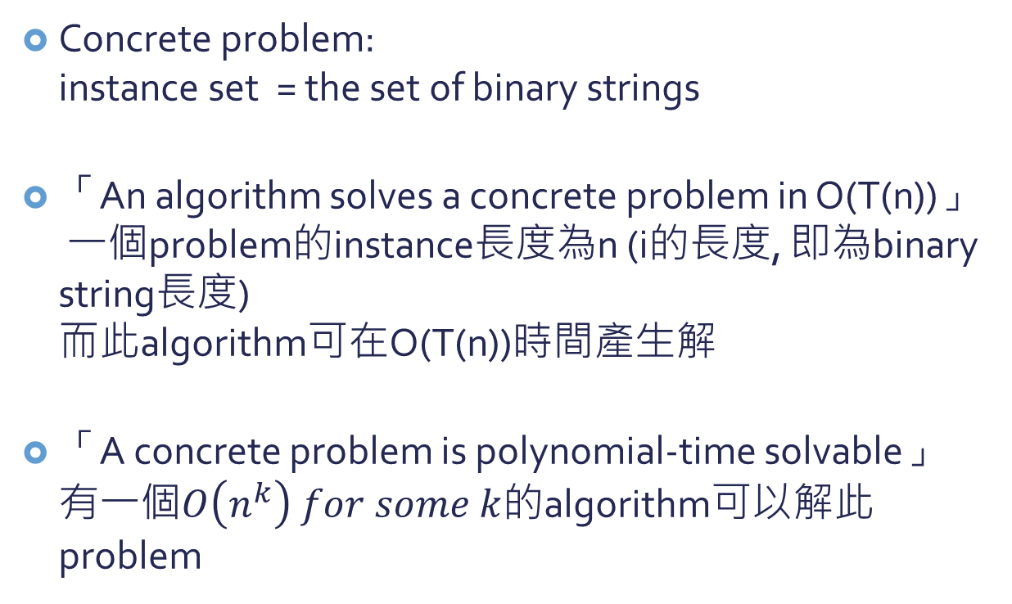
Concrete problem
Concrete problem: instance set = the set of binary strings
「An algorithm solves a concrete problem in O(T(n))」 一個problem的instance長度為n (i的長度, 即為binary string長度) 而此algorithm可在O(T(n))時間產生解
「A concrete problem is polynomial-time solvable」 有一個$O\left(n^{k}\right) for some k$的algorithm可以解此problem

Slide 7
P的正式定義
The complexity class P: The set of concrete decision problems that are polynomial-time solvable

Slide 8
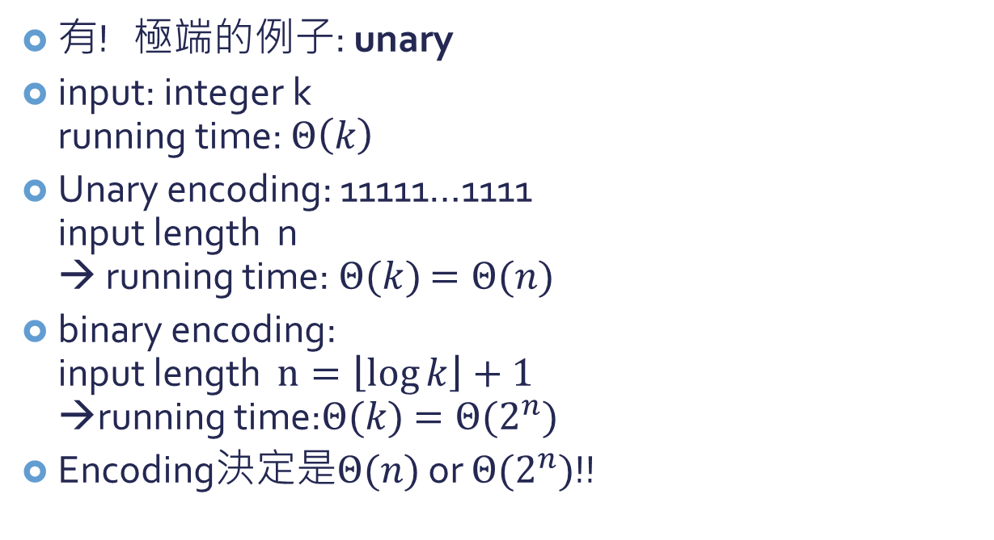
Encoding和花的時間有關嗎?
有! 極端的例子: unary
input: integer k running time: $Θ\left(k\right)$
Unary encoding: 11111…1111 input length n → running time: $Θ(k)$ $=Θ(n)$
binary encoding: input length $n=\left\lfloor \log{k}\right\rfloor +1$ →running time:$Θ(k)$ $=Θ(2^{n})$
Encoding決定是$Θ(n)$ or $Θ(2^{n})$!!
k個

Slide 9
Encoding和花的時間有關嗎?
然而如果我們不考慮這麼極端的encoding方式(unary), 其他的encoding都不會影響到一個問題是否可以在polynomial time解決.
例: 使用三進位數和二進位數是沒有差別的, 因為我們可以在polynomial time裡面將三進位數轉換成二進位數.

Slide 10
polynomial-time computable function
input
f: {0,1}*→{0,1}*
output
如果f花polynomial time可以把任何input轉成output, 則稱為polynomial-time computable

Slide 11
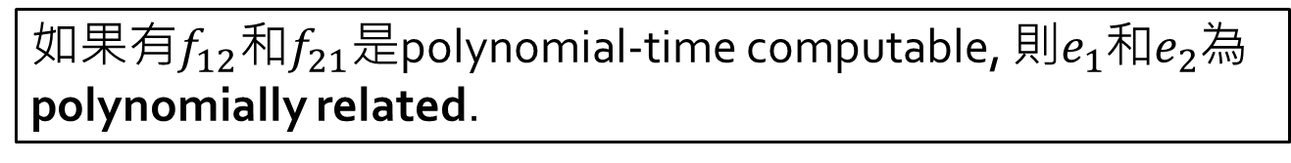


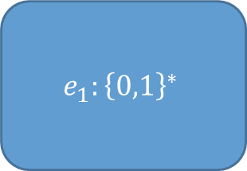

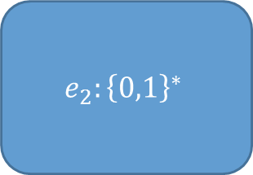

Polynomially related
I: instances of problem
$$e_{1}:I→{\left\{0,1\right\}}^{∗}$$
$$e_{2}:I→{\left\{0,1\right\}}^{∗}$$
$$e_{1}:{\left\{0,1\right\}}^{∗}$$
$$f_{21}\left(e_{2}\left(i\right)\right)=e_{1}(i)$$
$$e_{2}:{\left\{0,1\right\}}^{∗}$$
$$f_{12}\left(e_{1}\left(i\right)\right)=e_{2}(i)$$
如果有$f_{12}$和$f_{21}$是polynomial-time computable, 則$e_{1}$和$e_{2}$為polynomially related.

Slide 12
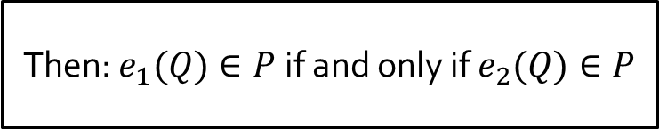


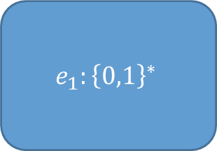



Lemma:
$$e_{2}:{\left\{0,1\right\}}^{∗}$$
$e_{2}(Q)$: Concrete problem
$$e_{2}:I→{\left\{0,1\right\}}^{∗}$$
if:
I: instances of problem
S: solutions
polynomially related
Q: Abstract problem (binary relation)
Decision problem:
S={0,1}
$$e_{1}:I→{\left\{0,1\right\}}^{∗}$$
$$e_{1}:{\left\{0,1\right\}}^{∗}$$
$e_{1}(Q)$: Concrete problem
Then: $e_{1}(Q)∈P$ if and only if $e_{2}(Q)∈P$

Slide 13
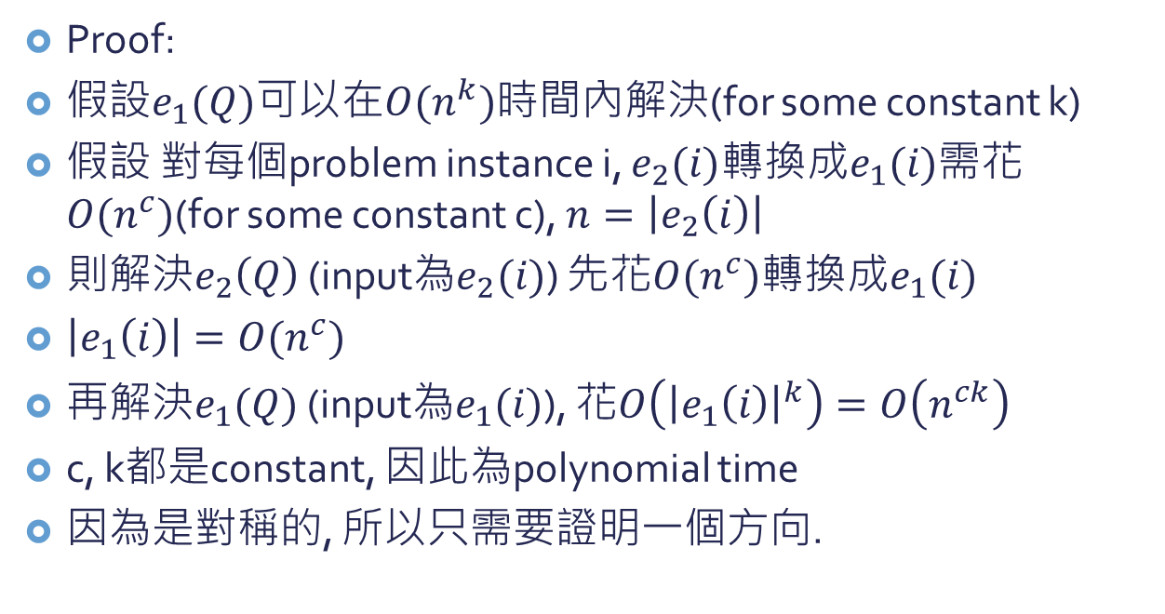
Proof:
假設$e_{1}(Q)$可以在$O(n^{k})$時間內解決(for some constant k)
假設 對每個problem instance i, $e_{2}(i)$轉換成$e_{1}(i)$需花$O(n^{c})$(for some constant c), $n=\left|e_{2}\left(i\right)\right|$
則解決$e_{2}\left(Q\right)$ (input為$e_{2}(i)$) 先花$O(n^{c})$轉換成$e_{1}(i)$
$\left|e_{1}\left(i\right)\right|=O(n^{c})$
再解決$e_{1}(Q)$ (input為$e_{1}(i)$), 花$O\left({\left|e_{1}\left(i\right)\right|}^{k}\right)=O\left(n^{ck}\right)$
c, k都是constant, 因此為polynomial time
因為是對稱的, 所以只需要證明一個方向.
只要encoding都是”合理的” (“簡要的”)表示方式, 一個問題的複雜度(能否在polynomial time裡面解掉)不會被encoding影響.

Slide 14
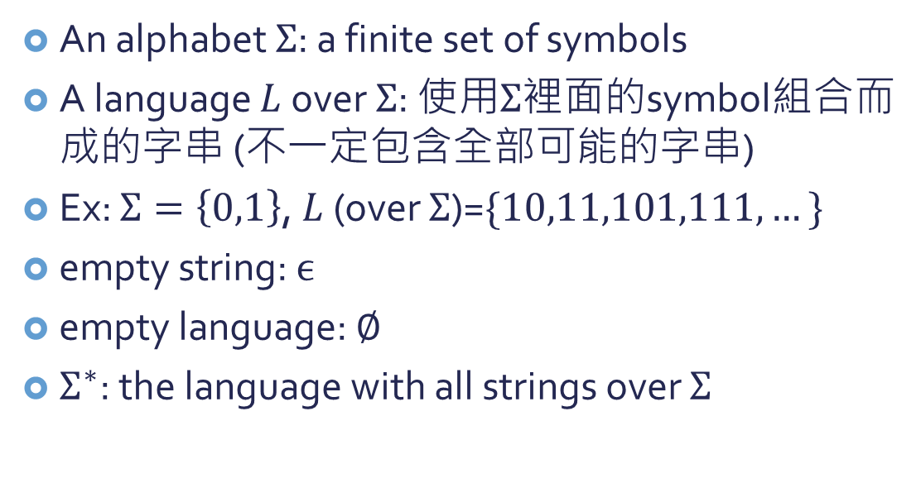
A Formal-language Framework
An alphabet $Σ$: a finite set of symbols
A language $L$ over $Σ$: 使用$Σ$裡面的symbol組合而成的字串 (不一定包含全部可能的字串)
Ex: $Σ=\left\{0,1\right\}$, $L$ (over $Σ$)=$\{10,11,101,111,…\}$
empty string: $ϵ$
empty language: $∅$
$Σ^{∗}$: the language with all strings over $Σ$

Slide 15
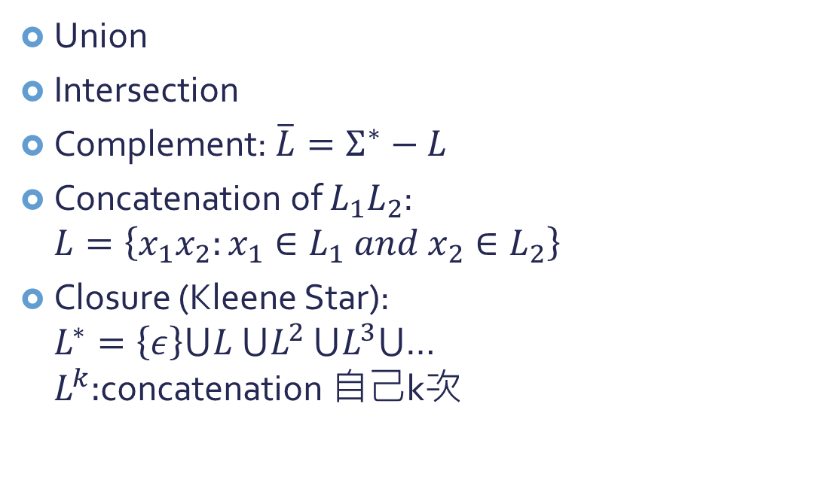
Operations on languages
Union
Intersection
Complement: $\overline{L}=Σ^{∗}−L$
Concatenation of $L_{1}L_{2}$: $L=\left\{x_{1}x_{2}:x_{1}∈L_{1} and x_{2}∈L_{2}\right\}$
Closure (Kleene Star): $L^{∗}=\left\{ε\right\}⋃L$ $⋃L^{2}$ $⋃L^{3}⋃$… $L^{k}:$concatenation 自己k次

Slide 16
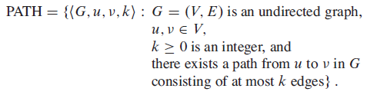
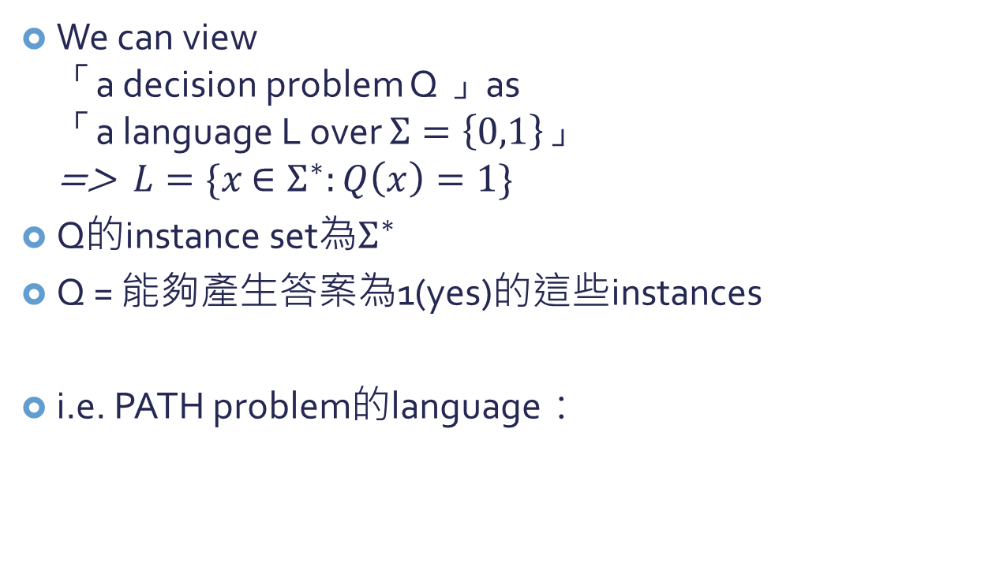
應用formal language framework…
We can view 「a decision problem Q 」as 「a language L over $Σ=\left\{0,1\right\}」$ => $L=\{x$ $∈Σ^{∗}:Q\left(x\right)=1\}$
Q的instance set為$Σ^{∗}$
Q = 能夠產生答案為1(yes)的這些instances
i.e. PATH problem的language：

Slide 17
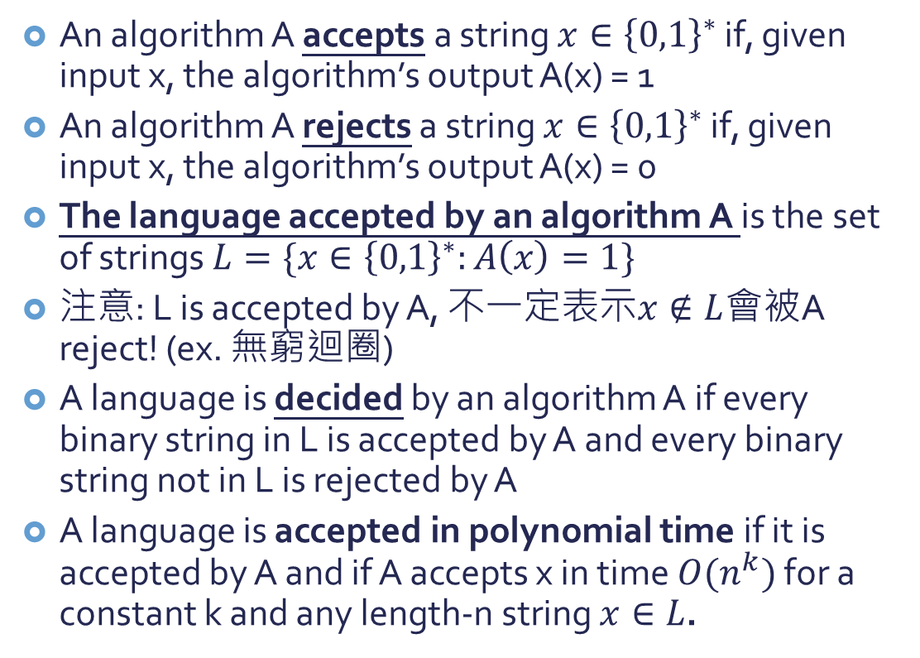
Accepts and Rejects
An algorithm A accepts a string $x∈{\left\{0,1\right\}}^{∗}$ if, given input x, the algorithm’s output A(x) = 1
An algorithm A rejects a string $x∈{\left\{0,1\right\}}^{∗}$ if, given input x, the algorithm’s output A(x) = 0
The language accepted by an algorithm A is the set of strings $L=\{x∈{\left\{0,1\right\}}^{∗}:A\left(x\right)=1\}$
注意: L is accepted by A, 不一定表示$x∉L$會被A reject! (ex. 無窮迴圈)
A language is decided by an algorithm A if every binary string in L is accepted by A and every binary string not in L is rejected by A
A language is accepted in polynomial time if it is accepted by A and if A accepts x in time $O(n^{k})$ for a constant k and any length-n string $x∈L$.

Slide 18
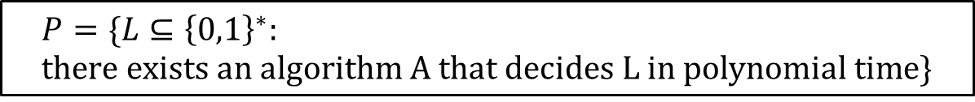
使用formal-language framework定義complexity class P
可以用「a set of languages」定義 「complexity class」 如何決定是不是在這個class(set)中： 由「決定一個string x是否屬於L」的 algorithm的running time而定
使用這個方式, 我們可以重新定義P這個complexity class:
$$P=\{L⊆{\left\{0,1\right\}}^{∗}: \\ there exists an algorithm A that decides L in polynomial time\}$$

Slide 19
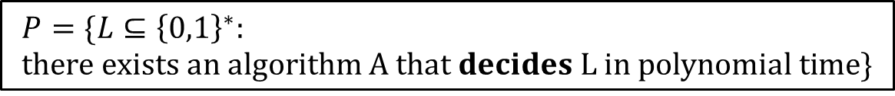
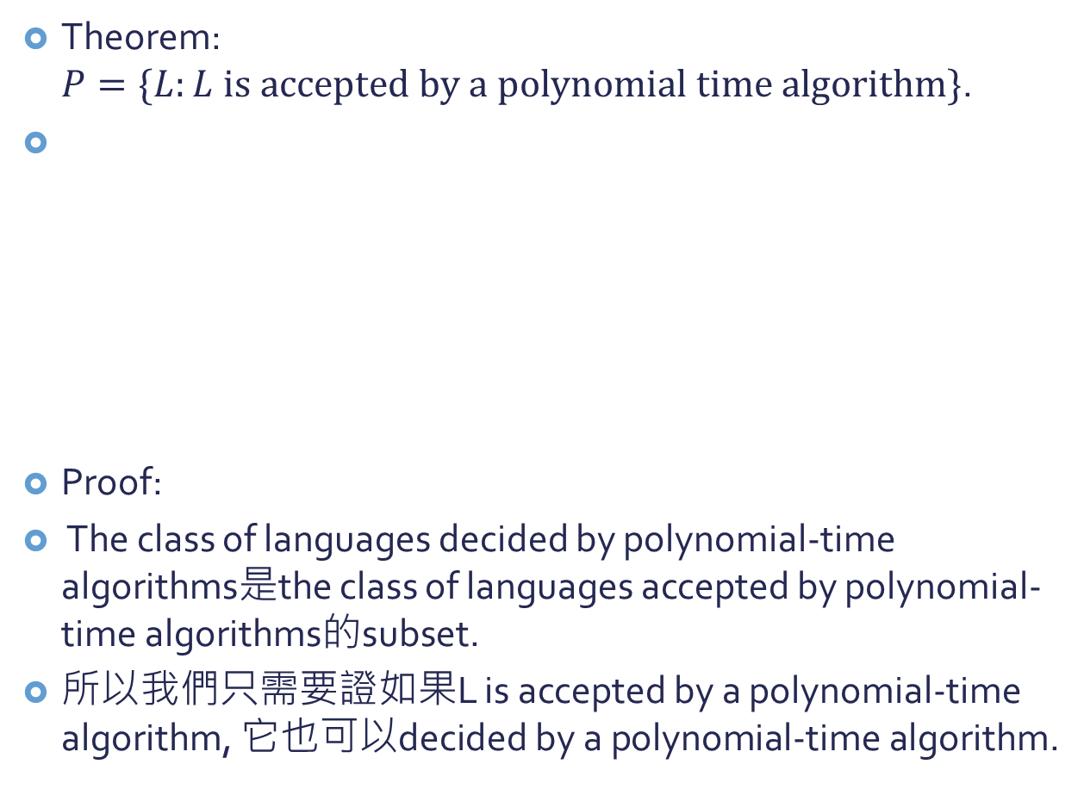
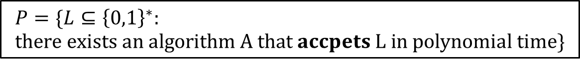
Theorem: $P=\{L:L is accepted by a polynomial time algorithm\}$.
Proof:
The class of languages decided by polynomial-time algorithms是the class of languages accepted by polynomial-time algorithms的subset.
所以我們只需要證如果L is accepted by a polynomial-time algorithm, 它也可以decided by a polynomial-time algorithm.
$$P=\{L⊆{\left\{0,1\right\}}^{∗}: \\ there exists an algorithm A that decides L in polynomial time\}$$
$$P=\{L⊆{\left\{0,1\right\}}^{∗}: \\ there exists an algorithm A that accpets L in polynomial time\}$$

Slide 20
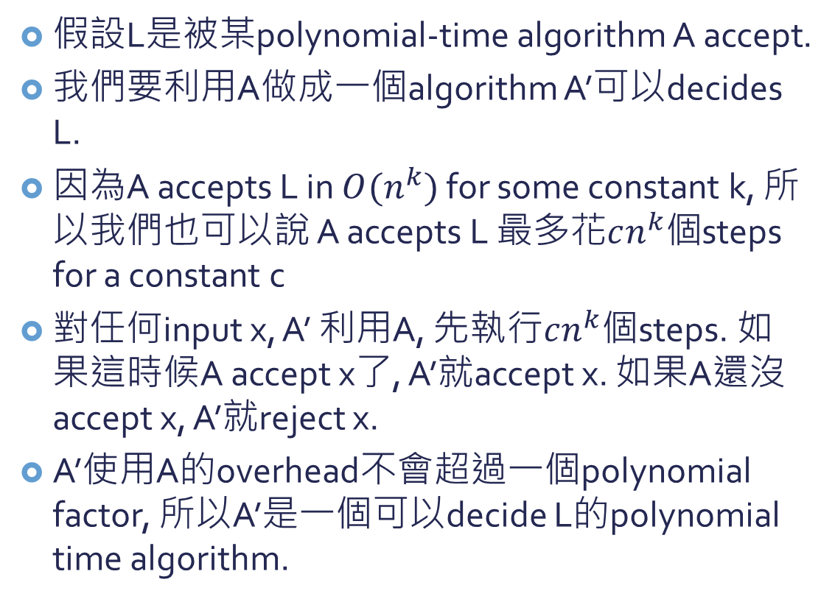
假設L是被某polynomial-time algorithm A accept.
我們要利用A做成一個algorithm A’可以decides L.
因為A accepts L in $O(n^{k})$ for some constant k, 所以我們也可以說 A accepts L 最多花$cn^{k}個$steps for a constant c
對任何input x, A’ 利用A, 先執行$cn^{k}個$steps. 如果這時候A accept x了, A’就accept x. 如果A還沒accept x, A’就reject x.
A’使用A的overhead不會超過一個polynomial factor, 所以A’是一個可以decide L的polynomial time algorithm.

