Slide 1

演算法設計與分析
台大資工系
呂學一
http://www.csie.ntu.edu.tw/~hil/

Slide 2

Today
Shortest path and cycle
Shortest-Path Tree
  Bellman-Ford
  Lawler
  Dijkstra

Slide 3
The settings
u
3
2
2
1
1
3
-3
1
v
2

Slide 4
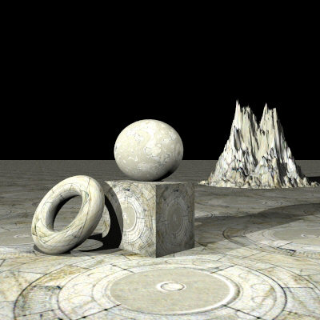
Shortest path and cycles
暖身一下

Slide 5


Question
u
v

Slide 6
Observation
u
v

Slide 7

Shortest-path tree problem

Slide 8
The problem

Slide 9
Without loss of generality
We may assume that each node in the graph is reachable from r.
Why?
  Unreachable nodes can be removed in linear time by a depth-first search starting from r.

Slide 10
Also known as
Single-source shortest-path problem
  The root r is the “source”.
r

Slide 11
Question
Such a shortest-path tree always exists?

Slide 12
Perhaps not..
A negative cycle
r

Slide 13
As a matter of fact
The input graph G has a shortest-path tree if and only if G does not contain any negative cycle.
  The only-if direction is “obvious”.
    If a node u belongs to a negative cycle, then there is no shortest path from r to u.
  Q: how about the other direction?

Slide 14
從r到u一定有shortest path
雖然從r到u的path可能有無窮多條（因為G可能有cycle），但是根據G沒有negative cycle，我們可以說明從r到u一定有一條shortest path：
  因為G沒有negative cycles, 所以任何包含cycle的path，在去掉cycle之後不會增加長度。
  沒有cycle的paths只有finite條，其中最短的任何一條一定就是從r到u的shortest path。

Slide 15
但是union起來未必就是答案
r
可能需要調整path，以維持tree的形狀

Slide 16
G has no negative cycle
Removing cycles from a path does not increase it length.
For each node u of G, there has to be a shortest path from r to node u that do not contain any cycle.
Some “adjusted” union of all these n shortest paths yields a shortest-path tree of G rooted at r.

Slide 17
An equivalent problem
The shortest-path tree problem is equivalent to finding the distance from r to each node u in graph G.
  The distance from r to node u in G is the length of any shortest path from r to u in G.
  By “equivalence” we mean that a solution to either problem can be obtained from a solution to the other problem in linear time.
Why?

Slide 18
Tree ➔ distance

Slide 19
Tree ⬅ distance

Slide 20
Example
0
3
2
3
0
2

Slide 21
接下來專心算「距離」就好
Let d(u) denote the distance from r to u in graph G. We focus only on computing the distance of each node u from r.
Without loss of generality, we may assume that the distance of each node from r is finite.
  That is, each node is reachable from r, since we can remove unreachable nodes in linear time.

Slide 22
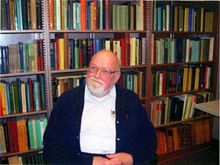

Bellman-Ford

Slide 23
Richard Bellman, 1920~1984
Norbert Wiener Prize in Applied Mathematics, 1970
Dickson Prize, Carnegie-Mellon University, 1970;
John von Neumann Theory Award, 1976.
IEEE Medal of Honor, 1979,
  "For contributions to decision processes and control system theory, particularly the creation and application of dynamic programming."
Fellow of the American Academy of Arts and Sciences, 1975.
Membership in the National Academy of Engineering, 1977.

Slide 24
Lester R. Ford, Jr. 1927~
A important contributor to the theory of network flow.
  We will learn Ford and Fulkerson’s maximum flow algorithm later.

Slide 25
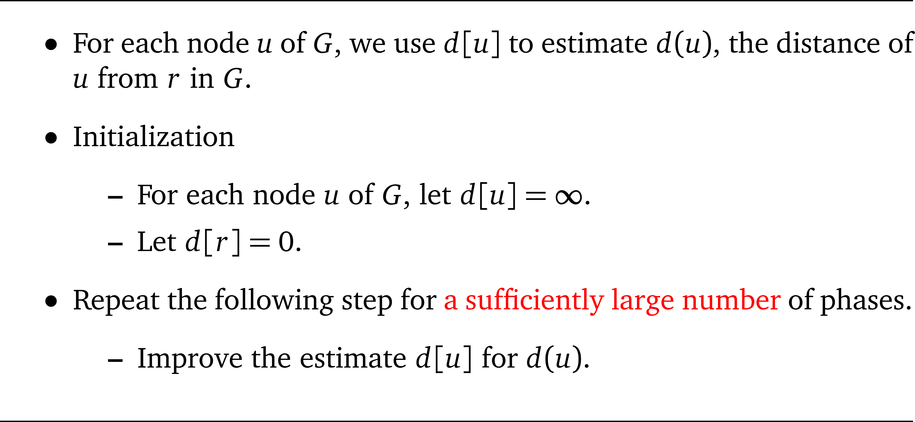
Sketch of Bellman-Ford

Slide 26

Improving the estimate

Slide 27
Illustration
r

Slide 28
Illustration
r

Slide 29
Illustration
r

Slide 30
Observations

Slide 31
Q: how many phases is needed?

Slide 32
A: n – 1 phases suffice.
If G contains no negative cycles, then each node u has a shortest path from r to u that has at most n – 1 edges.
Observe that after the first i phases of the improvement via relaxation, the estimate d[u] of d(u) for the first i + 1 nodes u in the path is precise.

Slide 33
Illustration

Slide 34
Bellman-Ford

Slide 35
Existence of negative cycles
Question:
  How do we know G has negative cycles?

Slide 36
Using another phase of improvement via relaxation
Run another phase of improvement of the estimate d[u] of d(u) for each node u of G via relaxing all edges of G.
If in the n-th phase, there are still some d[u] being modified, we know that G has negative cycles.

Slide 37
Why?

Slide 38
Summary
Bellman-Ford
  Time: O(mn)
  Detect whether the input graph has negative cycle.
  If the input graph does not contain any negative cycle, the algorithm outputs d(u) = d[u] for each node u of G.
A shortest-path tree of G can be obtained from d(u) for all nodes u in O(m + n) time.

Slide 39

If G is acyclic
Can we speed up Bellman-Ford?

Slide 40
No negative cycle!
Since the input graph has no cycle, it has no negative cycle.

Slide 41
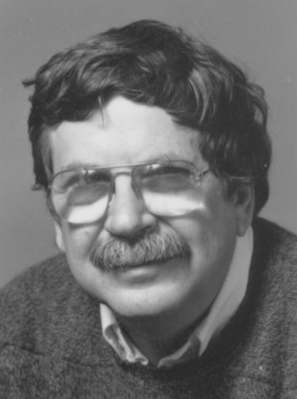
Eugene Lawler
1933-1994

Slide 42
One phase suffices
We first perform a topological sort in linear time on the input directed acyclic graph.
For i = 1 to n
  Let v_{i} be the i-th node in the above order.
  Relax each outgoing edge (v_{i}, u) from v_{i}.
The running time is O(m + n).

Slide 43
Illustration
r

Slide 44
Correctness
r
u
這是一條從r到u的shortest-path。雖然我們不知道它
在圖中的位置，但是只要我們按照topological sort完
的順序來relax這些點的outgoing edges，則在這一條
shortest path上面，左邊的edge一定會比右邊的edge
先被relax。所以一個回合的improvement就已經足夠。

Slide 45
Summary
If the input graph is a DAG, then it takes linear time to compute d(u) of each node u.
Therefore, it also takes linear time to compute a shortest-path tree for G.

Slide 46

If w is non-negative
Can we speed up Bellman-Ford?

Slide 47
No negative cycle!
Since the input graph has no negative edge, it has no negative cycle.

Slide 48
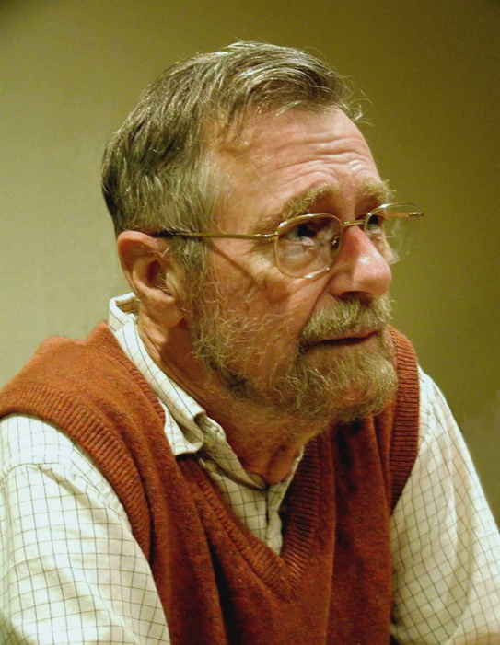
Edsger W. Dijkstra
Dutch, 1930 ~ 2002
Turing Award, 1972
“Goto is considered harmful.”
Inventor of P/V semaphores
  to resolve the “dining philosopher problem”

Slide 49
Dijkstra’s algorithm (sketch)
We cannot rely on topological sort, since G may contain cycles.
Still, one phase suffices!
  Initialize d[u] for all nodes u.
  The algorithm has n iterations:
    Each iteration relaxes the outgoing edges of an unprocessed node u whose d[u] is smallest among all unprocessed nodes.

Slide 50
Illustration
1
∞
∞
10
3
9
0
2
4
6
5
7
∞
∞
2

Slide 51
Illustration
1
10
∞
10
3
9
0
2
4
6
5
7
5
∞
2

Slide 52
Illustration
1
8
14
10
3
9
0
2
4
6
5
7
5
7
2

Slide 53
Illustration
1
8
13
10
3
9
0
2
4
6
5
7
5
7
2

Slide 54
Illustration
1
8
9
10
3
9
0
2
4
6
5
7
5
7
2

Slide 55
Illustration
1
8
9
10
3
9
0
2
4
6
5
7
5
7
2

Slide 56
Illustration
1
8
9
10
3
9
0
2
4
6
5
7
5
7
2

Slide 57
Correctness
u
r
x
y

Slide 58
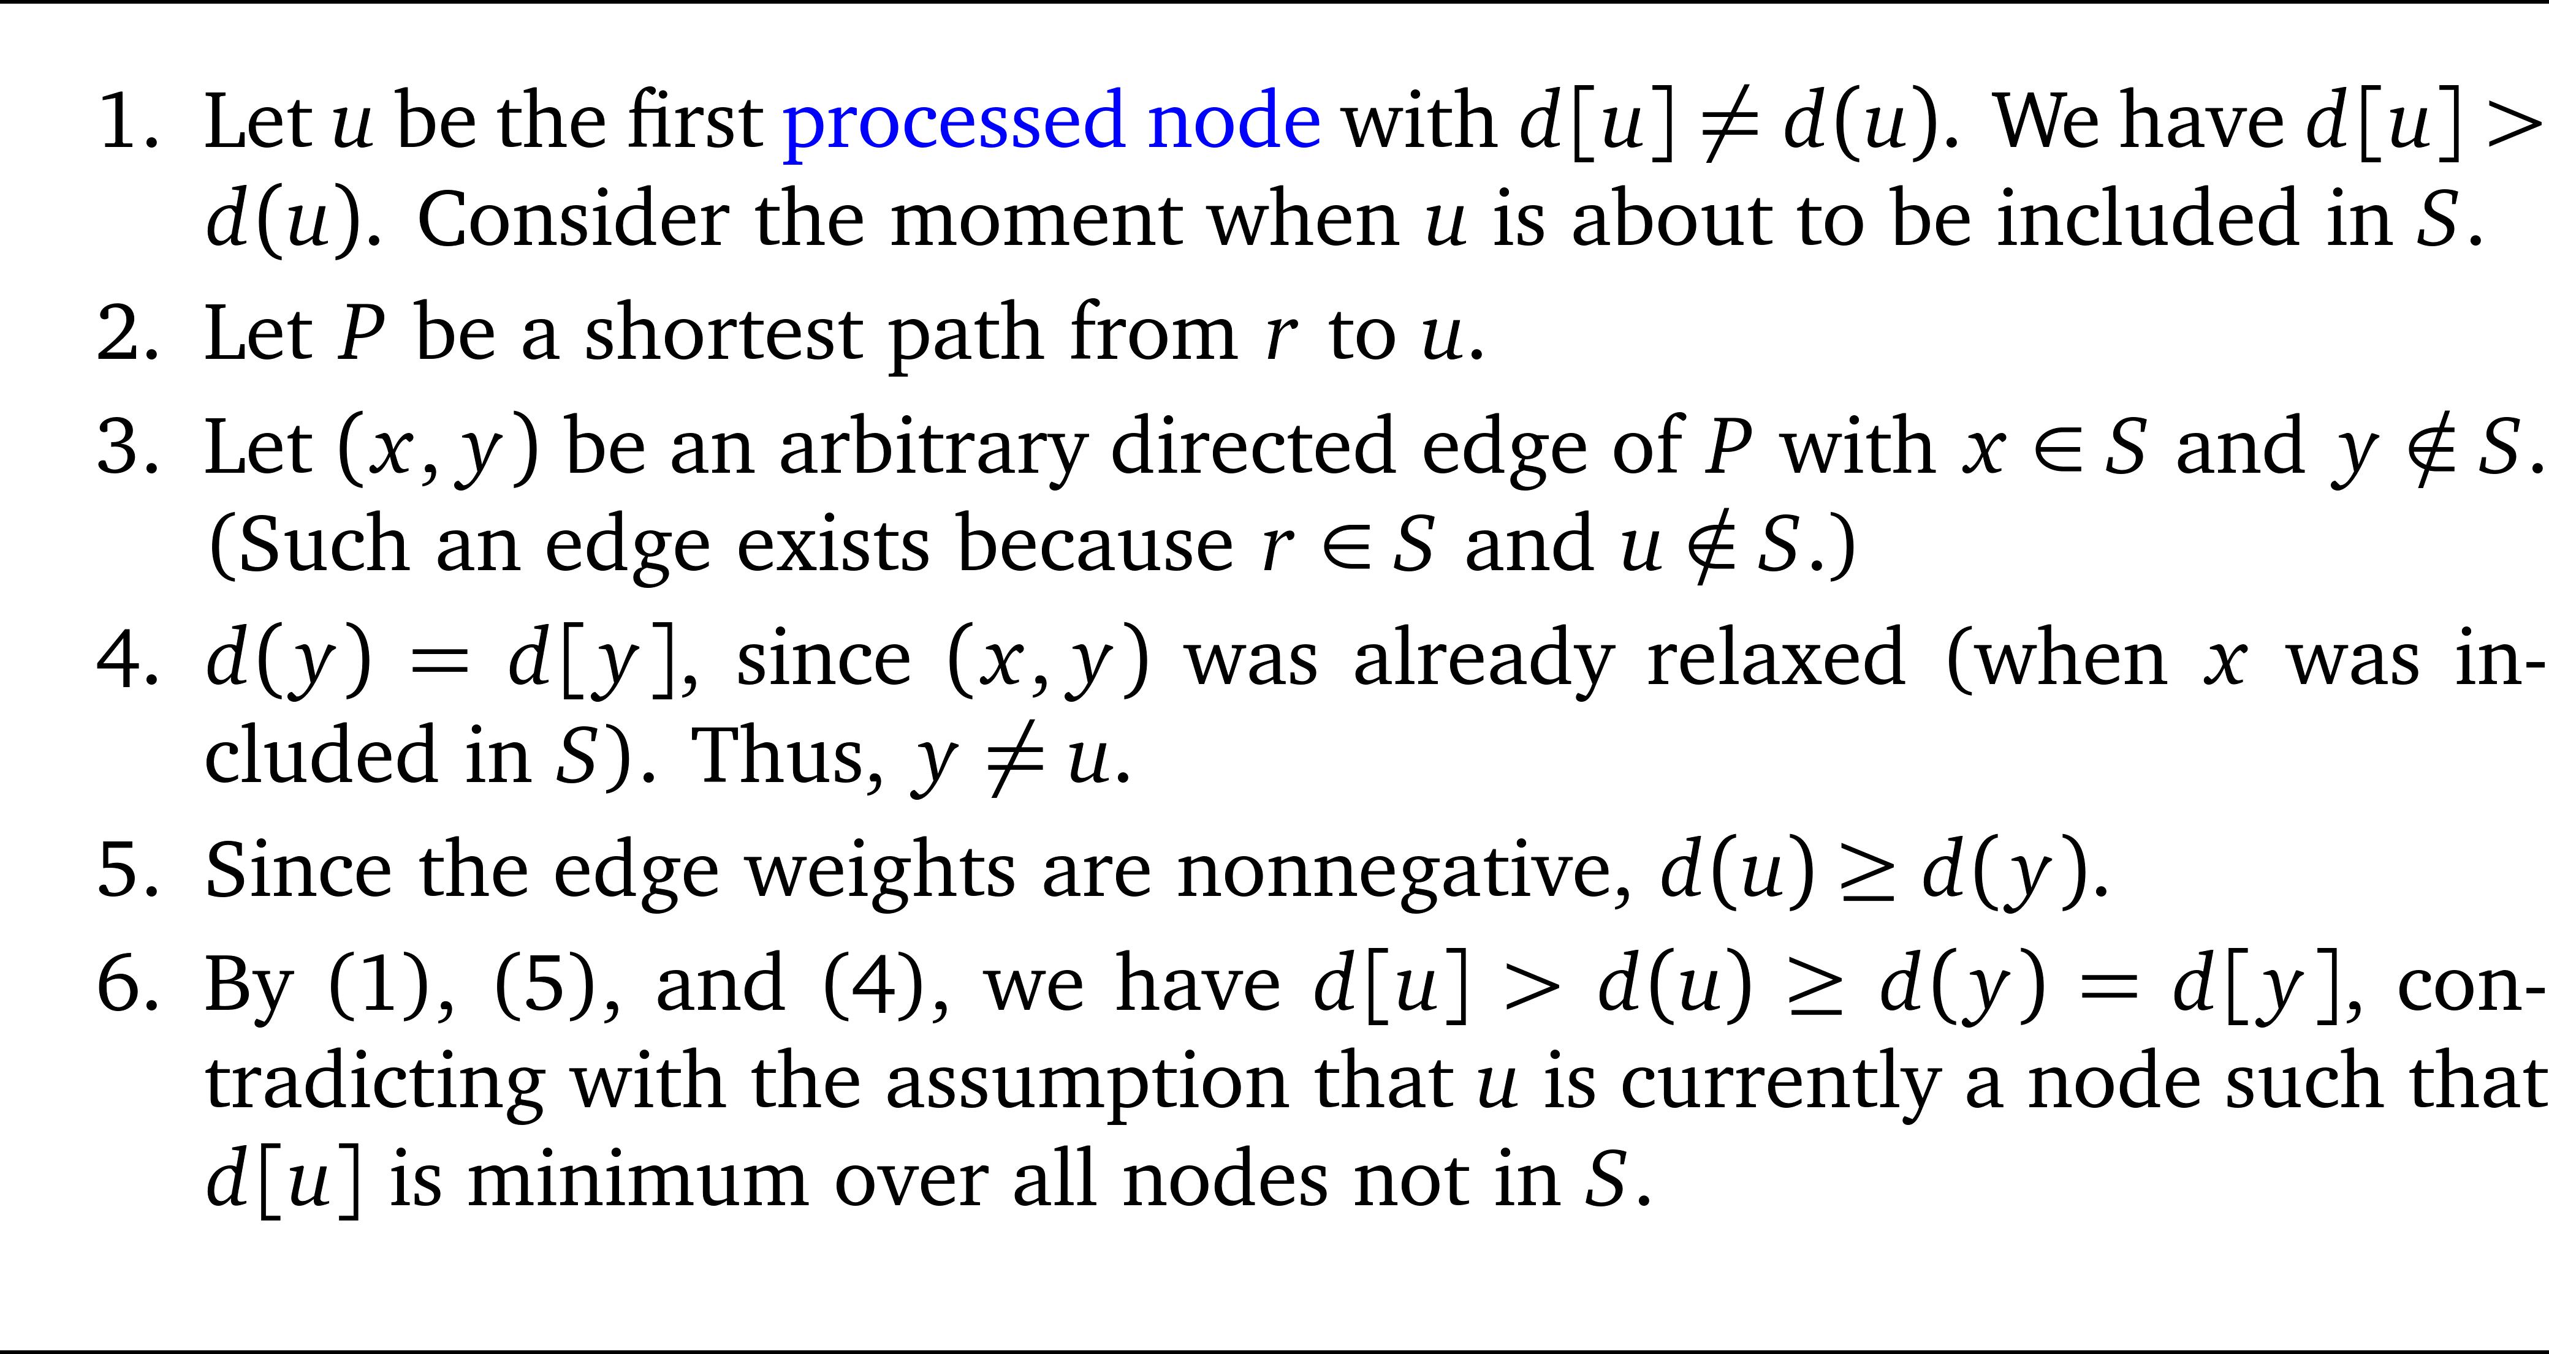
Proof sketch

Slide 59
Running time
One phase suffices!
  Same initialization for d[u] for all nodes u.
  The algorithm has n iterations:
    Each iteration relaxes the outgoing edges of an unprocessed node u whose d[u] is smallest among all unprocessed nodes.
O(n² + m) time using naïve implementation.
O(n log n + m) time using Fibonacci heap.

Slide 60
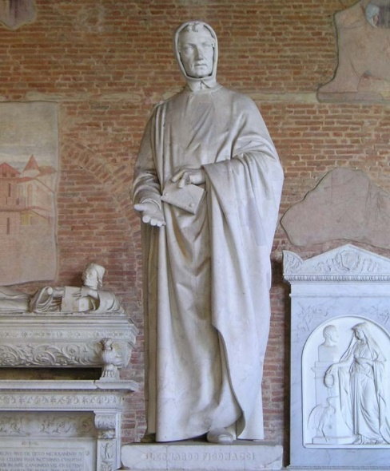
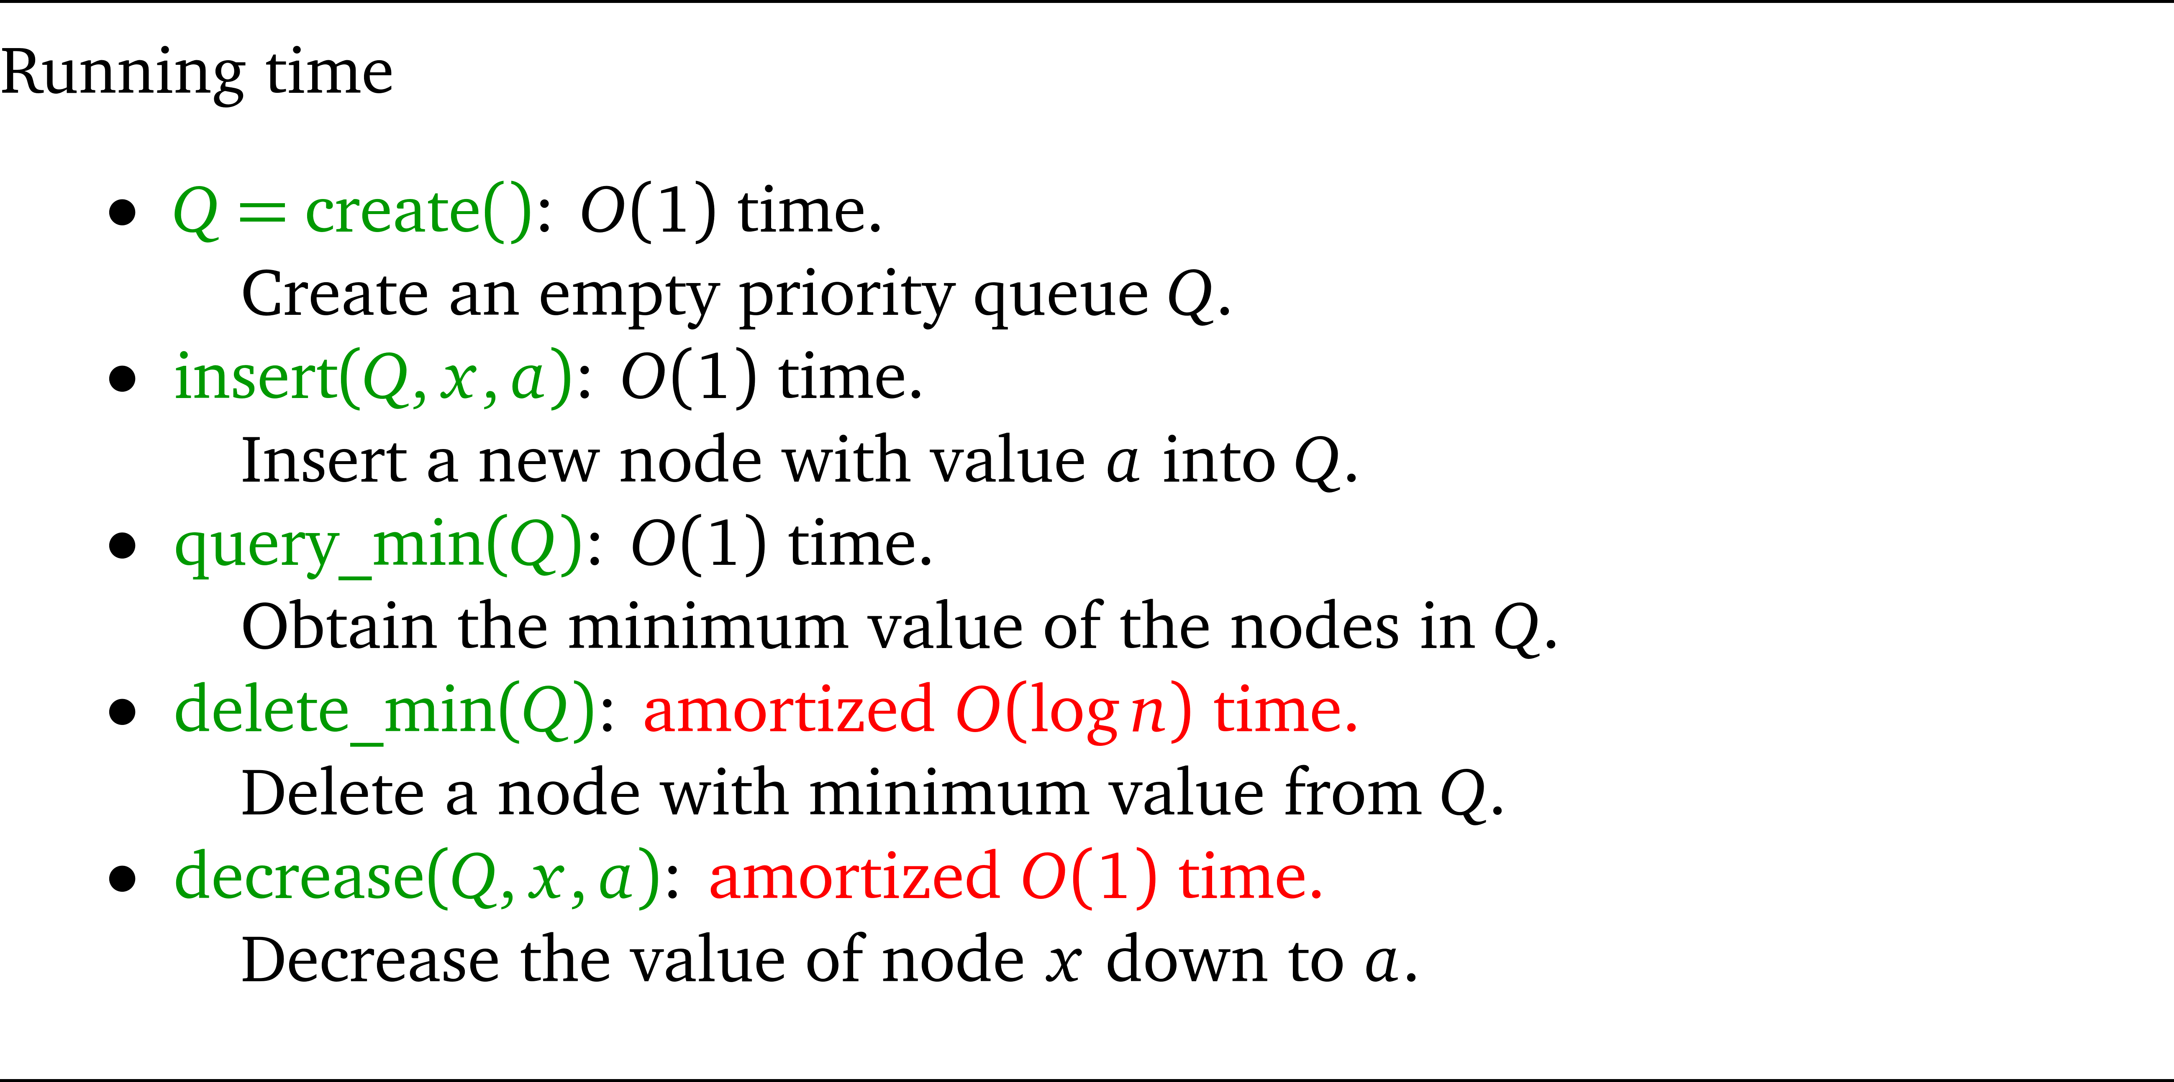
Fibonacci heap

