Slide 1
演算法設計與分析
台大資工系
呂學一
http://www.csie.ntu.edu.tw/~hil/

Slide 2
All-pairs distance
Relation with all-pairs shortest paths
Naïve algorithms from shortest-path tree
General weight: O(mn²).
Non-negative weight: O(mn + n²log n).
Dynamic-programming
O(n³log n)
O(n³): Floyd-Warshall
Reweighting
O(mn + n²log n): Johnson.

Slide 3
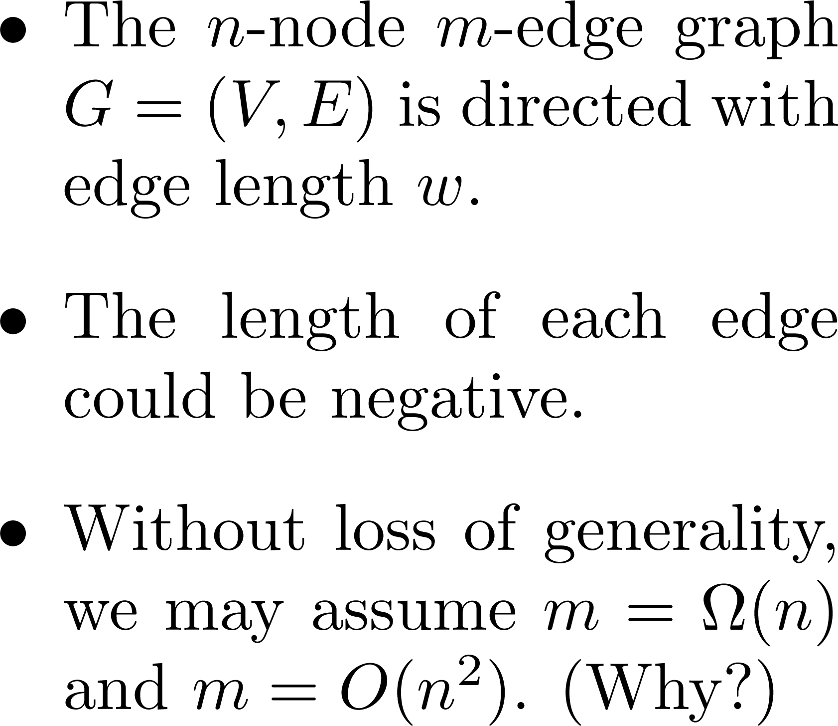
The settings
3
2
2
1
1
3
-3
1
2

Slide 4
The problem
Input:
An n-node m-edge directed graph G with edge length w.
Output:
The distance matrix d, where d(i, j) stands for the length of a shortest path from node i to node j.

Slide 5
Example
1
3
2
2
2
3
1
1
3
-3
d | 1 | 2 | 3 | 4 | 5 | 6
1 | 0 | 3 | 2 | 3 | 0 | 2
2 | ∞ | 0 | 2 | 1 | -2 | 0
3 | ∞ | ∞ | 0 | 1 | -2 | 0
4 | ∞ | ∞ | ∞ | 0 | -3 | -1
5 | ∞ | ∞ | ∞ | ∞ | 0 | 2
6 | ∞ | ∞ | ∞ | ∞ | ∞ | 0
4
5
1
6
2
input
output

Slide 6

Distance & shortest path trees
d | 1 | 2 | 3 | 4 | 5 | 6
1 | 0 | 3 | 2 | 3 | 0 | 2
2 | ∞ | 0 | 2 | 1 | -2 | 0
3 | ∞ | ∞ | 0 | 1 | -2 | 0
4 | ∞ | ∞ | ∞ | 0 | -3 | -1
5 | ∞ | ∞ | ∞ | ∞ | 0 | 2
6 | ∞ | ∞ | ∞ | ∞ | ∞ | 0
1
3
2
2
2
3
1
1
3
-3
4
5
1
6
2

Slide 7
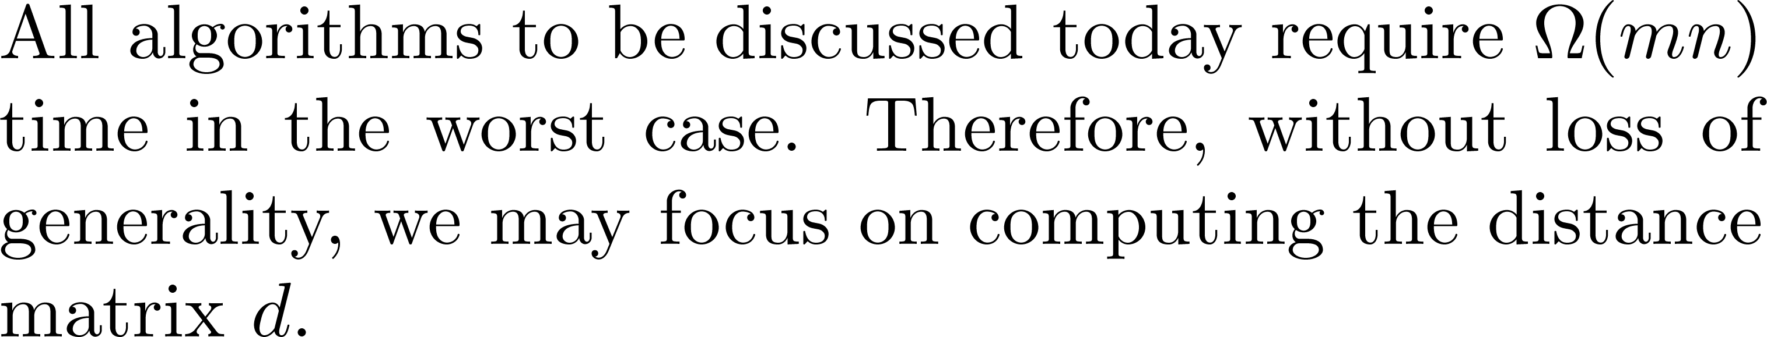

Focusing on distances

Slide 8
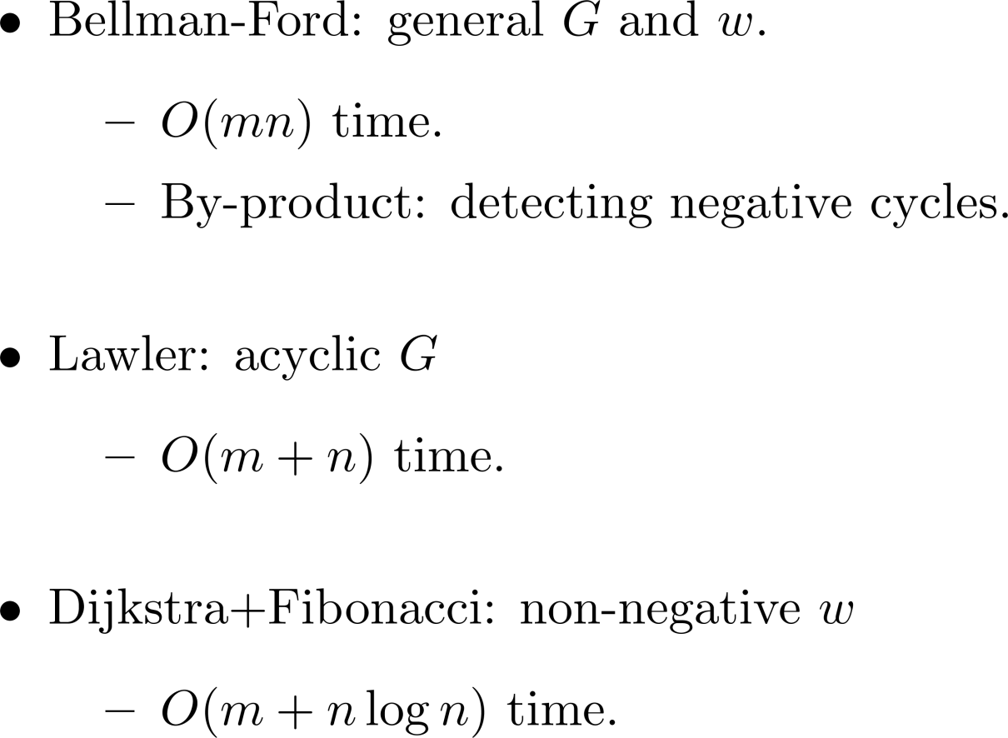
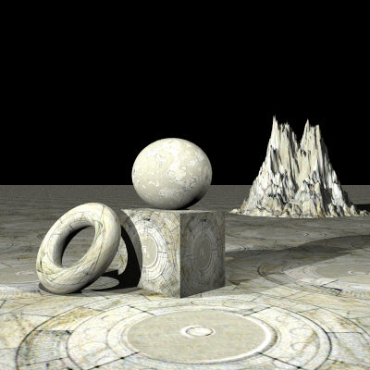
Recap: single source

Slide 9
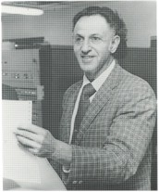

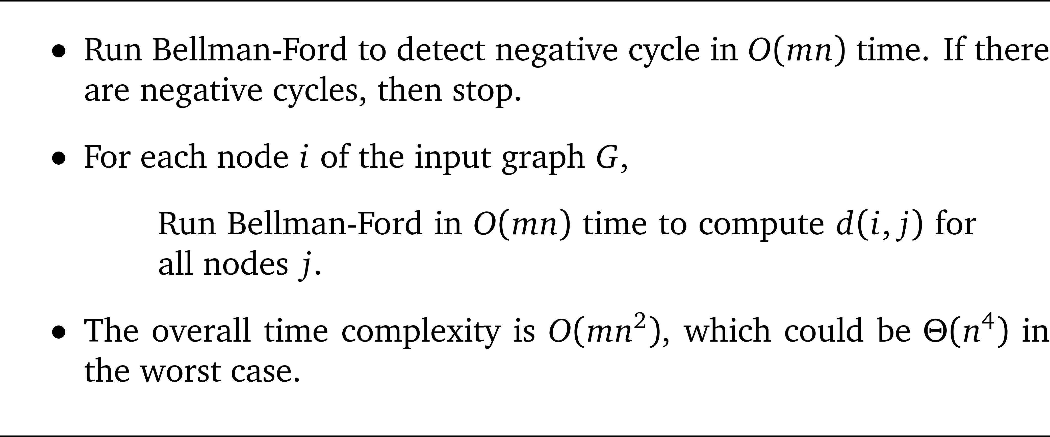
Naïve algorithm: general w

Slide 10

Today’s objective
Two ways to speed up the naïve algorithm for general w

Slide 11
Preprocessing
We first run Bellman-Ford in O(mn) time to rule out graphs with negative cycles.
We also ensure w(i, i) = 0 holds for each i.
n
e
g
a
t
i
v
e

Slide 12


Two techniques
Dynamic programming
Reweighting

Slide 13
Dynamic programming

Slide 14
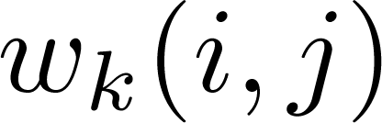
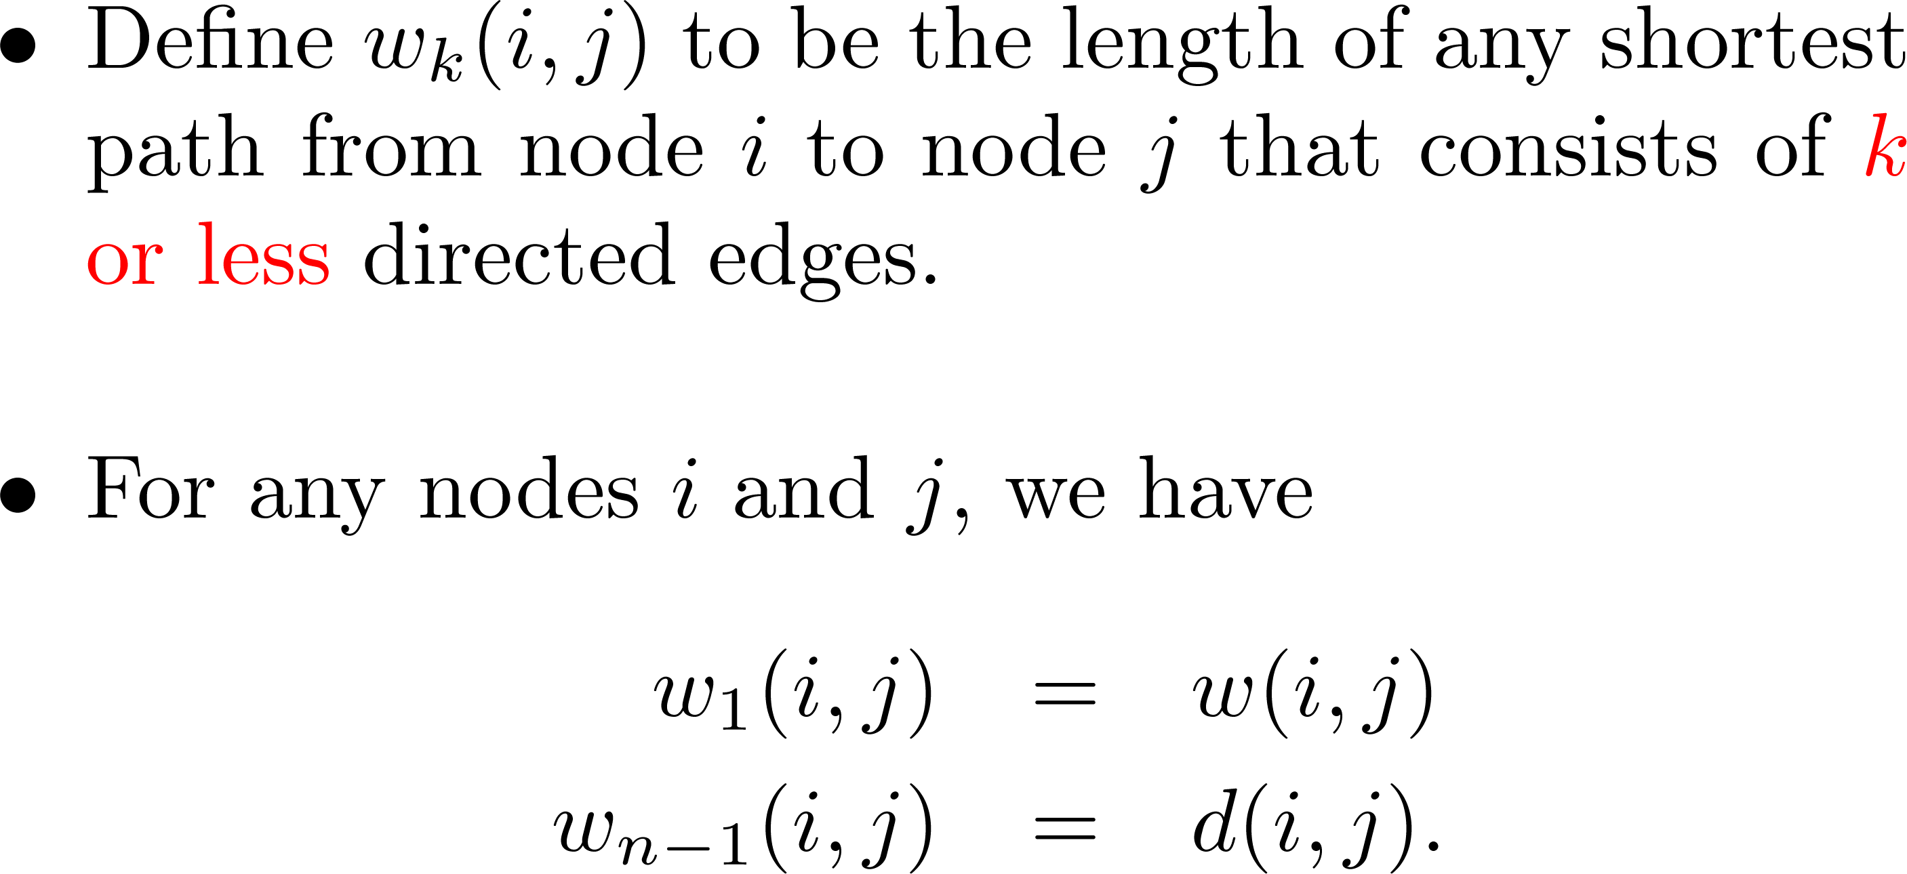
i
j

Slide 15
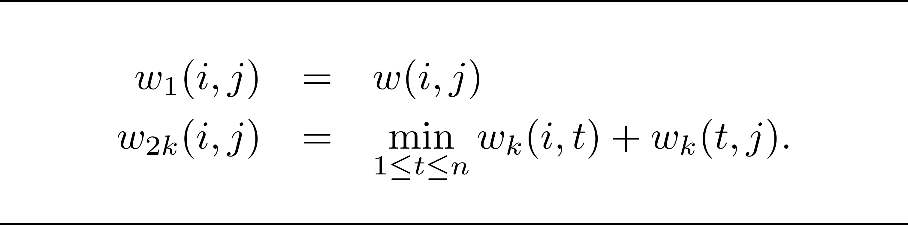
Recurrence relation
i
t
j

Slide 16
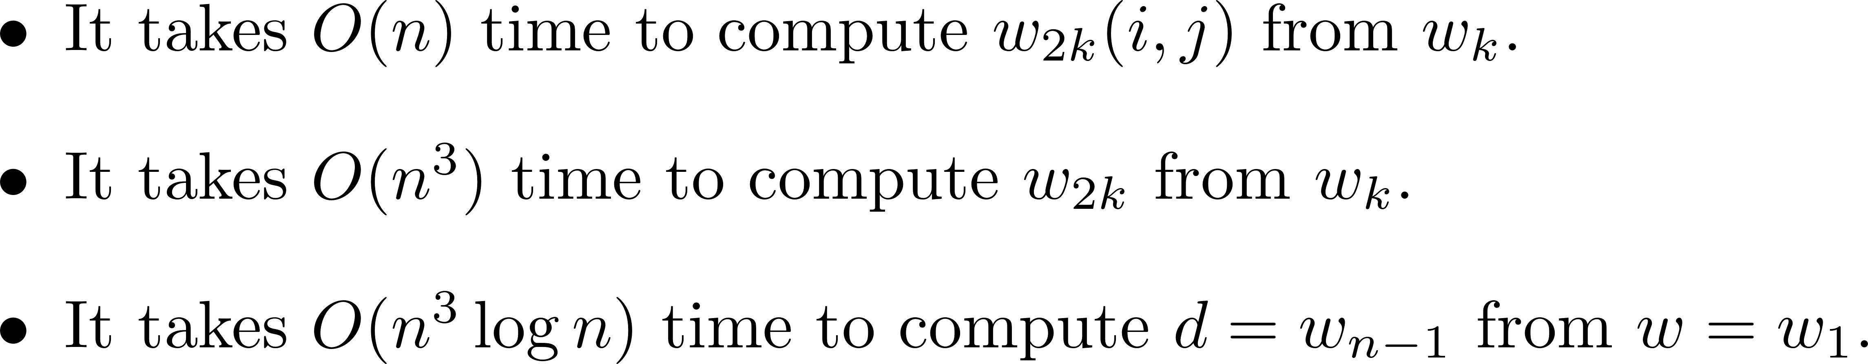
Time = O(n³log n)
w | 1 | 2 | 3 | 4 | 5 | 6
1 | 0 | 3 | 2 | ∞ | ∞ | ∞
2 | ∞ | 0 | 2 | 1 | ∞ | ∞
3 | ∞ | ∞ | 0 | 1 | 3 | ∞
4 | ∞ | ∞ | ∞ | 0 | -3 | 1
5 | ∞ | ∞ | ∞ | ∞ | 0 | 2
6 | ∞ | ∞ | ∞ | ∞ | ∞ | 0
d | 1 | 2` | 3 | 4 | 5 | 6
1 | 0 | 3 | 2 | 3 | 0 | 2
2 | ∞ | 0 | 2 | 1 | -2 | 0
3 | ∞ | ∞ | 0 | 1 | -2 | 0
4 | ∞ | ∞ | ∞ | 0 | -3 | -1
5 | ∞ | ∞ | ∞ | ∞ | 0 | 2
6 | ∞ | ∞ | ∞ | ∞ | ∞ | 0

Slide 18
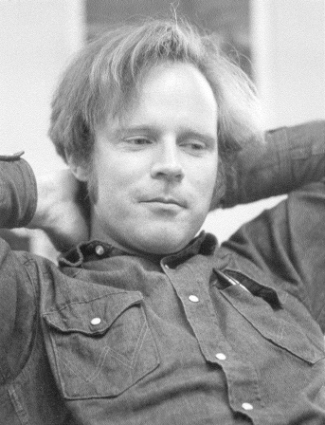
Robert W. Floyd, 1936-2001
Born in New York, Floyd finished school at age 14. At the University of Chicago, he received a Bachelor's degree in liberal arts in 1953 (when still only 17) and a second Bachelor's degree in physics in 1958.
Becoming a computer operator in the early 1960s, he began publishing many noteworthy papers and was appointed an associate professor at Carnegie Mellon University by the time he was 27 and became a full professor at Stanford University six years later. He obtained this position without a Ph.D.
Turing Award, 1978.

Slide 19
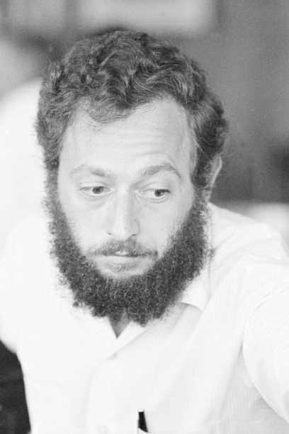
Stephen Warshall
1935 – 2006
Proving the correctness of the transitive closure algorithm for boolean circuit.
(Wikipedia) There is an interesting anecdote about his proof that the transitive closure algorithm, now known as Warshall's algorithm, is correct. He and a colleague at Technical Operations bet a bottle of rum on who first could determine whether this algorithm always works. Warshall came up with his proof overnight, winning the bet and the rum, which he shared with the loser of the bet. Because Warshall did not like sitting at a desk, he did much of his creative work in unconventional places such as on a sailboat in the Indian Ocean or in a Greek lemon orchard.

Slide 20
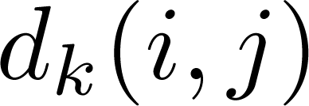
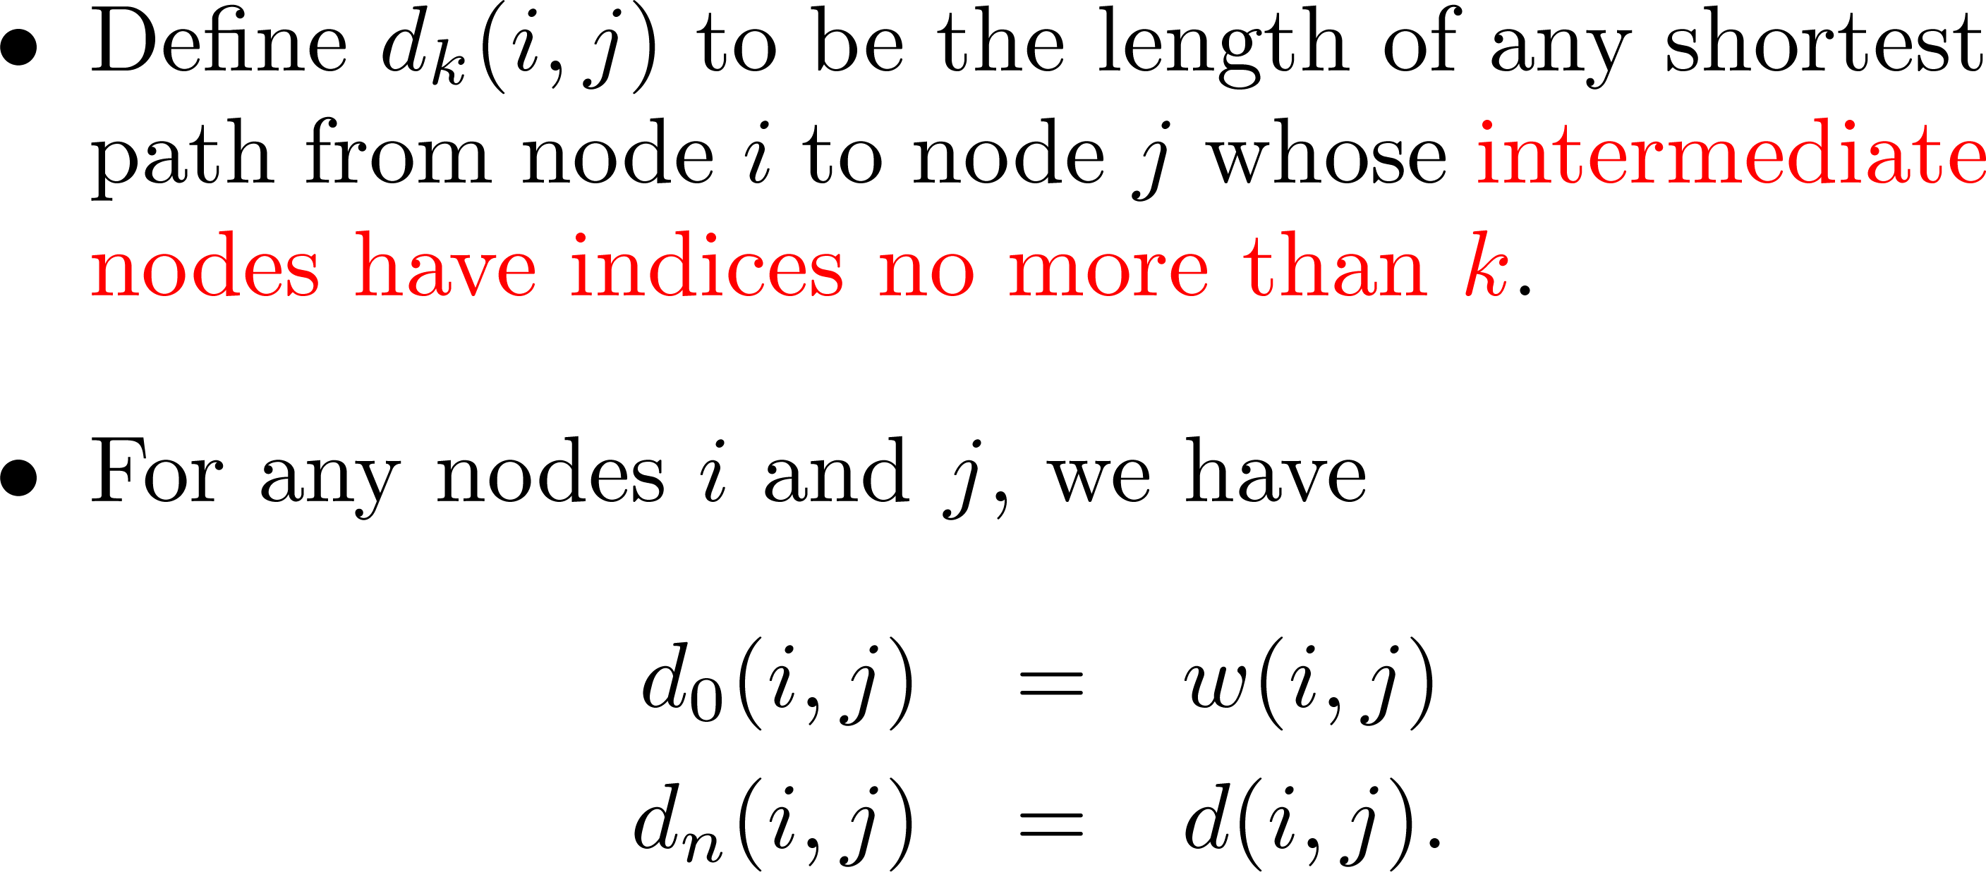
i
j

Slide 21
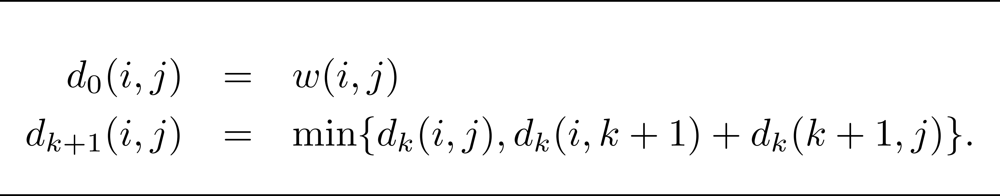
Recurrence relation
i
k+1
j

Slide 22
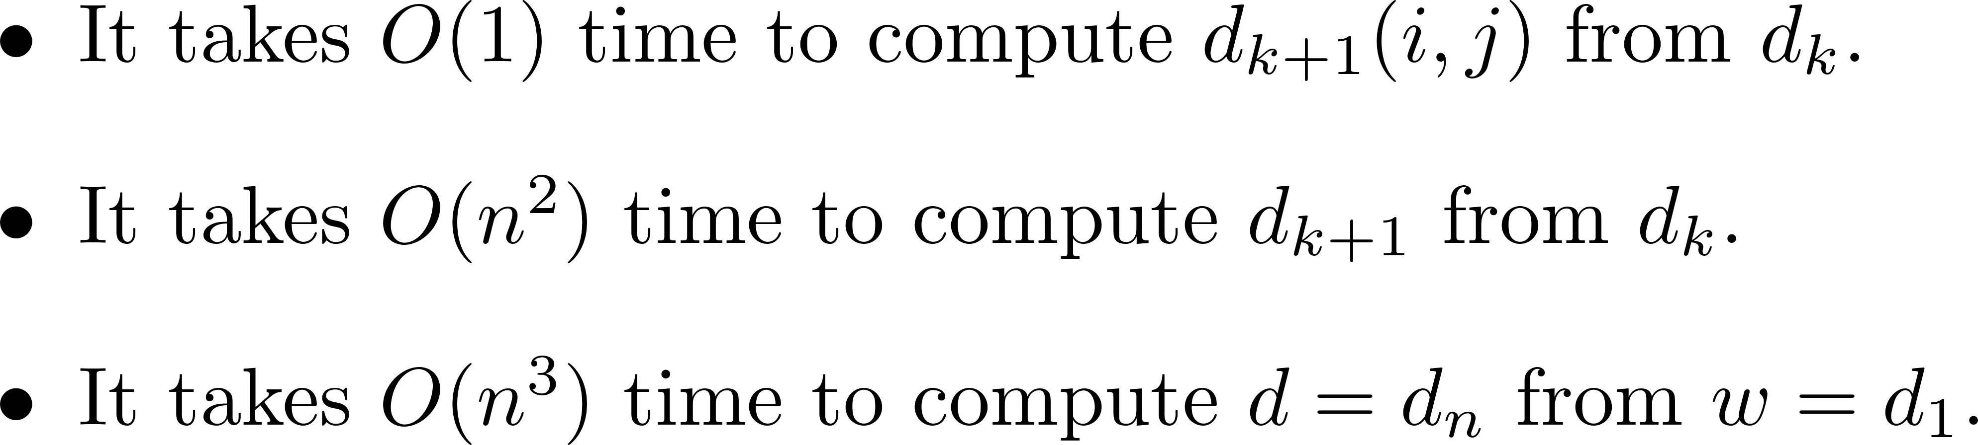
Floyd-Warshall: O(n³) time
w | 1 | 2 | 3 | 4 | 5 | 6
1 | 0 | 3 | 2 | ∞ | ∞ | ∞
2 | ∞ | 0 | 2 | 1 | ∞ | ∞
3 | ∞ | ∞ | 0 | 1 | 3 | ∞
4 | ∞ | ∞ | ∞ | 0 | -3 | 1
5 | ∞ | ∞ | ∞ | ∞ | 0 | 2
6 | ∞ | ∞ | ∞ | ∞ | ∞ | 0
d | 1 | 2` | 3 | 4 | 5 | 6
1 | 0 | 3 | 2 | 3 | 0 | 2
2 | ∞ | 0 | 2 | 1 | -2 | 0
3 | ∞ | ∞ | 0 | 1 | -2 | 0
4 | ∞ | ∞ | ∞ | 0 | -3 | -1
5 | ∞ | ∞ | ∞ | ∞ | 0 | 2
6 | ∞ | ∞ | ∞ | ∞ | ∞ | 0

Slide 23
Reweighting

Slide 24
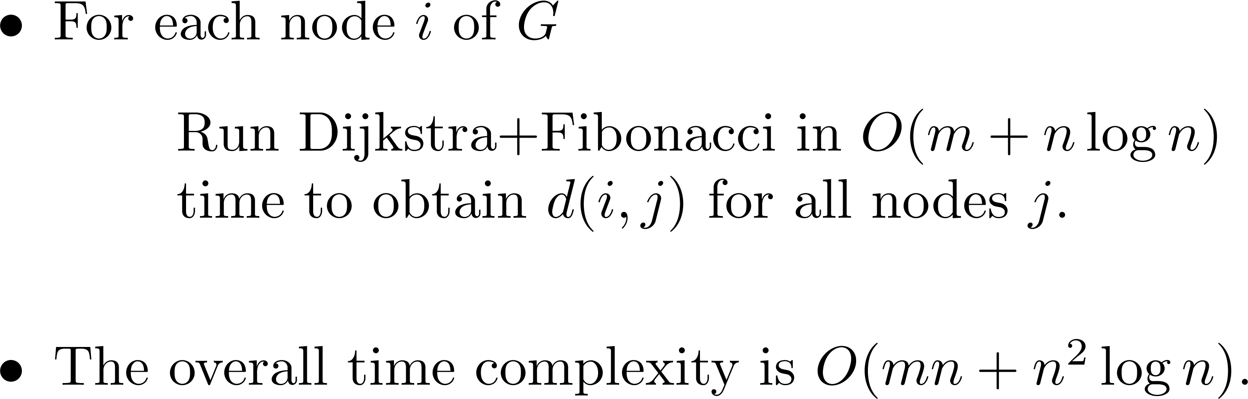
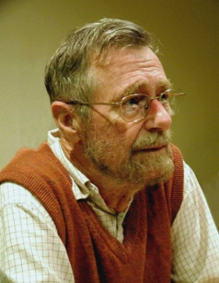
Naïve algorithm: nonnegative w

Slide 25
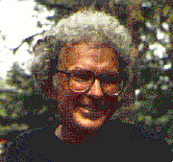
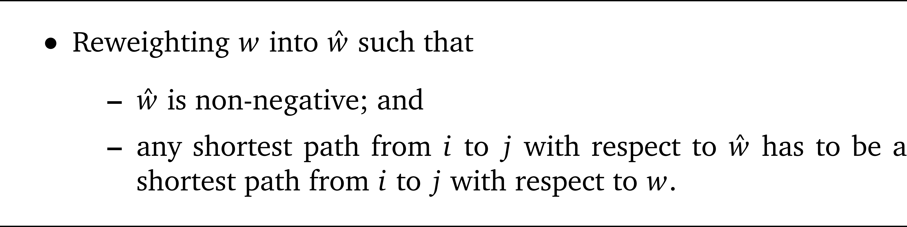
Donald B. Johnson

Slide 26
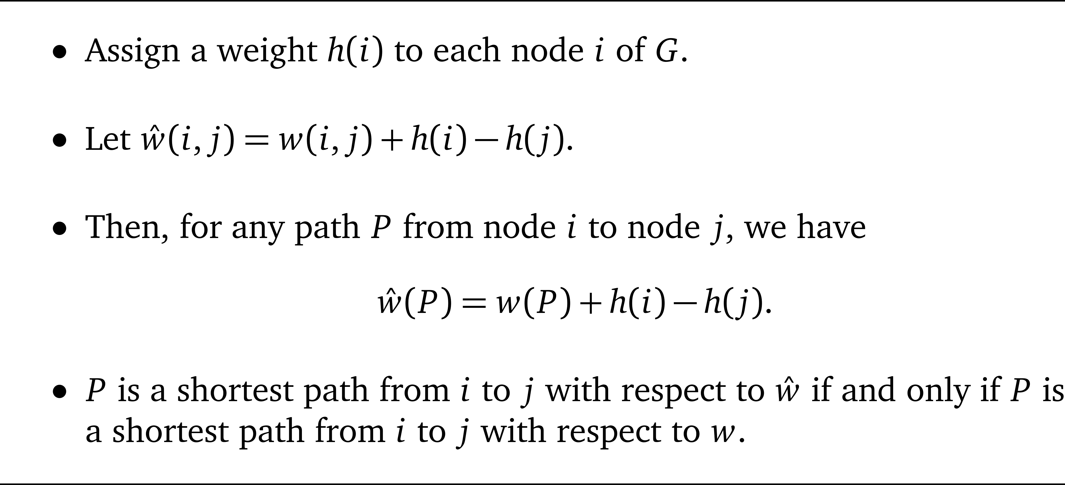
The idea of reweighting

Slide 27


Illustration
2
1
8
4
5
3
4
-1
2
2
4
4
3
2
7
11
7
6
10
11
3

Slide 28

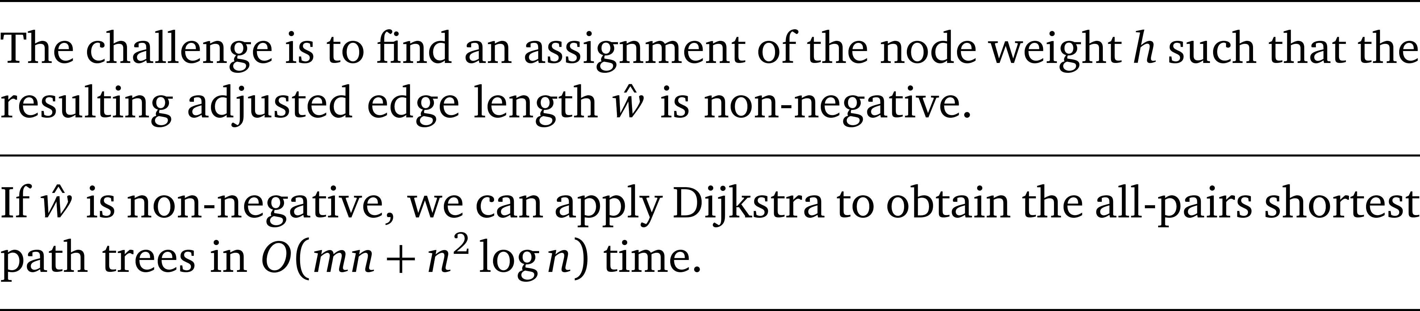
The challenge

Slide 29
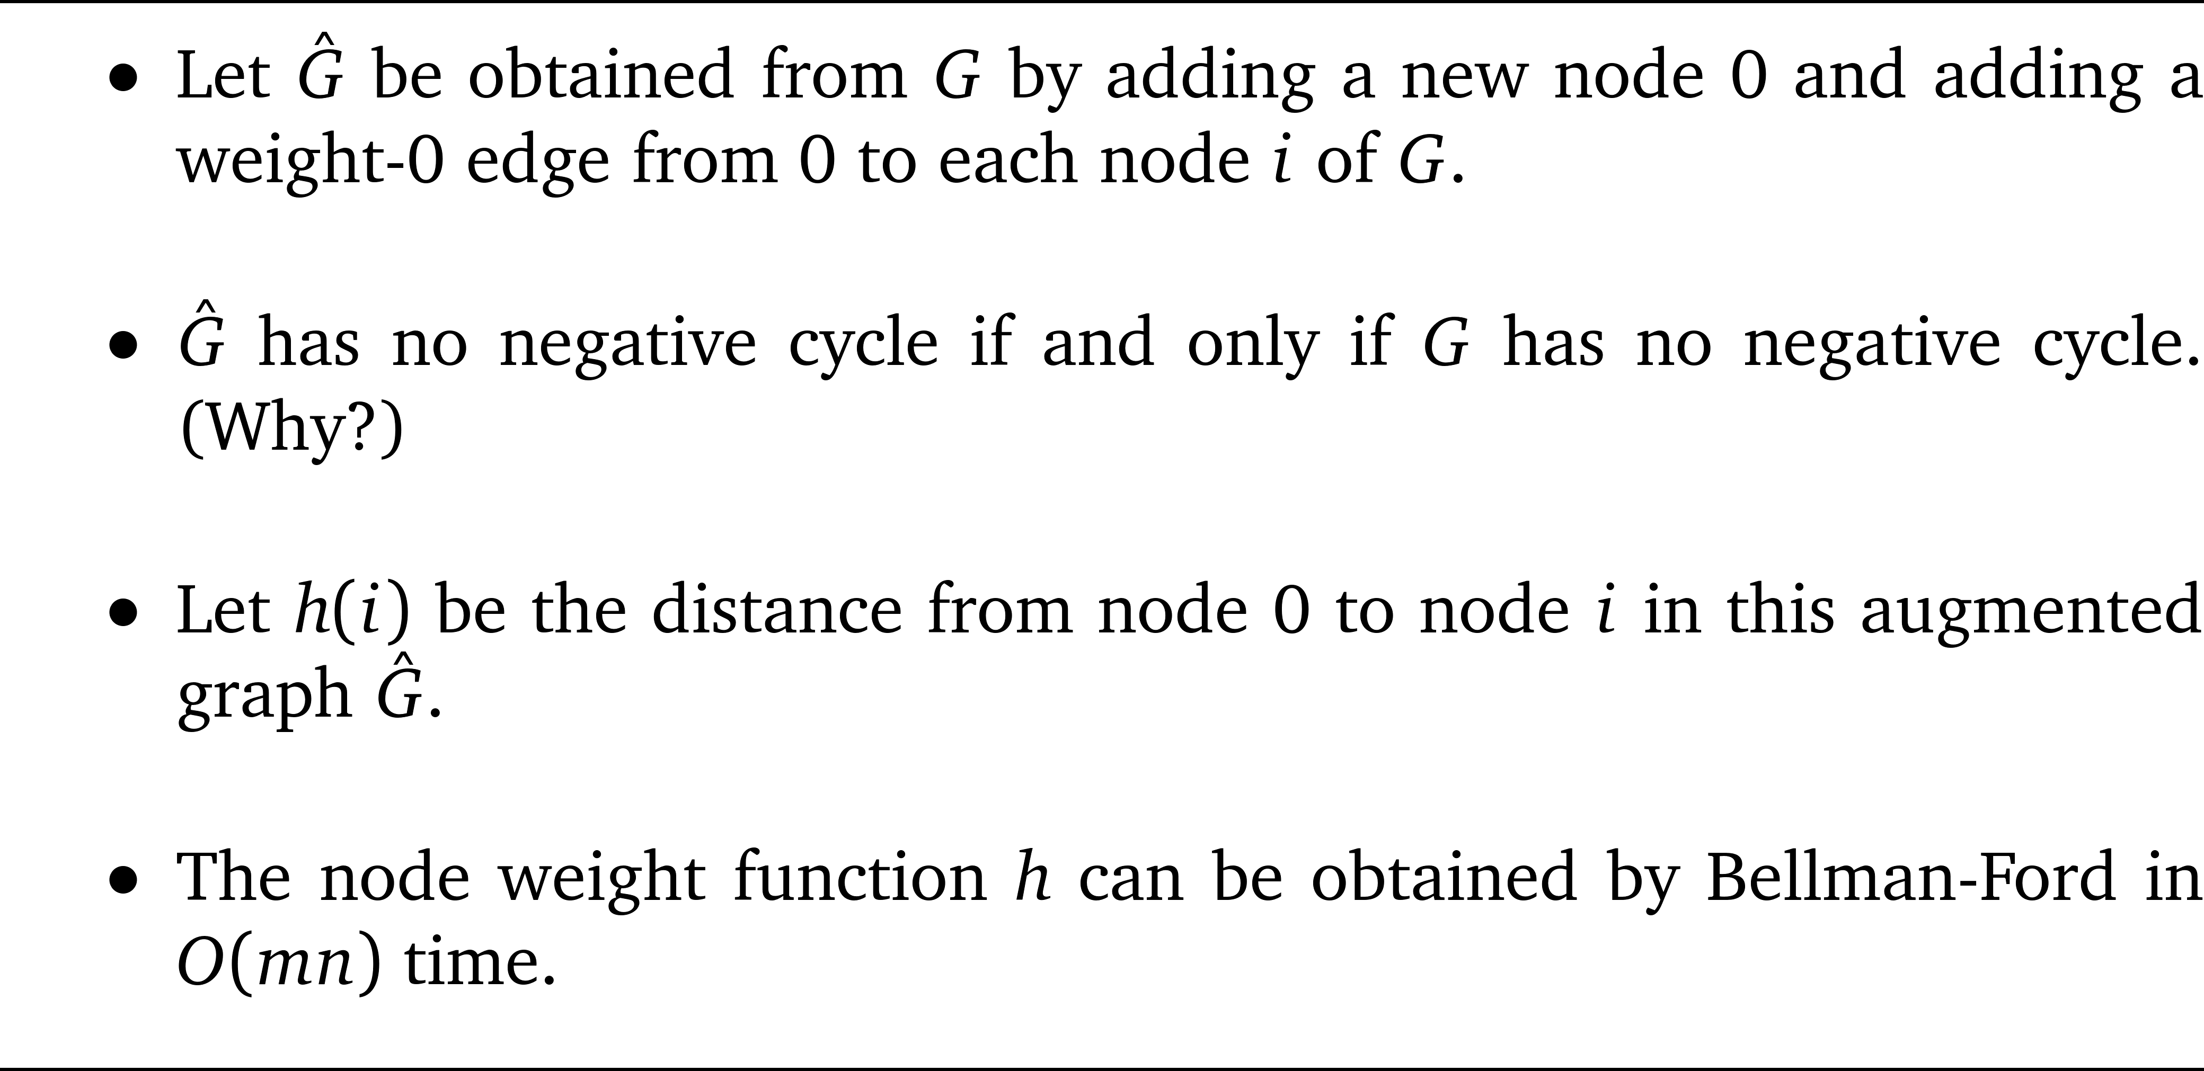
Johnson’s technique

Slide 30
Illustration
0
3
2
2
0
0
1
1
3
-3
0
-3
1
-1
2

Slide 31
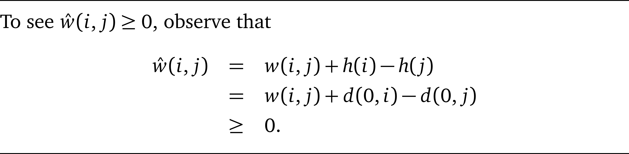
Non-negativity?
0
i
j

Slide 32
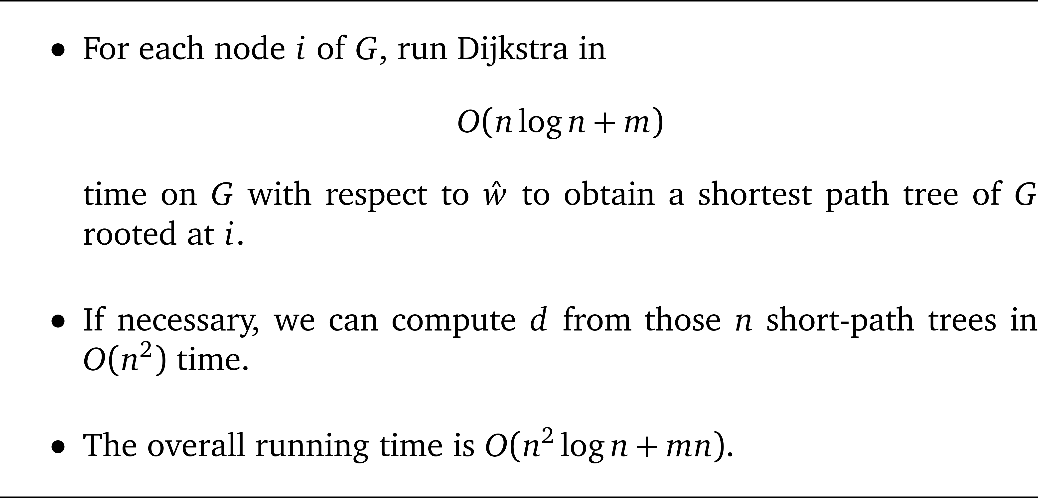
Johnson’s algorithm

Slide 33
Summary
Using Johnson’s reweighting technique, the problem of computing all-pairs shortest paths for general w can be reduced to that for non-negative w.

