Slide 1

演算法設計與分析
台大資工系
呂學一

Slide 2

Today: max flow
Network flow
Ford-Fulkerson
  Augmenting path
Edmonds-Karp
  Polynomial-time algorithm
An application: bipartite matching

Slide 3



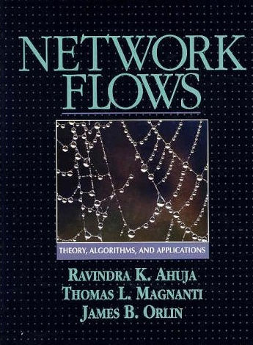
Network Flow
1
1
4
2
2
1
1
s
2
t
3
2
1
3
1
1
864 pages!

Slide 4
Network
1
4
2
s
2
t
3
3
1

Slide 5
Flow
1
1
4
2
2
1
1
s
2
t
3
2
1
3
1
1

Slide 6
Capacity constraint
The amount of flow passing through an edge has to be no more than the capacity of the edge.
1
1
4
2
2
1
1
s
2
t
3
2
1
3
1
1

Slide 7
Conservation law
For any node u other than s and t, the amount of flow entering u has to be equal to the amount of flow leaving u.
1
1
4
2
2
1
1
s
2
t
3
2
1
3
1
1

Slide 8
The Max Flow Problem
1
1
4
2
2
1
1
s
2
t
3
2
1
3
1
1

Slide 9
A famous theorem
Maximum flow ←→ minimum cut.

Slide 10
A minimum cut of value 4
1
4
2
s
2
t
Not maximum
3
3
1
1
1
4
2
2
1
1
s
2
t
3
2
1
3
1
1

Slide 11
The Competition

Slide 12
James B. Orlin
James B. Orlin: Max flows in O(nm) time, or better. STOC 2013: 765-774

Slide 13
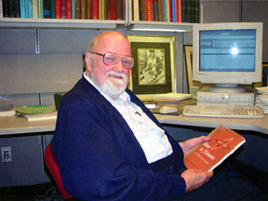
Lester R. Ford, Jr.
1927~
A important contributor to the theory of network flow.

Slide 14
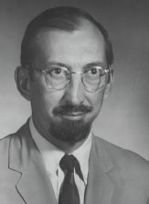
Delbert R. Fulkerson
1924 ~ 1976
In 1979, the renowned Fulkerson Prize was established which is now awarded every three years for outstanding papers in discrete mathematics jointly by the Mathematical Programming Society and the American Mathematical Society

Slide 15
Ford-Fulkerson

Slide 16
Example: residual network
1
1
4
2
2
1
1
s
2
t
3
2
1
1
3
1
2
1
1
1
2
s
1
t
2
1
2
1
1
1

Slide 17
Why residual network?
Let N be a network. Let f be a flow of N.
  g is a flow of the residual graph N(f) if and only if f + g is a flow of N.
One can see the above property by checking the capacity constraint and conservation law.

Slide 18
Illustration
1
1
4
2
2
1
1
s
2
t
3
2
1
1
3
1
2
1
1
1
2
s
1
t
2
1
2
1
1
1

Slide 19
The key observation
f is not maximum for N if and only if
reach(N(f), s, t) = yes.

Slide 20
f is not maximum for N ⬅➔ reach(N(f), s, t) = yes.
1
1
4
2
2
1
1
s
2
t
3
2
1
1
3
1
2
1
1
1
2
s
1
t
2
1
2
1
1
1

Slide 21
Adding 1 unit of flow to f
1
1
4
2
2
1
1
s
2
t
3
2
1
1
3
1
2
1
1
1
2
s
1
t
2
1
2
1
1
1

Slide 22
A larger flow f*
1
1
4
3
2
1
2
N(f*)
s
2
t
3
3
1
1
3
1
3
1
1
1
1
s
2
t
3
2
1
1

Slide 23
Are “back edges” needed?
1
2
2
1
2
s
2
t
2
2
1
1
1
1
2
s
t
2
2
1
1

Slide 24
The resulting flow.
1
1
2
2
1
1
1
s
2
t
2
2
1
1
1
1

Slide 25
f is not maximum for N ➔ reach(N(f), s, t) = yes.
1
1
4
2
2
1
1
s
2
t
3
2
1
1
3
1
2
1
1
1
2
s
1
t
2
1
2
1
1
1

Slide 26
f is not maximum for N ⬅ reach(N(f), s, t) = yes.
1
1
4
2
2
1
1
s
2
t
3
2
1
1
3
1
2
1
1
1
2
s
1
t
2
1
2
1
1
1

Slide 27
Proof sketch
The path from s to t in the residual graph gives a positive flow g in the residual graph.
Adding g to f gives another flow f+g for N whose value is larger than f.
  Why is f + g a flow of N?
    Conservation law?
    Capacity constraint?

Slide 28
f is not maximum for N ➔ reach(N(f), s, t) = yes.
1
1
4
2
2
1
1
s
2
t
3
2
1
1
3
1
2
1
1
1
2
s
1
t
2
1
2
1
1
1

Slide 29
Proof sketch
If h is a flow whose value is larger than that of f, then g = h – f has to be a positive flow in N(f).
  Why is g a flow of N(f)?
    Conservation law?
    Capacity constraint?
Therefore, t is reachable from s in N(f).
  Why?

Slide 30

An algorithm for Max Flow

Slide 31
Polynomial-time algorithm?

Slide 32

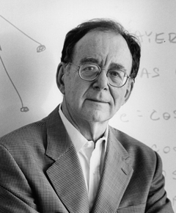
Solvable in P-time
[Edmonds and Karp, JACM 1972].
  If one makes sure that the directed path P in N(f) is a shortest path from s to t in N(f), then the running time of maxflow can be proved to be O(|E|² |V|).

Slide 33
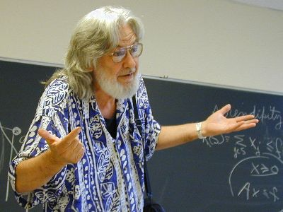
Jack Edmonds
Jack Edmonds is a Canadian mathematician, regarded as one of the most important contributors to the field of combinatorial optimization. He was the recipient of the 1985 John von Neumann Theory Prize.
From 1969 on, with the exception of 1991-1993, he held a faculty position at the Department of Combinatorics and Optimization at the University of Waterloo's Faculty of Mathematics. Edmonds retired in 1999.

Slide 34
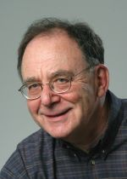
Richard Karp, 1935~
“Reducibility Among Combinatorial Problems”, 1972
Turing Award in 1985.
Harvard University, Bachelor's degree in 1955, Master's degree in 1956, and Ph.D. in applied mathematics in 1959.
IBM's Thomas J. Watson Research Center
Professor, UC Berkeley, 1968. Apart from a 4-year period as a professor at the University of Washington, he has remained at Berkeley.

Slide 35
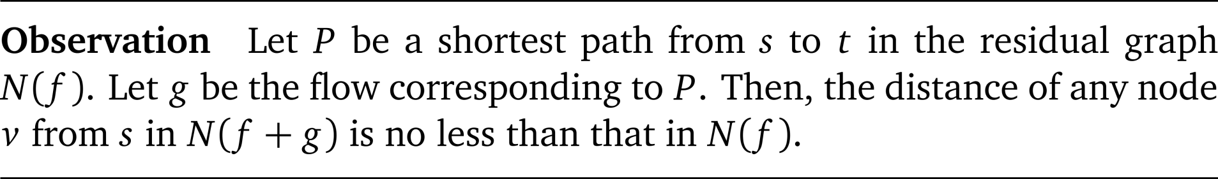
A key observation

Slide 36
Illustration
2
1
3
2
2
1
1
s
2
t
3
2
1
1
3
1
1
2
2
2
1
1
1
1
0
1
1
3
2
2
1
1
1
2
1
1

Slide 37
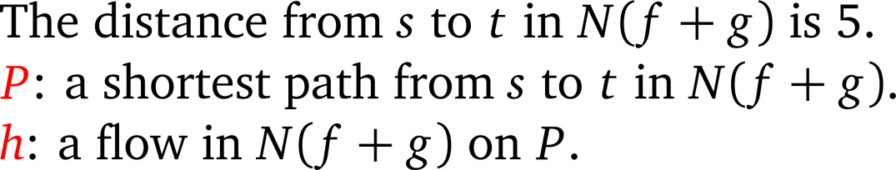
A larger flow f+g
2
1
3
3
2
1
2
s
2
t
3
3
1
1
3
1
1
2
3
2
1
1
1
0
2
5
3
2
1
3
4
1
1

Slide 38
An even larger flow f+g+h
2
2
3
3
2
2
1
s
2
t
3
3
2
2
3
2
∞
∞
3
2
2
1
0
1
∞
3
1
∞
∞
2
2

Slide 39

Proving the observation

Slide 40
Proof sketch
s
v
u
Q
Assume for contradiction that there is a node v whose distance d*(v) from s in N(f + g) is less than its distance d(v) from s in N(f).
Let Q be a shortest path from s to v in N(f + g).
There has to be some node u on Q such that d*(u) ≥ d(u). (Reason: s is such a node.)
Therefore,
  d*(u) ≥ d(u)
  d*(v) < d(v)
for the an edge (u,v) of a shortest path Q in N(f + g).

Slide 41
Q是N(f+g)上到v的最短路徑
s
v
s
v
u

Slide 42
Proof sketch
Q ⊆ N(f + g)
g: P ⊆ N(f )
s
v
u
We know that (u, v) cannot be an edge of N(f), since otherwise we have the following contradiction:
    d(v) ≤ d(u) + 1 ≤ d*(u) + 1 = d*(v).
Since (u, v) belongs to Q ⊆ N(f + g) but not N(f), we know that g (and P) goes from v to u. We still reach the following contradiction:
    d(v) = d(u) – 1 ≤ d*(u) – 1 = d*(v) – 2.

Slide 43

Theorem
The number of augmentation-through-shortest-path phases required by Edmonds-Karp algorithm is O(mn).
即使網路的edge capacity非整數，也是如此.

Slide 44
Proof sketch
g: P ⊆ N(f )
s
u
v
In each phase, the flow g along a shortest P of N(f) saturates at least one edge (u,v) of N(f).
If g saturates edge (u,v) of N(f), then
    d(v) = d(u) + 1; and
    edge (u, v) disappears in N(f + g).
Claim: Throughout the execution of Edmonds-Karp, each edge (u,v) re-appear in the residual graph O(n) times.

Slide 45
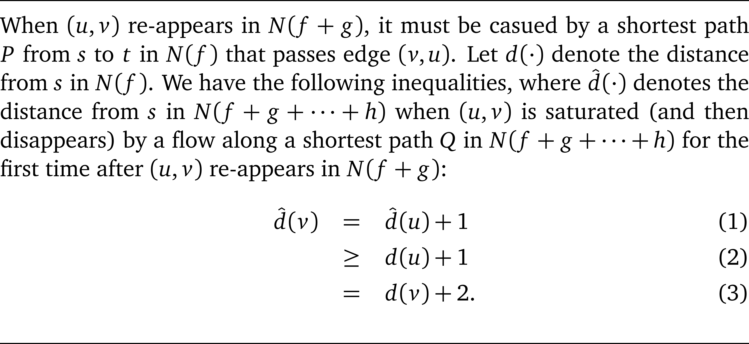
Proof sketch for the claim
Q ⊆ N(f + g + … +h )
u
v
P ⊆ N(f )

Slide 46
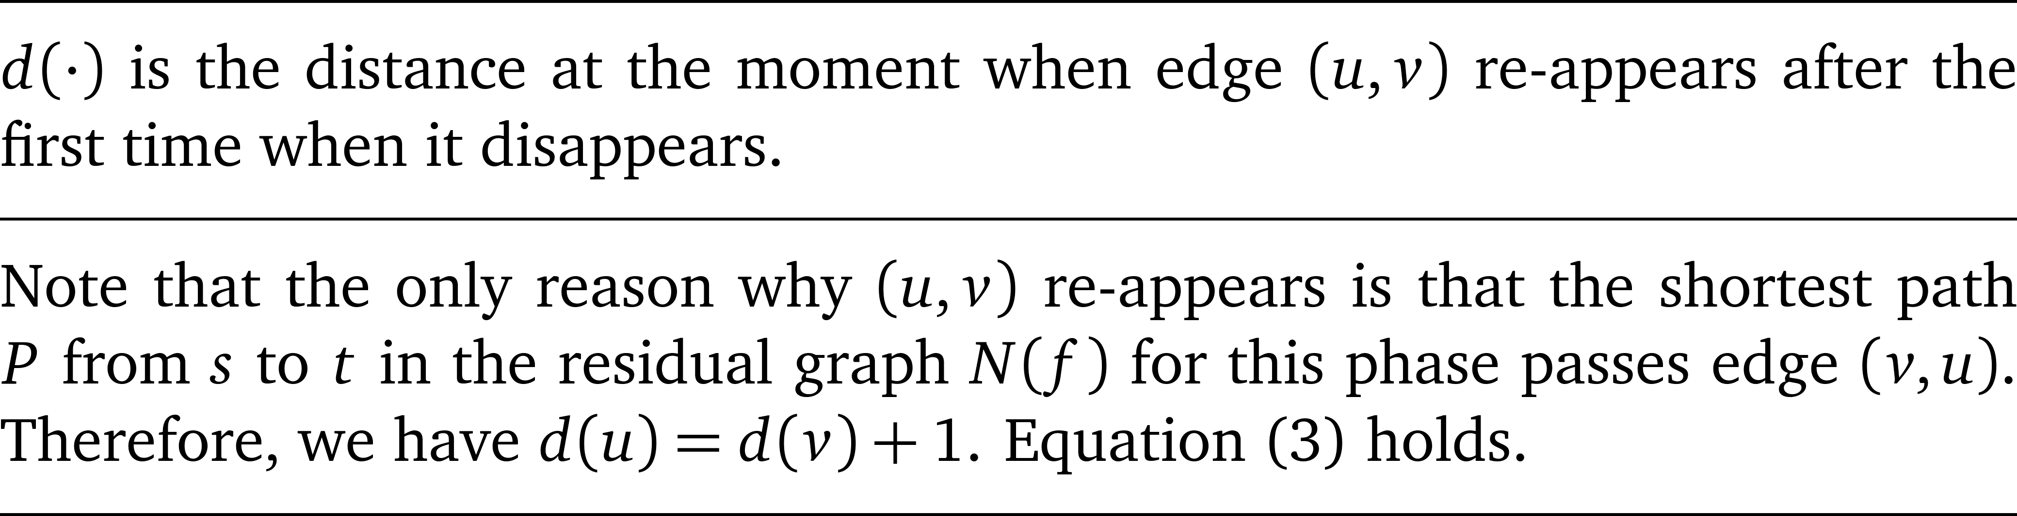
Equation (3)

Slide 47
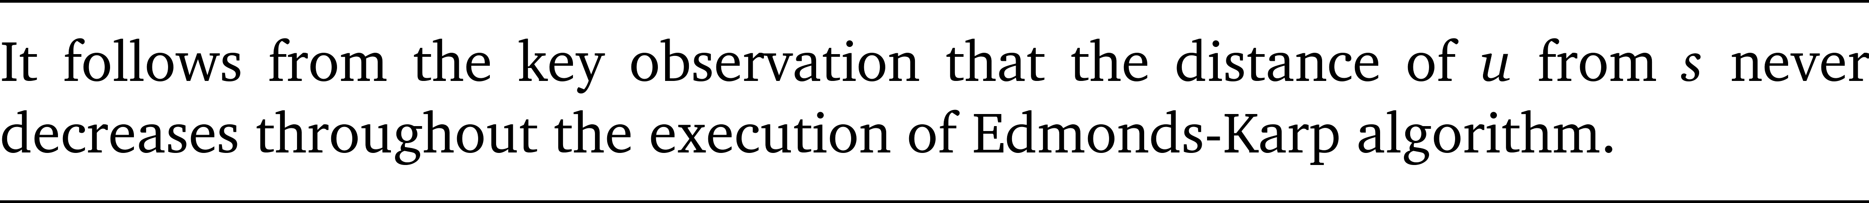
Inequality (2)

Slide 48
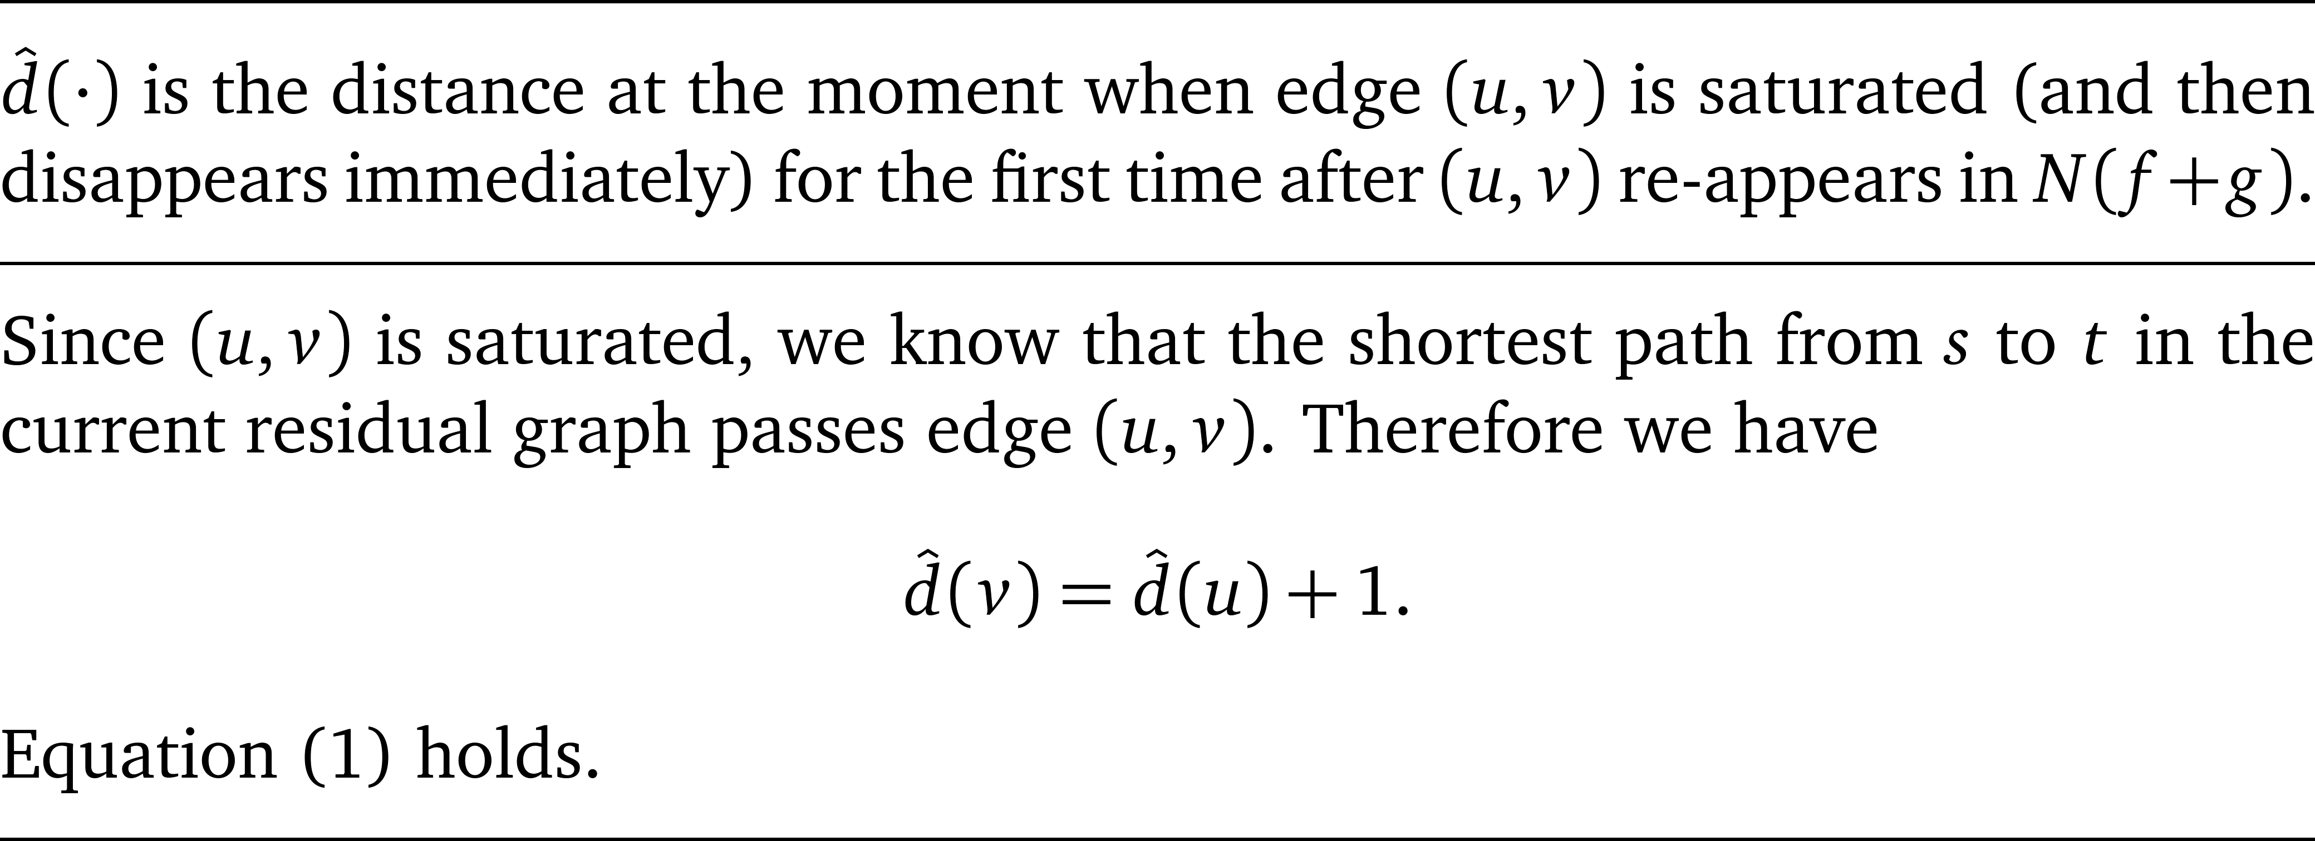
Equation (1)

Slide 49
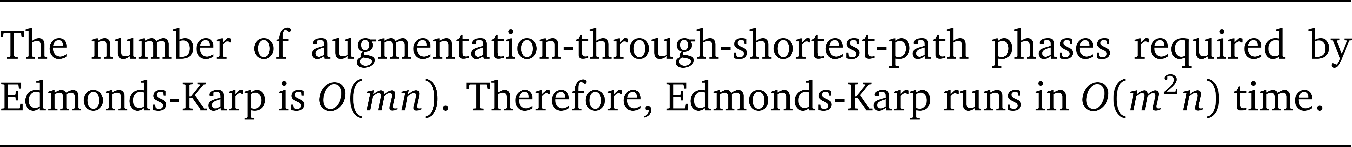
Theorem

Slide 50
An application
Bipartite Matching

Slide 51





Summer intern

Slide 52
Summer intern

Slide 53
Summer intern

Slide 54
Maximum matching of G

Slide 55
Maximum flow of G*

Slide 56
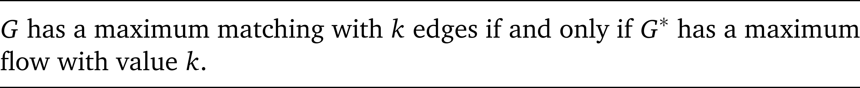
Theorem

Slide 57
Proof (➔): easy

Slide 58
Proof (⬅): more challenging

Slide 59
Integrality of max flow
Fortunately, Ford-Fulkerson (and Edmonds-Karp) ensures that if G* has a maximum flow with value k, then G* has an integral flow with value k. (Why?)
Since each edge of G* has unit capacity, the set of edges in the middle part of G* with non-zero flow consists of a matching of G with k edges.

Slide 60
Theorem

