Slide 1
演算法設計與分析
台大資工系
呂學一

Slide 2

Nearest points

Slide 3
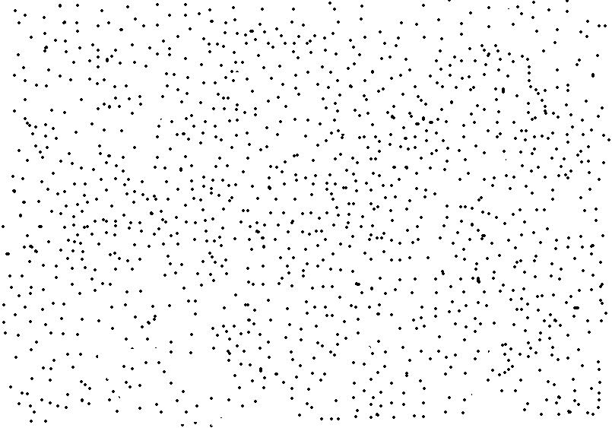
「最近兩點」問題
Input:
n points in the plane
Each point is specified by its coordinate.
Output:
Two points whose distance is minimized.

Slide 4

Naïve algorithm
O(n²) time
替 O(n²) 個point pairs的距離解一個冠軍問題。

Slide 5
聰明的遞迴演算法
Step 1: Partition the points in two sets L and R with the same size such that all points L are to the left of all points in R.
O(n) time. (用median selection)
Step 2: Output a closest pair among the following three:
2-(1) Recursively find a closest pair in L.
2-(2) Recursively find a closest pair in R.
2-(3) Find a closest pair of points (p, q) such that p belongs to L and q belongs to R.
目標：O(n) time.

Slide 6
時間複雜度
如果
2-(3) Find a closest pair of points (p, q) such that p belongs to L and q belongs to R
這一步可以在O(n)的時間內完成，整個演算法所需要的時間就是O(n log n)。
因為由T(n) = 2 T(n/2) + O(n)配上Master Theorem, we have T(n) = O(n log n).

Slide 7

準備動作

Slide 8
Illustration
L
R

Slide 9

2-(3)只要O(n)時間的關鍵
Step 2-(3) can be done cleverly from the results of Steps 2-(1) and 2-(2) in O(n) time:
For each node in L, we just need to check 8 or less points in R.

Slide 10
Specifically,
Suppose that d is the smallest distance obtained from Steps 2-(1) and 2-(2).
Any two points in R are at least d units apart.
Therefore,
any d-by-d box in R has at most 4 points.

Slide 11
Illustration
L
R
At most 4 points
d
d
d
d
At most 4 points
d
d

Slide 12
Details: O(n) time
把所有距離分割線不超過d的點挑出來，不要忘記他們已經根據他們的y座標排序好了。我們稱這個sorted list為M*。
M*裡面在L中的點的形成L*。
M*裡面在R中的點的形成R*。
For each point p in L*,
check four points of R* above p in M.
check four points of R* below p in M.

Slide 13
Illustration
M*
L*
R*
L
R
d
d

Slide 14

「最近兩點」的複雜度

