Slide 1

演算法設計與分析
台大資工系
呂學一
http://www.csie.ntu.edu.tw/~hil/

Slide 2

Today
P versus NP
NP, NP-complete, NP-hard
Polynomial-time reduction

Slide 3

Part 1
P versus NP

Slide 4

Millennium problems
Birch and Swinnerton-Dyer Conjecture
Hodge Conjecture
Navier-Stokes Equations
P vs NP
Poincaré Conjecture
Riemann Hypothesis
Yang-Mills Theory

Slide 5
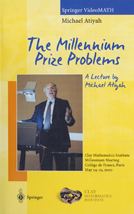
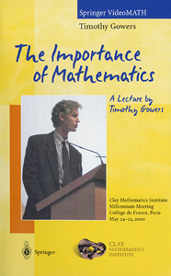
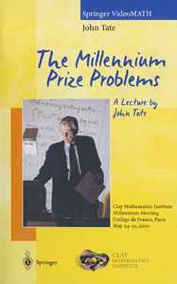
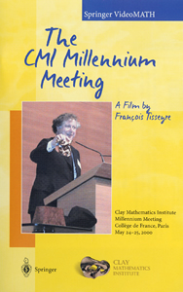
US$1,000,000 per problem
http://www.claymath.org/millennium/

Slide 6
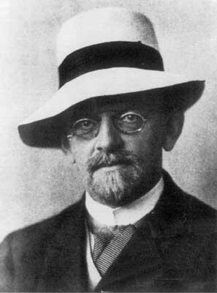
David Hilbert
1862 ~ 1943
German mathematician
Presented 23 problems in 1900

Slide 7
Hilbert’s 23 problems
Cantor 連續體的基數問題，
算術公理的無矛盾性，
等底等高兩四面體的等積性，
兩點間最短路程做為直線的問題，
連續群的定義函數除去可微性的問題
物理學公理化，
某些數的無理數性及超越性，
質數問題，
任何代數體中最一般的互逆法則，
決定 Diophantine 方程式的可解性，
係數為代數數的二次式，
推廣 Kronecker 的 Abel 擴張定理到任何代數體上

Slide 8
Hilbert’s 23 problems
七次方程式不能用兩變數函數來解，
某些完備函數的有限性，
Schubert 算法的嚴密基礎，
代數曲線與曲面的拓樸，
正定型的平方和表現，
以全等多面體鋪成空間的問題，
正則變分問題的解都是解析的？
一般的邊界值問題，
給定 Monodromy 群，線性微分方程式的存在問題，
以自我同構函數做解析關係的一致化，
變分法的進一步開展。

Slide 9
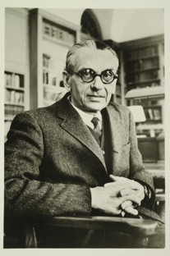
Kurt Godel
1906~1978
Austrian American
  mathematician
  philosopher
Incompleteness theorems
  25 years old
  One year after his doctorate degree

Slide 10
Millennium problems
Birch and Swinnerton-Dyer Conjecture
Hodge Conjecture
Navier-Stokes Equations
P vs NP
Poincaré Conjecture
Riemann Hypothesis
Yang-Mills Theory

Slide 11

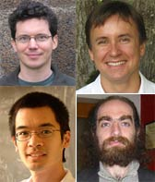
Grigory Perelman
1966 ~
Russian mathematician
Solved the Poincaré Conjecture in 2003
Fields medalist, 2006
  Declined to accept the award

Slide 12
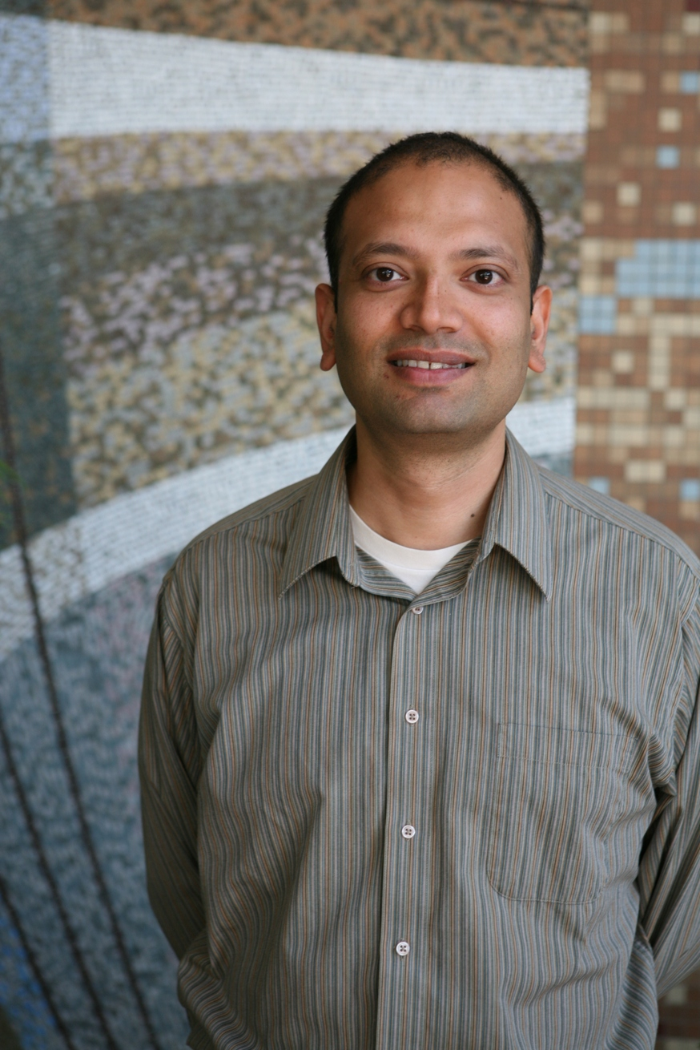
Vinay Deolalikar
Aug 2010 claimed a proof of P is not equal to NP.

Slide 13

P = NP ?

Slide 14
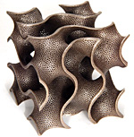
P
The class P consists of all the problems that can be solved in polynomial time.
  Sorting
  Exact string matching
  Maximum flow
  Minimum spanning tree
  Primes
  …

Slide 15

NP
NP consists of the problems that can be solved in non-deterministically polynomial time.
P consists of the problems that can be solved in (deterministically) polynomial time.

Slide 16
Deterministic algorithm
Initial configuration
Initial configuration

Slide 17
Non-deterministic algorithm
Initial configuration
Initial configuration

Slide 18
Non-deterministic bubble sort
for i = 1 to n
  for j = 1 to n – 1
    if A[j] < A[j+1] then
      Either exchange A[j] and A[j+1] or do nothing
This is not a randomized algorithm.

Slide 19
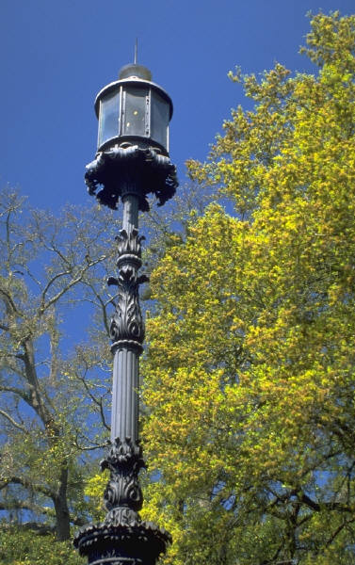
Vertex Cover Problem
Input:
  A graph G
Output:
  A smallest vertex subset of G that covers all edges of G.
Known to be NP-complete

Slide 20
Illustration

Slide 21
Vertex Cover (decision version)
Input: A Graph G and an integer k.
Output: Does G contain a vertex cover of size no more than k?
這是原始「路燈問題」(computation version)的Yes/No版(i.e., decision version)
  原先的路燈問題是要算出放路燈的方法
  這個版本是問k盞路燈夠不夠照亮整個公園

Slide 22
A nondeterministic algorithm
Let set S be empty
For each vertex x of G
  Non-deterministically insert x to S.
If |S| > k, then output no.
If S is not a vertex cover, then output no.
Output yes.

Slide 23
Correctness
If the correct answer is yes, then there is a computation path of the algorithm that leads to yes.
  YES-instance: 至少有一條路是對的(會回答YES).
If the correct answer is no, then all computation paths of the algorithm lead to no.
  NO-instance: 每一條路都是對的(會回答NO).

Slide 24
Non-deterministically solving a problem
Initial configuration
Initial configuration
Initial configuration
Correct answer

Slide 25
Non-deterministically polynomial time
polynomial

Slide 26
P versus NP

Slide 27
Part 2
NP, NP-complete, NP-hard

Slide 28
Common mistakes
“NP stands for non-polynomial time”.
  Correct version:
    “NP stands for non-deterministic polynomial time”
“Traveling Salesman Problem is an NP problem, so it is a very difficult problem.”
  Correct version:
    TSP is an NP-complete (or NP-hard) problem, so it is a very difficult problem.

Slide 29

NP-hardness
A problem is NP-hard if it is as least as hard as all the problems in NP.
What does it mean?

Slide 30
NP-hardness
A problem X is NP-hard if the following condition holds:
  If X can be solved in (deterministic) polynomial time, then all the problems in NP can be solved in (deterministic) polynomial time.

Slide 31
NP-completeness
A problem is NP-complete if
  it is NP-hard and
  it is in NP.
An NP-complete problem is one of the “hardest” problems in the class NP.
In other words, an NP-complete problem is a “hardness representative” of the class NP.

Slide 32
Question:
Is there any NP-complete problem?

Slide 33
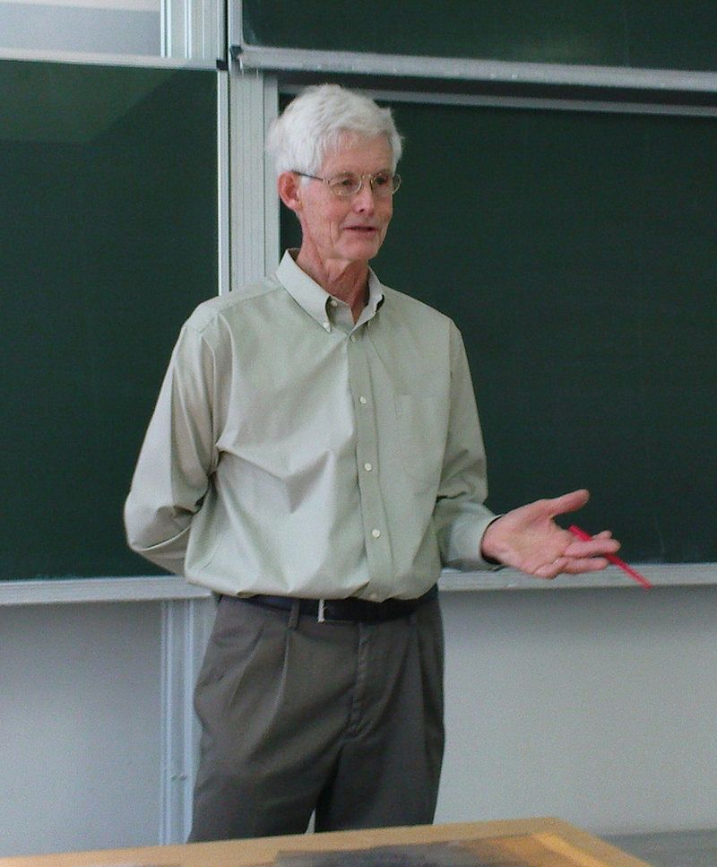
Stephen A. Cook
1939 ~
Ph.D., Harvard
UC Berkeley
Currently with
  University of Toronto
Turing Award, 1982

Slide 34
SAT (Satisfiability)
Input:
  A boolean formula with variables,
Output:
  whether there is a truth assignment for the variables that satisfies the input boolean formula.

Slide 35

Cook’s contribution
SAT is the first known NP-complete problem.
Cook [FOCS 1971] proved that
  SAT can be solved in non-deterministic polynomial time.
  If SAT can be solved in deterministic polynomial time, then so can any NP problems.

Slide 36
SAT: a key to P versus NP
If one proves that SAT can be solved by a polynomial-time algorithm, then NP = P.
If somebody proves that SAT cannot be solved by any polynomial-time algorithm, then NP ≠ P.

Slide 37
Part 3
Polynomial-time reduction

Slide 38
Question
Are there other NP-complete problems?

Slide 39
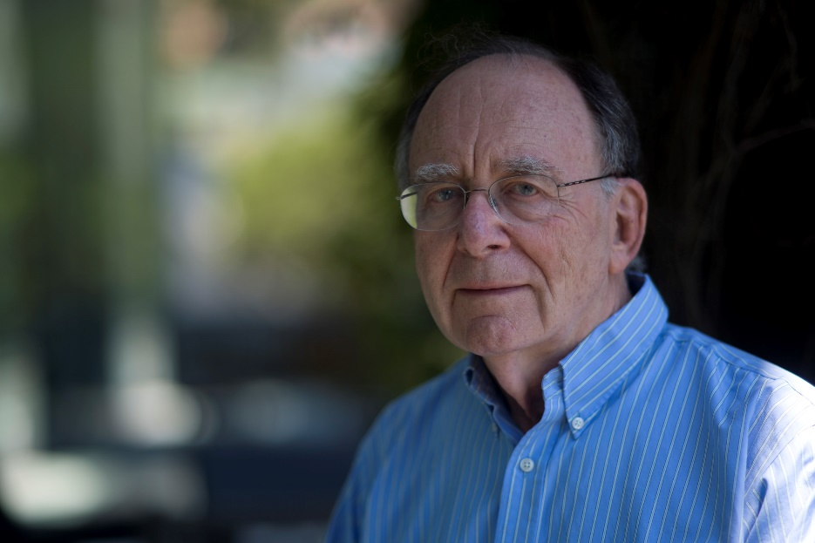
Richard N. Karp
1935 ~
Currently with UC Berkeley
Turing award, 1985

Slide 40
Karp’s 21 NP-complete problems
CNF-SAT
0-1 INTEGER PROGRAMMING
CLIQUE
SET PACKING
VERTEX COVER
SET COVERING
FEEDBACK ARC SET
FEEDBACK NODE SET
DIRECTED HAMILTONIAN CIRCUIT
UNDIRECTED HAMILTONIAN CIRCUIT
3-SAT

Slide 41
Karp’s 21 NP-complete problems
CHROMATIC NUMBER
CLIQUE COVER
EXACT COVER
3-dimensional MATCHING
STEINER TREE
HITTING SET
KNAPSACK
JOB SEQUENCING
PARTITION
MAX-CUT

Slide 42



Garey and Johnson
A huge collection of NP-complete problems,
  All except SAT are proved via Karp’s polynomial-time reductions.

Slide 43
Reduction
Problem A can be reduced (in polynomial time) to Problem B if the following condition holds:
  if problem B has a polynomial-time algorithm, then so does problem A.
We also call this condition as “Problem B can be reduced (in polynomial time) from Problem A”.
歸約 ➔重整

Slide 44
Question 1:
If A is an NP-hard problem and B can be reduced from A, then B is an NP-hard problem?

Slide 45
Question 2:
If A is an NP-complete problem and B can be reduced from A, then B is an NP-complete problem?

Slide 46
Question 3:
If A is an NP-complete problem and B can be reduced from A, then B is an NP-hard problem?

Slide 47
Examples of reductions

Slide 48
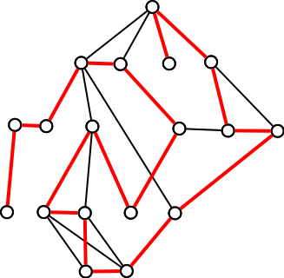
Hamiltonian path
Input: A graph G and two nodes x and y
Output: whether or not G admits a path from x to y passing each node of G exactly once.
Known to be NP-complete

Slide 49
Longest path problem
Input: a graph G and two nodes x and y.
Output: a longest simple path in G from x to y.
Prove that the problem is NP-hard.

Slide 50
A reduction
Let (G, x, y) be an input for the Hamiltonian Path problem.
Suppose that the Longest-Path Problem has a polynomial-time algorithm A.
We run A(G, x, y). If the output path passing all nodes of G exactly once, we answer yes for the Hamiltonian Path problem; answer no otherwise.

Slide 51
Vertex Cover Problem
Input:
  A graph G
Output:
  A smallest vertex subset of G that covers all edges of G.
Known to be NP-complete

Slide 52
Illustration

Slide 53
Max Independent Set
Input: A graph G
Output: A maximum subset S of G’s nodes such that any two nodes in S are not adjacent in G.
Prove that Max Independent Set problem is NP-hard.

Slide 54
Hint
Let G = (V, E) be a graph and S be a subset of V. Then
  S is a vertex cover of G if and only if V – S is an independent set of G.
S
V - S

Slide 55
A reduction
If G is an input for the vertex cover problem and A is a polynomial-time algorithm for solving the independent set problem. Then we run A(G) to obtain a maximum independent set X of G. By the hint, we know V – X has to be a minimum vertex cover of G.

Slide 56
A less obvious example
A reduction from 3-SAT to Independent set

Slide 57
Literal, clause, and CNF

Slide 58
K-SAT

Slide 59
g(φ)

Slide 60
Claim

Slide 61
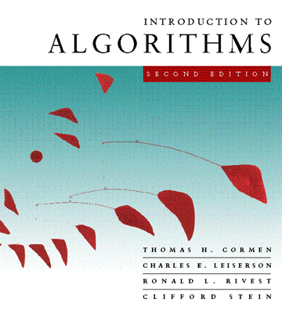
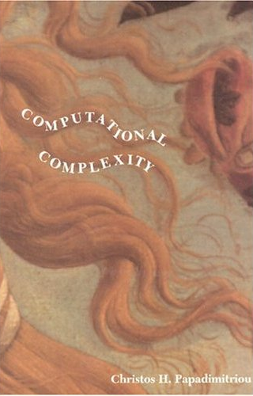
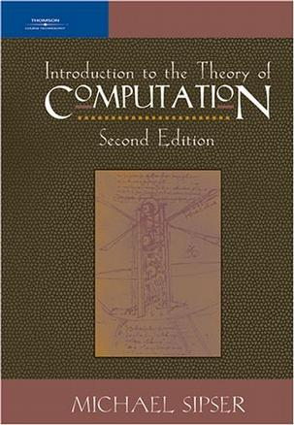
For more examples

