Slide 1
演算法設計與分析
台大資工系
呂學一

Slide 2

Magic of Randomness
骰子的魔力
hash
fingerprinting

Slide 3
Hash
雜湊

Slide 4
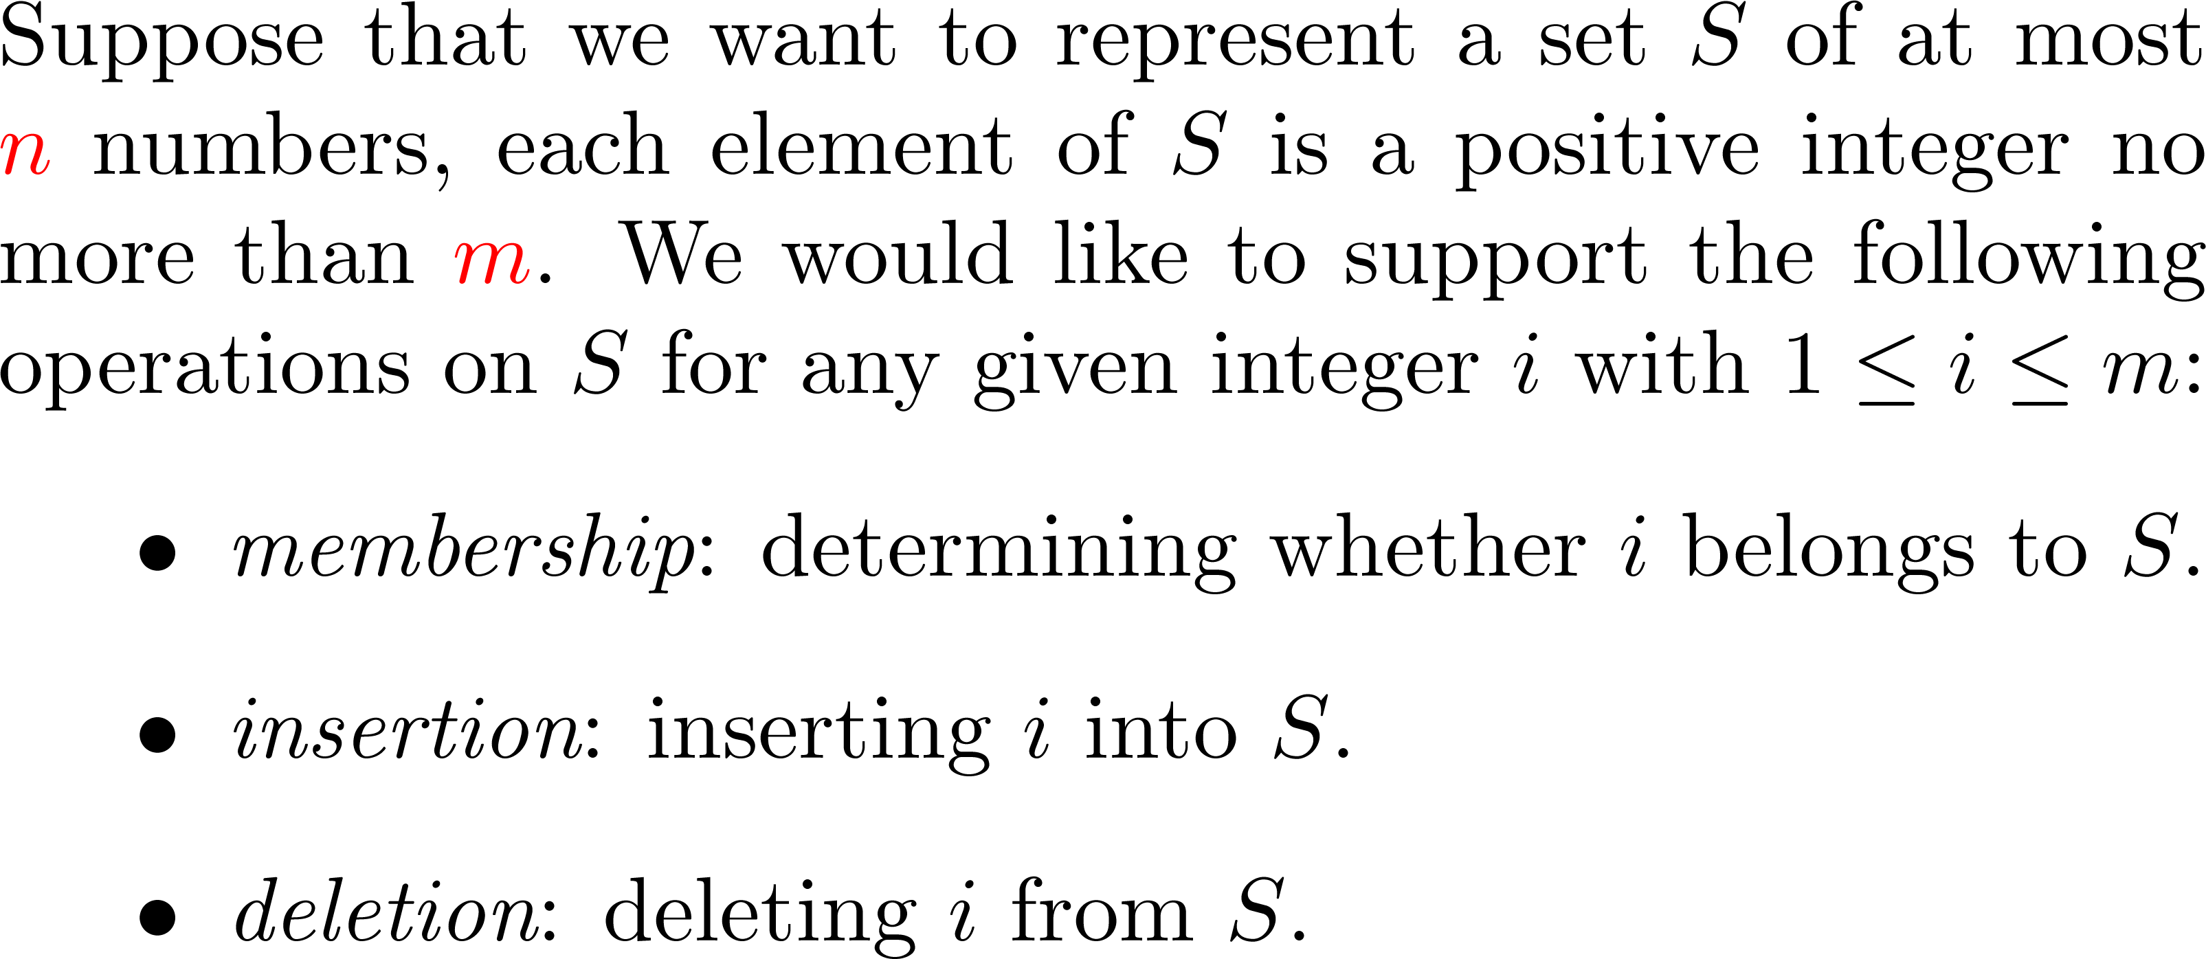
集合

Slide 5
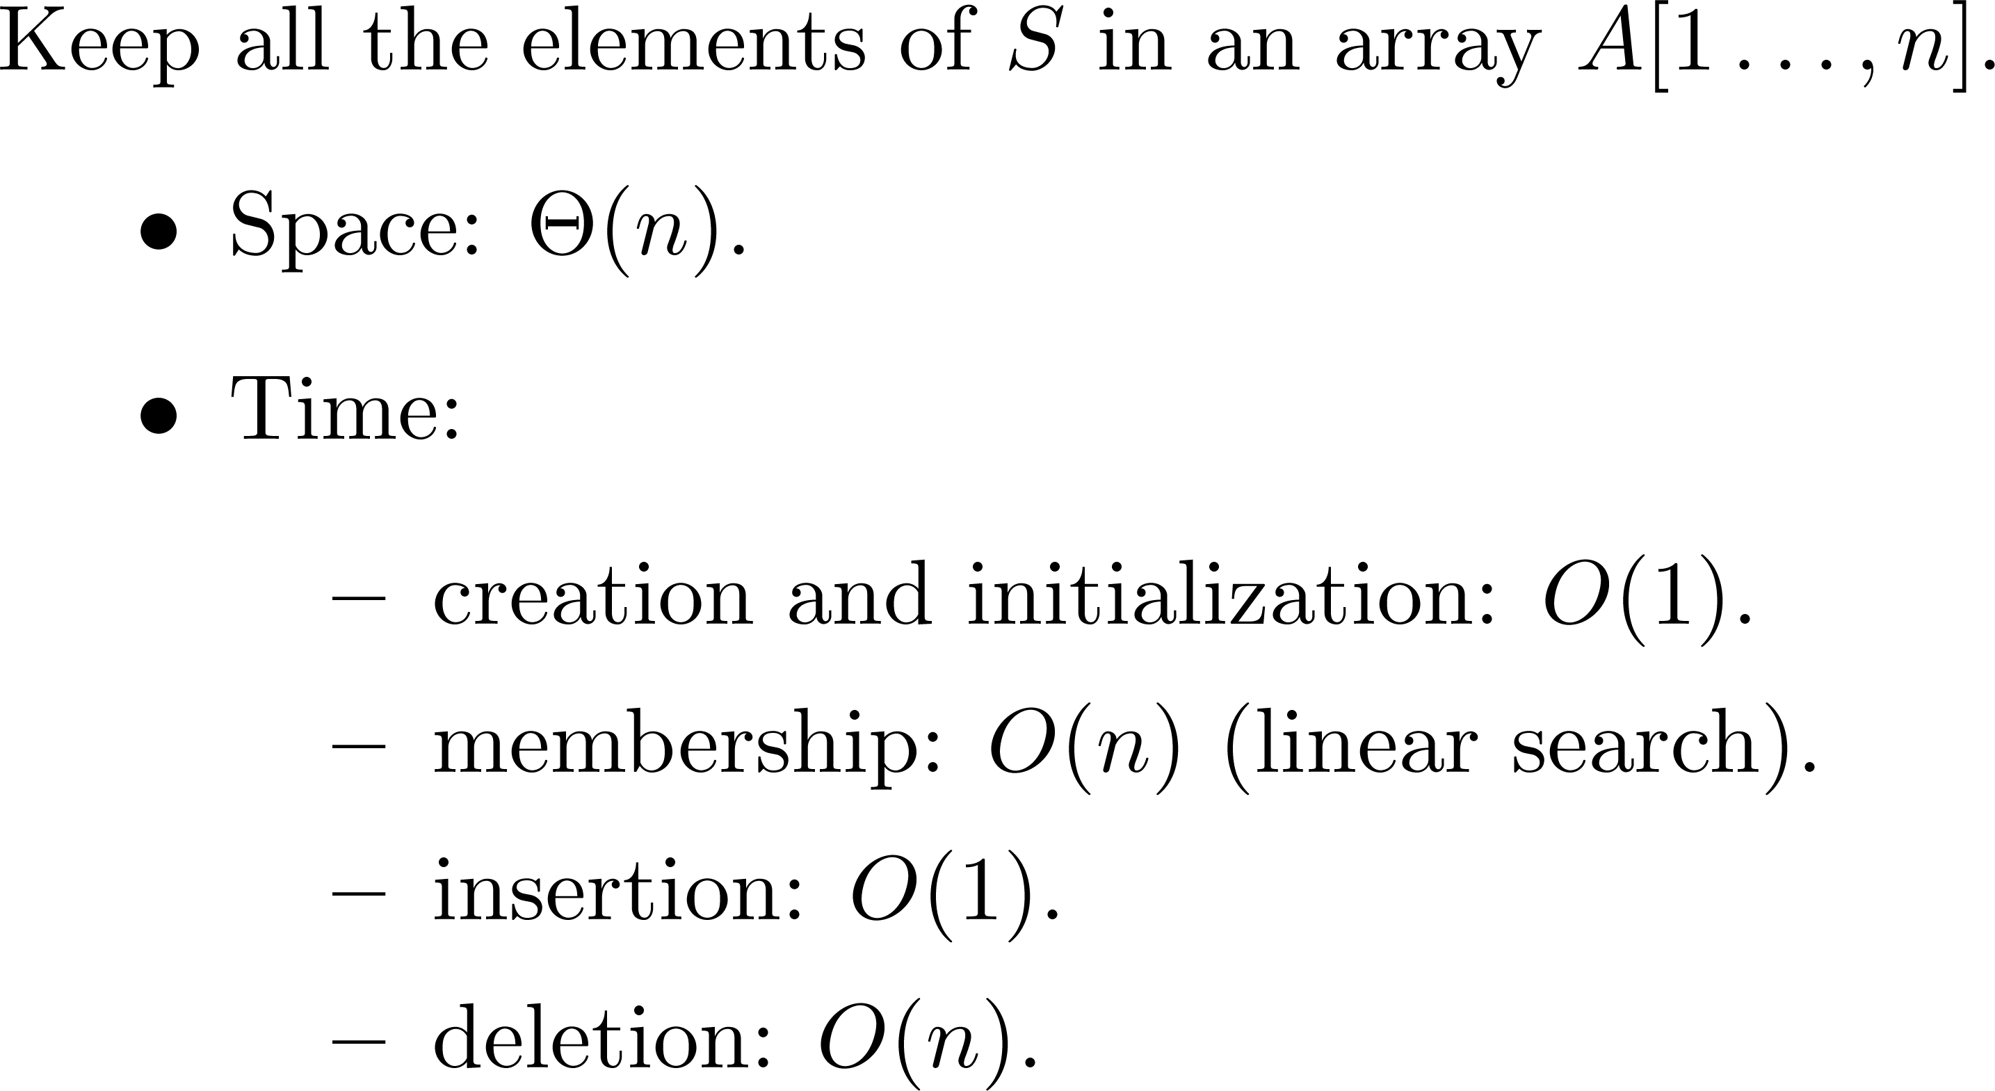
Attempt #1

Slide 6
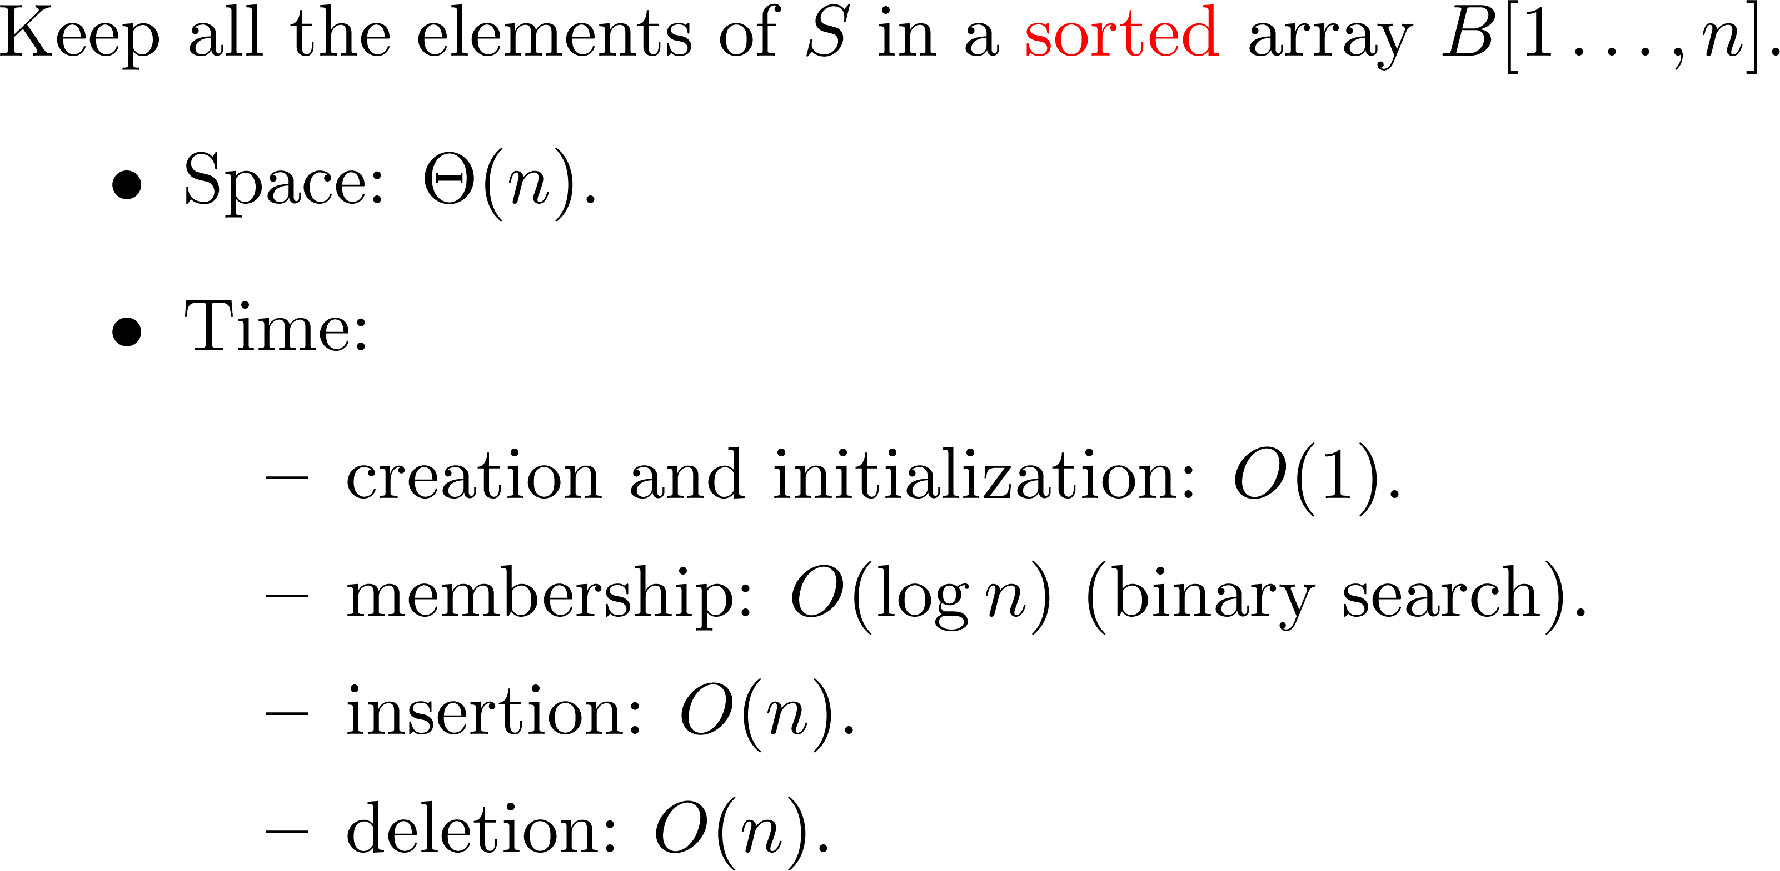
Attempt #2

Slide 7
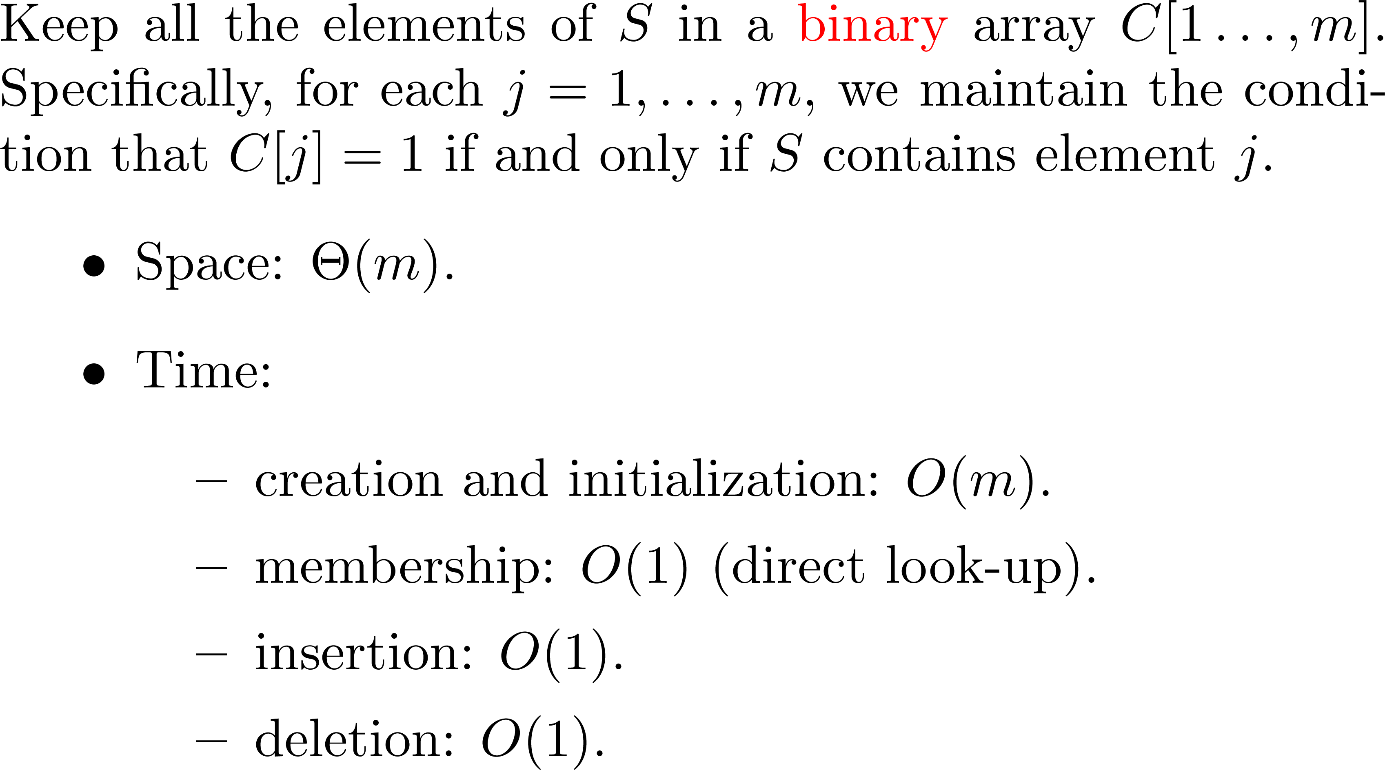
Attempt #3

Slide 8

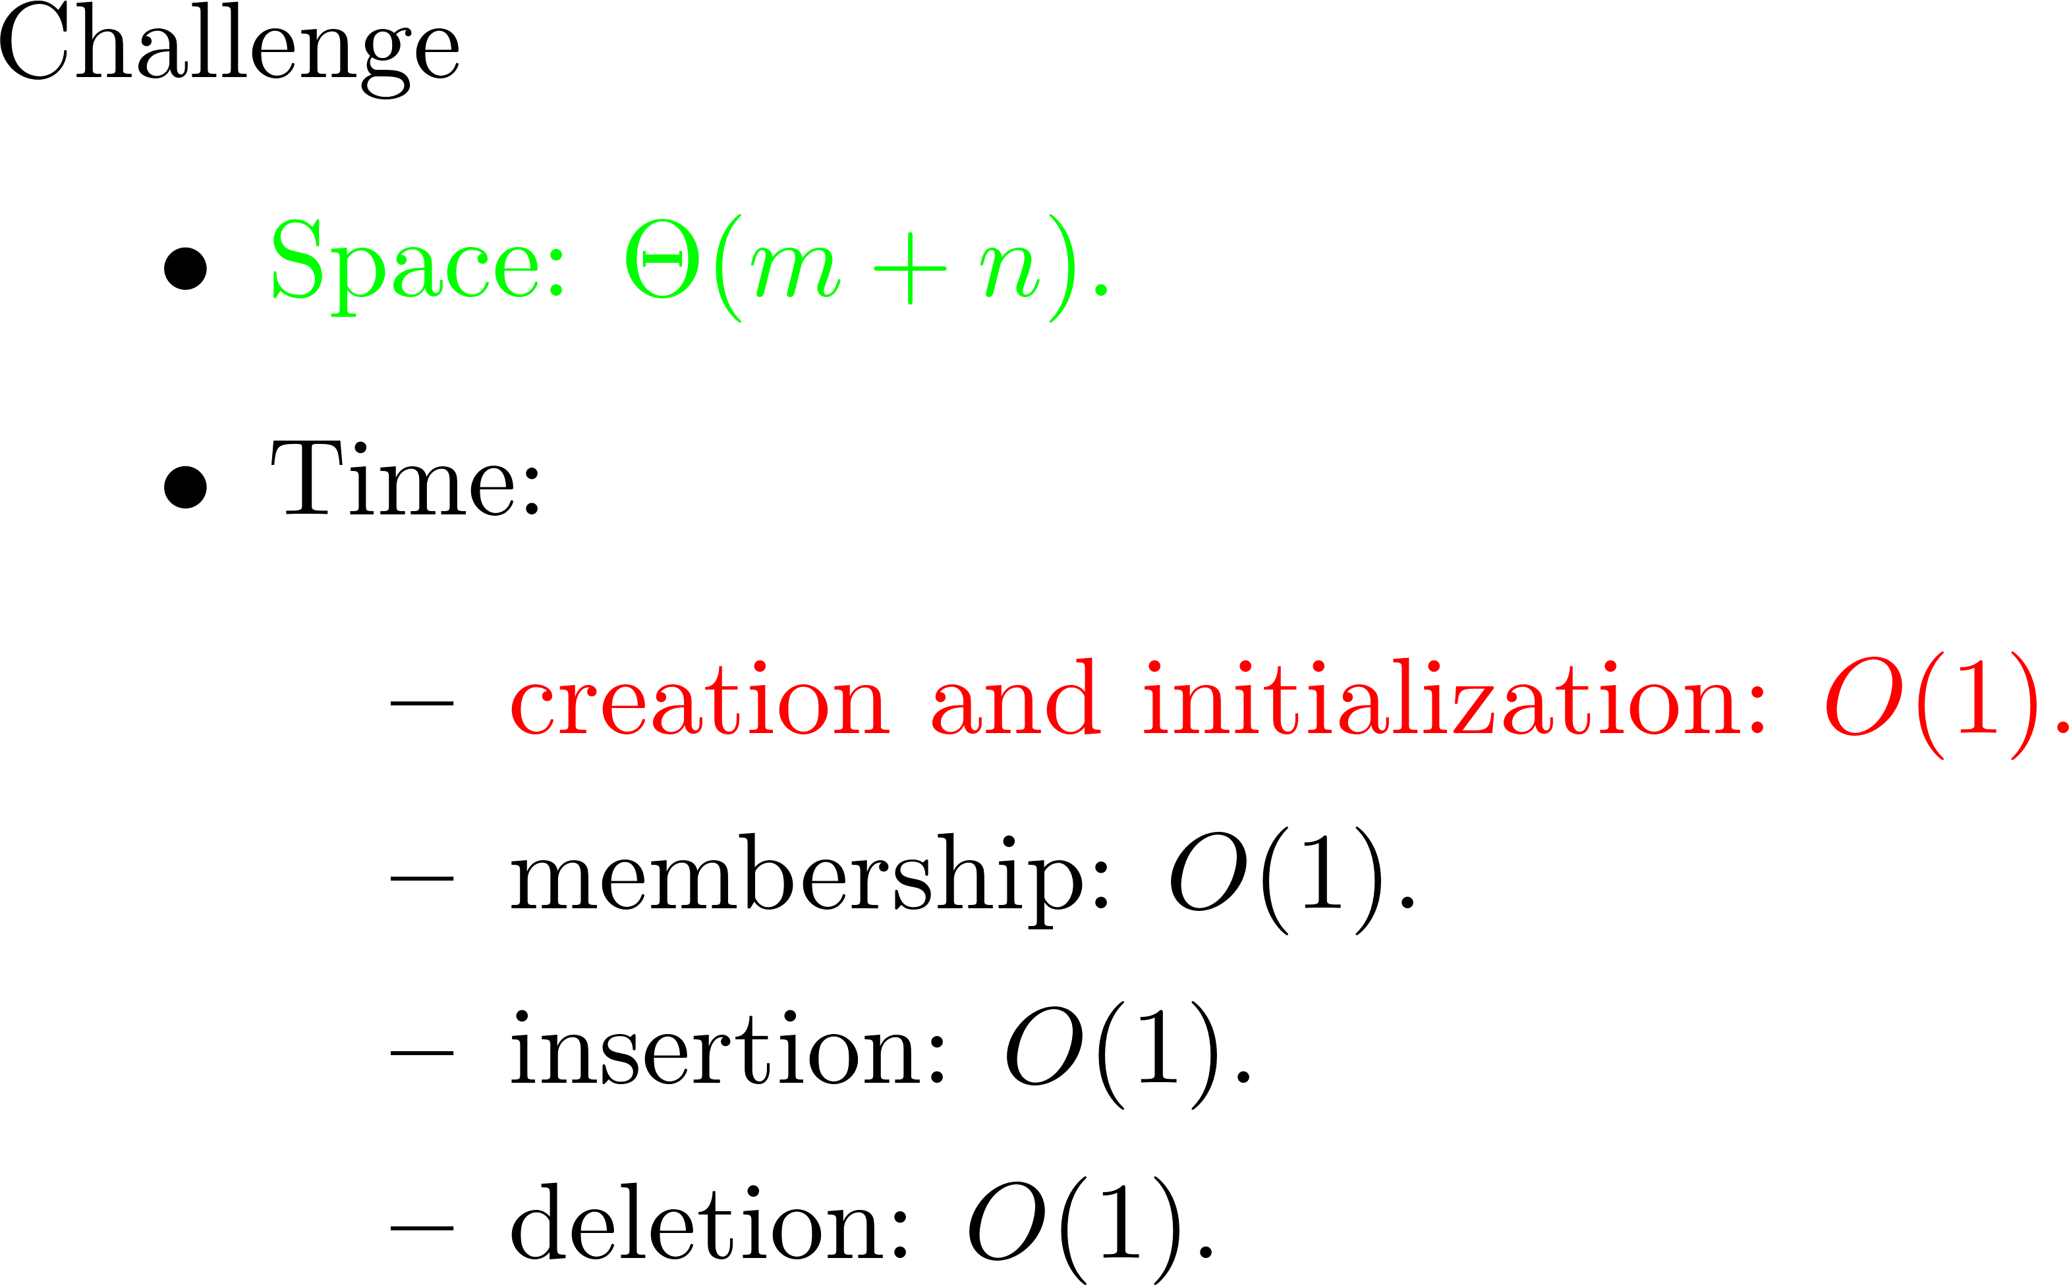
挑戰

Slide 9


Hint

Slide 10
溫習：2-3-4 tree
50
15,33
60,70,79
9,11
19,23,30
35,39
55,58
61,67
73,77
81,83

Slide 11
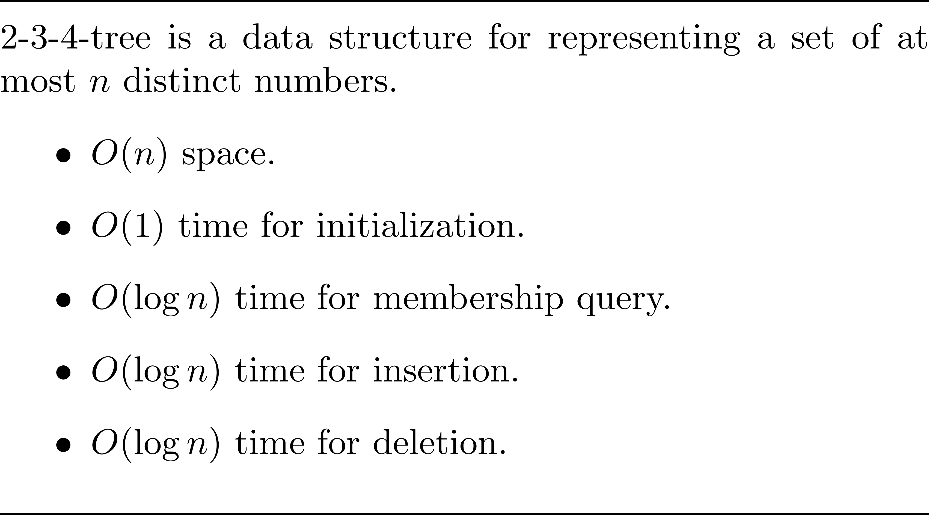
溫習: 2-3-4樹的表現

Slide 12
如果有一個神奇的函數H
能夠把集合S中的數字x對映到{1,…,n}中的位置H(x)
而且居然可以x ≠ y if and only if H(x) ≠ H(y)

Slide 13
或者退而求其次
能夠把集合S中的數字x對映到{1,…,n}中的位置H(x)
而且不會有太多個不同的數字被對映到相同的位置。

Slide 14
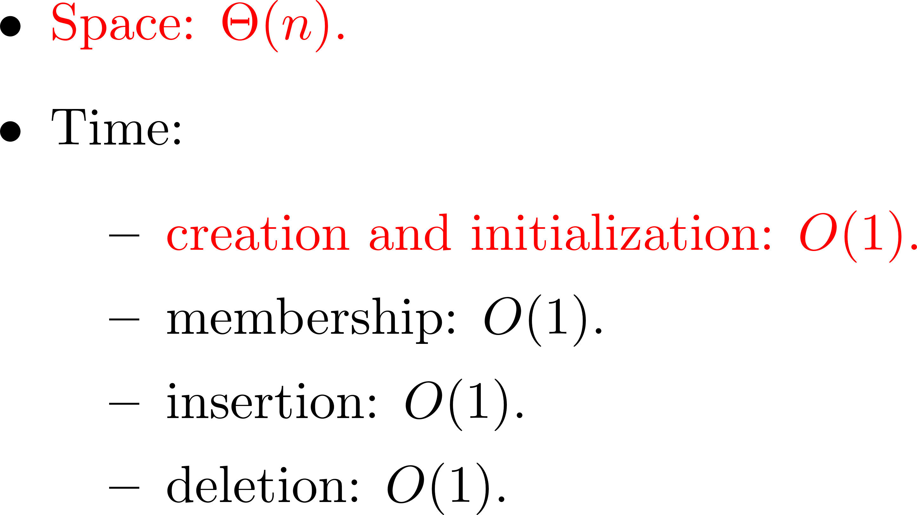
則可以達成

Slide 15
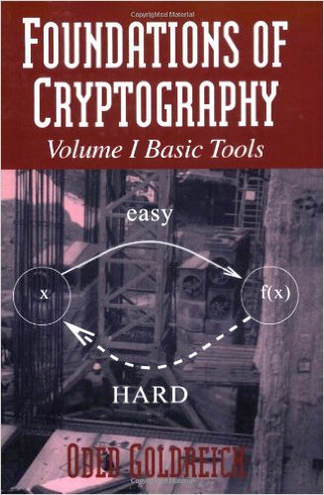
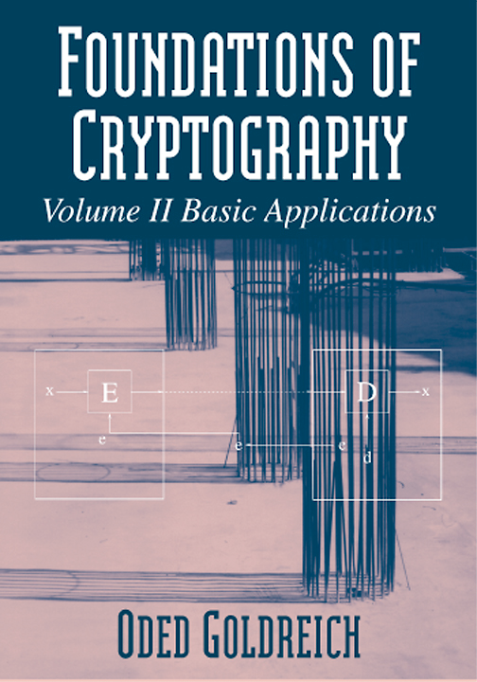
只不過
有沒有這樣神奇的函數，至今仍然懸而未決…
pseudo-random generator
one-way function
the existence of one-way function implies NP≠P.
the converse is not true.

Slide 16

Fingerprinting

Slide 17




Is X equal to Y?
?
=
?
=

Slide 18
Are Two Matrices Identical?

Slide 19
The problem
Input: two n-by-n matrices A and B.
Output: determining whether A = B?
A
B
?
=

Slide 20
Naïve approach
Comparing all elements.
Needs n² comparisons.
Can we reduce the number of comparisons if a small probability of error is allowed?

Slide 21
Fingerprinting approach
Choose an n-element column vector r,
where each element of r is either 0 or 1 independently and equally likely.
Comment: As a matter of fact, 0 and 1 can be any two distinct numbers.
Compare Ar and Br, and output whether they are identical.

Slide 22
Fingerprinting
A
B
?
=
A
r
B
r
?
=
Only n comparisons.

Slide 23
Error Probability?

Slide 24
Proof

Slide 25
Bounding the probability

Slide 26
Therefore, …

Slide 27
Criticism: Computing Ar takes Ω(n²) time.
A
B
?
=
A
r
B
r
?
=
Only n comparisons.

Slide 28
More interesting example: Is AB = C?
Input: three n-by-n matrices A, B, C.
Output: determining whether AB = C.
Naïve approach takes O(n³) time for matrix multiplication and O(n²) time for comparison.
Or, the fast matrix multiplication takes O(n^{2.37}) time.

Slide 29
Fingerprinting approach
Choose an n-element column vector r,
where each element of r is either 0 or 1 independently and equally likely.
Comment: As a matter of fact, 0 and 1 can be any two distinct numbers.
Compare ABr and Cr, and output whether they are identical.

Slide 30
Fingerprinting
A
B
C
?
=
A
B
r
C
r
?
=
Only O(n²) operations
Only n comparisons.
Only O(n²) comparisons.

Slide 31
Error Probability?

Slide 32
Are two Polynomials Identical?

Slide 33
Is A(x)*B(x) = C(x)?
Input:
A(x) and B(x) are two degree-n polynomials.
C(x) is a degree-2n polynomial.
Output:
Determine whether the product of A(x) and B(x) is equal to C(x).

Slide 34
Naïve approach
Multiplying A(x) and B(x) takes Ω(n log n) time
e.g., using Fast Fourier Transform.
Comparing A(x)*B(x) and C(x) takes Ω(n) time.

Slide 35
Fingerprinting approach
Let R consist of arbitrary 4n distinct numbers.
Choose a number r from R uniformly at random.
Evaluate A(r)*B(r) and C(r), and output whether they are identical.
Time complexity
O(n) for computation;
O(1) for comparison.

Slide 36
Error Probability?

Slide 37
Proof

