Slide 1
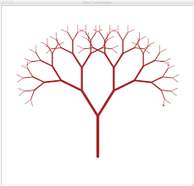
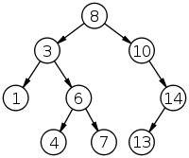
Binary Trees
© 2010 Goodrich, Tamassia
Trees
Notes:
Trees

Slide 2
Binary Trees
A binary tree is a tree with the following properties:
  Each internal node has one or two children (exactly two for proper binary trees)
  The children of a node are an ordered pair
We call the children of an internal node left child and right child
Alternative recursive definition: a binary tree is either
  a tree consisting of a single node, or
  a tree whose root has an ordered pair of children, each of which is a binary tree
Applications:
  arithmetic expressions
  decision processes
  searching
A
B
C
D
E
F
G
H
© 2010 Goodrich, Tamassia
Trees

Slide 3
Arithmetic Expression Trees
Binary tree associated with an arithmetic expression
  internal nodes: operators
  external nodes: operands
Example: arithmetic expression tree for the expression (2 × (a − 1) + (3 × b))
+
Proper binary tree
if no unary operator!
×
×
2
−
3
b
a
1
© 2010 Goodrich, Tamassia
Trees

Slide 4
Decision Trees
Binary tree associated with a decision process
  internal nodes: questions with yes/no answer
  external nodes: decisions
Example: dining decision
Proper binary tree!
Want a fast meal?
Yes
No
How about coffee?
On expense account?
Yes
No
Yes
No
Starbucks
Spike’s
Al Forno
Café Paragon
© 2010 Goodrich, Tamassia
Trees

Slide 5
Properties of Binary Trees
Notation
  n: # of nodes
  n_{e}: # of external nodes
  n_{i}: number of internal nodes
  h: height
Properties:
  h+1 ≤ n ≤ 2^{h+1}−1
  1 ≤ n_{e} ≤ 2^{h}
  h ≤ n_{i} ≤ 2^{h}−1
  log₂(n+1)-1 ≤ h ≤ n−1
Quiz!
level=0
Level d has at most 2^{d} nodes.
level=1
level=2
level=3
© 2010 Goodrich, Tamassia
Trees

Slide 6
Properties of Proper Binary Trees
Notation
  n: # of nodes
  n_{e}: # of external nodes
  n_{i}: number of internal nodes
  h: height
Properties:
  2h+1 ≤ n ≤ 2^{h+1}−1
  h+1 ≤ n_{e} ≤ 2^{h}
  h ≤ n_{i} ≤ 2^{h}−1
  log₂(n+1)-1 ≤ h ≤ (n−1)/2
  n_{e} = n_{i}+1
Quiz!
Proper!
level=0
level=1
Level d has at most 2^{d} nodes.
level=2
level=3
© 2010 Goodrich, Tamassia
Trees

Slide 7
Proof of n_{e} = n_{i}+1 for Proper Binary Trees
  Prove that n_{e} = n_{i}+1
  When n_{i} = 1 ...
  When n_{i} = 2 ...
  Assume the identity holds when n_{i} ≤ k, then when n_{i} = k+1 …
For general BT, we have
n₂=n₀+1
n_{i} = 1
n_{i} = 2
n_{i} = k+1
© 2010 Goodrich, Tamassia
Trees
Notes:
Trees

Slide 8
Quiz
  Give a proper binary tree with n node
  Explain why n is always odd.
  If n is 51, what is the numbers of internal and external nodes, respectively?
© 2010 Goodrich, Tamassia
Trees
Notes:
Trees

Slide 9
BinaryTree ADT
The BinaryTree ADT extends the Tree ADT, i.e., it inherits all the methods of the Tree ADT
Additional methods:
  position p.left()
  position p.right()
Update methods may be defined by data structures implementing the BinaryTree ADT
Proper binary tree: Each node has either 0 or 2 children
© 2010 Goodrich, Tamassia
Trees

Slide 10
Linked Structure for Trees
A node is represented by an object storing
  Element
  Parent node
  Sequence of children nodes
Link to list of
pointers to children
B
∅
A
∅
D
F
∅
B
Link to parent
A
D
F
C
E
C
∅
E
∅
© 2010 Goodrich, Tamassia
Trees

Slide 11
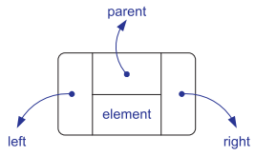
Linked Structure for Binary Trees
A node is represented by an object storing
  Element
  Parent node
  Left child node
  Right child node
B
A
D
∅
B
C
E
∅
∅
A
D
∅
∅
∅
∅
C
E
© 2010 Goodrich, Tamassia
Trees

Slide 12
Vector Representation of Binary Trees
Nodes of tree T are stored in vector S
1
A
B
D
…
G
H
…
A
0
1
2
3
10
11
2
3
B
D
Node v is stored at S[f(v)]
  f(root) = 1
  if v is the left child of parent(v), f(v) = 2*f(parent(v))
  if v is the right child of parent(v), f(v) = 2*f(parent(v)) + 1
f() is known as
level numbering
4
5
6
7
E
F
C
J
10
11
Quiz!
G
H
© 2010 Goodrich, Tamassia
Trees

Slide 13
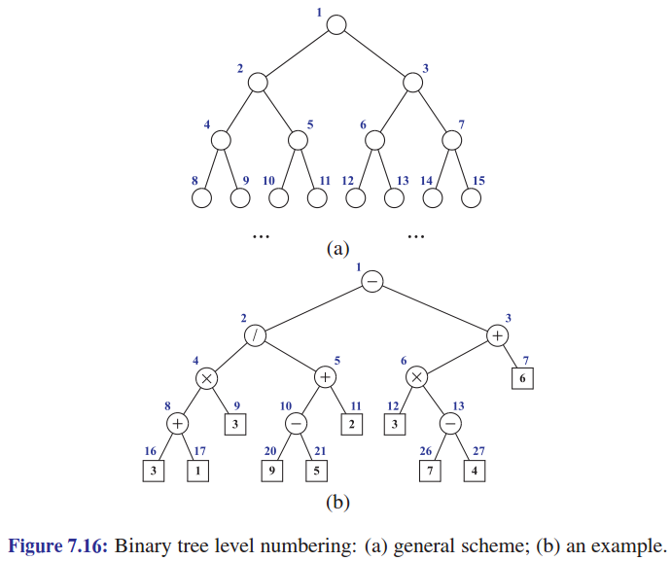
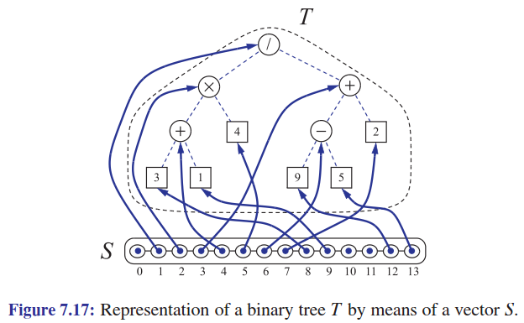
Vector Representation of Binary Trees: More Examples
© 2010 Goodrich, Tamassia
Trees

Slide 14
Quiz
1
A
The binary tree is stored level-by-level in a one-dimensional array. What are the indices of nodes N and M?
2
3
B
D
F
C
J
G
H
N
L
K
P
M
© 2010 Goodrich, Tamassia
Trees

Slide 15
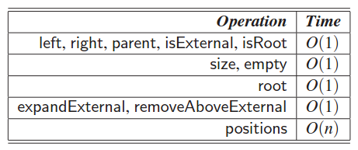
Vector Representation of Binary Trees: Analysis
Notation
  n: # of nodes in tree T
  N: size of vector S
Time complexity
Space complexity
  O(N), which is O(2^{n}) in the worse case
Major drawback!
(So we always want to keep
trees as shallow as possible!)
© 2010 Goodrich, Tamassia
Trees

Slide 16
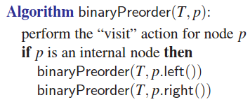
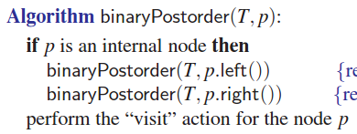
Traversal of Binary Trees
Basic types of traversal
  Preorder
  Postorder
  Inorder
  Level order
© 2010 Goodrich, Tamassia
Trees

Slide 17
Postorder Traversal for BT
Can be applied to any “bottom-up” evaluation problems
  Evaluate an arithmetic expression
  Directory size computation
© 2010 Goodrich, Tamassia
Trees

Slide 18
Evaluate Arithmetic Expressions
Based on postorder traversal
  Recursive method returning the value of a subtree
  When visiting an internal node, combine the values of the subtrees
Algorithm evalExpr(v)
  if v.isExternal()
    return v.element()
  x ← evalExpr(v.left())
  y ← evalExpr(v.right())
  ← operator stored at v
  return x ◊ y
+
×
×
Postorder traversal ≡ Postfix notation
2
−
3
2
5
1
© 2010 Goodrich, Tamassia
Trees

Slide 19
Inorder Traversal
Inorder traversal: a node is visited after its left subtree and before its right subtree
Application
  Draw a binary tree
  Print arithmetic expressions with parentheses
Algorithm inOrder(v)
  if v is NULL
  return
  inOrder(v.left())
  visit(v)
  inOrder(v.right())
6
2
8
Inorder traversal ≡ Projection!
1
4
7
9
3
5
© 2010 Goodrich, Tamassia
Trees

Slide 20
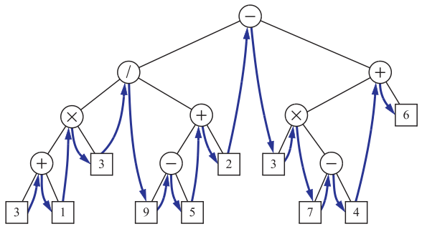
Inorder Traversal: Examples
Properties of inorder traversal
  Very close to infix notation
  Can be obtained by tree projection
© 2010 Goodrich, Tamassia
Trees

Slide 21
Print Arithmetic Expressions
Based on inorder traversal
  Print operand or operator when visiting node
  Print “(“ before traversing left subtree
  Print “)“ after traversing right subtree
Algorithm printExpression(v)
  if v is NULL
  return
  print(“(’’)
  inOrder(v.left())
  print(v.element())
  inOrder(v.right())
  print (“)’’)
+
×
×
2
−
3
b
((2 × (a − 1)) + (3 × b))
a
1
© 2010 Goodrich, Tamassia
Trees

Slide 22
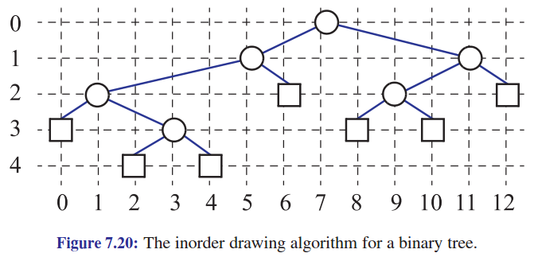
Draw a Binary Tree
Since inorder traversal is equivalent to tree projection, it is easy to draw a binary tree using inorder traversal.
© 2010 Goodrich, Tamassia
Trees

Slide 23
Euler Tour Traversal
Generic traversal of a binary tree
Includes a special cases the preorder, postorder and inorder traversals
Walk around the tree and visit each node three times:
  On the left (preorder) ➔ + x 2 – 5 1 x 3 2
  From below (inorder) ➔ 2 x 5 – 1 + 3 x 2
  On the right (postorder) ➔ 2 5 1 – x 3 2 x +
+
Quiz!
L
×
R
×
B
2
−
3
2
5
1
© 2010 Goodrich, Tamassia
Trees

Slide 24
Euler Tour Traversal
Applications
  Determine the number of descendants of each node in a tree
  Fully parenthesize an arithmetic expression from an expression tree
© 2010 Goodrich, Tamassia
Trees

Slide 25
Quiz
Determine a binary tree
  Inorder=[c q f p x z k y]
  Preorder=[f c q z x p y k]
Determine a binary tree
  Inorder=[z b j d e f m c]
  Postorder=[b z d e m c f j]
Determine a binary tree
  Preorder=[a b c]
  Postorder=[c b a]
© 2010 Goodrich, Tamassia
Trees

Slide 26
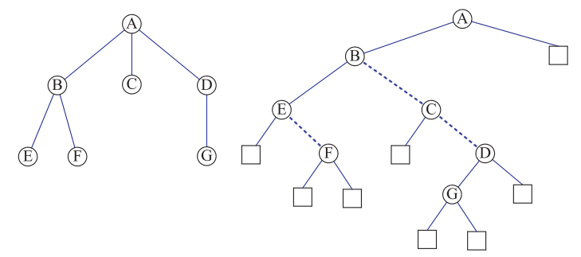
From General to Binary Trees
How to transform a general tree to a binary tree ➔ Left-child right-sibling representation
Quiz!
© 2010 Goodrich, Tamassia
Trees

