Slide 1
Dynamic Programming
張智星 (Roger Jang)
jang@mirlab.org
http://mirlab.org/jang
多媒體資訊檢索實驗室
台灣大學 資訊工程系

Slide 2
Dynamic Programming
Dynamic Programming (DP)
  An effective method for finding the optimum solution to a multi-stage decision problem, based on the principal of optimality
Applications: NUMEROUS!
  Longest common subsequence, edit distance, matrix chain products, all-pair shortest distance, dynamic time warping, hidden Markov models, …
Quiz!

Slide 3
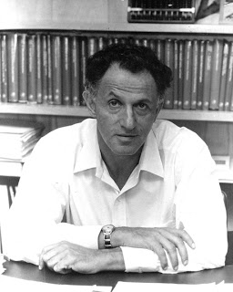
Principal of Optimality
Richard Bellman, 1952
  An optimal policy has the property that whatever the initial state and the initial decisions are, the remaining decisions must constitute an optimal policy with regard to the state resulting from the first decision.

Slide 4
Problems Solvable by DP
Characteristics of problems solvable by DP
  Decomposition: The original problem can be expressed in terms of subproblems.
  Subproblem optimality: the global optimum value of a subproblem can be defined in terms of optimal subproblems of smaller sizes.

Slide 5
Three-step Formula of DP
Quiz!
DP formulation involves 3 steps
  Define the optimum-value function
  Derive the recurrent formula of the optimum-value function, with boundary conditions
  Specify the answer to the original task in terms of the optimum-value function.

Slide 6
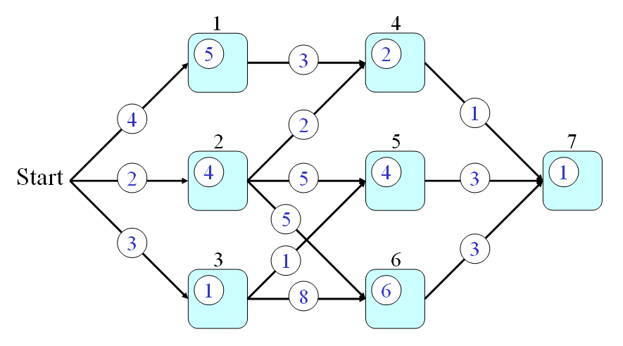
DP Example: Optimal Path Finding
Path finding in a feed-forward network
  p(a,b): transition cost
  q(a): state cost
Goal
  Find the optimal path from nodes 0 to 7 such that the total cost is minimized.
Node index
0
q(3)=1
p(3,6)=8

Slide 7
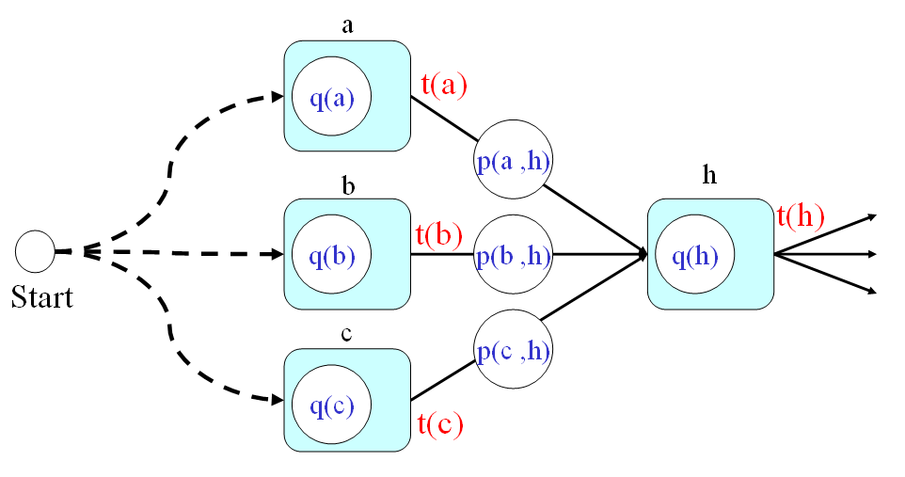
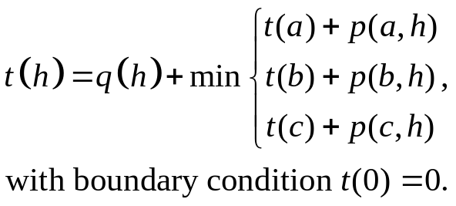
DP Example: Optimal Path Finding
Three steps in DP
  Optimum-value function t(h): the minimum cost from the start point to node h.
  Recurrent formula
  Answer: t(7)
0
Optimum-value function

Slide 8
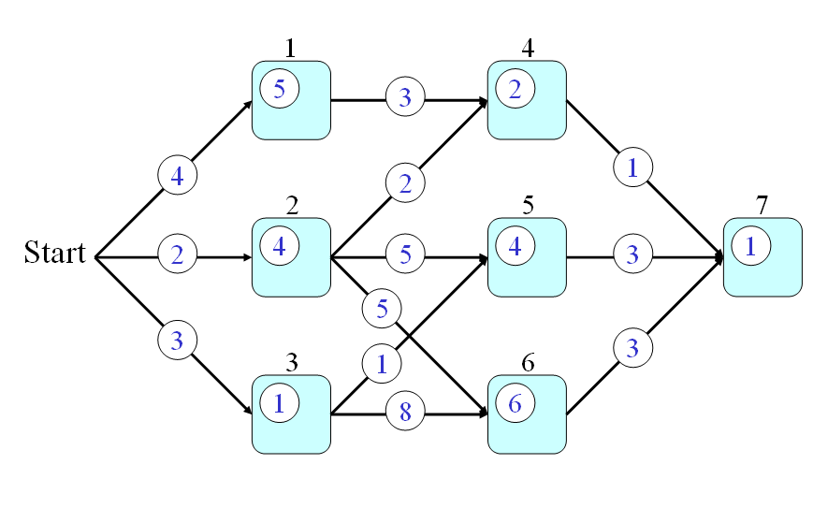
DP Example: Optimal Path Finding
Step-by-step animation of DP
Click to go through DP

Slide 9
Principal of Optimality: Example
In terms of the min-cost path problem
  Any partial path of the min-cost path should itself be an min-cost path given the starting and ending nodes

Slide 10
General Approach to DP
Usually bottom-up design
  Start from the bottom (base cases)
  Solve small sub-problems
  Store solutions
  Reuse previous results for solving larger sub-problems
Usually it’s reduced
to table filling!

Slide 11
Characteristics of DP
Some general characteristics of DP
  We need to store back-tracking information in order to identify the path efficiently.
  Once the optimal path is found, all the related sub-problems are also solved.
  DP can only find the optimal path. To find the second best, we need to invoke a more complicated n-best approach.

Slide 12
Comparison: Recursion, Divide & Conquer, DP
Recursion
  A problem of size n is solved by first solving a sub-problem of size n-1.
Divide & conquer
  A problem of size n is solved by first solving a sub-problem of size k and another of size n-k.
DP
  A problem of size n is solved by first solving all sub-problems of all sizes k, where k < n.

Slide 13
Longest Common Subsequence
Subsequence
  Given a string, we can delete some elements to form a subsequence:
    s1=uvwxyz ➔ s2=uwyz (after deleting v and x)
    s2 is a subsequence of s1.
Longest common subsequence (LCS)
  The similarity of two string can be define as the length of the LCS between them.
  Example: abcdefg and xzackdfwgh have acdfg as a longest common subsequence
For word suggestion!

Slide 14
Brute-Force Approach to LCS
A brute-force solution
  Enumerate all subsequences of X
  Test which ones are also subsequences of Y
  Pick the longest one.
Analysis:
  If X is of length n, then it has 2^{n} subsequences
  This is an exponential-time algorithm!

Slide 15
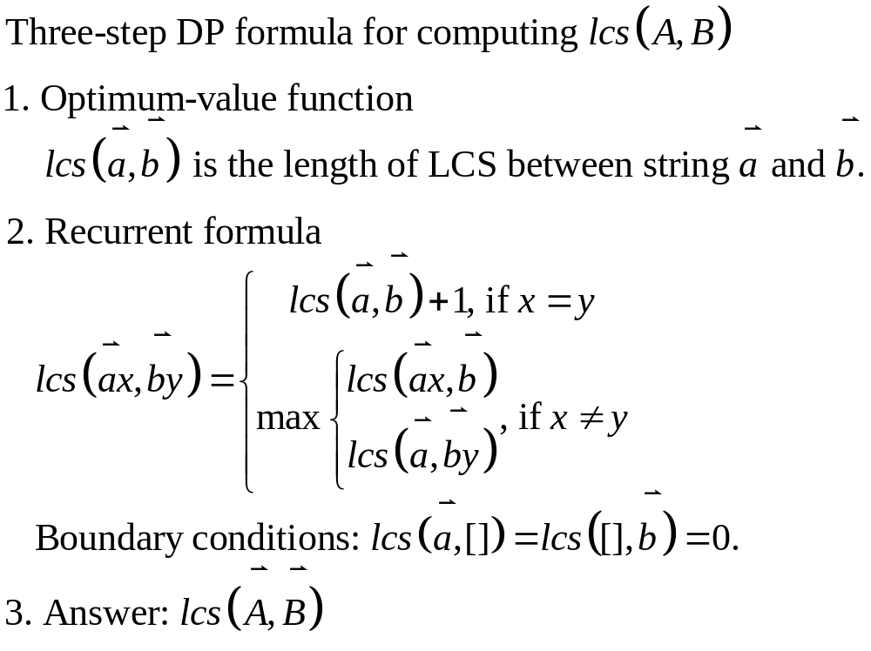
DP for LCS: 3-step Formula
Quiz!

Slide 16
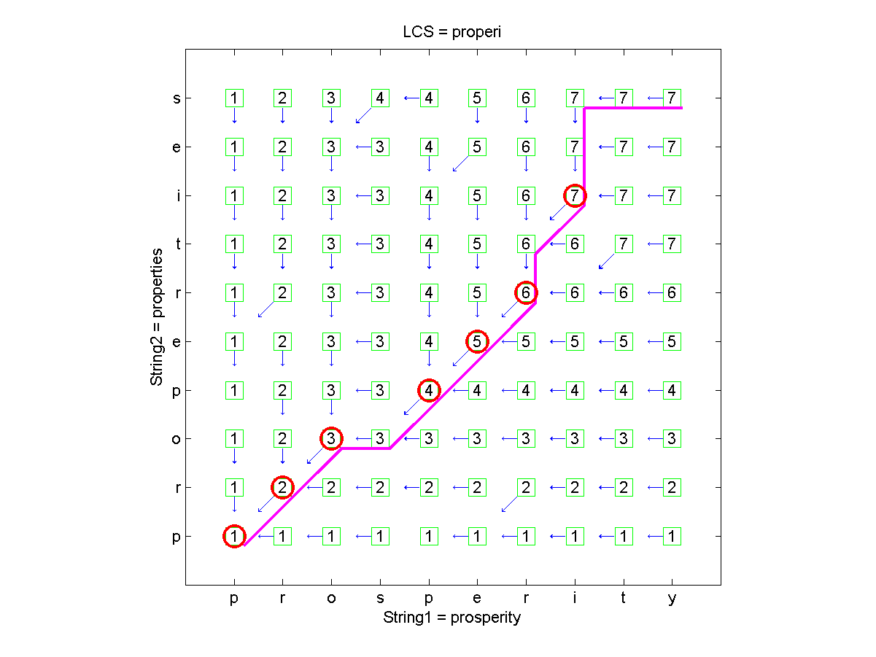
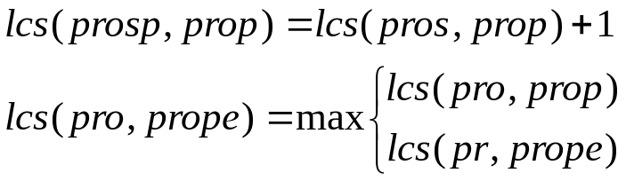
DP for LCS: Table Filling (1/2)

Slide 17
DP for LCS: Table Filling (2/2)
Observations
  LCS=‘properi’ or ‘propert’ (which is obtained by keeping multiple back-tracking paths)
  A match occurs when the node has a 45-degree back-tracking path

Slide 18

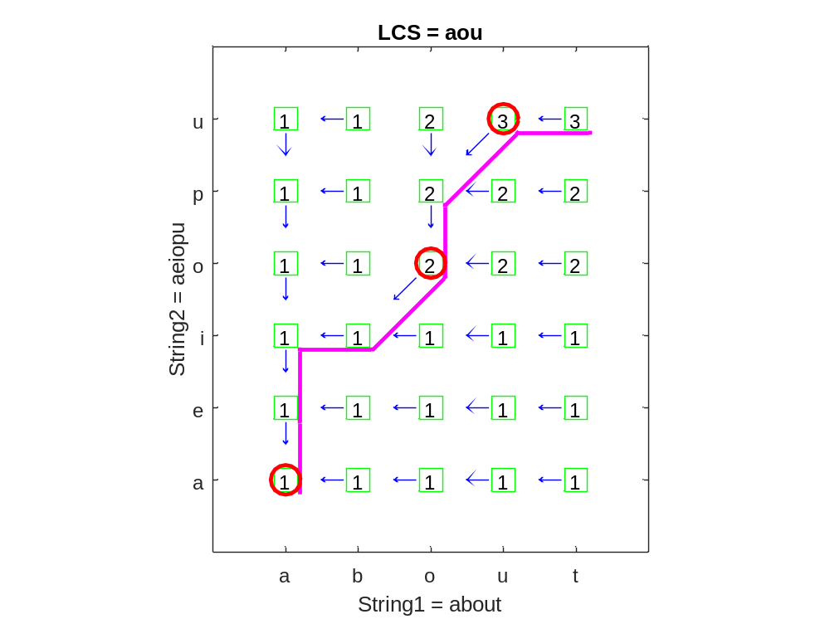
DP for LCS: Quiz for Table Filling
Quiz!
Hints
  Create a (m+1)*(n+1) matrix for table filling
  Fill row 0 and column 0 with 0 first to establish the base cases of boundary conditions
  Fill all the other elements in a layer-by-layer manner.

Slide 19
Quiz Solution
To create this plot
  Download Machine Learning Toolbox
  Run lcs('about', 'aeiopu', 1) under MATLAB

Slide 20
Edit Distance
Edit distance
  The minimum total cost of the basic operations (delete with cost 1, insert with cost 1, substitute with cost 2) that are required to convert a string into another.
For ‘diff’ under unix!

Slide 21
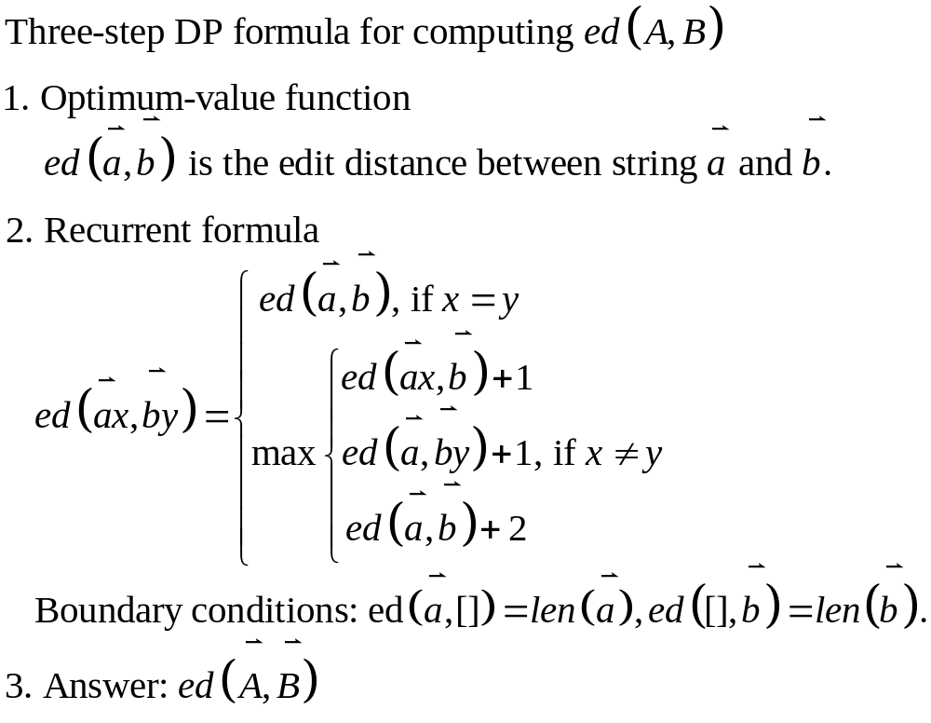
DP for Edit Distance: 3-step Formula
min

Slide 22
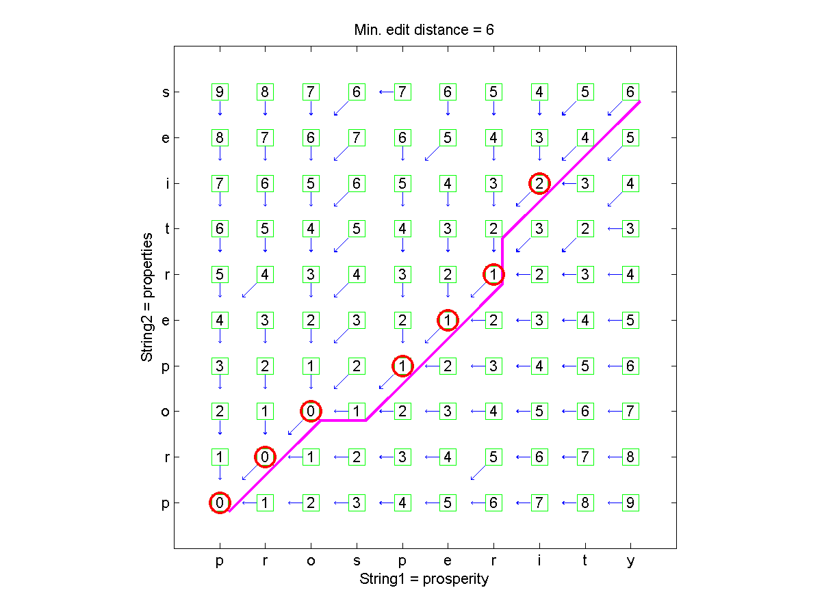
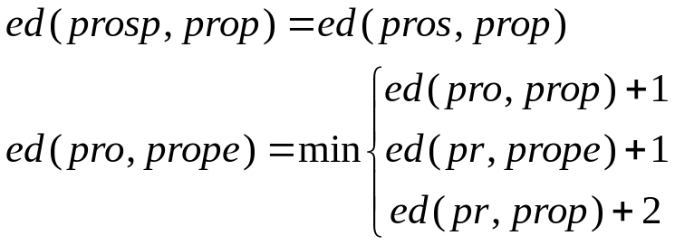
DP for Edit Distance: Table Filling (1/2)

Slide 23
DP for Edit Distance: Table Filling (2/2)
To create this plot
  Download Machine Learning Toolbox
  Run editDistance('prosperity', 'properties', [2 1 1], 1) under MATLAB
  A 45-degree back-tracking path indicates a “substitute” or “equal”.

Slide 24
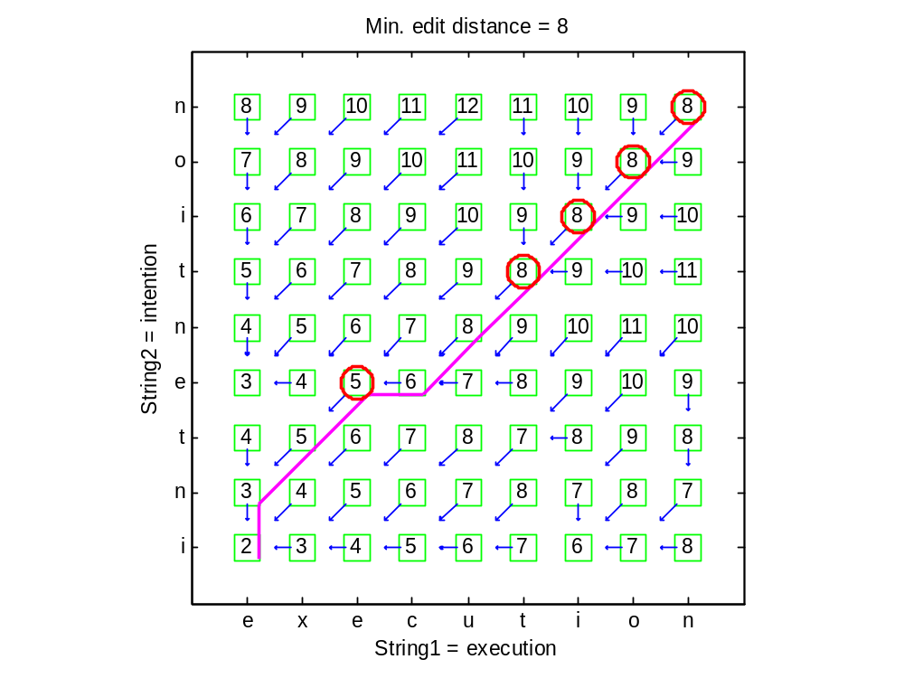
DP for Edit Distance: Quiz for Table Filling
Hints
  Create a (m+1)*(n+1) matrix for table filling
  Fill row 0 and column 0 first to establish the base cases of boundary conditions
  Fill all the other elements in a layer-by-layer manner.

Slide 25
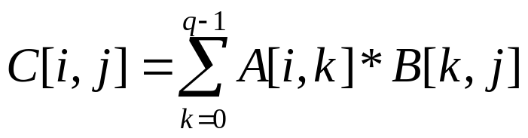
Matrix Chain Products (MCP)
Review: Matrix Multiplication.
  C = A*B
  A is p × q and B is q × r
  O(pqr ) time
r
j
B
q
q
for (i=0; i<p; i++)
for (j=0; j<r; j++){
c[i,j]=0;
for (k=0; k<q; k++)
c[i,j]+=a[i,k]*b[k,j];
}
A
C
p
i
i,j
p
r

Slide 26
Matrix Chain-Products
Problem definition
  Given n matrices A₀, A₁, …, A_{n-1}, where A_{i} is of dimension d_{i}×d_{i+1}
  How to parenthesize A₀*A₁*…*A_{n-1} to minimize the overall cost?

Slide 27
Example of MCP
  The product A (2×3), B (3×5), C (5×2), D (2×4) can be fully parenthesized in 5 distinct ways:
    (A (B (C D))) ➔ 5×2×4 + 3×5×4 + 2×3×4 = 124
    (A ((B C) D)) ➔ 3×5×2 + 3×2×4 + 2×3×4 = 78
    ((A B) (C D)) ➔ 2×3×5 + 5×2×4 + 2×5×4 = 110
    ((A (B C)) D) ➔ 3×5×2 + 2×3×2 + 2×2×4 = 58
    (((A B) C) D) ➔ 2×3×5 + 2×5×2 + 2×2×4 = 66
The way the chain is parenthesized can have a dramatic impact on the cost of evaluating the product.

Slide 28
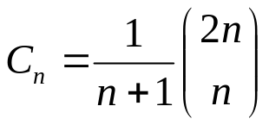
An Enumeration Approach
Matrix Chain-Product Alg.:
  Try all possible ways to parenthesize A=A₀*A₁*…*A_{n-1}
  Calculate total number of operations for each way
  Pick the one that is best
Running time:
  The number of ways of parenthesizations is equal to the number of binary trees with n leave nodes
  It is called the Catalan number, and it is almost 4^{n} ➔ exponential!
((A₀(A₁A₂))A₃)➔binary tree
Dynamic Programming

Slide 29
Observations Leading to DP
Define subproblems:
  Find the best parenthesization of A_{i}*A_{i+1}*…*A_{j}.
  Let N_{i,j} denote the minimum number of operations required by this subproblem.
  The optimal solution for the whole problem is N_{0,n-1}.
Subproblem optimality: The optimal solution can be defined in terms of optimal subproblems
  There has to be a final multiplication (root of the expression tree) for the optimal solution.
  Say, the final multiply is at index i: (A₀*…*A_{i})*(A_{i+1}*…*A_{n-1}).
  Then the optimal solution N_{0,n-1} is the sum of two optimal subproblems, N_{0,i} and N_{i+1,n-1} plus the time for the last multiply.

Slide 30
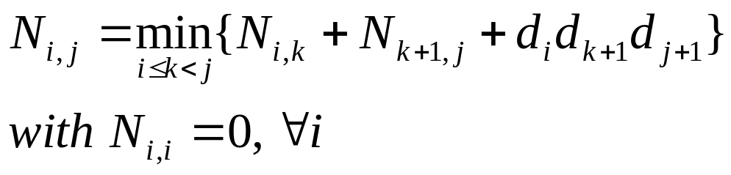
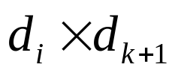
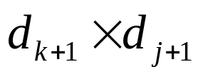
Three-Step DP Formula
To solve matrix chain-product with DP
  Optimum-value function
    N_{i,j}: the minimum number of operations required by parenthesizing A_{i}*A_{i+1}*…*A_{j}.
  Recurrent equation
  Answer
    N_{0, n-1}
(A_{i}*A_{i+1}*…*A_{k})(A_{k+1}*A_{k+2}*…*A_{j})

Slide 31
Subproblem Overlap
0..3
(A₀)( A₁A₂A₃)
(A₀A₁A₂)(A₃)
(A₀ A₁)( A₂A₃)
0..0
1..3
0..1
2..3
0..2
3..3
1..1
2..3
1..2
3..3
0..0
1..1
2..2
3..3
...
2..2
3..3
1..1
2..2
Due to the overlap,
we need to keep track
of previous results

Slide 32
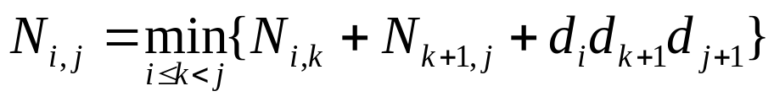
Table Filling for DP
The bottom-up approach fills in the upper-triangle of the n×n array by diagonals, starting from N_{i,i}’s.
N_{i,j} gets values from pervious entries in row i and column j.
Filling in each entry in the N table takes O(n) time ➔ Total time O(n³)
Actual parenthesization can be found by storing the best “k” for each entry
N
0
1
2
j
…
n-1
Answer!
0
1
…
i
n-1
Easy for back tracking
Hint: IJ-mode vs. XY-mode

Slide 33
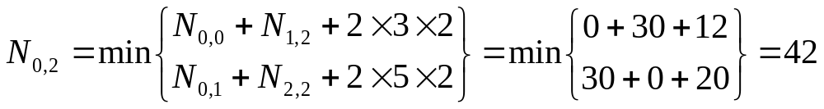
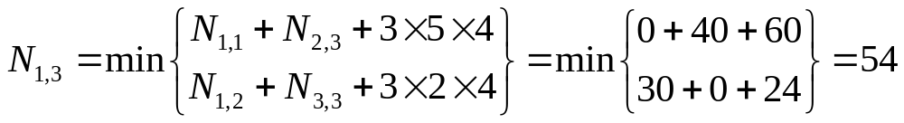
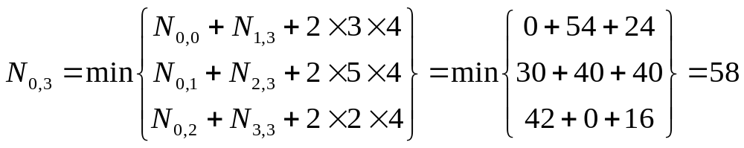
Walkthrough of an MCP Example
Quiz!
Product of A₀ (2×3), A₁ (3×5), A₂ (5×2), A₃ (2×4)
A₀
2×3
A₁
3×5
A₂
5×2
A₃
2×4
A₀
2×3
0 2×3 | 30 2×5 k=0 | 42 2×2 k=0 | 58 2×4 k=2
 | 0 3×5 | 30 3×2 k=1 | 54 3×4 k=2
 |  | 0 5×2 | 40 5×4 k=2
 |  |  | 0 2×4
A₁
3×5
A₂
5×2
A₃
2×4
Optimum value of k
(for back tracking)
Solution (after back tracking) ➔
(A₀A₁A₂)(A₃)=(A₀(A₁A₂))(A₃)

Slide 34
Exercise
Quiz!
Product of A₀ (2×3), A₁ (3×5), A₂ (5×2), A₃ (2×4), A₄ (4×1)
A₀
2×3
A₁
3×5
A₂
5×2
A₃
2×4
A₄
4×1
A₀
2×3
0 2×3 | 30 2×5 k=0 | 42 2×2 k=0 | 58 2×4 k=2 | 2×1 k=
 | 0 3×5 | 30 3×2 k=1 | 54 3×4 k=2 | 3×1 k=
 |  | 0 5×2 | 40 5×4 k=2 | 5×1 k=
 |  |  | 0 2×4 | 5×1 k=3
 |  |  |  | 0 4×1
A₁
3×5
A₂
5×2
A₃
2×4
A₄
4×1
Solution ➔

Slide 35
Dynamic Time Warping (DTW)
Intro to DTW
Applications
  DTW for speech recognition
  DTW for query by singing/humming

