Slide 1
Sorting Algorithms
Jyh-Shing Roger Jang (張智星)
CSIE Dept, National Taiwan University

Slide 2
About Sorting
We have covered
  Selection sort
  Insertion sort
  Bubble sort
  Heap sort
Other efficient sorting algorithms
  Merge sort ➔ O(n log n) in worse case
  Quick sort ➔ O(n log n) in average case
O(n²) in average case
O(n log n) in worse case

Slide 3
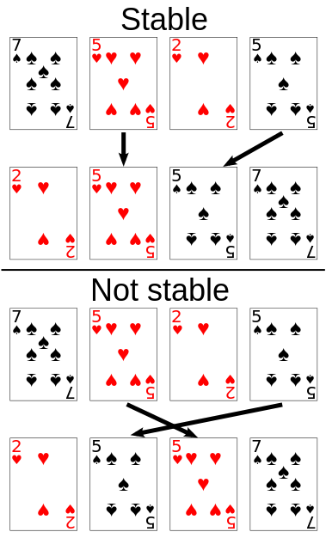
TERMINOLOGIES FOR SORTING
In-place sorting
  Sorting a sequence with O(1) extra space to store intermediate results
Stable sorting
  If the same element is presented multiple time, then they remain the original relative order of positions after sorting
External sorting
  Sorting records not stored in memory
Slow access!
Locality important!
Important for
Multiple-key sorting!

Slide 4
C++ STL Sorting Functions
sort function template
  void sort(iterator begin, iterator end)
  void sort(iterator begin, iterator end, Comparator cmp)
  begin and end are start and end marker of a container (or a range of it)
  Container needs to support random access such as vector
  Sort() is not a stable sorting
    stable_sort() is stable

Slide 5
Animation for Sorting
key value
N distinct keys within [1,N]
before execution during execution after execution
Animation of sorting algorithms
Index
45-degree line after sorting

Slide 6
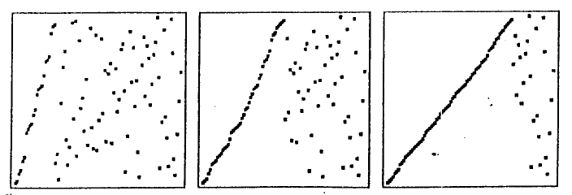
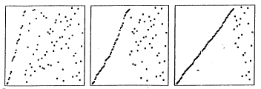
Insertion Sort

Slide 7
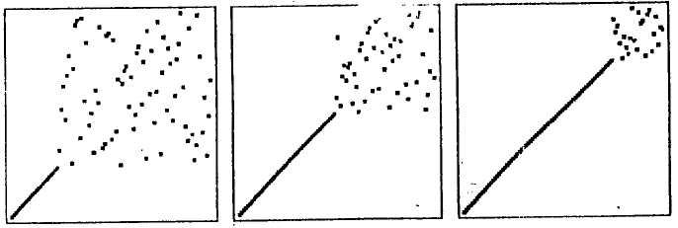
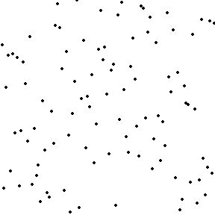
Selection Sort

Slide 8
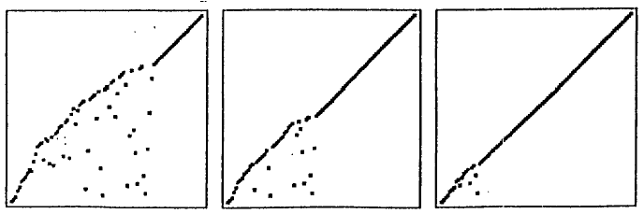
Bubble Sort

Slide 9
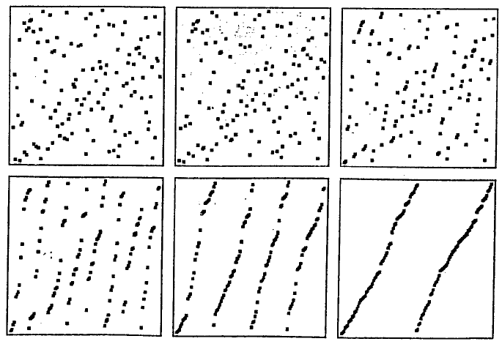
Merge Sort

Slide 10
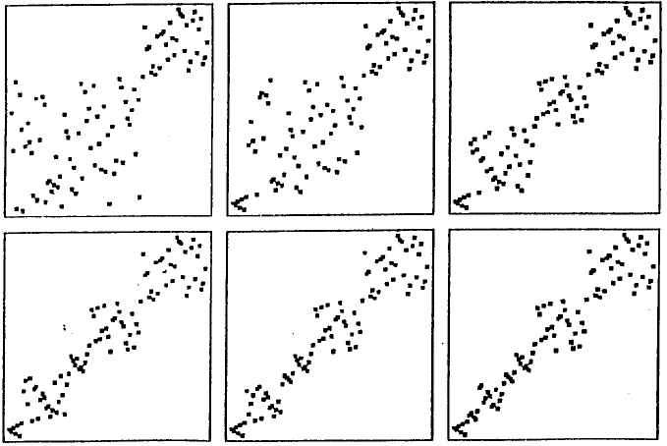
Quicksort

Slide 11
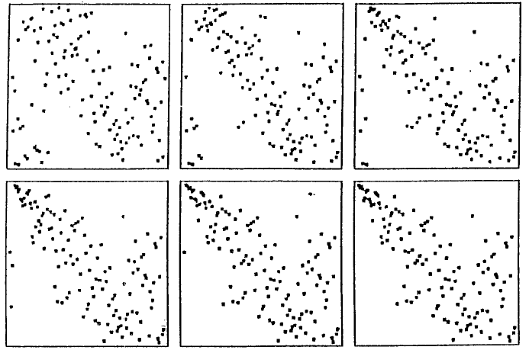
Heap Sort: Heap Construction

Slide 12
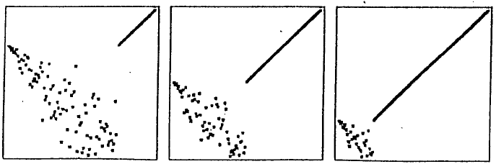
Heap Sort: Sorting Phase

Slide 13
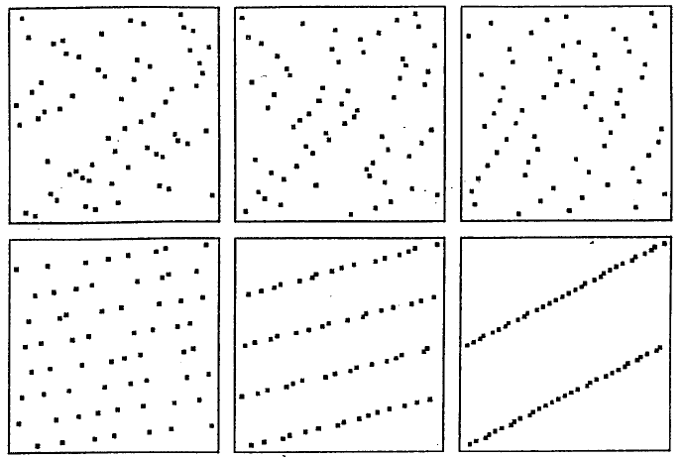
Straight Radix Sort

Slide 14
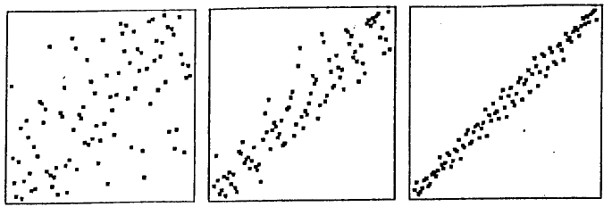
Shell Sort

