Slide 1
Quick-Sort
7 4 9 6 2 → 2 4 6 7 9
4 2 → 2 4
7 9 → 7 9
2 → 2
9 → 9
Quick-Sort
Notes:
Quick-Sort

Slide 2
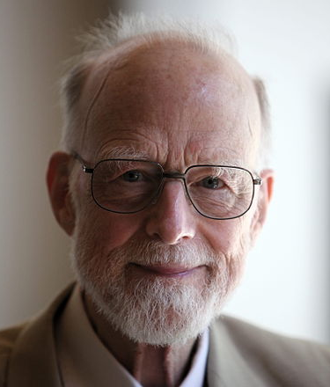
Quick-Sort Inventor
Invented by Hoare in 1962
查爾斯·安東尼·理察·霍爾爵士(Charles Antony Richard Hoare，縮寫為 C. A. R. Hoare，1934年1月11日－ )，生於斯里蘭卡可倫坡，英國計算機科學家，圖靈獎得主。他設計了可快速進行排序程序的快速排序(quick sort)演算法，提出可驗證程式正確性的霍爾邏輯(Hoare logic) 、以及提出可訂定並時程序(concurrent process)的交互作用(如哲學家用餐問題(dining philosophers problem)的交談循序程續(CSP, Communicating Sequential Processes)架構 。 (圖及說明摘自維基百科)
Quick-Sort

Slide 3
About Quick-Sort
Fastest known sorting algorithm in practice
  Caveat: not stable
  In-place, good for internal sorting
Complexity
  Average-case complexity O(n log n)
  Worse-case complexity O(n²)
    Rarely happens if implemented correctly
Under a few assumptions
Quick-Sort

Slide 4
Quick-Sort Example
81
43
31
57
75
13
92
65
26
0
Select pivot
81
43
31
57
75
13
65
26
0
92
<65
>65
Pivot
partition
13
31
57
65
81
43
26
0
92
75
Recursive call
Recursive call
0
13
26
31
43
57
75
81
92
Merge
0
13
26
31
43
57
65
75
81
92

Slide 5
Quick-Sort
Quick-sort is a sorting algorithm based on divide-and-conquer:
  Divide: pick an element x (called pivot) and partition S into
    L elements less than x
    E elements equal x
    G elements greater than x
  Conquer: sort L and G
  Combine: join L, E and G
x
x
L
G
E
x
Key to the success of quicksort:
Select a good pivot
In-place partition

Slide 6
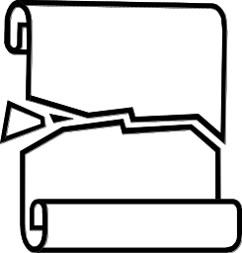
Partition
We partition an input sequence as follows:
  We remove, in turn, each element y from S and
  We insert y into L, E or G, depending on the result of the comparison with the pivot x
Each insertion and removal is at the beginning or at the end of a sequence, and hence takes O(1) time
Thus, the partition step of quick-sort takes O(n) time
Algorithm partition(S, p)
Input sequence S, position p of pivot
Output subsequences L, E, G of the
elements of S less than, equal to,
or greater than the pivot, resp.
L, E, G ← empty sequences
  x ← S.erase(p)
  while ¬S.empty()
  y ← S.eraseFront()
  if y < x
  L.insertBack(y)
  else if y = x
  E.insertBack(y)
  else { y > x }
  G.insertBack(y)
  return L, E, G
Quick-Sort

Slide 7
Quick-Sort Tree
An execution of quick-sort is depicted by a binary tree
  Each node represents a recursive call of quick-sort and stores
    Unsorted sequence before the execution and its pivot
    Sorted sequence at the end of the execution
  The root is the initial call
  The leaves are calls on subsequences of size 0 or 1
7 4 9 6 2 → 2 4 6 7 9
4 2 → 2 4
7 9 → 7 9
2 → 2
9 → 9
Quick-Sort

Slide 8
Execution Example
Pivot selection
7 2 9 4 3 7 6 1 → 1 2 3 4 6 7 8 9
7 2 9 4 → 2 4 7 9
3 8 6 1 → 1 3 8 6
2 → 2
9 4 → 4 9
3 → 3
8 → 8
9 → 9
4 → 4
Quick-Sort

Slide 9
Execution Example (cont.)
Partition, recursive call, pivot selection
7 2 9 4 3 7 6 1 → 1 2 3 4 6 7 8 9
2 4 3 1 → 2 4 7 9
3 8 6 1 → 1 3 8 6
2 → 2
9 4 → 4 9
3 → 3
8 → 8
9 → 9
4 → 4
Quick-Sort

Slide 10
Execution Example (cont.)
Partition, recursive call, base case
7 2 9 4 3 7 6 1 → → 1 2 3 4 6 7 8 9
2 4 3 1 →→ 2 4 7
3 8 6 1 → 1 3 8 6
1 → 1
9 4 → 4 9
3 → 3
8 → 8
9 → 9
4 → 4
Quick-Sort

Slide 11
Execution Example (cont.)
Recursive call, …, base case, join
7 2 9 4 3 7 6 1 → 1 2 3 4 6 7 8 9
2 4 3 1 → 1 2 3 4
3 8 6 1 → 1 3 8 6
1 → 1
4 3 → 3 4
3 → 3
8 → 8
9 → 9
4 → 4
Quick-Sort

Slide 12
Execution Example (cont.)
Recursive call, pivot selection
7 2 9 4 3 7 6 1 → 1 2 3 4 6 7 8 9
2 4 3 1 → 1 2 3 4
7 9 7 1 → 1 3 8 6
1 → 1
4 3 → 3 4
8 → 8
9 → 9
9 → 9
4 → 4
Quick-Sort

Slide 13
Execution Example (cont.)
Partition, …, recursive call, base case
7 2 9 4 3 7 6 1 → 1 2 3 4 6 7 8 9
2 4 3 1 → 1 2 3 4
7 9 7 1 → 1 3 8 6
1 → 1
4 3 → 3 4
8 → 8
9 → 9
9 → 9
4 → 4
Quick-Sort

Slide 14
Execution Example (cont.)
Join
7 2 9 4 3 7 6 1 → 1 2 3 4 6 7 7 9
2 4 3 1 → 1 2 3 4
7 9 7 → 17 7 9
1 → 1
4 3 → 3 4
8 → 8
9 → 9
9 → 9
4 → 4
Quick-Sort

Slide 15
Worst-case Running Time
The worst case for quick-sort occurs when the pivot is the unique minimum or maximum element
One of L and G has size n − 1 and the other has size 0
The running time is proportional to the sum
n + (n − 1) + … + 2 + 1
Thus, the worst-case running time of quick-sort is O(n²)
depth | time
0 | n
1 | n − 1
… | …
n − 1 | 1
…
Quick-Sort

Slide 16
Expected Running Time
Consider a recursive call of quick-sort on a sequence of size s
  Good call: the sizes of L and G are each less than 3s/4
  Bad call: one of L and G has size greater than 3s/4
A call is good with probability 1/2
  1/2 of the possible pivots cause good calls:
7 2 9 4 3 7 6 1 9
7 2 9 4 3 7 6 1
2 4 3 1
7 9 7 1 → 1
1
7 2 9 4 3 7 6
Good call
Bad call
1 2 3 4 5 6 7 8 9 10 11 12 13 14 15 16
Bad pivots
Good pivots
Bad pivots
Quick-Sort

Slide 17
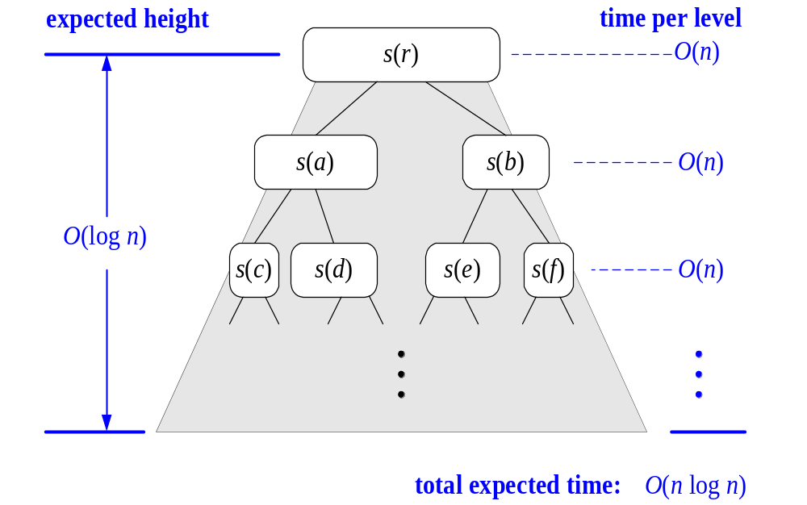
Expected Running Time, Part 2
Probabilistic Fact: The expected number of coin tosses required in order to get k heads is 2k
For a node of depth i, we expect
  i/2 ancestors are good calls
  The size of the input sequence for the current call is at most (3/4)^{i/2}n
Therefore, we have
  For a node of depth 2log_{4/3}n, the expected input size is one
  The expected height of the quick-sort tree is O(log n)
The amount or work done at the nodes of the same depth is O(n)
Thus, the expected running time of quick-sort is O(n log n)
Quick-Sort

Slide 18
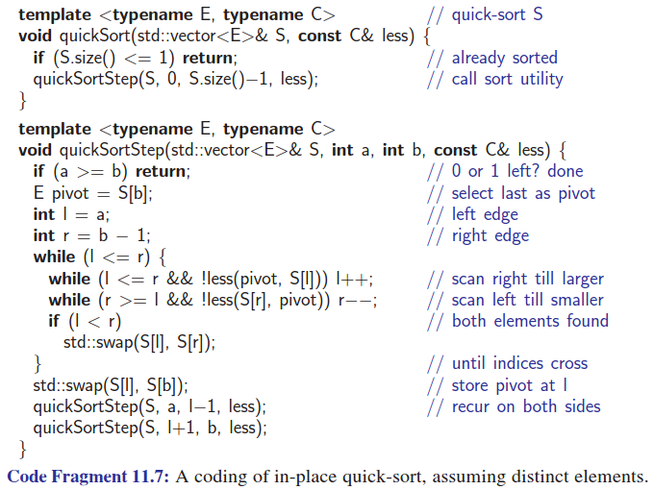
In-Place Quick-Sort

Slide 19
Partitioning Algorithm Illustrated
l
r
pivot
8 1 4 9 0 3 5 2 7 6
Move
l
r
pivot
8 1 4 9 0 3 5 2 7 6
swap
l
r
pivot
2 1 4 9 0 3 5 8 7 6
move
l
r
pivot
2 1 4 9 0 3 5 8 7 6
swap
l
r
pivot
2 1 4 5 0 3 9 8 7 6
l and r
have crossed!
move
r
l
pivot
2 1 4 5 0 3 9 8 7 6
Swap S[i]
with pivot
2 1 4 5 0 3 6 8 7 9
r
l
pivot
Animation

Slide 20
How to Pick the Pivot (1/2)
Strategy 1: Pick the first or the last element
  Works only if the input is random
  O(n²) if input S is sorted or almost sorted
Strategy 2: Pick a random element
  Usually works well
  Extra computation for random number generation
Strategy 3: Perform random permutation of input S first
  Usually works well
Quick-Sort

Slide 21
How to Pick the Pivot (2/2)
Quiz!
Strategy 4: Median of three
  Ideally, the pivot should be the median of input S, which divides the input into two sequences of almost the same length
  However, computing median takes O(n)
  So we find the approximate median via
    Pivot = median of the left-most, right-most, and the center element of the array S
Quick-Sort

Slide 22
Example of Median of Three
Let input S = {6, 1, 2, 9, 0, 3, 5, 2, 7, 8}
  left=0 and S[left] = 6
  right=9 and S[right] = 8
  center = (left+right)/2 = 4 and S[center] = 0
  Pivot = median of {6, 8, 0} = 6
Quick-Sort

Slide 23
Dealing with Small Arrays
For small arrays (say, N ≤ 20),
  Insertion sort is faster than quicksort
Quicksort is recursive
  So it can spend a lot of time sorting small arrays
Hybrid algorithm:
  Switch to using insertion sort when problem size is small (say for N < 20)
Quick-Sort

Slide 24
Summary of Sorting Algorithms
Algorithm | Time | Notes
selection-sort | O(n²) | in-place, unstable slow, for small data sets (< 1K)
insertion-sort bubble-sort | O(n²) | in-place, stable slow, for small data sets (< 1K)
quick-sort | O(n log n) expected | in-place, unstable, randomized fastest (?), for large data sets (1K ~ 1M)
heap-sort | O(n log n) | in-place, unstable fast, for large data sets (1K ~ 1M)
merge-sort | O(n log n) | not in-place, stable fast, for huge data sets (> 1M)
Reference
Quiz!
Random pivot
FB: Why? Can you
make it stable?
Quick-Sort

