Slide 1
Bucket-Sort and Radix-Sort
1, c
3, a
3, b
7, d
7, g
7, e
∅
∅
∅
∅
∅
∅
∅
B
0
1
2
3
4
5
6
7
8
9
Bucket-Sort and Radix-Sort
Notes:
Radish-Sort

Slide 2
Introduction
Comparison-based sorting algorithms ➔ Ω(n log n)
  Quick-sort, heap-sort, merge-sort
Can we do better?
  Yes, if the keys have a restricted type
  Examples: Bucket-sort and radix-sort
  Complexity: Linear!
No comparison needed!
Bucket-Sort and Radix-Sort

Slide 3

Bucket-sort Example
Key range [0, 9]
7, d
1, c
3, a
7, g
3, b
7, e
Phase 1
1, c
3, a
3, b
7, d
7, g
7, e
B
0
1
2
3
4
5
6
7
8
9
∅
∅
∅
∅
∅
∅
∅
Animation of bucker sort
Phase 2
1, c
3, a
3, b
7, d
7, g
7, e
Bucket-Sort and Radix-Sort

Slide 4

Bucket-Sort
Let be S be a sequence of n (key, element) entries with keys in the range [0, N − 1]
Bucket-sort uses the keys as indices into an auxiliary array B of sequences (buckets)
  Phase 1: Empty sequence S by moving each entry (k, o) into its bucket B[k]
  Phase 2: For i = 0, …, N − 1, move the entries of bucket B[i] to the end of sequence S
Analysis:
  Phase 1 takes O(n) time
  Phase 2 takes O(n + N) time
Bucket-sort takes O(n + N) time
Algorithm bucketSort(S, N)
Input sequence S of (key, element)
items with keys in the range
[0, N − 1]
Output sequence S sorted by
increasing keys
B ← array of N empty sequences
  while ¬S.empty()
  (k, o) ← S.front()
  S.eraseFront()
  B[k].insertBack((k, o))
  for i ← 0 to N − 1
  while ¬B[i].empty()
  (k, o) ← B[i].front()
  B[i].eraseFront()
  S.insertBack((k, o))
Bucket-Sort and Radix-Sort
Linear time if N << n

Slide 5
Counting-sort
Characteristics of counting-sort
  A special case of bucket-sort
  Avoid the use of linked list by counting the number of occurrence of each key
Bucket-Sort and Radix-Sort

Slide 6
Count-sort Example
Quiz!
  Input array:
  Count array:
  Position array:
  Output array:
6
0
1
3
2
3
4
2
2
Keys in 0~6
0
1
Use keys as indices
2
3
4
5
6
1
1
3
2
1
0
1
0
1
2
3
4
5
6
0
1
2
5
7
8
8
Cumulative sum
of the count array
Starting positions
0
1
2
3
4
5
6
7
8
0
1
2
2
2
3
3
4
6
Animation of count-sort
Bucket-Sort and Radix-Sort

Slide 7

Properties and Extensions
Key-type Property
  The keys are used as indices into an array and cannot be arbitrary objects
  No external comparator
Stable Sort Property
  The relative order of any two items with the same key is preserved after the execution of the algorithm
Extensions
  Integer keys in the range [a, b]
    Put entry (k, o) into bucket
    B[k − a]
  String keys from a set D of possible strings, where D has constant size (e.g., names of the 50 U.S. states)
    Sort D and compute the rank r(k) of each string k of D in the sorted sequence
    Put entry (k, o) into bucket
    B[r(k)]
You need to convert keys into
buckey array indices.
Bucket-Sort and Radix-Sort

Slide 8

Lexicographic Order
Dictionary order
A d-tuple is a sequence of d keys (k₁, k₂, …, k_{d}), where key k_{i} is said to be the i-th dimension of the tuple
Example:
  The Cartesian coordinates of a point in space are a 3-tuple
The lexicographic order of two d-tuples is recursively defined as follows
(x₁, x₂, …, x_{d}) < (y₁, y₂, …, y_{d})
⇔
x₁ < y₁ ∨ x₁ = y₁ ∧ (x₂, …, x_{d}) < (y₂, …, y_{d})
I.e., the tuples are compared by the first dimension, then by the second dimension, etc.
Bucket-Sort and Radix-Sort

Slide 9
Lexicographic-Sort
Let C_{i} be the comparator that compares two tuples by their i-th dimension
Let stableSort(S, C) be a stable sorting algorithm that uses comparator C
Lexicographic-sort sorts a sequence of d-tuples in lexicographic order by executing d times algorithm stableSort, one per dimension
Lexicographic-sort runs in O(dT(n)) time, where T(n) is the running time of stableSort
Algorithm lexicographicSort(S)
Input sequence S of d-tuples
Output sequence S sorted in
lexicographic order
for i ← d downto 1
  stableSort(S, C_{i})
Another example:
Sort dates
Example:
(7, 4, 6) (5, 1, 5) (2, 4, 6) (2, 1, 4) (3, 2, 4)
(2, 1, 4) (3, 2, 4) (5, 1, 5) (7, 4, 6) (2, 4, 6)
(2, 1, 4) (5, 1, 5) (3, 2, 4) (7, 4, 6) (2, 4, 6)
(2, 1, 4) (2, 4, 6) (3, 2, 4) (5, 1, 5) (7, 4, 6)
Bucket-Sort and Radix-Sort

Slide 10

Radix-Sort
Radix-sort is a specialization of lexicographic-sort that uses bucket-sort as the stable sorting algorithm in each dimension
Radix-sort is applicable to tuples where the keys in each dimension i are integers in the range [0, N − 1]
Radix-sort runs in time O(d(n + N))
Algorithm radixSort(S, N)
Input sequence S of d-tuples such
that (0, …, 0) ≤ (x₁, …, x_{d}) and
(x₁, …, x_{d}) ≤ (N − 1, …, N − 1)
for each tuple (x₁, …, x_{d}) in S
Output sequence S sorted in
lexicographic order
for i ← d downto 1
  bucketSort(S, N)
Animation of radix sort
Bucket-Sort and Radix-Sort

Slide 11

Radix-Sort for Binary Numbers
Consider a sequence of n b-bit integers
x = x_{b − 1} … x₁x₀
We represent each element as a b-tuple of integers in the range [0, 1] and apply radix-sort with N = 2
This application of the radix-sort algorithm runs in O(bn) time
For example, we can sort a sequence of 32-bit integers in linear time
Algorithm binaryRadixSort(S)
Input sequence S of b-bit
integers
Output sequence S sorted
replace each element x
of S with the item (0, x)
for i ← 0 to b − 1
replace the key k of
each item (k, x) of S with bit x_{i} of x
bucketSort(S, 2)
Bucket-Sort and Radix-Sort

Slide 12
Radix-sort Example
Sorting a sequence of 4-bit integers
1001
0010
1001
1001
0001
0010
1110
1101
0001
0010
1101
1001
0001
0010
1001
0001
1101
0010
1101
1101
1110
0001
1110
1110
1110
Bucket-Sort and Radix-Sort

Slide 13
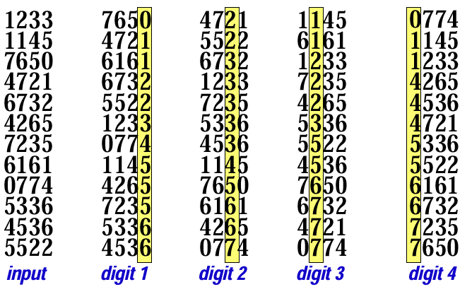
Another Radix-sort Example
Quicksort: O(n log n)
Bucket sort: O(d(n+10))
Quiz!

