Slide 1
Cadence genus
Training lab for bku
May, 2021
NGUYEN XUAN PHUC
FRONTEND DESIGN 1 DEPARTMENT
Renesas DESIGN VIETNAM CO., LTD

Slide 2
AGENDA
PRACTICE WITH LAB 1
PRACTICE WITH LAB 3
SEARCH FOR MAXIMUM OPERATING FREQUENCY OF DESIGN & SUBMISSION DATA

Slide 3
LAB structure

Slide 4
LAB DIRECTORY STRUCTURE (1/2)
To run the lab, it requires 4 below data
RTL DESIGN (*.v)
SYNTHESIS LIBRARY (*.lib)
SYNTHESIS CONSTRAINT
SAMPLE ENVIRONMENT
Please copy Sample Environment Kit from Cadence to your each synthesis working folder
[rvc@localhost ~]$
cd /home/vlsi_group??/${Student_ID}/work/synthesis_env
[rvc@localhost synthesis_env]$
cp -rf /home/share_file/cadence/installs/Genus_CUI_RAK/ ./Genus_BoundFlasher

Slide 5
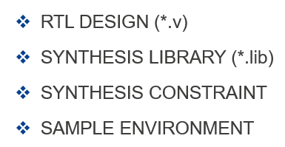
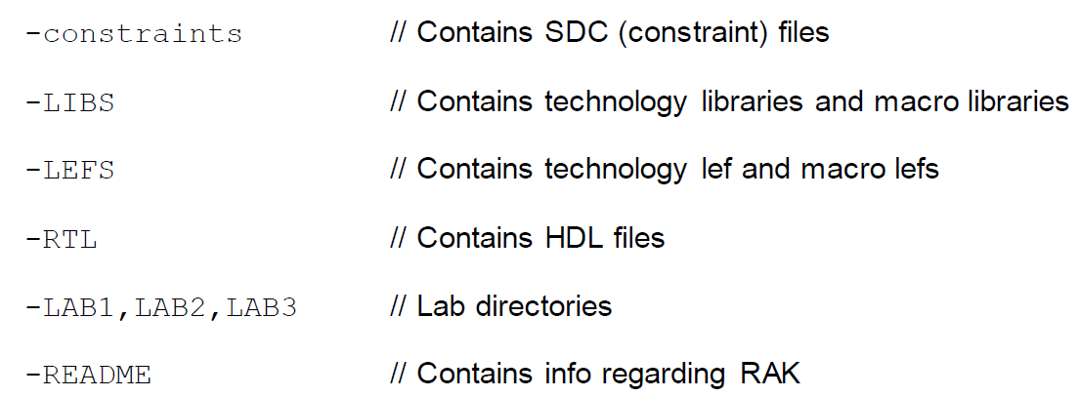
LAB DIRECTORY STRUCTURE (2/2)
[rvc@localhost synthesis_env]$
ls Genus_BoundFlasher
①
③
②
②
③
④
①
④

Slide 6
LAB 1: BASIC GENUS FLOW

Slide 7
LAB1: BASIC GENUS FLOW
Step 1: Prepare your RTL and put to below path ./Genus_BoundFlasher/RTL/
Step 2: Prepare constraints as below at
[rvc@localhost synthesis_env]$
vi ./Genus_BoundFlasher/constraints/bound_flasher_gate.sdc
Design Module Name
bound_flasher_gate.sdc
# Set the current design
current_design bound_flasher
create_clock -name "clk" -add -period 5.0 -waveform {0.0 2.5} [get_ports clk]
set_input_delay -clock [get_clocks clk] -add_delay 2.5 [get_ports flick]
set_input_delay -clock [get_clocks clk] -add_delay 2.5 [get_ports rst_n]
set_output_delay -clock [get_clocks clk] -add_delay 2.5 [get_ports lamp ]
set_max_fanout 15.000 [current_design]
set_max_transition 1.2 [current_design]
Clock Port Name
Inputs / Outputs

Slide 8
LAB1: BASIC GENUS FLOW
Step 3: Modify environment a bit to map current design
[rvc@localhost synthesis_env]$
vi ./Genus_BoundFlasher/LAB1/run.tcl
##############################################################################
## Preset global variables and attributes
##############################################################################
. . .
set DESIGN bound_flasher
####################################################################
## Load Design
####################################################################
read_hdl "bound_flasher.v"
elaborate $DESIGN
. . .
####################################################################
## Constraints Setup
####################################################################
read_sdc ../constraints/bound_flasher_gate.sdc
. . .
#######################################################################################################
## Optimize Netlist
#######################################################################################################
. . .
write_hdl > ${_OUTPUTS_PATH}/${DESIGN}_m.v
#################################
### write_do_lec
#################################
quit
Design Module Name
RTL File Name
Constraint File Name
NETLIST File (Important)
Quit at end

Slide 9
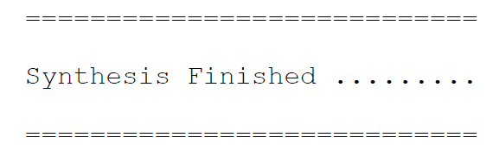
LAB1: BASIC GENUS FLOW
Step 4: Source Genus & license files. Then, execute Synthesis
The following message will show in the Genus session when synthesis is done:
[rvc@localhost synthesis_env]$ cd /home/share_file/cadence [rvc@localhost cadence]$ source add_path [rvc@localhost cadence]$ source add_license
[rvc@localhost cadence]$ cd -
[rvc@localhost synthesis_env]$ cd ./LAB1/
Genus_BoundFlasher
[rvc@localhost LAB1]$ genus -f run.tcl | tee -i sync.log

Slide 10
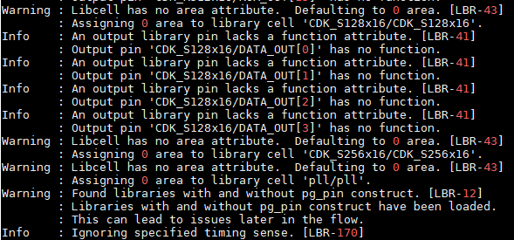
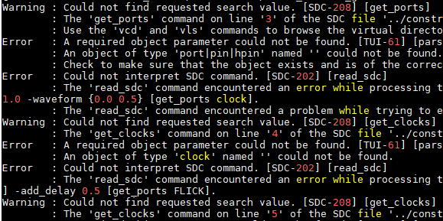
LAB1: BASIC GENUS FLOW
Step 5: Check synthesis Log file to confirm no “Error” occur
If it occurs “Error”, you need to resolved all Error before go to next step.
[rvc@localhost LAB1]$ vi sync.log
OK
NG

Slide 11
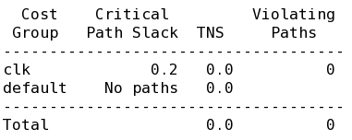
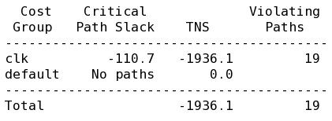
LAB1: BASIC GENUS FLOW
Step 6: Check Synthesis Report
[rvc@localhost synthesis_env]$ cd ./LAB1/
[rvc@localhost LAB1]$ vi reports??/final_area.rpt //Check Design Area
[rvc@localhost LAB1]$ vi reports??/final_qor.rpt //Check QoR Information
[rvc@localhost LAB1]$ vi reports??/final_time.rpt //Check Detail Timing Path
Critical Path Slack (CPS)(unit:ps) >= 0 proves QUALIFIED NETLIST
OK
NG

Slide 12
LAB1: BASIC GENUS FLOW
Step 7: Prepare script to load NETLIST
[rvc@localhost LAB1]$ vi gui.tcl //Create new file
Design Module Name
set DESIGN bound_flasher
###############################################################
## Library setup
###############################################################
read_libs "../LIB/slow.lib ../LIB/pll.lib ../LIB/CDK_S128x16.lib ../LIB/CDK_S256x16.lib ../LIB/CDK_R512x16.lib "
read_physical -lef " ../LEF/gsclib045_tech.lef ../LEF/gsclib045_macro.lef ../LEF/pll.lef ../LEF/CDK_S128x16.lef ../LEF/CDK_S256x16.lef ../LEF/CDK_R512x16.lef "
####################################################################
## Load Design
####################################################################
read_hdl "./outputs/bound_flasher_m.v"
elaborate $DESIGN
gui.tcl
Suppose that NETLIST is stored at LAB1/outputs/bound_flasher_m.v

Slide 13
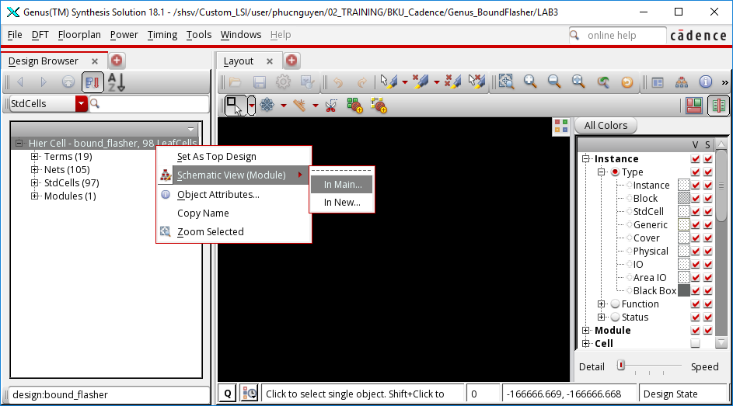
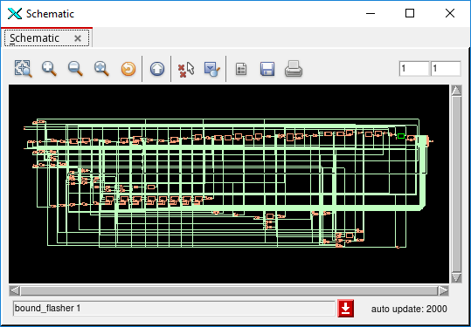
LAB1: BASIC GENUS FLOW
Step 8: Invoke NETLIST Schematic Window
[rvc@localhost LAB1]$ genus -f gui.tcl -gui //Open Genus GUI and load NETLIST
Righ Click

Slide 14
LAB 3: LOW-POWER SYNTHESIS

Slide 15
LAB3: running low-power synthesis
Step 1: Prepare your RTL and put to below path ./Genus_BoundFlasher/RTL/
Step 2: Prepare constraints as below at
[rvc@localhost synthesis_env]$
vi ./Genus_BoundFlasher/constraints/bound_flasher_gate.sdc
Design Module Name
bound_flasher_gate.sdc
# Set the current design
current_design bound_flasher
create_clock -name "clk" -add -period 5.0 -waveform {0.0 2.5} [get_ports clk]
set_input_delay -clock [get_clocks clk] -add_delay 2.5 [get_ports flick]
set_input_delay -clock [get_clocks clk] -add_delay 2.5 [get_ports rst_n]
set_output_delay -clock [get_clocks clk] -add_delay 2.5 [get_ports lamp ]
set_max_fanout 15.000 [current_design]
set_max_transition 1.2 [current_design]
Clock Port Name
Inputs / Outputs

Slide 16
LAB3: running low-power synthesis
Step 3: Modify environment a bit to map current design
[rvc@localhost synthesis_env]$
vi ./Genus_BoundFlasher/LAB3/run.tcl
##############################################################################
## Preset global variables and attributes
##############################################################################
. . .
set DESIGN bound_flasher
####################################################################
## Load Design
####################################################################
read_hdl "bound_flasher.v"
elaborate $DESIGN
. . .
####################################################################
## Constraints Setup
####################################################################
read_sdc ../constraints/bound_flasher_gate.sdc
. . .
#######################################################################################################
## Optimize Netlist
#######################################################################################################
. . .
write_hdl > ${_OUTPUTS_PATH}/${DESIGN}_m.v
#################################
### write_do_lec
#################################
quit
Design Module Name
RTL File Name
Constraint File Name
NETLIST File (Important)
Quit at end

Slide 17
LAB3: running low-power synthesis
Step 4: Setting Power Optimization Attributes
Low-power synthesis is included as part of the synthesis process.
###############################################################
## Library setup
###############################################################
set_db / .lp_insert_clock_gating true
set_db / .leakage_power_effort medium
#######################################################################################
## Leakage/Dynamic power/Clock Gating setup.
#######################################################################################
#set_db "design:$DESIGN" .lp_clock_gating_cell [vfind /lib* -lib_cell <cg_libcell_name>]
set_db "design:$DESIGN" .max_leakage_power 0.0
set_db "design:$DESIGN" .lp_power_optimization_weight 0.5 ;#<value from 0 to 1>
set_db "design:$DESIGN" .max_dynamic_power 100
Enable Clock-Gating features. It must be enable before ELABORATE command
Set the leakage power optimization effort
Specify the optimization weight for dynamic power versus leakage power.
Set the maximum dynamic power attribute

Slide 18
LAB3: running low-power synthesis
Step 5: Source Genus & license files. Then, execute Synthesis
The following message will show in the Genus session when synthesis is done:
[rvc@localhost synthesis_env]$ cd /home/share_file/cadence [rvc@localhost cadence]$ source add_path [rvc@localhost cadence]$ source add_license
[rvc@localhost cadence]$ cd -
[rvc@localhost synthesis_env]$ cd ./LAB3/
[rvc@localhost LAB3]$ genus -f run.tcl | tee -i sync.log

Slide 19
LAB3: running low-power synthesis
Step 6: Check synthesis Log file to confirm no “Error” occur
If it occurs “Error”, you need to resolved all Error before go to next step.
[rvc@localhost LAB3]$ vi sync.log
OK
NG

Slide 20
LAB3: running low-power synthesis
Step 7: Check Synthesis Report (AS LAB 1)
[rvc@localhost synthesis_env]$ cd ./LAB3/
[rvc@localhost LAB3]$ vi reports??/final_area.rpt //Check Design Area
[rvc@localhost LAB3]$ vi reports??/final_qor.rpt //Check QoR Information
[rvc@localhost LAB3]$ vi reports??/final_time.rpt //Check Detail Timing Path
Critical Path Slack (CPS)(unit:ps) >= 0 proves QUALIFIED NETLIST
OK
NG

Slide 21
LAB3: running low-power synthesis
Step 8: Prepare script to load NETLIST
[rvc@localhost LAB3]$ vi gui.tcl //Create new file
Design Module Name
set DESIGN bound_flasher
###############################################################
## Library setup
###############################################################
read_libs "../LIB/slow.lib ../LIB/pll.lib ../LIB/CDK_S128x16.lib ../LIB/CDK_S256x16.lib ../LIB/CDK_R512x16.lib "
read_physical -lef " ../LEF/gsclib045_tech.lef ../LEF/gsclib045_macro.lef ../LEF/pll.lef ../LEF/CDK_S128x16.lef ../LEF/CDK_S256x16.lef ../LEF/CDK_R512x16.lef "
####################################################################
## Load Design
####################################################################
read_hdl "./outputs/bound_flasher_m.v"
elaborate $DESIGN
gui.tcl
Suppose that NETLIST is stored at LAB3/outputs/bound_flasher_m.v

Slide 22
LAB3: running low-power synthesis
Step 9: Invoke NETLIST Schematic Window
[rvc@localhost LAB3]$ genus -f gui.tcl -gui //Open Genus GUI and load NETLIST
Righ Click

Slide 23
Search maximum design frequency &
SUBMISSION DATA

Slide 24
Search maximum design frequency
Please re-use LAB1 and change Design Frequency until MAX while Critical Path Slave >= 0
Change Design Constraints and re-run Synthesis as LAB1
[rvc@localhost synthesis_env]$
vi ./Genus_BoundFlasher/constraints/bound_flasher_gate.sdc
Change Design Clock Period (ns)
Change so that Duty Cycle = 50%
bound_flasher_gate.sdc
# Set the current design
current_design bound_flasher
create_clock -name "clk" -add -period 5.0 -waveform {0.0 2.5} [get_ports clk]
set_input_delay -clock [get_clocks clk] -add_delay 2.5 [get_ports flick]
set_input_delay -clock [get_clocks clk] -add_delay 2.5 [get_ports rst_n]
set_output_delay -clock [get_clocks clk] -add_delay 2.5 [get_ports lamp ]
set_max_fanout 15.000 [current_design]
set_max_transition 1.2 [current_design]
Inputs / Outputs
Change so that it is 50% of Design Clock Period (ns)

Slide 25
Submission data
After re-synthesize with Maximum frequency, please submit below data: (Note that LAB1 & LAB3 just for practice, no need to submit any data related to them)
Netlist: outputs??/${DESIGN}_m.v (Ex: bound_flasher_m.v)
Area report: reports??/final_area.rpt
QoR report: reports??/final_qor.rpt
Timing report: reports??/final_time.rpt

Slide 26
Renesas.com

