Slide 1


AI Project
Nguyễn Tùng Lương - 20214913
Nguyễn Minh Phương - 20214924
Nguyễn Quy Ngọc - 20214920
Nguyễn Tiến Doanh - 20214881

Slide 2
TABLE OF CONTENTS
01
02
03
04
Problem
Solution
Description
Presentation
Uniform Cost Search
A* search
Analysis
Conclusion
Time comparison
Comment
Ideas of improvement

Slide 3
01
Problem

Slide 4
Problem
I.Description
Similar the route planning, the intelligent vehicle can only travel between 2 adjacent cities, and also additional time if it goes at peak hour. The objective is to minimize the distance between the two cities.
2.Presentation
Initial problem | Find a way to travel between two different cities
Goal | The minimum distance needed to travel
Input | The starting city, the goal city, and the time start
Output | The distance cost (in km) of traveling or 0 if cannot find a way
Practical application

Slide 5
02
Solution

Slide 6
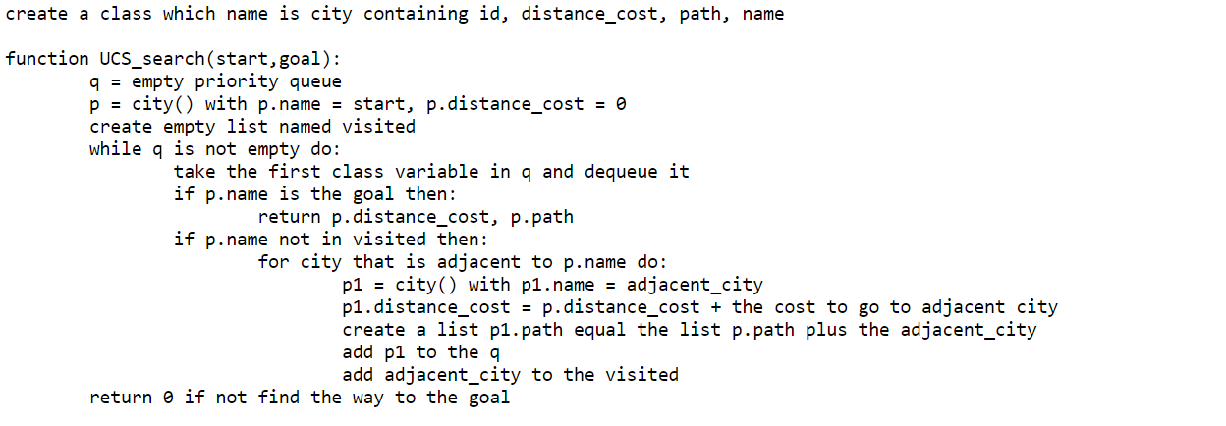
Solution
Uniform cost search

Slide 7
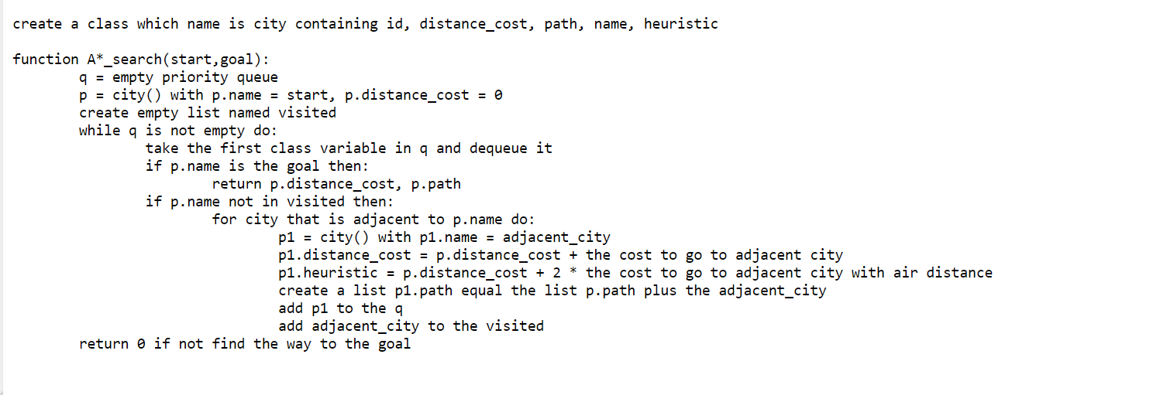
Solution
A* Search

Slide 8
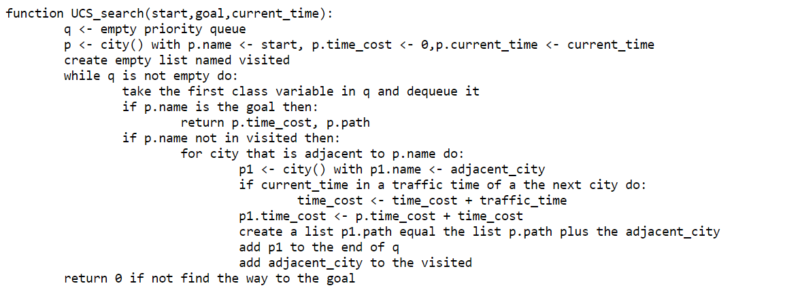
Solution
Uniform cost search with time

Slide 9
03
Analysis

Slide 10
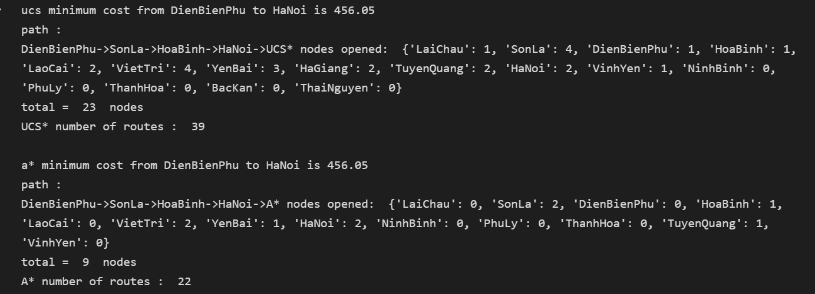
Analysis

Slide 11
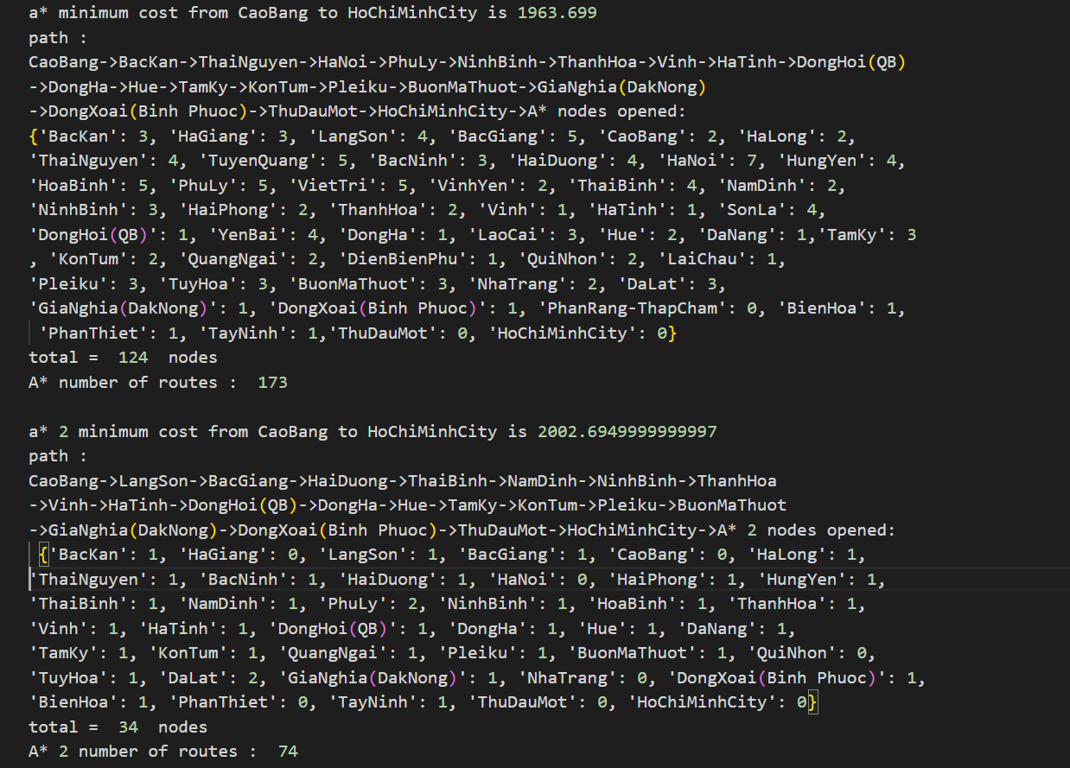
Analysis

Slide 12
Analysis
 | Uniform cost search | A* search | A* search with heuristic*2
Optimal solution | Yes | Yes | No
Time running | 3rd | 2nd | 1st
Memory usage | 3rd | 2nd | 1st

Slide 13
04
Conclusion

Slide 14
Comment
Although the time complexity of the two algorithms is O(n²), the n is constant so we can use matrix input here
The heuristic is not as far as good. It can cause unexpected solution that not optimal.
Improve the important of heuristic can reduce a lot of the running time but also may not give optimal solution.
Must find the adjacent city by hand there for it costs a quite long time.
The A* and UCS can give optimal results in all starting and goal cities because the Vietnam city map is not too complex and also central Vietnam is at most two adjacent cities (not including the previous city) for each city in here which are much more simple for the algorithms.

Slide 15
Ideas of improvement
Try to predict the traffic time by google support and machine learning instead of giving it a certain time. In the future, a better prediction algorithm will give a more accurate time cost.
Using a tree as input data rather than a matrix for less complicated and reduces the unnecessary loop. The space cost for data input will be less than the matrix and more efficient.
Add the borderline between cities and some specific places in each city as the starting or destination point to achieve higher accuracy instead of just traveling from city to city.
It’s possible to input and train a module to improve the heuristic as it can be both better at time cost and still give optimal solution.

Slide 16
—SOMEONE FAMOUS
“This is a quote, words full of wisdom that someone important said and can make the reader get inspired.”

Slide 17
THANKS!
DO YOU HAVE ANY QUESTIONS?
addyouremail@freepik.com
+91 620 421 838
yourwebsite.com
Please keep this slide as attribution

