Slide 1


AI Project
Nguyễn Tùng Lương - 20214913
Nguyễn Minh Phương - 20214924
Nguyễn Quy Ngọc - 20214920
Nguyễn Tiến Doanh - 20214881

Slide 2
TABLE OF CONTENTS
01
02
03
04
Problem
Solution
Description
Presentation
Uniform Cost Search
A* search
Analysis
Conclusion
Time comparison
Comment
Ideas of improvement

Slide 3
01
Problem

Slide 4
Problem
I.Description
Similar the route planning, the intelligent vehicle can only travel between 2 adjacent cities, and also additional time if it goes at peak hour. The objective is to minimize the distance between the two cities.
2.Presentation
Initial problem | Find a way to travel between two different cities
Goal | The minimum distance needed to travel
Input | The starting city, the goal city, and the time start
Output | The distance cost (in km) of traveling or 0 if cannot find a way
Practical application

Slide 5
02
Solution

Slide 6
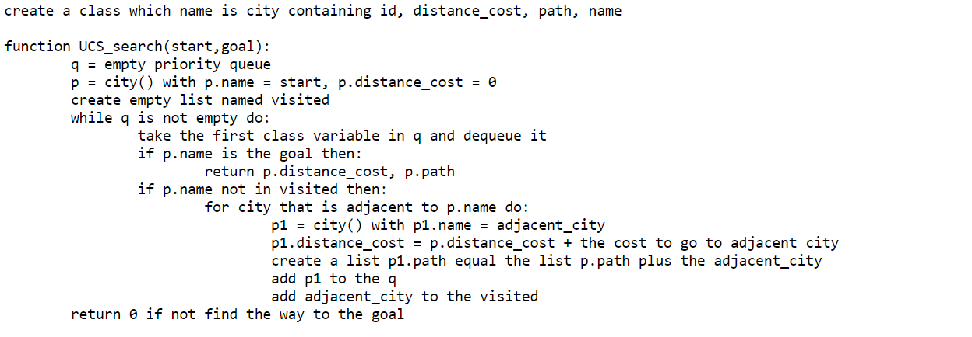
Solution
Uniform cost search

Slide 7
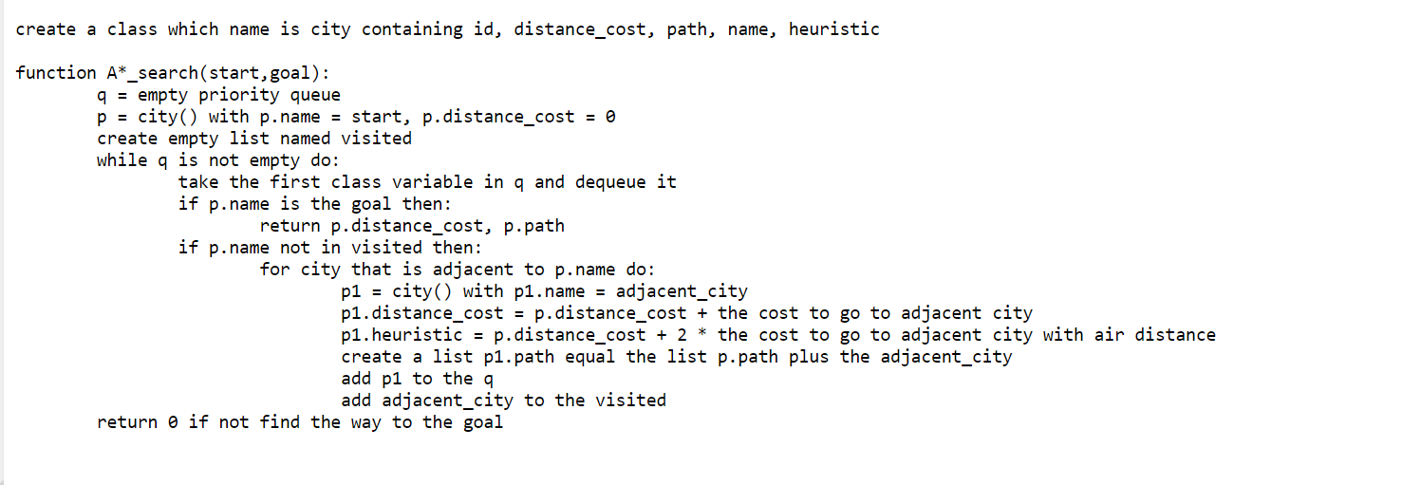
Solution
A* Search

Slide 8
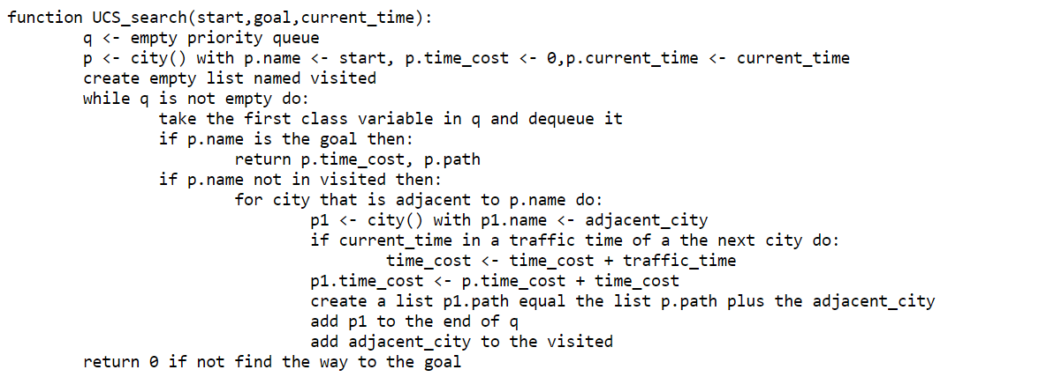
Solution
Uniform cost search with time

Slide 9
03
Analysis

Slide 10
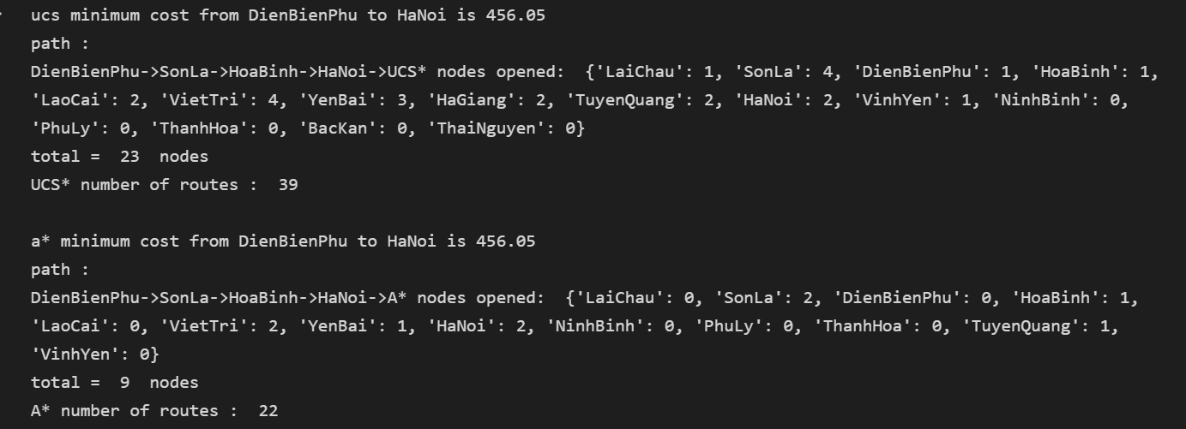
Analysis

Slide 11
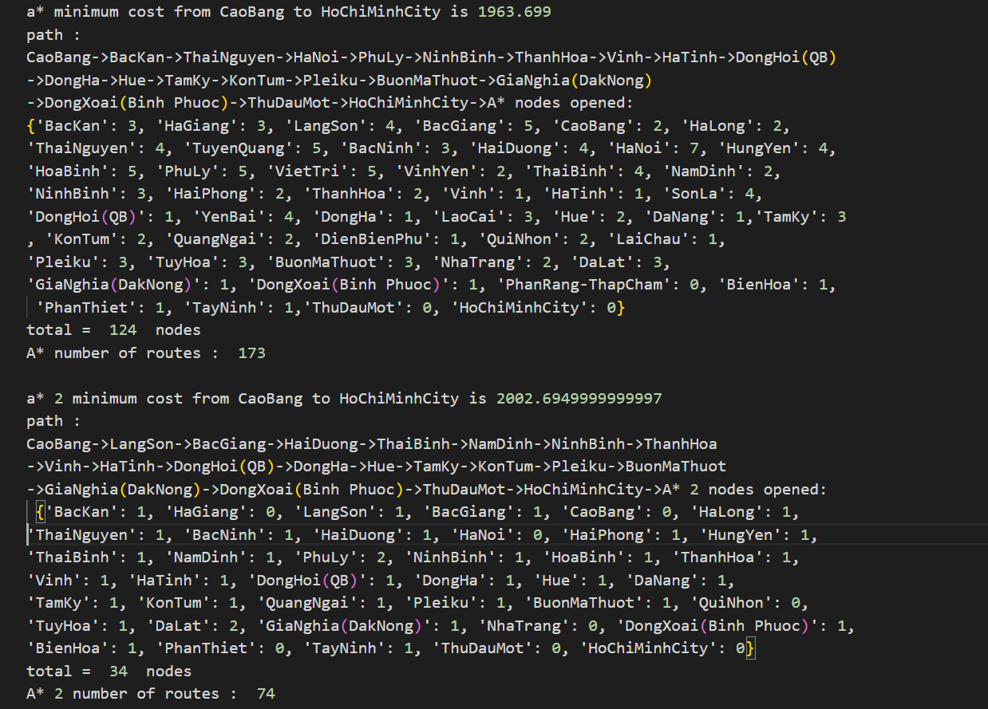
Analysis

Slide 12
Analysis
 | Uniform cost search | A* search | A* search with heuristic*2
Optimal solution | Yes | Yes | No
Time running | 3rd | 2nd | 1st
Memory usage | 3rd | 2nd | 1st

Slide 13
04
Conclusion

Slide 14
Comment
Say st

Slide 15
Ideas of improvement
Say st

Slide 16
—SOMEONE FAMOUS
“This is a quote, words full of wisdom that someone important said and can make the reader get inspired.”

Slide 17
THANKS!
DO YOU HAVE ANY QUESTIONS?
addyouremail@freepik.com
+91 620 421 838
yourwebsite.com
Please keep this slide as attribution

