Slide 1



SPRING HIBERNATE STRUTS2

Slide 2
hello!
I am PhongNT9
Project Tenchnical Leader at FSU2.BU6

Slide 3
1.
SPRING
Day 1
Spring Framework Introduction
Getting Started with Spring
Day 2
Spring IoC – Dependencies Injection
Spring AOP
Spring common annotations
Day 3
Spring Web MVC
Day 4
Spring Security
Spring Form

Slide 4
SPRING FRAMEWORK INTRODUCTION
What exactly Spring offers?
Reasons for Spring’s popularity in Java world?

Slide 5


Slide 6

Roderick B. Johnson
is an Australian computer specialist who created the Spring Framework and co-founded SpringSource

Slide 7
2002
2003
2004
current

Slide 8

first version
publication in book Expert One-on-One J2EE Design and Development in October 2002

Slide 9

first released
The framework was first released under the Apache 2.0 license in June 2003

Slide 10

first milestone released
Version 1.0 was released in March 2004, with further milestone releases in September 2004 and March 2005.

Slide 11

lasted version
The lasted version in current (2017) is 5.0.2 (5.0.3-snapshot)
Last updated in 2017-11-27

Slide 12
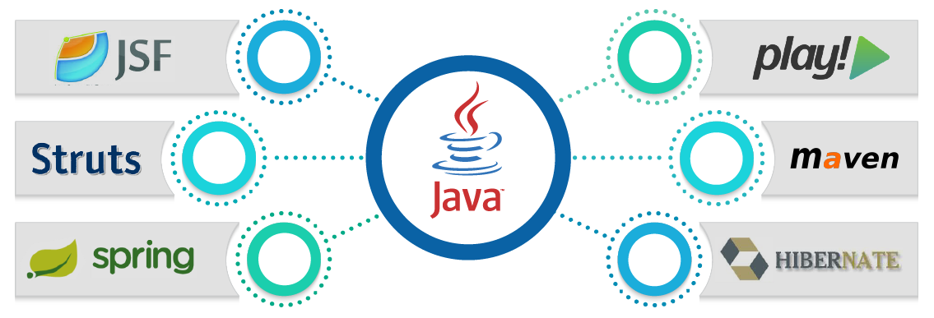
It is…
an application development framework for the Java platform

Slide 13

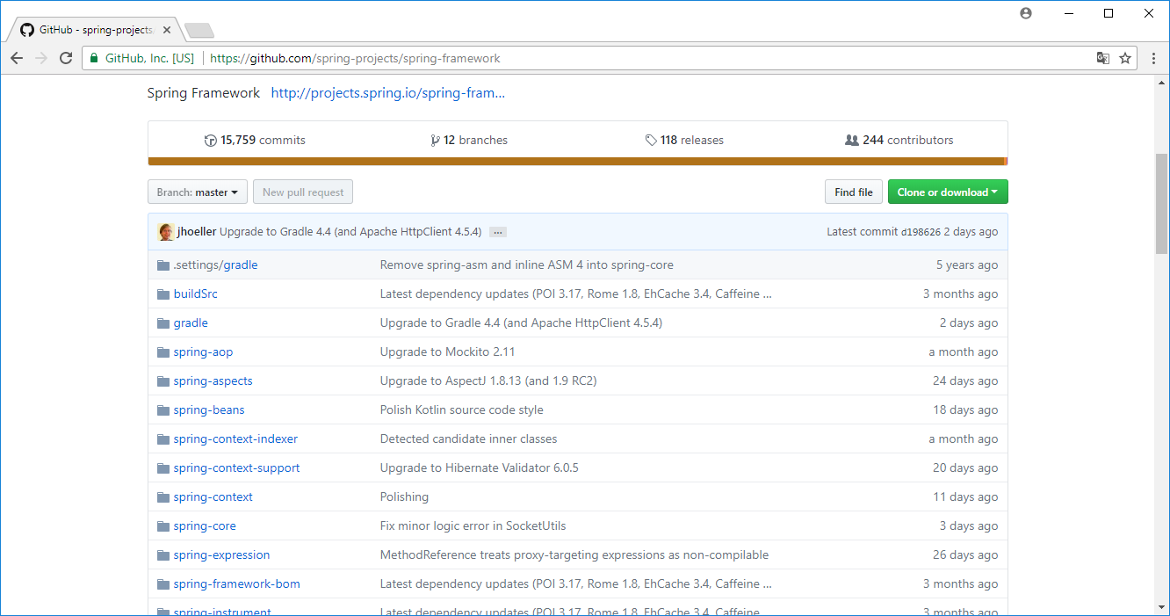
It is…
an open source project
https://github.com/spring-projects/spring-framework

Slide 14
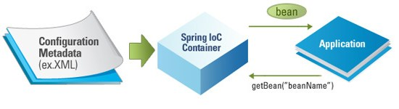
It is…
an Inversion of Control container for Java platform

Slide 15
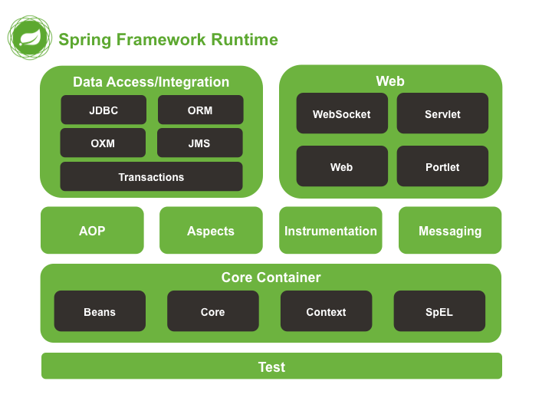
It is…
a complete and a modular framework

Slide 16



Slide 17
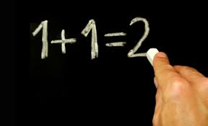
simplicity
because its non-invasive as it uses POJO and POJI models

Slide 18
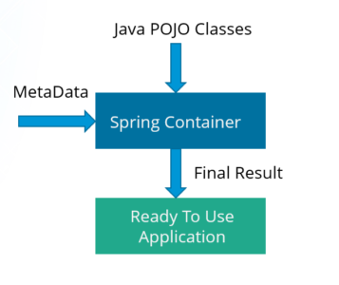
testability
for writing the Spring application, server is not mandatory

Slide 19
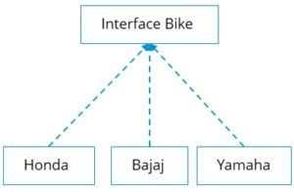
loose coupling
it has concepts like Dependency Injection, help in reducing dependency and increasing the modularity within the code
public interface Bike {
public void start();
}
public class Rider {
Bike b;
public void setBike(Bike b) {
this.b = b;
}
void ride() {
b.start();
}
}

Slide 20
GEETING STARTED WITH SPRING
Preparing Environment
Hello World with Spring

Slide 21




preparing environment
http://www.oracle.com/technetwork/java/javase/downloads
http://repo.spring.io/release/org/springframework/spring
http://www.eclipse.org/downloads
https://maven.apache.org/download.cgi
https://tomcat.apache.org/download.cgi

Slide 22
hello world with spring
【01DemoHelloSpring】: is Without Maven project
【02DemoHelloSpringWithMaven】: is With Maven project

Slide 23
Day 1 - Problems
① Finished task [preparing environment]
② Creating project [HelloSpringWithMaven]
③ Research & Report about [Modules in Spring Framework]
Core Container
Beans
Core
Context
Data Access
JDBC
ORM

Slide 24
1.
SPRING
Day 1
Spring Framework Introduction
Getting Started with Spring
Day 2
Spring IoC – Dependencies Injection
Spring AOP
Spring common annotations
Day 3
Spring Web MVC
Day 4
Spring Security
Spring Form

Slide 25
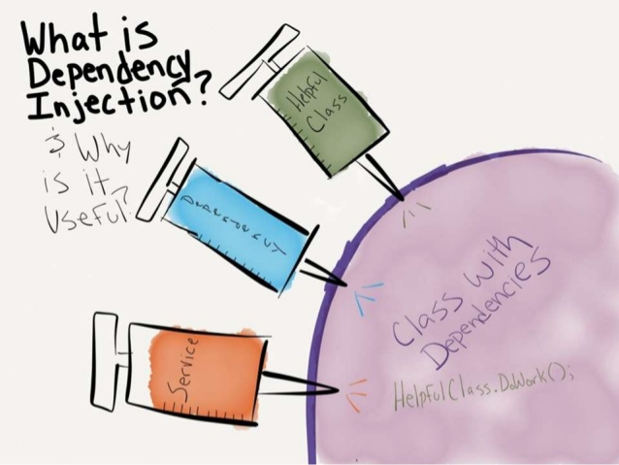
Spring IoC – Dependency Injection
Do not create or instantate an object inside another Java class.
Instead, rely on Spring’s IoC module to create the object for you.

Slide 26
what is dependency ?
public class ClassA {
public void methodA() {
ClassB objectB = new ClassB();
}
}
Class A is complete dependent on Class B
Modifications in Class B ⇒ may force you to modify Class A as well
Replacing Class B with a new Class C ⇒ will force you to modify Class A also

Slide 27
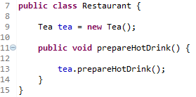
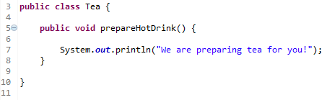
problem if you do not use it
Problem 1
Modifying Tea class say Parametering its constructor ⇒ will force you to modify Restaurent class at Line 9

Slide 28
problem if you do not use it
Problem 2
Replacing Tea class with another class ⇒ will force you to modify Restaurent class at Line 9 and 13

Slide 29
problem if you do not use it
Problem 3
You can not test Restaurant class without including Tea class

Slide 30
what is dependency injection ?
NEVER create an object inside another class by using a NEW operator
public class ClassA {
public void methodA() {
ClassB objectB = new ClassB();
}
}

Slide 31

How to use it ?

Slide 32
How to use it ?
Outsource the task of handling all dependencies of an object to an expert (some third party program)

Slide 33
How to use it ?
When the Restaurant object is created,
the Tea object will be created and provided to it from outside by some third party program
👆 In order to do this, you need an interface

Slide 34
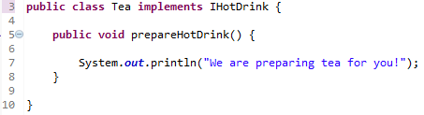

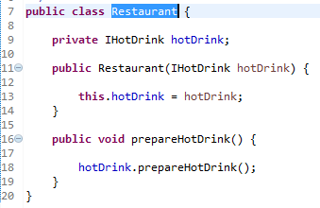
How to use it ?
The inteface will BIND the Restaurant and Tea class

Slide 35
How to use it ?
Spring framework provides 2 ways of DI:
① Using CONSTRUCTOR
② Using SETTER method

Slide 36

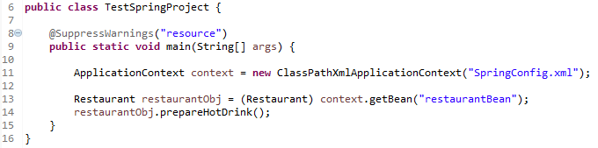
How to use it ?
① Using CONSTRUCTOR

Slide 37
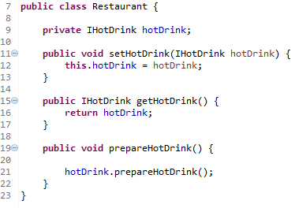

How to use it ?
② Using SETTER method

Slide 38
Day 2 - Problems
① Implement [Assignment.xlsx]
② Research & Report about [Spring AOP]
③ Research & Report about [Spring common annotations]

Slide 39
1.
SPRING
Day 1
Spring Framework Introduction
Getting Started with Spring
Day 2
Spring IoC – Dependencies Injection
Spring AOP
Spring common annotations
Day 3
Spring Web MVC
Day 4
Spring Security
Spring Form

Slide 40
Spring Web MVC

Slide 41
Spring Web MVC
What is MVC Framework?
What is Spring Web MVC Framework?

Slide 42
MVC FRAMEWORK
Model View Controller
architecture - a guideline which says how you should write a code for developing an application having a UI ( User Interface)

Slide 43
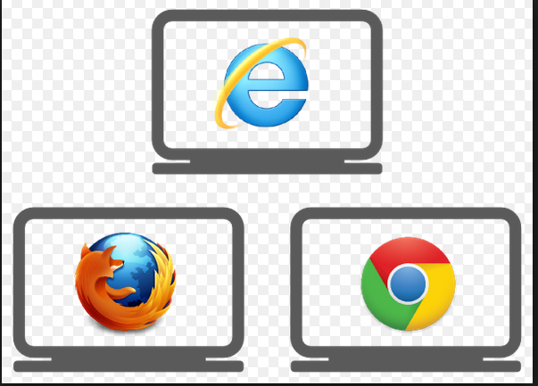
MVC FRAMEWORK
Web app developed using SERVLET technology
Web server
SERVLET
Web client
client requests for web page
the request is mapped to a particular servlet
( based on the url )
SERVLET
sends back the generated response
( html and data to the client’s browse)
the servlet processes the request
SERVLET
Notes:
HTML code embedded into Java code

Slide 44
MVC FRAMEWORK
Web app developed using JSP (JavaServer Pages) technology
Web server
JSP Page
Web client
client requests for web page
the request is mapped to a particular JSP
( based on the url )
JSP Page
sends back the generated response
( html and data to the client’s browse)
the JSP processes the request
JSP Page
Notes:
Java code embedded into HTML code

Slide 45
MVC FRAMEWORK
Problem…?
A typical JSP page or a Servlet which developers write would have two things or responsibilities mixed together:
① code which actually renders UI on the screen (ex: html code)
② code which executes some logic in order to provide data which is to be displayed on the UI

Slide 46
MVC FRAMEWORK
Problem…?
UI developer and Business logic developer difficult to work independently as both resides in the same file and as a result it takes more time to develop/maintenance

Slide 47
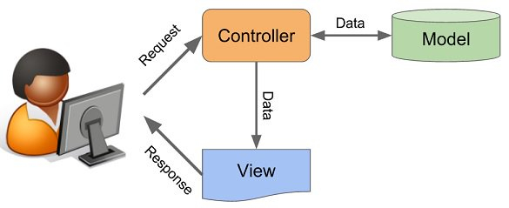
MVC FRAMEWORK
MVC says we can overcome all such problems
Controller
Bussiness Service
Model
View

Slide 48
MVC FRAMEWORK
MVC says we can overcome all such problems
Model
Represents data
Is typically a Java Object having some properties along with getters and setters method
Business services are also the Java Objects having some Business logic to produce a model object

Slide 49
MVC FRAMEWORK
MVC says we can overcome all such problems
View
Represents UI part
Is html code displaying data by retrieving it from the model object

Slide 50
MVC FRAMEWORK
MVC says we can overcome all such problems
Controller
Manages the application flow, makes a call to some sort of service producing MODEL and then passes on the model to VIEW

Slide 51
SPRING WEB MVC
Is a Web application development framework
Built on the Servlet API
Included in the Spring Framework

Slide 52
SPRING WEB MVC
Web server
Handler
Mapping
It will scan url and tells the extract address which can
generate data for this web page request
It prepares data, creates Java object to hold this data
Web client
1
Is called as a Dispatcher Servlet
2
Front
Controller
Data
Generator
Java Object
4
3
Final Response Builder
View
Resolver
Bussiness Service
Notes:
HTML code embedded into Java code

Slide 53
SPRING WEB MVC
Web server
Handler
Mapping
Web client
Front
Controller
Controller
Model
View
View
Resolver
Bussiness Service
Notes:
HTML code embedded into Java code

Slide 54
SPRING WEB MVC
Demo [07DemoHelloSpringWebMVC]

Slide 55
SPRING WEB MVC
① Create FontController/DispatcherServlet by:
Modify「web.xml」
Create「spring-dispatcher-servlet.xml」
② Create a Controller「HelloController.java」
③ Create a View「HelloPage.jsp」

Slide 56
Day 3 - Problems
① Step by step create Maven Project for SpringWebMVC
② Planning for [assignment]: HieuNH, PhuNPV, AnhNQ, HuyLM

Slide 57
thanks!
Any questions?

Slide 58
SlidesCarnival icons are editable shapes.
This means that you can:
Resize them without losing quality.
Change fill color and opacity.
Isn’t that nice? :)
Examples:

Slide 59
Extra graphics

