Slide 1
Lecture 2
Hadoop & HDFS
Core concepts, architecture, commands, and practice
Distributed storage
Replication & fault tolerance
NameNode / DataNode
Read / write paths
Big Data • Lecture 2: Hadoop / HDFS
1

Slide 2
Learning outcomes
After this lecture, students should be able to explain core Hadoop and HDFS concepts and apply basic HDFS commands.
Core coverage
Explain why Hadoop uses distributed storage and large block-based files.
Differentiate NameNode, DataNode, Secondary NameNode, Backup Node, Standby NameNode, and YARN daemons.
Trace HDFS read/write mechanisms and the role of metadata, blocks, replication, and data locality.
Use basic HDFS shell commands such as copyFromLocal and understand common design trade-offs.
Hadoop definition and origin
HDFS architecture
Metadata, FsImage and EditLogs
Replication factor and redundancy
Data locality and block size
HDFS shell and commands
Big Data • Lecture 2: Hadoop / HDFS
2

Slide 3
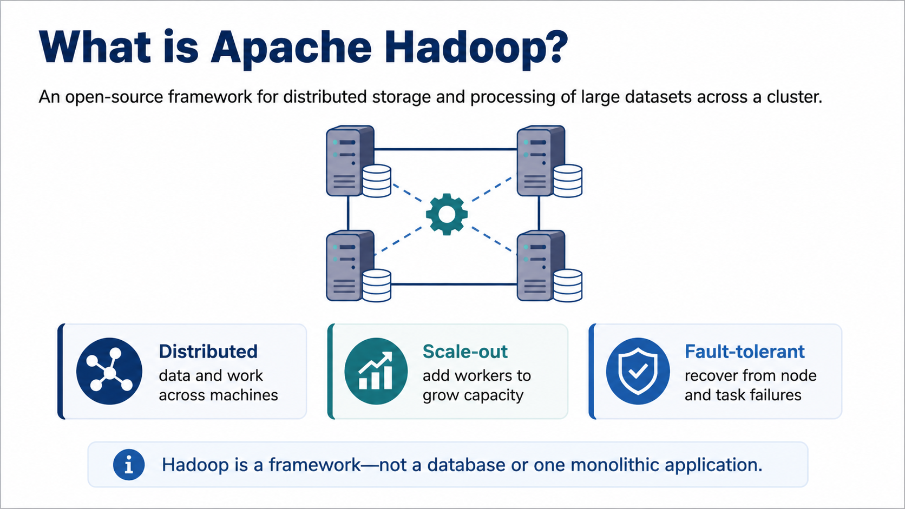

Slide 4
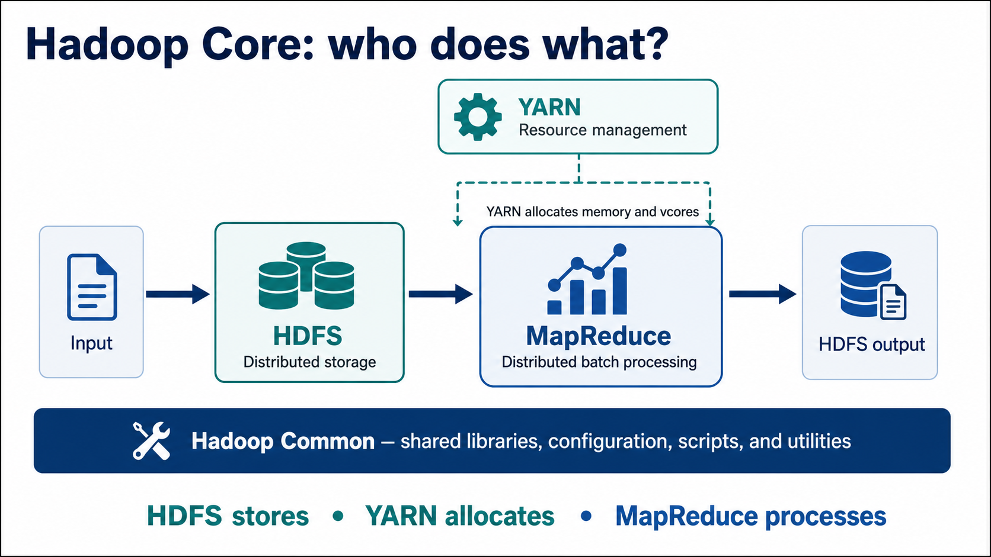

Slide 5
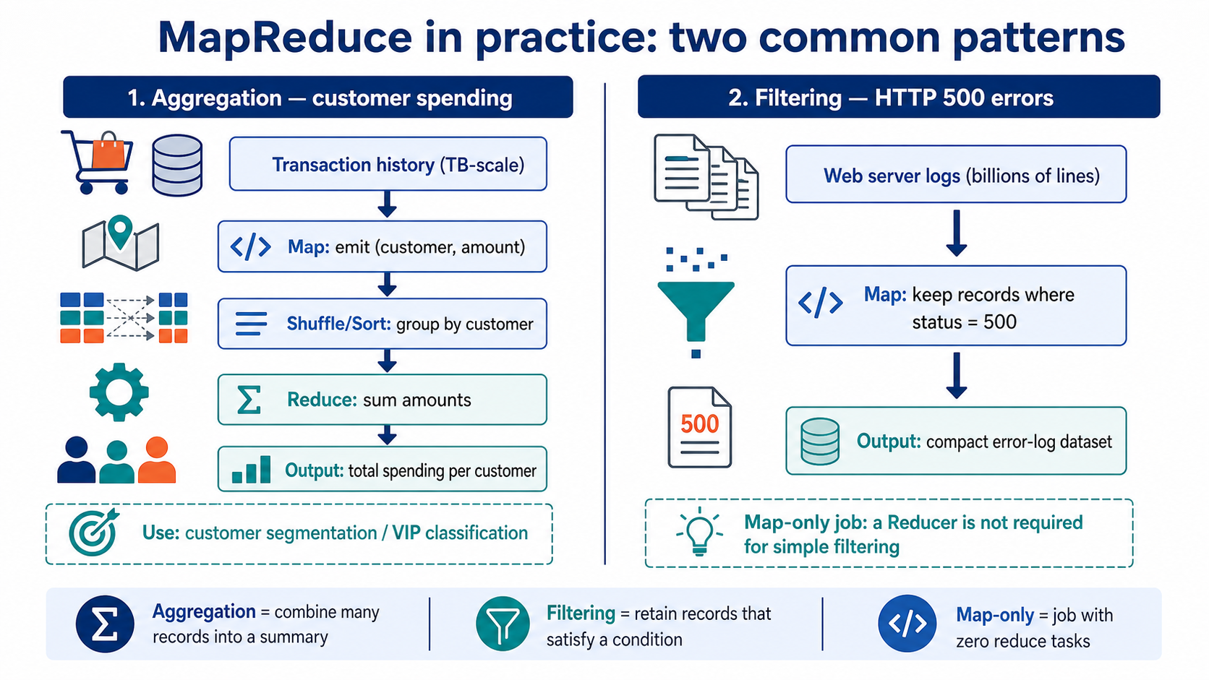

Slide 6
Data types in big data
The same Hadoop platform can store many kinds of files; HDFS does not require relational table structure.
Structured
CSV, relational tables
fixed schema
Semi-structured
JSON, XML, logs
flexible fields
Unstructured
images, audio, video, PDFs, text
Image data is normally treated as unstructured data because the system stores pixels/files rather than fixed rows and columns.
HDFS stores files as blocks; higher-level engines decide how to parse and process the content.
For data analytics, structure is often created later by OCR, parsing, feature extraction, or schema-on-read.
Big Data • Lecture 2: Hadoop / HDFS
6

Slide 7
Distributed File System → HDFS
A distributed file system stores files across networked machines, while presenting a single logical file system.
HDFS is designed for distributed storage and processing on commodity hardware.
It supports streaming access to large files and high-throughput sequential reads/writes.
Files are split into blocks and stored across multiple DataNodes.
Replication keeps extra copies so the system can tolerate disk, machine, or rack failures.
HDFS includes command-line access, permissions, and authentication support.
Core idea
Move computation near data, not data near computation.
Result
Reduced network transfer + higher throughput for large datasets
Big Data • Lecture 2: Hadoop / HDFS
7

Slide 8
Where Hadoop came from
Hadoop, HDFS, Google File System and MapReduce are related concepts, but they are not the same.
HDFS was inspired by GFS (2003), a Google distributed file system design.
Hadoop processing was inspired by Google MapReduce (2004).
Hadoop is an open-source Apache project, written primarily in Java, originally created by Doug Cutting and collaborators.
Lucene is a Java text search library; it is not a cluster computing framework.
Google File System (GFS)
HDFS
Google MapReduce
Hadoop MapReduce
Big Data & Cloud Computing • Lecture 2: Hadoop / HDFS
8

Slide 9
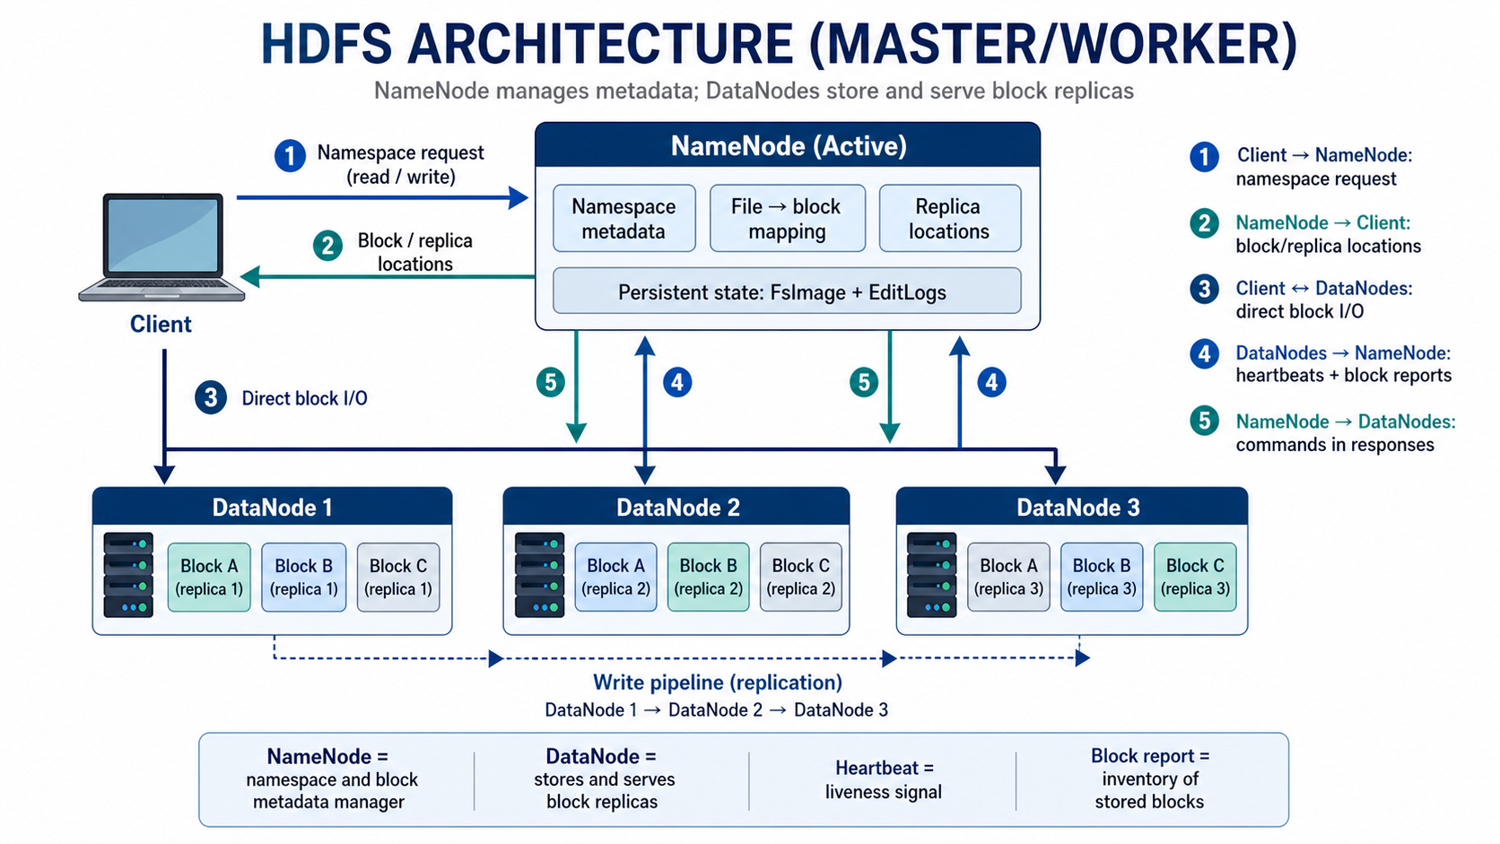

Slide 10
NameNode: the HDFS metadata master
The NameNode is the master service that maintains the file system namespace.
Keeps the directory tree: folders, files, file names, ownership, permissions, and access-control information.
Maintains mapping from each file to blocks and from blocks to DataNode replica locations.
Handles namespace operations: open, close, rename, delete, mkdir, permission checks.
Does not store user file content; actual file blocks are stored on DataNodes.
If the single NameNode is unavailable in a non-HA cluster, the cluster cannot serve normal HDFS requests.
NameNode = metadata
Master node
Stores metadata
Single Point of Failure in non-HA HDFS
Big Data • Lecture 2: Hadoop / HDFS
10

Slide 11
What counts as HDFS metadata?
Metadata describes the structure and location of files; it is not the same as the file content itself.
Namespace
Block mapping
Replica locations
Permissions / ACLs
Metadata shows the structure of HDFS directories and files.
Metadata includes block count, block IDs, block locations, and replica placement.
FsImage and EditLogs are metadata files used by the NameNode.
A vague option such as “No. of file records” is not normally named as a standard HDFS metadata type.
Big Data • Lecture 2: Hadoop / HDFS
11

Slide 12
FsImage and EditLogs
NameNode metadata is persisted using a checkpoint image plus a log of namespace changes.
FsImage
point-in-time snapshot of namespace metadata
EditLogs
sequence of changes after the last checkpoint
Checkpoint
merged metadata image
On restart, the NameNode loads FsImage and replays EditLogs to rebuild current metadata.
The checkpoint process periodically merges FsImage and EditLogs to prevent unbounded log growth.
Losing the only persistent copy of metadata is serious; recovery depends on available backups/checkpoints.
Big Data & Cloud Computing • Lecture 2: Hadoop / HDFS
12

Slide 13
DataNode: the worker that stores actual blocks
DataNodes are worker/slave services that manage local disk storage for HDFS blocks.
Stores actual HDFS block files on local disks.
Serves read/write requests from clients after the client has received block locations from the NameNode.
Creates, deletes, and replicates blocks according to NameNode instructions.
Sends frequent heartbeats and block reports to the NameNode.
A typical worker machine runs one DataNode process.
DataNode = actual data
Worker/slave node
Stores block replicas
Reports health and block inventory
CS411 – Big Data & Cloud Computing • Lecture 2: Hadoop / HDFS
13

Slide 14
Blocks and block size
HDFS splits large files into blocks so they can be distributed and processed in parallel.
Large file
Block 1
Block 2
Block 3
Block 4
A block is the minimum unit that HDFS stores, replicates, and tracks.
Large block sizes reduce the number of metadata entries for large files.
Large blocks reduce the relative cost of disk seek time and support long sequential streaming reads.
Older tutorials mention 64 MB; many modern Hadoop deployments use 128 MB or larger, configurable by dfs.blocksize.
Big Data & Cloud Computing • Lecture 2: Hadoop / HDFS
14

Slide 15
Replication: availability through redundant block copies
Replication stores multiple copies of blocks on different DataNodes, and often different racks.
Default replication factor is commonly 3, but it is configurable per file or cluster.
Replication creates data redundancy intentionally; the purpose is fault tolerance and availability.
Clients can read from the nearest replica, improving throughput and reducing network traffic.
If one DataNode fails, another replica can serve the block.
DataNode 1
A
Block A
DataNode 2
A
DataNode 3
A
Big Data & Cloud Computing • Lecture 2: Hadoop / HDFS
15

Slide 16
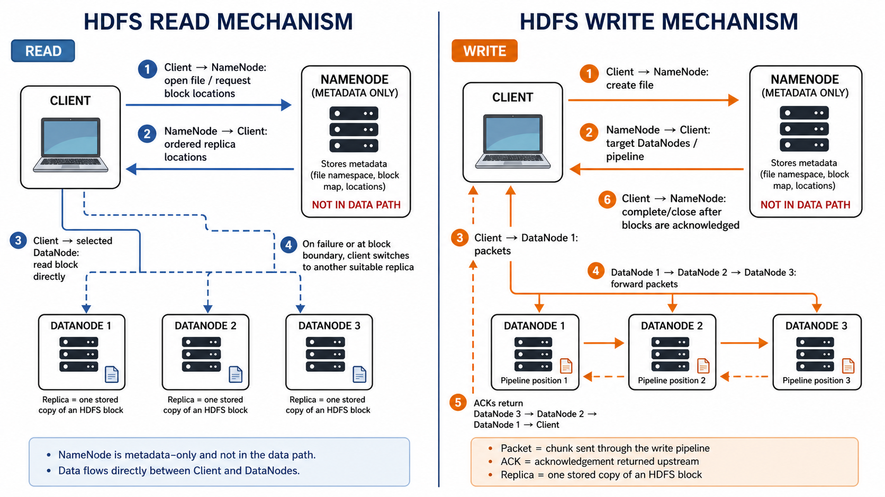

Slide 17
HDFS write mechanism
Writes are coordinated by the NameNode and streamed through a DataNode pipeline.
NameNode
create + allocate targets
Client
DataNode 1
DataNode 2
DataNode 3
Client requests file creation from the NameNode.
NameNode verifies permissions and chooses DataNodes for replicas.
Client streams packets to the first DataNode; packets flow through the replication pipeline.
Acknowledgements return through the pipeline; NameNode records final block metadata.
CS411 – Big Data & Cloud Computing • Lecture 2: Hadoop / HDFS
17

Slide 18
Heartbeats and block reports
DataNodes keep the NameNode informed about health and block inventory.
Heartbeat: frequent signal that the DataNode is alive.
Block report: inventory of blocks stored by the DataNode.
If heartbeats stop, the NameNode treats the DataNode as failed and schedules re-replication.
Key point: DataNodes send frequent heartbeats to NameNode = True.
DataNode 1
NameNode
DataNode 2
DataNode 3
CS411 – Big Data & Cloud Computing • Lecture 2: Hadoop / HDFS
18

Slide 19
Secondary NameNode, Checkpoint Node, Backup Node, Standby NameNode
These names are often confused; the roles are related but not identical.
Secondary NameNode / Checkpoint Node
Backup Node
Standby NameNode (HA)
Periodically downloads FsImage + EditLogs, merges them, and creates a checkpoint image. It is not a hot standby for automatic failover.
Maintains an up-to-date in-memory copy of the namespace by receiving edits. When used, a separate checkpoint/secondary node may not be needed.
Runs in high availability mode and can become active during failover, using shared edits and block reports.
Key distinction: Secondary NameNode ≠ Backup Node; Secondary NameNode ≠ active standby. It supports checkpointing, not automatic failover.
When a Backup Node is used, a separate Secondary NameNode or Checkpoint Node is usually not required.
If the NameNode loses its only FsImage copy, recovery may use a checkpoint if available; otherwise metadata loss is severe.
CS411 – Big Data & Cloud Computing • Lecture 2: Hadoop / HDFS
19

Slide 20
Single Point of Failure and high availability
In old/non-HA HDFS, the NameNode is the Single Point of Failure.
Non-HA HDFS
HA HDFS
Not SPOF
One active NameNode
If it fails, the namespace service is unavailable
Active NameNode + one or more Standby NameNodes
Failover reduces downtime
DataNode failure is expected; replication handles it.
Secondary NameNode is not the main active metadata service.
NameNode availability is critical because every file operation needs metadata.
Modern Hadoop supports HA with Standby NameNodes and shared edit logs.
Replication protects block data, not the metadata service itself.
CS411 – Big Data & Cloud Computing • Lecture 2: Hadoop / HDFS
20

Slide 21
HDFS command-line interface: FS Shell
Hadoop provides a filesystem shell to interact with HDFS from the command line.
FS Shell / HDFS Shell
Key point: command names are case-sensitive. The intended command is copyFromLocal, not CopyFromLocal or copyfromlocal.
List files: hdfs dfs -ls /path
Create directory: hdfs dfs -mkdir /path
Upload local file: hdfs dfs -copyFromLocal local.txt /user/hadoop/
Download file: hdfs dfs -copyToLocal /hdfs/file local_file
Display content: hdfs dfs -cat /path/file
Command pattern
hdfs dfs -<command> <arguments>
CS411 – Big Data & Cloud Computing • Lecture 2: Hadoop / HDFS
21

Slide 22
Data locality: bring computation near storage
Large data is expensive to move; Hadoop tries to run tasks where the data blocks already exist.
Storage node
Data block A
Computation task
Map / Spark task
Remote data transfer
less preferred
Data locality means locating computation near the data, not simply locating data near storage or client.
It reduces network traffic and improves throughput for large datasets.
HDFS block placement and YARN scheduling cooperate to make locality possible.
CS411 – Big Data & Cloud Computing • Lecture 2: Hadoop / HDFS
22

Slide 23
HDFS design trade-offs
HDFS is excellent for large, sequential workloads but unsuitable for some workloads.
Good fit
Poor fit
Very large files
High-throughput streaming reads
Batch analytics
Write-once, read-many datasets
Fault tolerance on commodity hardware
Many tiny files
Low-latency random reads
Frequent in-place updates
Small transactional workloads
Unplanned NameNode metadata growth
CS411 – Big Data & Cloud Computing • Lecture 2: Hadoop / HDFS
23

Slide 24
YARN: cluster resource management
YARN separates resource management from application logic.
ResourceManager
cluster-wide scheduler
ApplicationMaster
one per application attempt
Client
NodeManager 1
Container
NodeManager 2
Container
NodeManager 3
Container
Key distinction: NodeManager and ResourceManager are YARN daemons, not HDFS storage daemons.
CS411 – Big Data & Cloud Computing • Lecture 2: Hadoop / HDFS
24

Slide 25
MapReduce: distributed batch processing
MapReduce processes HDFS data using map tasks, shuffle/sort, and reduce tasks.
Simple formula
Input → Map → Shuffle/Sort → Reduce → Output
Input splits
from HDFS
Map
key-value pairs
Shuffle / Sort
group by key
Reduce
aggregate
Output
HDFS directory
MapReduce is Hadoop’s programming model and execution framework for distributed batch processing of large datasets.
Map phase: each mapper reads an input split and produces intermediate key–value pairs.
Shuffle/Sort phase: the framework groups all values with the same key together.
Reduce phase: each reducer aggregates or combines the grouped values and writes the final output to HDFS.
CS411 – Big Data & Cloud Computing • Lecture 2: Hadoop / HDFS
25

Slide 26
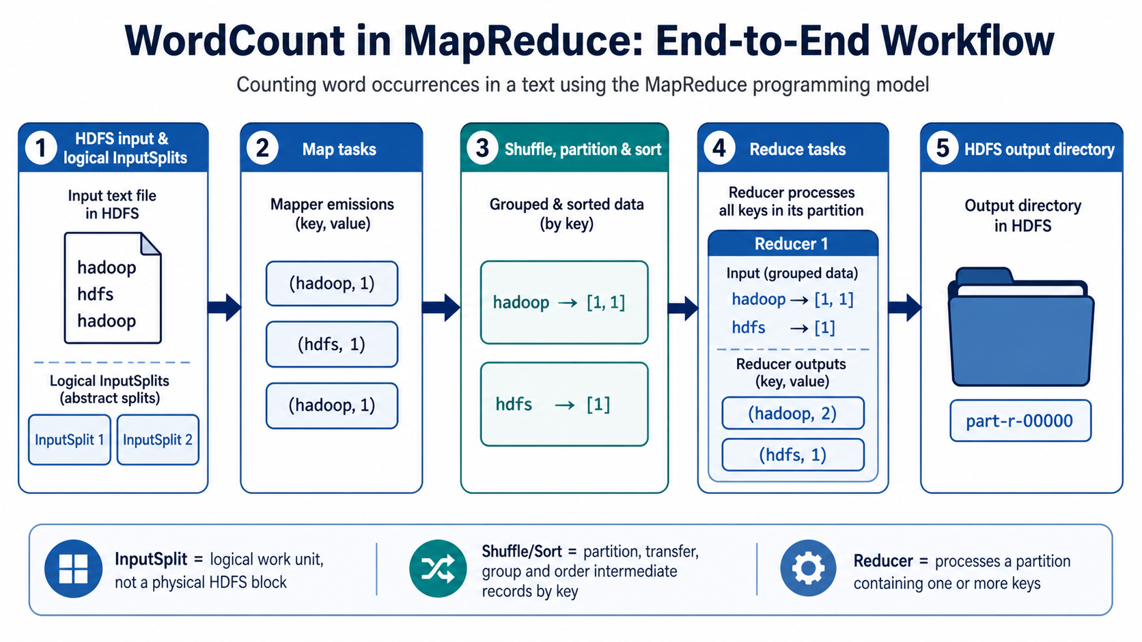

Slide 27
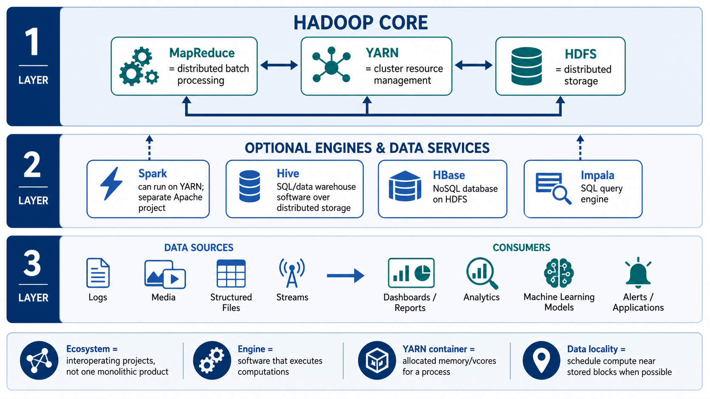

Slide 28
HDFS operations: enough commands for practical use
Commands help students connect architecture concepts with hands-on practice.
Purpose
Command example
List
hdfs dfs -ls /user
Create folder
hdfs dfs -mkdir /user/student
Upload local → HDFS
hdfs dfs -copyFromLocal data.csv /user/student/
Read content
hdfs dfs -cat /user/student/data.csv
Check disk usage
hdfs dfs -du -h /user/student
Change replication
hdfs dfs -setrep -w 3 /user/student/data.csv
CS411 – Big Data & Cloud Computing • Lecture 2: Hadoop / HDFS
28

Slide 29
Review: key concepts
Use this slide for an end-of-lecture review.
HDFS is inspired by Google File System; Hadoop MapReduce is inspired by Google MapReduce.
NameNode stores metadata; DataNode stores actual block data.
DataNodes send frequent heartbeats to the NameNode.
Clients first contact NameNode for metadata; they read/write blocks through DataNodes.
Default replication factor is commonly 3; replication intentionally creates redundancy.
Large 128 MB blocks reduce relative disk seek overhead.
Data locality means moving computation near stored data.
copyFromLocal is the case-sensitive command for local-to-HDFS upload.
CS411 – Big Data & Cloud Computing • Lecture 2: Hadoop / HDFS
29

Slide 30
Practical lab
A short lab after the lecture reinforces architecture concepts and command-line skills.
1
Start pseudo-distributed Hadoop or use a prepared Colab-style simulation.
2
Create an HDFS directory, upload a file with copyFromLocal, list it, and read content.
3
Inspect block size, replication factor, and filesystem metadata using fsck / dfs commands.
4
Run WordCount and observe input splits, map output, reduce output, and HDFS output directory.
5
Discuss what changes in real multi-node clusters: replication, rack awareness, and failover.
CS411 – Big Data & Cloud Computing • Lecture 2: Hadoop / HDFS
30

Slide 31
Practice questions
Use these questions for quick review at the end of the lecture.
Which service stores HDFS namespace metadata? → NameNode.
Which service stores the actual HDFS block replicas? → DataNode.
Which file records a persistent snapshot of HDFS namespace metadata? → FsImage.
Which file records changes after the last checkpoint? → EditLogs.
Which Hadoop layer manages containers and cluster resources? → YARN.
Why does Hadoop prefer data locality? → To reduce network transfer and improve throughput.
CS411 – Big Data & Cloud Computing • Lecture 2: Hadoop / HDFS
31

Slide 32
Common misconceptions
These distinctions help clarify the roles of Hadoop and HDFS components.
NameNode is not where file content is stored; it stores metadata only.
Secondary NameNode is not a hot failover replacement for the NameNode.
DataNode is an HDFS daemon; NodeManager and ResourceManager belong to YARN.
Replication creates redundancy by design; redundancy is not an error in HDFS.
Large block size helps streaming throughput and reduces seek overhead, but does not make HDFS ideal for tiny files.
HDFS Shell / FS Shell command names are case-sensitive.
CS411 – Big Data & Cloud Computing • Lecture 2: Hadoop / HDFS
32

Slide 33
References
Use these readings to extend the lecture content.
TutorialsPoint: Hadoop – HDFS Overview, including HDFS features, NameNode, DataNode, block, and goals.
Apache Hadoop Documentation 3.5.x: HDFS architecture, HDFS shell, YARN, and MapReduce references.
Current course lecture: Distributed File Systems, HDFS, replication, YARN, MapReduce, design trade-offs, and practice.
Recommended flow: distributed storage → HDFS architecture → metadata/blocks/replication → read/write → YARN/MapReduce → hands-on commands → review.
Additional readings:
• GeeksforGeeks – Hadoop Ecosystem
• DZone – An Introduction to HDFS
• James Serra – Introduction to Hadoop
CS411 – Big Data & Cloud Computing • Lecture 2: Hadoop / HDFS
33

