Slide 1
Computer Network Assignment 1

Slide 2
Functional Requirements (Core function)
When the Client presses the ‘Setup’ button the session is being sat up and ready to play the playback.
When the Client presses the ‘Play’ button they must be able to see the playback start playing.
When the Client presses the ‘Pause’ button the playback must be paused at the current frame but still able to proceed to the next frame play when the Client selects the ‘Play’ button.
When the Client presses the ‘TearDown’ button the playing session is terminated and the Client has to ‘Setup’ to play again.
The Server always replies to all the messages the Client sends.

Slide 3
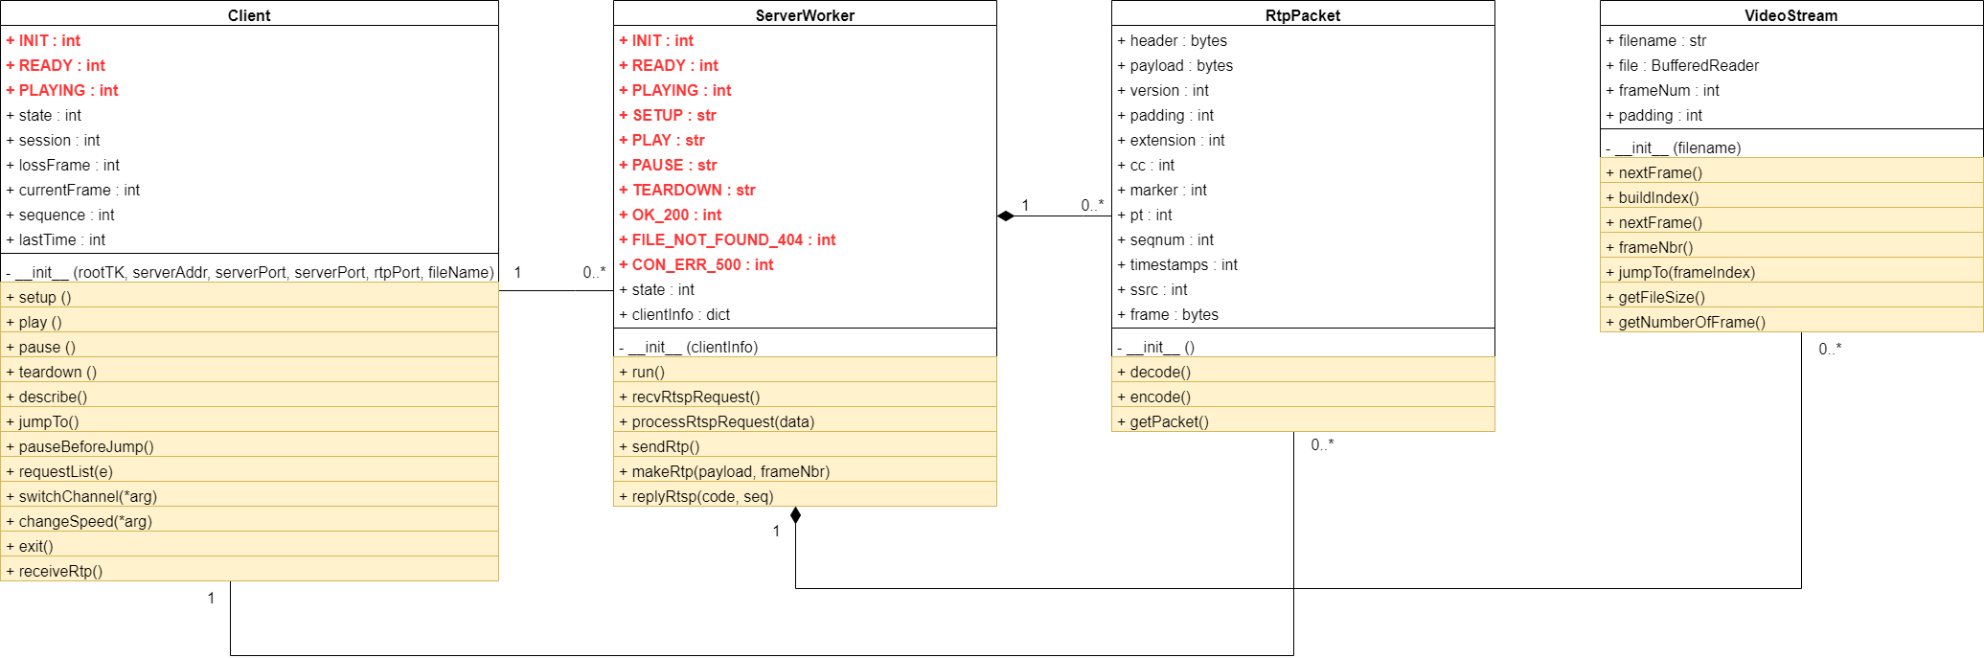
Complete Class Diagram

Slide 4
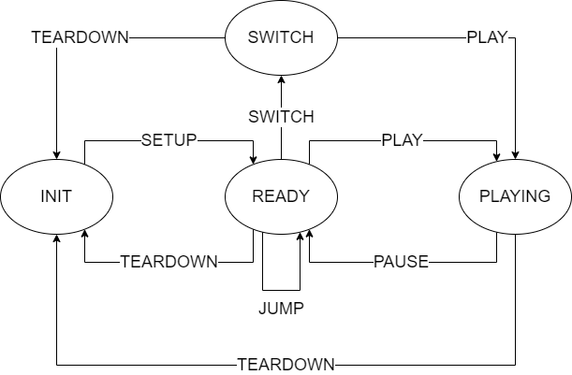
State diagram

Slide 5
SETUP
CLIENT
SERVER
sequence number starts from 0 and increase by 1 after each request
session number is created in the SETUP request (random between 10000 - 99999)
SETUP <filename> RTPS/1.0
CSeq: <sequence>
Transport: RTP/UDP; client_port= <rtp port>
RTSP/1.0 200 OK
CSeq: <sequence>
Session: <session>
TotalFrame <number of frame>
RTSP/1.0 FILE_NOT_FOUND_404
CSeq: <sequence>

Slide 6
PLAY
CLIENT
SERVER
PLAY <filename> RTPS/1.0
CSeq: <sequence>
Session: <session>
RTSP/1.0 200 OK
CSeq: <sequence>
Session: <session>

Slide 7
PAUSE
CLIENT
SERVER
PAUSE <filename> RTPS/1.0
CSeq: <sequence>
Session: <session>
RTSP/1.0 200 OK
CSeq: <sequence>
Session: <session>

Slide 8
TEARDOWN
CLIENT
SERVER
TEARDOWN <filename> RTPS/1.0
CSeq: <sequence>
Session: <session>
RTSP/1.0 200 OK
CSeq: <sequence>
Session: <session>

Slide 9
DESCRIBE
CLIENT
SERVER
info length is length of the information returned to the Client
DESCRIBE <filename> RTPS/1.0
CSeq: <sequence>
Session: <session>
RTSP/1.0 200 OK
CSeq: <sequence>
Session: <session>
Content-Length: <info length>
v=2
o=<Server IP address>
s=RTSP <session>
m=video <file name> RTP/Mjpeg
m=size <file size> Bytes
RTSP/1.0 FILE_NOT_FOUND_404
CSeq: <sequence>

Slide 10
JUMP
CLIENT
SERVER
frame index is the index of the current playing frame
JUMP <filename> RTPS/1.0
CSeq: <sequence>
Session: <session>
Frame: <frame index>
RTSP/1.0 200 OK
CSeq: <sequence>
Session: <session>
RTSP/1.0 FILE_NOT_FOUND_404
CSeq: <sequence>

Slide 11
SWITCH
CLIENT
SERVER
file list is the list of playback files (.Mjpeg) in the Server.
SWITCH <filename> RTPS/1.0
CSeq: <sequence>
Session: <session>
RTSP/1.0 200 OK
CSeq: <sequence>
Session: <session>
Video: <file list>
RTSP/1.0 FILE_NOT_FOUND_404
CSeq: <sequence>

Slide 12
CHANGESPEED
CLIENT
SERVER
frame delay is the delay after each frame sent.
CHANGESPEED <file name> RTPS/1.0
CSeq: <sequence>
Session: <session>
Delay: <frame delay>
RTSP/1.0 200 OK
CSeq: <sequence>
Session: <session>

Slide 13
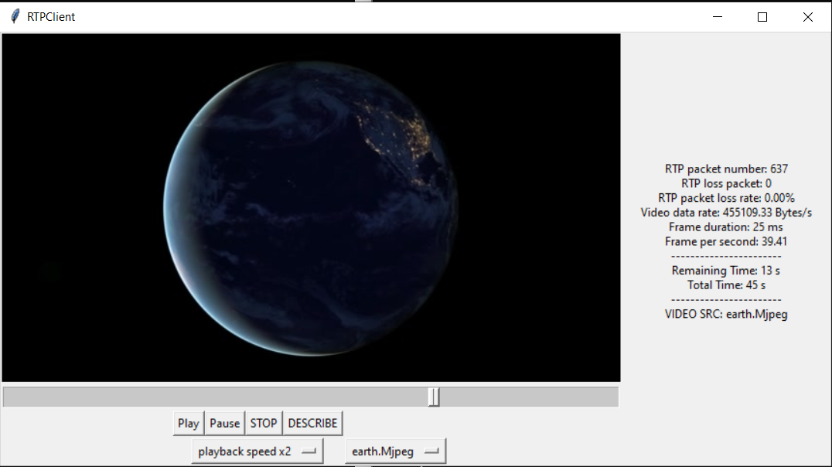
Graphic User Interface (GUI)

Slide 14
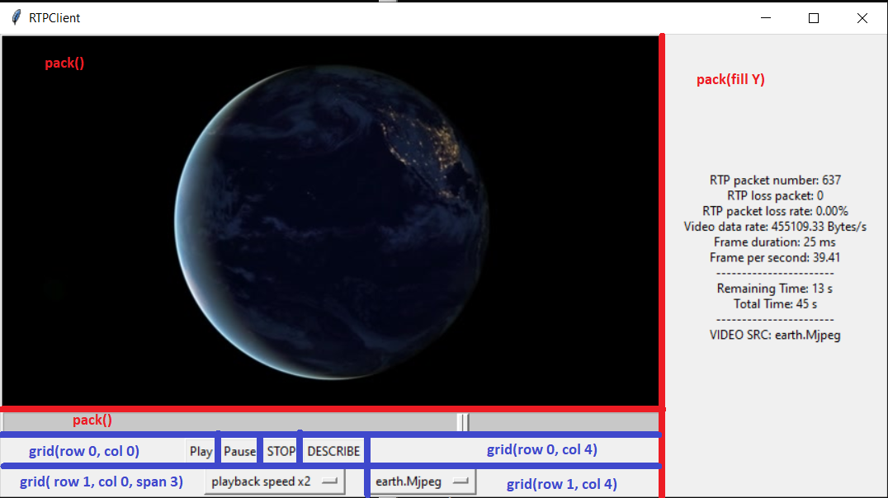
GUI Layout

Slide 15
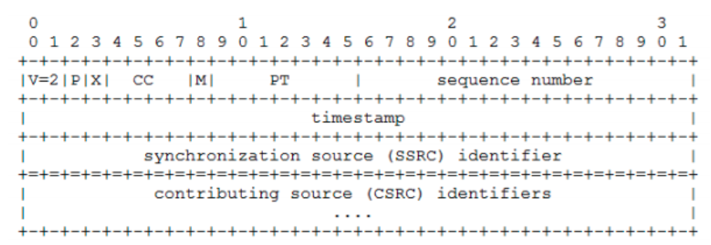
RTP Packet

Slide 16
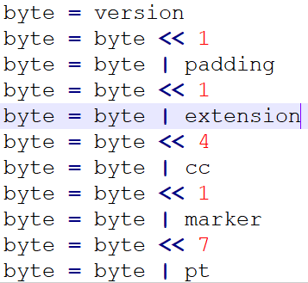
Encoding (V = 2, P = 0, X = 1, CC = 0, M = 0, PT = 26)
0000 0000 0000 0010
0000 0000 0000 0100
0000 0000 0000 1000
0000 0000 0000 1001
0000 0000 1001 0000
0000 0001 0010 0000
1001 0000 0000 0000
1001 0000 0001 1010

Slide 17
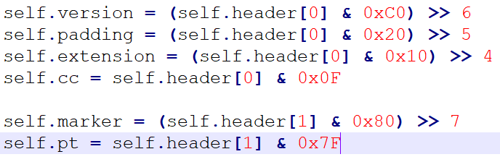
Decoding (header[0:2] = 10010000 00011010)
Apply masking to extract individual bit, then shift the result based on their position:
V: 0xC0 = 1100 0000
P: 0x20 = 0010 0000
X: 0x10 = 0001 0000
CC: 0x0F = 0000 1111
M : 0x80 = 1000 0000
PT: 0x7F = 0111 1111

Slide 18
Appendix: Mjpeg format used in Assignment 1
Composed of many JPEG images concatenated together in the same file.
Before each JPEG image, there’s a 5 byte header contain a string of 5 digits representing the size (in bytes) of the image immediately follow it.
This is consider non-standard for modern Mjpeg format.
Since the given movie.Mjpeg file is very special, that’s mean to have more videos for user to choose from, we have to convert from other video sources ourselves.
Luckily, we have:
A JPEG file always start with 0xFFD8, and end with 0xFFD9.

Slide 19
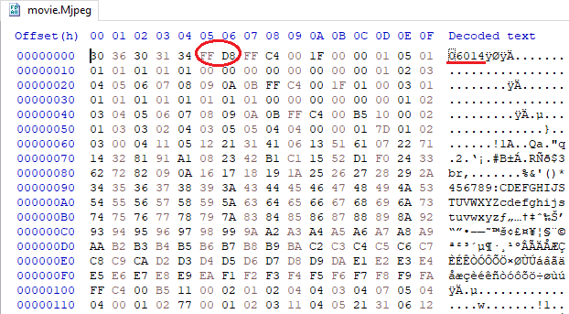
Example of our special Mjpeg format
JPEG start point
Size of the first JPEG

Slide 20
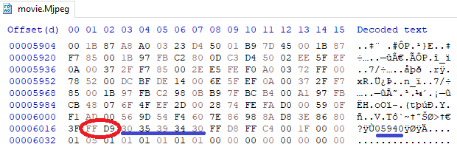
Example of our special Mjpeg format
JPEG end
next JPEG size

Slide 21
