Slide 1
CanCURVE
Heather McGrath
Nicky Hastings
Lisa Landon-Roy
March 2024

Slide 2
Background
There are a lack of Canadian specific damage curves to assess risks from floods
Damage curves are a key methodological piece in the calculation of impacts and consequences from a natural hazard event
Flood risk assessments in Canada have historically relied on curves from FEMA, generic curves from the UK multi coloured manual or Australian National curves
From damages calculated to buildings, impacts to people (displacement, disruption, etc.), and economic impacts can be interpreted

Slide 3
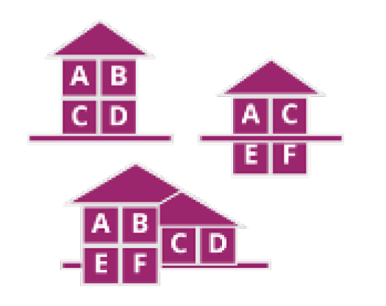
Overview
New method for development of stage-damage functions for buildings
Transparent calculation methodology
In-line with industry cost estimators
Canadian made tool for Canadian buildings
Support for geographic variability
Features:
Open source tool
Composite level information
Support for non-traditional building archetypes
Probabilistic modelling
Ability to change spatially/temporally the damage function

Slide 4
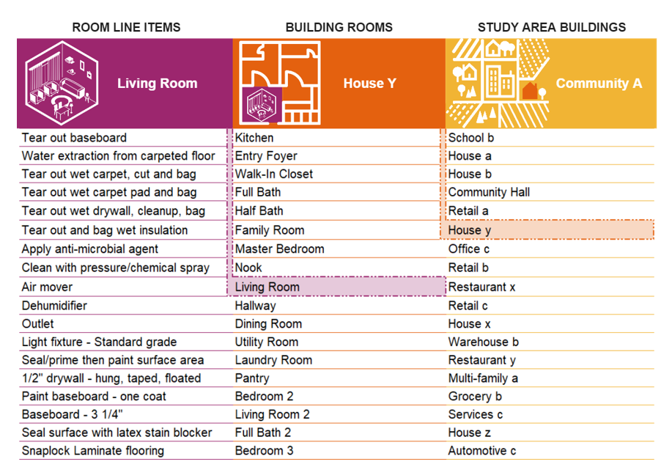
Metholology
Tiered approach
link line items to rooms, rooms to room definitions, and room definitions to buildings via a Master Rule Book
Benefits:
Mix and match:
Default room configurations
User modifiable
Can add items and pricelists
Formal building archetypes are not required

Slide 5
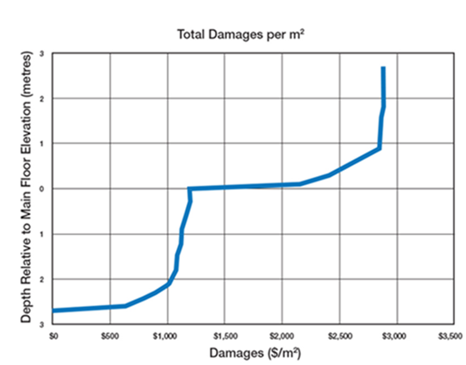
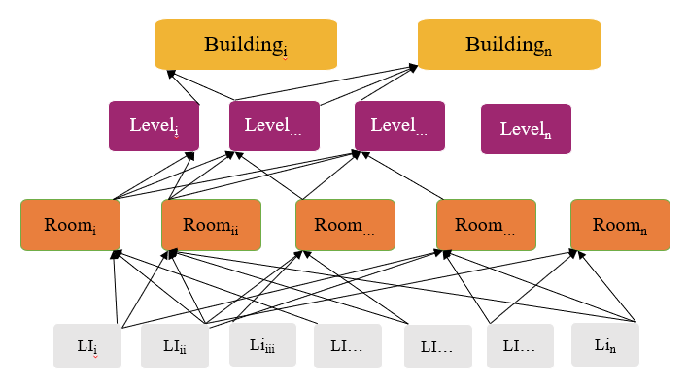
Multi-level results
Every line item essentially has it’s own depth-damage curve
‘roll-up’ to create damage curve for the whole structure
‘drill-down’ to view component curves e.g.:
Level: 1st floor, basement, etc.
Room: kitchen, bedroom, etc.

Slide 6
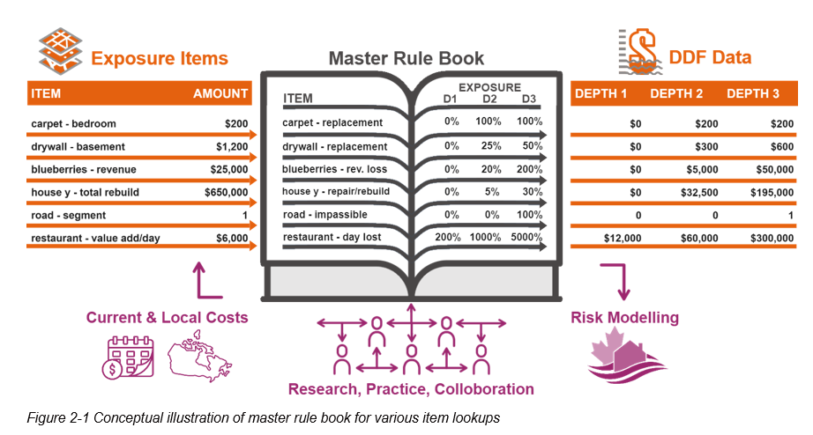
Base structure:

Slide 7
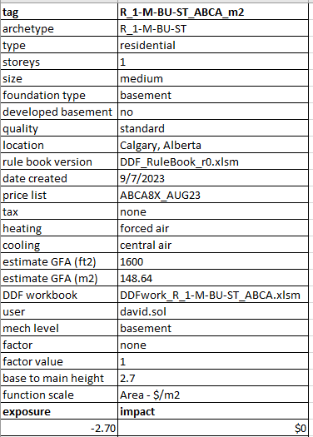
Transparency of origin
Contain metadata which describes details of their creation

Slide 8
Prototype ---> Application
Currently an excel prototype exists
Limited data for backend Master Rulebook
Single family residential homes
Structural losses only
Requires Xactimate files
Contract just started
To program it in Python
More robust
Integrate with CanFlood
User friendly
FEATURES:
Users can Browse Library of existing curves (very limited- presently)
Users can build/develop their own curves
Users can upload their own backend data (line items, costing, to develop curves)
Draft expected May 2024

Slide 9
Backend Data (Master Rulebook)
Looking to add more data (line items) and rooms/archetype definitinos

Slide 10




Program Mockup
User enter:
General Building
Input
Room Specification
based on occupancy
Defaults + user edits
DDF

Slide 11
Proposed structure
MasterRuleBook
Line Items
All items found in a building: structural and contents
Depth Replacement
Unique list and value for each item at each water depth
$
(by location & date)
Unique list and value for each item at each place & time
Backend databases
MasterRuleBook
Contains all unique items – construction and content related
E.g.: drywall, flooring, baseboard, sink, etc.
Primary KEY: Cat.Sel
Contains : depth replacement value, 0 to 1 for each Cat.Sel
Contains: cost, by location and date
Example: MasterRuleBook_LineItems.xls
Cat.Sel = unique identifier
Columns : variable based on location and price list data
Rows: variable
Columns :Fixed : based on water depths
Rows: Variable

Slide 12
Proposed Databases
User Input fields: (UIGeneralInfo.xlsx)
To populate GUI
Masterlist (MasterRuleBook_LineItems.xlsx)
All LineItems, costing, depth replacement
Room Specifications (ItemsByArchType.csv)
LineItems per room type, quantity, group(s) and building archetype
Room Dimensions (RoomDimensions.csv)
Based on Building Archetype

Slide 13
GUI Mockup
Preliminary suggestions – open to discussion

Slide 14
GUI Mockups:
Welcome to CanCurve
Create New Curve
Browse Existing Library

Slide 15
Create New Section:
Welcome to CanCurve
Create New Curve
Browse Existing Library

Slide 16
Mockup: Page 1 General Input
Create New Curve
General Info
Room Details/Levels
Generate DDF
Curve Name
What location are you interested in?
What timeframe do you want the prices to reflect?
What type of DDF (Depth Damage Function) do you want to create?
What type of structure are you interested in?
If Residential:
How many storeys or levels are there?
What is the estimated square footage or square meters of the structure?
What are the quality of the finishes?
Does it have a basement? | None/Basement/Crawlspace
*Is the basement developed? | Finished Unfinished
**If Yes: Percent Developed (0 to 100) 100 == fully developed= default = 0
What level is the mechanical equipment located on?
What type of Heating is there?
What type of Cooling (if any)?
What is the height of the first floor (m) from the ground elevation?
Add Location
Add Pricelist
NEXT
Maybe instead of a ist of questions, it's pages(s) with pictures a user selects with text below?
Notes:
All of the specifications/requirements to be captured as metadata and requirements for development of the DDF

Slide 17
Mockup Page 3: Room Dimensions
General Info
Residential
Room Details/Levels
Generate DDF
Rooms | Total | Main Level | Basement | Upper Level
1.5 Bath | 1 | 1 | 0 | 0
Bedroom | 9 | 5 | 4 | 0
Dining Room | 1 | 1 | 0 | 0
Entry Foyer | 2 | 1 | 0 | 0
Full Bath | 3 | 1 | 2 | 0
Half Bath | 2 | 1 | 0 | 0
Hallway | 4 | 2 | 2 | 0
Kitchen | 1 | 1 | 0 | 0
Laundry Room | 3 | 1 | 1 | 0
Living Area | 4 | 2 | 2 | 0
Nook | 2 | 1 | 1 | 0
Utility Room | 2 | 1 | 1 | 0
Walk-In Closet | 2 | 1 | 1 | 0
Bedroom
Hallway
Family
Read from items by “ItemsByArchType”
Generates dynamically - DEFAULT
…
Suggest: user can override -add room/change room
?
Walkincloset
Bathroom
Dining
Bedroom
Kitchen
UtilityRoom
Maybe a figure? Of the rooms and how they are hypothetically laid out and their sizes?
Add Room
Advanced Settings (Optional)
BACK
NEXT
From ItemsByArchType.csv – need to look at Group.Description & Group2 columns of buildarchtype column filtered by A_B-C-DE-FF
Notes:
Describe what needs to be done by the user.
User needs to specify the details for each room

Slide 18
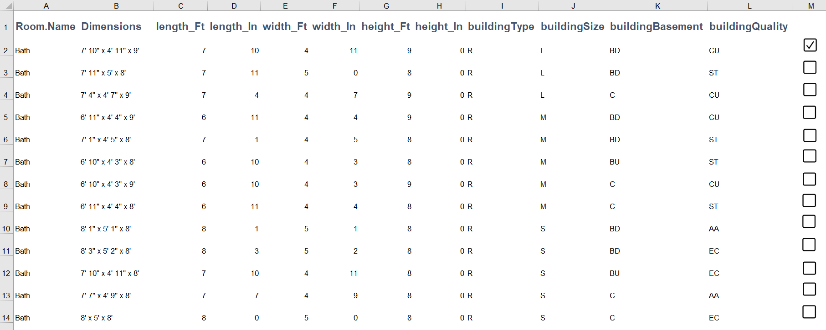
Mockup Page 3: Room Dimensions
General Info
Residential
Room Details/Levels
Generate DDF
From RoomDimensions.csv
Add Room
Takes you back to previous page (Residential
Room Details/Levels)
Advanced Settings (Optional)
Save

Slide 19
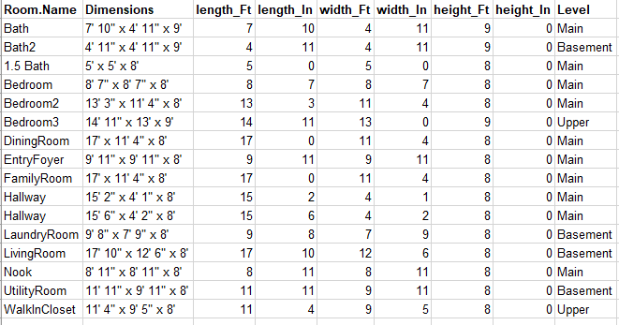
Mockup Page 3: Room Dimensions
Create New Curve
General Info
Room Details/Levels
Generate DDF
Advanced Settings
Bedroom
Hallway
Family
Room Dimensions
Room Contents
Depth Response
?
Walkincloset
Bathroom
Dining
Bedroom
Kitchen
UtilityRoom
Maybe a figure? Of the rooms and how they are hypothetically laid out and their sizes?
Save
Combination of: ItemsByArchType.csv – need to look at Group.Description & Group2 columns of buildarchtype column filtered by A_B-C-DE-FF & RoomDimensions.csv filtered/queried by: buildingType, buildingSize, buildignBasement buildingQuality
Default From UI RoomDetails, user can overwrite Levels from previous page
Notes:
Describe what the user needs to do...

Slide 20
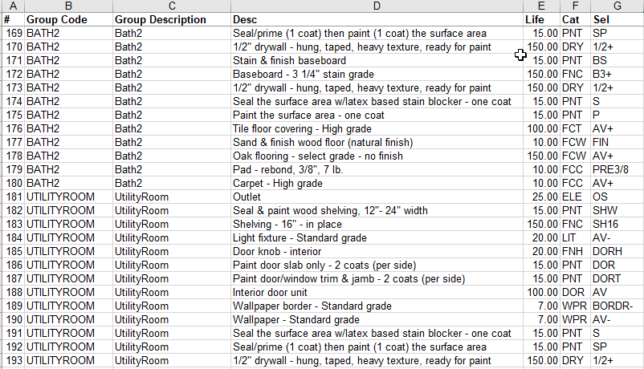
Mockup Page 3: Room Dimensions
Create New Curve
General Info
Room Details/Levels
Generate DDF
Advanced Settings
Bedroom
Hallway
Family
Room Dimensions
Room Contents
Depth Response
?
Walkincloset
Bathroom
Dining
Bedroom
Kitchen
UtilityRoom
Maybe a figure? Of the rooms and how they are hypothetically laid out and their sizes?
Save
ItemsByArchType.csv
Notes:
Describe what the user needs to do...

Slide 21
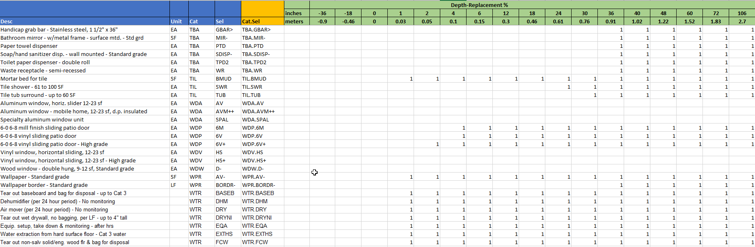
Mockup Page 3: Room Dimensions
Create New Curve
General Info
Room Details/Levels
Generate DDF
Advanced Settings
Bedroom
Hallway
Family
Room Dimensions
Room Contents
Depth Response
?
Walkincloset
Bathroom
Dining
Bedroom
Kitchen
UtilityRoom
Maybe a figure? Of the rooms and how they are hypothetically laid out and their sizes?
Save
From: MasterRuleBook_LineItems: Depth Replacement worksheet
Notes:
Describe what the user needs to do...

Slide 22
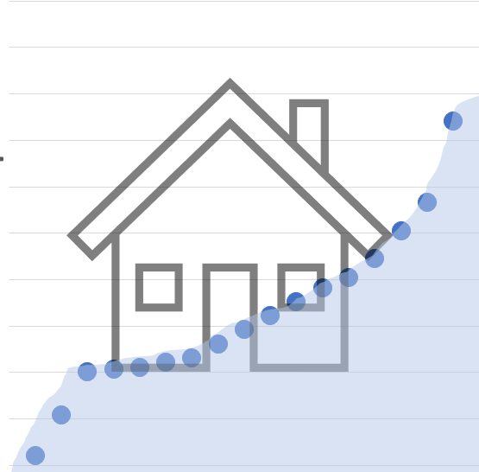


Mockup Page 4: Run the calculations
General Info
Room Details/Levels
Generate DDF
DDF Curve XXX is generated
Explore &
Visualize
Download
Summary of input:
Pricelist:
Type
Levels:
Quality:
…
…
…
…
When complete, download file option: with DDF and report/log of all the input and some of the data/tables used.
RUN
(Generate Curve)
Results
Notes:
Define file types for the resulting DDF – report? Csv file?

Slide 23
Things to consider in Design:
Considerations: Scaling/Factor of CURVE for different location
Users :
Super user (specific buildings)
Community/Regional
?
Focus more on loading curves and translation to different times/places?
-find out those typical curves.
StatsCan – typical homes. Simple categories.

Slide 24
UI Mockups:
Welcome to CanCurve
Create New Curve
Browse Existing Library

Slide 25
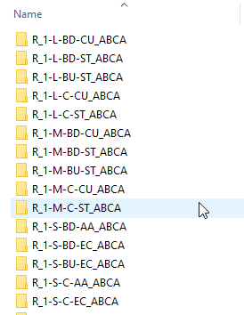
Browse Existing:
Browse Existing Library
Library
Browse By:
Location
Building Type
Date
Functions for each of these tabs:
Select
View curve(s) graphically
View metadata
Download
Download (single or multiple)
Curve
Metadata
From: \ExistingLibrary\ there are xls. That can be read in for this…maybe there is a better way to read/store/access

Slide 26
Calculations
Refer to XLS samples

Slide 27
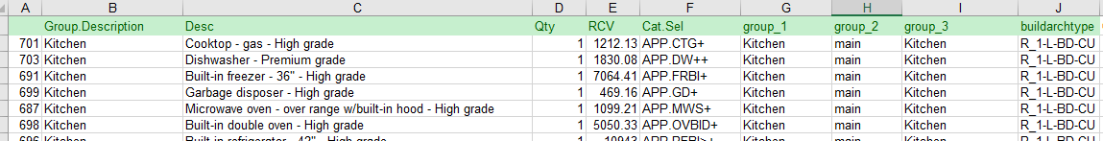
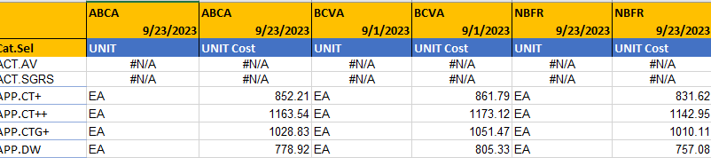
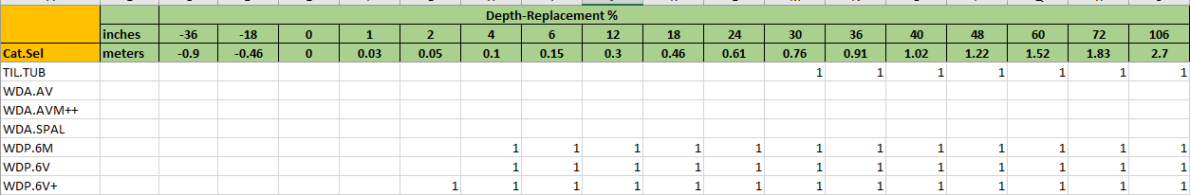
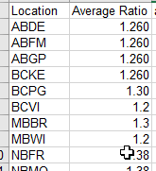
DDF: Calculations: Get Data
ItemList
Costs : XXYY
Depths
Factor: XXYY

Slide 28
Sum by Group 2
Group 2: Sum costs per water depth
Not all – necessarily, but could have:
Group2.Mech
GroupBasem
Split
Main
Upper
Depth | main | mechanical | split | upper | basement | Grand Total
 | GM | GMech | GS | GU | GB
-0.9 | $0 | $0 | $0 | $0 | $0 | $0
-0.46 | $0 | $0 | $0 | $0 | $0 | $0
0 | $0 | $0 | $0 | $0 | $0 | $0
0.03 | $14,866 | $0 | $3,523 | $17,207 | $13,806 | $49,401
0.05 | $26,497 | $0 | $5,678 | $27,524 | $20,917 | $80,615
0.1 | $28,347 | $1,577 | $5,678 | $27,524 | $20,917 | $84,042
0.15 | $31,733 | $5,624 | $5,781 | $27,569 | $20,917 | $91,624
0.3 | $31,733 | $5,624 | $5,962 | $27,569 | $20,917 | $91,805
0.46 | $35,760 | $5,624 | $18,020 | $31,147 | $23,997 | $114,548
0.61 | $36,339 | $5,624 | $18,124 | $35,505 | $25,575 | $121,167
0.76 | $38,763 | $5,624 | $19,148 | $39,535 | $27,590 | $130,660
0.91 | $49,217 | $7,645 | $21,882 | $53,792 | $37,096 | $169,632
1.02 | $53,342 | $7,645 | $29,027 | $54,405 | $37,096 | $181,516
1.22 | $53,646 | $7,645 | $29,582 | $54,597 | $37,149 | $182,619
1.52 | $55,784 | $7,645 | $29,814 | $56,838 | $38,808 | $188,889
1.83 | $55,784 | $15,148 | $29,814 | $56,838 | $38,808 | $196,391
2.7 | $55,784 | $15,148 | $29,814 | $56,838 | $38,808 | $196,391

Slide 29
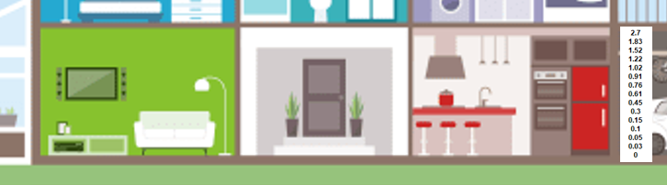
Master list water depths :
The Water depths, in the master list, relate to depth of water above the floor (any floor level)
e.g.:
for a basement or a main floor, 0 is the floor, the surface you walk on.
0.3 = height of bottom of electrical outlet – basement or main floor

Slide 30
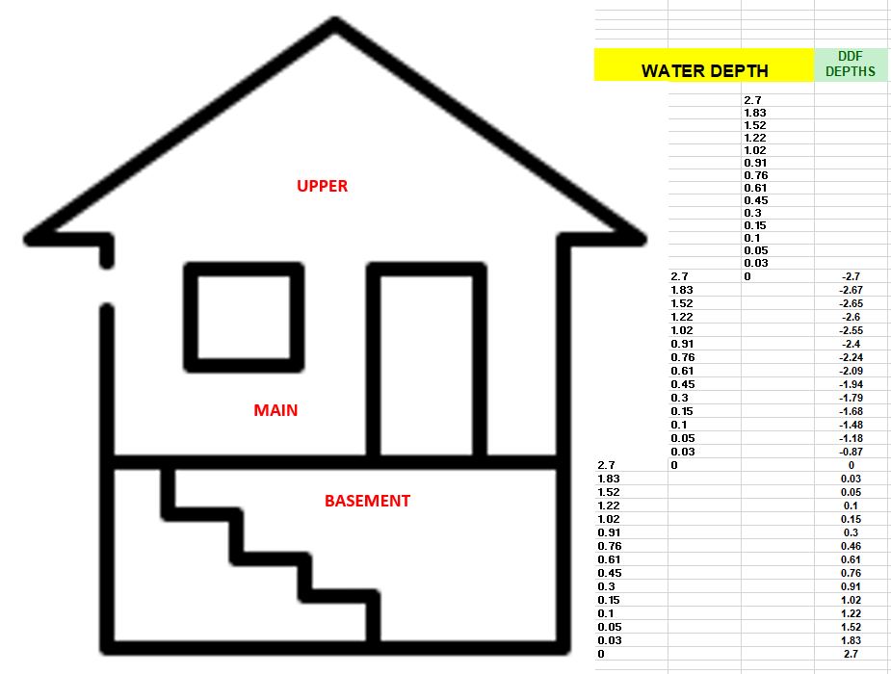

Slide 31
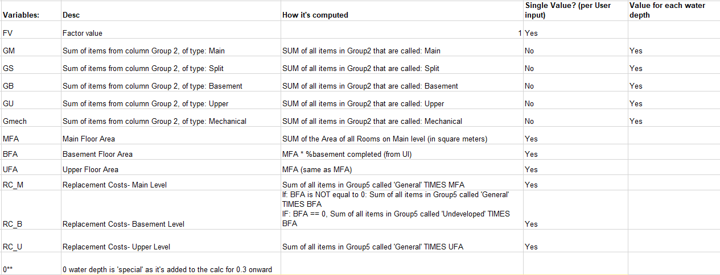
Variables needed for calculations:

Slide 32
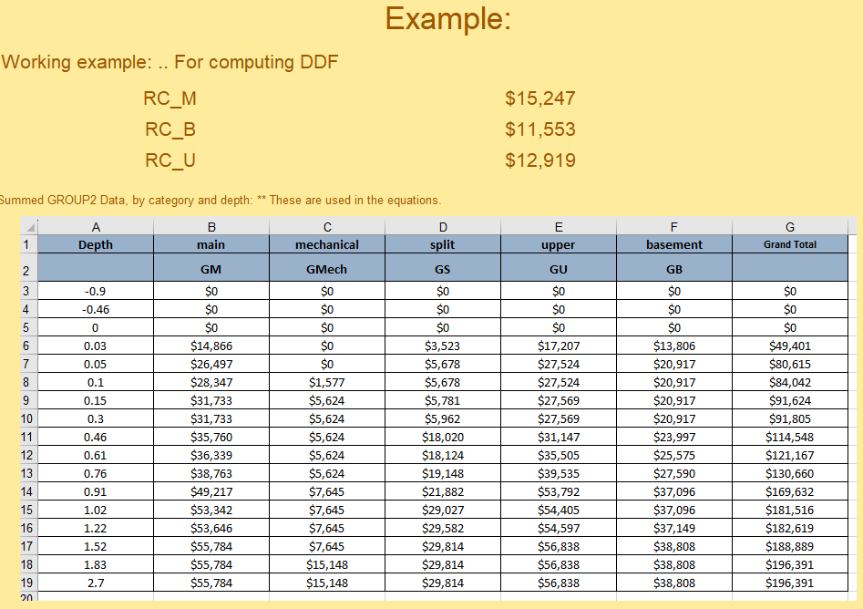
This is data from Slide 25 – once you ‘sum’ by Group2 category.

Slide 33
Calc 1: Basement
Depth | Equation: | Example: (referencing previous slide data) | Values | Calculated: | WHAT IT SHOULD BE | Difference?
-2.7 | ( Gmech + GS/2 + GB ) * FV | (C5 + D5/2 + F5) * FV | (0 + 0/2 + 0) * 1 | $0 | $0 | $0
-2.67 | ( Gmech + GS/2 + GB + RC_B ) * FV | (C6 + D6/2 + F6 + RC_B) * FV | (0 + 3523/2 + 13806 + 11553) * 1 | $27,121 | $27,120 | -$1
-2.65 | ( Gmech + GS/2 + GB + RC_B ) * FV | (C7 + D7/2 + F7 + RC_B) * FV | (0 + 5678/2 + 20917 + 11553) * 1 | $35,309 | $35,308 | -$1
-2.6 | ( Gmech + GS/2 + GB + RC_B ) * FV | (C8 + D8/2 + F8 + RC_B) * FV | (1577 + 5678/2 + 20917 + 11553) * 1 | $36,886 | $36,885 | -$1
-2.55 | ( Gmech + GS/2 + GB + RC_B ) * FV | (C9 + D9/2 + F9 + RC_B) * FV | (5624 + 5781/2 + 20917 + 11553) * 1 | $40,985 | $40,984 | -$1
-2.4 | ( Gmech + GS/2 + GB + RC_B ) * FV | (C10 + D10/2 + F10 + RC_B) * FV | (5624 + 5962/2 + 20917 + 11553) * 1 | $41,075 | $41,074 | -$1
-2.24 | ( Gmech + GS/2 + GB + RC_B ) * FV | (C11 + D11/2 + F11 + RC_B) * FV | (5624 + 18020/2 + 23997 + 11553) * 1 | $50,184 | $50,183 | -$1
-2.09 | ( Gmech + GS/2 + GB + RC_B ) * FV | (C12 + D12/2 + F12 + RC_B) * FV | (5624 + 18124/2 + 25575 + 11553) * 1 | $51,814 | $51,813 | -$1
-1.94 | ( Gmech + GS/2 + GB + RC_B ) * FV | (C13 + D13/2 + F13 + RC_B) * FV | (5624 + 19148/2 + 27590 + 11553) * 1 | $54,341 | $54,340 | -$1
-1.79 | ( Gmech + GS/2 + GB + RC_B ) * FV | (C14 + D14/2 + F14 + RC_B) * FV | (7645 + 21882/2 + 37096 + 11553) * 1 | $67,235 | $67,234 | -$1
-1.68 | ( Gmech + GS/2 + GB + RC_B ) * FV | (C15 + D15/2 + F15 + RC_B) * FV | (7645 + 29027/2 + 37096 + 11553) * 1 | $70,808 | $70,807 | $0
-1.48 | ( Gmech + GS/2 + GB + RC_B ) * FV | (C16 + D6/2 + F16 + RC_B) * FV | (7645 + 29582/2 + 37149 + 11553) * 1 | $71,138 | $71,138 | $0
-1.18 | ( Gmech + GS/2 + GB + RC_B ) * FV | (C17 + D17/2 + F17 + RC_B) * FV | (7645 + 29814/2 + 38808 + 11553) * 1 | $72,913 | $72,913 | $0
-0.87 | ( Gmech + GS/2 + GB + RC_B ) * FV | (C18 + D18/2 + F18 + RC_B) * FV | (15148 + 29814/2 + 38808 + 11553) * 1 | $80,416 | $80,415 | -$1
0 | ( Gmech + GS/2 + GB + RC_B ) * FV | (C19 + D19/2 + F19 + RC_B) * FV | (15148 + 29814/2 + 38808 + 11553) * 1 | $80,416 | $80,415 | -$1

Slide 34
Calc 2: Main Floor
Depth | Equation: | Example: | Values | Calculated: | WHAT IT SHOULD BE | Difference?
0** | ( Gmech + GS/2 + GB + RC_B ) * FV | (C19 + D19/2 + F19 + RC_B) * FV | (15148 + 29814/2 + 38808 + 11553) * 1 | $80,416 | $80,415 | -$1
0.03 | ((GM + GS/2 + RC_M) * FV) + 0** | ( B6 + D6/2 + RC_M)* FV + E19 | (14866 + 3523/2 + 15247) * 1 + 80415 | $112,290 | $112,290 | $1
0.05 | ((GM + GS/2 + RC_M) * FV) + 0** | ( B7 + D7/2 + RC_M)* FV + E19 | (26497 + 5678/2 + 15247) * 1 + 80415 | $124,998 | $124,998 | $0
0.1 | ((GM + GS/2 + RC_M) * FV) + 0** | ( B8 + D8/2 + RC_M)* FV + E19 | (28347 + 5678/2 + 15247) * 1 + 80415 | $126,848 | $126,848 | $0
0.15 | ((GM + GS/2 + RC_M) * FV) + 0** | ( B9 + D9/2 + RC_M)* FV + E19 | (31733 + 5781/2 + 15247) * 1 + 80415 | $130,286 | $130,286 | $1
0.3 | ((GM + GS/2 + RC_M) * FV) + 0** | ( B10 + D10/2 + RC_M)* FV + E19 | (31733 + 5962/2 + 15247) * 1 + 80415 | $130,376 | $130,377 | $1
0.46 | ((GM + GS/2 + RC_M) * FV) + 0** | ( B11 + D11/2 + RC_M)* FV + E19 | (35760 + 18020/2 + 15247) * 1 + 80415 | $140,432 | $140,433 | $1
0.61 | ((GM + GS/2 + RC_M) * FV) + 0** | ( B12 + D12/2 + RC_M)* FV + E19 | (36339 + 18124/2 + 15247) * 1 + 80415 | $141,063 | $141,063 | $0
0.76 | ((GM + GS/2 + RC_M) * FV) + 0** | ( B13 + D13/2 + RC_M)* FV + E19 | (38763 + 19148/2 + 15247) * 1 + 80415 | $143,999 | $144,000 | $1
0.91 | ((GM + GS/2 + RC_M) * FV) + 0** | ( B14 + D14/2 + RC_M)* FV + E19 | (49217 + 21882/2 + 15247) * 1 + 80415 | $155,820 | $155,821 | $1
1.02 | ((GM + GS/2 + RC_M) * FV) + 0** | ( B15 + D15/2 + RC_M)* FV + E19 | (53342 + 29027/2 + 15247) * 1 + 80415 | $163,518 | $163,519 | $1
1.22 | ((GM + GS/2 + RC_M) * FV) + 0** | ( B16 + D16/2 + RC_M)* FV + E19 | (53646 + 29582/2 + 15247) * 1 + 80415 | $164,099 | $164,099 | $0
1.52 | ((GM + GS/2 + RC_M) * FV) + 0** | ( B17 + D17/2 + RC_M)* FV + E19 | (55784 + 29814/2 + 15247) * 1 + 80415 | $166,353 | $166,353 | $0
1.83 | ((GM + GS/2 + RC_M) * FV) + 0** | ( B18 + D18/2 + RC_M)* FV + E19 | (55784 + 29814/2 + 15247) * 1 + 80415 | $166,353 | $166,353 | $0
2.7 | ((GM + GS/2 + RC_M) * FV) + 0** | ( B19 + D19/2 + RC_M + RC_U)* FV + E19 | (55784 + 29814/2 + 15247) * 1 + 80415 | $166,353 | $166,353 | $0

Slide 35
Calc 3:Upper Floor
Depth | Equation: | Example: | Values | Calculated: | WHAT IT SHOULD BE | Difference?
2.7 | ((GM + GS/2 + RC_M) * FV) + 0** | ( B19 + D19/2 + RC_M + RC_U)* FV + E19 | (55784 + 29814/2 + 15247) * 1 + 80415 | $166,353 | $166,353 | $0

Slide 36
Response costs
Still working out BFA == 0 Group_5 Response cost
Could set, for now:
sum Group_5 Response cost = 35
First: Floor Area: * dynamic
** X = SUM of all rooms on Main Level
MFA = Main: X
BFA = Main: X * % developed basement
UFA Upper: X
RC_M = Main: sum(Group_5 General Response cost) * MFA
RC_B = Basement:
If BFA != 0 : sum(Group_5 General Response cost) * BFA
If BFA == RC_U = Upper0: sum(Group_5 Undeveloped Response cost) * undeveloped Area
RC_U = : sum(Group_5 General Response cost) * UFA

Slide 37
DDF: Area = $/m2
*compute $/Structure DDF first then:
$/structure curve / main floor area (m2)
Round to nearest dollar

