Slide 1
Your APIs are only as good as the documentation that comes with them.

Slide 2
API documentation and sandboxing using Swagger
Nikhil Deshpande
Full Stack Developer @UniCourt

Slide 3
Agenda
Why Swagger?
What is “Swagger UI” & it’s advantages.
How Swagger UI works?
Demo
Dev Process
Alternatives
References
Q & A

Slide 4
Why Swagger?
Used to Design API, Build API, Document API & Test API
Removes guesswork by allowing testing before implementation
Free and open source framework
Linux Foundation Collaboration Project

Slide 5




{Swagger Editor}
Design New API
{Swagger INSPECTOR}
Test API
{SWAGGER}
{Swagger CODEGEN}
Can Build API in 40 different language
{Swagger UI}
Document API

Slide 6
What is “Swagger UI” & it’s advantages
Swagger UI is client side project, build on RectJs
Allow to visualize and interact with the API’s resources without having any of the implementation logic in place
Swagger UI Fully Customizable
Style and tweak your Swagger UI the way you want with full source code access
All Browser support
Swagger UI allows document API in 2 ways
Swagger Open Source
SwaggerHub (Online Platform)

Slide 7
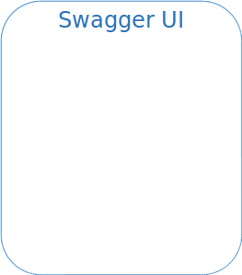
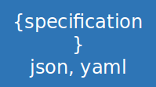




How Swagger UI works?
Since it’s a client side project a web server and web browser is enough to run the project
Setup is one time
API Server
Ajax

Slide 8
Demo

Slide 9
Dev Process
Include the Swagger UI script into your project
CDN
https://cdnjs.cloudflare.com/ajax/libs/swagger-ui/3.19.0/swagger-ui.css
https://cdnjs.cloudflare.com/ajax/libs/swagger-ui/3.17.0/swagger-ui-bundle.js
https://cdnjs.cloudflare.com/ajax/libs/swagger-ui/3.17.0/swagger-ui-standalone-preset.js
Git Clone
https://github.com/swagger-api/swagger-ui.git
Include the “dist” folder scripts
Configure your web server
Write the JSON/YAML specification
That’s it, your API sandbox is ready.

Slide 10



Made with Swagger
https://seller.flipkart.com/api-docs/order-api-docs/OMAPIRef.html
https://unicourt.com/developer-hub
https://data.gov.in/ogpl_apis
Many more..!

Slide 11
Alternatives
Reinvented OpenAPI (ReDoc)
https://github.com/Rebilly/ReDoc
OpenAPI GUI
https://github.com/Mermade/openapi-gui

Slide 12
References
https://swagger.io/
https://swagger.io/swagger-ui/
https://github.com/swagger-api/swagger-ui
https://github.com/OAI/OpenAPI-Style-Guide#the-specification-name-and-usage
https://www.linuxfoundation.org/press-release/new-collaborative-project-to-extend-swagger-specification-for-building-connected-applications-and-services/

Slide 13

Thank you...!
Code + Presentation Slides:
https://github.com/niksrd/swagger.git

