Slide 1
DEBUG IRENA

Slide 2
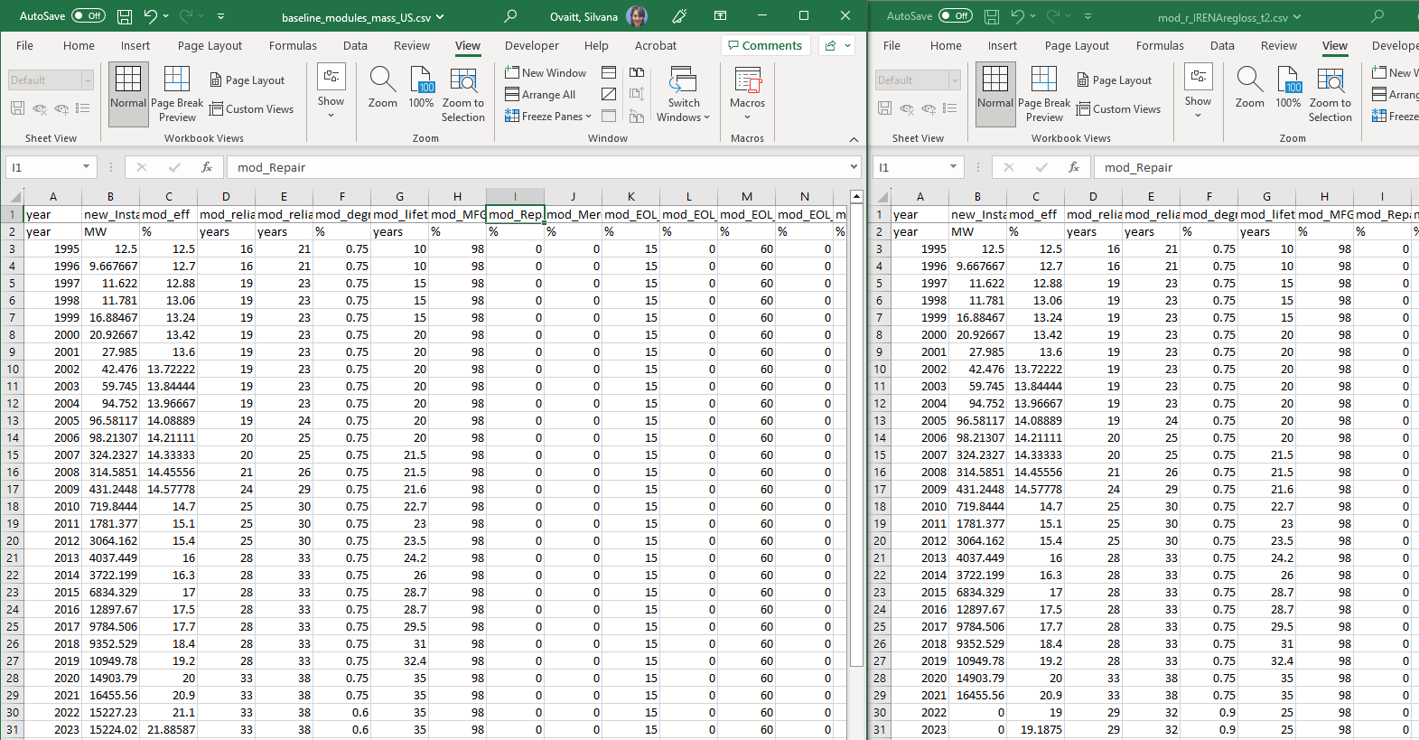
Input files comparisons

Slide 3
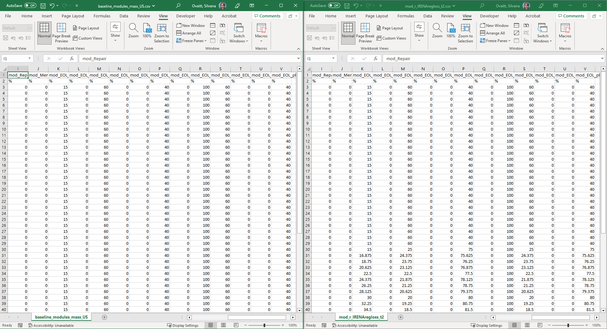
Input files comparison
RECYCLING INCREASES
RECYCLING INCREASES

Slide 4
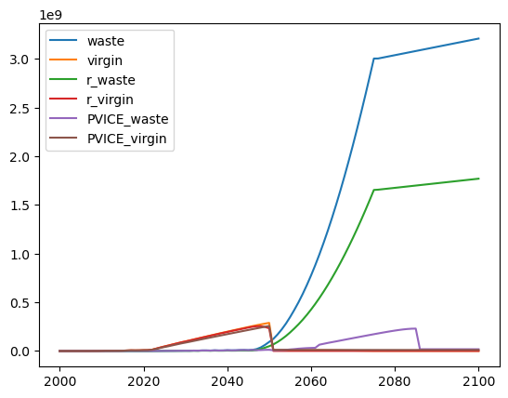
Problem: Waste is larger than Virgin
Waste all Module
VirginStock Module
IRENA Wastes
This uses the standard material baselines
It looks cumulative instead of annual
r_IRENA Wastes
This is lower because this one uses the high recycling materials
It looks cumulative instead of annual
IRENA Virgin, PV ICE waste and virgin

Slide 5
Code to produce the previous graph
*Does not use weilbull params
ii_yearly, ii_cumu = sim1.aggregateResults() #have to do this to get auto plots
plt.plot(ii_yearly['WasteAll_Module_sim1_IRENA_[Tonnes]'], label='waste')
plt.plot(ii_yearly['VirginStock_Module_sim1_IRENA_[Tonnes]'], label='virgin')
plt.plot(ii_yearly['WasteAll_Module_sim1_r_IRENA_[Tonnes]'], label='r_waste')
plt.plot(ii_yearly['VirginStock_Module_sim1_r_IRENA_[Tonnes]'], label='r_virgin')
plt.plot(ii_yearly['WasteAll_Module_sim1_PV_ICE_[Tonnes]'], label='PVICE_waste')
plt.plot(ii_yearly['VirginStock_Module_sim1_PV_ICE_[Tonnes]'], label='PVICE_virgin')
plt.legend()

Slide 6
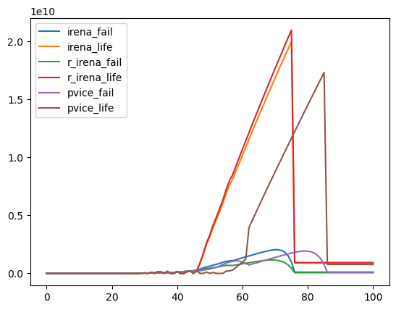
DataOut_m area failures seem reasonable…?
plt.plot(sim1.scenario['IRENA'].dataOut_m['Yearly_Sum_Area_disposedby_Failure'], label='irena_fail')
plt.plot(sim1.scenario['IRENA'].dataOut_m['Yearly_Sum_Area_disposedby_ProjectLifetime'], label='irena_life')
plt.plot(sim1.scenario['r_IRENA'].dataOut_m['Yearly_Sum_Area_disposedby_Failure'], label='r_irena_fail')
plt.plot(sim1.scenario['r_IRENA'].dataOut_m['Yearly_Sum_Area_disposedby_ProjectLifetime'], label='r_irena_life')
plt.plot(sim1.scenario['PV_ICE'].dataOut_m['Yearly_Sum_Area_disposedby_Failure'], label='pvice_fail')
plt.plot(sim1.scenario['PV_ICE'].dataOut_m['Yearly_Sum_Area_disposedby_ProjectLifetime'], label='pvice_life')
plt.legend()
Killed by lifetime from DataOut_m
Killed by Fails from DataOut_m

Slide 7
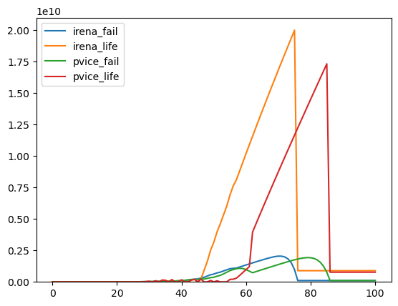

Slide 8
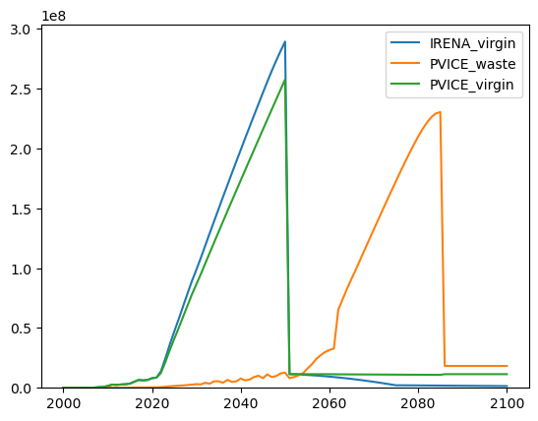
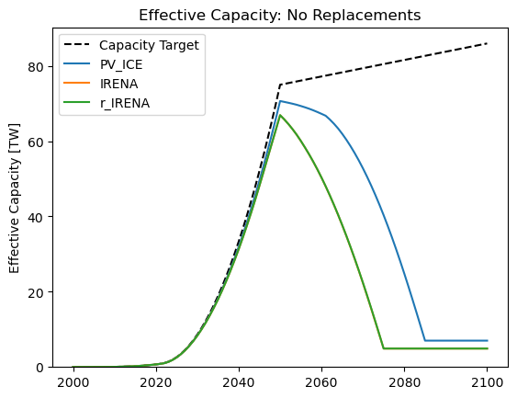
Things that look correct

Slide 9
IRENA and r_IRENA dataIn_m are essentially identical
R_IRENA has slightly different t50 t90 values, eventually these should get overwritten by Weibull params.

Slide 10
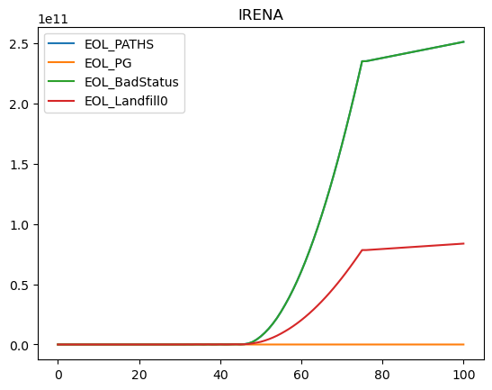
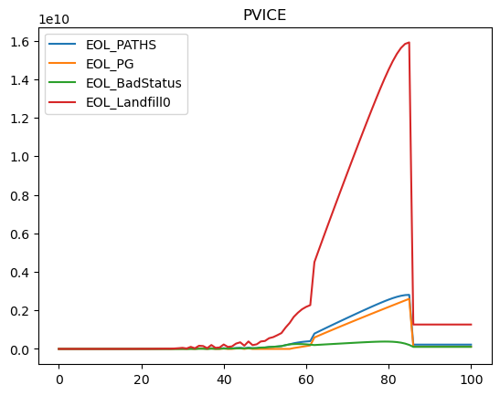
DataOut_M

Slide 11
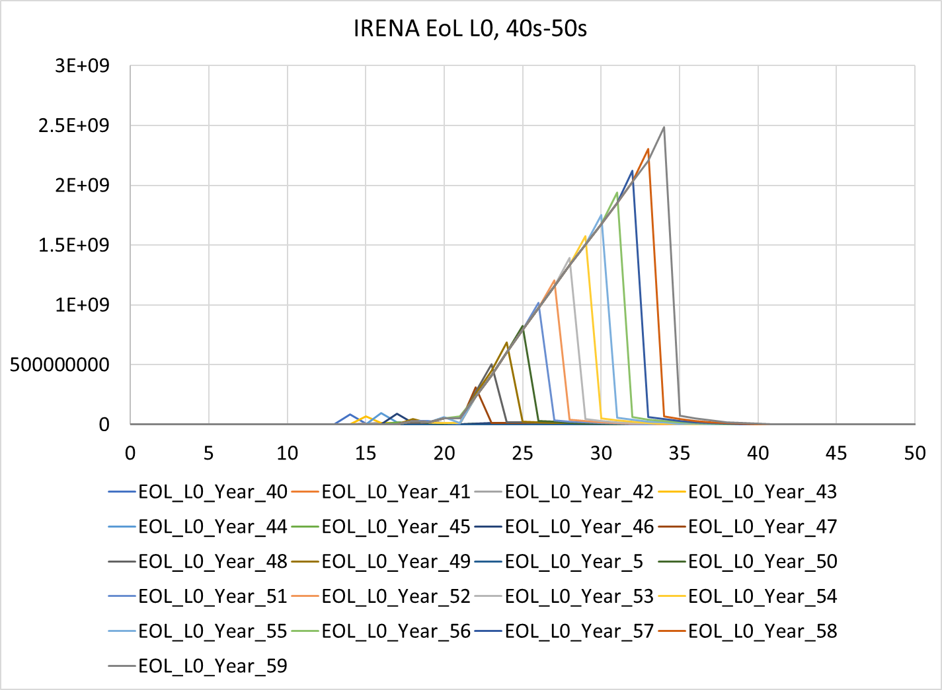
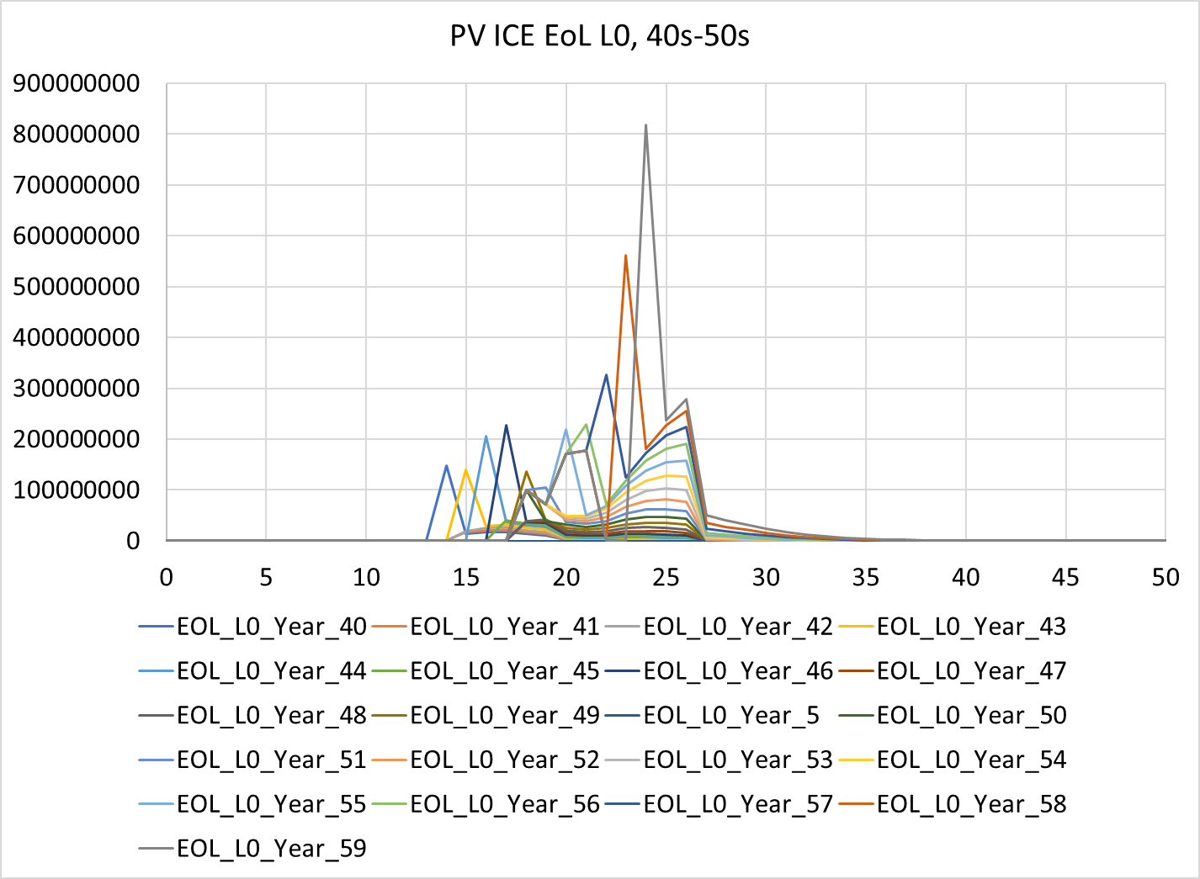
EOL L0 – the end of life on year ## is possibly cumulative??

Slide 12
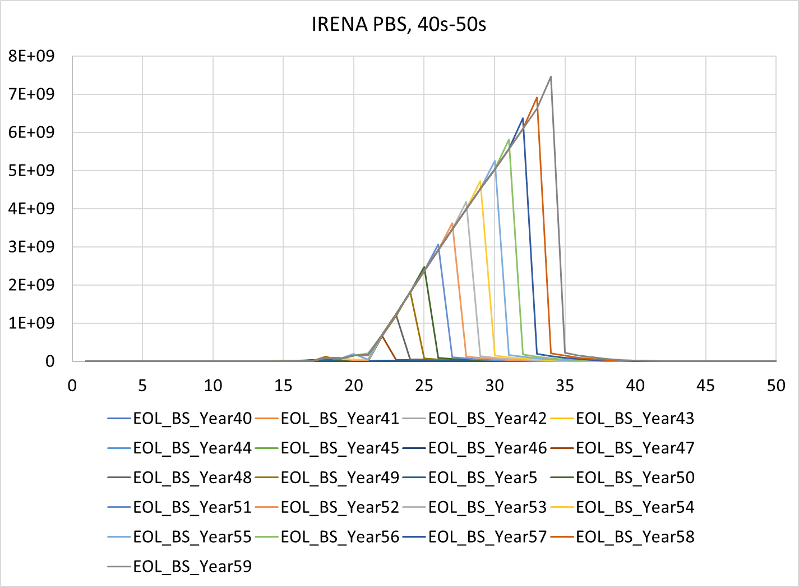
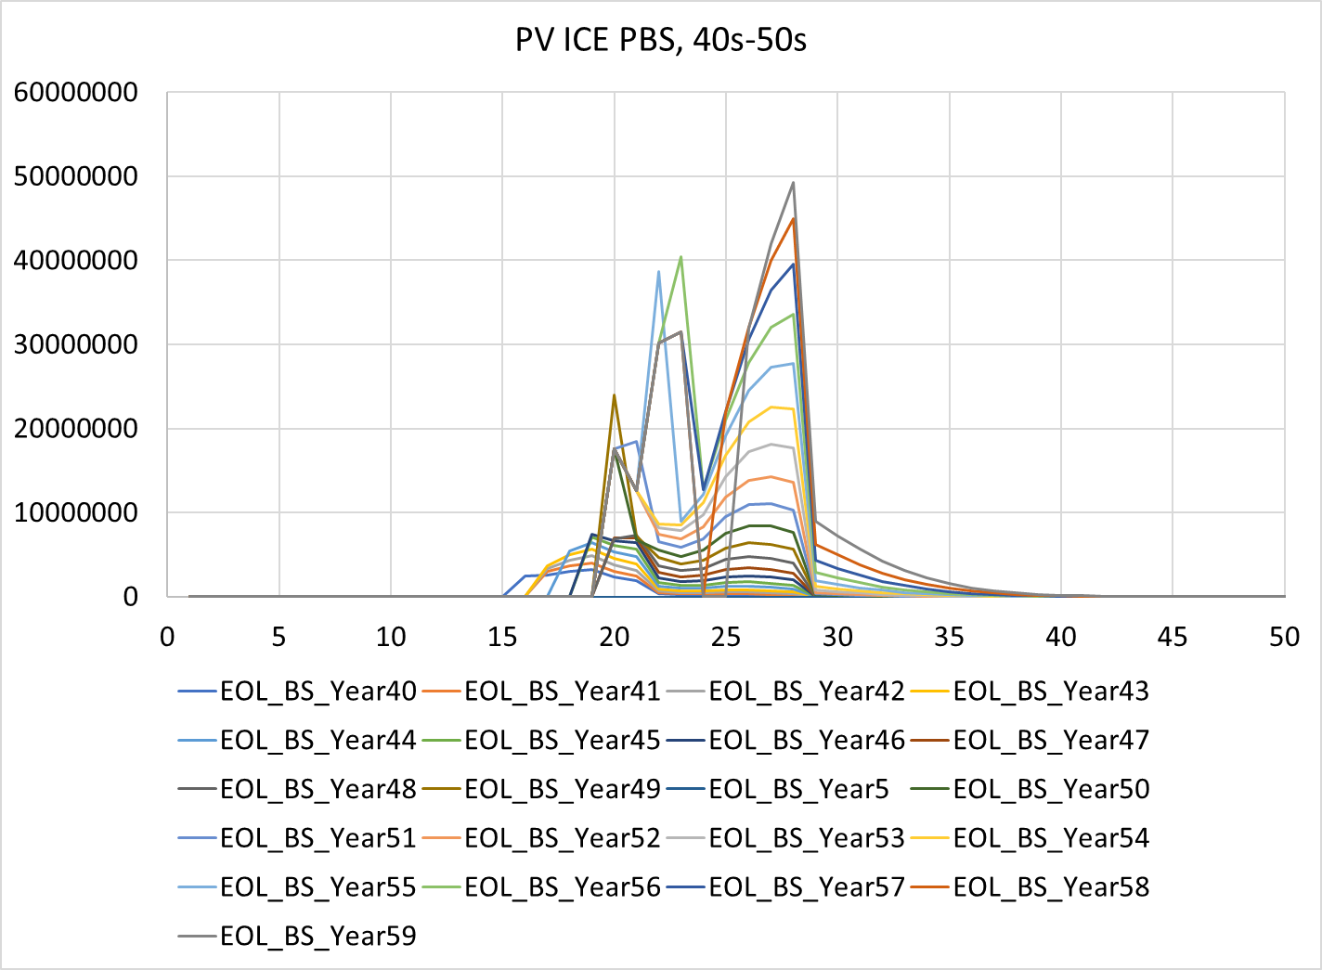
EOL PBS also looks cumulative

Slide 13
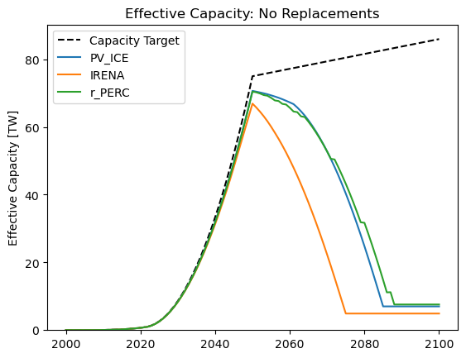
Check non-IRENA module files
Ran with PERC
Didn’t modify materials, just modules

Slide 14
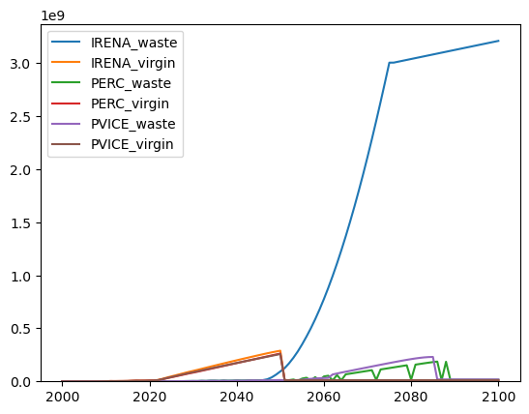
r_PERC shows jagged, but not blow up

Slide 15
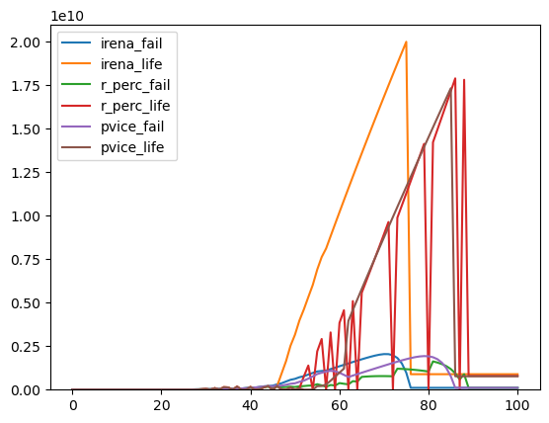
Data out yearly sums still look ok, except for jagged r_PERC

Slide 16
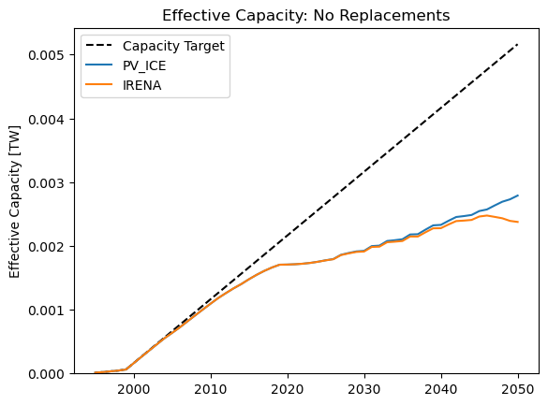
Remove Trim year extension
Did not use trim years to extend the simulation
Used a 100.0 MW annual install

Slide 17
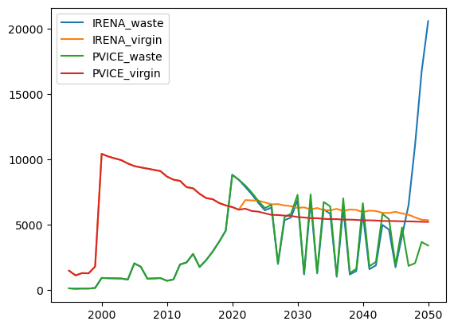
Aggregate Results, both jagged and blow up
From iiyearly2, aggregate results function
This is demonstrating the jagged results as well as waste blowing up.
PV ICE waste doesn’t blow up…?

Slide 18
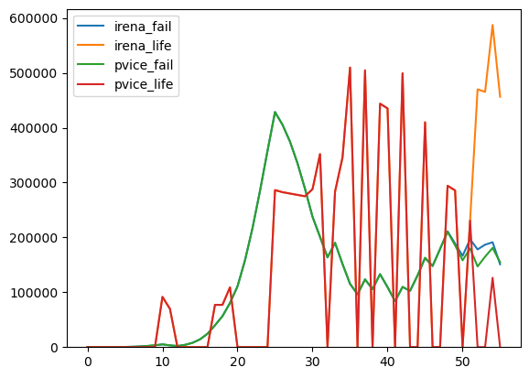
DataOut_m shows both jagged and blow up?
Area disposed by failures and
Area disposed by project life

Slide 19
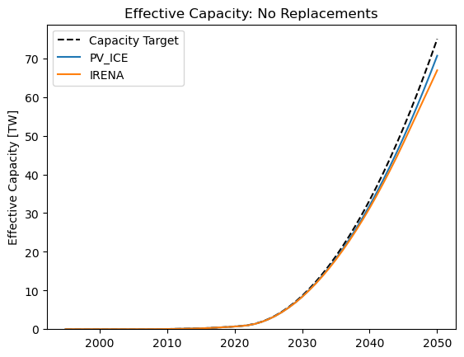
Remove the Trim year extension
Did not use trim years to extend the simulation
Use global projection through 2050

Slide 20
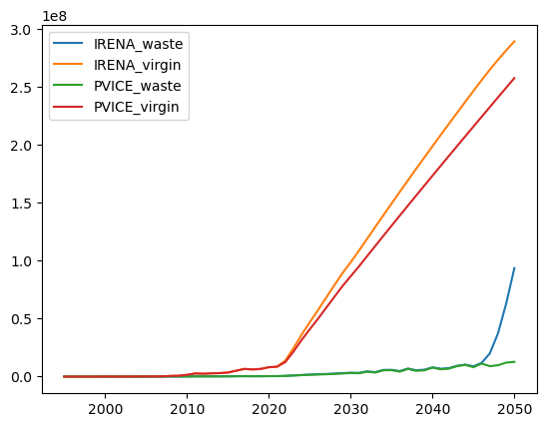
Aggregate Results, blow up starts
From iiyearly2, aggregate results function
PV ICE waste doesn’t blow up
Like the 100MW/yr, the blowing up seems to only start the last two-ish years before 2050

Slide 21
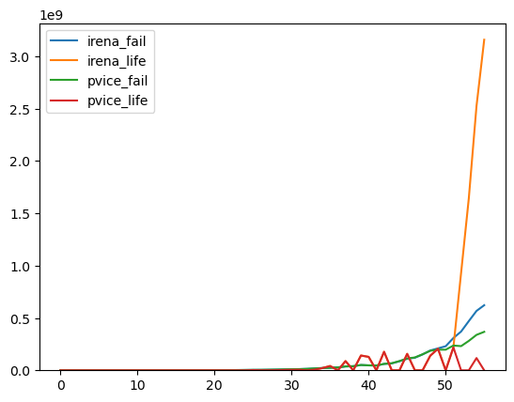
DataOut_m shows both jagged and blow up?
Area disposed by failures and
Area disposed by project life

Slide 22
New tests..

Slide 23
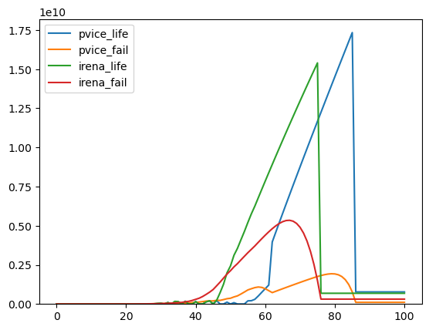
Doing t50 t90 for PV ICE, and Weibull Params for Irena
This looks more like what I was expecting; more failures in the Irena and lower failures due to life. But this is probably on the rounding errors or lifetime of project set for the irena. Is it set to 40?

Slide 24
Aggregated results functin
Check DecommisionedCapacity column - W units, Garvin issue
WasteAll_Module – looks cumulative

Slide 25
Testing on r_PERC
Testing in bottom Sim3 of DEBUG-IRENA
Calculated T10 to be same as project lifetime ➔ jagged lines
The problem goes away if you greatly increase or decrease Mod_lifetime

Slide 26
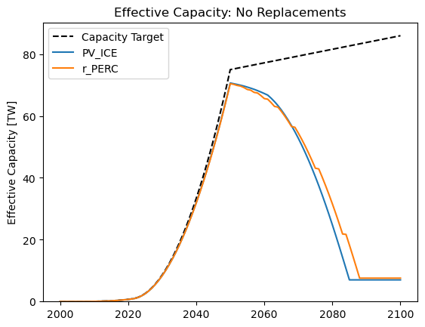
Jagged lines start as kinks in effective capacity

Slide 27
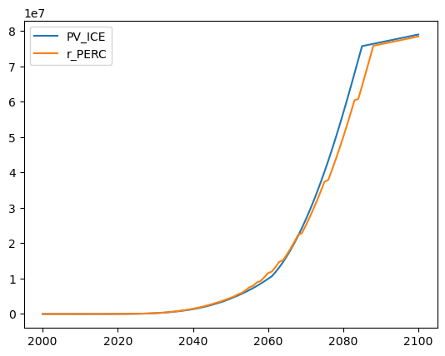
And almost flat lines in decommissions

Slide 28
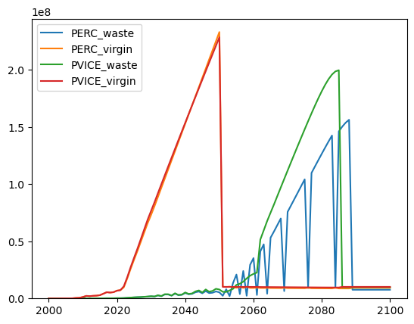
Results in jagged wastes

Slide 29
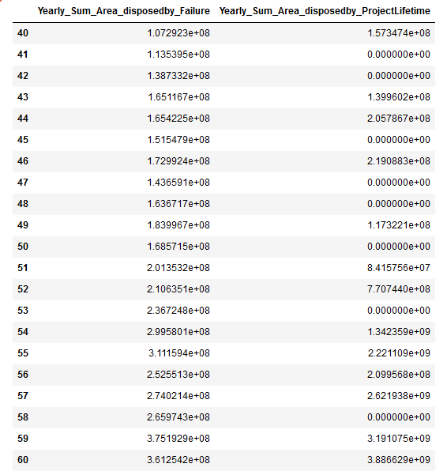
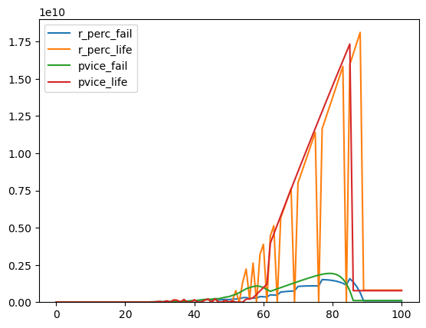
Both fail and lifetime kills are kinky, the lifetime falls to 0 whenever the fail kinks

Slide 30
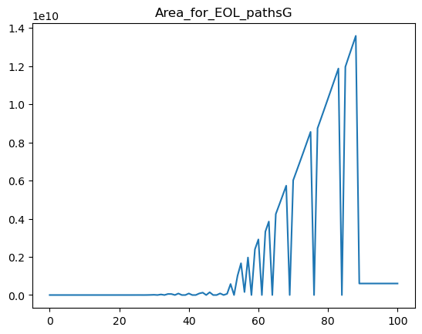
Area for end of life paths good follows lifetime kills

Slide 31
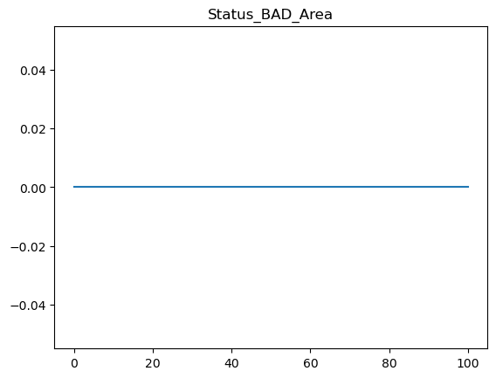
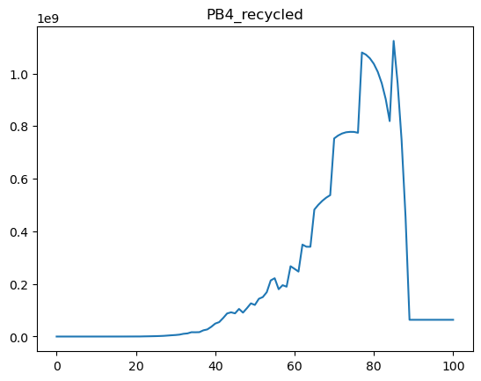
Despite having kills from failure, the end of life status bad area is 0?!? BUT, Path Bad recycling is NOT 0

Slide 32
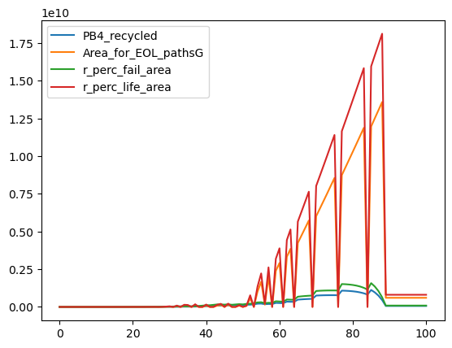
Disposed Areas are driven by recycle and path good

