Slide 1
Inter-Model Data Flows Using the AESD Records API
Nicholas Brunhart-Lupo, Brian Bush, Kenny Gruchalla, Michael Rossol
Analysis Coffee Break
10 August 2017

Slide 2
Abstract
We present an overview of the dataflow architecture developed for the National Renewable Energy Laboratory’s Advanced Energy System Design (AESD) capability. The dataflow architecture is general-purpose, supporting a wide range of multivariate time-varying data producers, including measurements from real-time sensors and results from high performance computing (HPC) simulations, and allowing multiple concurrent consumers, including visualizations, statistical analyses, and datastores. The AESD Records API (application program interface) enables software that serves multidimensional record-oriented data to interoperate with software than uses such data. In the context of the Records API, multidimensional data records are simply tuples of real numbers, integers, and character strings, where each data value is tagged by a variable name and each record is assigned a unique identifier. We discuss three major use cases for serving and consuming records data: (i) static data, (ii) dynamically augmented data, (iii) on-demand simulations, (iv) with filters, and (v) with bookmarks. Separate implementations of the API exist in C++, Haskell, JavaScript, Python, and R.

Slide 3

Advanced Energy System Design to Solve Complex Challenges
New capabilities with value and impact:
Foster reliable, affordable and clean energy systems at scales that matter
Assist cities, communities, and industry with optimal energy systems designs
Provide new opportunities for job creation and economic growth
Using innovative new scientific approaches:
Interactive systems dynamics simulation
Integrated virtual exploration
Immersive computational steering
First-of-a-kind lab and field system experiments
Leveraging deep technology expertise:
Energy Analysis • Decision Science • Solar • Wind • Water • Geothermal • Buildings • Bioenergy • Hydrogen and Fuel Cells • Vehicles • Manufacturing • Computational Science • Grid Modernization

Slide 4


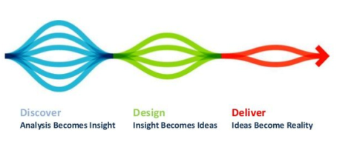
Advanced Energy Systems Design
A systems approach to energy transformation: applicable at multiple scales, different levels of maturity
Characterize “as is” state
Engage stakeholders to define priorities
Formulate future scenarios
Hardware and software modeling
Explore “what if” questions
Create design blueprint
Develop supporting institutions
Deploy, operate and validate
Discover
Design
Demonstrate

Slide 5
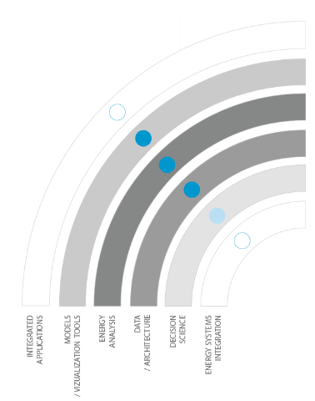
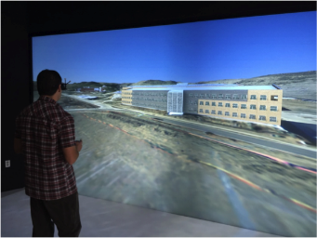
NREL Intelligent Campus
GOAL: collect and use historical and real‐time campus energy data to enhance operational awareness and enable improved energy use decisions
Capture data from meters, sensors, and other key instruments located throughout campus.
Incorporate data into a working “as-is” model of the campus energy system.
Visualize in a working Campus Energy Operations Center, located at ESIF
Develop options for peak electric load reduction
Use interactive computation and visualization to explore value of peak load reduction options
Convene stakeholders from across campus to develop “design blueprint” for to guide future investments
Integrated with NREL Capabilities
Clean Energy System Design will accelerate NREL’s ability to identify energy savings, advance environmental stewardship performance, improve system maintenance, and more quickly identify problems in campus energy system operations.

Slide 6
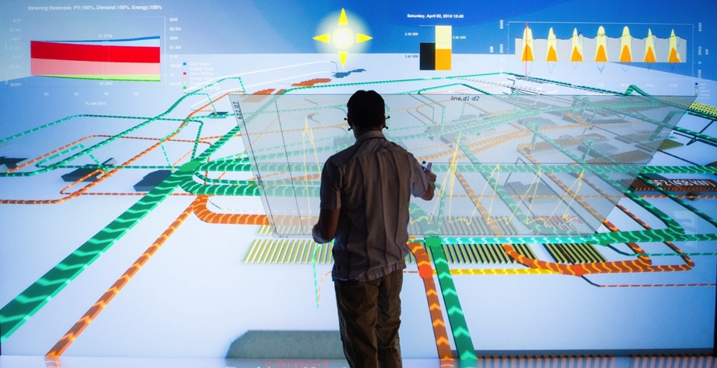
Rapid exploration and prototyping
Enabling Rapid Exploration of Infrastructure Options
Faster, reduced-form, HPC-ready economic dispatch and power flow models enable more rapid (~1 min) interactive evaluation of potential power system design choices across a wide variety of technology, economic and policy possibilities.
Additional integration opportunities and value streams are discovered by coupling power models with similar reduced-form models for heating/cooling, hydrogen, natural gas, liquid transportation fuels, water and wastewater systems, and communications networks.
Deeper understanding of energy system dynamics can be obtained with “computational steering” of models using immersive visualization and physical object manipulation
IMPACT: Optimized energy system designs for cities, communities and industrial campuses with higher reliability, security and resilience, affordability, and use of advanced technologies.
Advanced Energy System Design

Slide 7
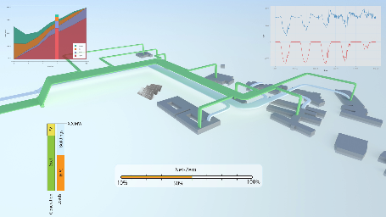
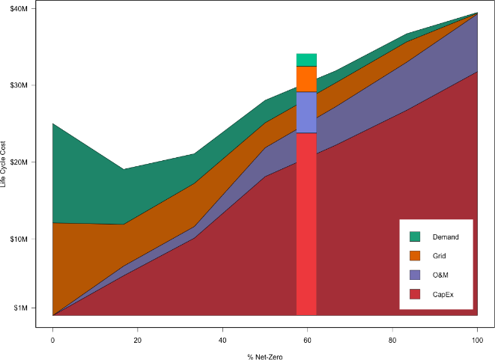
Workflow – PV Installation/Design
3. User sets modifies PV install
(i.e., location, type, or size)
OpenDSS runs with new generation profiles
Design costs update based on ReOpt cost model
Power visualizations update on new OpenDSS data
Net-Zero slider updates to new position based on ReOpt model
Life Cycle Cost break-down of current
design
In the context of the
Life Cycle Cost break-down of cost-optimal solutions from ReOpt
Positioned at the current design’s %
Net-zero based on ReOpt Model

Slide 8
Architecture
Immersive App
Immersive App
Web
App
Web
App
R
Script
iPython
Script
…
…
Immersive Interface (Isopach)
Web Interface
Data Interfaces
AESD Records API
Simulation
(HPC, Hardware, Cloud,…)
Heterogeneous
Data Stores

Slide 9
Design Goals
Simplify and normalize interaction between data sources and data processors for multidimensional record-oriented data
Example multidimensional record-oriented data
Tabular data
Rows in a relational database
Key-value maps
Flat JSON objects
Example data sources
CSV, TSV, or Excel files
Time series data
Data feeds from sensors
Simulation output
Example data processors
Visualization software
Statistics software
Web browsers
Simulations
Only require essential metadata
Uniquely identify “models”
Support simple schemas
Support basic data types:
Real numbers
Integers
Character strings
Implementable in nearly any programming language and computing environment
Reduce the barriers to a minimum, for both server and client implementations
Client implementations are packaged as libraries: users just need to import the correct module to access the servers
Server implementations can start from a template that handles all of the details of serialization and communications: users just need to connect their data or simulation backend to the template
Client server model with both pull and push:
Clients ask for available datasets, receive extant data and any new records as they are generated, and, as needed, ask for the simulation of new data based on user input
Support pipeline model for dataflow:
Servers and clients can be chained together
Transformation paths for records
Coupled models
Bookmarks
Filtering

Slide 10
Design and Implementation Details
WebSockets for data transport.
Libraries available for all common programming languages and platforms.
Works in web browsers.
Firewall friendly.
Bidirectional communication.
Large data payloads.
Google Protocol Buffers 3 for data serialization.
Libraries available for all common programming languages and platforms.
Efficient.
Users of client libraries, precompiled servers, and server templates need not concern themselves with the low level WebSocket and Protocol Buffer aspects of the API.
Implementations (Linux, Mac OS X, Windows)
Ready-to-use clients:
Plotty (3D scatterplots in ESIF B311 immersive visualization environment).
Web browser
Libraries for client access to data in several programming languages:
C++
JavaScript
R
Haskell
Python
Ready-to-use servers:
Comma-separated-value (CSV) files
Tab-separated-value (TSV) files
PostgreSQL tables/views
MySQL tables/views
SQLite3 tables/views
ODBC data sources (includes MS Access and MS Excel)
Haystack sensor feeds (e.g., campus and building data on NREL’s SkySpark servers)
Templates for creating new special-purpose servers in various programming languages:
C++
Haskell
R (pending)
Python (planned)
Prepackaged Docker/rkt containers for services

Slide 11
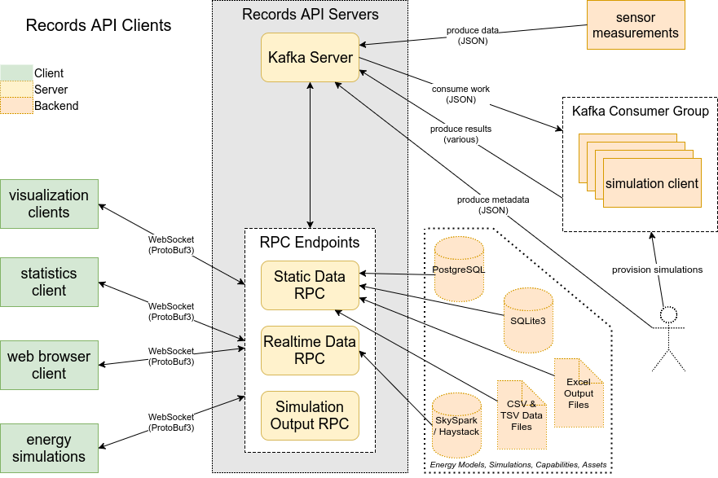
Clients and Backends for AESD Records API v4

Slide 12
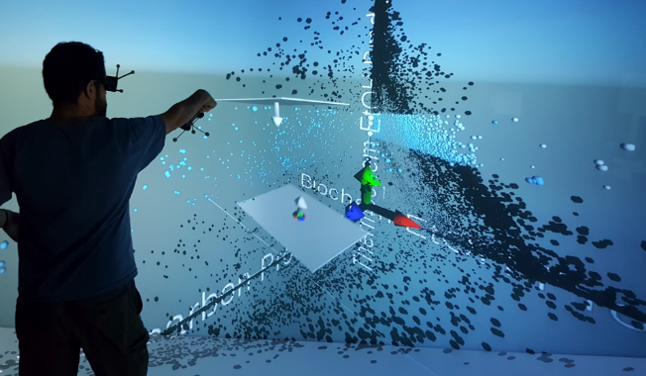
Using AESD Records for Immersive 3D Scatterplots
Organize your data as comma- or tab-separated-value data file (wide format).
Alternatively, create an SQL query for PostgreSQL, MySQL, SQLite3, or ODBC or create an R data frame.
Start an AESD Records Server on your laptop.
Move the data file into the directory from which the server finds its datasets.
Open the Plotty app in ESIF B311.
Explore.

Slide 13
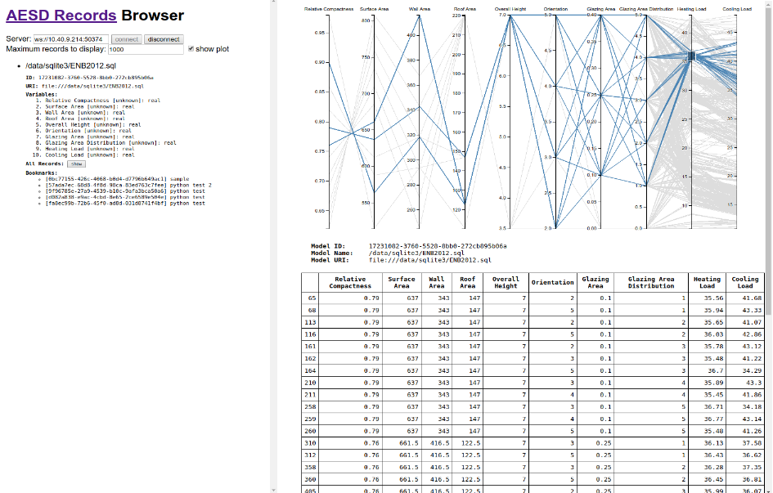
AESD Records Client
URL for data server
SQL backend
Model metadata
Visualization
Variables metadata
Bookmarked subsets of data
Tabular data

Slide 14
WebSocket Requests and Responses
Request | Response
Metadata for model(s) | ModelMetaList
Data records | RecordData
Metadata for bookmark(s) | BookmarkMetaList
Saving a bookmark | BookmarkMetaList
Canceling a previous request | n/a
New work, such as a simulation | RecordData

Slide 15
Illustrative Excerpt from Protocol Buffer Definitions
message BookmarkIntervalContent {
int64 first_record = 1; /// [semantically optional]
int64 last_record = 2; /// [semantically optional]
}
message BookmarkSetContent {
repeated int64 record_ids = 1; /// [semantically optional]
}
message BookmarkMeta {
string bookmark_id = 1; /// [semantically optional]
string bookmark_name = 2; /// [semantically required]
oneof content /// [semantically required]
{
BookmarkIntervalContent interval = 3;
BookmarkSetContent set = 4;
FilterExpression filter = 5;
}
}
message BookmarkMetaList {
repeated BookmarkMeta bookmark_metas = 1; /// [semantically optional]
}

Slide 16
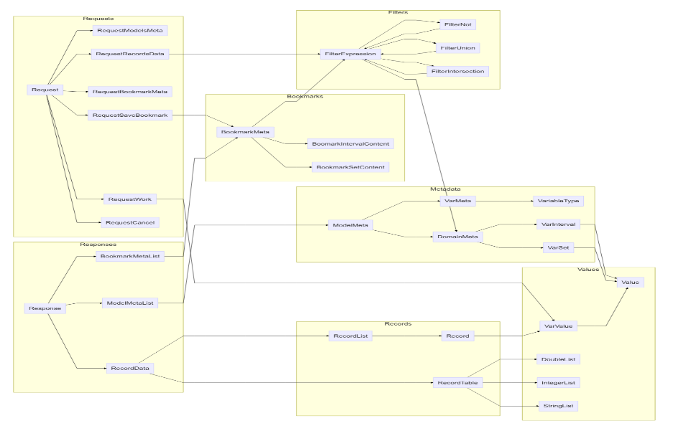
Request and Response Object Relationships

Slide 17
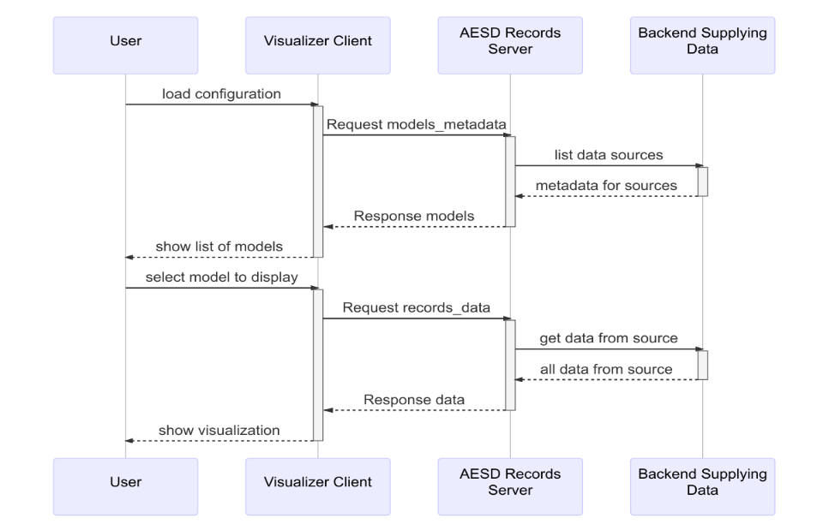
Use Case: Serving Static Data

Slide 18
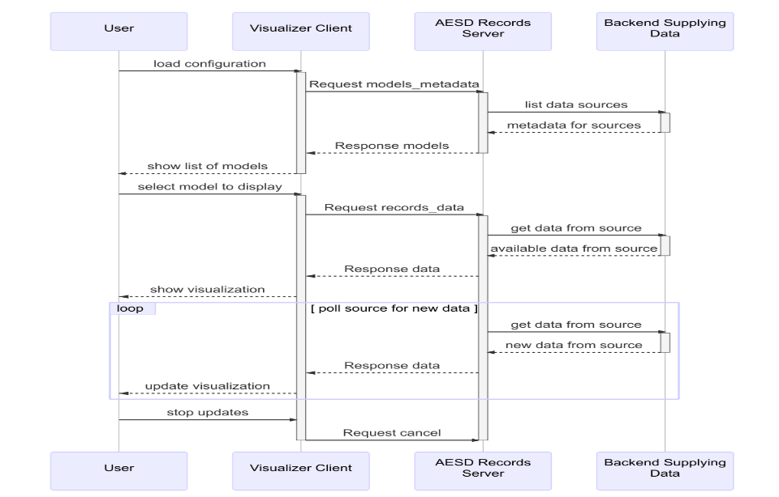
Use Case: Serving Real-time/Sensor Data

Slide 19
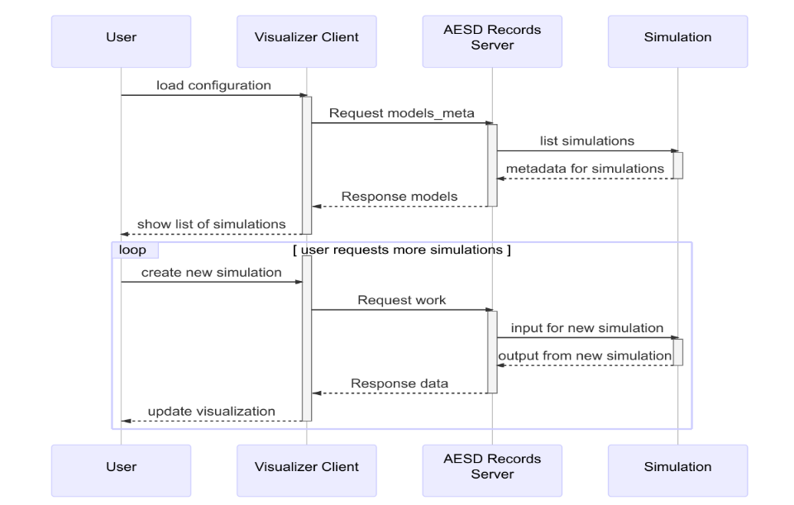
Use Case: Creating and Serving Simulation Data

Slide 20
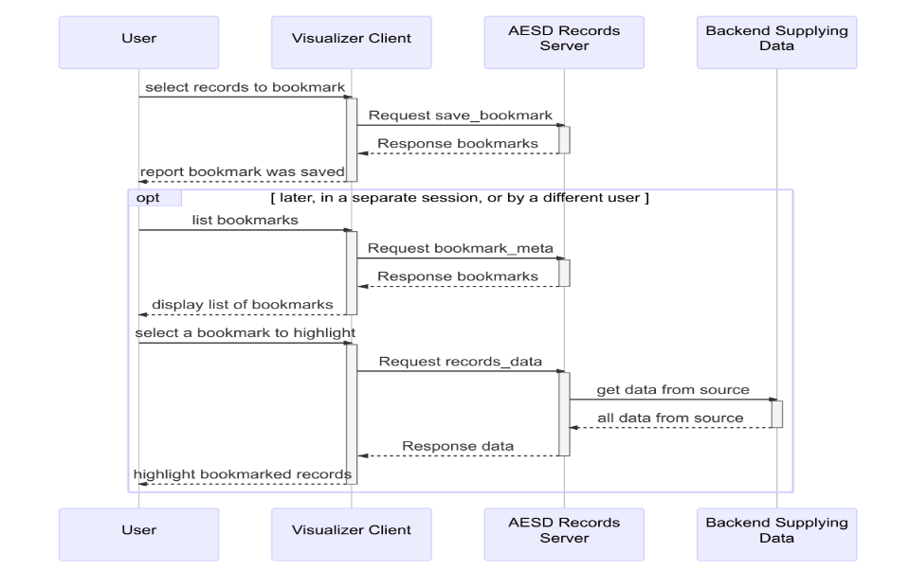
Use Case: Bookmarking Data for Later Retrieval

Slide 21
Example Client Implementation: JavaScript
Connect to a server connect(wsURL)
Disconnect from a server disconnect(connection)
Retrieve list of data models requestModelsMetadata(connection, modelId, notify, notifyError)
Retrieve data records requestRecordsData(connection, modelId, maxRecords, variableIds, bookmarkId, notify, notifyError)
Retrieve list of bookmarks requestBookmarkMeta(connection, modelId, bookmarkId, notify, notifyError)
Create/update a bookmark requestSaveBookmark(connection, modelId, name, filter, notify, notifyError)

Slide 22
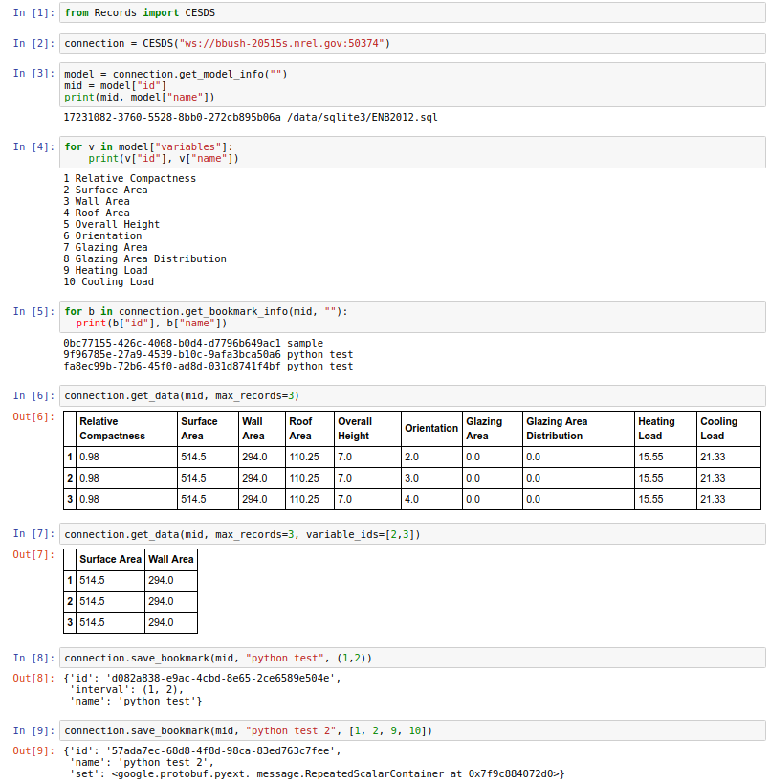
Example Client Usage: Python
Connect to server
Discover data model and variables
List bookmarks
Retrieve some data
Create new bookmarks

Slide 23
Possibilities for Collaborative Use
Sharing regardless of physical location
Data
Simulation results
Bookmarks of data discoveries
Team in ESIF B311
Staff Interacting with Immersive Visualization
Statistician Designing Simulation Experiments
Office in RSF
Analyst Viewing Bookmarked Data
AESDS Records Servers
Team in NREL DC Conference Room
Staff Remotely Interacting with Visualization
Compute Servers (Peregrine, AWS EC2, Other)

Slide 24
Resources
Official release at end of September
<https://github.nrel.gov/d-star/data-feeds/blob/master/README.md> (preliminary / work in progress)
Online data browser
URLs of existing data feeds
How to deploy your own server
How to create your own client
Links to source code
Links to documentation
Advice
Nicholas Brunhart-Lupo (general questions, C++)
Brian Bush (general questions, JavaScript, Haskell, SQL)
Kenny Gruchalla (R)
Michael Rossol (Python)

