Slide 1

Opal-RT Technologies
RT-LAB Orchestra
Distributor meeting October 2007
Loïc Schoen
RT-LAB Team leader

Slide 2
Introduction

Slide 3
What is RT-Lab Orchestra ?
RT-LAB Orchestra is an add-on extending RT-LAB’s connectivity capabilities to heterogeneous co-simulations
Heterogeneous co-simulations consist of simulations written in different programming languages, or generated by various simulation tools

Slide 4
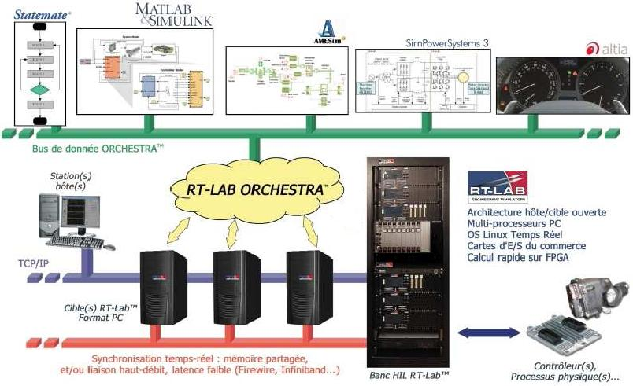
What is RT-Lab Orchestra ?
Heterogeneous Co-Simulation Environment
Orchestra data bus
Command
Station
Open Architecture Host/Target
Multicore target PC
QNX6 / Redhawk / Win32 OS
COTS I/O
Fast calculation on FPGA
Target PC
Real-time synchronization: shared memory or fast real-time link with small latency like Firewire, Infiniband ..)
ECU ..
HIL Unit

Slide 5
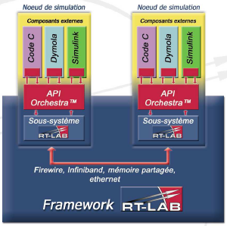
What is RT-Lab Orchestra ?
Heterogeneous Co-Simulation Environment
Simulation node
Simulation node
External Component
External Component
Sub-System
Sub-System
Firewire, Infiniband, shared memory,
ethernet

Slide 6
What is RT-Lab Orchestra ?
Communication layer between
RT-LAB and simulation components
User-configurable through an XML description file
C-code API used by simulation components to exchange data with the RT-LAB framework
Library of Matlab/Simulink blocks

Slide 7
Data-Centered Co-simulation
RT-Lab Subsystem
Publish « Data 1 »
Subscribe « Data 3 »
Publish « Data 2 »
Domain
(RT-API)
Subscribe « Data 2 »
Subscribe « Data 1 »
Publish « Data 3 »
Publish « Data 4 »
External Component

Slide 8
Data-Centered Co-simulation
RT-Lab Subsystem
Publish « Data 1 »
Subscribe « Data 3 »
Publish « Data 2 »
Domain 1
Rate 1
Domain 2
Rate 2
Subscribe « Data 1 »
Publish « Data 4 »
Publish « Data 3 »
Subscribe « Data 2 »
External Component 1
External Component 2

Slide 9
Data-Centered Co-simulation
RT-Lab Subsystem 1
RT-Lab Subsystem 2
Publish « Data 2 »
Publish « Data 1 »
Subscribe « Data 3 »
Domain 1
Sync.
Domain 2
Async.
Subscribe « Data 2 »
Subscribe « Data 1 »
Publish « Data 4 »
Publish « Data 3 »
External Component 1
External Component 2

Slide 10
Why is co-simulation required ?
- Multiple simulation domains involved
- Different teams working together
Various languages/simulation tools used
Legacy code is re-used
As a result, models can :
- Be heterogeneous
- Require data hiding

Slide 11
Why use RT-Lab Orchestra ?
Flexibility
  Co-simulation components can be developed and tested by different teams, using their preferred tools, then integrated to form a cohesive co-simulation system.
  Refer to the data by name
Enables real-time co-simulation
- Loose coupling, allowing for dynamic connection management

Slide 12
New features
RT-LAB 8.2

Slide 13
New features
Goto/From blocks
When using a Proxy block, input and output signals are accessible through Goto/From blocks.
This decreases the amount of wires in the model. Goto/From blocks allow to access the corresponding signals all over the subsystem
It also fixed connection problem when item are renamed or deleted.

Slide 14
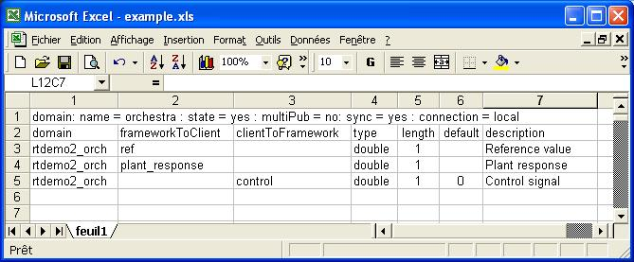
New features
CVS file converter
With large models containing a huge amount of signals, it becomes easier to generate the XML description file, from a CSV file. Use DDF configurator.

Slide 15
New features
Support of new data types
Supported data types:
  Integer & integer arrays
  Double & double arrays
  Char & char arrays

Slide 16
New features
Support of Reflective Memory link (1)
➔ Extend a domain to 2 targets
A single Orchestra domain can now be shared between 2 targets, using the Reflective Memory link.
This was impossible with a shared memory configuration
P
S
Orchestra
Domain
S
P

Slide 17
New features
Support of Reflective Memory link (2)
➔ Extend execution to 2 different OS
P
S
Orchestra
Domain
S
P
Target 1
Target 2
Windows XP
Windows XP
QNX 6.3.2
QNX 6.3.2
Windows XP
QNX 6.3.2
QNX 6.3.2
Windows XP

Slide 18
New features
Support of Statemate 4.2 (Win & QNX)
Statemate is now supported in QNX targets. A Statemate model is used as an external C code component

Slide 19
New features
Support of CANoe
CANoe is now supported, by using the Reflective Memory link.
Supported configurations:
CANoe target
Framework target
Windows XP
Windows XP
Windows XP
QNX 6.3.2
Windows XP Embedded
QNX 6.3.2

Slide 20
Licensing

Slide 21
Licensing
Three configurations:
Development: User could create model with multiple connection and execute it.
Pro: User could only execute model with multiple connection.
Basic: User could only execute model with one connection.

Slide 22
Application examples

Slide 23
Application examples
Multiple models (1)
Simulink model
(Simulink)
C code
FRAMEWORK (Simulink model)
Domain
Statemate model
(C code)

Slide 24
Application examples
Multiple models (2)
CANoe model
(RfM)
Simulink model
(Simulink)
FRAMEWORK (Simulink model)
Domain 2
Domain 1
Domain 3
Statemate model
(C code)
This configuration is used By Renault for their “PIV”

Slide 25
Application examples
Multiple OS
Reflective memory link
Windows PC
(CANoe using RT-API)
QNX Target
(Orchestra Framework)

Slide 26
Application examples
I/O server
Simulink C Model
Dymola C Model
Windows
Matlab/Simulink
Real Time Workshop
RT-Lab Host Full Development
Orchestra
Windows
RT-Lab Host Runtime Environment
Orchestra
Model based on Simulink
Model based on Dymola
Department A
Department B
QNX
RT-Lab Target Env Orchestra
QNX
RT-Lab Target Env Orchestra

Slide 27
Information about Orchestra
Go to RT-Lab MainControl and click on the Help button
Click on the Help button on the Orchestra blocks
- Access the PDF file: C:/OPAL-RT/RT-LAB8.XX/Help/pdf

Slide 28
How to use RT-Lab Orchestra ?

Slide 29
Orchestra with Simulink models
- Overview: Initial RT-Lab model
plant_response
SM_controller
control
SS_plant
ref
SC_user_interf
ref

Slide 30
Orchestra with Simulink models
- Overview: Model with RT-Lab Orchestra
plant_response
SM_framework
control
SS_plant
ref
Publish « plant_response »
Publish « ref »
Subscribe « control »
Domain
SC_user_interf
ref
Subscribe « plant_response »
Subscribe « ref »
Publish « control »
SM_controller

Slide 31
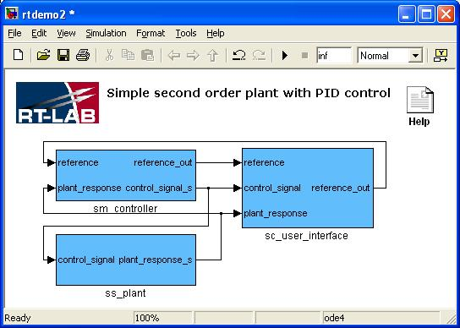

Orchestra with Simulink models
- This is the initial model. Rename the sm_controller subsystem to sm_framework

Slide 32
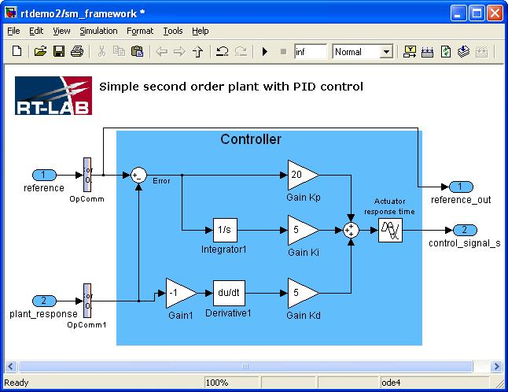
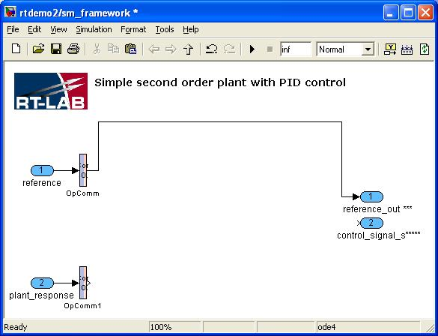
Orchestra with Simulink models
- In the sm_framework subsystem, delete the controller blocks

Slide 33
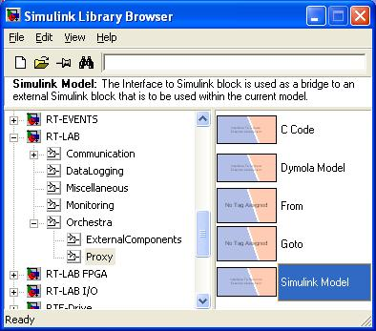
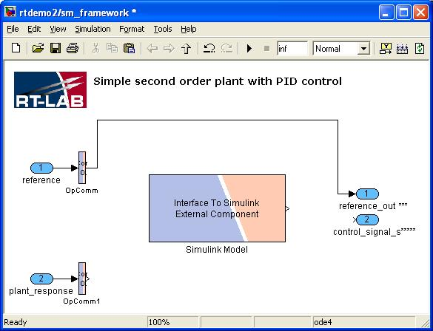
Orchestra with Simulink models
- Insert a Simulink Model Proxy block

Slide 34
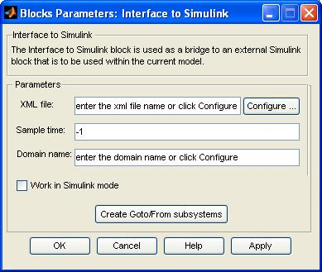
Orchestra with Simulink models
Double-click on the Proxy Block to open the block parameters
Click on the Configure… button

Slide 35
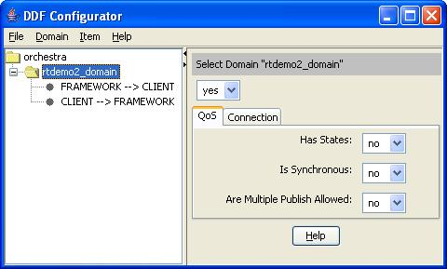
Orchestra with Simulink models
Select Domain → Add New Domain
Select the domain New Domain0 and rename it to rtdemo2_domain (hit enter after change)

Slide 36
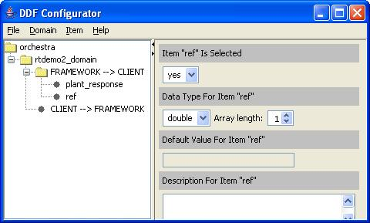
Orchestra with Simulink models
Select FRAMEWORK → CLIENT
Add 2 new items by selecting Item → Add New Data Item
Select each item and rename it to
  plant_response
  ref

Slide 37
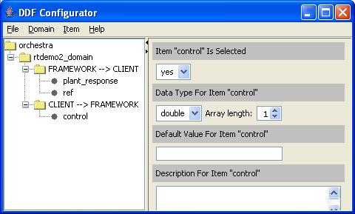
Orchestra with Simulink models
Select CLIENT →FRAMEWORK
Add 1 new item by selecting Item → Add new data item
Rename the item to
  control

Slide 38
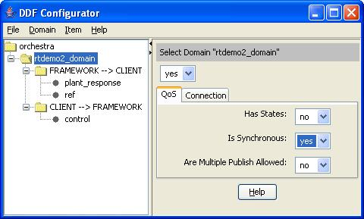
Orchestra with Simulink models
Select rtdemo2_domain and change Is Synchronous to yes

Slide 39
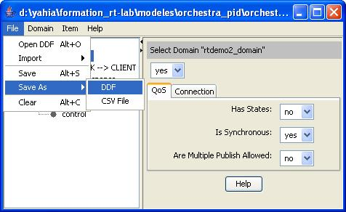
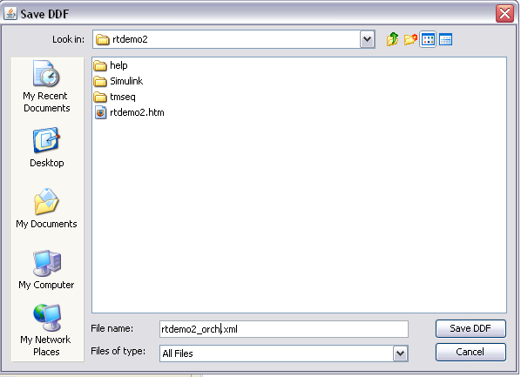
Orchestra with Simulink models
Select File → Save As → DDF and save in the local directory as rtdemo2_orch.xml
Close the DDF Configurator

Slide 40
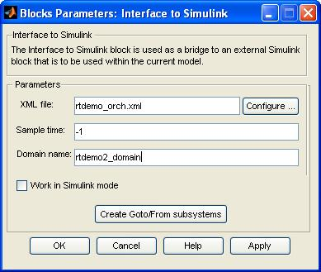
Orchestra with Simulink models
Back to the Block Parameters panel
  Set Sample time to –1 (same as model)
  Set Domain name to rtdemo2_domain
Select Create Goto/From subsystems
  This will create a
  Goto/From block for
  each Input/Output
  declared
Click OK

Slide 41
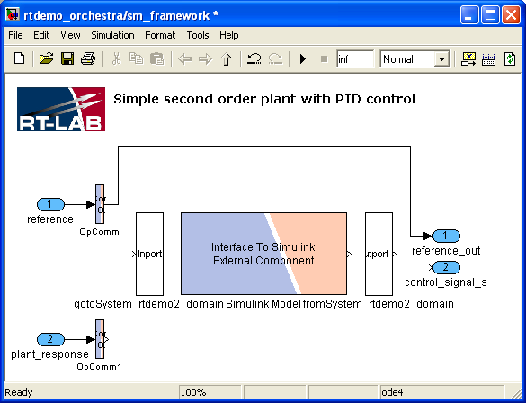
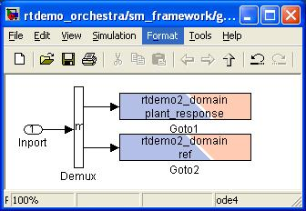
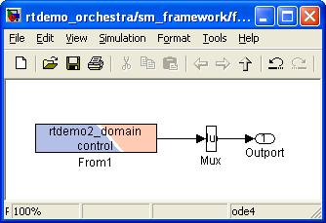
Orchestra with Simulink models
The blocks created by clicking on the Create Goto/From subsystems button give access to the signals exchanged with the client
This output indicates whether the client is connected (1) or not (0)

Slide 42
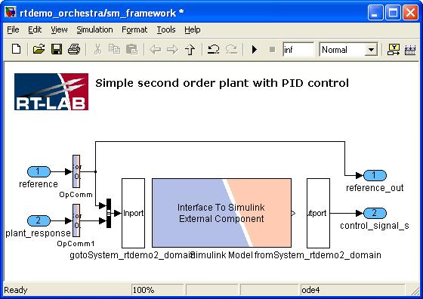
Orchestra with Simulink models
Connect the model with the Goto/From blocks and save it
The Orchestra Framework is ready

Slide 43
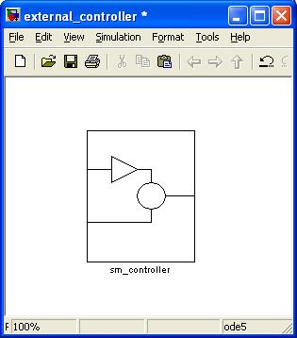
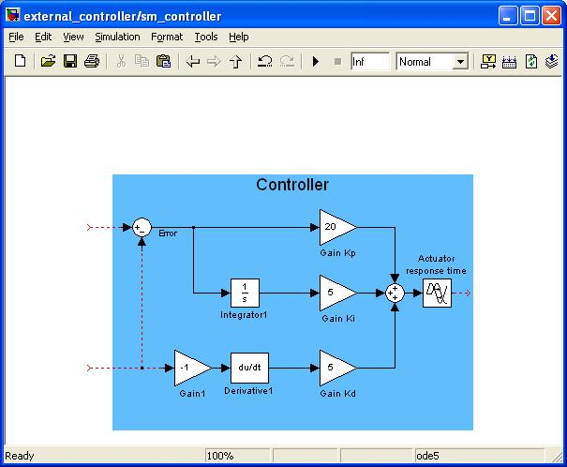
Orchestra with Simulink models
Create a new model and paste the controller blocks (ext_controller.mdl)
Put the controller blocks into sm_controller subsystem

Slide 44
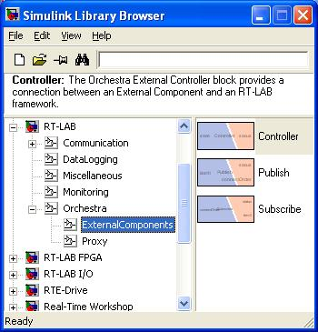
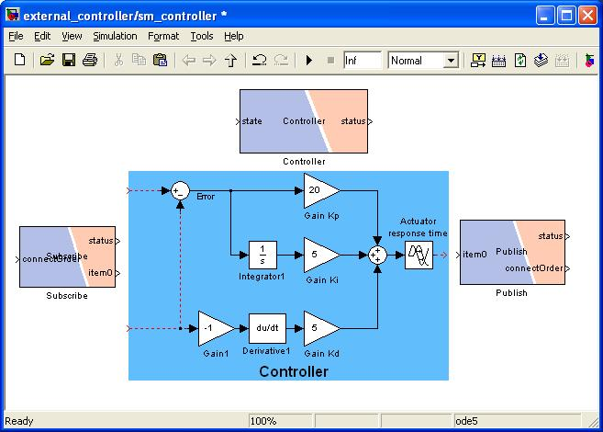
Orchestra with Simulink models
- Add a Publish, Subscribe and Controller Block from the External Components Library

Slide 45
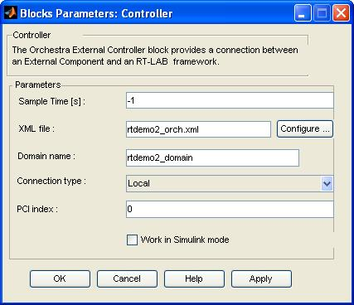
Orchestra with Simulink models
Open the Controller block
Set XML file to rtdemo2_orch.xml
Set Domain name to rtdemo2_domain

Slide 46
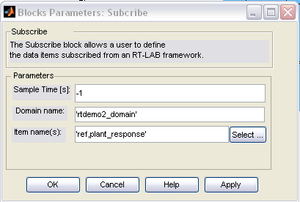
Orchestra with Simulink models
Open the Subscribe block
Set Domain name to ‘rtdemo2_domain’

Slide 47
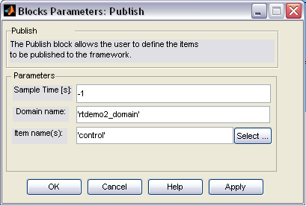
Orchestra with Simulink models
Open the Publish block
Set Domain name to rtdemo2_domain

Slide 48
Orchestra with Simulink models
Connect the Subscribe/Publish blocks with the model
Save the model as ext_controller.mdl and close it

Slide 49
Orchestra with Simulink models
Open RT-Lab MainControl
Open the framework rtdemo2_orch.mdl
Compile
Load
Execute
Disconnect

Slide 50
Orchestra with Simulink models
Open the external model ext_controller.mdl
Compile
Load
Execute
Disconnect

Slide 51
Orchestra with Simulink models
The model is now running using Orchestra
Connect to the framework and display the Console
Try unloading/loading the external model

Slide 52
Orchestra with C code
Orchestra can also be used to bring in external C Code to RT-Lab
sine
SM_framework
sine_gain
SC_user_interf
gain
Publish « sine »
Publish « gain»
Subscribe « sine_gain »
Domain
Subscribe « sine »
Subscribe « gain»
Publish « sine_gain »
External C code

Slide 53
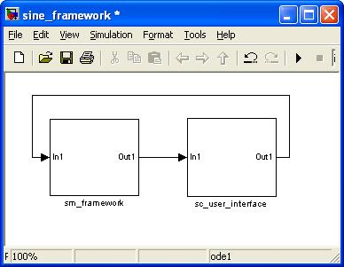
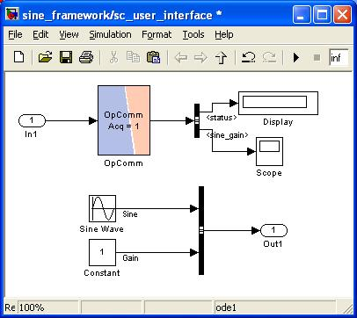
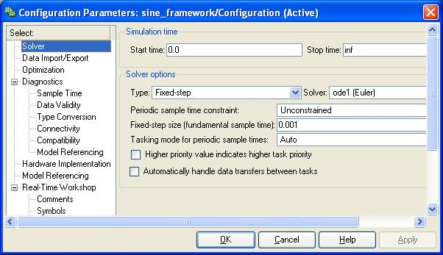
Orchestra with C code
- Create the RT-Lab model

Slide 54
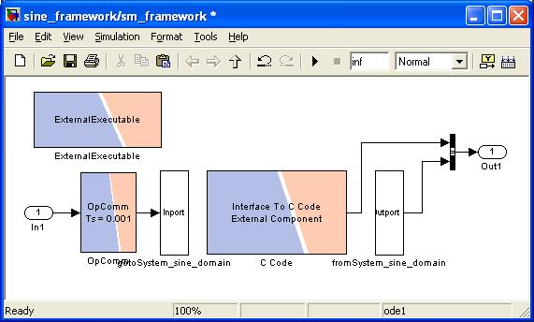
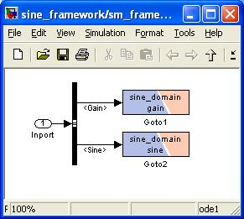
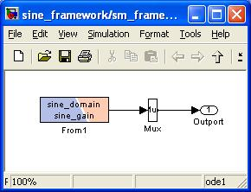
Orchestra with C code
The framework for a C Code model is similar to a framework for a Simulink model…Just use an Interface to C Code Block instead!

Slide 55
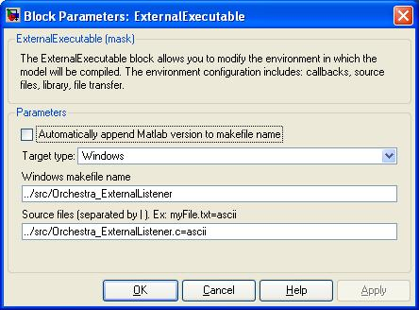
Orchestra with C code
By including the information on the C Code in an OpExternalExecutable block, all of the file transfers and compilation is taken care of
This block uses an .m file which handles the transfer of the C code into the target for its compilation. The .m file and the block can be found in the RT-Lab example folder for orchestra C code feature.

Slide 56
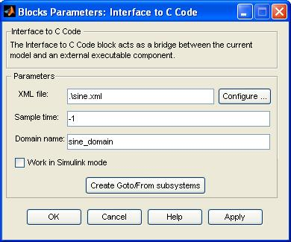
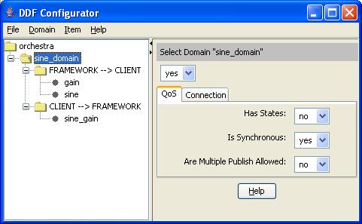
Orchestra with C code
Domain names, Data Items, … are all entered the same way as for a Simulink model using the DDF Configurator.

Slide 57
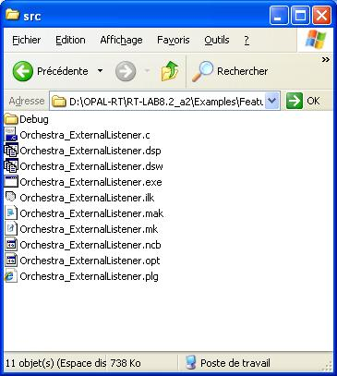
Orchestra with C code
Use Orchestra_ExternalListener project to edit the code (in RT-Lab example folder for orchestra C code feature)

Slide 58
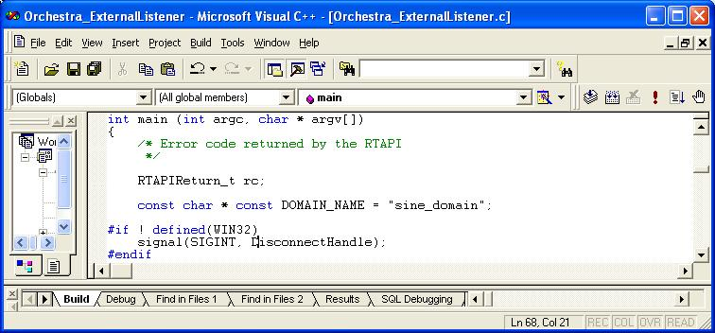
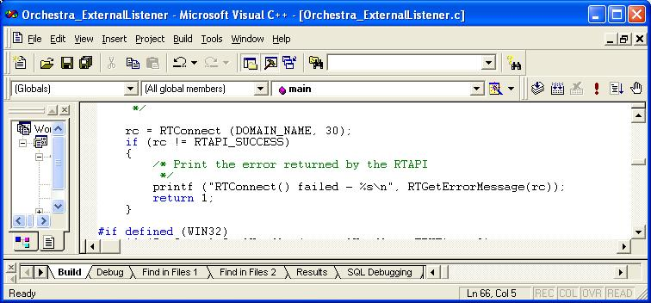
Orchestra with C code
Set the domain name
Connect the code to the framework

Slide 59
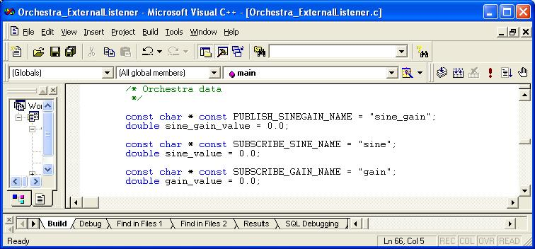
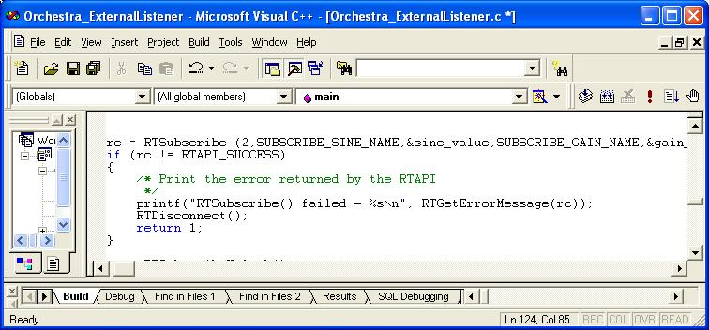
Orchestra with C code
Set the names of the exchanged signal & the associated variables
Read (subscribe) the values from the framework

Slide 60
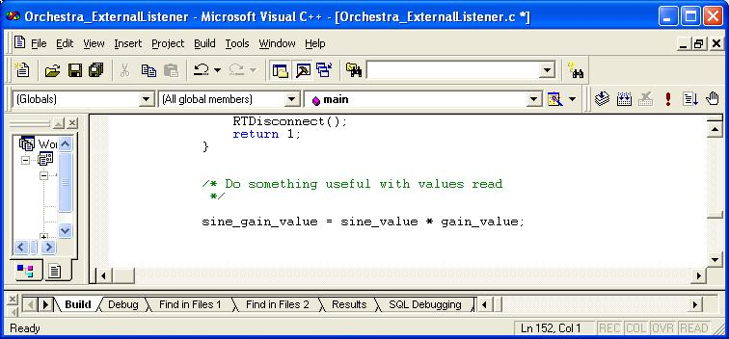
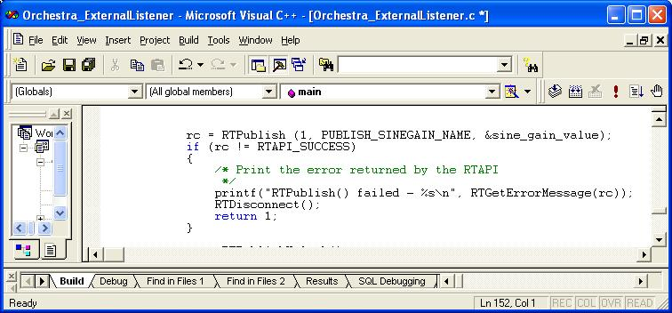
Orchestra with C code
Perform some computation
Write (publish) the results to the framework

Slide 61
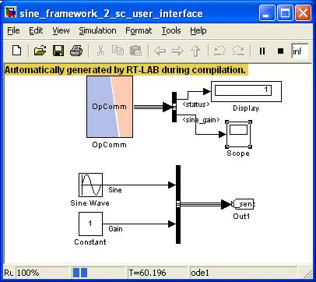
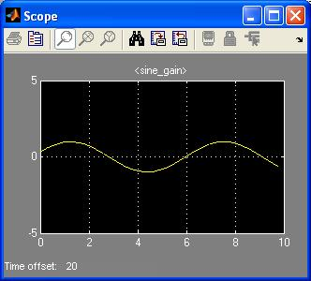
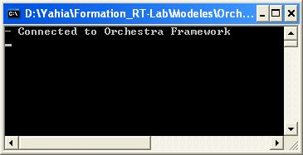
Orchestra with C code
Save the projet, the framework mode
Open the framework with MainControl
Compile, Load, Execute framework
Execute the C code

