Slide 1

High Performance Geometric Multigrid: A Supercomputer Benchmark & Metric
Mark Adams and Sam Williams
with
Jed Brown, John Shalf, Erich Strohmaier, Brian Van Straalen

Slide 2
HPGMG Project Design Goals
General benchmarking efforts and provide compact benchmark codes to aid engineers & centers to design & deploy well balanced machines
Benchmark code with sensitivities to machine metrics that correlate well with applications
Presented some data from LLNL at ISC ’14
HPGMG-FV: Supercomputer ranking metric
A specification and packaging built from Sam’s finite volume code base

Slide 3
HPGMG-FV design
Compact stand alone: C + MPI (+OMP, CUDA)
Conceptually simple: solve Ax = b with multigrid
Finite Volume, 3D non-constant coef. Laplacian
Non-iterative (full) geometric multigrid solver
Metric: equations (N) solved / sec
Map to flops/sec: 1200N (not exact nor well defined)
HPL uses 2N³ map

Slide 4
Stable HPGMG-FV metric
This year transitioned to 4th order accurate discretization
First “official” 4th order list, stable specification
Sensitive to more machine parameters than 2nd order:
MPI message rates: 3x messages/op-apply
MPI bandwidth: 2x message sizes (two ghost cell layers)
More pressure on cache: ~2x working set size
Large stencil, many data streams
Wide range of message sizes: coarse grids are smaller
Full MG: more small messages (more coarse grid visits)
More floating point intensive (flop/byte ~1)
With respect to “book-end” strategy of HPL-HPCG
We try to be in the middle
Notes:
Can beat STREAM in MB

Slide 5
Maintainable, durable (+ dynamic range)
Experience TOP500, HPL, other benchmarking initiatives
Simplicity key
Need unambiguous specification
Can not afford to micro-manage or adjudicate each submission
Dynamic range, or strong scaling, important to applications
But Constraints interfere with incorporating dynamic range in metric
Criterion | HPGMG-FV | HPL | HPCG
Architecture Free | ✔ | ✔ | Minimum 25% “main memory” usage
Scale/PM Free | ✔ | ✔ | Gauss-Seidel only on “sub domains”
Math/algorithm fully specified | ✔ | ✔ (!Str) | Vertex order not specified for G-S, affects convergence, affects metric
Dynamic range | 1, 1/8, 1/64 | R_{½}
Notes:
HPL, specified N^3 algo
Top500 not funded

Slide 6
HPGMG-FV ranking, June ‘16
# | Site | Sys | Arch | 10⁹ 1* | DOF 1/8 | Sec 1/64 | MPI *the | OMP metric | #GPU | # HPL | #HPCG
1 | DOE/ANL/USA | Mira | IBM-BGQ | 500 | 313 | 107 | 49K | 64 | 0 | 6 | ~6
 |  | Mira | Base | 395 | 286 | 107 | 49K | 64 | 0
2 | HLRS/Germany | Hazel Hen | Cray XC40 | 495 | 411 | 221 | 15K | 12 | 0 | 9 | ~7
3 | DOE/ORNL/US | Titan | Cray XK7 | 440 | 163 | 39 | 16K | 4 | 1 | 3 | ~4
4 | KAUST/SA | Sha. II | Cray XC40 | 326 | 287 | 175 | 12K | 16 | 0 | 10 | ~10
5 | DOE/NER/USA | Edison | Cray XC30 | 296 | 246 | 127 | 11K | 12 | 0 | 49 | ~16
6 | CSCS Swiss | Piz Daint | Cray XC30 | 153 | 69 | 19 | 4K | 8 | 1 | 8 | ~9
8 | HLRS/G | NEC | SX-AC | 3.3 | 1.8 | .75 | 256 | 1 | 0 | - | -
Notes:
Edison relatively strong relative to HPL ranking because
1) FPU ½ capacity, DDR MB just a little smaller
2) XC40 have small cache and 4th order uses larger working set
Shaheen II has great dynamic range – 53% eff.
Edison 43 % eff. (Ivy Bridge)
Titan: 9% eff.

Slide 7
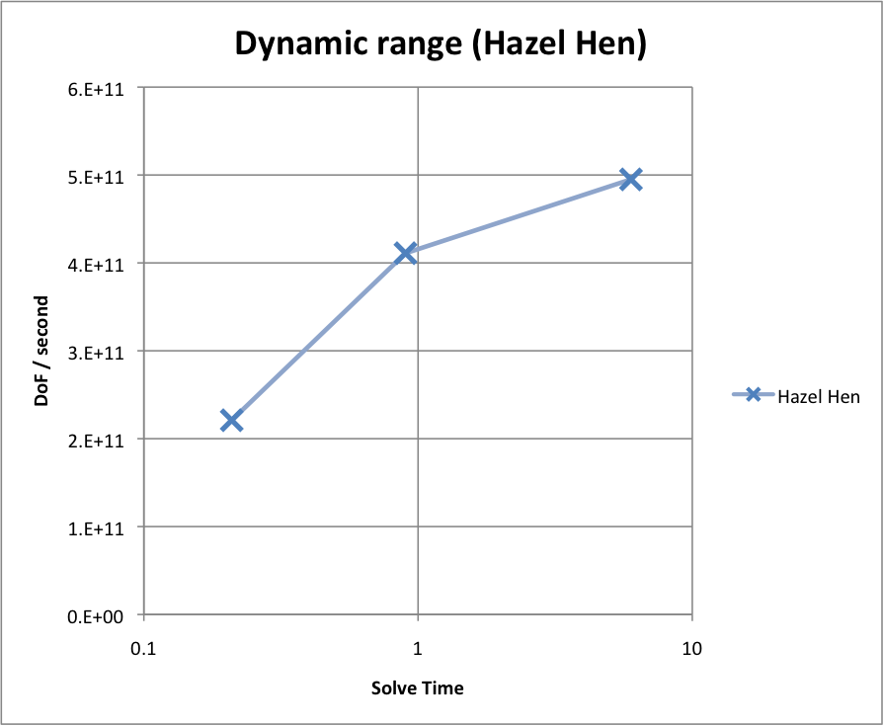
Turn around time: DoF/sec vs. Time
Dynamic range:
Same concurrency
Reduce problem size
Flat lines perfect
Strong scaling:
Same problem size
Increase concurrency
Weak scaling:
Increase both
1
1/8
1/64
Notes:
Strong scaling is important to applications.
Eg, The DOE climate (ACME v1) performance goal is 5 Sim Year Per Day..
Performance versus solution time plots remove the scale of the problem and show strong scaling clearly.
From this we can see (or infer in this case) the limit of turnaround time, which is often figure of merit.
For instance the [climate] has mandated a X simulation years per day.
Here we see that Shaheen II has the flattest, hence best profile, followed closely by Edison
Enough memory to amortize network – balanced
Not just a stream proxy
Roll over indicates network limited

Slide 8
Turn around time: DoF/sec vs. Time
Dynamic range:
Same concurrency
Reduce problem size
Flat lines perfect
Strong scaling:
Same problem size
Increase concurrency
Weak scaling:
Increase both
Machine Size
(the metric)
Notes:
Strong scaling is important to applications.
Eg, The DOE climate (ACME v1) performance goal is 5 Sim Year Per Day..
Performance versus solution time plots remove the scale of the problem and show strong scaling clearly.
From this we can see (or infer in this case) the limit of turnaround time, which is often figure of merit.
For instance the [climate] has mandated a X simulation years per day.
Here we see that Shaheen II has the flattest, hence best profile, followed closely by Edison
Enough memory to amortize network – balanced
Not just a stream proxy
Roll over indicates network limited

Slide 9
Turn around time: DoF/sec vs. Time
Dynamic range:
Same concurrency
Reduce problem size
Flat lines perfect
Strong scaling:
Same problem size
Increase concurrency
Weak scaling:
Increase both
Network and memory latency dominate (flat line perfect)
Notes:
Strong scaling is important to applications.
Eg, The DOE climate (ACME v1) performance goal is 5 Sim Year Per Day..
Performance versus solution time plots remove the scale of the problem and show strong scaling clearly.
From this we can see (or infer in this case) the limit of turnaround time, which is often figure of merit.
For instance the [climate] has mandated a X simulation years per day.
Here we see that Shaheen II has the flattest, hence best profile, followed closely by Edison
Enough memory to amortize network – balanced
Not just a stream proxy
Roll over indicates network limited

Slide 10
Turn around time: DoF/sec vs. Time
STREAM proxy (usually)
On right
Balance of latencies to memory capacity
Roll-over
On left
(generally) more memory, hides latencies
DOE ACME v1 target (5 SYPD)
Balance latency and DDR BW
Roll Over
Minimum turn around time
Notes:
Strong scaling is important to applications.
Eg, The DOE climate (ACME v1) performance goal is 5 Sim Year Per Day..
Performance versus solution time plots remove the scale of the problem and show strong scaling clearly.
From this we can see (or infer in this case) the limit of turnaround time, which is often figure of merit.
For instance the [climate] has mandated a X simulation years per day.
Here we see that Shaheen II has the flattest, hence best profile, followed closely by Edison
Enough memory to amortize network – balanced
Not just a stream proxy
Roll over indicates network limited

Slide 11
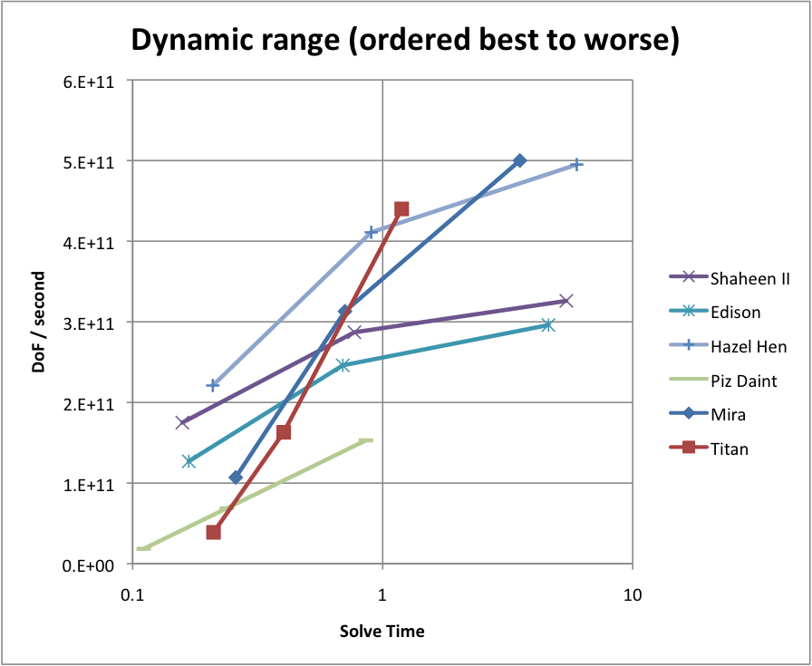
Turn around time: DoF/sec vs. Time
Dynamic range:
Same concurrency
Reduce problem size
Strong scaling:
Same problem size
Increase concurrency
Weak scaling:
Increase both
Notes:
Strong scaling is important to applications.
Eg, The DOE climate (ACME v1) performance goal is 5 Sim Year Per Day..
Here we see that Shaheen II has the flattest, hence best profile, followed closely by Edison
Enough memory to amortize overheads (network, GPU, etc) – balanced
Roll over indicates overhead limited
Titan's memory capacity is not balanced against the high latencies and overheads of the network and the GPU for the frequent/fine grained operations demanded by MG

Slide 12
Consider a dynamic range metric
Consider the sum for the three data points (dof/sec) and not the maximum
Convergent series, will roll over eventually
Hazel Hen 1130 (x10⁹ dof/second)
Mira 920
Shaheen II 788
Edison 669
Titan 642
Piz Daint 240
Notes:
Asymptote to a constant

Slide 13
Community buy-in & related efforts
Vendor buy-in
Nvidia optimized 2nd & 4th order for Kepler & Pascal
MPI + OpenMP + CUDA
Intel recently started KNL optimizing (Sam already started)
Sam Williams’ GMG codes used in several efforts
HPGMG-FV is the ranking metric instantiation …
DOE FastForward2: selected as a 1/6 proxy apps
DOE DEGAS project:
investigated one-sided UPC++ implementations
PYGMG (python version HPGMG) with
SEJITS (selective just in time specialization)
DOE DTEC project: Halide stencil DSL of GMG
DOE Traleika Glacier project (Intel)
OCR dynamic task runtime (3 versions, low to higher level)
Other groups:
UCB, MIT, Rice, ORNL, SDSC, Riken, HLRS, KAUST, NREL
Notes:
Sam’s work

Slide 14
Submissions SC16 (hpgmg.org)
Welcome submissions, collaborations & questions
Contact hpgmg-forum@hpgmg.org
Visit hpgmg.org
Submission instructions: hpgmg.org/fv
Next list release at SC16 BoF, more architectures:
Accelerators: TH-2A, …
Cluster of commodity processors, infiniband
SuperMUC (all 17 islands, only have data with 4), …
K: want full scale 4th order data and G-S optimization
More, THL …
Our repositories
OpenMP: bitbucket.org/hpgmg/hpgmg
CUDA: bitbucket.org/nsakharnykh/hpgmg-cuda

Slide 15
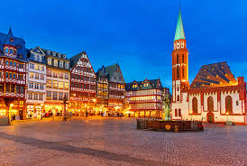
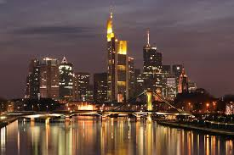
Thank you
https://hpgmg.org/
https://bitbucket.org/hpgmg/hpgmg
Mark Adams
Jed Brown
John Shalf
Erich Strohmaier
Brian Van Straalen
Sam Williams

Slide 16
…. More back ground
4 architectures on list

Slide 17
1) Nvidia GPUs
# | Site | Systm | Arch. | 10⁹ x h* | DOF/ 2h | sec 4h | MPI | OMP | GPU | HPLrank
1 | DOE/ANL/USA | Mira | IBM-BGQ | 500 | 313 | 107 | 49K | 64 | 0 | 5
 |  | Mira | (Base) | 395 | 286 | 107 | 49K | 64 | 0
2 | HLRS/Germany | Hazel Hen | Cray XC40 | 495 | 411 | 221 | 15K | 12 | 0 | 8
3 | DOE/ORNL/US | Titan | Cray XK7 | 440 | 163 | 39 | 16K | 4 | 1 | 2
4 | KAUST/SA | Sha. II | Cray XC40 | 326 | 287 | 175 | 12K | 16 | 0 | 9
5 | DOE/NER/USA | Edison | Cray XC30 | 296 | 246 | 127 | 11K | 12 | 0 | 40
6 | CSCS Swiss | Piz Daint | Cray XC30 | 153 | 69 | 19 | 4K | 8 | 1 | 7
8 | HLRS/Germany | NEC | SX-ACE | 3.3 * The | 1.8 metric | .75 | 256 | 1 | 0 | -
Notes:
Our first list with GPUs:

Slide 18
2) Light-weight in-order cores
# | Site | Systm | Arch. | 10⁹ x h* | DOF/ 2h | sec 4h | MPI | OMP | GPU | HPLrank
1 | DOE/ANL/USA | Mira | IBM-BGQ | 500 | 313 | 107 | 49K | 64 | 0 | 5
 |  | Mira | (Base) | 395 | 286 | 107 | 49K | 64 | 0
2 | HLRS/Germany | Hazel Hen | Cray XC40 | 495 | 411 | 221 | 15K | 12 | 0 | 8
3 | DOE/ORNL/US | Titan | Cray XK7 | 440 | 163 | 39 | 16K | 4 | 1 | 2
4 | KAUST/SA | Sha. II | Cray XC40 | 326 | 287 | 175 | 12K | 16 | 0 | 9
5 | DOE/NER/USA | Edison | Cray XC30 | 296 | 246 | 127 | 11K | 12 | 0 | 40
6 | CSCS Swiss | Piz Daint | Cray XC30 | 153 | 69 | 19 | 4K | 8 | 1 | 7
8 | HLRS/Germany | NEC | SX-ACE | 3.3 * The | 1.8 metric | .75 | 256 | 1 | 0 | -

Slide 19
3) Cray – Xeon processors
# | Site | Systm | Arch. | 10⁹ x h* | DOF/ 2h | sec 4h | MPI | OMP | GPU | HPLrank
1 | DOE/ANL/USA | Mira | IBM-BGQ | 500 | 313 | 107 | 49K | 64 | 0 | 5
 |  | Mira | (Base) | 395 | 286 | 107 | 49K | 64 | 0
2 | HLRS/Germany | Hazel Hen | Cray XC40 | 495 | 411 | 221 | 15K | 12 | 0 | 8
3 | DOE/ORNL/US | Titan | Cray XK7 | 440 | 163 | 39 | 16K | 4 | 1 | 2
4 | KAUST/SA | Sha. II | Cray XC40 | 326 | 287 | 175 | 12K | 16 | 0 | 9
5 | DOE/NER/USA | Edison | Cray XC30 | 296 | 246 | 127 | 11K | 12 | 0 | 40
6 | CSCS Swiss | Piz Daint | Cray XC30 | 153 | 69 | 19 | 4K | 8 | 1 | 7
8 | HLRS/Germany | NEC | SX-ACE | 3.3 * The | 1.8 metric | .75 | 256 | 1 | 0 | -

Slide 20
4) NEC vector architecture
# | Site | Systm | Arch. | 10⁹ x h* | DOF/ 2h | sec 4h | MPI | OMP | GPU | HPLrank
1 | DOE/ANL/USA | Mira | IBM-BGQ | 500 | 313 | 107 | 49K | 64 | 0 | 5
 |  | Mira | (Base) | 395 | 286 | 107 | 49K | 64 | 0
2 | HLRS/Germany | Hazel Hen | Cray XC40 | 495 | 411 | 221 | 15K | 12 | 0 | 8
3 | DOE/ORNL/US | Titan | Cray XK7 | 440 | 163 | 39 | 16K | 4 | 1 | 2
4 | KAUST/SA | Sha. II | Cray XC40 | 326 | 287 | 175 | 12K | 16 | 0 | 9
5 | DOE/NER/USA | Edison | Cray XC30 | 296 | 246 | 127 | 11K | 12 | 0 | 40
6 | CSCS Swiss | Piz Daint | Cray XC30 | 153 | 69 | 19 | 4K | 8 | 1 | 7
8 | HLRS/Germany | NEC | SX-ACE | 3.3 | 1.8 | .75 | 256 | 1 | 0 | -

Slide 21
Dynamic range, DDR BW, cache size
# | Site | Systm | Arch. | 10⁹ x h* | DOF/ 2h | sec 4h | MPI | OMP | GPU | HPLrank
1 | DOE/ANL/USA | Mira | IBM-BGQ | 500 | 313 | 107 | 49K | 64 | 0 | 5
 |  | Mira | (Base) | 395 | 286 | 107 | 49K | 64 | 0
2 | HLRS/Germany | Hazel Hen | Cray XC40 | 495 | 411 | 221 | 15K | 12 | 0 | 8
3 | DOE/ORNL/US | Titan | Cray XK7 | 440 | 163 | 39 | 16K | 4 | 1 | 2
4 | KAUST/SA | Sha. II | Cray XC40 | 326 | 287 | 175 | 12K | 16 | 0 | 9
5 | DOE/NER/USA | Edison | Cray XC30 | 296 | 246 | 127 | 11K | 12 | 0 | 40
6 | CSCS Swiss | Piz Daint | Cray XC30 | 153 | 69 | 19 | 4K | 8 | 1 | 7
8 | HLRS/Germany | NEC | SX-ACE | 3.3 * The | 1.8 metric | .75 | 256 | 1 | 0 | -
Notes:
Edison relatively strong relative to HPL ranking because
1) FPU ½ capacity, DDR MB just a little smaller
2) XC40 have small cache and 4th order uses larger working set
Shaheen II has great dynamic range – 53% eff.
Edison 43 % eff.
Titan: 9% eff.

Slide 22
Geometric Multigrid
Extremely fast/efficient…
O(N) computational complexity (#flops)
O(N) DRAM data movement (#bytes)
O(N^{0.66}) MPI data movement
“MG V-cycle”
restriction
interpolation

Slide 23
Ideal Performance
Nominally, multigrid has three components that affect performance
DRAM data movement and flop’s to perform each stencil
MPI data movement for halo/ghost zone exchanges
latency/overhead for each operation (MPI when it matters)
These are constrained by
DRAM and flop rates
MPI P2P Bandwidth
MPI overhead, OpenMP/CUDA overheads, etc…
The time spent in each of these varies with level in the v-cycle
coarse grids have ⅛ the volume (number of cells), but ¼ the surface area (MPI message size)
Dominated by
On-Node Performance
Dominated by
MPI Performance
Overhead
Dominates
DRAM BW and Flop/s
Time in Component in Level
MPI P2P
Overhead / Latency
Level in the V-Cycle

Slide 24
Faster Machines?
If one just increases DRAM bandwidth by 10x, then the code becomes increasingly dominated by MPI P2P communication
If one improves just DRAM and MPI bandwidth, the code will eventually be dominated by CUDA, OpenMP, and MPI overheads.
Unfortunately, the overheads are hit O(logN) times.
Thus, if overhead dominates (flops and bytes are free), then MGSolve Time looks like O(logN)
Co-Design for MG requires a balanced scaling of flop/s, GB/s, memory capacities, and overheads.
Time in Component in Level
MPI P2P
DRAM BW and Flop/s
Overhead / Latency
Level in the V-Cycle

Slide 25
FMG
HPGMG-FV implements Full Multigrid (FMG).
FMG uses an F-Cycle with a V-Cycle at each level.
No iterating. One global reduction (to calculate the final residual)
Essentially, an O(N) direct solver (discretization error in 1 pass)
Smooth
Residual
Restrict
Initial Restriction of RHS
Bottom Solve
Interpolate
Interpolate (High Order)
Fine grids (those in slow “capacity” memory) are accessed only twice
Coarser grids (those that have progressively smaller working sets) are accessed progressively more
Same routines are used many times with highly varied working sets
Coarsest grids are likely latency-limited (run on host?)
FMG sends O(log²(P)) messages (needs low overhead communication)
Stresses many aspect of the system (memory hierarchy, network, compute, threading overheads, heterogeneity, …)

Slide 26
HPGMG-FV detailed timing….
Time within a MG level by function
Total Time by function
0 1 2 3 4 5 6 7 8 9
box dimension 128^3 64^3 32^3 16^3 8^3 8^3 8^3 4^3 2^3 9^3 total
------------------ ------------ ------------ ------------ ------------ ------------ ------------ ------------ ------------ ------------ ------------ ------------
smooth 0.083160 0.009769 0.002024 0.000753 0.000592 0.000711 0.000833 0.001602 0.001382 0.000000 0.100826
residual 0.018734 0.000940 0.000204 0.000088 0.000073 0.000087 0.000102 0.000181 0.000158 0.000155 0.020721
applyOp 0.000000 0.000000 0.000000 0.000000 0.000000 0.000000 0.000000 0.000000 0.000000 0.001907 0.001907
BLAS1 0.004449 0.000115 0.000057 0.000053 0.000064 0.000069 0.000082 0.000206 0.000197 0.014692 0.019984
BLAS3 0.000000 0.000000 0.000000 0.000000 0.000000 0.000000 0.000000 0.000000 0.000000 0.000000 0.000000
Boundary Conditions 0.000000 0.000308 0.000080 0.000017 0.000005 0.000005 0.000005 0.000013 0.000014 0.000011 0.000458
Restriction 0.000922 0.000350 0.000297 0.000141 0.000435 0.000363 0.000445 0.000603 0.000790 0.000000 0.004346
local restriction 0.000915 0.000342 0.000288 0.000130 0.000032 0.000037 0.000042 0.000129 0.000146 0.000000 0.002062
pack MPI buffers 0.000001 0.000001 0.000000 0.000001 0.000001 0.000001 0.000001 0.000001 0.000001 0.000000 0.000007
unpack MPI buffers 0.000001 0.000001 0.000001 0.000001 0.000095 0.000106 0.000124 0.000140 0.000224 0.000000 0.000694
MPI_Isend 0.000001 0.000000 0.000001 0.000001 0.000001 0.000001 0.000001 0.000001 0.000001 0.000000 0.000007
MPI_Irecv 0.000001 0.000001 0.000001 0.000001 0.000035 0.000045 0.000061 0.000056 0.000063 0.000000 0.000263
MPI_Waitall 0.000000 0.000001 0.000001 0.000001 0.000263 0.000164 0.000205 0.000263 0.000340 0.000000 0.001239
Interpolation 0.002921 0.001742 0.001107 0.000369 0.000499 0.000579 0.000741 0.000631 0.000740 0.000000 0.009329
local interpolation 0.002916 0.001735 0.001098 0.000358 0.000068 0.000077 0.000085 0.000137 0.000147 0.000000 0.006621
pack MPI buffers 0.000000 0.000000 0.000001 0.000001 0.000157 0.000179 0.000202 0.000147 0.000238 0.000000 0.000926
unpack MPI buffers 0.000000 0.000000 0.000001 0.000001 0.000001 0.000001 0.000001 0.000001 0.000002 0.000000 0.000009
MPI_Isend 0.000000 0.000000 0.000001 0.000001 0.000131 0.000154 0.000196 0.000154 0.000185 0.000000 0.000822
MPI_Irecv 0.000000 0.000000 0.000001 0.000001 0.000001 0.000001 0.000001 0.000001 0.000001 0.000000 0.000007
MPI_Waitall 0.000001 0.000001 0.000001 0.000001 0.000132 0.000155 0.000241 0.000176 0.000150 0.000000 0.000856
Ghost Zone Exchange 0.010486 0.005997 0.003671 0.003480 0.003963 0.004767 0.005602 0.007449 0.007796 0.002098 0.055309
local exchange 0.000003 0.000003 0.000004 0.000005 0.000006 0.000007 0.000008 0.001059 0.001659 0.001838 0.004589
pack MPI buffers 0.001327 0.000467 0.000442 0.000518 0.000624 0.000743 0.000863 0.000991 0.001208 0.000026 0.007210
unpack MPI buffers 0.000473 0.000455 0.000485 0.000593 0.000738 0.000878 0.001019 0.001130 0.001331 0.000025 0.007125
MPI_Isend 0.000302 0.000339 0.000450 0.000781 0.000937 0.001143 0.001334 0.001515 0.001190 0.000018 0.008009
MPI_Irecv 0.000093 0.000096 0.000140 0.000165 0.000210 0.000250 0.000299 0.000313 0.000257 0.000012 0.001835
MPI_Waitall 0.008260 0.004603 0.002103 0.001355 0.001370 0.001656 0.001970 0.002306 0.002008 0.000011 0.025641
MPI_collectives 0.001312 0.000000 0.000000 0.000000 0.000000 0.000000 0.000000 0.000000 0.000000 0.002378 0.003691
------------------ ------------ ------------ ------------ ------------ ------------ ------------ ------------ ------------ ------------ ------------ ------------
Total by level 0.122319 0.018799 0.007384 0.004927 0.005706 0.006680 0.008064 0.010724 0.010967 0.021933 0.217503
Total time in MGBuild 225.675795 seconds
Total time in MGSolve 0.217941 seconds
number of v-cycles 1
Bottom solver iterations 70
Performance 4.489e+11 DOF/s
calculating error...
h = 2.170138888888889e-04 ||error|| = 4.595122248560908e-11
smooth on finest level is only 38% of solve time
Time in an operation by level
demonstrates performance of MPICH’s MPI_Comm_split/dup is broken at scale !
Used to verify implementation…error should be 2nd order

Slide 27
How sensitive is exascale to operations with limited parallelism?
MG’s computational complexity is premised on the assumption that N/8 flops requires N/8 time.
N+N/8+N/64… = O(N) flops ~ O(N) time
Today, the performance of MIC/GPU processors decreases substantially when parallelism falls below a certain threshold (underutilization)
If time ceases to be tied to N but saturates at some constant, then
N+N/8+N/8+N/8+…N/8 ~ O( Nlog(N) )
Does your FastForward processor performance on coarse (coasrer) grids impede overall multigrid performance?
Are there architectural features you can exploit to avoid this?
If so, how do you succinctly specialize code to exploit them?
(i.e. do we really have to write every routine twice?)
Are there other approaches to ensure coarse grid operations are not a bottleneck?

Slide 28
Acknowledgements
All authors from Lawrence Berkeley National Laboratory were supported by the DOE Office of Advanced Scientific Computing Research under contract number DE-AC02-05CH11231.
This research used resources of the National Energy Research Scientific Computing Center, which is supported by the Office of Science of the U.S. Department of Energy under Contract No. DE-AC02-05CH11231.
This research used resources of the Argonne Leadership Computing Facility at Argonne National Laboratory, which is supported by the Office of Science of the U.S. Department of Energy under contract DE-AC02-06CH11357.
This research used resources of the Oak Ridge Leadership Facility at the Oak Ridge National Laboratory, which is supported by the Office of Science of the U.S. Department of Energy under Contract No. DE-AC05-00OR22725.

Slide 29
Memory Capacity Issues
In AMR MG Combustion codes, you need a separate field/component/vector for each chemical species (NH₄, CO₂, …) on each AMR level
As such, given today’s memory constraints, the size of each process’s subdomain might be small (64³…128³)
Future machines may have 10x more memory than today’s…
100GB of fast memory
1TB of slow memory
Why not run larger problems to amortize inefficiencies?
Application scientists would prefer to use it for new physics or chemistry.
e.g. increase the number of chemical species from 20 to 100
AMR codes could use the memory selectively (where needed) with deeper AMR hierarchies.
The memory hierarchy can be used to prioritize the active working set…
e.g. fit the MG solve on current species of the current AMR level in fast memory
If performance is not feasible, we need to know soon as significant changes to LMC would be required to increase on-node parallelism

Slide 30
Choice of Smoother
In the manycore era, the choice of smoother:
must balance mathematical (convergence) and architectural constraints (TLP/SIMD/BW).
may see up to a 100x performance hit without threading on a Xeon Phi (MIC)
Using HPGMG-FV we observed differences in performance among smoothers…
GSRB and w-Jacobi were the easiest to use
SYMGS required fewer total smooths, but its performance per smooth was very poor.
Based on Rob/Ulrike’s paper, L1 Jacobi was made as fast as w-Jacobi
Chebyshev was fastest in the net (smooth was little slower, but required fewer smooths)
Unfortunately, Chebyshev is a bit twitchy as it needs eigenvalue estimates.
SYMGS
(blocked)
Gauss-Seidel
Red-Black
Chebyshev
Polynomial
weighted
Jacobi
L1
Jacobi
Convergence
very good
(2 SYMGS)
good
(2-3 GSRB)
very good
Degree 2 or 4
slow
(8+ smooths)
slow
(8+ smooths)
Requirements
(in addition to D⁻¹)
N/A to high-order operators
spectral properties of the operator
not necessarily stable
L1 norm
Threading?
extremely
difficult
yes
yes
yes
yes
SIMD?
extremely
difficult
inefficient
(stride-2)
yes
yes
yes

Slide 31
Cell-Centered MG
Values can represent…
cell averages (cell-centered)
face averages (face-centered)
i face
centered
value
cell-centered
value
Restriction/Prolongation can be either cell- or face-centered.
In piecewise constant restriction, coarse grid elements are the average value of the region covered by fine grid elements
j face centered
Solutions variables are usually cell-centered, but boundary values exist on cell faces (face-centered)
enforcing a homogeneous Dirichlet boundary condition is not simply forcing the ghost cells to zero.
Rather one has to select a value for each ghost cell that allows one to interpolate to zero on the face.
cell-centered
restriction
face-centered
restriction

Slide 32
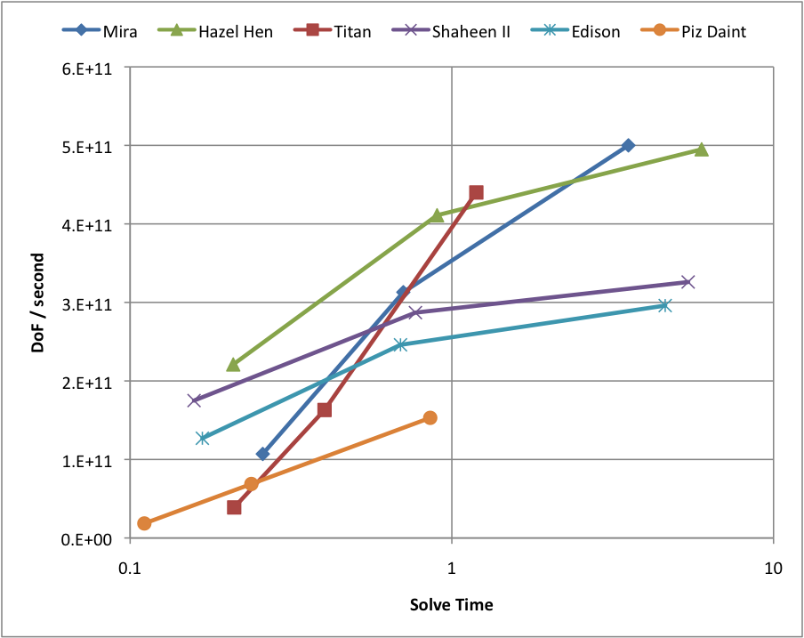
Strong scaling: DoF/sec vs Time
Turn around time
Flat lines = perfect strong scaling
DOE ACME v1 target (5 SYPD)
Notes:
Strong scaling is important to applications.
Eg, The DOE climate (ACME v1) performance goal is 5 Sim Year Per Day..
Performance versus solution time plots remove the scale of the problem and show strong scaling clearly.
From this we can see (or infer in this case) the limit of turnaround time, which is often figure of merit.
For instance the [climate] has mandated a X simulation years per day.
Here we see that Shaheen II has the flattest, hence best profile, followed closely by Edison

