Slide 1
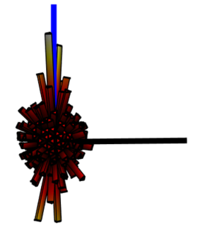
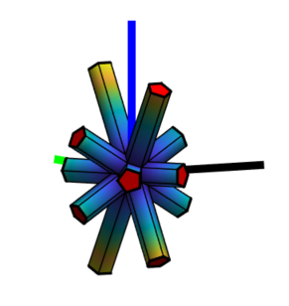
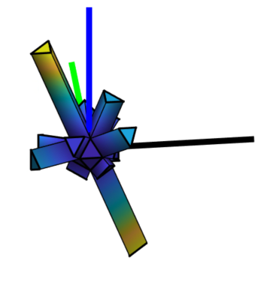
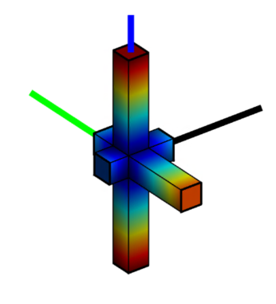
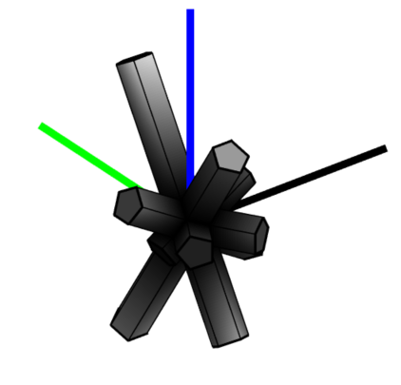
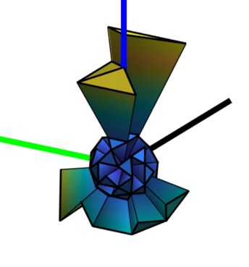
3D Polar Histogram
Intuitively visualize where a group of vectors point to in 3D space… and whether a preferential direction exists
By Alexander Quinn
Donal Finegan

Slide 2


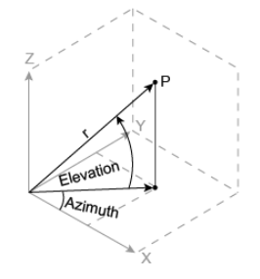



Input Examples
$$θ=[0,2π]$$
$$φ=[−π/2,π/2]$$
($θ,φ$) or (theta,phi) or (th,phi) or (azimuth, elevation)
follow conventions used in sph2cart and cart2sph matlab functions (shown below)

Slide 3
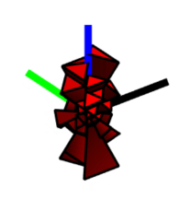
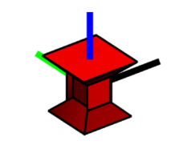

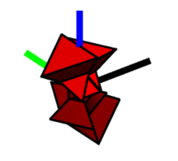

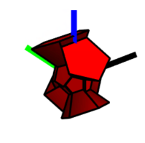
Examples

Slide 4
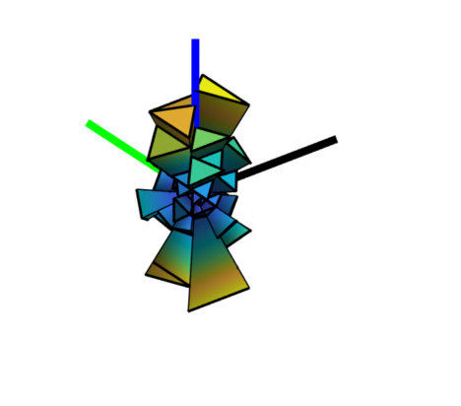

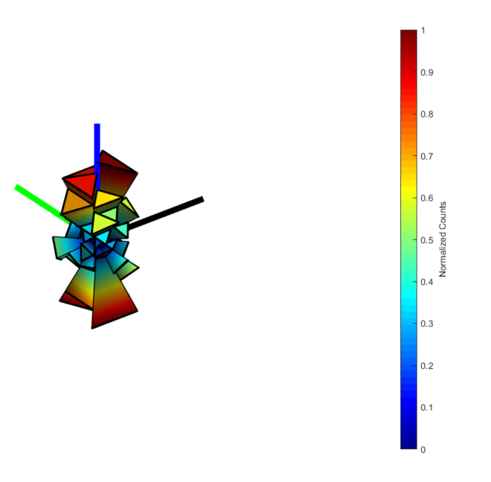

Examples

Slide 5
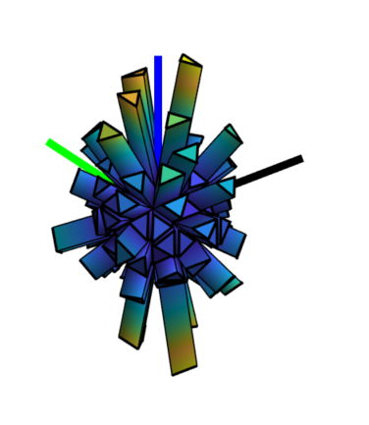

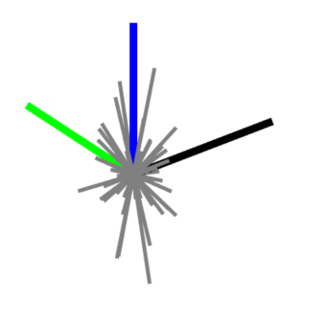

Examples

Slide 6
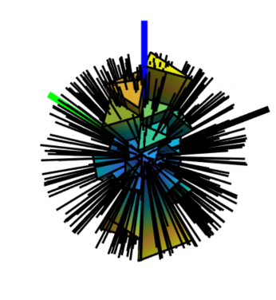

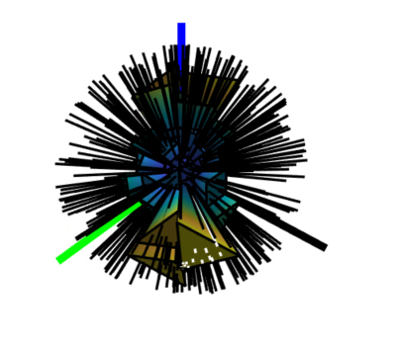

Examples
Note white lines indicate the ‘most_frequent_direction’

Slide 7
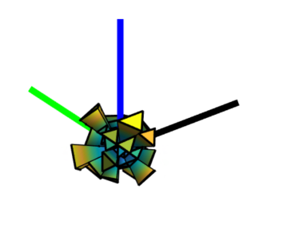

Examples

Slide 8
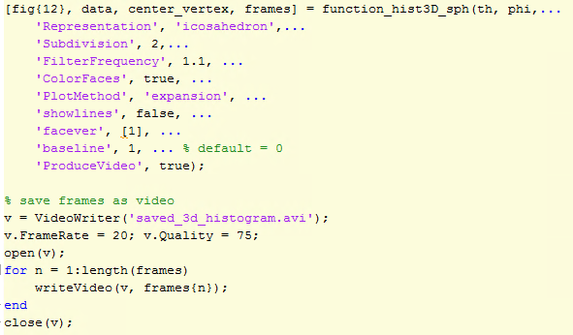
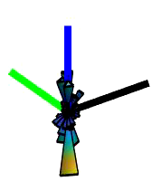
Examples

Slide 9
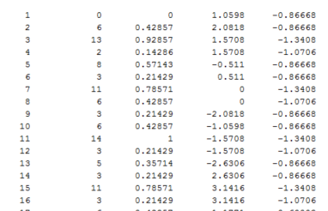
Output: binned data matrix (data, or D)
Data for each bin returned with function call (2nd output value)
Assigned bin #
Count of vectors in bin
Normalized counts
Theta of bin center (azimuth)
Phi of bin center (elevation)

