Slide 1
LIDARGO: standardization
Stefano Letizia
04/02/2024

Slide 2
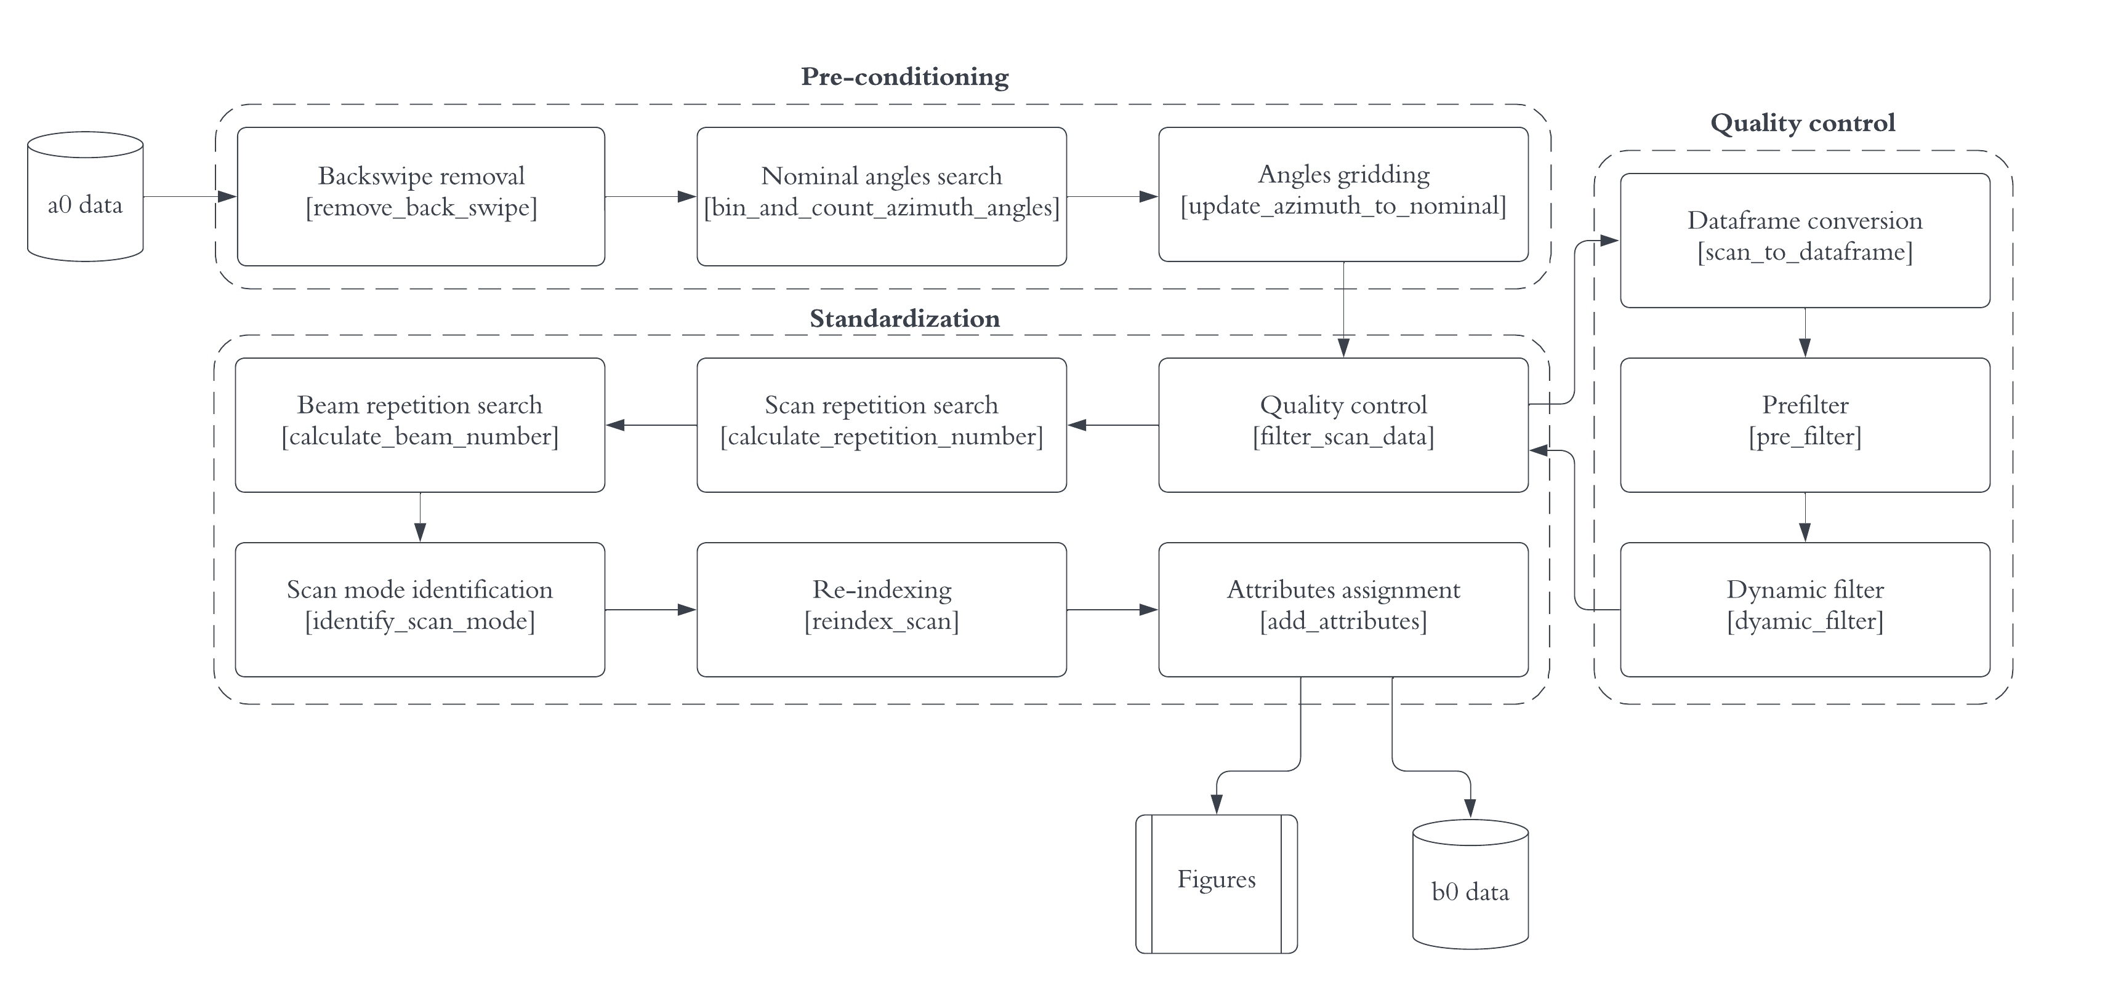
Standardization: overview

Slide 3

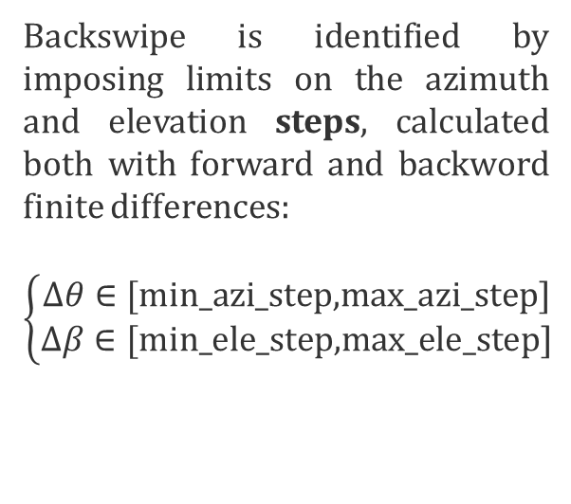
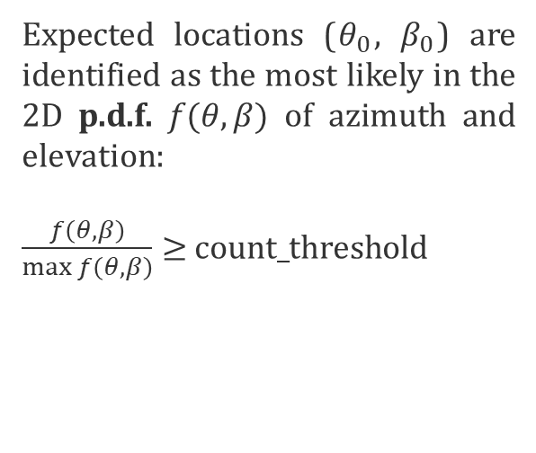
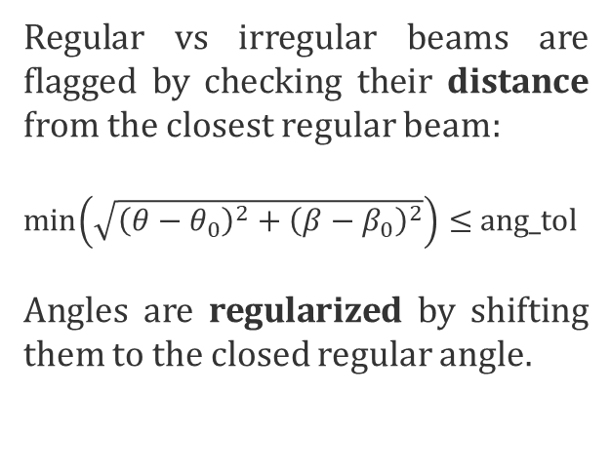
Pre-conditioning
Raw angles would contain backswipe, when the lidar scans fast to return to home position
Selected angles would contain irregular beams outside the regular geometry
Regularized angles only include angles corresponding to the regular geometry
Backswipe is identified by imposing limits on the azimuth and elevation steps, calculated both with forward and backword finite differences:
$$\left\{\begin{aligned}Δθ∈[\text{min}\text{_}\text{azi}\text{_}\text{step}\text{,}\text{max}\text{_}\text{azi}\text{_}\text{step}\text{]} \\ Δβ∈[\text{min}\text{_}\text{ele}\text{_}\text{step}\text{,}\text{max}\text{_}\text{ele}\text{_}\text{step}\text{]}\end{aligned}\right.$$
Expected locations ($θ_{0}$, $β_{0}$) are identified as the most likely in the 2D p.d.f. $f(θ,β)$ of azimuth and elevation:
$\frac{f\left(θ,β\right)}{\max{f\left(θ,β\right)}}≥$ $count_threshold$
Regular vs irregular beams are flagged by checking their distance from the closest regular beam:
$\min\left(\sqrt{{\left(θ−θ_{0}\right)}^{2}+{\left(β−β_{0}\right)}^{2}}\right)≤$ang_tol
Angles are regularized by shifting them to the closed regular angle.

Slide 4
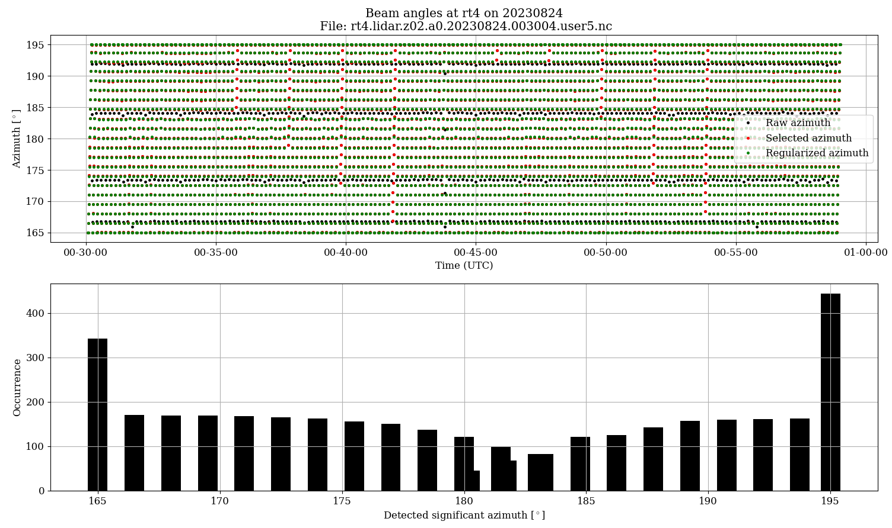
Pre-conditioning
Angles classification for a PPI scan
2D pdf for the selection of the regular angles
$count_threshold$

Slide 5
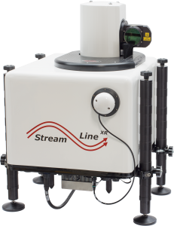

Quality control: pre-filter
Geometrical constraints
Physical constraints
SNR
range_max
range_min
ground_level
snr_min
$$u_{LOS}$$
rws_min
The pre-filter applies general geometrical and physical limits to the data that do not depend on the flow. It proceeds the subsequent dynamic filter and speeds up/facilitates its processing.
rws_max

Slide 6
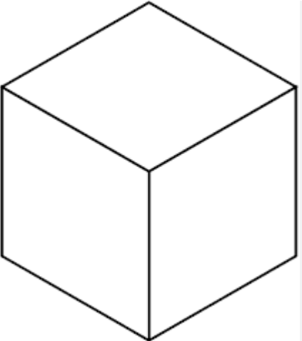



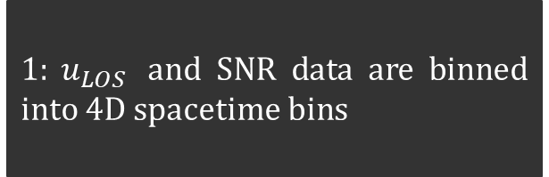


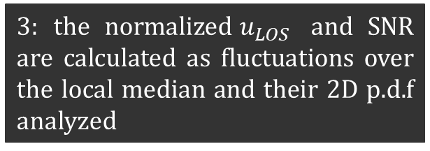



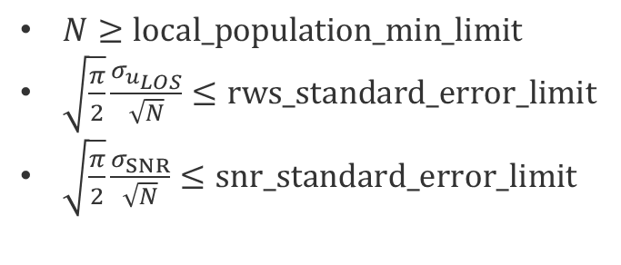



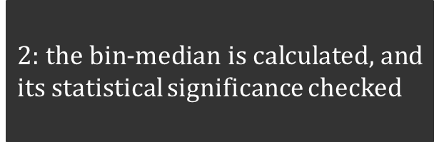
Quality control: dynamic filter
$1: u_{LOS}$ and SNR data are binned into 4D spacetime bins
$2:$ the bin-median is calculated, and its statistical significance checked
$3:$ the normalized$u_{LOS}$ and SNR are calculated as fluctuations over the local median and their 2D p.d.f analyzed
dy
dx
SNR’
$$⟨u_{LOS,1}⟩$$
$$⟨u_{LOS,2}⟩$$
$$⟨u_{LOS,3}⟩$$
dz
$$z$$
$$⟨{SNR}_{,1}⟩$$
$$⟨{SNR}_{,2}⟩$$
$$⟨{SNR}_{,3}⟩$$
$$x$$
$$y$$
$$t$$
$N≥\text{local}\text{_}\text{population}\text{_}\text{min}\text{_}\text{limit}$
$\sqrt{\frac{π}{2}}\frac{σ_{u_{LOS}}}{\sqrt{N}}≤\text{rws}\text{_}\text{standard}\text{_}\text{error}\text{_}\text{limit}$
$\sqrt{\frac{π}{2}}\frac{σ_{SNR}}{\sqrt{N}}≤\text{snr}\text{_}\text{standard}\text{_}\text{error}\text{_}\text{limit}$
$${u′}_{LOS}$$
dtime

Slide 7
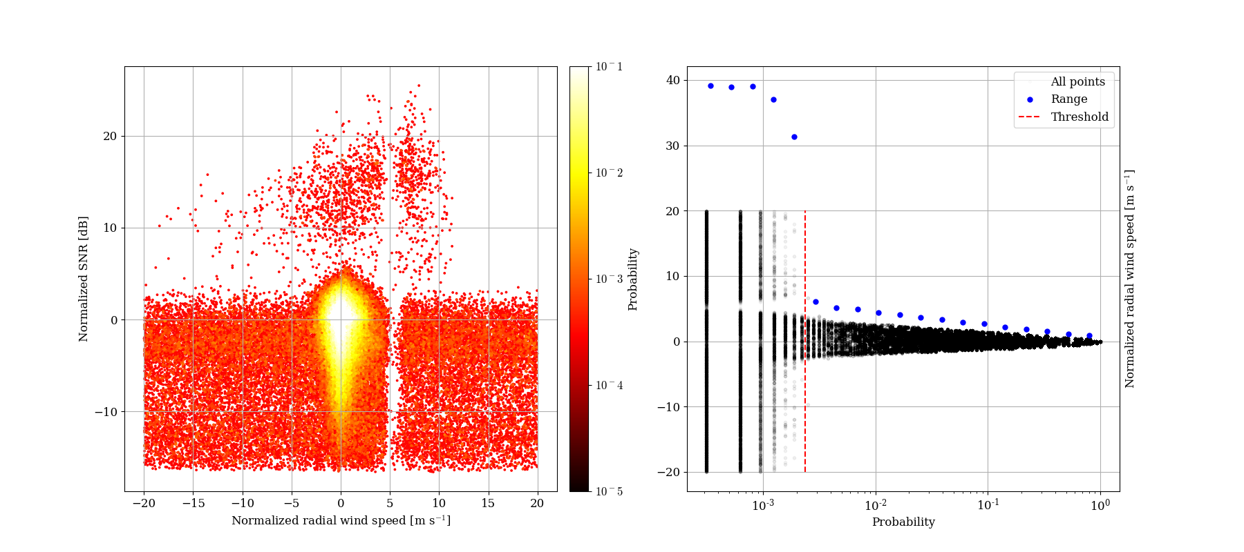
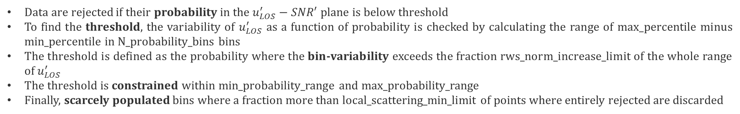
Quality control: dynamic filter
rws_norm_limit
max_probability_range
min_probability_range
max_percentile - min_percentile
Data are rejected if their probability in the $u_{LOS}^{′}−SNR′$ plane is below threshold
To find the threshold, the variability of $u_{LOS}^{′}$ as a function of probability is checked by calculating the range of max_percentile minus min_percentile in N_probability_bins bins
The threshold is defined as the probability where the bin-variability exceeds the fraction rws_norm_increase_limit of the whole range of $u_{LOS}^{′}$
The threshold is constrained within min_probability_range and max_probability_range
Finally, scarcely populated bins where a fraction more than local_scattering_min_limit of points where entirely rejected are discarded

Slide 8
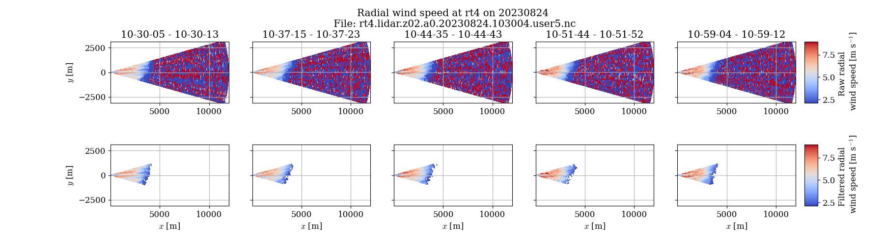
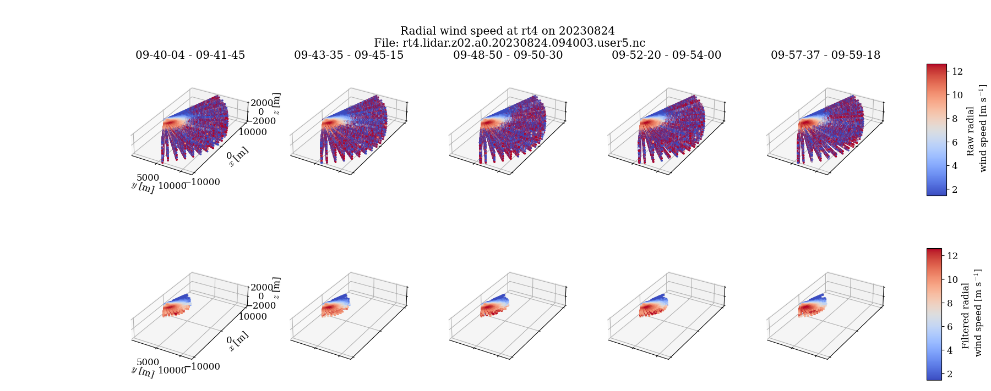
Quality control: examples

Slide 9
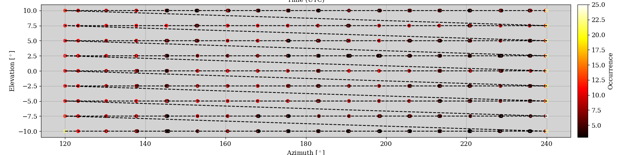
Standardization
scanID=1
scanID=2
scanID=3
Angle
The beam repetition (i.e. the scan trajectory in time) is found by the median time it takes for the beams to reach every angular position, which is a tricky task since many beams may have been filtered out at this stage.
The scan repetition is found by checking the nearest previous time the beams scan the initial angular position
RHI
3D
PPI
Finally, scans a classified in three categories that are useful for plotting:

