Slide 1
LandBased_Reanalysis_26July2022
File created on: 7/26/22 4:56:08 PM MDT

Slide 2
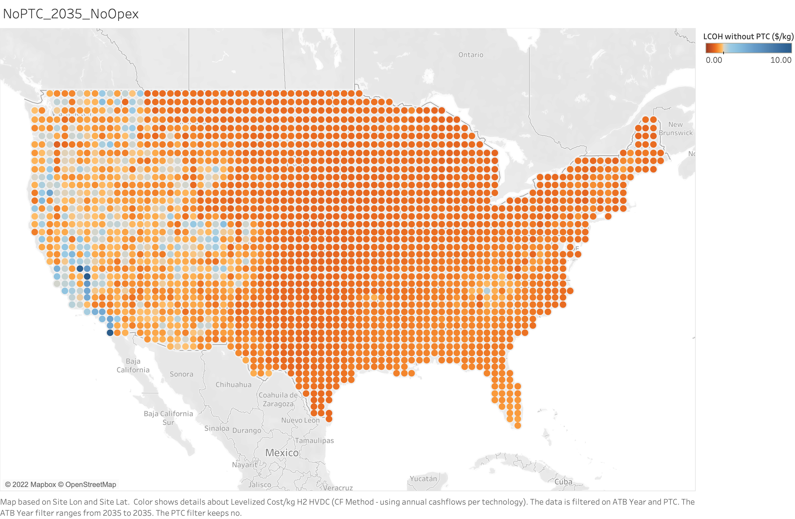

Slide 3
