Slide 1
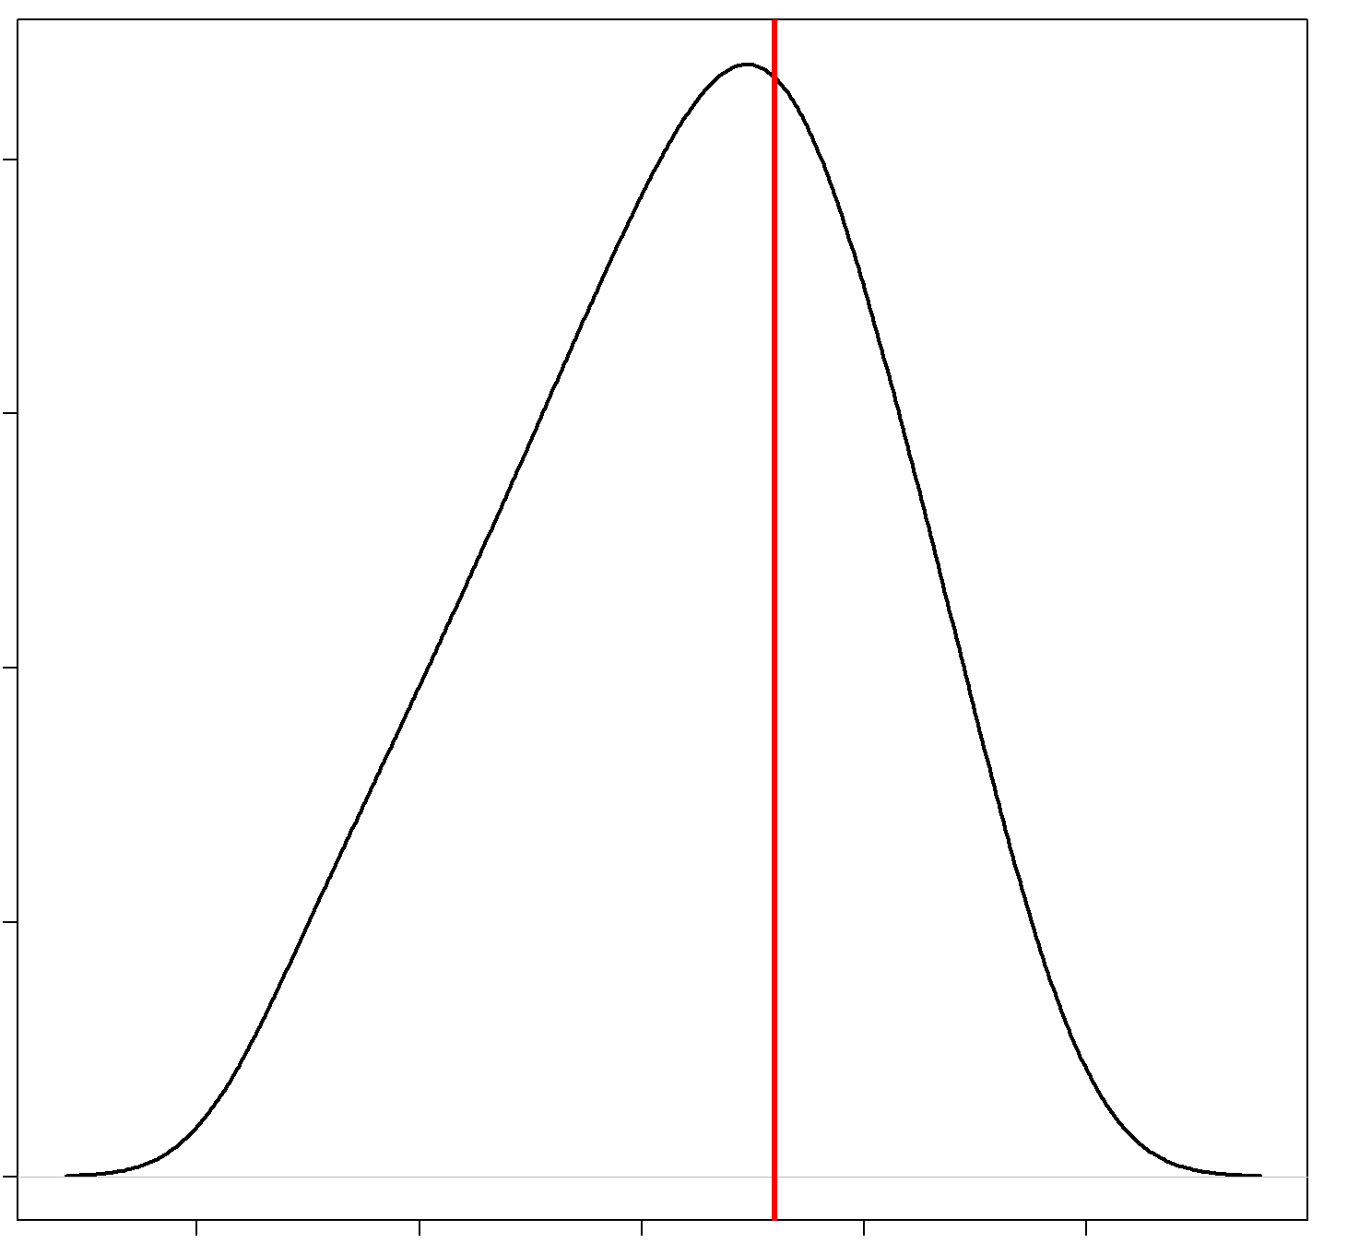
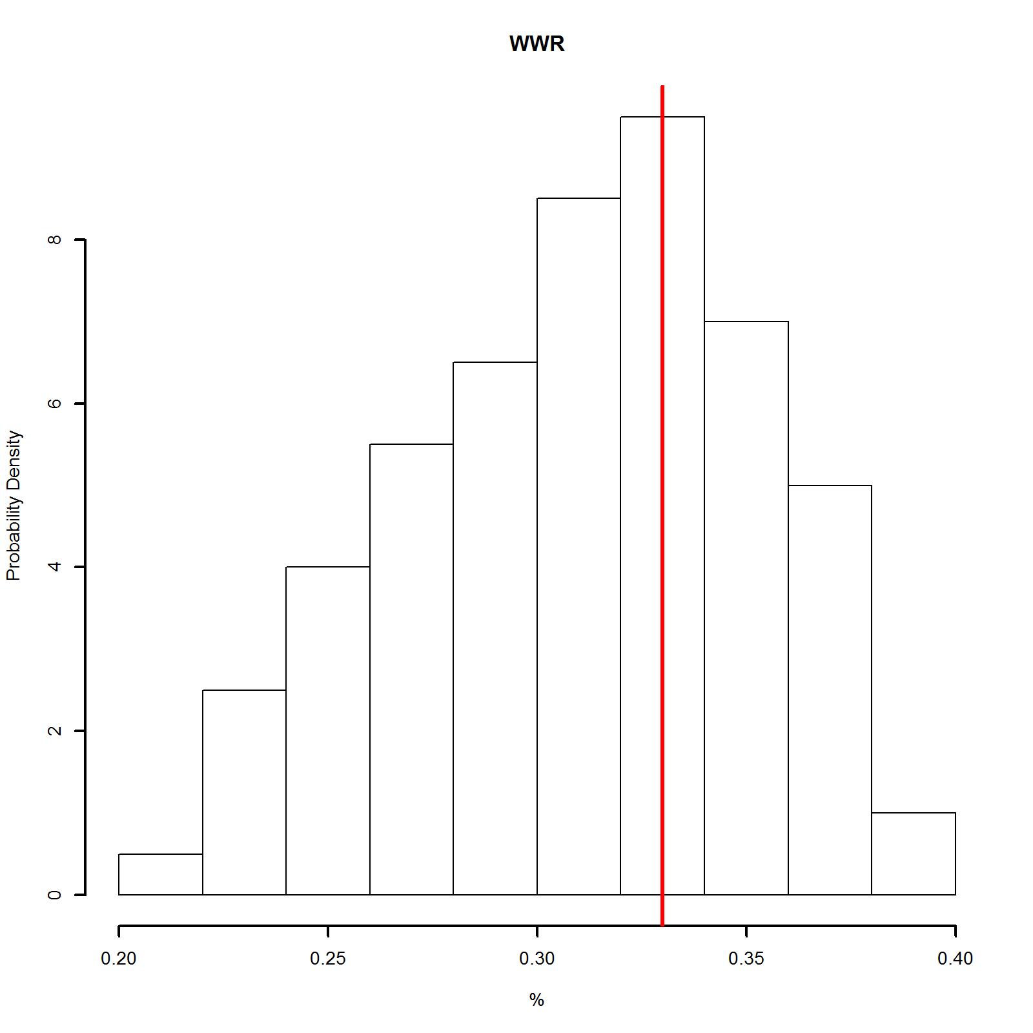
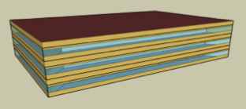
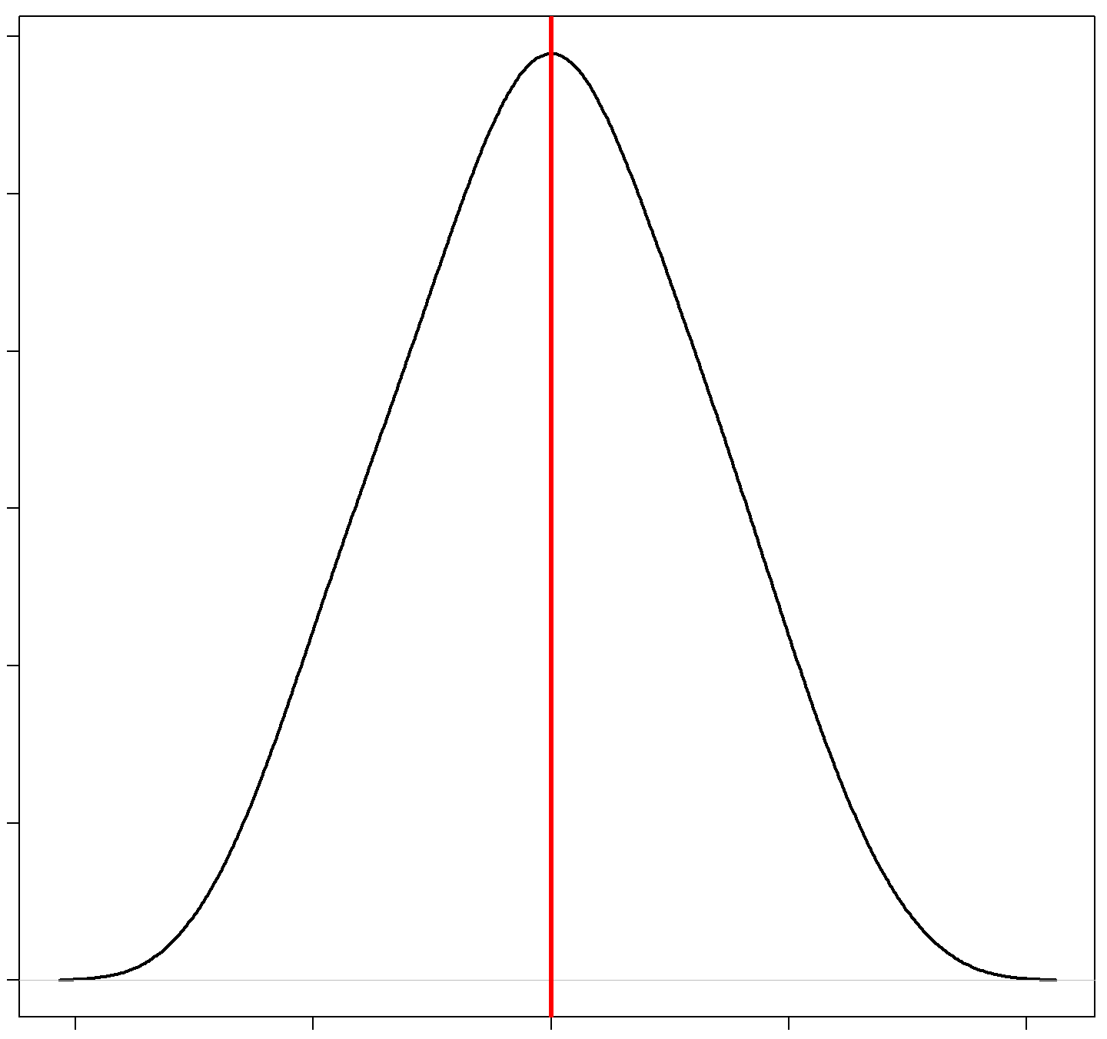
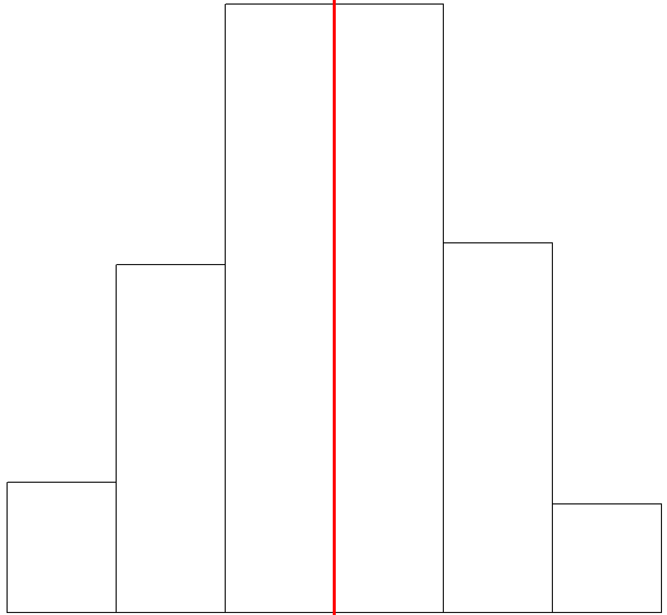
Beyond Single Point Analysis
Window-to-Wall Ratio Probability Density Function (PDF)
OpenStudio and EnergyPlus enable analysis that considers uncertainty in the baseline building.
This illustrative example is built with DOE’s medium office prototype building model and two typical sources of variability.
0.20
0.25
0.30
0.35
0.40
Infiltration % Change PDF
Red lines denote “nominal” (DEER-like) model results absent variability
-40
-20
0
20
40
Notes:
This is meant as an illustrative example of what how DEER could be populated with OpenStudio/EnergyPlus. No attempt was made to align the model with a California prototype.
DOE Medium Office model situated in San Francisco used as a starting point
Applied uncertainty to window-to-wall ratio and infiltration to create a family of medium office buildings that reflect that uncertainty
Lighting power reduction and ERV energy conservation measures were applied to those families to create distributions of EUI performance predictions for both measures
This is a scalable solution. Can easily apply many more sources of uncertainty to the baseline model – e.g. HVAC system types, insulation, occupancy density and schedules, etc. Easy to apply additional ECM. Easy to apply additional ECMs as well.
Note that distributions aren’t simply shifted to lower EUI ranges. The width of the distributions changes depending upon which measure is applied. This demonstrates that we can quantify the uncertainty in expected energy savings associated with specific measures, and provides guidance on determining if a measure’s savings could be deemed or should be calculated on a custom basis. These nonlinear effects will become more pronounced as additional sources of uncertainty are added in establishing the baseline family.

Slide 2
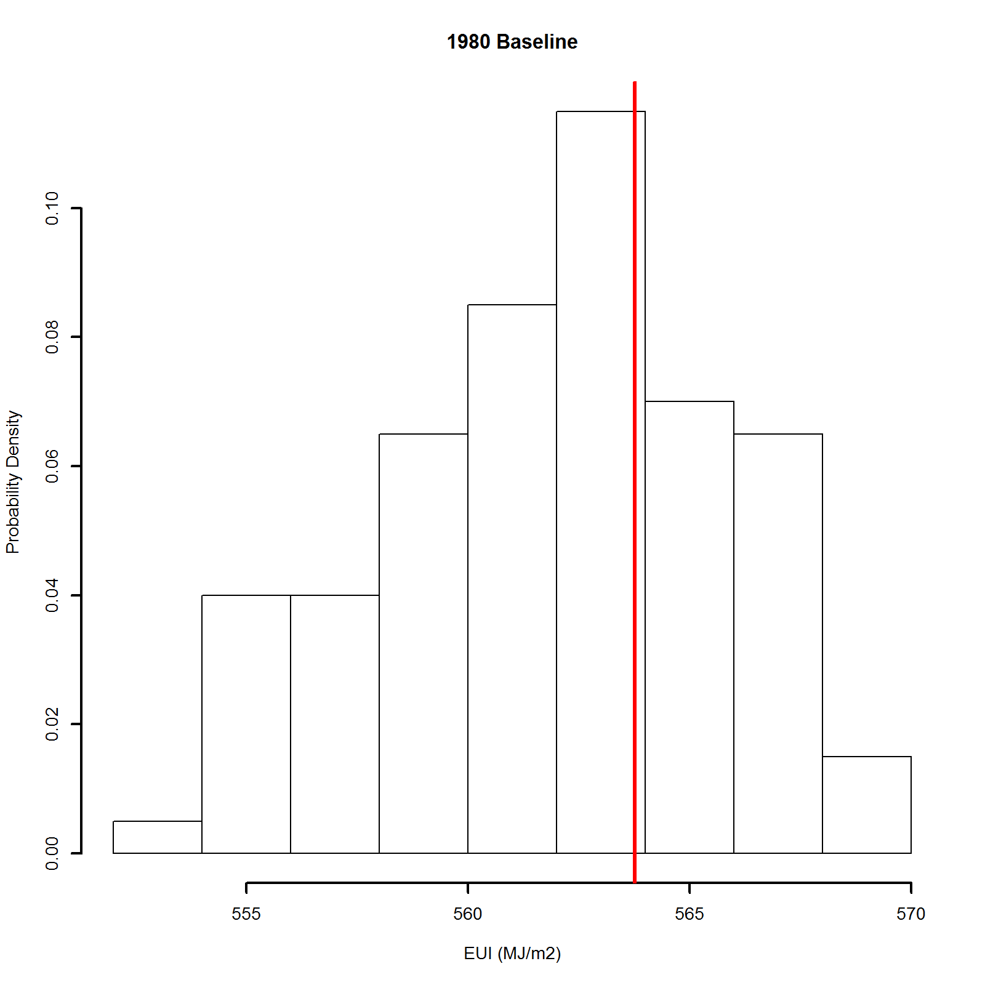
Beyond Single Point Analysis
Window-to-Wall Ratio Probability Density Function (PDF)
Pre-1980
Baseline
PDF
555
560
565
570
0.20
0.25
0.30
0.35
0.40
EUI (MJ/m²)
Scalable use of commodity cloud computing enables rapid creation of a family of baseline buildings that includes uncertainty.
Infiltration % Change PDF
-40
-20
0
20
40
Notes:
This is meant as an illustrative example of what how DEER could be populated with OpenStudio/EnergyPlus. No attempt was made to align the model with a California prototype.
DOE Medium Office model situated in San Francisco used as a starting point
Applied uncertainty to window-to-wall ratio and infiltration to create a family of medium office buildings that reflect that uncertainty
Lighting power reduction and ERV energy conservation measures were applied to those families to create distributions of EUI performance predictions for both measures
This is a scalable solution. Can easily apply many more sources of uncertainty to the baseline model – e.g. HVAC system types, insulation, occupancy density and schedules, etc. Easy to apply additional ECM. Easy to apply additional ECMs as well.
Note that distributions aren’t simply shifted to lower EUI ranges. The width of the distributions changes depending upon which measure is applied. This demonstrates that we can quantify the uncertainty in expected energy savings associated with specific measures, and provides guidance on determining if a measure’s savings could be deemed or should be calculated on a custom basis. These nonlinear effects will become more pronounced as additional sources of uncertainty are added in establishing the baseline family.

Slide 3
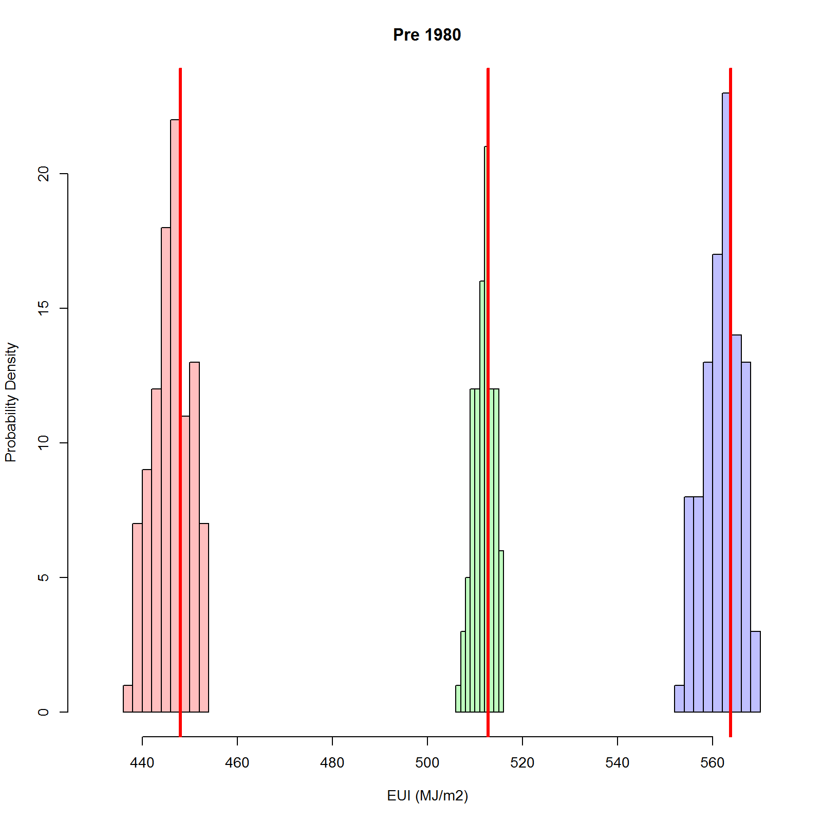
Beyond Single Point Analysis
Window-to-Wall Ratio Probability Density Function (PDF)
Potential analysis now includes uncertainty in estimated savings that can aid in deemed/custom determinations.
Pre-1980
Baseline
PDF
555
560
565
570
0.20
0.25
0.30
0.35
0.40
EUI (MJ/m²)
Solid
State Lighting Measure
+
Infiltration % Change PDF
Energy Recovery Ventilation Measure
+
-40
-20
0
20
40
440
460
480
500
520
540
560
EUI (MJ/m²)
Notes:
This is meant as an illustrative example of what how DEER could be populated with OpenStudio/EnergyPlus. No attempt was made to align the model with a California prototype.
DOE Medium Office model situated in San Francisco used as a starting point
Applied uncertainty to window-to-wall ratio and infiltration to create a family of medium office buildings that reflect that uncertainty
Lighting power reduction and ERV energy conservation measures were applied to those families to create distributions of EUI performance predictions for both measures
This is a scalable solution. Can easily apply many more sources of uncertainty to the baseline model – e.g. HVAC system types, insulation, occupancy density and schedules, etc. Easy to apply additional ECM. Easy to apply additional ECMs as well.
Note that distributions aren’t simply shifted to lower EUI ranges. The width of the distributions changes depending upon which measure is applied. This demonstrates that we can quantify the uncertainty in expected energy savings associated with specific measures, and provides guidance on determining if a measure’s savings could be deemed or should be calculated on a custom basis. These nonlinear effects will become more pronounced as additional sources of uncertainty are added in establishing the baseline family.

Slide 4
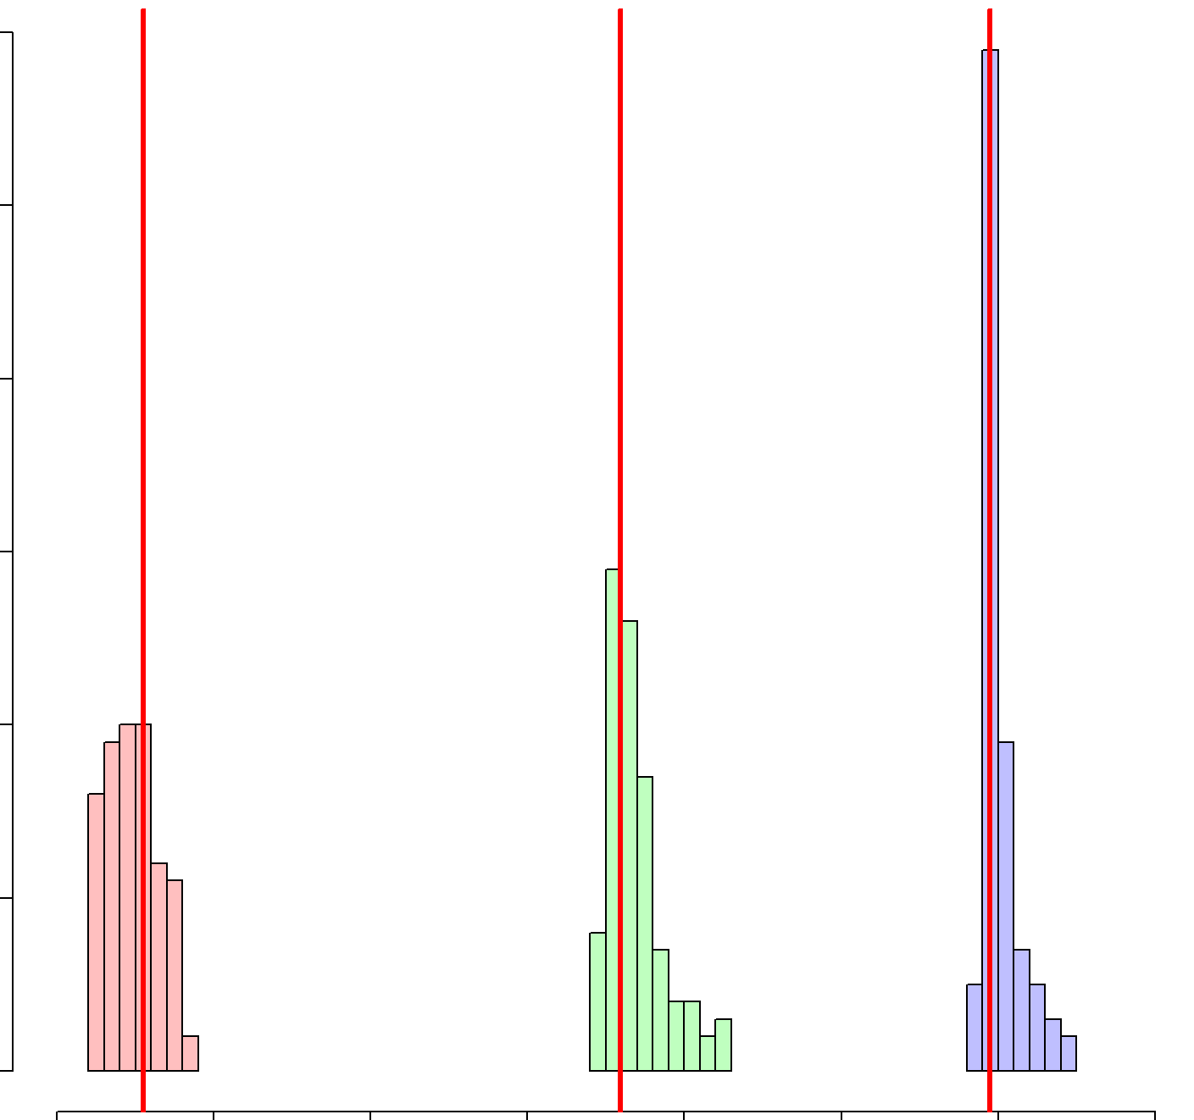
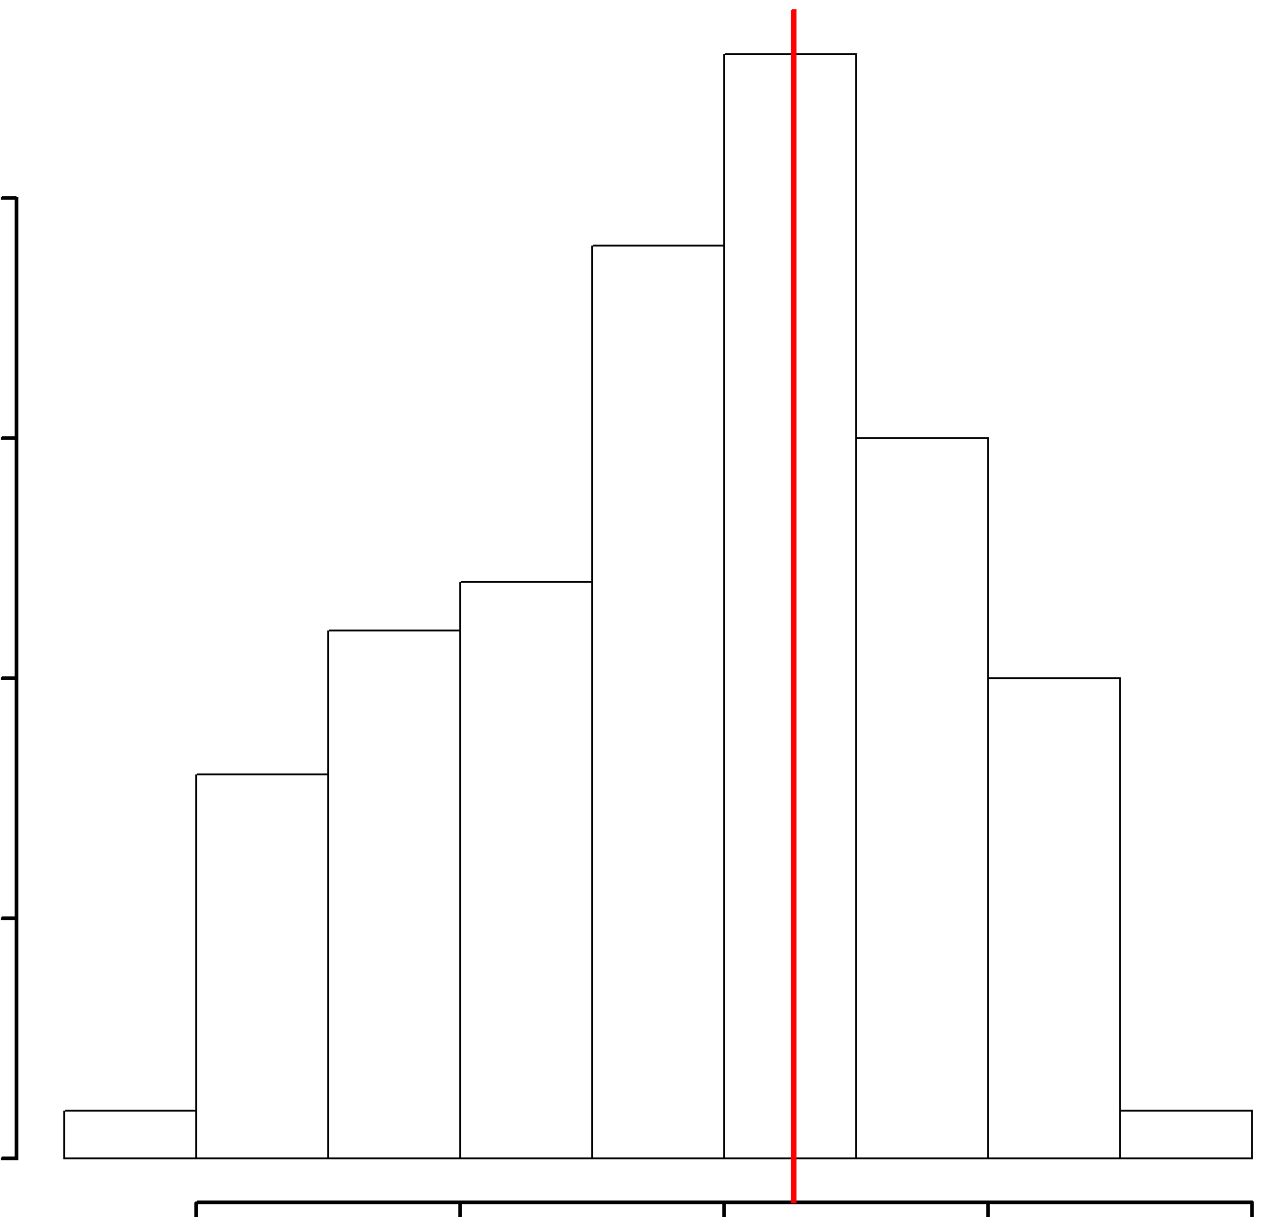
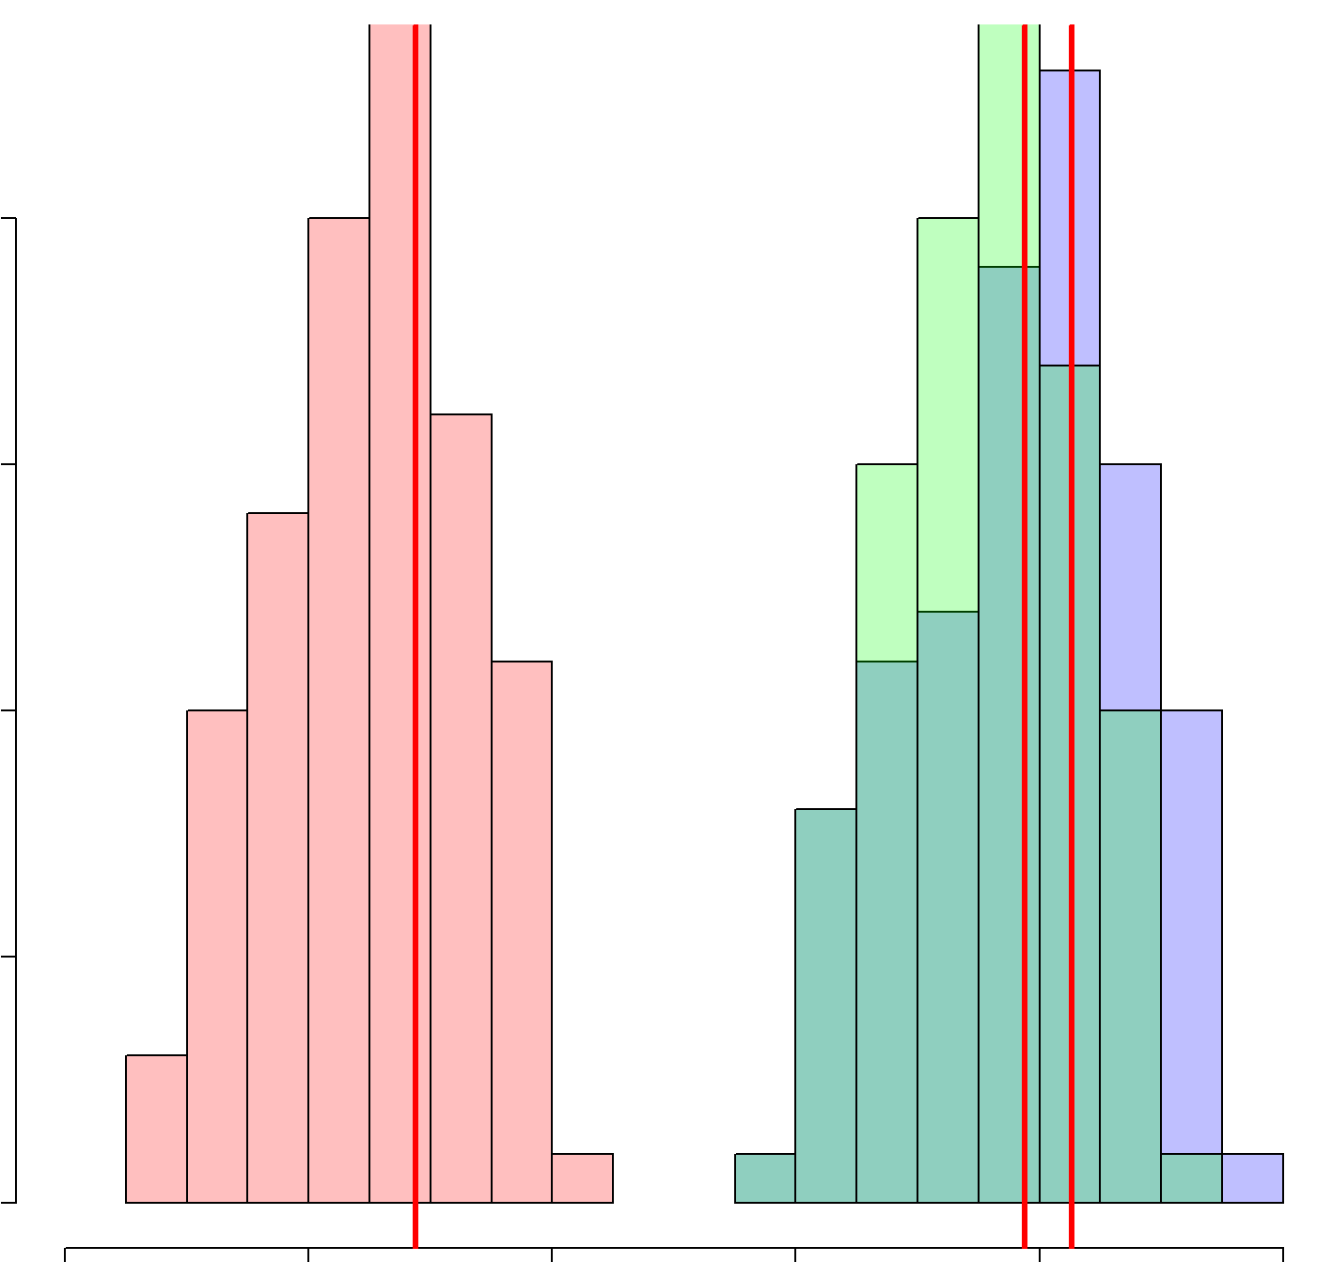
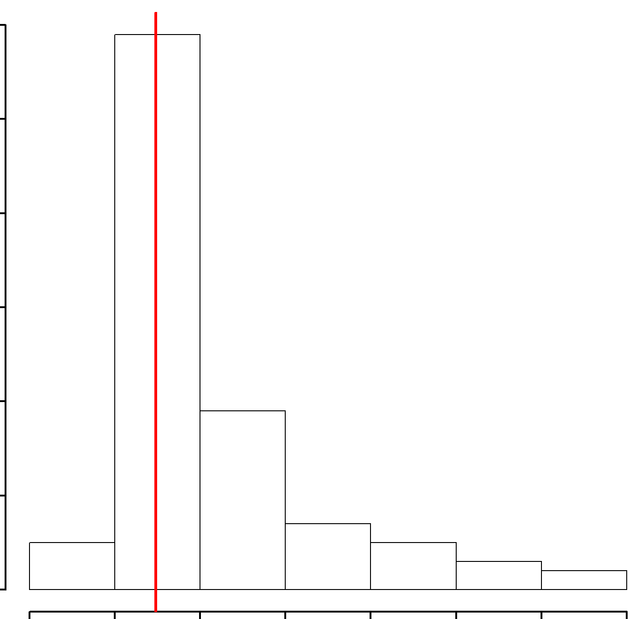
Comparison Against Multiple Baselines
Pre-1980
Baseline
PDF
Pre-1980
The system also enables easy comparison of savings predictions relative to a range of baselines.
555
560
565
570
90.1-2010
90.1-2004
Baseline
PDF
440
460
480
500
520
540
560
EUI (MJ/m²)
90.1-2004
440
460
480
90.1-2010
Baseline PDF
310
315
320
325
330
335
340
EUI (MJ/m²)
Baseline
Baseline + Energy Recovery Ventilation
339
340
341
342
380
400
420
440
460
480
Baseline + Solid State Lighting
EUI (MJ/m²)
EUI (MJ/m²)
Notes:
ERV savings in the 90.1-2004 case are negligible due to increased fan loads.
These losses are offset by higher fan efficiencies and improved controls in the 90.1-2010 baseline making ERV of benefit.
When measures are applied to a calibrated model, the savings relative to the building’s current conditions may be calculated with greater confidence.

