Slide 1
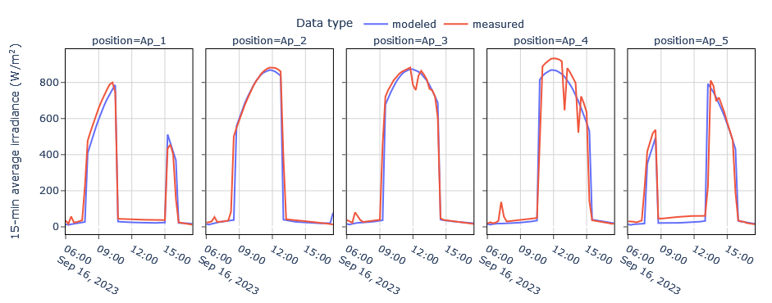
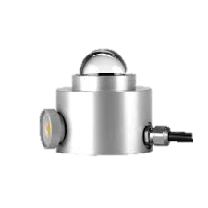
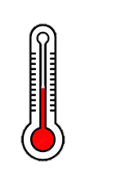
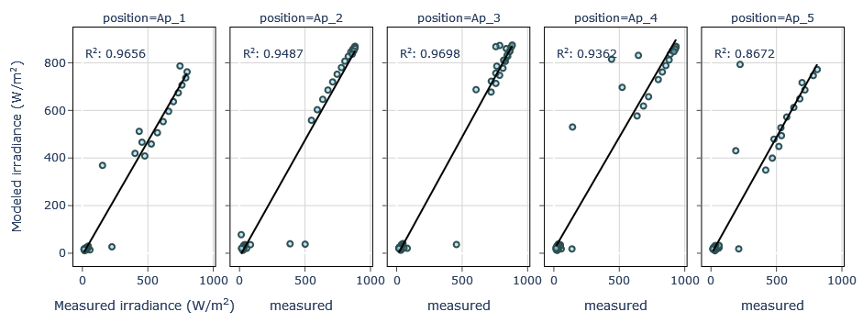
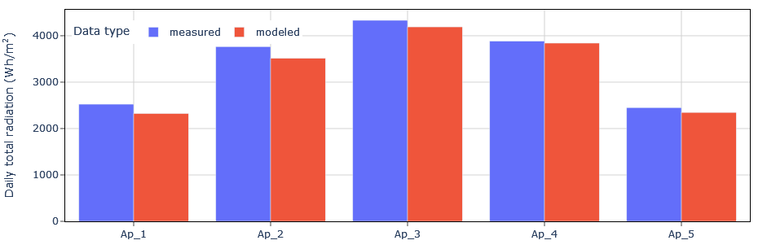
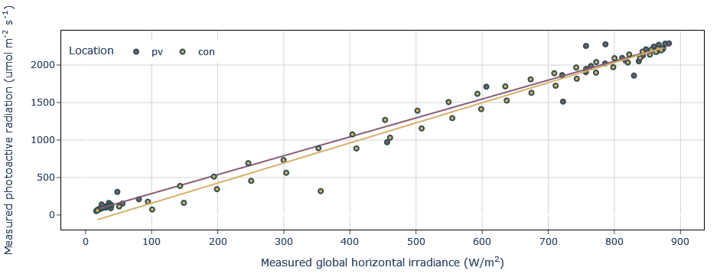
West
East
CONTROL AREA
(no shading)
Ap_1
Ap_2
Ap_3
Ap_4
Ap_5
0.4m
1.2m
1.2m
1.2m
1.2m
0.4m
a
b
c
d

Slide 2
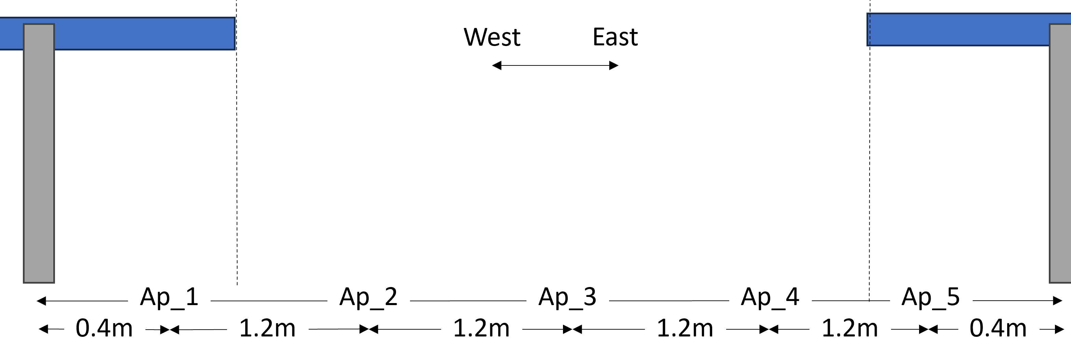
a
b
c
d

