Slide 1
OSGridView

Slide 2
Wrapper
Holder
OSWidget
QLayoutItem* item = gridView->itemAtPosition(row, column)
Wrapper* wrapper = item->widget();
QGridLayout* innerLayout = wrapper->layout();
QLayoutItem* innerItem = innerLayout >itemAtPosition(row, column)
Holder* holder = innerItem->widget();
OSLineEdit* lineEdit = holder->widget(); // or other OSWidget
Holder
OSWidget
Holder
OSWidget
Holder
OSWidget
Holder
OSWidget

Slide 3
 | Concept 1 | Concept 2
Drives GridView
Makes Widgets
QGridLayout
OSGridController
addXXXColumn
modelObjects
baseConcepts
widgetAt
makeWidget
Header
Filter
Object 1
GridView
gridLayout
addWidget
Wrapper
Holder widget
ObjectSelector
selectedObjects
selectableObjects
GridCell
Location
inFocus signal only
Object 1 | SubObject 1 SubObject 2
Object 2 | SubObject 1 SubObject 3
GridCell
Info
Refresh GridView if Category Changes
Add new objects to bottom row until refresh
Hide removed objects until refresh
Cell widgets update themselves

Slide 4
Name | Selector | Property | Reference
Model Object 1 ModelObject1 | □ ModelObject1 | Prop = 1.2 ModelObject1 | Ref = Model Object 7 ModelObject7
Model Object 2 ModelObject2 | □ ModelObject2 | Prop = 1.3 ModelObject2 | Ref = None None
Model Object 3 ModelObject3 | □ ModelObject3 | Prop = 1.4 ModelObject3 | Ref = Model Object 7 ModelObject7
ObjectSelector only cares about the Model Objects associated with selectors
Name | Selector | Property | Reference
Model Object 1 ModelObject1 | □ ModelObject5 | Prop = 1.2 ModelObject5 | Ref = Model Object 9 ModelObject9
Model Object 2 ModelObject2 | □ ModelObject6 | Prop = 1.3 ModelObject6 | Ref = None None
Model Object 3 ModelObject3 | □ ModelObject7 | Prop = 1.4 ModelObject7 | Ref = Model Object 9 ModelObject9
Model Object 2 ModelObject2 | □ ModelObject5 | Prop = 1.2 ModelObject5 | Ref = Model Object 9 ModelObject9
 | □ ModelObject6 | Prop = 1.3 ModelObject6 | Ref = None None
 | □ ModelObject8 | Prop = 1.5 ModelObject8 | Ref = Model Object 10 ModelObject10
Model Object can only be used for two selectors if inherited

Slide 5
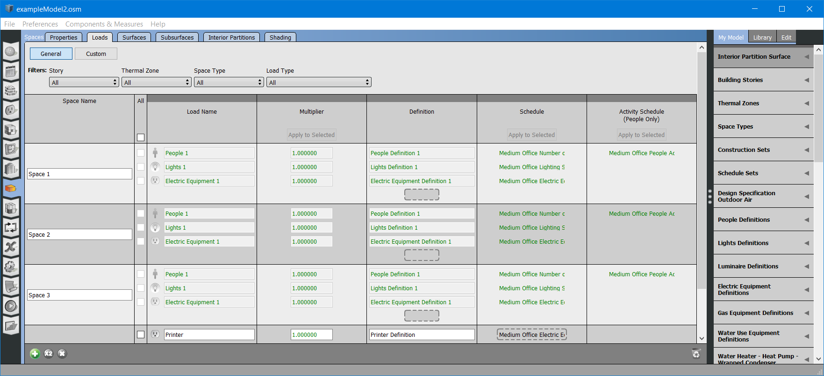
GridSubTabView CategoryButtonLayout GridView FilterLayout QGridLayout HorizonalHeaders
DropZone
m_checkBox
Row 0
1
m_pushButton
Row 1
Subrow 0
Subrow 1
ModelObject 0
Subrow 2
Row 2
ModelObject 1
Row 3
ModelObject 2
Checkbox for select all column comes from the column concepts Header, created and connected in concrete GridView

Slide 6
Checks for Header Button Presses by checking if row ==0, otherwise configures Select All button
Object InFocus
Adds data and emits inFocus
Applies style and emits inFocus
OSGrid Controller
onInFocus
GridCell Location
onInFocus
Widget
focusInEvent
focusOutEvent
inFocus
inFocus, hasData
OSGrid Controller
Object Selector
GridCell Location
Holder
Widget
inFocus
inFocus, hasData,
row, column, subrow
inFocus
inFocus, hasData,
row, column, subrow
Horizontal Header Widget
Horizontal Header Push Button
Widget
focusInEvent
focusOutEvent

Slide 7
Calls virtual onClearSelection and onSelectItem, enables Header buttons
gridRow
SelectionChanged
Object Selected
OSGrid Controller onSelectAll clearSelection
Select All
CheckBox concrete GridView
onGridRow SelectionChanged
stateChanged
state
GridView SubTab
ObjectSelector selectAll
ObjectSelector clearSelection
gridRow
SelectionChanged
GridView
OSGrid Controller
gridRow
SelectionChanged
gridRow
SelectionChanged
ObjectSelector getObjectSelected
getObject
Selected
ObjectSelector setObjectSelected
setObject Selected
Row Select
CheckBox
gridRow
SelectionChanged

Slide 8
Grid Cell Changed
Update locked, selected, visible
onGridCell Changed
OSGrid
View
OSGrid Controller
Object Selector
gridCellChanged
location, info
gridCellChanged
location, info

