Slide 1
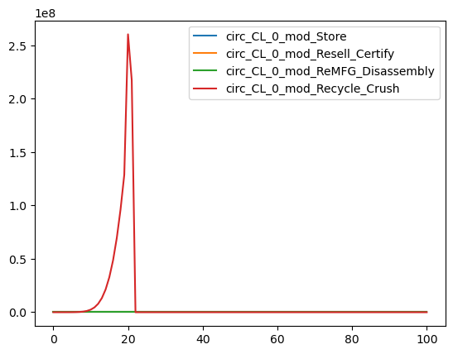
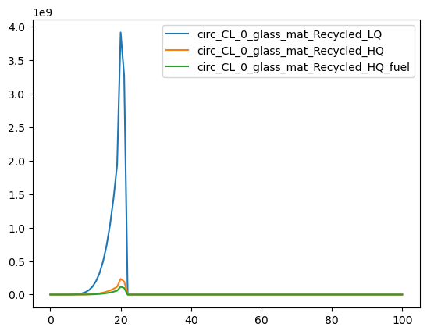
CL_0 is not applying recycling crush energy to any modules
Good
CL_O is no recycling glass at EoL
Good

Slide 2
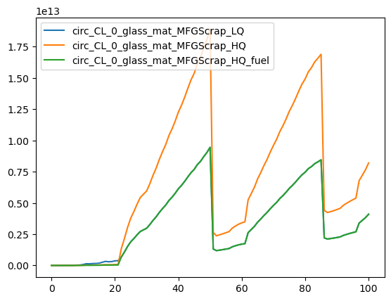
CL_0 IS recycling MFGing Scrap!! Demanding 1e13 Wh

Slide 3
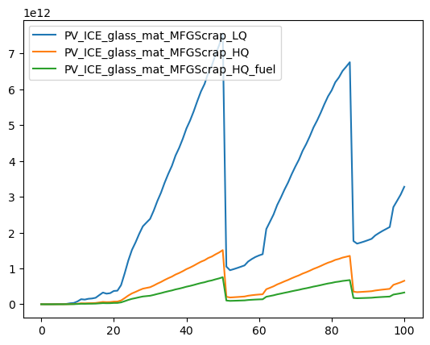
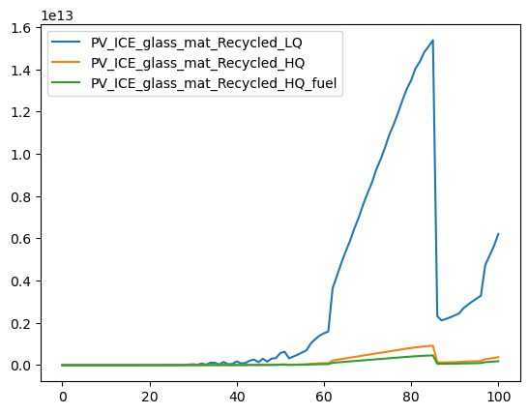

Slide 4
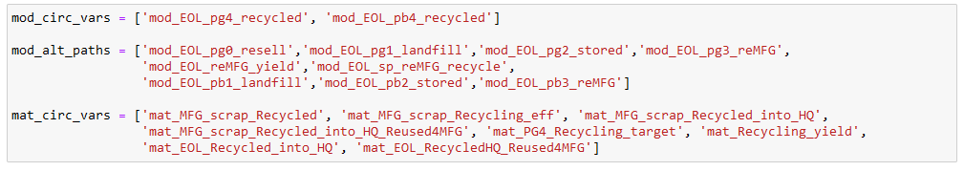
I was maxing out path to mfgin scrap recycling without controlling the path at the specificied rate

Slide 5
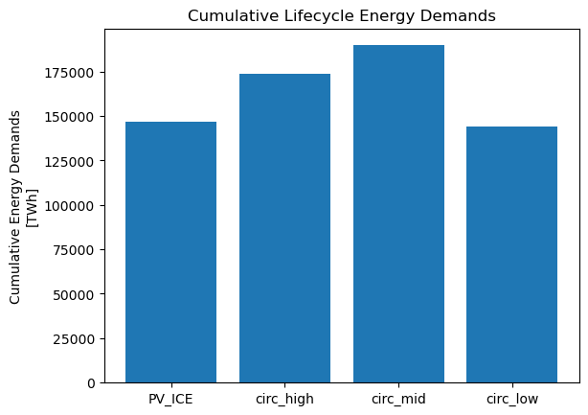
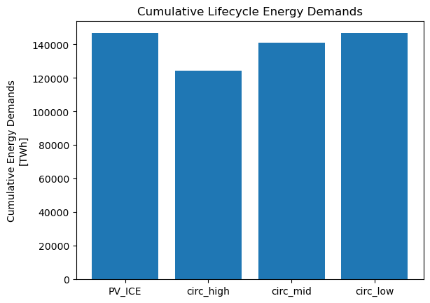
Accidentally maxing out MFGscrap
Removed MFGing scrap from sensitivity:
PV_ICE 1.467115e+17 circ_high 1.734309e+17 circ_mid 1.897816e+17 circ_low 1.441579e+17 Name: 2100, dtype: float64
PV_ICE 1.467115e+17 circ_high 1.244406e+17 circ_mid 1.407912e+17 circ_low 1.466881e+17
PV ICE is higher than circ_low. This is expected because baseline has non-zero EoL recycle

Slide 6
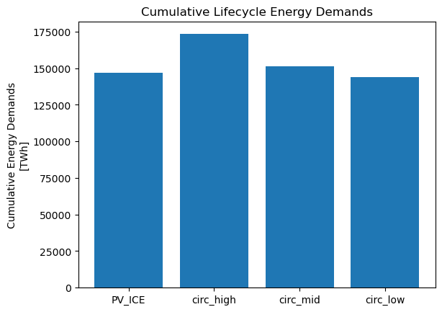
So I do change the mfging scrap recycling in the extreme circular to max
Therefore, for the sensitivity, it mightmaek most sense to also change mfging scrap
Need to add a line that controls path into mfgin scrap recycling at the same rate rates[r]
Removed MFGing scrap from sensitivity:
Actively control MFGing scrap at same rate as EoL
PV_ICE 1.467115e+17 circ_high 1.244406e+17 circ_mid 1.407912e+17 circ_low 1.466881e+17
PV_ICE 1.467115e+17 circ_high 1.734309e+17 circ_mid 1.511411e+17 circ_low 1.441579e+17
For some reason adding mfging scrap flipped the trend, massively increased energy demands

Slide 7
dm['mat_MFG_Scrap_Sentto_Recycling'] = dm['mat_MFG_Scrap'] * dm['mat_MFG_scrap_Recycled'] * 0.01 #control path to recycle mfgscrap, everything that enters recycling (yield + unyield, LQ + HQ)
dm['mat_MFG_Scrap_Recycled_Successfully'] = (dm['mat_MFG_Scrap_Sentto_Recycling'] *dm['mat_MFG_scrap_Recycling_eff'] * 0.01) #yield of mfgscrap recycle
dm['mat_MFG_Scrap_Recycled_Losses_Landfilled'] = (dm['mat_MFG_Scrap_Sentto_Recycling’] - dm['mat_MFG_Scrap_Recycled_Successfully’]) #unyield
dm['mat_MFG_Recycled_into_HQ'] = (dm['mat_MFG_Scrap_Recycled_Successfully'] *dm['mat_MFG_scrap_Recycled_into_HQ'] * 0.01) #% of LQ sent to additional HQ
dm['mat_MFG_Recycled_into_OQ'] = dm['mat_MFG_Scrap_Recycled_Successfully'] - dm['mat_MFG_Recycled_into_HQ’] #stays as LQ
dm['mat_MFG_Recycled_HQ_into_MFG'] = (dm['mat_MFG_Recycled_into_HQ'] *dm['mat_MFG_scrap_Recycled_into_HQ_Reused4MFG'] * 0.01) #% of HQ that offsets virgin
dm['mat_MFG_Recycled_HQ_into_OU'] = dm['mat_MFG_Recycled_into_HQ'] - dm['mat_MFG_Recycled_HQ_into_MFG']
demat['mat_MFGScrap_LQ'] = dm['mat_MFG_Scrap_Sentto_Recycling']*matEnergy['e_mat_MFGScrap_LQ'] #OQ only - everything that goes into mfgscrap recycle
demat['mat_MFGScrap_HQ'] = dm['mat_MFG_Recycled_into_HQ']*(matEnergy['e_mat_MFGScrap_HQ']+matEnergy['e_mat_MFGScrap_LQ']) #fraction sent to HQ separate from OQ
I think this double counts the LQ recycling energy

Slide 8
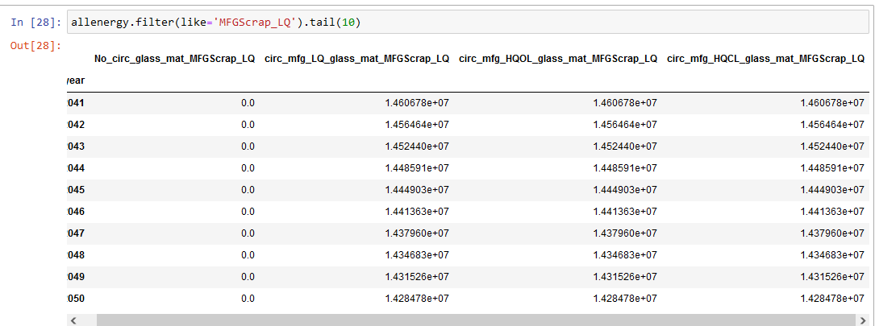
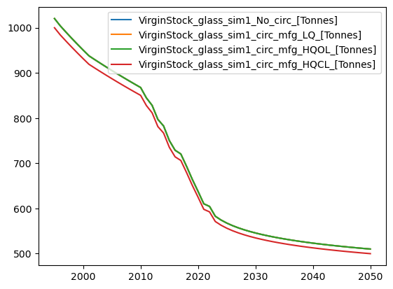
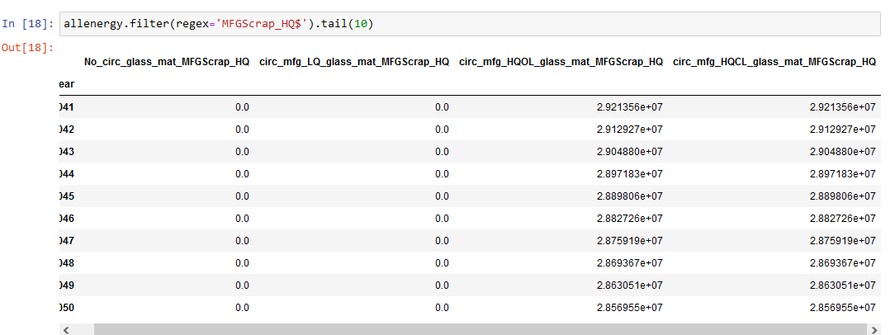
Check double counting LQ recycling energy with extreme simple case:
Module of only glass, deploy same annually
scens:
No mfgscrap recycling
Only LQ mfgscrap recycling
Only HQ_4MFG mfgscrap recycling
Only HQ_OU mfgscrap recycling
Confirm all mfgscrap scenarios have LQ energy demands
Good.
Confirm, both HQ have HQ energy, the others don’t
Good
Note: CL offsets on the first year. I guess this is fine.
Confirm that only CL is offsetting material demand
Good

