Slide 1
SAM “Arch-3” Quick How-To
23 January 2014

Slide 2
Key differences relative to Arch-2
Different forms can have the SAME variable names, but not within a single configuration
Input pages are loaded ON-DEMAND. So cannot ‘modify’ a widget on another page from a callback. Must use the ‘on_load’ event handler for the form to set up the UI each time it is shown: see utility rate page for example. This minimizes resource usage
All equations (both single/multiple output) written in LK script
All UI callbacks, including plotting, written in LK script
Direct integration with SSC. This means there has to be a one-to-one correspondence between UI variable names to those expected by the SSC modules – there is no layer of variable manipulation like we have with the interop layer in SAMSIM currently – this is good for simplicity, speed, and ease of use for SDK folks
The callback scripts, equations, variable definitions, and user interface are all stored in a single binary .ui file in the SAM/runtime/ui folder

Slide 3
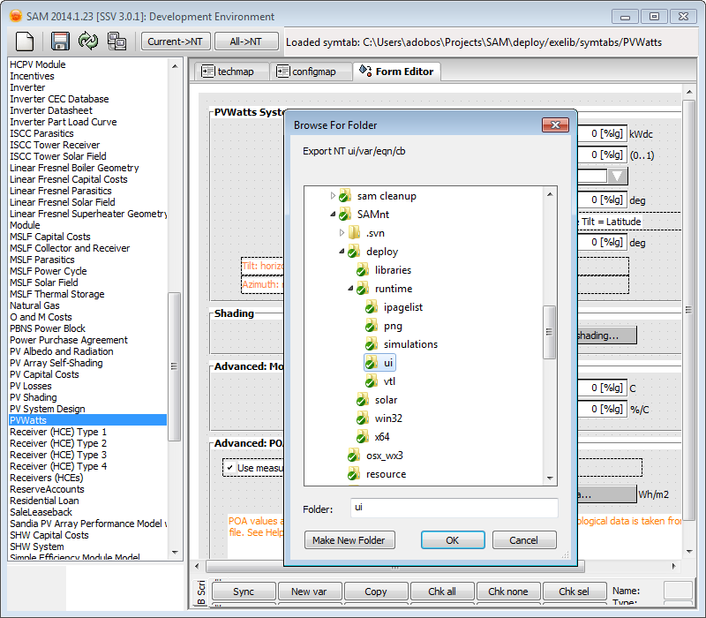
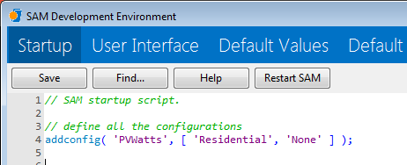

Example process for importing technology from Arch-2
Export the relevant input from Arch-2
Shift-F7 to start the dev environment
Select the form to export
Press the “Current->NT” button on the toolbar
Select the SAMNTDIR/deploy/runtime/ui folder
In Arch-3, start the dev environment (Shift-F7)
Define a new configuration in the startup script
Set the active config, the call setmodules to define the SSC modules needed to run the simulations for that configuration
Write a function that sets up the input pages

Slide 4

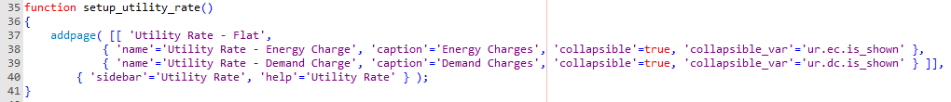
Setting up input pages (1)
Easy for basic pages:
Make sure to use the double brackets [[ ]]
‘sidebar’ is the name shown on the navigation bar in SAM
‘help’ is the context ID for the help system
For stacked pages, add the names in a list
For stacked + collapsible pages, as above, unless it’s collapsible, in which case create a table { } with these fields
‘name’ is file name of the UI page
‘caption’ is what’s shown on the +/- widget
‘collapsible’=true means it can be shown/hidden
‘collapsible_var’ is the name of the variable that should be created to govern whether the page is shown or not. It is a numeric boolean variable (true=shown, false=hidden)

Slide 5
Setting up input pages (2)
Exclusive pages (i.e. inverter selection)
Each set of exclusive pages goes in a bracket [ ] in the top-level bracket list, per below.
For the toplevel page options, set up an ‘exclusive_var’ that is internally set to which of the exclusive pages is shown. It is an integer, zero indexed. For example, pv.inv.model_type=2 means that the inverter part load curve option is active
Exclusive pages, with collapsible sub panes
Same as above, but a collapsible page is done in { } with the options on the previous slide

Slide 6
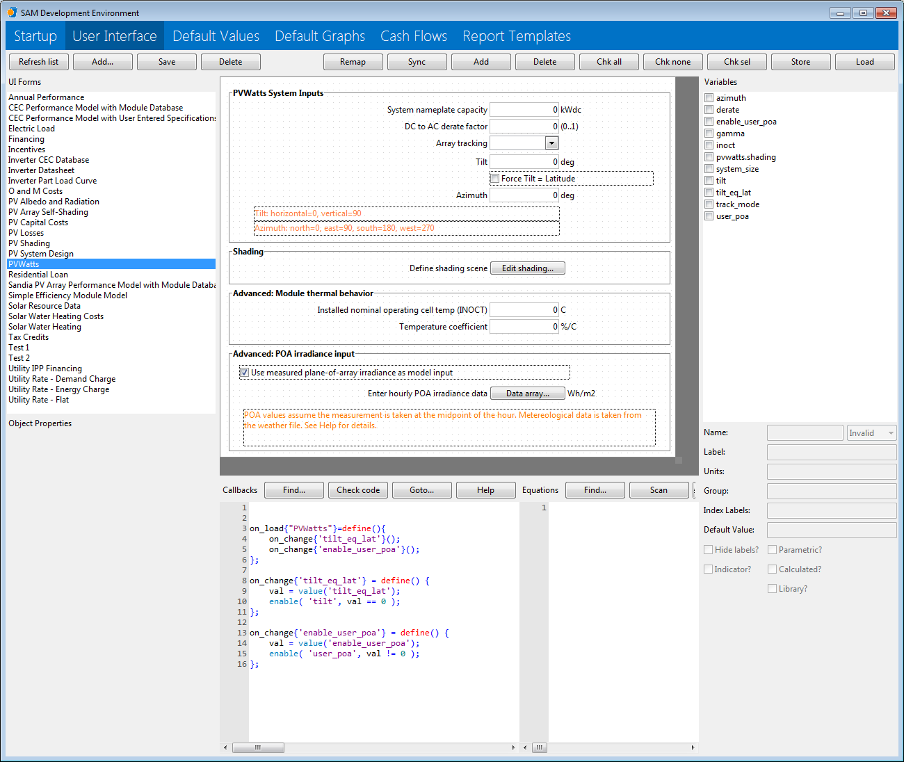
Creating the UI
To create a new form, click “Add” on the top bar. To edit an existing form, click on it in the list. Then, right click on the new form to create/edit/delete UI widgets. When a widget it selected, it’s properties are shown on the bottom left
Each form is associated with variables (right hand side). For a widget and variable to interact, they must have identical names. If a variable is associated with a widget, the variable’s label and units are drawn automatically on the form.
Callbacks are scripts that run to handle things like:
User clicks on a button on the UI to download a weather file
A variable changes, and a plot needs to be redrawn
A variable changes, and other inputs need to be enabled/disabled

Slide 7
Working with variables
Remap: opens a dialog that helps you change the name of multiple variables in both the UI, variable table, callback, and script of the active UI form. On the second tab, an SSC variable table is loaded so you can easily remember what the names are. On the third tab, SAM loads VTL (variable translation layer) files to help migrate Arch-2 names to Arch-3/SSC.
Sync: Suppose you create a bunch of new input widgets, and you’ve assigned them appropriate names, click sync, and the associated variables will be created automatically with appropriate data types.
Add/Delete: create or remove a variable from the table. Delete will remove the selected one as well as any checked variables
Chk all/none: check/uncheck each variable in the list (used for delete/store commands)
Chk sel: Select multiple widgets on the UI form, and those with associated variables will be checked.
Store: Save the checked variables to a “clipboard”
Load: Load the variables currently stored in the “clipboard”.
Store/Load are useful for moving variables from one UI page to another (like when I moved a lot of PV variables from some pages to other pages)

Slide 8
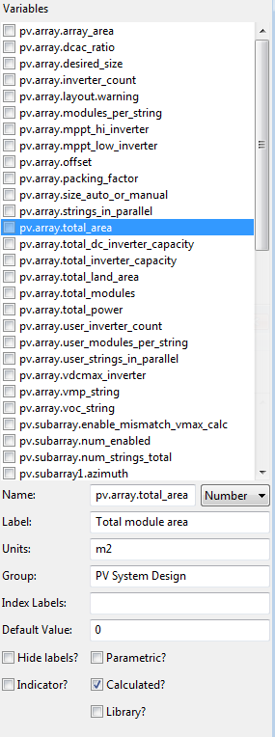
Variable properties
Name: internal name of variable used in equations, widgets, SSC, everywhere
Data type: Number, Array, Matrix, String, Table
Label/Units: self explanatory
Group: when you go to a parametric and you select variables, this is the grouping in the tree. Same as ‘Context’ in Arch-2
Index Labels: for integer variables in a fixed domain (i.e. tracking mode is 0=fixed,1=1axis,2=2axis,3=aziaxis), list the option names as a comma separated list.
Default value: this is the “internal” default value. Good to set a reasonable value. These will be overridden by configuration-specific defaults stored elsewhere, but it’s good to have a reasonable value here when developing a new form and testing it before the configuration defaults have been established
Parametric? – do we allow this variable to be parameterized
Indicator? – disable user input and show as grayed out read only
Calculated? – is this variable’s value calculated by an equation
Library? – does this variable store the name/selection of library entry. More details on this flag on the “Library” slide

Slide 9
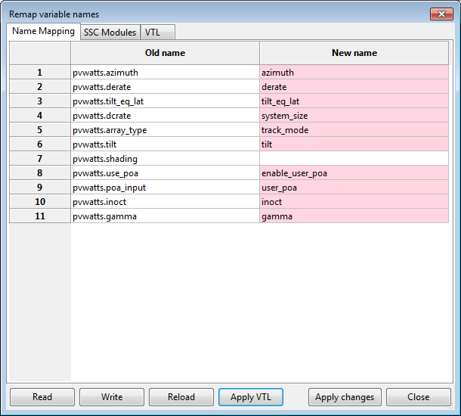
Renaming variables via ‘Remap’
All variables on the current form/vartable are loaded. You can just type the new names into the grid, and click ‘apply changes’. The UI widgets are renamed, so are the variable table, and find/replace is done in the callbacks and equations to rename the variables. If you leave a ‘new name’ blank, that variable will not be renamed.
‘Read’/’Write’ loads/saves the table as a CSV file of your choice
‘Reload’ rescans the current form for variables
‘Apply VTL’ uses the VTL in the third tab to try to automatically find new names for the old ones, and fills in the second column. Variables it found are highlighted in pink. As shown, the ‘pvwatts.shading’ variable could not be found in the VTL, so you have to do that one manually. Check the SSC modules tab to see what the right variable name is.

Slide 10

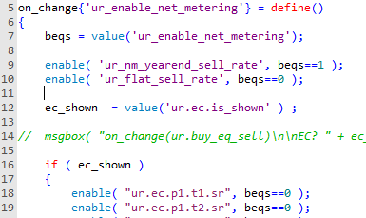
Callbacks
on_load{‘<form name>’} = define()
Called when the form loads. Note this happens every time it is shown in Arch-3, unlike Arch-2. Also called when it is un-collapsed. Can be used to set up which widgets are enabled/disabled etc. Can call other functions, callbacks, etc
on_change{‘<variable name>’} = define()
Called when a variable changes, can be used to update a plot, or enable/disable other widgets, or check inputs, or run some checks, etc.
Click ‘Help’ to find out what built-in functions exist, or ‘Goto’ to automatically create the outline code of a callback for a variable or form.

Slide 11
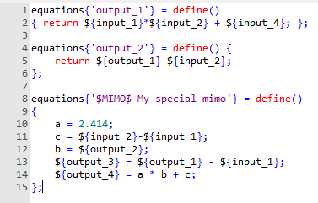
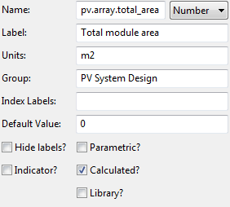
Equations (1)
Equations are written as script code exclusively, and can handle both MISO/MIMO
Can use the ${…} notation to directly access variables.
For MISO, the return statement is used.
For MIMOs, the $MIMO$ identifier must be first. SAM will scan the equation code to find all the inputs/outputs.
Equations can call script functions, handle text strings, basically do anything a script can do.
In Arch-2 there was a variable called ‘case.technology’, ‘case.financing’. In Arch-3, there are built-in functions called ‘technology()’ and ‘financing()’ that return STRING name of the tech/financing option. Then you can use IF statement to do different things
Note: for a calculated output, the associated variable must have the ‘Calculated?’ option checked

Slide 12
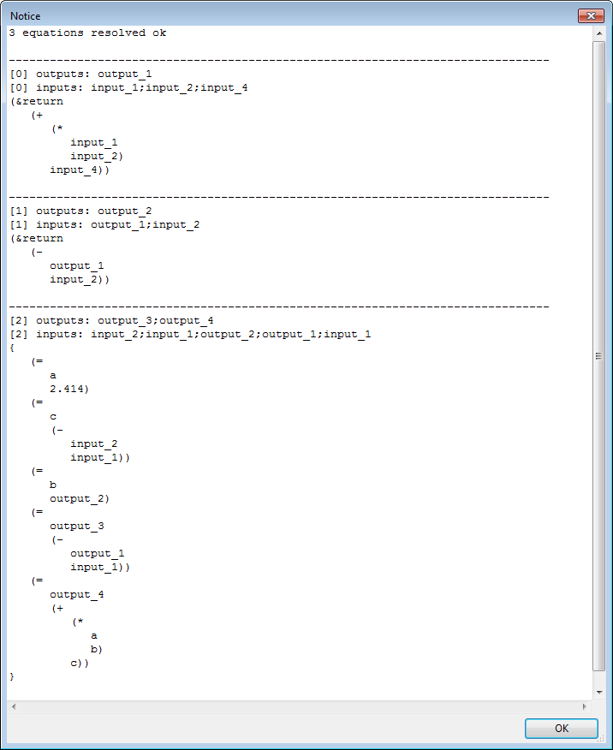
Equations (2)
To check your equations, press the Scan button
SAM interprets the code and tells you how many equations were resolved, and for each, which inputs/outputs were detected. Then you can confirm what you intended.
SAM uses its detection of inputs and outputs to determine the order in which equations must be evaluated in the user interface, and to maintain records of which equations must be recalculated when a particular input changes.

Slide 13
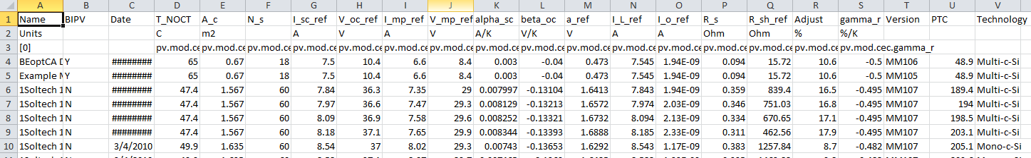
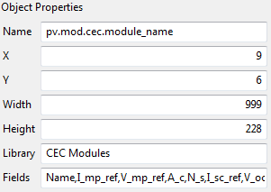
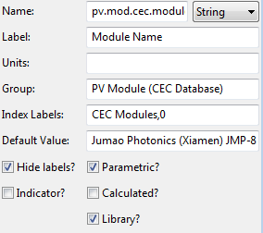
Libraries
All libraries stored in an Excel-readable CSV in SAMNTDIR/deploy/libraries
First row is data column name, second row is units, next rows that start with [0], [1], etc.. are associated SAM variable names, subsequent rows are data entries
The first column is the Entry name or ‘unique ID’ used to select between entries in SAM – this is the name saved in a project file
To use a library in SAM, use the LibraryCtrl widget and set its properties to define the name of the library (file name of the .csv file), and the fields you want to show up in selector widget
Then set up the associated variable:
IndexLabels is set to <LibraryName>,<VariableSetIndex>
Default entry name is the selection by default
Check the ‘Library’ option
For variables that are defined by the library values, check the ‘Calculated? Option for those (the library “calculates” the value of that input)

Slide 14
Weather Data
All SAM solar data is now converted to Excel readable .csv (TMY2, TMY3, intl, etc). The format is described in the wfcsv.pdf document
When SAM starts up, it scans all the headers of all the weather files it finds in the SAMNTDIR/deploy/solar folder. Then a “library” with name ‘SolarResourceData’ is created from the header data, and the UI simply uses the normal Library mechanism to show the locations.
We’ll add converters to import TMY2, TMY3, and EPW formatted files to SAM and create the .csv format. Also note: often TMY3s have the .csv extension. SAM will now only detect TMY3s if they have a .tm3 extension, and otherwise will assume they’re in wfcsv format.
Wind data files don’t change format, will continue to use .csv/.srw

Slide 15
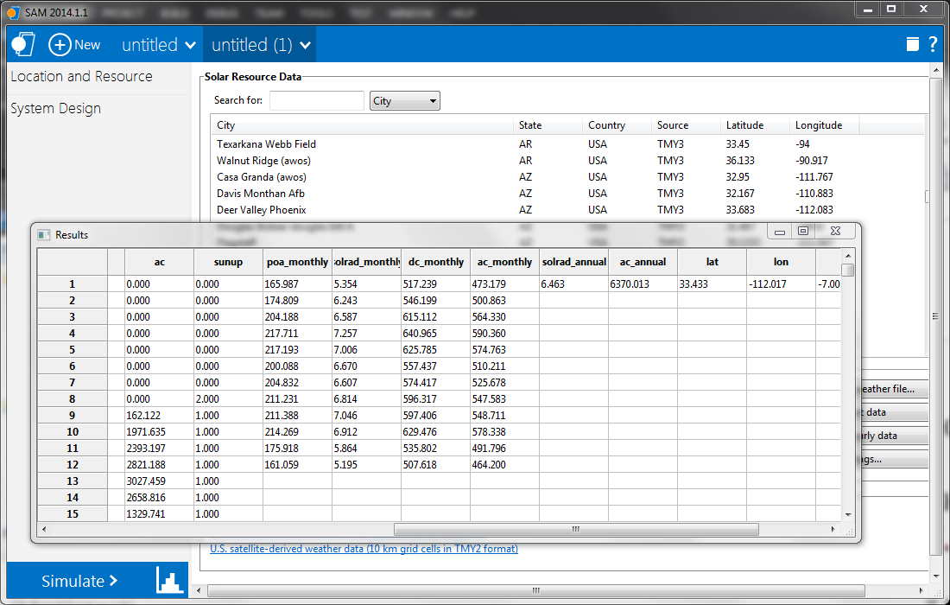
Testing a simulation
Create the UI, variables, configuration. Press ‘Restart SAM’ on the ‘Startup’ tab, or quit and start SAM anew. In debug mode, the log window will show up at startup and give any error messages, otherwise you can press Shift-F4 to show it anyways once SAM is loaded
Create a new project with that configuration
Press simulate. If all OK, the SSC modules defined for that config will run in sequence and the outputs will be generated in a table
Otherwise, SSC error messages will be reported

Slide 16
Tables and SSC
Example issue: “shading” is stored in a structure in SAM UI with 8 fields
‘shading’ { en_hourly, hourly, en_mxh, mxh, en_azal, azal, en_diff, diff }
In SSC, 4 separate variables are used: shading_hourly, shading_mxh, shading_azal, shading_dff
By naming them as ‘shading:hourly’, ‘shading:mxh’, ‘shading:azal’, ‘shading:diff’, SAM automatically interprets them as “table:field” structure and pulls the appropriate variable value.
It’s not that simple though: SAM UI stores whether each field is enabled/disabled as another boolean field in the table called “en_<field>”. The last user entered value for each field is still stored whether it is enabled or not. So, this would be a problem if the last user entered table for ‘mxh’ was sent to SSC even if it was disabled.
Solution: SAM UI checks for the existence of an ‘en_<field>’ variable in the table IF it is using the table:field convention for a variable, AND the variable is defined as optional (“?” in the required field in SSC). If the en_<field> variable exists and is ‘false’, SAM does NOT assign that variable to SSC, and so is implicitly turned off.
Why do something so complicated/subtle??
Input widgets in SAM can only change one variable. So, the various shading input options must be stored in a single variable, and tables allow this.
Having a single variable in SSC called ‘shading’ that requires a table input is really hard for someone using the SDK to use, because where would we document the exact table structure that SSC is requesting? Maybe a solution to this would be have the ability to write a couple of paragraphs of compute module documentation that is stored in SSC and can be retrieved along with all the other variable info.
Another way to do it would be to have the “shading” button in the UI, and have an equation that sets values for shading_mxh, shading_hourly, shading_azal, shading_diff depending on the selection of fields. This would also work.
What do you all think? We can use all of these options in different places!
Similar approach will be needed for the “Availability” widget that allows input of 8760 factors, or user-specified outage time periods, or a month x hour schedule, or other input method

Slide 17
Good luck!
Known TODO items:
Monolithic versions of financial models in SSC with consistent inputs
Standardize weather file variable name in SSC models (solar_data_file instead of weather_file, or file_name, or others)
Convert all solar models to be able to use WFCSV reader in SSC engine
CSP trough: parameters for different HCEs defined as arrays, need to be separate variables. Translation currently is in SAMSIM interop, but that translation now is inside SSC as it sets up TCS
Issue with SAMnt not setting library parameters if form is not shown first – will be fixed very shortly.

