Slide 1
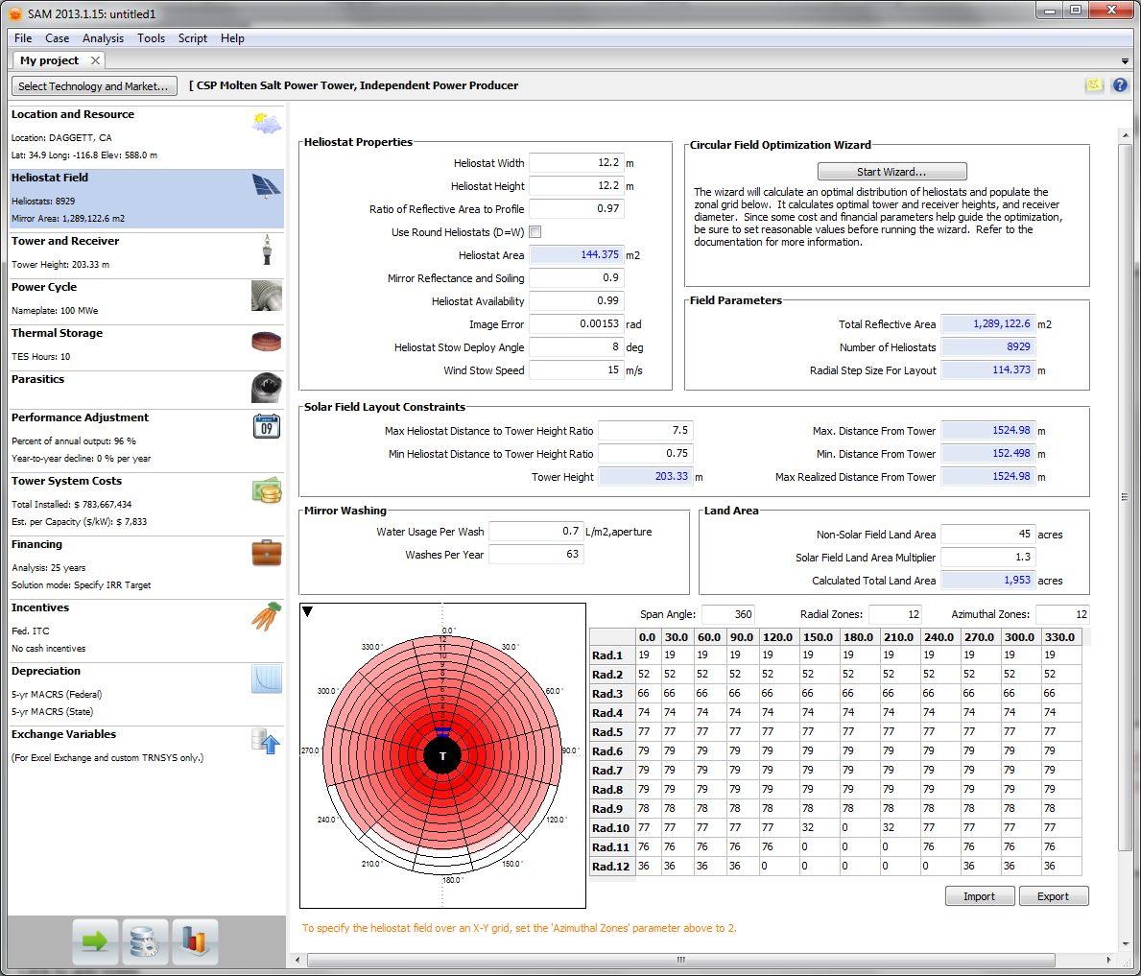
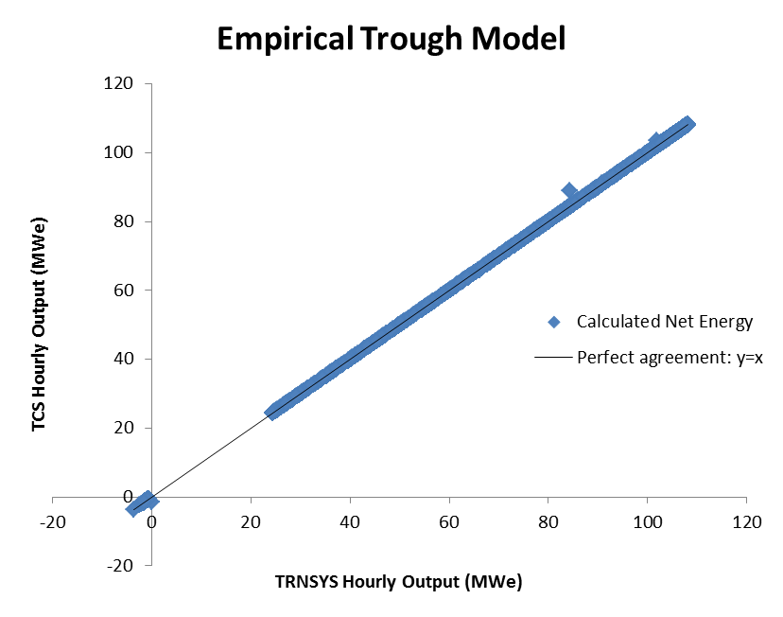
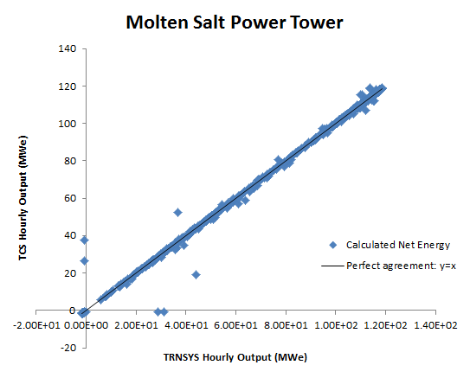
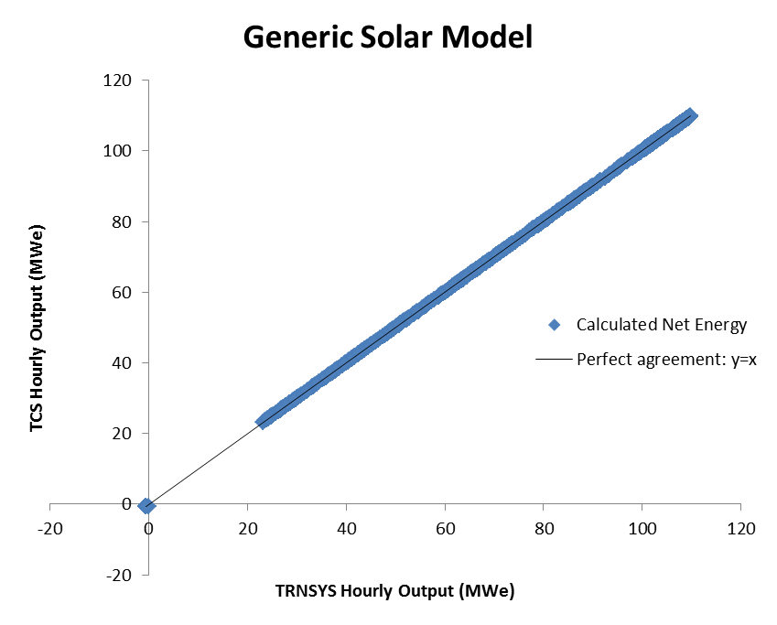
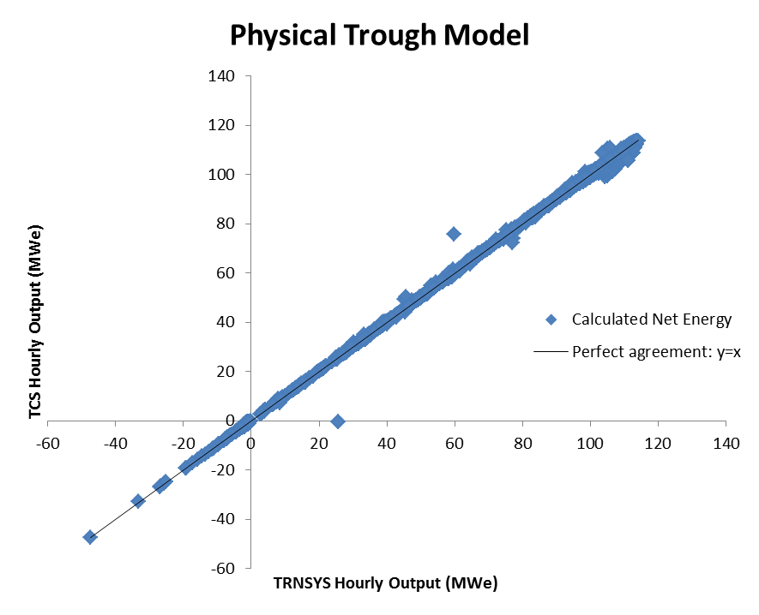
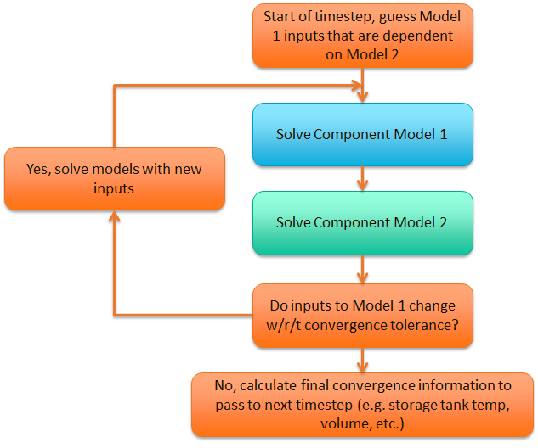
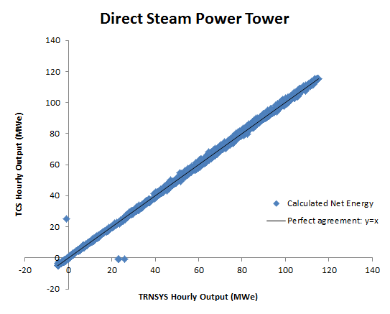
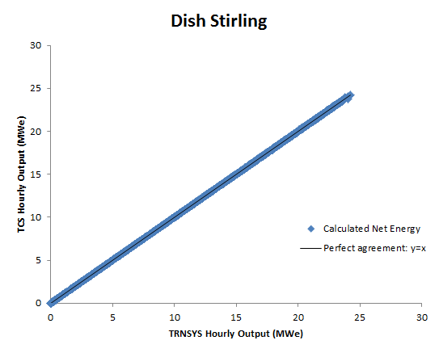
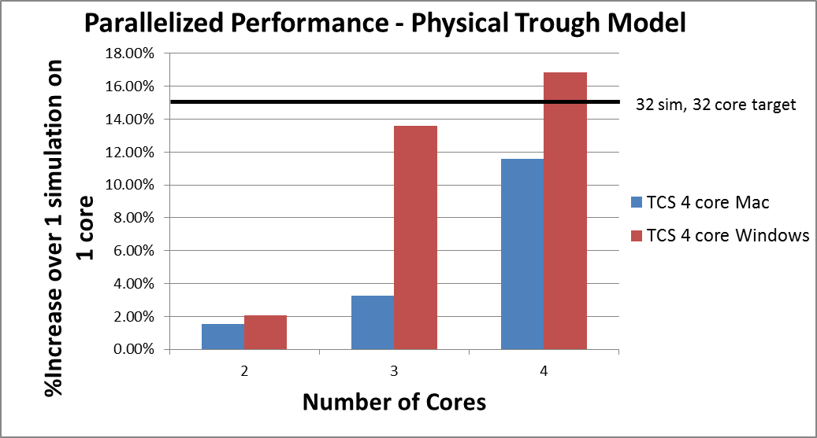
Advances in CSP Simulation Technology in the System Advisor Model
A. P. Dobos, T. W. Neises, M. J. Wagner
National Renewable Energy Laboratory, Golden, CO
Key features of TCS
Fully dynamic type interface API: Types can be written in C or C++, and dynamically loaded by the TCS kernel.
Multithreading: The TCS kernel is fully reentrant and thread-safe.
Data types: Input and output variables can be numbers, arrays, matrices, or strings.
Tolerances: TCS enables each connection between an output and an input to be given a unique tolerance value
The TCS kernel solution strategy is indicated in the flowchart below. The default strategy in the solver is to use successive substitution of output values to input values with a cyclical arrangement until they converge upon a constant value.
To date, SAM has utilized the general purpose commercial TRNSYS transient systems modeling software package for CSP simulations and originally PV and wind. To achieve: (1) significantly faster model performance, (2) easy parallelization of concurrent simulations to take advantage of modern multi-core processor desktop computers, (3) to allow straightforward modification of CSP component models in the SAM environment, and (4) ability to include CSP technologies in the SAM Software Development Kit (SDK), NREL has undertaken to reformulate the CSP models into a new transient simulation framework written in C++, by NREL. This framework is tailored specifically for use in SAM and not for general purpose modeling like TRNSYS. Preliminary results show excellent matching with the accepted TRNSYS-based models, as well as an order of magnitude reduction in simulation time for certain models.
Model Name | RSME (%)
Empirical trough model | 0.06
Physical trough model | 0.69
Generic solar model | 0.02
Molten salt power tower | 0.78
Direct steam power tower | 0.69
Dish Stirling | 0.05
The System Advisor Model (SAM) is modeling software for renewable energy systems developed by the National Renewable Energy Laboratory (NREL).
Transient Component Simulator (TCS) is a new solver kernel written in C++ that has the potential to achieve faster simulation times and easier parallelization.
Original TRNSYS technology system models for CSP systems were compared against the new TCS C++ implementations. Very low root mean squared (RMS) errors were observed.
Overview
Approach
Validation
Model Name | TCS (s) | TRNSYS (s) | Diff. (TCS-TRN.)
Empirical trough | 1.3 | 2.1 | -38%
Physical trough | 9.4 | 12.4 | -24%
Generic solar | 0.7 | 1.9 | -63%
Molten salt power tower | 1.8 | 3.0 | -40%
Direct steam power tower | 23.6 | 13.8 | 71%
Dish Stirling | 1.3 | 1.7 | -24%
A high performance transient time series solver framework (TCS) for SAM has been implemented in C++ and compared to TRNSYS, the current simulation engine for CSP models in SAM.
Equivalent model implementations for six CSP system models show very low root mean square deviations between the two simulation frameworks, and that the TCS version provides a significant reduction in computation time for the same model relative to TRNSYS.
Future implementations in SAM will leverage the multi-threading parallelization potential of the TCS kernel, and will consequently reduce simulation times for large parametric scenario analysis, as well as enable the use of CSP simulation engines on a variety of platforms including Linux, Mac OS X, web servers, and others.
This new framework will enable distribution of the CSP models within the SAM Software Development Kit (SDK) which currently only includes PV, Wind and Geothermal technologies.
In the future, TCS will be used by NREL to continue to augment SAM with new and emerging CSP technologies.
Test system: 2.5 GHz processor, 8 GB RAM, Windows 7 64-bit, and a solid state hard drive, 32 bit TCS kernel
Notes
The performance improvements for the empirical and generic solar models are due to the fact that the TRNSYS version spends most of the time reading and writing files on disk, while in the TCS system the inputs are set programmatically and outputs at each time step are extracted directly.
The physical trough and power tower models require iteration of the solver kernel at each time step, and thus the performance difference relative to the TRNSYS version is not as large, though still significant.
The direct steam power tower was not fully converted and validated at the time of writing, and we expect its simulation time will be shorter than TRNSYS when it is finished, judging from the experience with all of the other models.
We set an aggressive parallelization target for TCS by aiming to limit parallelization overhead to 15 % of simulation time up to 32 processor cores. Our initial results suggest that since parallelization “startup” overhead will necessarily increase with the number of cores utilized, even if simulation time for one annual time series calculation is constant. This may make it difficult to limit overhead to 15 % on a 32 core machine. To date we have only been able to test the software on a four core machine.
Notes
For simulations running in parallel threads, a “startup” overhead of about 2 % is observed on both Mac OS X 10.8 and Windows 7 64 bit.
This startup overhead appears to increase non-linearly with the number of threads. This is somewhat surprising and we are working to discover the cause of it.
We emphasize that despite the parallelization overhead, the absolute total simulation time is still significantly reduced.
SAM User Interface
SAM Simulation Core (SSC SDK)
TCS Kernel
Trough
Tower
Lin.Fres.
Elapsed time for a single annual time series simulation using the SAM default system parameters is in most cases significantly lower using the TCS solver kernel.
Multithreaded simulations are possible using TCS. This allows parametric or sensitivity studies to be completed in much less time by utilizing multiple processing cores in parallel.
TCS is a robust and flexible solver kernel that provides advantages to the SAM software. Soon, the CSP models will be programmatically accessible in the SAM SDK.
Simulation Speed
Parallelization
Conclusions
This work was supported by the U.S. Department of Energy under Contract No. DE-AC36-08-GO28308 with the National Renewable Energy Laboratory.
The information contained in this poster is subject to a government license.
SolarPaces Conference
Las Vegas, NV, USA
September 17-20, 2013

