Slide 1
General Free-falling Particle Receiver (Updated)
Side View:
Top View:
Particles Releasing
Cavity Depth
1. Flat Curtain
Aperture Window
Curtain Width
Particle Curtain
Particle Curtain
Radiation
Aperture Window
Total Curtain Height
Aperture Width
2. Curved Curtain
Aperture Height
Curtain Width
Particle Curtain
Height of i^{th} Trough
Aperture Window
Radius of Curtain Curvature
Particles Exiting
Depth of i^{th} Trough

Slide 2
With and Without SNOUT
SolarPILOT should be able to toggle the SNOUT on and off?
When on, acceptance angles should be constrained
When off, constraints can be removed
Side View:
Top View:
Top Vertical Angle
Aperture Window
SNOUT
Aperture Window
SNOUT
Radiation
Horizontal Angle
Zero horizontal angle will result in parallel SNOUT sides
Bottom Vertical Angle
Depth

Slide 3
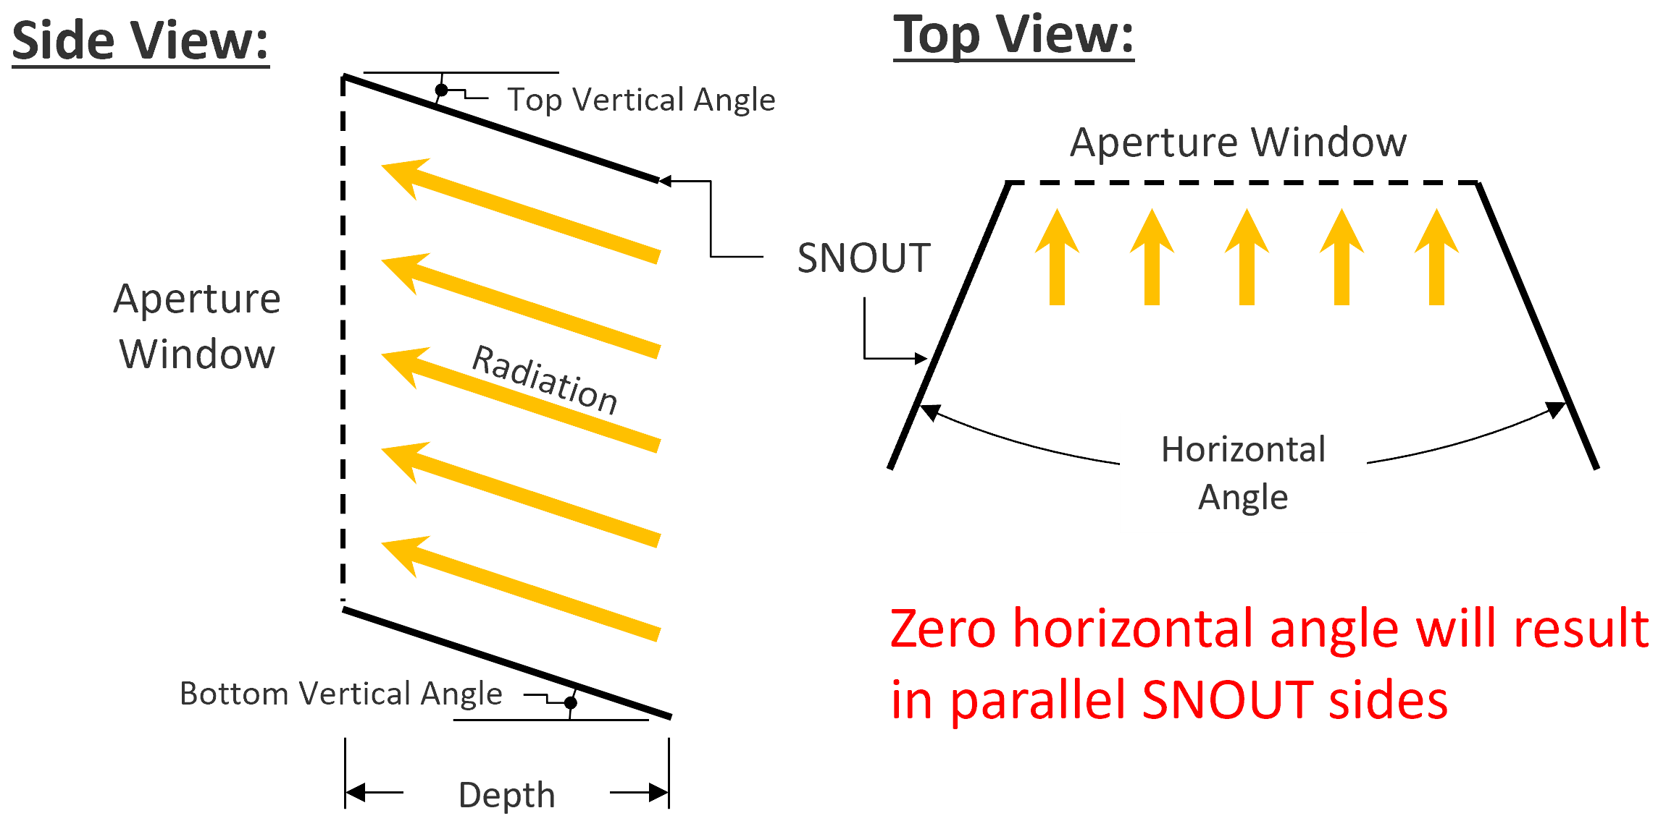
With and Without SNOUT
Side View:
Top View:
Top Vertical Angle
Aperture Window
SNOUT
Aperture Window
Radiation
Horizontal Angle
Zero horizontal angle will result in parallel SNOUT sides
Bottom Vertical Angle
Depth

Slide 4
Radius sets the back curtain curvature
This is how it is implemented.
Radius is adjusted as curtain depth changes

