Slide 1
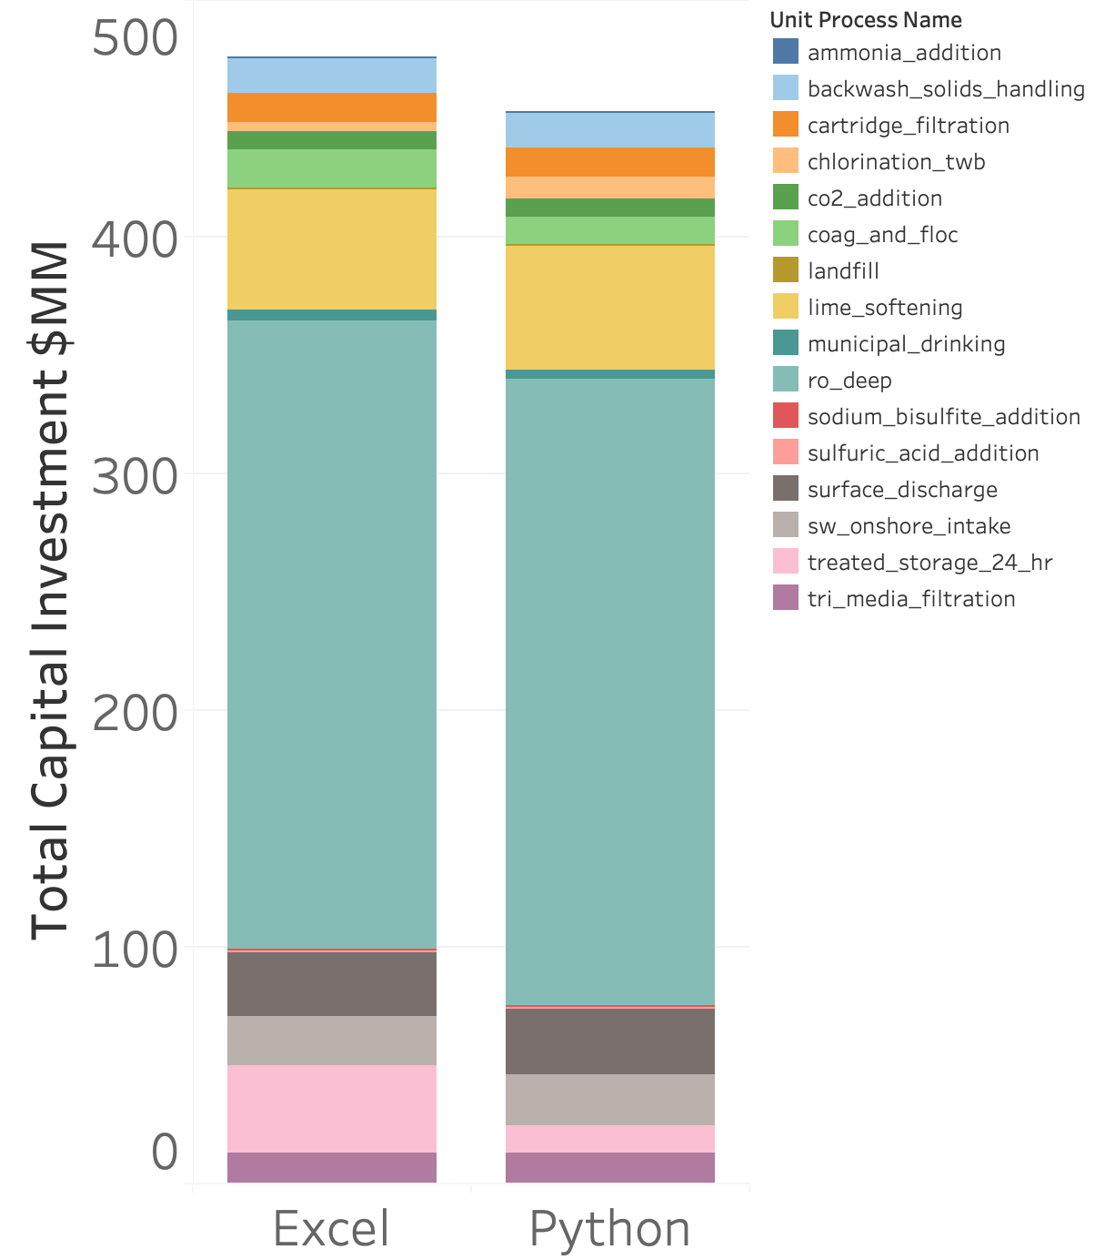
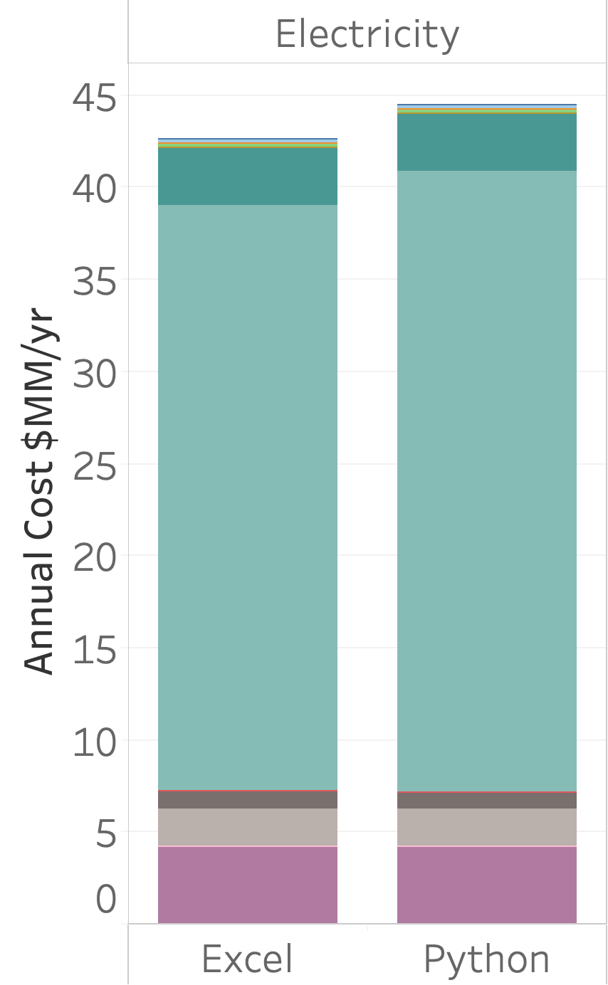
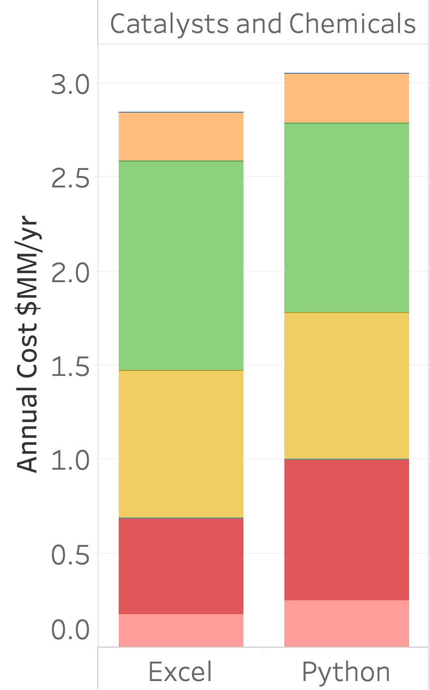
Carlsbad baseline results comparison for Python and Excel
Excel LCOW: 1.28 $/m3
Python LCOW: 1.31 $/m3
Catalysts and Chemicals
FCI
Electricity
Notes:
Main differences:
Do not use a capacity basis if not necessary
Modules:
Chlorination (Python replicates TWB equations and cost table)
Landfill and Surface discharge (different way to calculate mass)
Storage tank (Poseidon method)

Slide 2
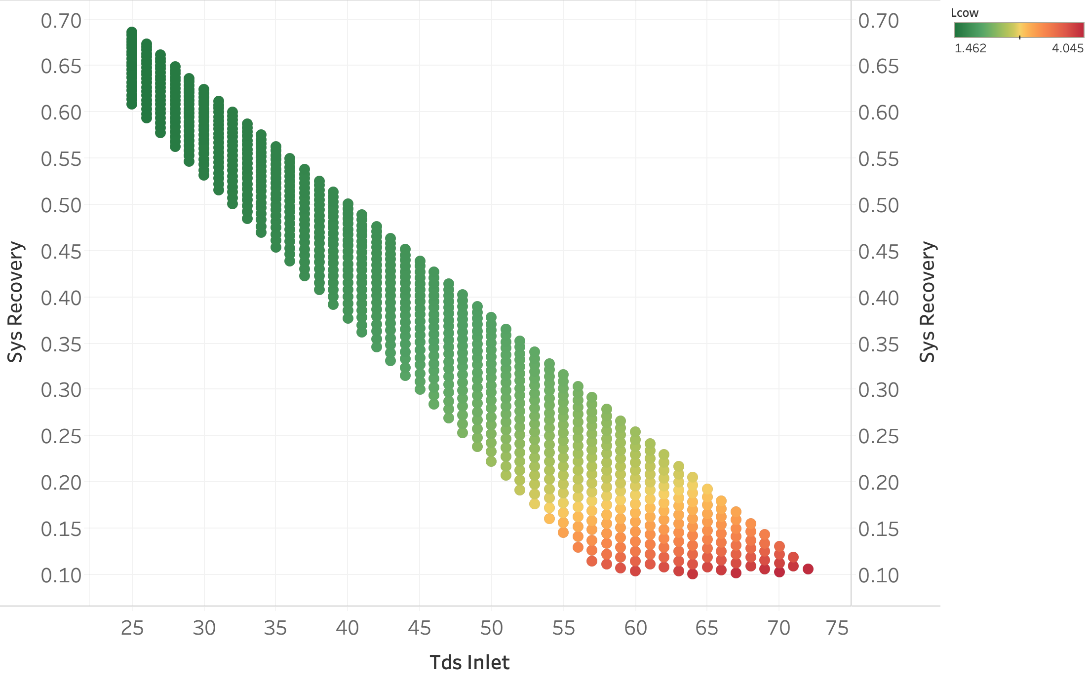
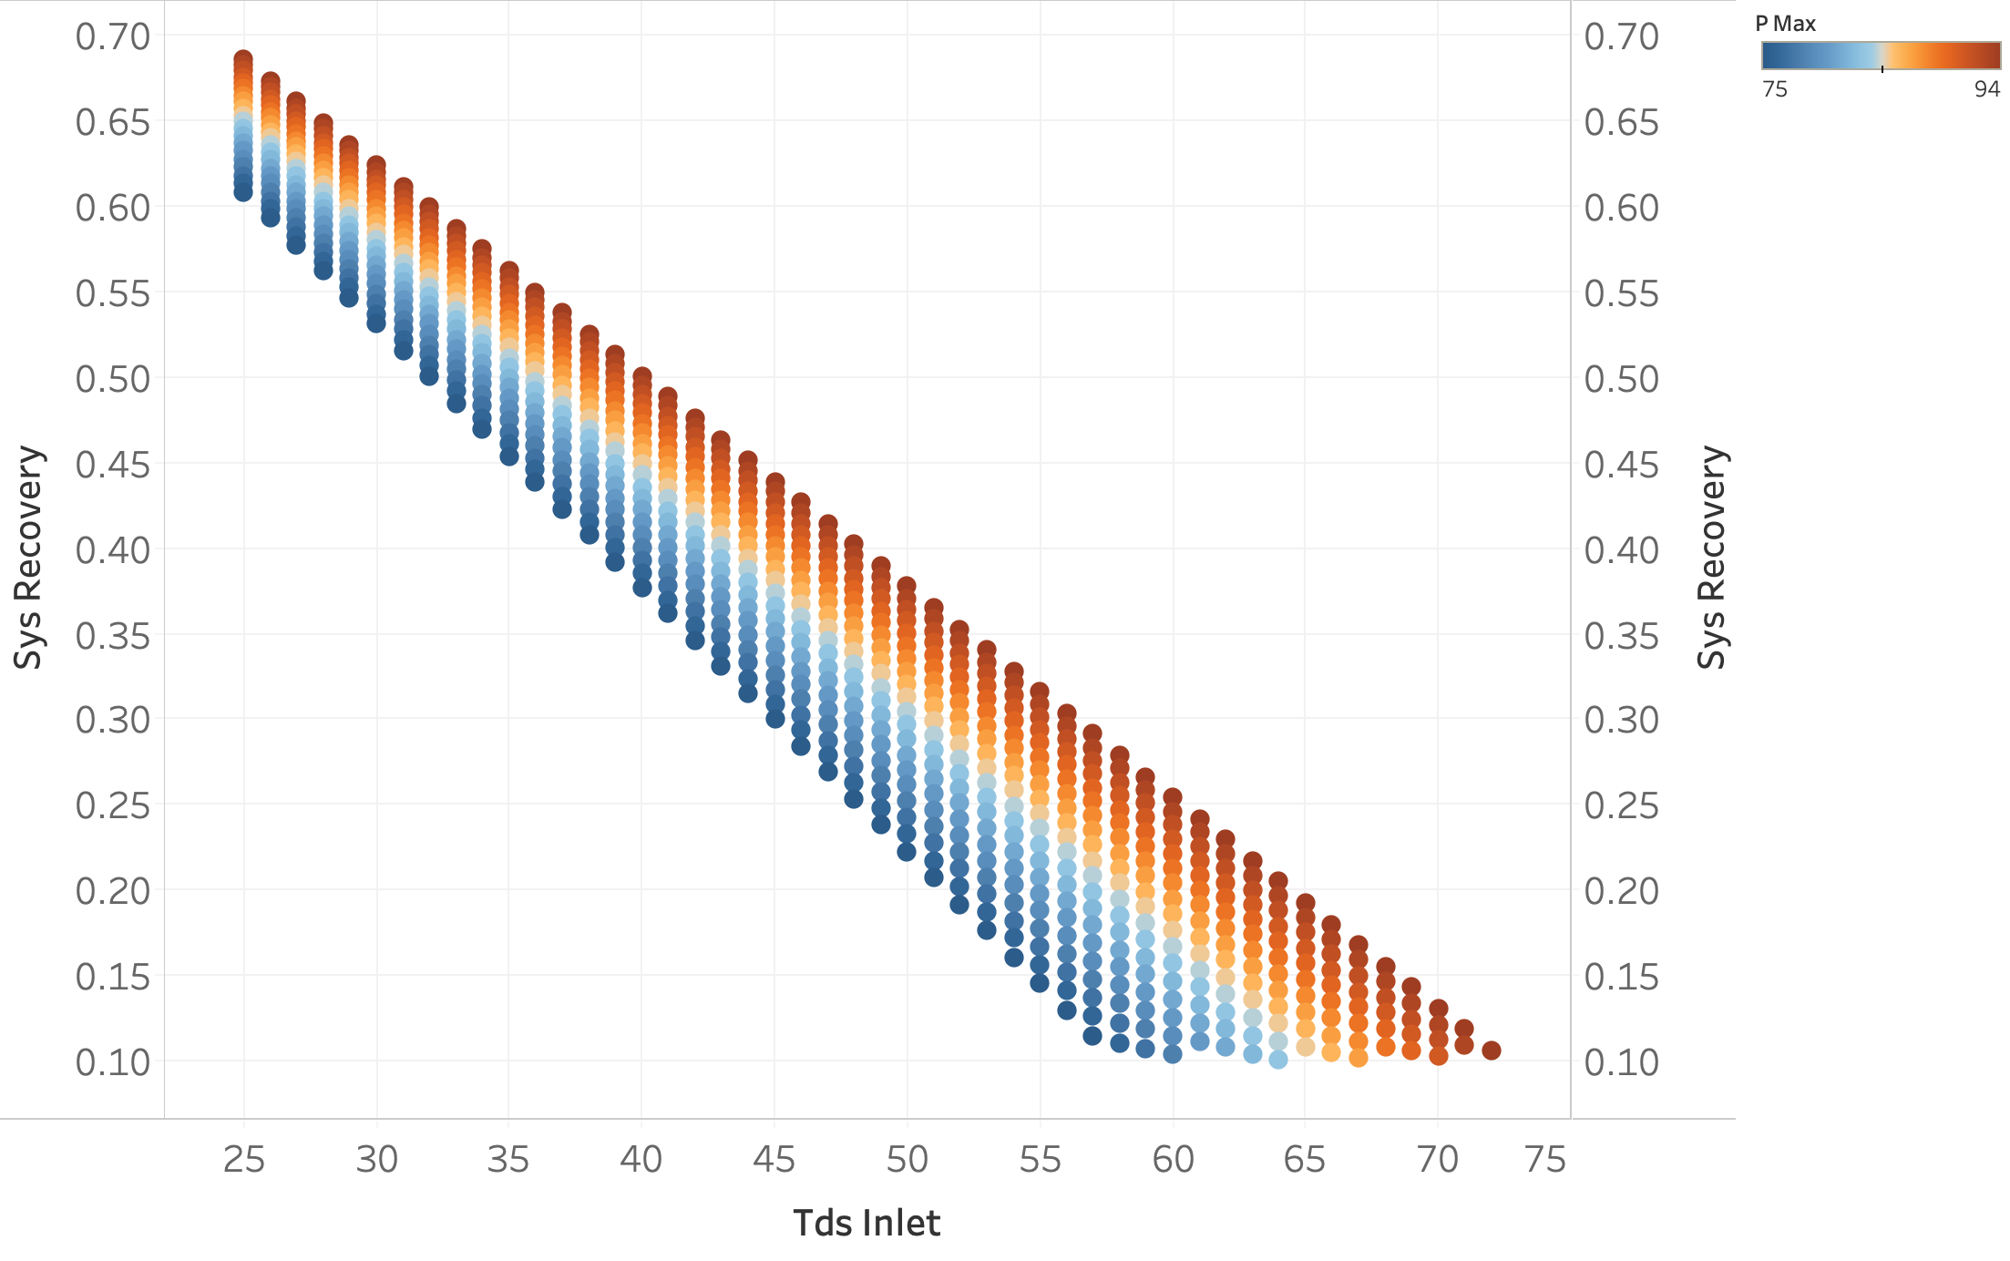
TDS & Design pressure of the membrane impacts on LCOW and System Recovery LCOW in $/m3. Pmax = maximum design pressure of the membrane (bar) Input variables that changed: - TDS inlet 25-75 (kg/m3) - pmax 75-94 (bar)
Carlsbad
Carlsbad

Slide 3
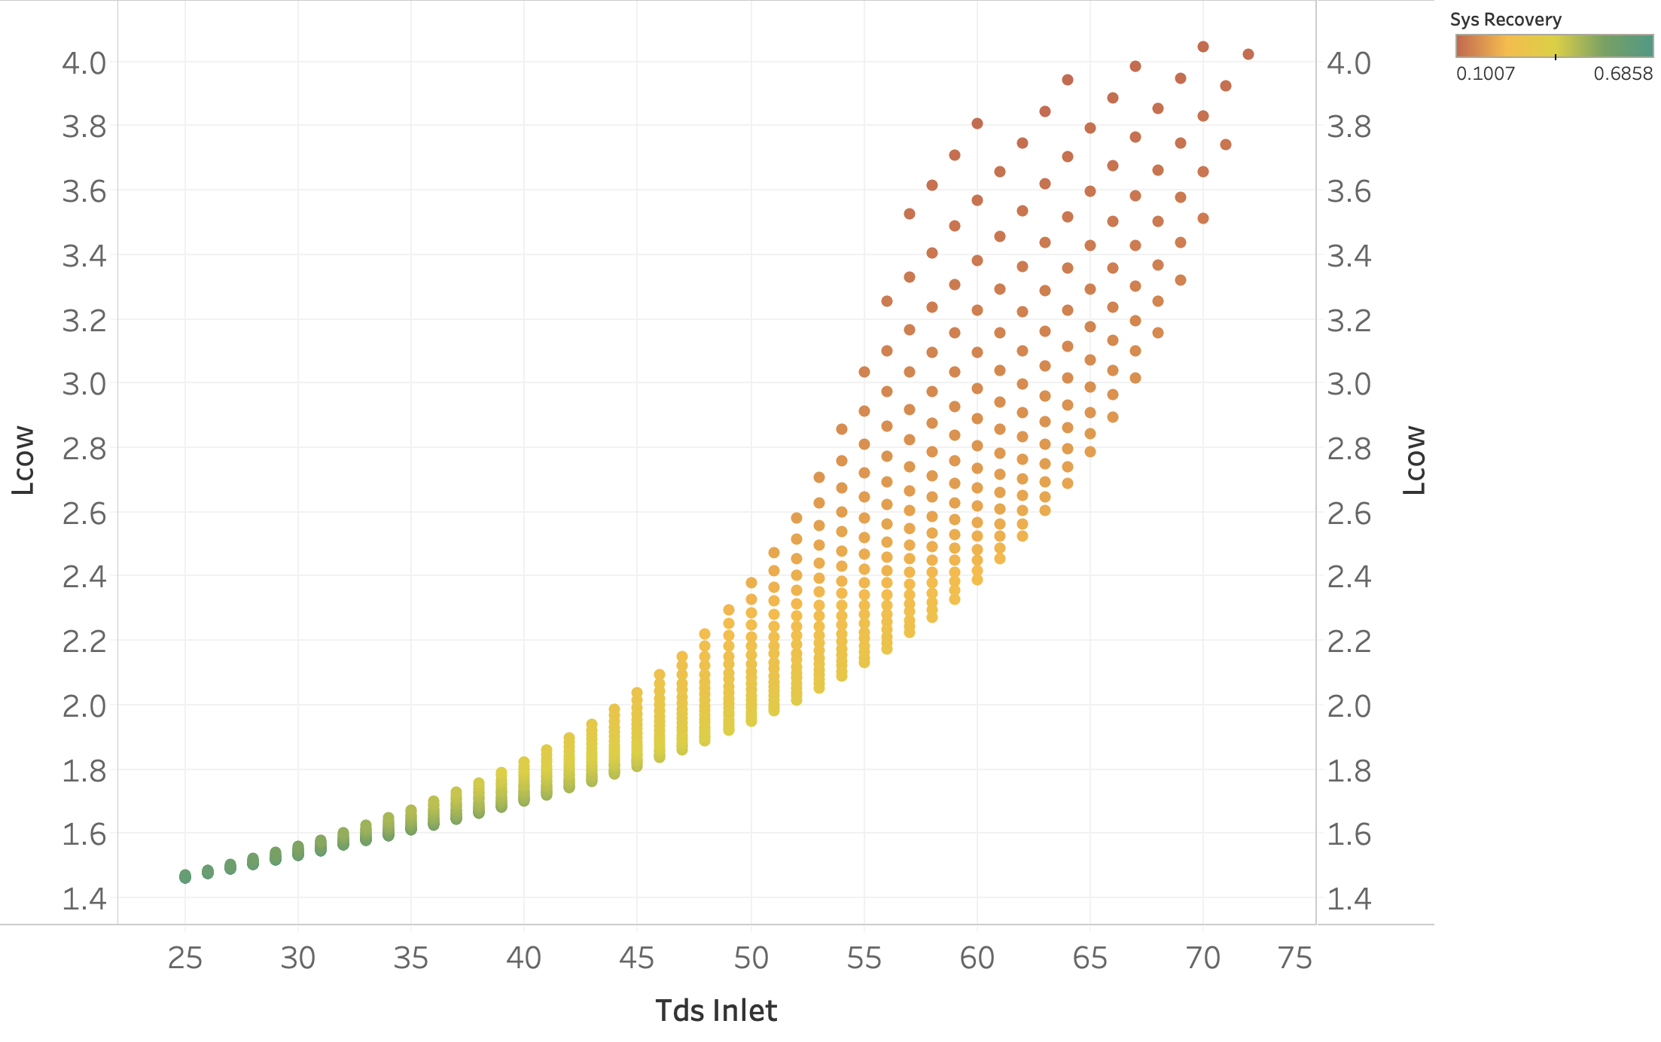
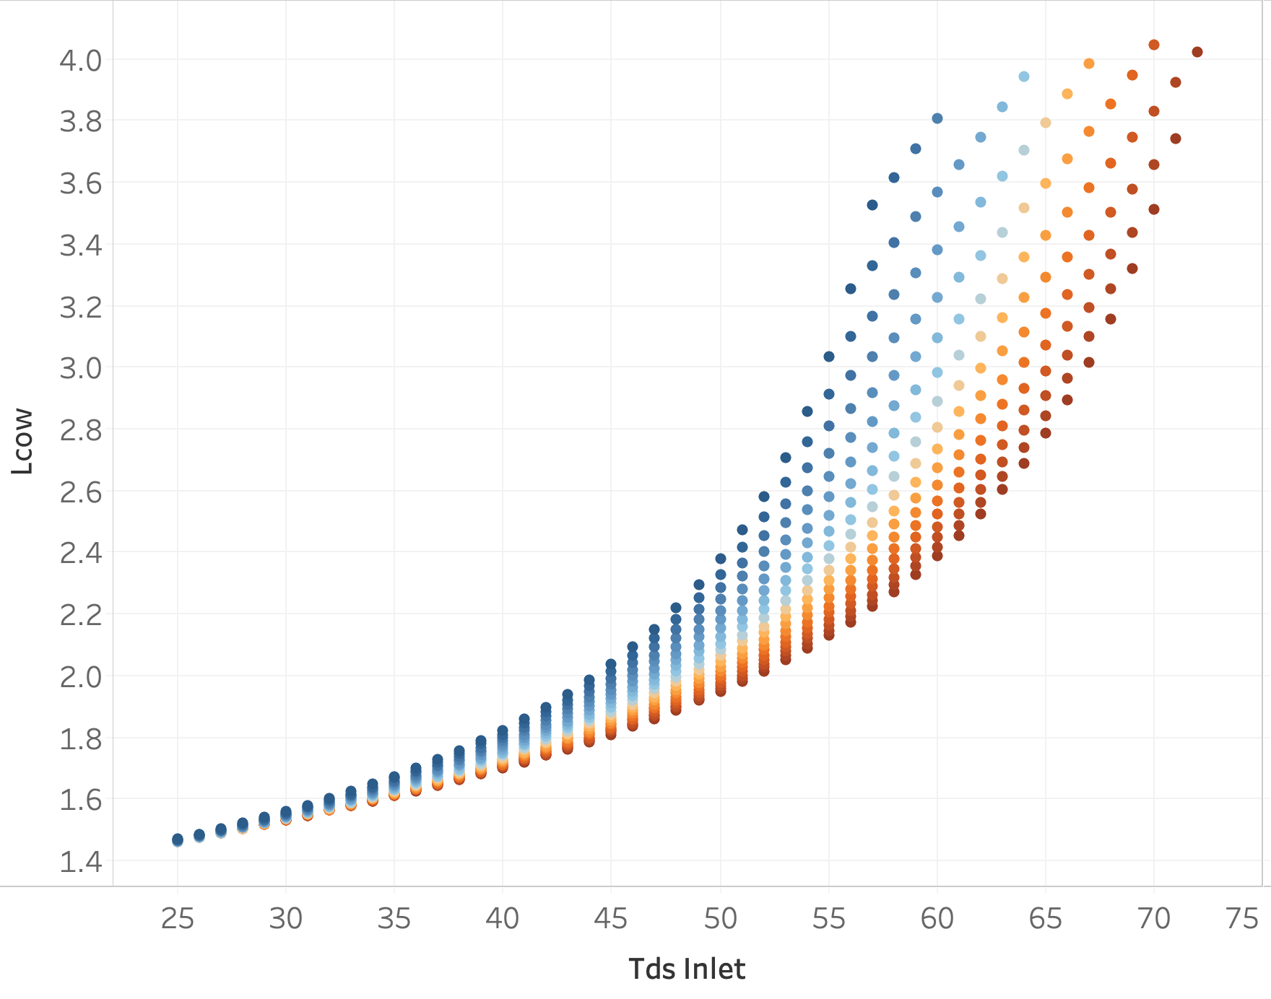
TDS & Design pressure of the membrane impacts on LCOW and System Recovery LCOW in $/m3. Pmax = maximum design pressure of the membrane (bar) Input variables that changed: - TDS inlet 25-75 (kg/m3) - pmax 75-94 (bar)
Carlsbad
Carlsbad

Slide 4
General updates
Storage UP
Anna to reach out to authors
The hour needs to be read in from a .csv input. Ariel to show where this will come from.
Type of storage to be an option
Go over new units added since Carlsbad - slides, results, Excel comparison.
Excel comparison function
Go over name mappings. Add other variables we may want to look at?
FUNCTION ADDED TO GIT. ANNA TAKE A LOOK.
How many units left to convert total? For brackish and municipal?
brackish – 3. municipal – 14.
Chemical addition discussion (next week)
Moving away from using constants -> Revisit Monday
Parameters for UPs
Creating a function/class for pumps.
Recovery rates.
Moving costing to financials.py -> Revisit Monday
Adjustments to input data from Mike - > create python function to handle.
Renaming of unit models to process name only (later) -> Revisit Monday
Automatic creation of train.
Complete database for all trains.
GitHub updates/issues
Documentation -> sphinx and Ann will come up with proposal of use
RO model -> updated.
Plans for the week
7 results and slides.
Confirm unit models run without errors. Add trains to .csv input. Constituent tables
Data inputs from Mike (Anna)
Change ”TDS” into RO to “tds”
Santa B. then upload (Ariel)
Anna needs to send unit list in order
2 more seawater. Adding train to .csv to make train
Ashk (Kurby), Tampa (Anna)
Run seawater.
Check point. Look at results. Thursday.
Confirm unit models for brackish run (Kurby, Anna). Storage should read the train .csv
4 more brackish – adding them to .csv.
Run brackish
Check point. Look at results. Friday.
RED – do we have that information for the case study
Pump in UV
Make quicker with regressions.
Lookup for electricity costs.

