Slide 1
/watertap3
setup.py
/watertap3
__init__.py
/data
/notebooks
/results
/utils
__init__.py
watertap.py
case_study_trains.py
design.py
...
etc.py
/wt_units
__init__.py
wt_unit.py
...
etc.py
We want to install watertap3 as an editable package.
This way, we can edit it.

Slide 2
Installing as an editable package:
In Terminal, navigate to /watertap3 parent directory containing setup.py
Activate watertap3 environment
>>> python –m pip install –e .
You should end up with a /watertap3.egg-info directory

Slide 3
What has changed
Biggest changes relate to how packages are imported within watertap3
Improving readability of code
Most chemical addition units no longer require chemical_name in parameters
EXCEPTIONS: chlorination.py, chemical_addition.py
Still require dose
If they require chemical_name, cannot be in list []
{‘chemical_name’: ‘Chlorine’}
reverse_osmosis.py only requires erd

Slide 4
Running notebooks from /notebooks
%cd ..
%pwd
(should put you in ~/watertap3/watertap3)
from watertap3.utils import watertap_setup, get_case_study, run_water_tap, run_water_tap_ro

Slide 5
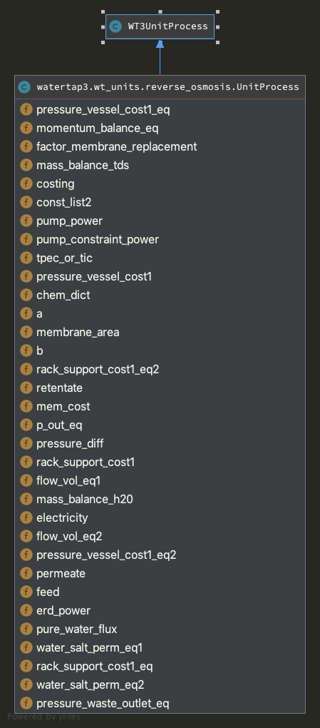
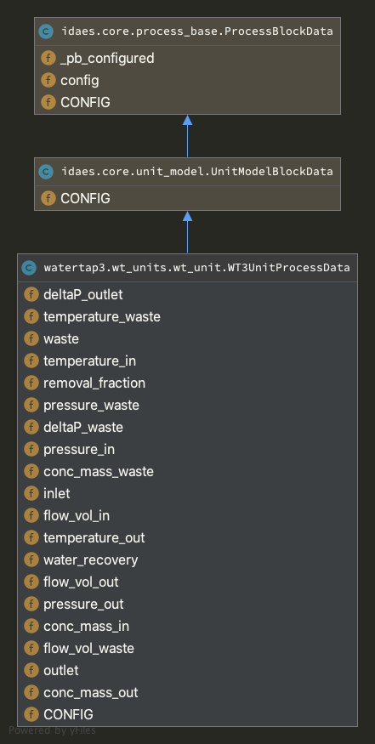
All unit models are child classes of WT3UnitProcess()
unit_process_equations.py does not get used anymore

Slide 6
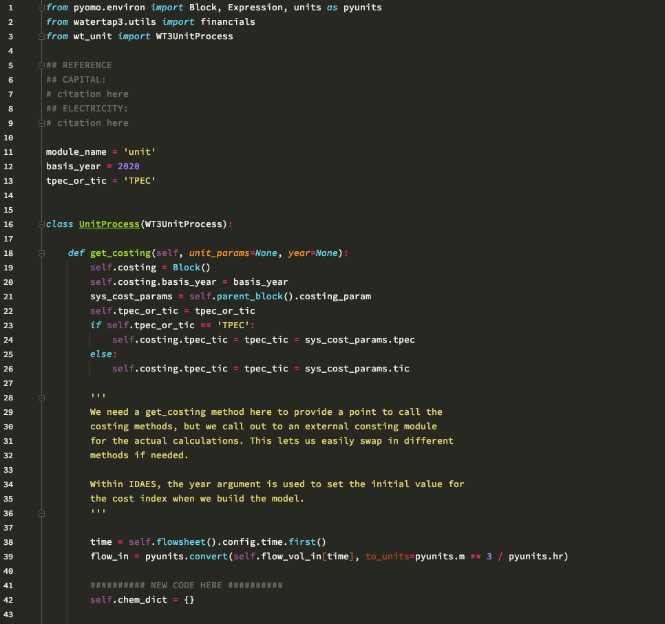
unit_template.py
Everything you need to make a new unit

Slide 7
Be better
Continue to improve code readability
Chemical additions could (should) be a single file
Dynamically calculate chlorine demand
Dynamically calculate UV dose
Based on log removal of pathogens?
Evaporation pond and other ZLD technologies
IX and GAC technologies
Able to run with IDEAS-pse >= 1.9.0
Visualizations!
Electricity missing on some units

Slide 8
Bye bye
unit_process_equations.py
basic_mass_based.py
anything ro_deep.py
treated_storage.py
nanofiltration_twb.py
anion_exchange_epa.py → ion_exchange.py

