Slide 1
EP to BRICK to Alfalfa workflows
High-level workflow
BRICK parser workflow
Appendix: dictmap.json

Slide 2





EnergyPlus -> BRICK <-> Alfalfa
OS Measure
High-level workflow
Ruby
Forward-translate
Generate TTL file
Find setpoints/sensors
Add Alfalfa/BCVTB I/O
*See note 2
*See note 3
Python
EP parser library
Simple RDF query script
Generate OSM
.TTL
.IDF
*See note 1
OpenStudio Measure:
Create DOE Prototype Building
Use as model measure
Misc. resources
Use as seed model
ZIP
.OSM
.OSW
Alfalfa

Slide 3
Notes:
*1: The other steps rely on measures to add elements to an OS model, so we need to have an OSM. We use an OS measure for generating the OSM because translating an IDF to an OSM strips the airloops. Instead of doing it here, we could add it to the OSW as a step but doing this returns errors on the Alfalfa worker. The Create DOE Prototype measure fails.
*2: the IDF to BRICK graph program is coded in Python. It could be a good idea to have a Ruby Gem for it to avoid calling external programs.
*3: I had issues using the Ruby RDF library on the Alfalfa machine, so instead I have a 20-line Python script that does the SPARQL query for you. Same as for *1, it would be a good idea to figure out what is going wrong with the Ruby library and keep this 100% Ruby.

Slide 4
EnergyPlus -> BRICK Python library
2. Init a class for each component in the IDF
EP Component class
EP Component class
To step 5…
opyplus library
Stores data on the model and methods for parsing it
Type: AHU
Inlets: inlet 1
Predicates: feeds VAV
1. Iterate through all components
.IDF
3. Parse the component
The dictmap.json file defines which information to extract from a given component.
Examples:
Info: BRICK type
References: Return references to other EP components
Custom methods: Add predicates (part of, feeds, etc.)
4. Store all information into class attributes
dictmap.json
Maps EP object types to BRICK type and custom methods.
See appendix for details.

Slide 5
EnergyPlus -> BRICK Python library
Cont’d
Example:
Duplicates
Incomplete components
No BRICK equivalent
EP-specific components (e.g., nodelists)
From step 4…
5. Filter invalid components
.TTL
6. Find hierarchy between components
8. Serialize
Identify:
Predicates
Properties
Parent/Child groups
Infer:
Global hierarchy
Root element
rdflib
Bob a BRICK:example hasFullName Robert
7. Build graph

Slide 6
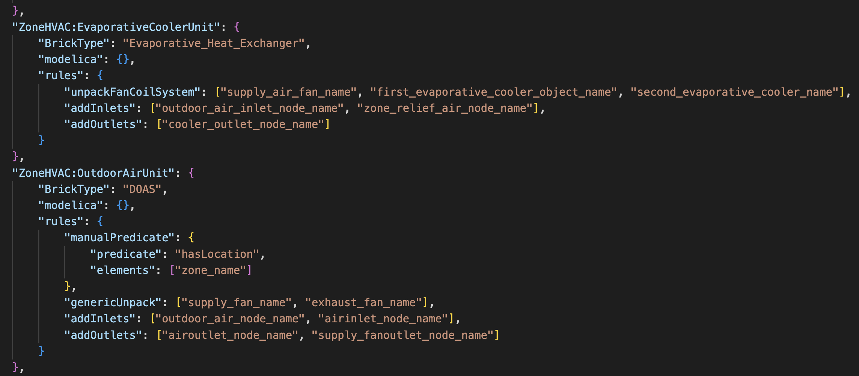
Appendix: map.json
The instructions on how to parse a specific EnergyPlus component are recorded in the dictmap.json file. Each entry represents an EnergyPlus component type. In the screenshot below, the type of the two entries would be ZoneHVAC:EvaporativeCoolerUnit and ZoneHVAC:OutdoorAirUnit.
For each EnergyPlus component type, an entry in this JSON file defines a set of properties and custom methods. Properties are used when possible to enrich the BRICK model. Custom methods tell the parser how to treat the fields that describe that component in the IDF. Different components may have different field names to define the same object, so this custom mapping is necessary.
In the screenshot from the dictmap.json file below, the first entry, an evaporative heat exchanger, includes several custom methods. First, one method retrieves references to other components: this specific component represents a system that contains a supply air fan and two evaporative coolers. Then, two other methods retrieve the name of the inlet and outlet nodes in this component. The second entry has another custom method which adds a BRICK predicate to that element, inferred from an IDF field named “zone_name”.
The custom methods have been written in the EPComponent class. Adding a method to that class makes it available for all the EP component types in the dictmap.json file.

